Slide 1
Improving CubeSat Telecommunications and Ground Systems
National Aeronautics and Space Administration
The CubeSat Communications Platform and the Near Earth Network
Presenter: Justin Long (University of Alaska Fairbanks, GSFC 567)
Contributors:
Obadiah Kegege (GSFC 453)
Denise Thorsen (University of Alaska Fairbanks)
Scott Schaire (GSFC 453)
Yen Wong (GSFC 566)
Contact: justin.long@nasa.gov
www.nasa.gov
Notes:
Hi, I’m Justin Long. I’m a graduate student at the university of Alaska Fairbanks, and a co-op with code 567, the spacecraft telecommunications branch here at Goddard.
I’m going to talk today about some initiatives to improve CubeSat communications, including new spacecraft technologies, ground system improvements, and a planned demonstration mission.

Slide 2
Agenda
Background
Key spacecraft technologies being developed
Near Earth Network (NEN) Initiatives for CubeSats
CubeSat Communication Platform Mission Summary
Notes:
I’ll start by giving some background, and then talking about the key spacecraft technologies, the ground sytem initiatives NASA is working on, and then a planned CubeSat mission to demonstrate all these new initiatives and technology.

Slide 3
Background
University of Alaska Fairbanks (UAF)
Space Systems Engineering Program (SSEP)
Funded through AFRL University Nanosatellite Program (UNP) to develop a CubeSat that will demonstrate these technologies
NASA Near Earth Network (NEN)
Developing advanced CubeSat communication technologies
The CubeSat mission will provide means for NEN to demonstrate new CubeSat support and capabilities
Several new initiatives aimed at improving CubeSat mission support
Ground support for the UAF CubeSat mission
Notes:
I mentioned that this is a mission to demonstrate new technologies and initiatives on both the spacecraft and ground system.
On the spacecraft side, the University of Alaska Fairbanks has had a series of Master’s thesis aimed at developing advanced communication systems for CubeSats.
This year, they acquired funding through the Air Force University Nanosatellite program to begin developing a CubeSat to demonstrate those technologies.
NASAs near earth network will provide the ground support for that mission. The near earth network has had several initiatives to improve CubeSat support, including both technology development and process improvements. The UAF CubeSat mission will be one of the first to test these new improvements.

Slide 4
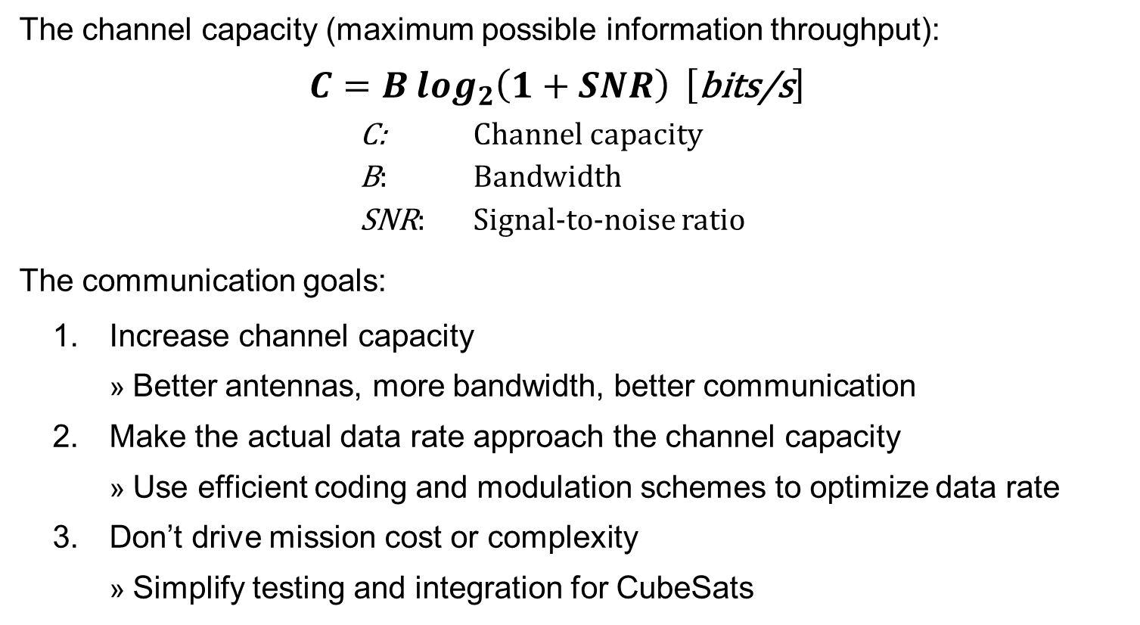
The Communication Problem
The channel capacity (maximum possible information throughput):
  $$C=B\log_{2}\left(1+SNR\right) \left[\text{bits}\text{/}\text{s}\right]$$
            C: Channel capacity
            B: Bandwidth
            SNR: Signal-to-noise ratio
The communication goals:
  Increase channel capacity
    Better antennas, more bandwidth, better communication
  Make the actual data rate approach the channel capacity
    Use efficient coding and modulation schemes to optimize data rate
  Don’t drive mission cost or complexity
    Simplify testing and integration for CubeSats
Notes:
When we talk about improving CubeSat communications, we’re talking about improving the information throughput.
There are two major pieces to this.
First, we need to improve the channel capacity, which is the theoretical limit for information throughput.
This depends on the available bandwidth, and the signal to noise ratio.
We improve the bandwidth by getting CubeSats to use higher frequencies, where more bandwidth is available.
We improve the signal to noise by improving technology on the spacecraft, and using larger ground stations like the near earth network.
Second, we have to make the actual data rate match the channel capacity. To do this, we optimize the modulation and coding schemes to match the dynamics of the link.
Lastly, we want to do all of this without driving mission cost or complexity.

Slide 5
Initiatives
Ground Segment: The Near Earth Network (NEN)
Expansions that will improve CubeSat Support
CubeSat hardware compatibility tests, constellation support and arraying, new sites, etc.
Ongoing initiatives to decrease costs and complexity on CubeSat missions
Dedicated CubeSat equipment, reduced reporting, optimized testing plans
Space Segment: The CubeSat Communications Platform
Developing and demonstrating specialized CubeSat technologies
Miniature Phased Array Antenna
Variable Coded Modulation (DVB-S2 and custom)
Notes:
This is just a summary slide on those initiatives. On the CubeSat, the primary technologies include a miniature high gain phased array and various Variable Coded Modulation algorithms.
I’ll talk about these technologies more shortly.
On the ground side is the Near Earth Network, NASA’s network of ground stations that support orbits from launch and suborbital out to lunar and lagrangian.
The NEN is exploring expansions that are going to benefit CubeSats, and I’ll list those in more detail further on. There’s also a lot of information in the back-up slides of this presentation.

Slide 6
Cubesat Communication Platform
Spacecraft Technologies
Notes:
Starting with the CubeSat mission form the University of Alaska Fairbanks

Slide 7
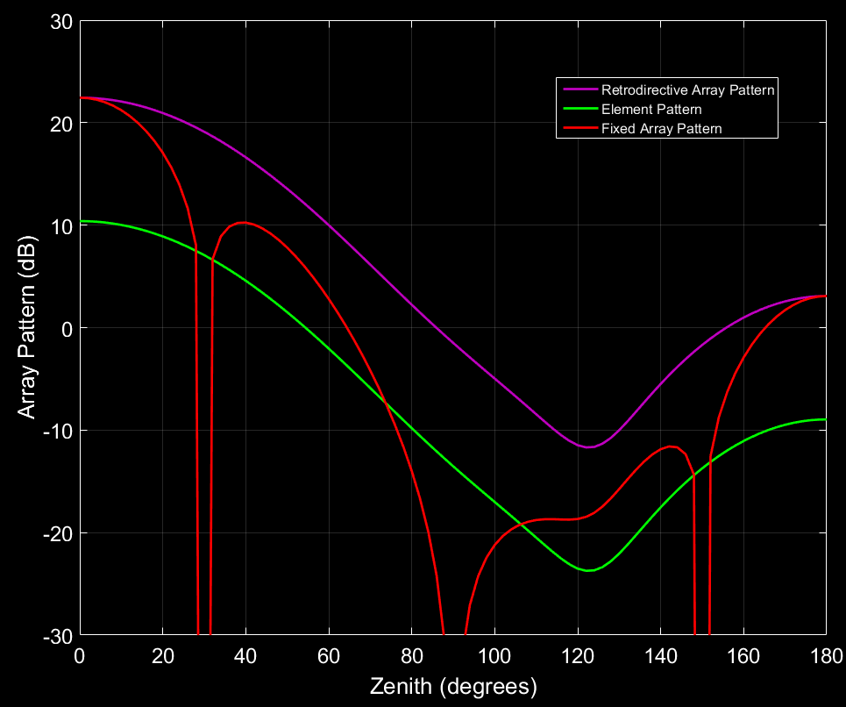
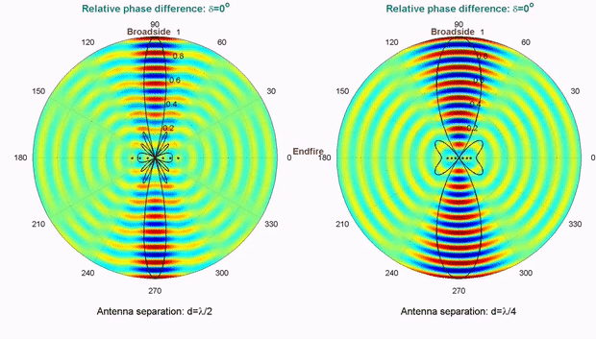
Phased Array Antenna (RDA)
High gain antenna with operational versatility and minimal pointing requirements
  Phased array beamforming
Notes:
The mission will demonstrate a CubeSat Sized phased array antenna, which will provide moderately high gain in a very compact package.
The big advantage the phased array versus a conventional fixed array is beamforming which allows you to change the antennas direction of maximum gain, without physically moving it.
Without beamforming, arraying decreases the beam width of the antenna. With the phased array, you can use beamforming to restore the original beamwidth of the antenna.
Some honest advice:
For most 6U and 12U deep space missions, the reflect array, like the one that flew on MarCo, is the better solution. The reflectarray provides better gain, which is critical for deep space missions. The advantage of the phased array is its much smaller size, no deployables, and very lenient pointing requirements.
This is useful if you don’t want to slew the spacecraft because you’re pointing a science instrument, or if you’re trying to communicate with multiple targets, such as a constellation.

Slide 8
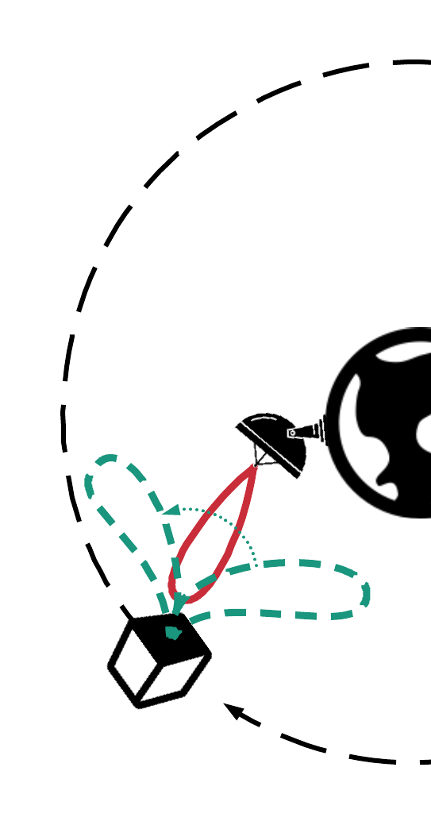
Phased Array Antenna
Technical Specifications
Antenna Fits on 1U face
Mission Details
0.25U of supporting electronics
Includes power amplifiers for use with low power radios
Configurable TX power up to 4W
Demonstrate performance versus fixed high gain antenna
Expected Gain: >9 dBi
Effective Beamwidth: ~60°
Demonstrate beamforming operations
Measure In-space performance (thermal and power)
Notes:
Phased arrays aren’t novel, but this one has been specifically designed for CubeSats.
We’ve designed it to fit on a 1U face, and rhe total electronics volume, occupies about a quarter U.
Based on simulations, we’re expecting greater than 9 dBi of gain and a 60 degree beamwidth.
We’ve included power amplifiers in the front-end electronics of output power up to 4 watts, so the antenna can be directly connected to a low power radio.
The CubeSat mission will demonstrate the beamforming, compare the phased array performance versus fixed array performance, and measure the operational thermal and power characteristics of the antenna.

Slide 9
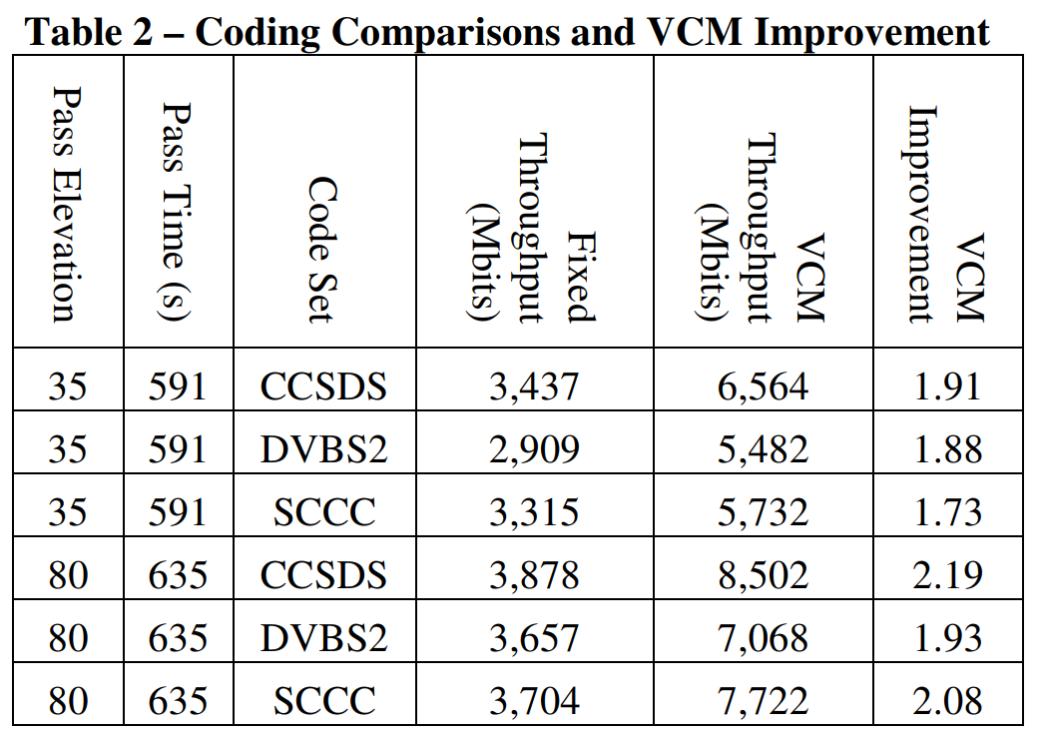
Variable Coded Modulation (VCM)
Adjust the data rate (modulation and coding) to match the channel capacity
  Typically 100% improvement in data throughput
Notes:
The other major demonstration on the CubeSat is variable coded modulation.
Most satellites today use a single fixed coding and modulation scheme. The plot here shows CubeSat elevation over time during a pass. Fixed modulation and coding is represented by the the green line.
In variable coded modulation, the modulation and coding is adjusted based on the link dynamics. This allows you begin the pass earlier, start it later, and increase the data rate when the link is strong. This is the blue line.
The area under the curves is the total data downlink during the pass. Clearly the blue line is better. STK simulations, shown in the table on the right side, showed about a 100% improvement in data throughput using VCM.
Laboratory channel simulations agreed with those results.

Slide 10
Variable Coded Modulation (VCM)
Mission Details
CCSDS Space Link Protocols over ETSI DVB-S2 standard
Technical Specifications
High order fixed modulation and coding schemes will also be demonstrated for comparison against variable coded modulation
Can be implemented on existing Software Defined Radios (SDRs,) or a custom FPGA solution
NEN has demonstrated that 16 Mbps can be achieved over 5 MHz bandwidth with higher order modes
Two VCM protocols will be demonstrated:
Variable Coded Modulation to Maximize Information (VITAMIN), a specialized protocol for CubeSats
Typically 2x improvement in data throughput compared to fixed modes
Notes:
As I mentioned, VCM provides a 2x improvement in data throughput over fixed modes. The catch is that the radio needs to be flexible and powerful enough to implement VCM. This can either be done on existing SDR platforms, or with a specially designed FPGA system. We’ll be doing VCM demonstrations on the ground with NEN next summer, where we’ll be using the B205 mini SDR, which is small enough to fit on a CubeSat.
For the CubeSat mission, we’re planning to demonstrate two VCM protocols. One is CCSDS over DVB-S2, a common VCM protocol for satellites. The other is a custom protocol we developed in house, specially for CubeSats.
For the mission, we will demonstrate both VCM protocols, and compare their performance on a pss-by-pass basis versus fixed modulation and coding schemes.
To my knowledge, no CubeSat system has ever flown that used VCM, and this mission will probably be the first. It will be the first VCM demonstration on the near earth network.

Slide 11
Near Earth network
Ground Support Capabilities

Slide 12
Near Earth Network
General Information
Composed of stations distributed worldwide
Supports launch, suborbital, LEO, GEO, HEO, LaGrange, and Lunar
NEN Expansions
5 new Ka-band antennas, 2 Ka-band antenna upgrades
Contact Scott Schaire, scott.h.schaire@nasa.gov, 757-824-1120, NASA Goddard Space Flight Center, Near Earth Network Wallops Manager
NEN Questions?
Delay Tolerant Networking
S-Band (up/down), X-band(up/down), and Ka-band (down)
DVB-S2 demonstrations
Lunar communication upgrades, X-band uplink (proposed)
Notes:
The Near earth network is a distributed global network of ground stations that provide coverage for satellites from low earth out to lunar and lagranagian orbits. Their ground stations cover S-band, X-band, and Ka-band.
They are exploring a lot of new expansions. I won’t cover them all, but there is a lot of information in the backup slides. Of particular interest to this group is probably their plans for lunar communication upgrades, and the DVB-S2 demonstrations.
I don’t work for the NEN, so if you have any questions I encourage to contact Scott Schaire, the NEN Wallops Manager.

Slide 13
NEN CubeSat Support
CubeSat Support Initiatives
NEN is currently ready to support CubeSats, and has plans to support several CubeSat missions in 2020 and 2021
CubeSat hardware compatibility testing and enhancements
Exploring enhancements for constellation support
Investigating new small aperture stations for CubeSats
Exploring enhancements for antenna arraying
Several initiatives to streamline CubeSat testing processes
Development of standard testing plan
Reduced reporting requirements
Dedicated CubeSat testing and integration equipment
Notes:
Particularly relating to CubeSats, the NEN has been preparing to support CubeSat missions, and making it easier for CubeSats to get reliable ground support.
This has included compatability testing and enhancements, new testing plans, reduced reporting requirements, and dedicated cubesat support equipment.
They’ve also been investigating the addition of small aperture stations, constellations support, and antenna arraying.
Again, there is a lot more information available in the backup slides.

Slide 14
Mission Overview
CCP and NEN
Notes:
I’ve told you about the CubeSat, and I’ve told you about the Near earth network, so I just have one last slide on the mission itself, and to summarize what the missions is demonstrating.

Slide 15
CubeSat Communication Platform Mission
Objectives
Demonstrate the high gain phased array antenna, to improve channel capacity
Timeline
Demonstrate NEN compatibility of aforementioned technologies
Mission is currently midway in phase A, launch date no earlier than 2022
Initial ground testing with NEN expected in July 2020
Other Technical Details
All demonstrations at NEN S-band (2200-2290 MHz)
Orbit will be LEO, dependent upon launch availability beyond that
Demonstrate NEN DVB-S2 capabilities
Demonstrate VCM on a CubeSat, to make the data rate approach the channel capacity
Demonstrate and provide feedback to NEN on CubeSat support initiatives

Slide 16





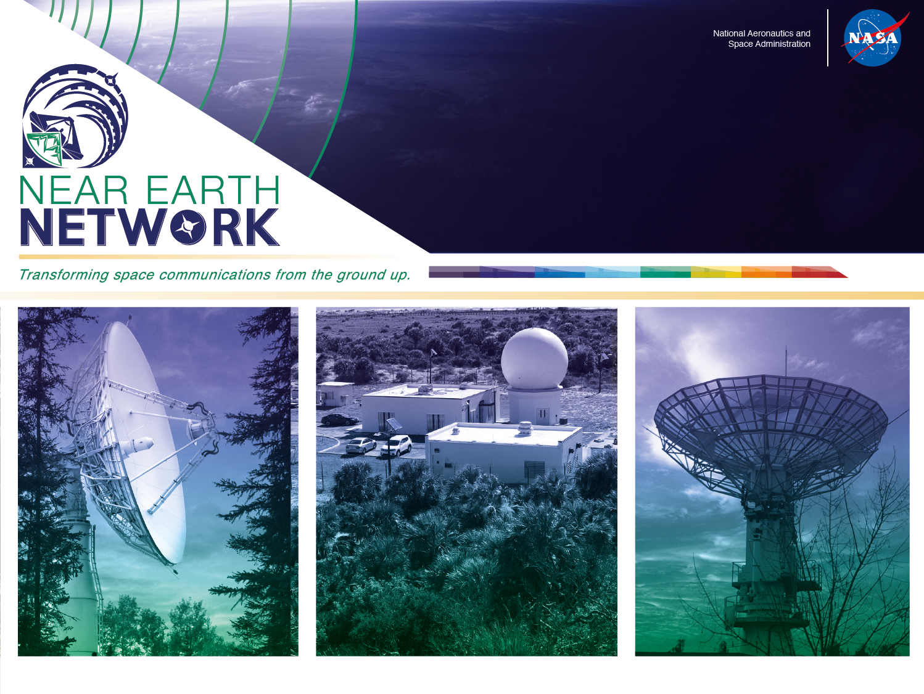
Mission Affiliations / Sponsors
The University of Alaska Fairbanks
  Alaska Space Grant Program
  Space Systems Engineering Program
Air Force Research Laboratory
  University Nanosatellite Program
National Aeronautics and Space Administration
  NASA Space Technology Research Fellowship Program
  Near Earth Network
Contacts:
  NASA NEN: Scott Schaire, scott.h.schaire@nasa.gov
  CCP CubeSat: Justin Long, justin.long@nasa.gov
  Dr. Denise Thorsen: dlthorsen@alaska.edu
Notes:
Thank you for your time.
If you have questions now, I think I have time. If you have further questions about the CubeSat mission, I encourage you to contact myself or Denise Thorsen, the mission PI.
If you have any specific questions about the NEN, I’m going to defer on those and ask you to contact Scott Schaire

Slide 17
SignOffPage
Notes:
NASA Presentation Sign-Off Page

Slide 18
Further NEN Information
Backup Slides

Slide 19
Near Earth Network Overview
As shown on the following slide, the NASA Near Earth Network (NEN) is composed of stations distributed throughout the world
NEN services are provided through
  NASA-owned and operated ground stations
  Partner agencies (e.g., National Oceanic and Atmospheric Administration (NOAA) Command and Data Acquisition (CDA))
  Commercial ground station providers (e.g., Kongsberg Satellite Services (KSAT), Swedish Space Corporation (SSC) and its subsidiaries
  The NEN supports orbits in the Near Earth region from Earth to 2 million kilometers
  Communication services are provided for various low-Earth orbits (LEO), geosynchronous orbits (GEO), highly elliptical orbits (HEO), LaGrange orbits, lunar and suborbital, and launch trajectories

Slide 20
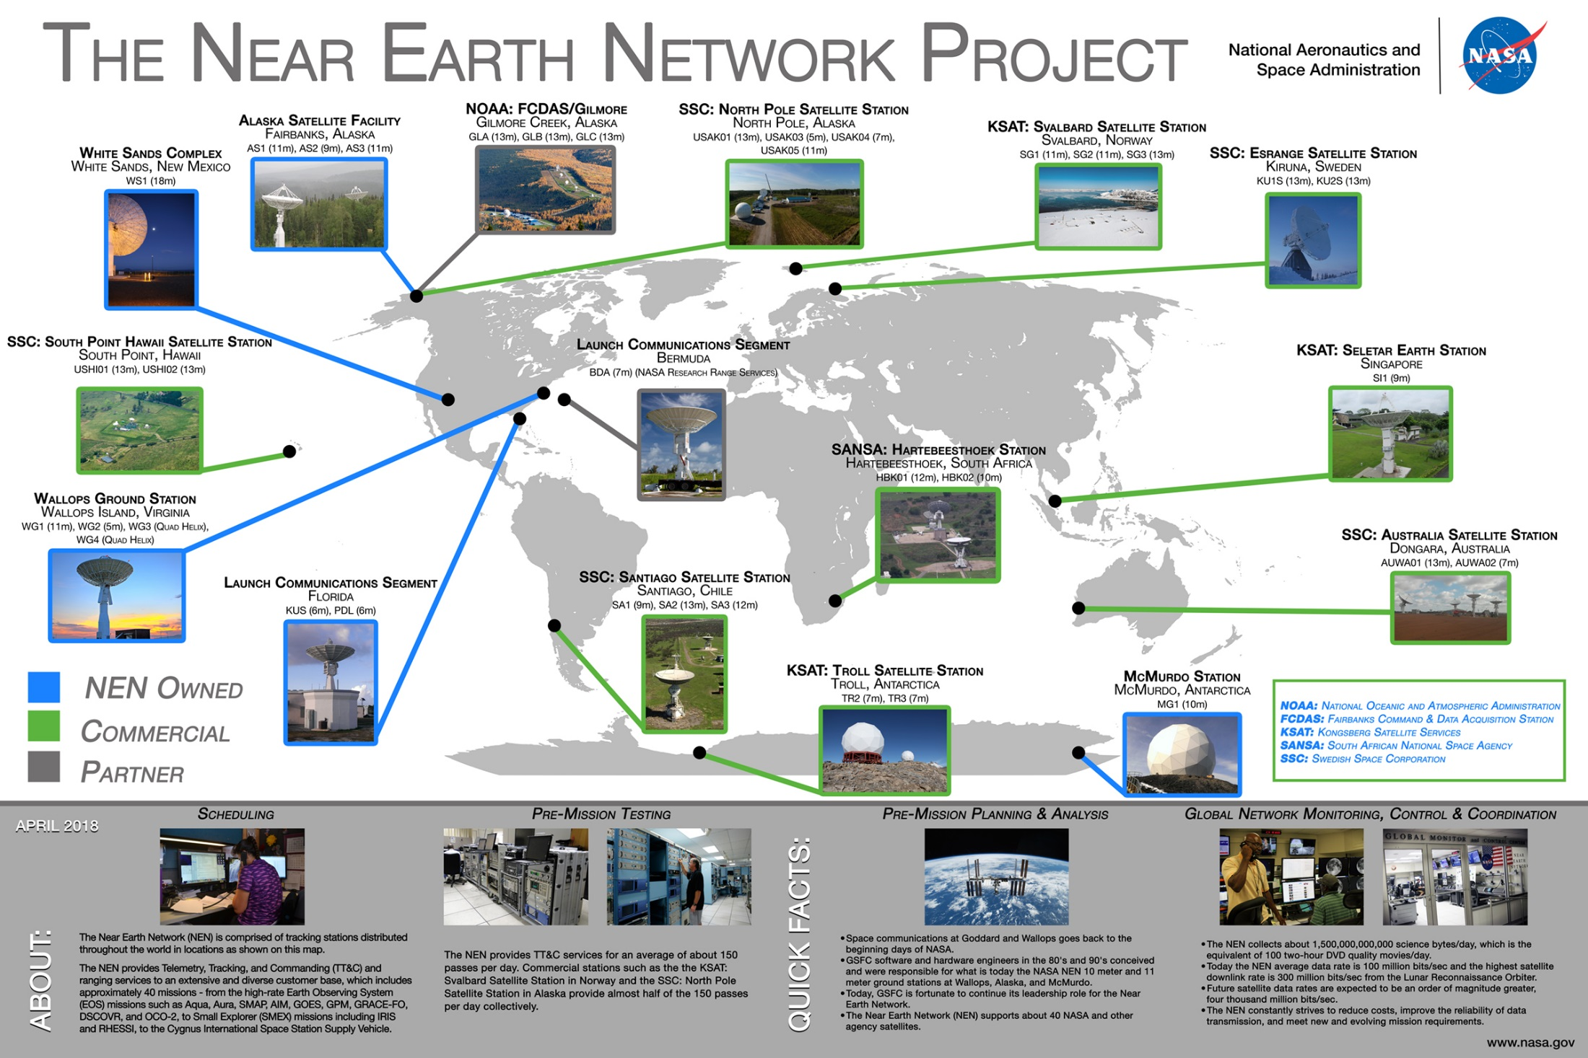

Slide 21
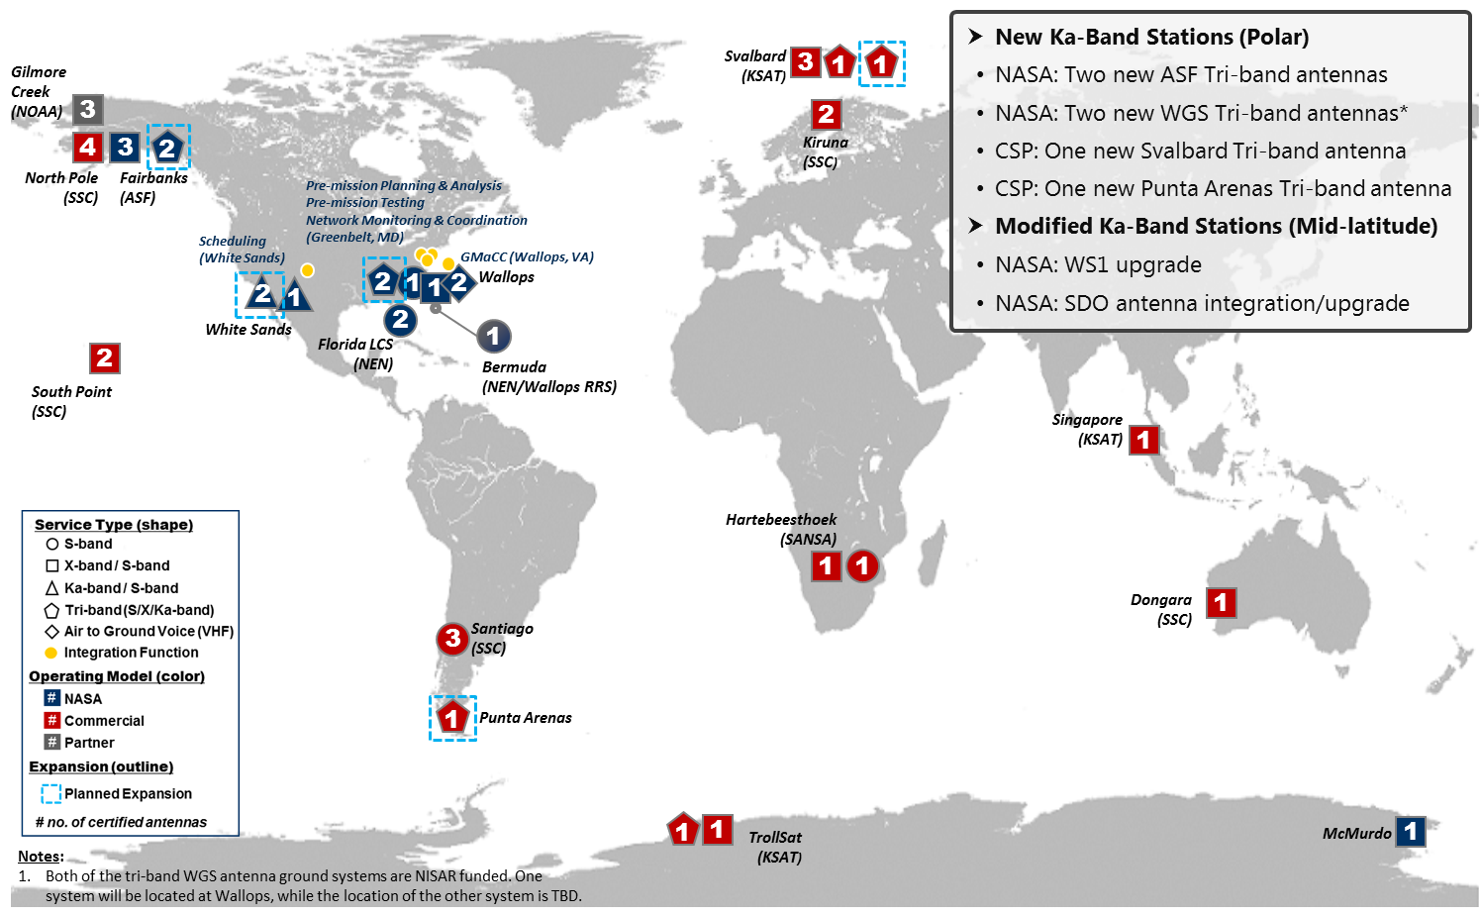
NEN Ka-Band Initiative Adds Stations for Increased Capacity
Notes:
Updated based on NIKA SRR Architecture slide

Slide 22
NEN Frequencies and Bandwidths for NTIA Licensing
Band | Function | Frequency Band (MHz) | Bandwidth (MHz) | Maximum Bandwidth per Transmitter (MHz)
S Uplink | Earth to Space | 2,025-2,110 | 85 | Typically <5
X Uplink | Earth to Space | 7,190-7,235 (Two NEN sites to 7,200) | 10 | Typically <5
S Downlink | Space to Earth | 2,200-2,290 | 90 | 5
X Downlink | Space to Earth, Earth Exploration | 8,025-8,400 | 375 | 375
X Downlink | Space to Earth, Space Research | 8,450-8,500 | 50 | 10
Ka Downlink | Space to Earth | 25,500 – 27,000 | 1,500 | 1,500
CubeSat Communications Platform

Slide 23
NEN CubeSat Support Analysis – LEO
CubeSat/SmallSat mission communication requirements including frequencies and data rates can be met by utilizing NEN S and X-band support based on 745 km low earth orbit
Coverage analysis indicates adequate ground coverage and support time utilizing NEN ground stations for CubeSats at an altitude of 745 km
Links | Data Rate | Mod & Coding | CubeSat EIRP | Link Margin
S-band Downlink | 2 kbps | BPSK, ½ conv. + RS | -1 dBw | 40.1 dB
S-band Downlink | 4 kbps | BPSK, ½ conv. | -1 dBW | 36.5 dB
S-band Downlink | 256 kbps | BPSK, ½ conv. | -1 dBW | 18.45 dB
S-band Downlink | 513.7 kbps | BPSK, RS | -1 dBW | 14.4 dB
X-band Downlink | 13.1 Mbps | QPSK, 7/8 LDPC | 4 dBW | 10.3 dB
X-band Downlink | 130 Mbps | QPSK, ½ conv + RS | 4 dBW | 3.2 dB
11.3 m at AS1, CubeSat PA = 1 W, 0 dBi Antenna Gain (S-band), Antenna Gain = 5 dBi (X-band)

Slide 24
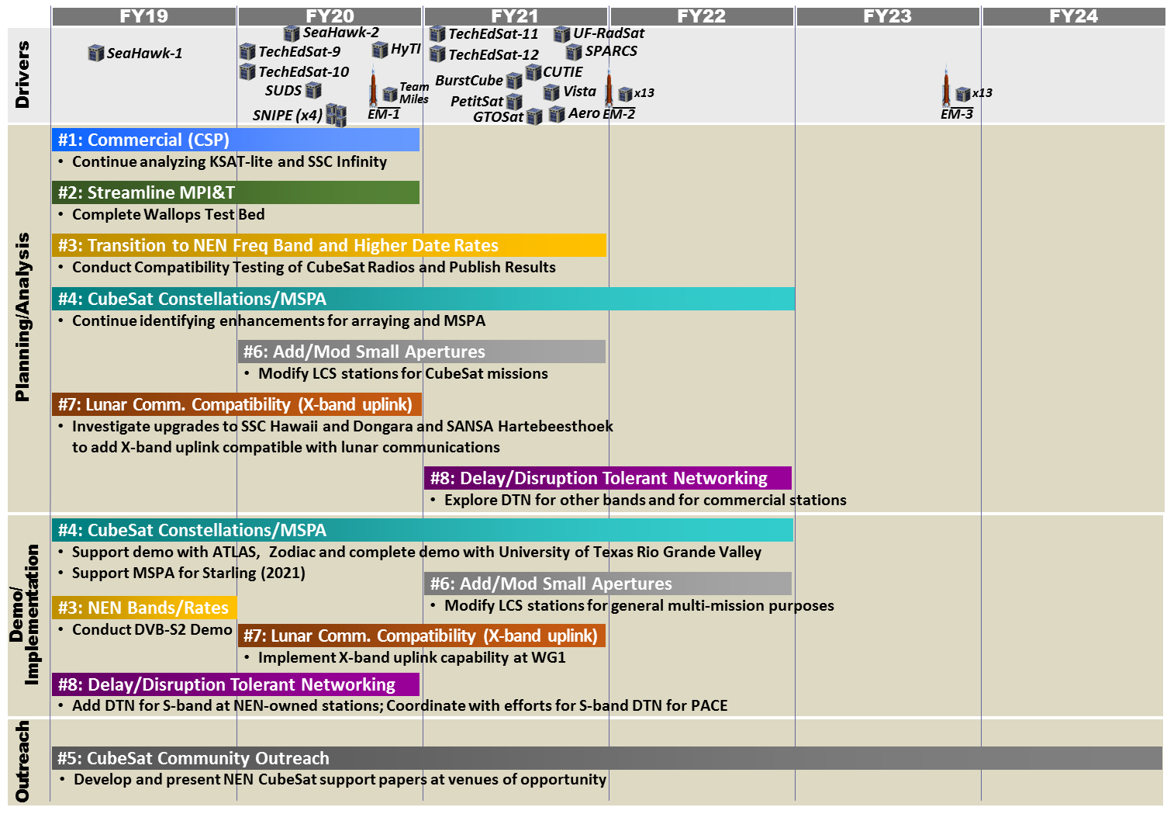
NEN CubeSat Strategy: Roadmap

Slide 25
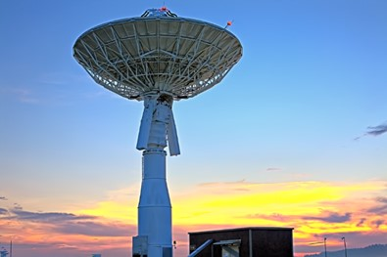

NEN Evolution
NEN is ready today to support CubeSats
Planned NEN expansions provide increased CubeSat support
CubeSat radios and NEN receivers achieve high data rates for CubeSat missions over X, S and Ka-band
NEN is capitalizing on Commercial Service Providers (CSP)/Academic Partnerships including small apertures, large apertures and X-Band uplink
NEN is investigating streamlining mission planning and integration and test and scheduling activities
NEN Wallops 11 Meter class antenna
NASA GSFC/Wallops LunarCube with deployable X-band antenna based on University of Colorado/Goddard X/S band CubeSat Radio and NEN

Slide 26
Lean Six Sigma (LSS) Compatibility Test
Process Improvements
NEN and NIMO worked together on a Lean Six Sigma (LSS) project to examine and propose compatibility test process changes for NIMO to be more responsive and cost effective for CubeSat missions
The LSS team identified seven improvement options to streamline the compatibility test process and evaluated their potential cost/schedule savings and risk level
Focus was placed on developing a fixed test plan with reduced reporting and establishing suites of dedicated equipment
  It was determined that these three improvements would result in a combined savings of 32% of cost, and 38% of schedule duration
Improvement | Cost Savings/Test* (% of Baseline Cost) | Risk to Mission/NEN
Reduced Reporting | 19 | Low
Fixed Test Plan | 6 | Low
Eliminate Some Tests | 19 | High
Dedicated Equipment at Wallops | 35 | Low
Dedicated Equipment at Greenbelt | 19 | Low
Automated Equipment Configuration | 6 | Low
Automated Test Scripts | 35 | Low
Notes:
New slide based on SpaceOps Compatibility Test Presentation

Slide 27
Conclusion
After selection, no charge for pass supports for NASA missions using NEN-owned stations
Questions – contact Scott Schaire, scott.h.schaire@nasa.gov, 757-824-1120, NASA Goddard Space Flight Center, Near Earth Network Wallops Manager

Slide 28
Further CCP Information
Backup Slides

Slide 29
Selected Publications and Contact
Long, J., D. Thorsen, O. Kegege “Retrodirective Phased Array Antenna for CubeSats”, Aerospace Conference, 2019 IEEE, March 2019 (submitted)
Klein, J., J. Hawkins, D. Thorsen, “Improving CubeSat Downlink Capacity with Active Phase Array Antennas”, Aerospace Conference, 2014 IEEE, March 2014, doi:10.11109/AERO.2014.6836238, 2014
Sielicki, T., J. Hamkins, D. Thorsen, “Variable Coded Modulation Software Simulation”, Aerospace Conference, 2013 IEEE, March 2013, doi:10.1109/AERO.2013.6497354
Contact for further CCP information:
  Justin Long at justin.long@nasa.gov
  Dr. Denise Thorsen at dlthorsen@alaska.edu

Slide 30

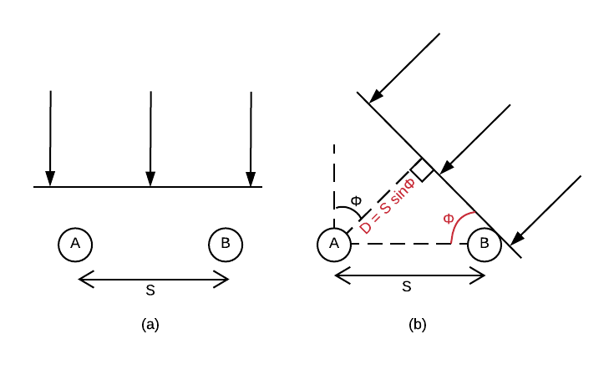
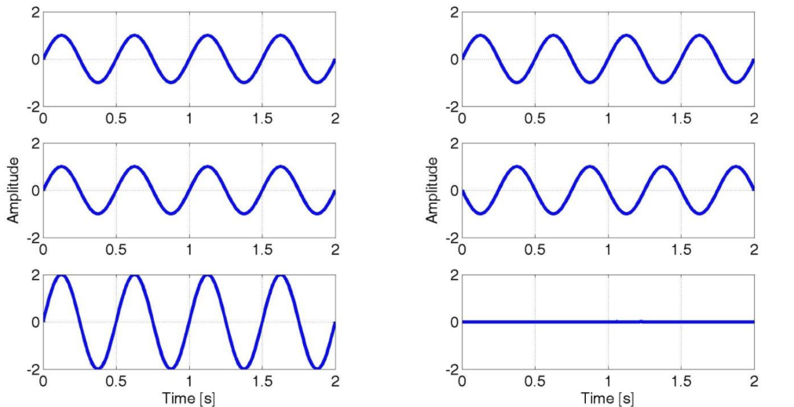



Array Theory
Array Pattern = (Element Pattern) x (Array Factor)
$$Δψ=0$$
$$Δψ=π$$
$$Δψ=S sin(φ)$$
(Phase Difference)
Spacing (S) in wavelengths
Notes:
A quick refresher on antenna array theory.
The total array pattern is estimated as the individual element pattern times the array factor
The array factor is a statement on the coherence of the signal being transmitted or received
This depends on the relative phase of the signal when it reaches each antenna element
The phase difference between two elements of a linear array is calculated as the spaceing between the elements times the sin of the incident angle
If there is little to no phase difference, the signals combine constructively, increasing the effective gain
If there is a lot of phase difference, the signals combine destructively

Slide 31
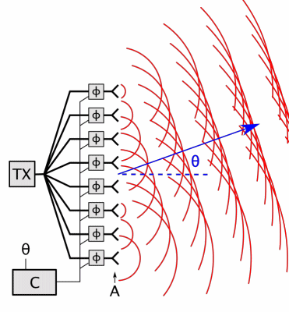
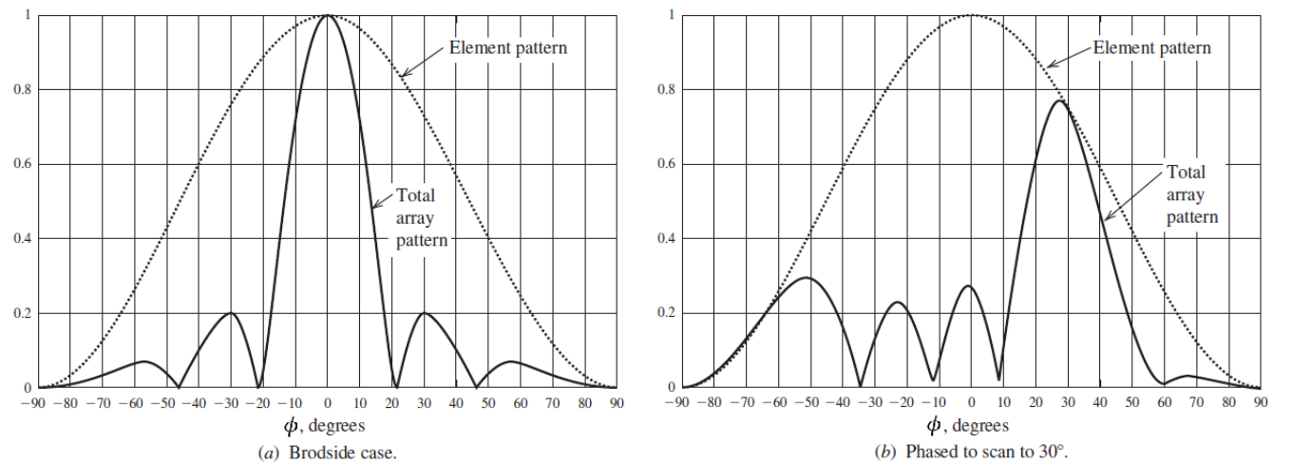
Phased Array Theory
Array Pattern follows element pattern!
Notes:
By introducing a phase shift to each element, we can choose in what directions the signal combines constructively or destructively.
This is the mechanism for beamforming.
Looking back to the previous array equation, there is an important observation:
The final array pattern follows the single element pattern.
This means as you beamform away from the main beam direction, the array gain will fall at the same rate as the single element gain.

Slide 32
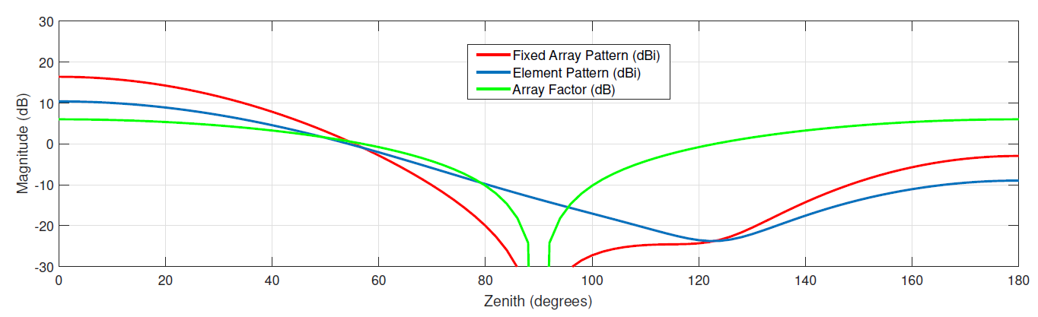
Analytical Simulations
Arrays:
  Increase gain
  Require better pointing
Notes:
I’m gonna run through three simulations that highlight the benefits of retrodirectivity.
This first simulation is for 2x2 array. The single element pattern is in blue, the array factor in green, and the array pattern in red.
There are three important observations from this simulation :
Array pattern is a synthesis of element pattern and array factor
Array pattern has higher gain the element pattern
Array pattern has narrower beamwidth than the element pattern, and therefore requires better pointing

Slide 33
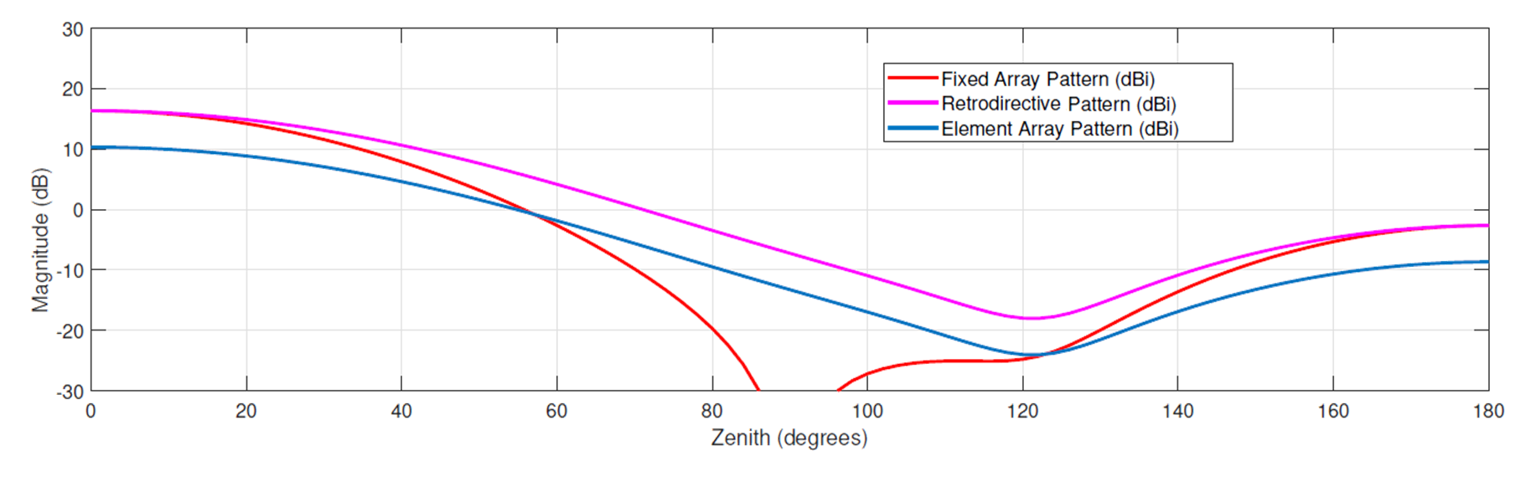
Analytical Simulations
Retrodirective Phased Arrays:
  Increase gain
  Require less pointing
Notes:
This is the same simulation, but showing the retrodirective array pattern
Note that the retrodirective array pattern assumes the array is always steered to maximize gain towards target
This plot shows two more important observations:
The effective retrodirective phased array pattern is the same shape as the element pattern
The effective beamwidth of the retrodirective phased array is identical to the beamwidth of the element

Slide 34
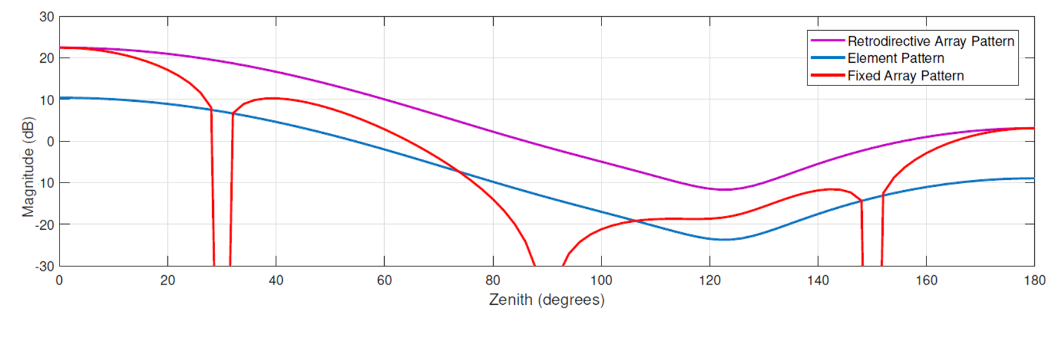
Analytical Simulations
Larger Arrays:
  Have higher gain
  Have narrower beams
  Benefit more from retrodirectivity (ideally…)
Notes:
This is the last simulation, and it shows a larger 4x4 array.
There are 3 final observations from this plot:
The 4x4 array shows more gain increase than the 2x2 array
The larger array has a narrower fixed beam width than the smaller array
The larger arrays benefit more from retrodirectivity (but this has limits, that will be discussed soon)

Slide 35
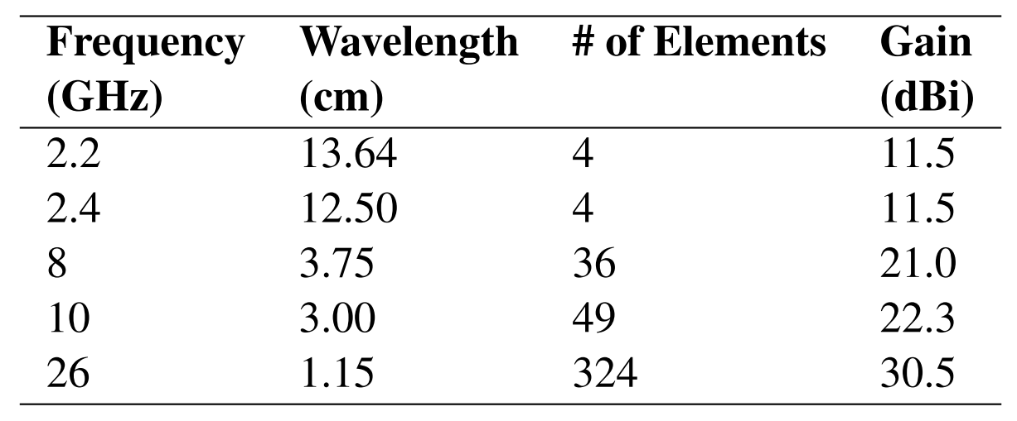
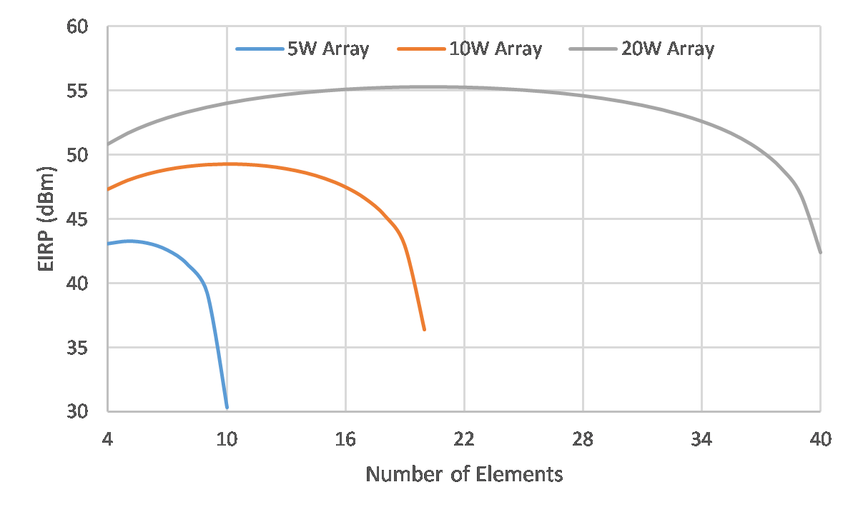
Analysis – Array Size
(on a 1U face,
10 cm x 10 cm)
Notes:
The first major analysis we did was to look at the array size. The table here shows how many elements can fit on a 10 cm x 10 cm face of a CubeSat.
More elements equals more gain, but each element of a phased array requires active control, which consumes power.
Too many elements, and the power overhead may overcome the increased gain.
So you may be able to fit a larger number of elements at X-band, but that doesn’t mean you should.
The graph shows the effective EIRP versus array size for our chosen implementation.
The results show that for a 5W array, there’s no reason to go larger than a 2x2 array size.
If you move up to 10W, then you benefit from a 3x3 array, and at 20W you benefit from a 4x4 array.
The shape of this curve is mostly dependent on the power amplifiers, so there is some room for optimization.

Slide 36
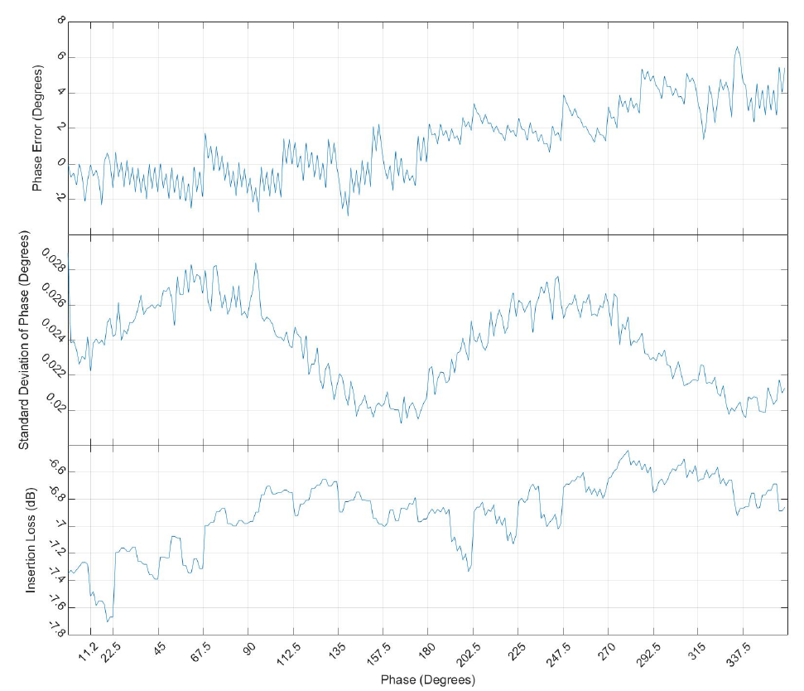
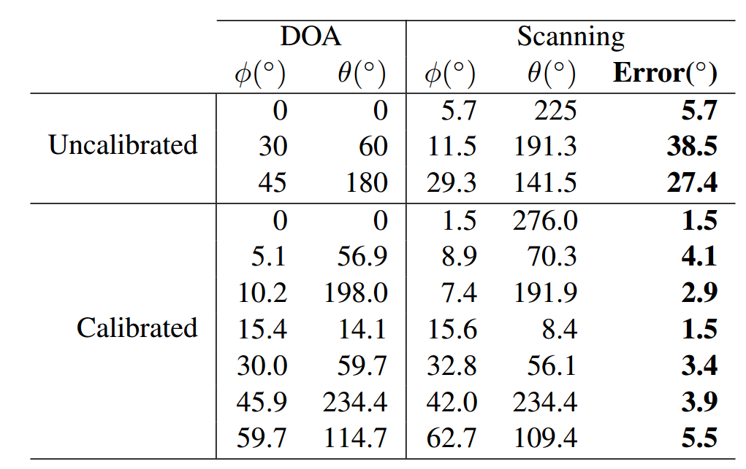
Analysis – Calibration Requirements
Possible errors:
  Phase error from:
    Phase shifter offsets
    Phase shifter resolution
    Mechanical tolerances
  Amplitude imbalance
Notes:
Another significant note is just how important calibration is for these systems.
We ran some scanning tests without any calibration, and as expected the results were terrible
This is largely due the inherent phase error of the phase shifters, but also has some contribution from the mechanical tolerances of the cables and connectors, and the amplitude imbalance across each channel of the array
The curves at the right show the performance of the phase shifter across it’s full phase range.
The top curve shows the phase error, the middle curve shows the standard deviation of phase error, and the bottom curve shows the insertion loss.
We generated a calibration table that accounted for the phase error in the cables and phase shifters, and this reduced the average error from 30 degrees to 4 degrees.
We did not calibrate for the amplitude imbalance, so this could be further improved.

Slide 37
Summary
Retrodirective phased arrays for CubeSats
  High gain, without strict pointing
  Feasible for 1U CubeSats in LEO
Analysis: Larger ≠ Better
  Per element overhead = diminishing returns on EIRP
Low-cost COTS parts are adequate
  Extensive calibration is required
Notes:
To summarize:
We’re designing a very small phased array system for CubeSats
Simulations show that it has lot of promise for CubeSats, providing high gain without strict pointing or deployables
The current prototype, at 2.2 GHz, fits on a 1U CubeSat
The prototype is using almost entirely COTS parts, except the patch antennas themselves
We included some analysis that show that big arrays are not necessarily better, and that each individual channel of the array needs careful calibration.

