Slide 1
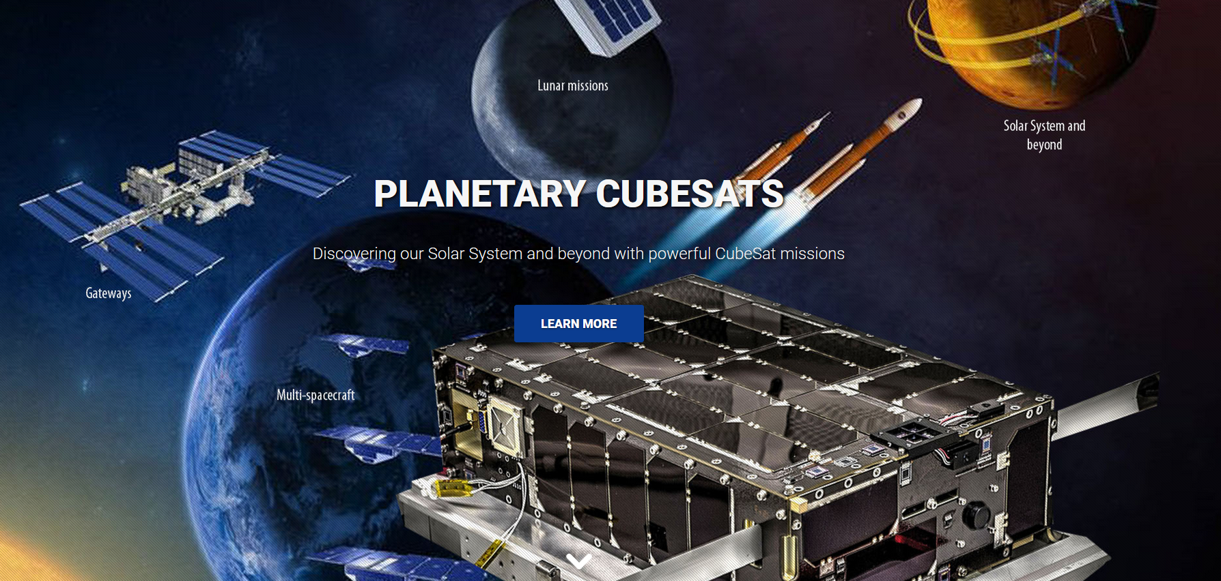

Deep Space Navigation
Cheryl.J.Gramling@nasa.gov
Navigation and Mission Design Branch
NASA Goddard Space Flight Center
4th Planetary CubeSat Science Symposium
28 June, 2019

Slide 2
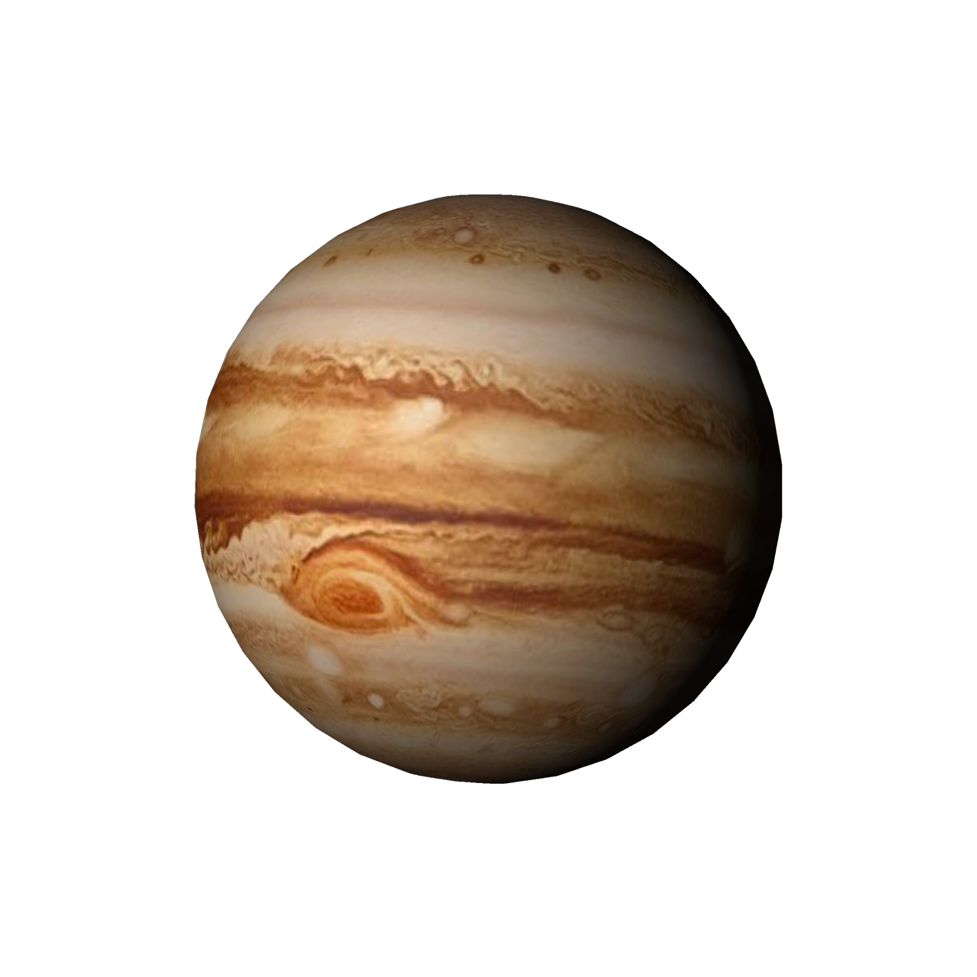

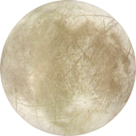
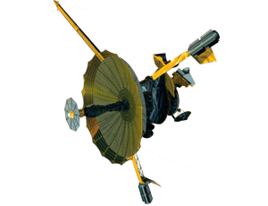
Agenda
Navigation Regimes
Data Types and Systems
Capabilities and SWaP
3rd Planetary CubeSat Science Symposium, NASA GSFC, August 16-18, 2018

Slide 3

Defining Navigation Regimes
Near Earth – central body is Earth or within 2e⁶ km of earth
Planetary – Moon, Planets and their moons, Asteroid,
Heliocentric – Non-Planetary designs, Drift away
Navigation refers to:
  Knowledge of the mission orbit wrt the central body (absolute) or wrt another object (relative)
  Knowledge of where the object resided or currently resides in the orbit (definitive) or will reside in the future (predictive),
  The trajectory design associated with achieving the mission,
  How to modify the object’s orbit to follow that trajectory,
  And the time associated with each of these.
Notes:
The predictive knowledge can be just as important as the definitive knowledge (science planning for event encounters, coordinated observing, instrument planning; mission planning (eclipses, orbital events); Network planning; trajectory planning; conjunction assessment.

Slide 4

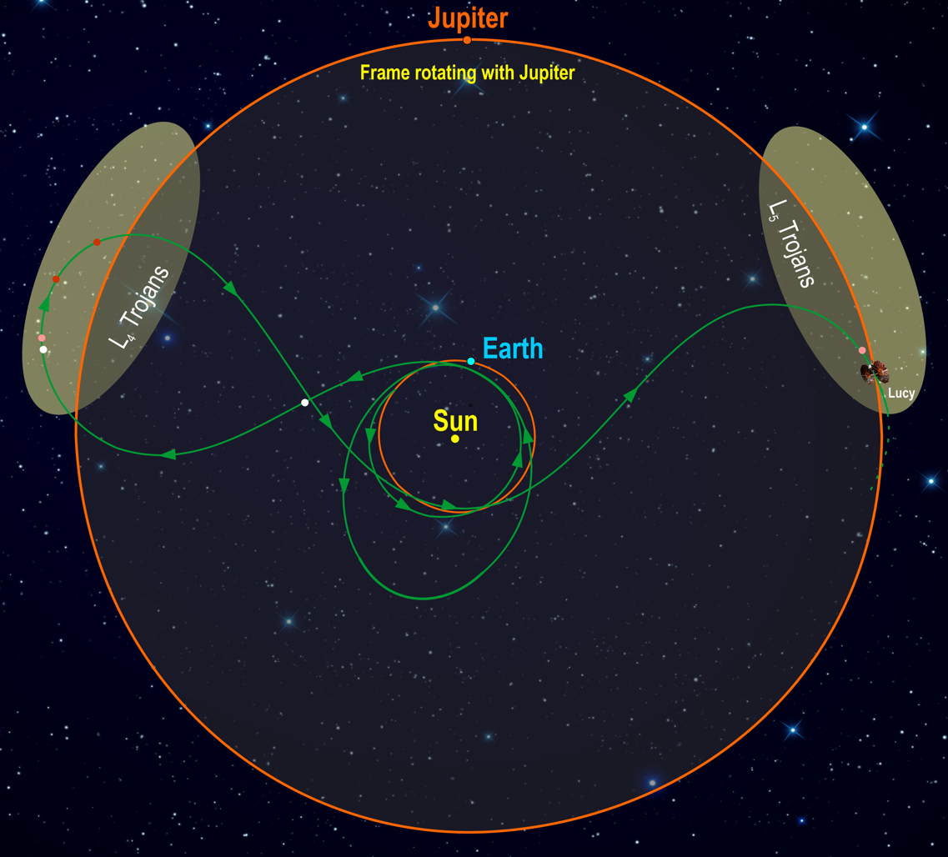


Navigation Regimes
Near Earth
DSN
Planetary
GEO
TDRSS Possible
~15+ R_{E}
Libration, L1
GPS
~7R_{E}
L1
~50 R_{E}
L2
~70 R_{E}
MMS Phase 2
25 R_{E}
...
~4R_{E}
LEO
Potential
Lunar Nav
GPS
Weak-signal
Possible

Slide 5
Forms of Direct Measurements
Time Delay Range (Distance)
Differential Delay Angle
Frequency shift (Doppler)
or Carrier Phase Line of Sight Velocity
Frequency Change Rate Line of Sight Acceleration
Angular Change, Orientation Bearing, Range
One common element
among each of these is:
TIME

Slide 6
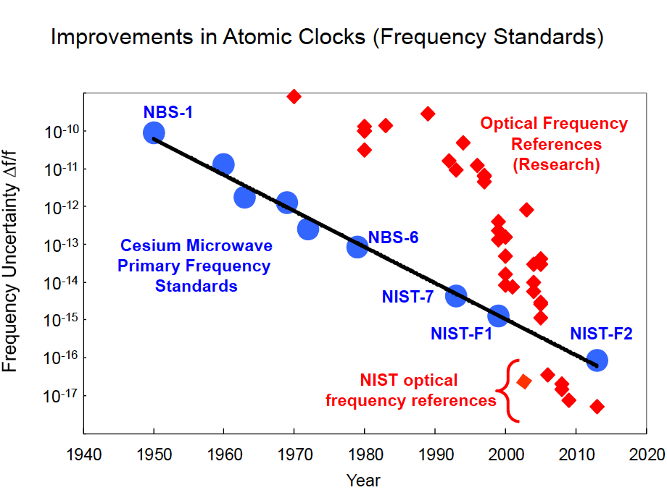
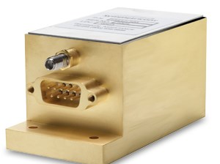
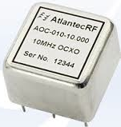
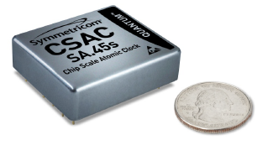
Time is Fundamental
Flight Units
TCXO
OCXO
Cs
Rb
Space Qualified: 1 sec/31,688 years
Notes:
Time is the foundation of any orbital tracking system. The time system provides a way to not only time stamp the measurements, but is fundamental to the measurements themselves. The source that provides the time also provides the frequency for the carrier and all signals that build the carrier. Now we can procure a space-qualified oscillator with the stability of 1 second in 31.7 thousand years (parts in 10 e-13) and even better stability for ground-based sources.

Slide 7
TIME is the Facilitator
  Ground element timing establishes boundary condition for end-user performance
  Applicable to communications, radiometrics, and science
  Sources clock and frequency
  Delay accountability
  Phase noise & jitter
  Coherency
Automatic exchange of timing state during a communication session enables:
  Synchronization across long distances
  Time-based communication schemes
Universal and onboard timing sources needed as orbit moves away from Earth
Round trip light time (RTLT) challenges our ability to perform navigation operations in real time
  Overcome by moving navigation onboard the spacecraft to provide in-situ real-time operations
Notes:
Can’t do any better than your base timing system

Slide 8
Data Types & Systems
Measurement Type | Providing Systems
Range – tone, swept tone | GN, TDRS TTC, DSN
Range – PN | TDRSS, GPS, DSN (variation)
Doppler or Carrier Phase | All
Angles – Direct Observation | GN, TDRS
Celestial Navigation – Indirect Angles | Star Sensor/Camera, Earth/Sun Sensors
Delta Differenced One-Way Range - Angles | DSN with Quasars
Imaging/Optical Navigation | Camera
XNAV | X-Ray Pulsars Detector
Perturbations – non-grav | Accelerometer
Time | Oscillator, Time Distribution
Range & Doppler can be either 1-way or 2-way;
Both improved by differencing.

Slide 9
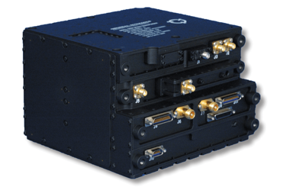
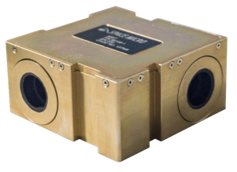


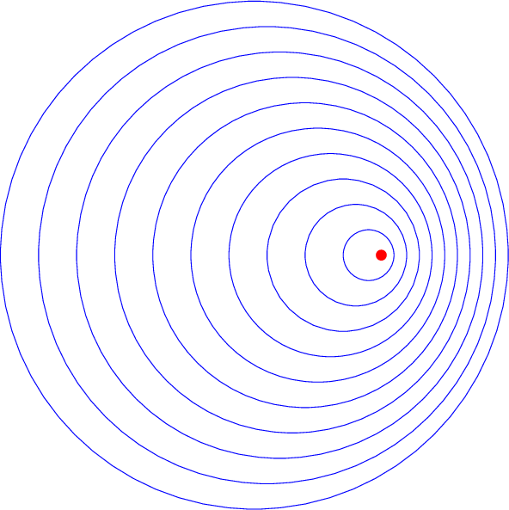

Planetary Navigation
Planetary Navigation options include traditional ground based, or can be facilitated by onboard systems
Traditional ground-based option includes
Use of the NEN and/or DSN
DSN compatible transponder, e.g. IRIS-V2, or DST
Requiring multiple station contacts
Higher precision or faster plane-of-sky knowledge requires two ground stations simultaneously for DDOR
Onboard options include
Doppler or pseudorange measured onboard from received communication signal using the receiver
Optical Navigation using a camera
Accelerometer/IMU
X-ray Pulsar Detector
All use Flight Software –
  unifies the system, runs under cFS
  Processes measurements
  Provides onboard knowledge of orbit and attitude
  Plans maneuvers
  Executes & controls maneuvers through closed-loop feedback
Improved accuracy and convergence using onboard system, especially for frequent maneuvers for formation control, momentum uploads, near-body targeting
Delta f
Delta T = R/C

Slide 10
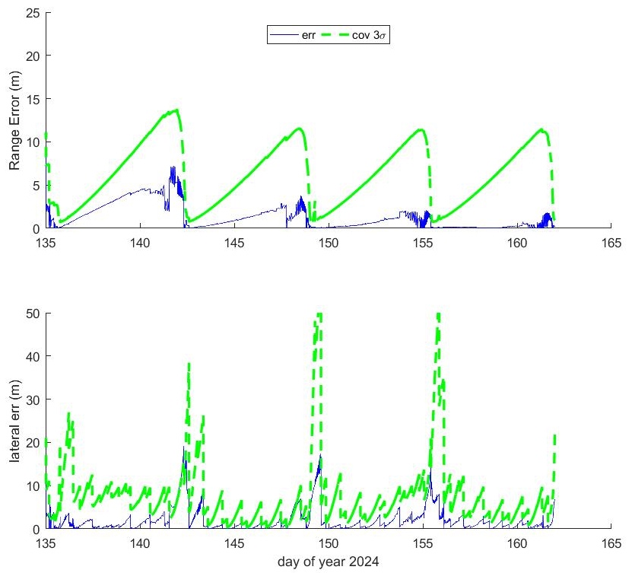
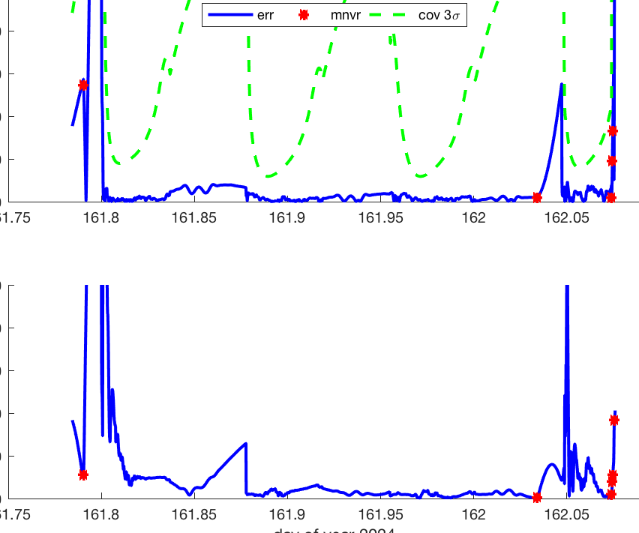
Optical Comm: Optimetrics at the Moon
1-way forward laser signal to vehicle from Earth stations.
Observations taken and processed onboard in real time.
Can be complemented with other data types (GPS, TRN)
Gateway (NRHO)
MC Max RSS position error:
1.5 m apolune, 17.6 m perilune
Lander During Descent (with maneuvers)
RSS position error: 1-5m, 157m @ touchdown

Slide 11
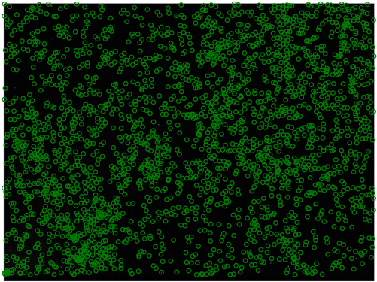




Optical Navigation, 1
Optical Navigation (OpNav) is a technique by which digital images can be used to determine the relative position and orientation of a camera with respect to something observed in the image
There are 3 primary types of OpNav:
star-based, celestial, and relative.
Star based OpNav generates inertial pointing measurements
CelNav produces bearing measurements to a number of objects
Relative OpNav (RelNav) generates bearing/position estimates to an observed object
Venus
Mars
Jupiter
Star based
CelNav
RelNav

Slide 12


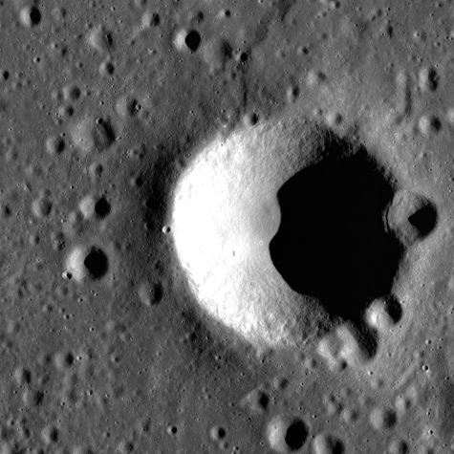
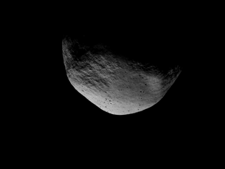




Optical Navigation, 2
The type of CelNav/RelNav used depends on the apparent size of the body in the image.
Star based
X
CelNav
RelNav
Unresolved Body
Extended Body
Model Fitting
Center Finding
Surface Feature Navigation (SFN)
Terrain Relative Navigation (TRN)
LROC image, April 2019

Slide 13
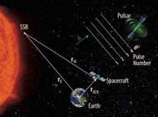
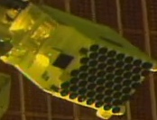
Pulsar Navigation – X-Nav
Couples precision timing of distant pulsars with geometric diversity to determine orbital state and time
Provides plane of sky information
Universally available
Advancements expected to achieve CubeSat SWaP

Slide 14
Autonomous Navigation, Guidance, Control
Onboard navigation operational since 1999 in LEO, 2015 in HEO (formation)
Follow-on to onboard orbit estimation is onboard orbit control: autonomous maneuver planning, execution, and calibration
AutoControl demonstrated on EO-1 in 2000; Established for single mission
Reduces ground ops required for maneuver planning and
execution and associated risks
Requires telemetry feed from the maneuver, similar to ground
planning/execution/calibration process
Algorithms for maneuver planning and formation
missions being implemented in FSW via IRAD

Slide 15
Simplified Measurement Capability
Broad summary of measurement capability
  Not intended to indicate one size fits all
  Some measurements not available in real-time
  Snowflake-like possible combinations for performance & robustness
Orbit | GPS | NEN/DSN (ground, radio) | NEN/DSN (onboard, laser) | ΔDOR (DSN) | OpNav: CELNAV | OpNav: TRN | Requirement/ Source
LEO | 50 cm @ 1 Hz | 10−20 m @ 1.5 orbit | 1e-3 m | N/A | 1 km @ 2 hr | -- -- | ≤ few m
HEO (perigee < constellation) | 10 m @ 1 Hz | 100 m | 1e-3 m | N/A | 0.1−15 km @ 1 orbit | -- -- | < 1 km / many
GEO | 5 m @ 1 Hz | 100−200 m @ 36 hrs | 1e-3 m | N/A | 1−5 km @ 1 orbit | -- -- | 10 m / many
Lunar, in view | 15-26 m | 50-200m @ 2 days | 1.5 m | 1 km @ 1 day | 0.5 km @ 0.5 days | 0.3 m (w NEN laser) | 500 m / LRO
Lunar, far side/hi lat | N/A | N/A | N/A | N/A | 0.5 km @ 0.5 days | 5-12 m (w maneuvers) | 500 m / LRO
Sun-Earth L1/L2 | N/A | 4-32 km @ 3 wks | 1.5 m | 1 km @ 1 day | 5−15 km @ 3 days | -- -- | 8 km / WFIRST
Planetary | N/A | 8-15 km @ 3 wks | -- -- | 1 km @ 1 day | 5-10 km @ 3 days | 1-5 m | ~ 5 km / Lucy

Slide 16
Estimated SWaP-C
Unit | Description | Size | Mass (kg) | Power (W) | Cost ($K/FTE) | Notes
RAFS | Supplies uniform, common stable time and frequency reference source with synchronized distribution across all elements; synchronizes to the earth ground element reference source; acts as Master Reference onboard the GW/Lander for all subsystems and units (see notes) | 4e-4m³ - 2.5 Liters | 0.45 - 3.4 | 10-35 | 600/0.3 | Either a RAFS or a USO needed, not both.
USO |  | 2x2x2 cm | 0.2 | 1 | 20
Miniature Integrated Star Tracker (camera) | Provides angular measurements to define plane-of-sky using distant sources (stars, planets), imaging of target celestial body limbs for Optical Navigation, and imaging of target (celestial object or a vehicle) surface features for Terrain Relative Navigation | 0.75 U (U=10x10x10 cm) | 0.7 | <4 | 500/.4 | Radiation hardened; 3 heads; main unit needed for attitude quaternion; 33% of listed SWaP-C applies to nav, 67% on bus
NavCube 3.0 Weak-Signal GPS Receiver | Observability of GNSS signals, including side-lobes, for pseudorange -- useful in cis-lunar or lunar vicinity | 20.5x28x14 cm | 6 | 20-25 | 1300/1.5 | Power depends on whether Discrete RF card of ASIC RF card is used; can be included as part of small satellite architecture
L-Band Antenna | Patch-type antenna for GPS | TBD | TBD | TBD | TBD
Accelerometer | Accelerometer to resolve maneuver DV | 24.6x25.5x38 cm/u | 0.071x3= 0.213 | 0.48 x 3 = 1.44 | 10x3= 30 | e.g. Honeywell QA3000, x3 units
GEONS | Heritage flight software that runs under core flight system to provide autonomous navigation using a fusion of data | NA | NA | NA | 350/1 | Runs on C&DH processor; bus accommodates command and telemetry; tailoring
Assumptions
Every element not applicable to all orbit regimes
Comm Receiver outputs pseudorange and Doppler (established techniques exist for both; soft/firmware); not included in table
Camera has integrated electronics with a head for far-field (attitude estimation) & at least one head for near-field imaging for OpNav/TRN;
C&DH exists on bus capable of running GEONS/AutoNGC
SWaP-C are per unit

Slide 17
Planetary Navigation Summary
Navigation in the near-earth regime, 2e⁶ km, can be performed by an array of systems to provide robust solutions with seamless transitions between orbit regimes
Navigation in the planetary regime has fewer options available, with traditional ground support using radiometric (or optimetric) tracking and onboard systems that rely on sensors and/or comm systems
Flight components are developed to meet the CubeSate size, weight, and power constraints
Components within a communications system influence the resultant radio/optimetric tracking data quality
GSFC Navigation offers relevant pre- and post-launch services to the planetary user and networks communities
Navigation needs to be an enabler for the science NASA hopes to achieve in the future – technology investments are key.

Slide 18
BACKUP

Slide 19
Simplified Navigation:Science Categories
Broad summary of navigation categories
  Not intended to indicate one size fits all
  More snowflakes
    Mission unique elements
    Combination of many known components
Category | Lower Accuracy | Accurate | High Accuracy | Precision Navigation
Absolute Definitive | 100 – 300 m | 5 – 40 m | 50 cm – 10 m | < 1mm – 50 cm
Absolute Predictive (1 day) | 1 km | 75 – 500 m | 5 – 50 m | 5 cm – 5 m
Relative Definitive | 1 – 50 m | 1 – 10 m | 0.1 – 1 m | <0.1 mm – 1 m
Relative Predictive (1 day) | <0.5 km | 50 – 75 m | 1 – 10 m | 0.1 mm – 10 cm
Science Objective | Astro, Spatial, Loose temporal | Temporal, Surface Observer, Human | Temporal, Surface Observer/Altimetry, Human | Altimetry, Gravity, Interior Composition
Orbit Regime | Low, libration, helio cruise, cis-lunar cruise | Low, GEO, High, loose formation, precise maneuvers | Low, GEO, High, approach, formation, cluster | low, GEO, High, precise formation, rendezvous/docking

Slide 20
Sensors
GPS/GNSS Receiver
  GSFC developed weak-signal GPS; licensed to companies (BRE)
  Assists in coverage in higher altitudes ou tto lunar distances
Crosslink
  Developed as element integrated with weak-signal GPS receiver to TRL 5 for MMS
  1-way range & Doppler measurement for relative navigation
  Low-rate data on signal (exchange science alerts, Health & Safety, nav)
Autonomous Rendezvous and Docking Sensor
XNav sensor (pulsar detector); translates pulsar timing to pseudo-range observation
Star Camera
Accelerometer
Integrate navigation sensor with communications receiver

Slide 21
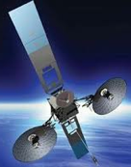

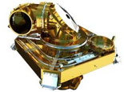
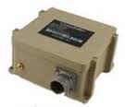
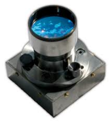
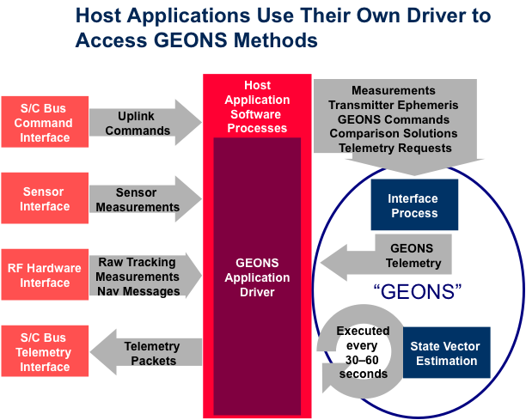
Systems
Fusion of multiple data types from independent systems
  Robust to outages or shortcomings of any one system
  High accuracy
  Seamless transitions across orbit regimes
GEONS flight software processes forward Doppler from ground stations and TDRSS, attitude sensor data for celestial nav, GPS, crosslink & broadcast service pseudo-range, Xnav, OpNav/TRN
  Solves for absolute and relative navigation
  Works under core Flight System
Test Facility: Formation Flying Test Bed
  Provides Test As You Fly simulation capability
  GPS simulator, Path Emulator for RF Signals, User Dynamics Environment Simulator
From the spacecraft side, as comm subsystem is developed, nav and comm engineers need to work together to define requirements

