Slide 1
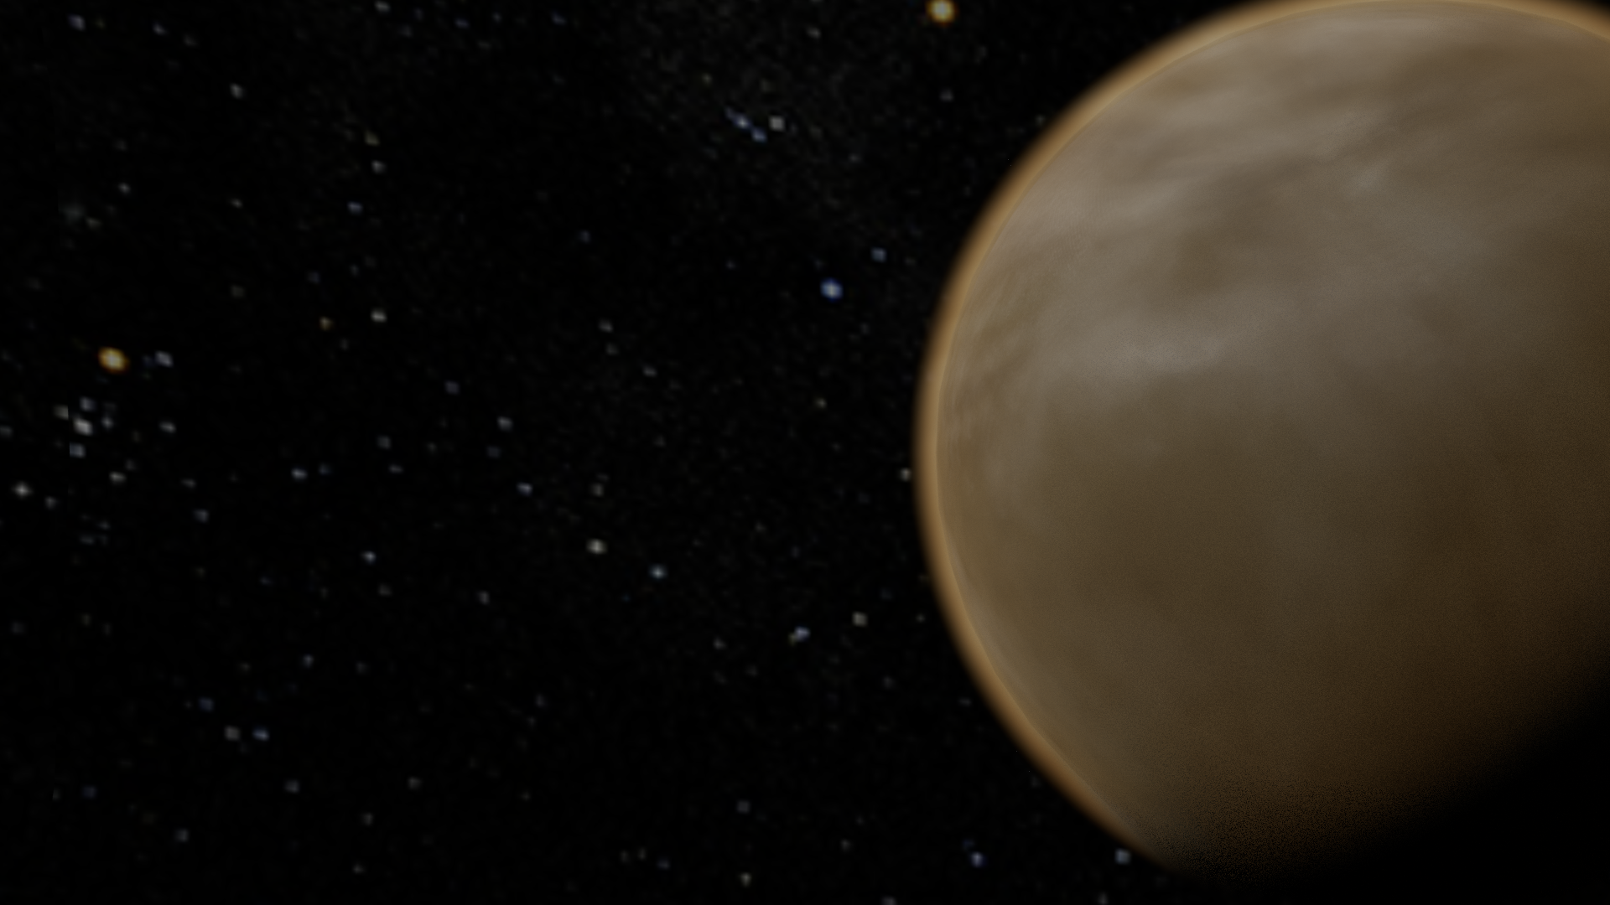




Lofted Environmental Venus Sensors (LEAVES)
Jeffrey Balcerski Ohio Aerospace Institute
Anthony Colozza (Vantage Partners, LLC), Gary Hunter (Glenn Research Center),
Maciej Zborowski (Vantage Partners, LLC), Darby Makel (Makel Engineering, Inc.)

Slide 2
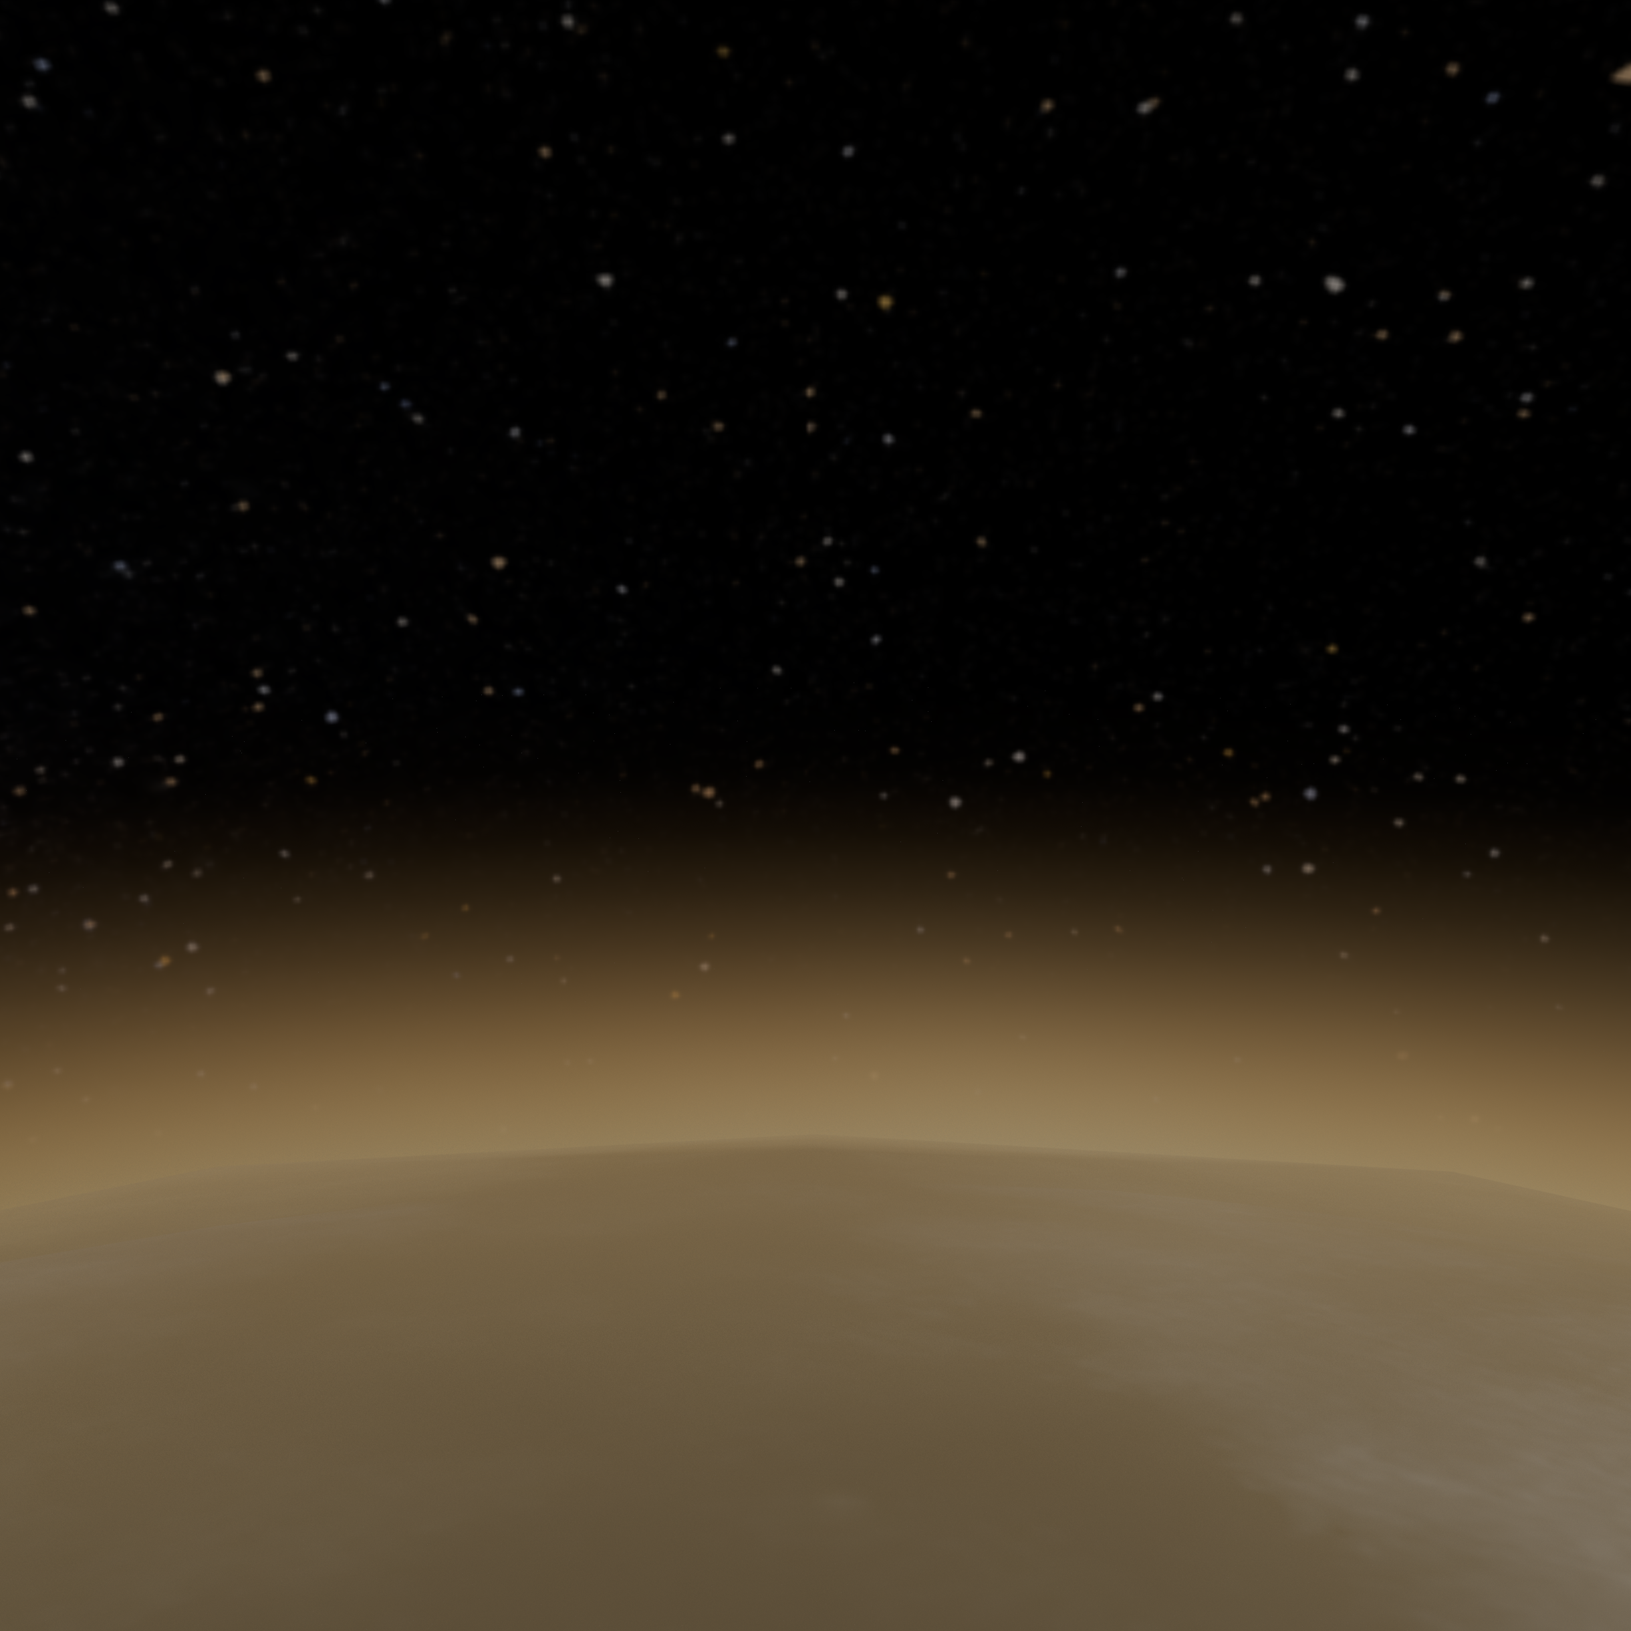
WHAT IS A “SWARM”?
“2a: a large number of animate or inanimate things massed together and usually in motion” – Merriam-Webster Dictionary
Order of magnitude lower in mass than a 1U cubesat (picosat or smaller)
Order of magnitude lower cost than SIMPLEX cost cap
At least ten individual units, having a common architecture and purpose, widely spatially distributed during an exploration campaign.

Slide 3

PLANETARY SWARM PROBES
Swarms
Low cost
Many units
Widely distributed
Focused science
Some failure expected
High redundancy
Conventional
High cost
Single unit
Limited location/time
Comprehensive science suite
Zero fault/failure
High reliability
RESILIENCY

Slide 4
PLANETARY SWARM PROBES
Swarms perform investigations that are either inappropriate or impossible for monolithic spacecraft.

Slide 5
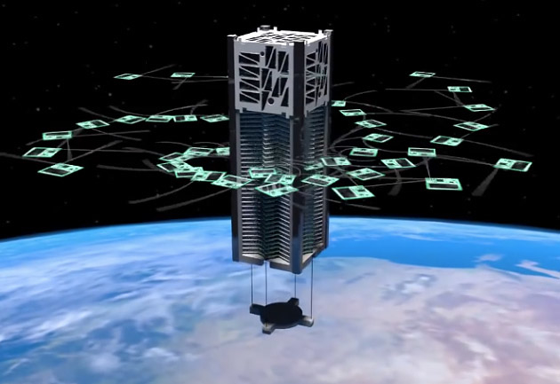
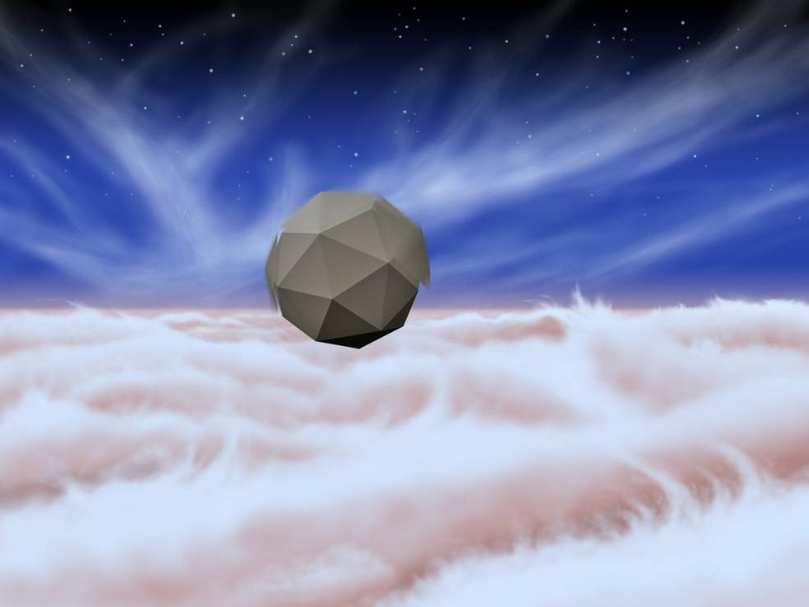
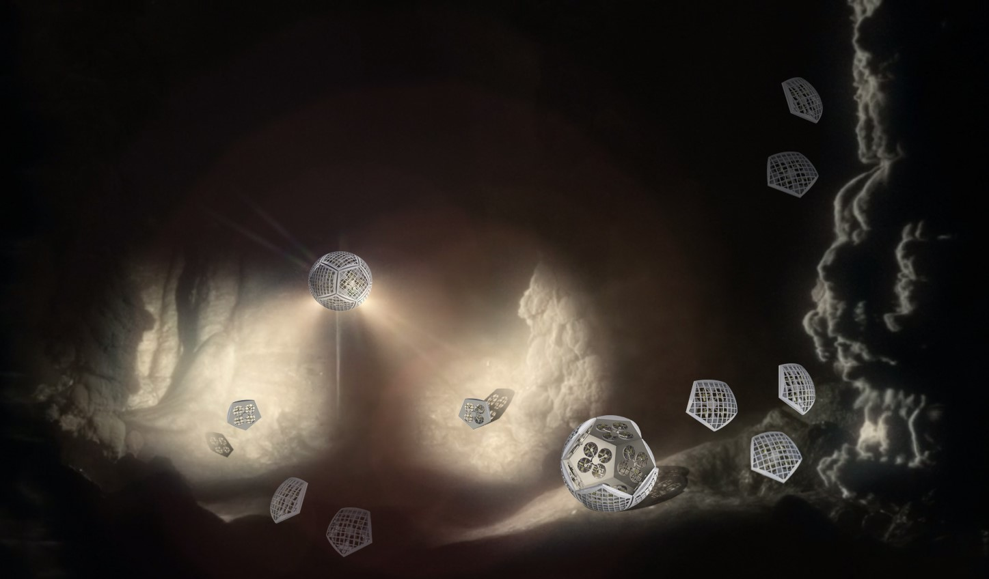
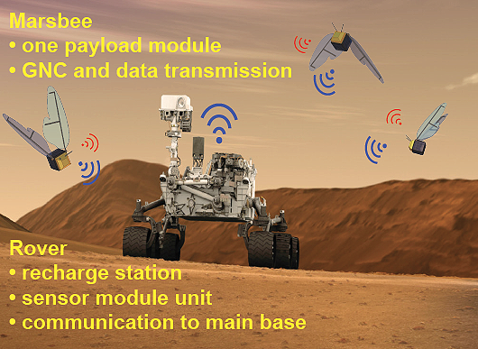
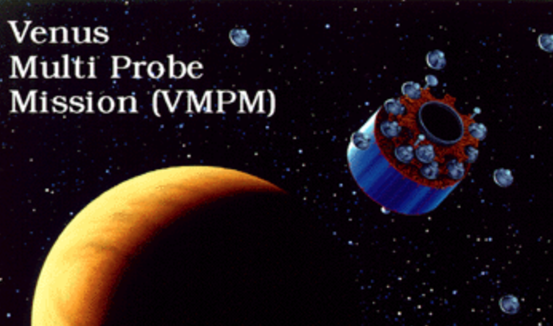
PLANETARY SWARM PROBES
KickSat (2015)
GOWON (2012)
Shapeshifters
(NIAC - 2018)
Windbots (NIAC - 2017)
(1999)
Marsbees (NIAC - 2018)
Flexible Electronic Platforms / STANLE
(NIAC – 2014)

Slide 6
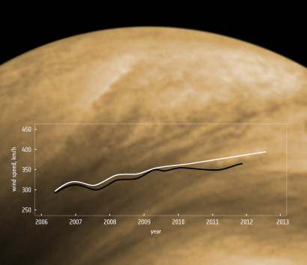
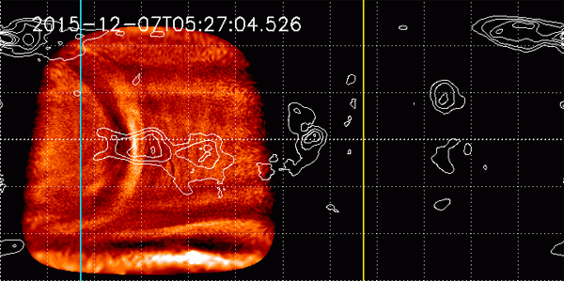
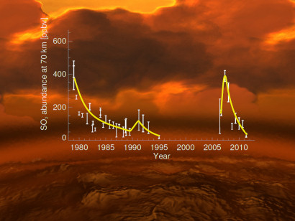
W H Y V E N U S?
Credit: JAXA (Nature Geoscience, 2017)
Credit : ESA (Icarus, 2013)
Credit : ESA (Nature Geoscience, 2013)

Slide 7

V E N U S C H A L L E N G E S
Easy to arrive… Difficult to survive
Venus is a tremendous engineering challenge and a tantalizing science mystery
100 km: -112 C, 2.7x10⁻⁵ bar
Dense, extensive atmosphere
68 km: -37 C, 0.07 bar
Sulfuric acid clouds
48 km: 93 C, 2.7 bar
0 km: 467 C, 93 bar
Highly reactive surface

Slide 8
APPROACH
Distributed, low cost, high resilience, low risk
targeted science
Utilize electronic components for extreme environments (Venus)
Optimize for atmospheric investigations – low mass, high drag
“Passive” swarm – No active navigation, no swarm home/hive
Keep It Simple payload
  Single chemical species sensor
  Ambient temperature, pressure, accelerometer, gyroscope
  Transmit-only radio with radar wake-up trigger

Slide 9
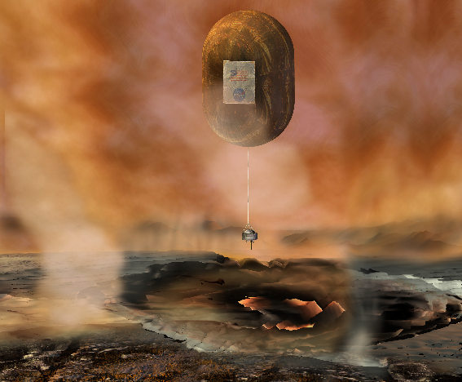
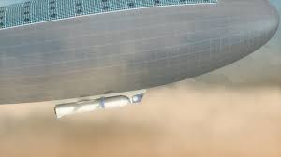
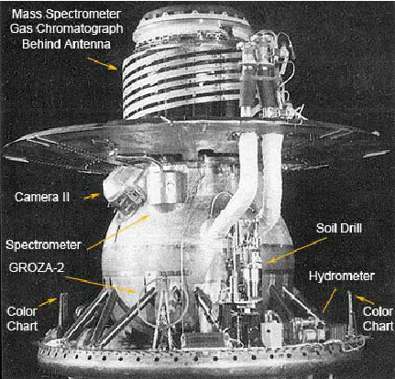

APPROACH
Intermediate-Life
Probe Swarms
Parallel data collection
Wide area coverage
Resiliency directly related to redundancy
But…
Short-lived Probes
Long-lived Platforms
VISE (2003)
Venera (1982)
HAVOC (2015)
Cupid’s Arrow (2014)
Redundancy is limited
by scalability
VAMP (2013)

Slide 10
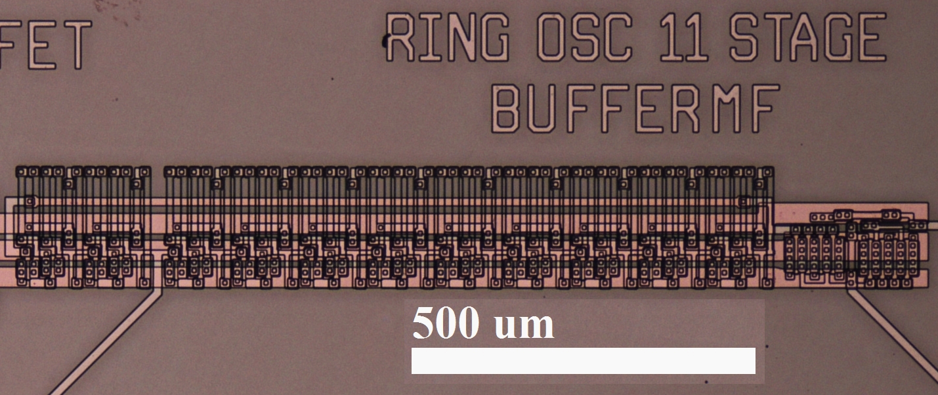
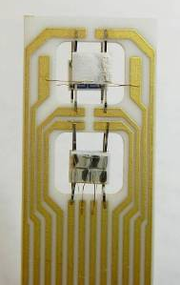
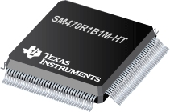
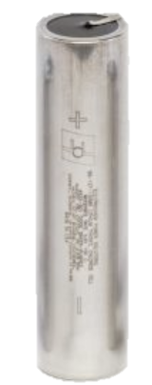
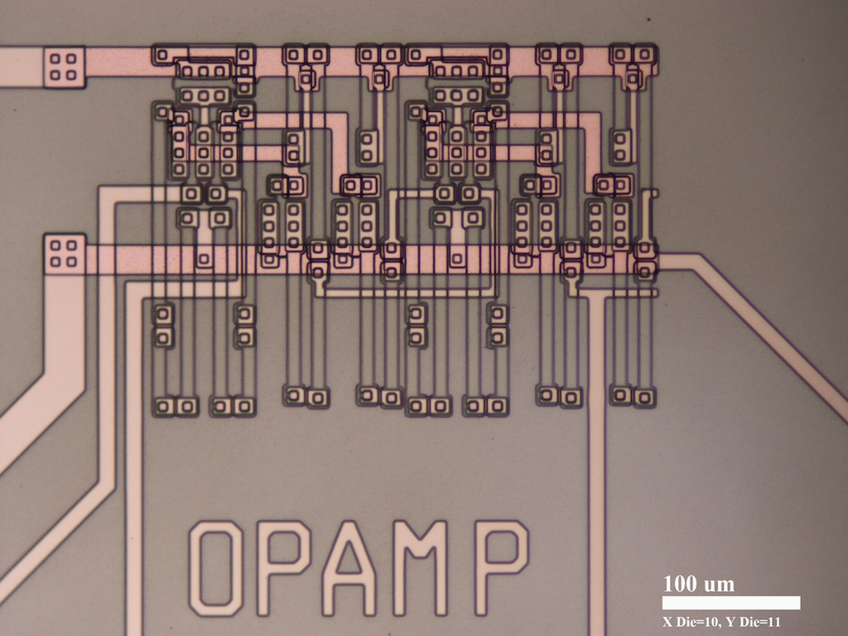
ENABLING TECHNOLOGY
Highly sensitive MEMS chemical sensors
Conventional miniaturized
electronics (-55° to 220° C)
High Temp Electronics
24-Transistor Ring Oscillator IC
  COTS power: Electrochem Solutions Inc. 200 MR Series (4410) cells designed for high temperature oil drilling applications.
2 cm
2-Stage Operational Amplifier IC
(NASA GRC / Makel Engineering Inc., 2016)
(NASA Glenn Research Center, 2016)

Slide 11
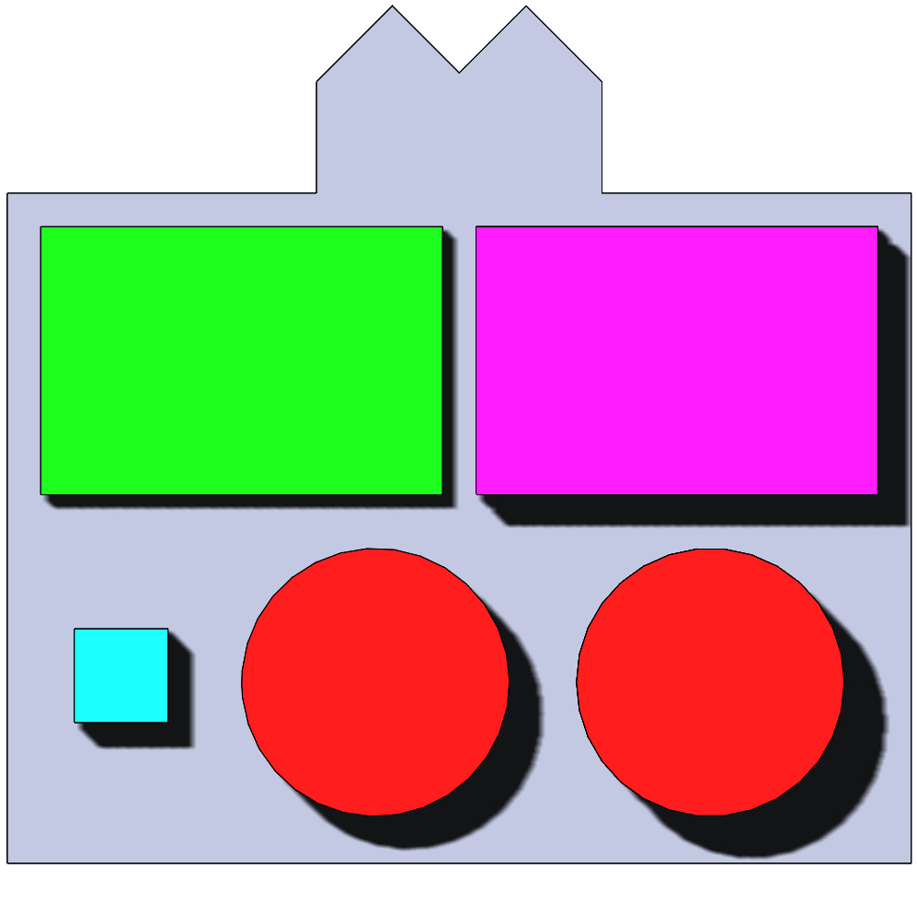
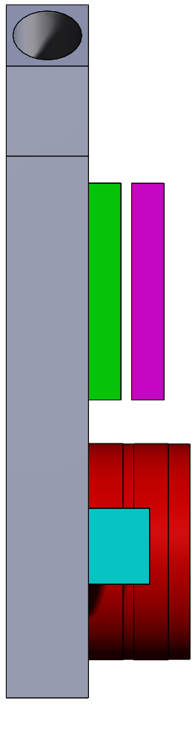
SCIENCE PAYLOAD
Payload mass: 53 g
Chemical sensors
3-Axis Accelerometer (AD&C)
Micro Transmitter (Communications)
Low and High Temperature Batteries (Power)
PCB (C&DH)
5.00 cm
0.94 cm
6.75 cm
0.76 cm

Slide 12
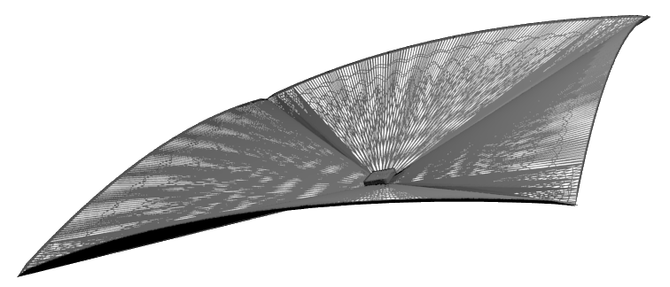
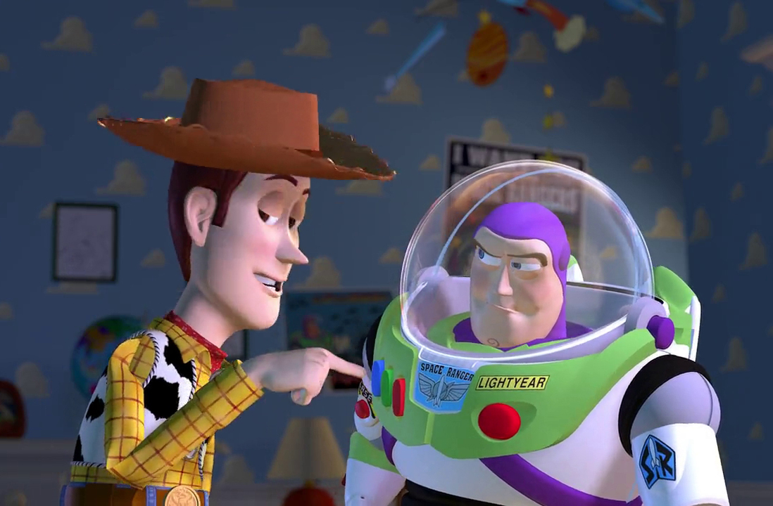
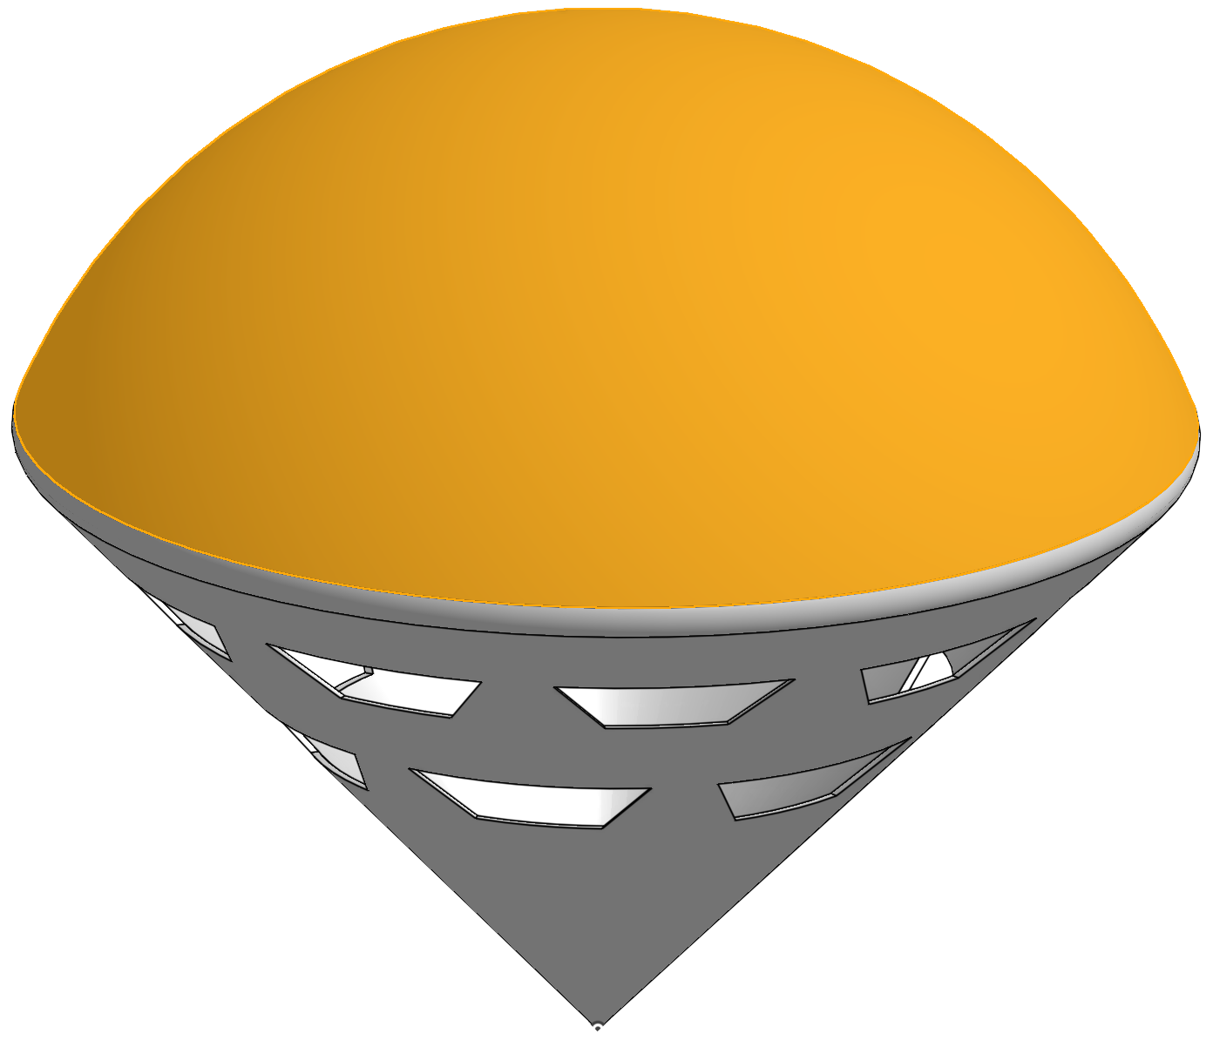
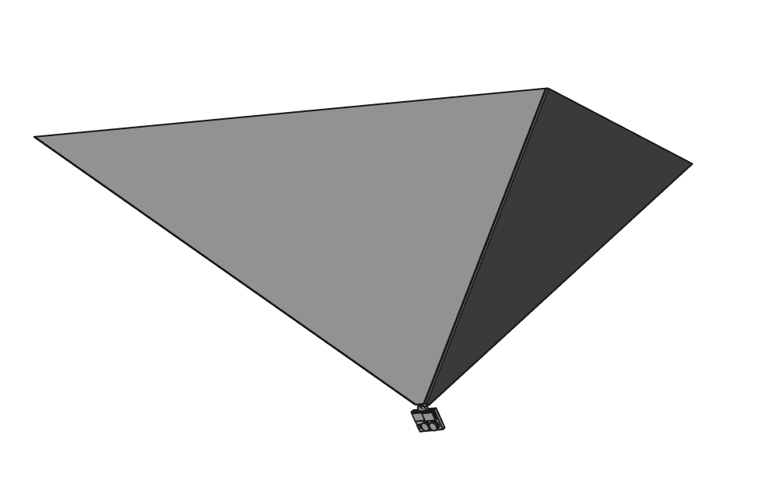
MAXIMIZING FLIGHT TIME
Planar “leaf” shape
Long flight
Unstable
THAT’S NOT FLYING
Ballute / parachute
Faster descent
Mass approaches balloon
© Disney Pixar
THAT’S FALLING… WITH STYLE
Inverted pyramid / shuttlecock
Self stabilizing
Intermediate flight time

Slide 13
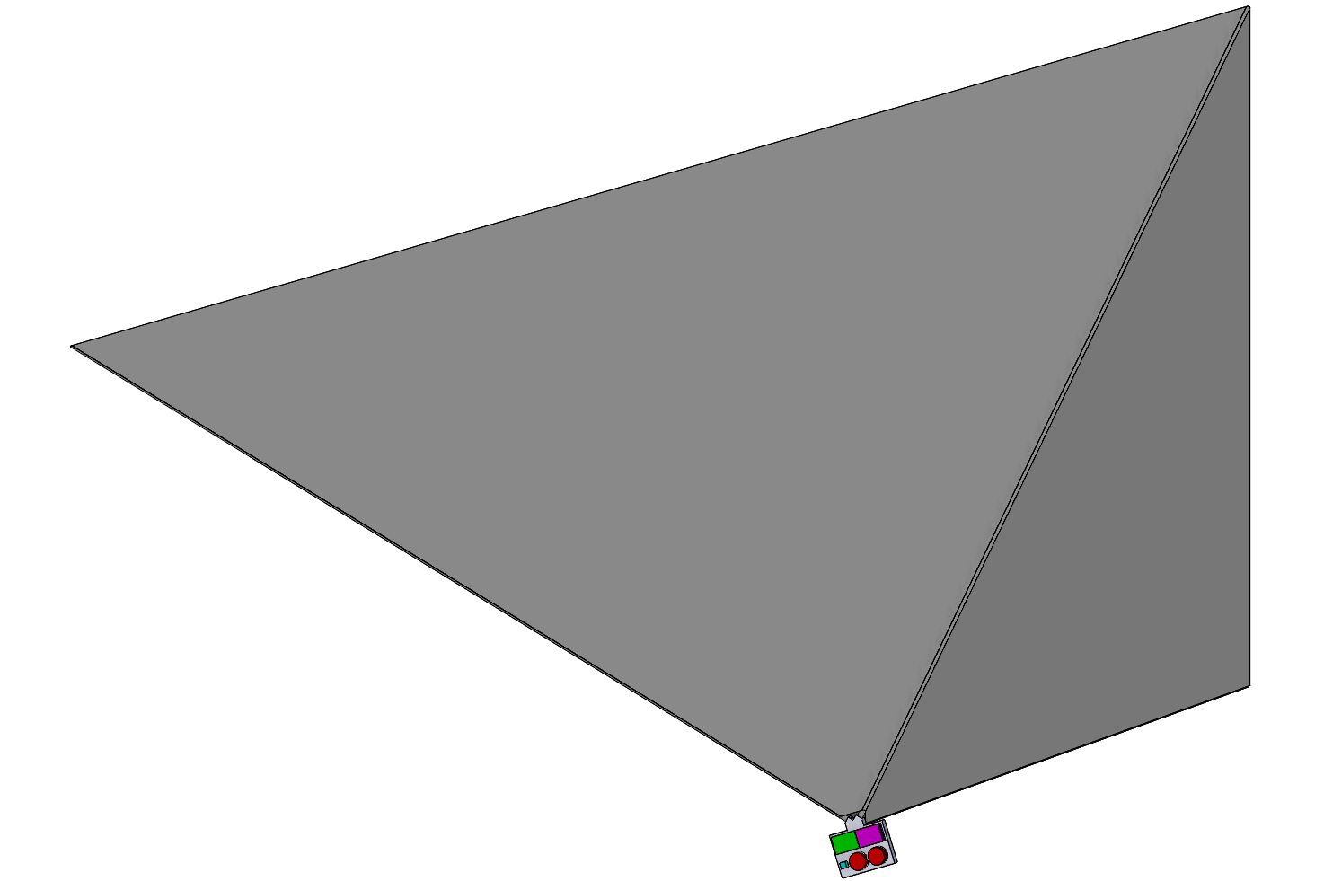
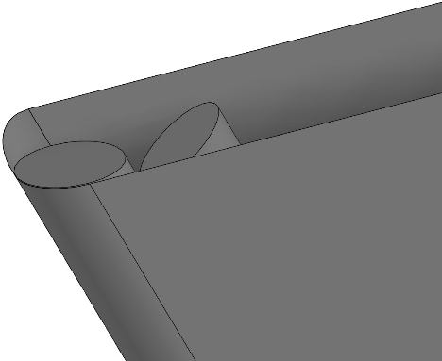
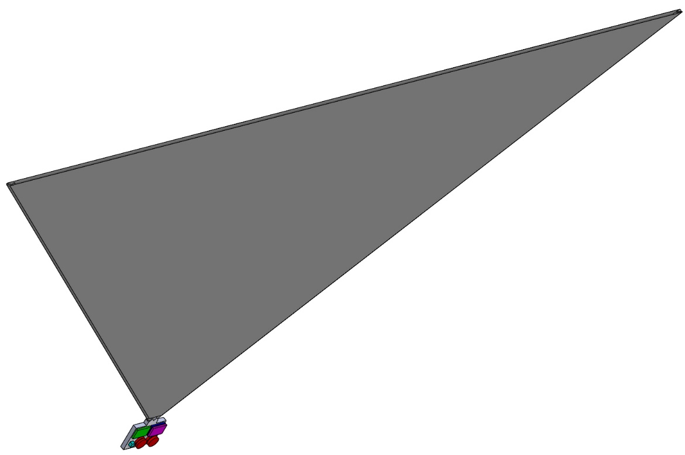
PLATFORM
Moveable Rod
Fixed Rod
Thin film sheet
Support rods
1.5 m
Flat stowed configuration

Slide 14
PLATFORM
Features
120 g total mass
  (~40% payload to structure ratio)
Collapses for flat packed stowage
Structure-as-science
  Inverted pyramid is a 10 GHz retroreflector

Slide 15
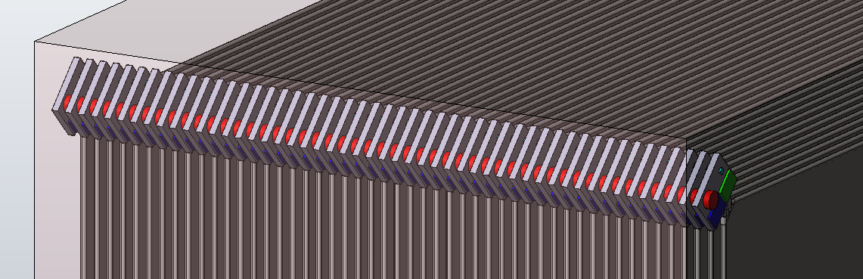
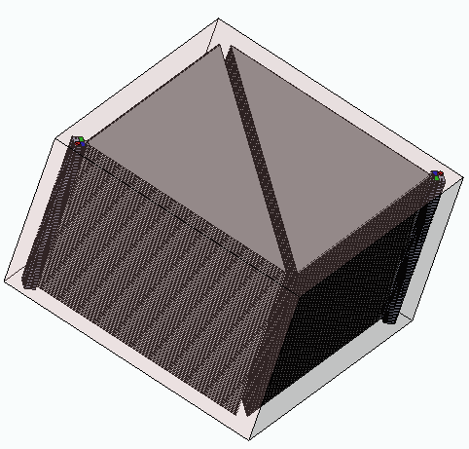
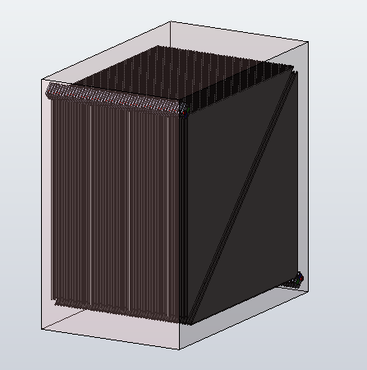
HITCHING A RIDE TO VENUS
“mailbox” attached to carrier orbiter spacecraft
(e.g. VERITAS / VOX)
Side by side stacks (50 each)
1.5 m x 1.5 m x 0.5m

Slide 16
DEPLOYMENT
Where’s the aeroshell???
LEAVES has a ballistic coefficient of 0.173.
At the right altitude, and the right velocity, these probes can be deployed directly from orbit.

Slide 17
DEPLOYMENT
Periapsis deployment during primary spacecraft aerobraking at 5 km/s
  Hp < 120 km results in nearly immediate entry (probable failure)
  120 < Hp < 145 km entry times between days and months (success)
  Hp > 145 km results in slow decay and no entry (probable failure)

Slide 18
DATA GATHERING
30 km
224° C
9.3 hours

Slide 19
DATA GATHERING
Drift distance
Wind speed
9.3 hours
~ 1600 km lateral drift
TIME (s)

Slide 20
TRADE STUDIES
Areal Density | Time to Surface | Time to 35 km Altitude | Drift Distance | Maximum Heat Load | Maximum Force Loading
0.032 (kg/m²) | 4347 Min | 891.0 Min | 6056 km | 1.25 W/cm² | 3.9 N/m²
0.063 (kg/m²) | 3130 Min | 627.0 Min | 4300 km | 2.54 W/cm² | 7.7 N/m²
0.126 (kg/m²) | 2203 Min | 436.8 Min | 3014 km | 5.20 W/cm² | 15.7 N/m²
0.253 (kg/m²) | 1533 Min | 300.1 Min | 2103 km | 10.70 W/cm² | 32.5 N/m²
Drift distance
Wind speed

Slide 21
COMMUNICATIONS AND POWER
Transmission triggered by radar signal
  400 MHz CDMA at ~ 3.5 kbps at 6000 km distance
LEAVES cache and transmit data from the start of record each time.
  Continuous acquisition of science data at 8 bps, navigation data at 80 bps.
  All gathered data transmitted in < 1 min.
Power use in data gathering mode: 0.15 W
Power use while transmitting: 1.5 W

Slide 22
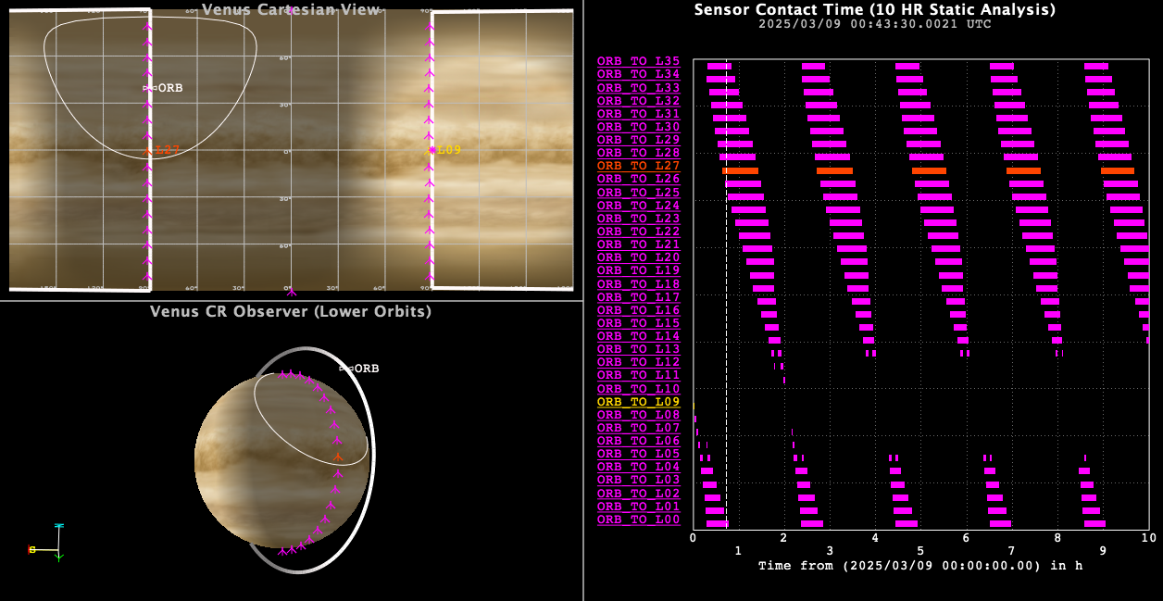
DATA GATHERING
(Orbiter 300 x 3000 km, 88.5°, T= 124 min)

Slide 23


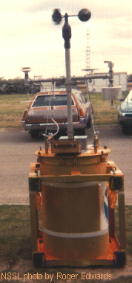
TECHNOLOGY INSPIRED BY FICTION
(which was inspired by reality)
NOAA Totable Tornado Observatory (TOTO) extreme weather instrument (1984)
© Warner Bros, 1996

Slide 24
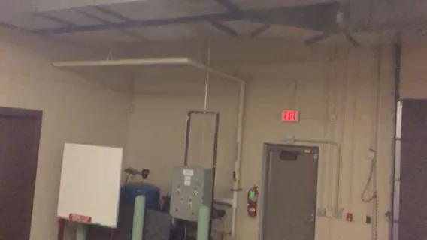


SUMMARY
DESTINATION: VENUS
UNIT MASS: 120 g
AREA: 1 m²
TOTAL UNITS: 100
LIFETIME: 9+ hours
FLIGHT READINESS: 3-5 YEARS
We gratefully acknowledge support by:

