Slide 1
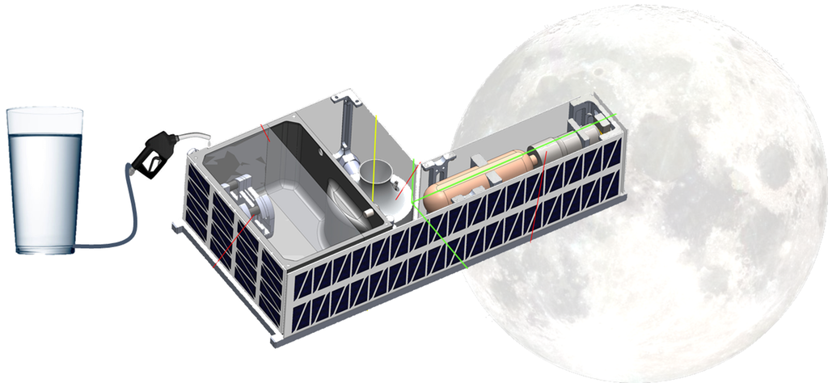
Cislunar Explorers Lunar CubeSat: Instant Spacecraft, Just Add Water
Kyle Doyle Cornell University Department of Mechanical and Aerospace Engineering June 27th, 2019

Slide 3
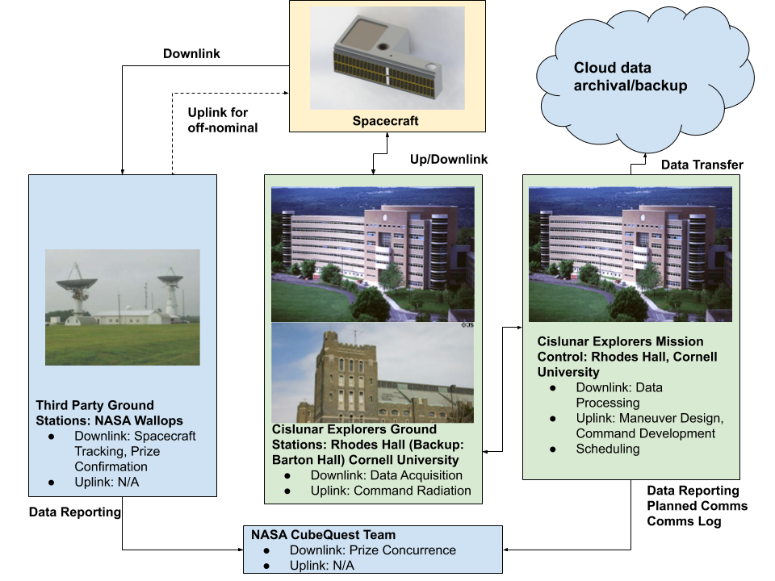
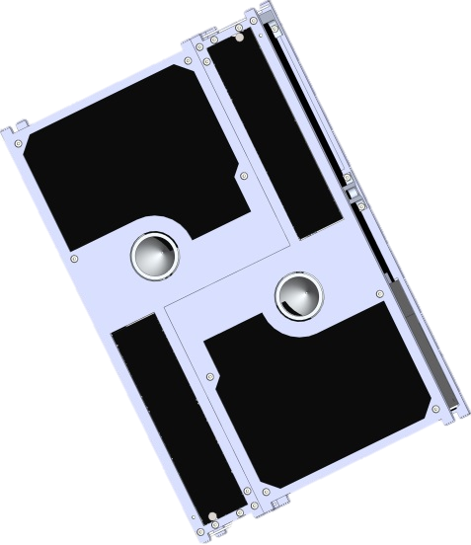
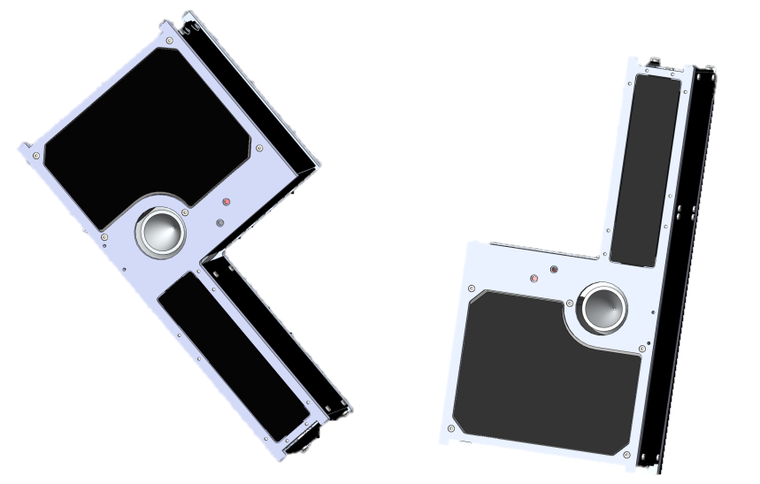
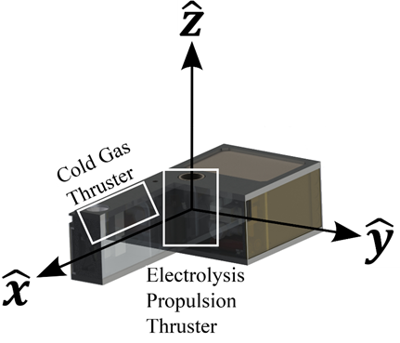
Spacecraft Operations

Slide 4
$$∆V=v_{e}\ln{\frac{m_{0}}{m_{e}}}$$

Slide 5
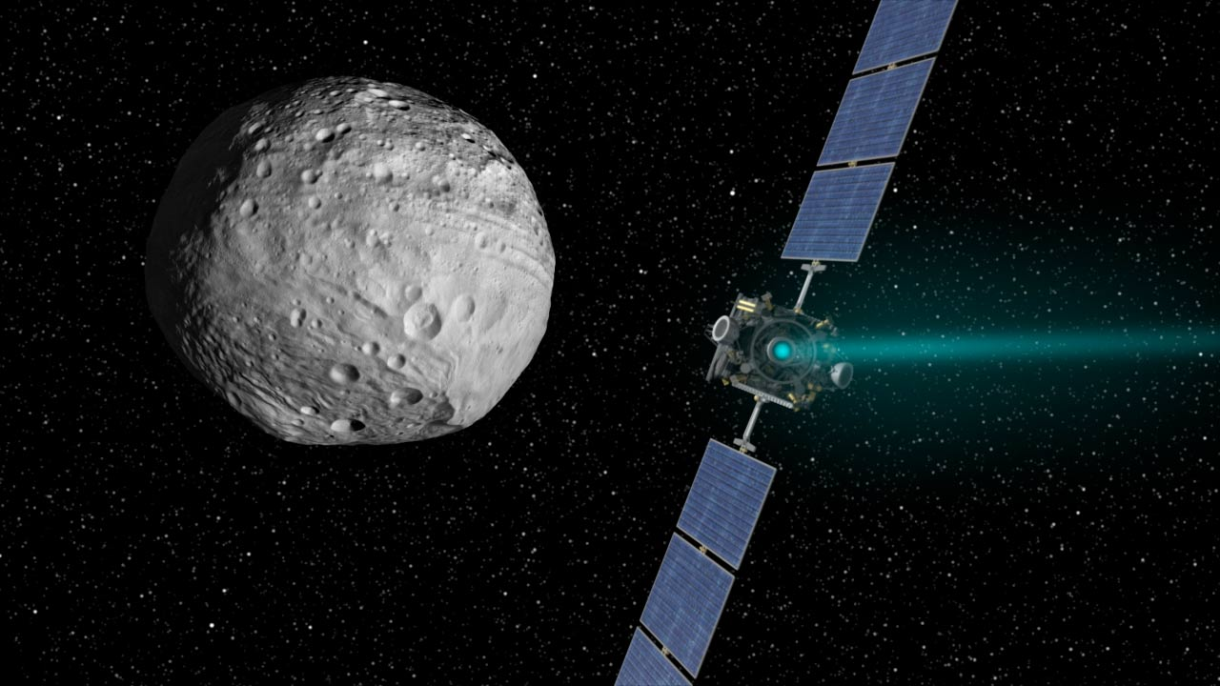
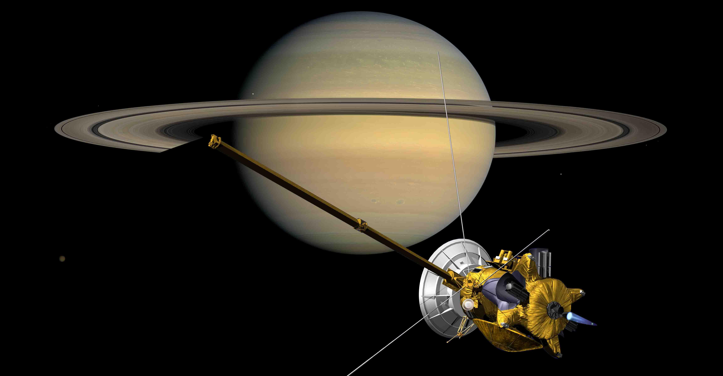
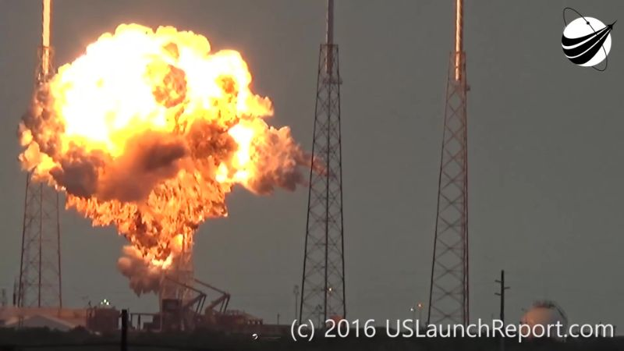
Motivation
1. Flight resources such as propellant limit mission duration
E.g. Cassini, Galileo, Dawn
2. Propulsion systems often costly, intricate, and hazardous
Turbopumps, high-pressure vessels, cryogenic storage
Hazardous materials e.g. hydrazine
Cryogenic filling can be dangerous
AMOS-6 incident:
Accident during cryogenic propellant loading
Payload hydrazine made the situation worse
3. CubeSats provide a low-cost approach to space exploration
There are additional limitations for nanosatellites
Few high ∆V propulsion technologies available
Strict mass, power, volume, and material constraints
Secondary payload status can limit ground processing options
Images: NASA
Incident during AMOS-6 fueling for static fire.

Slide 6
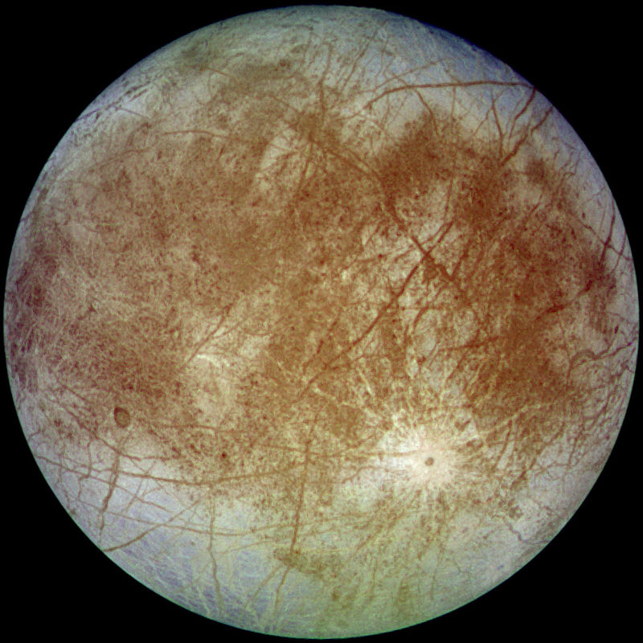
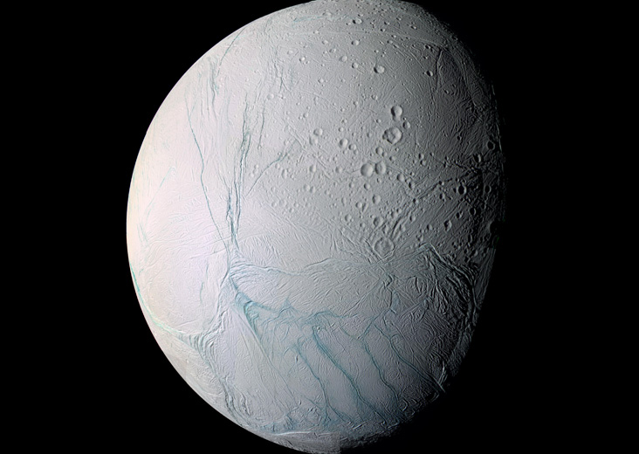
Water Electrolysis Propulsion Background
Technology gap: High ∆V at the CubeSat scale
CubeSat propulsion in its infancy
CubeSat framework poses challenges
Volume, mass, power constraints
CubeSat restrictions preclude:
High pressure vessels
Cryogenic filling before launch
Water has increasingly apparent abundance in the Solar System
In-Situ Resource Utilization potential
Water has uses beyond propulsion
Human needs
Radiation shielding
Slosh damping
Heat sink
Mueller, J., Hofer, R., and Ziemer, J. “Survey of Propulsion Technologies Applicable to CubeSats.” Jet Propulsion Laboratory, National Aeronautics and Space Administration: Pasadena, CA, 2010
Images: NASA

Slide 7
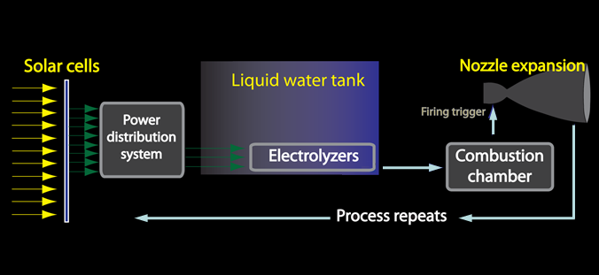
Electrolysis Propulsion Background: Operation
de Groot, Wim, et al. "Electrolysis propulsion for spacecraft applications." 33rd Joint Propulsion Conference and Exhibit. 1997.
Zeledon, R. A. and Peck, M. A. ”Electrolysis Propulsion for CubeSat-Scale Spacecraft,” AIAA SPACE 2011 Conference & Exposition, Long Beach, CA, 2011.
McElroy, J. F. Electrochemical hydrogen separator system for zero-gravity water electrolysis. 4,950,371, August 21, 1990

Slide 8
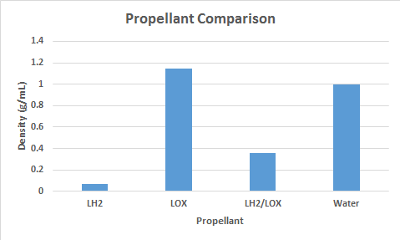
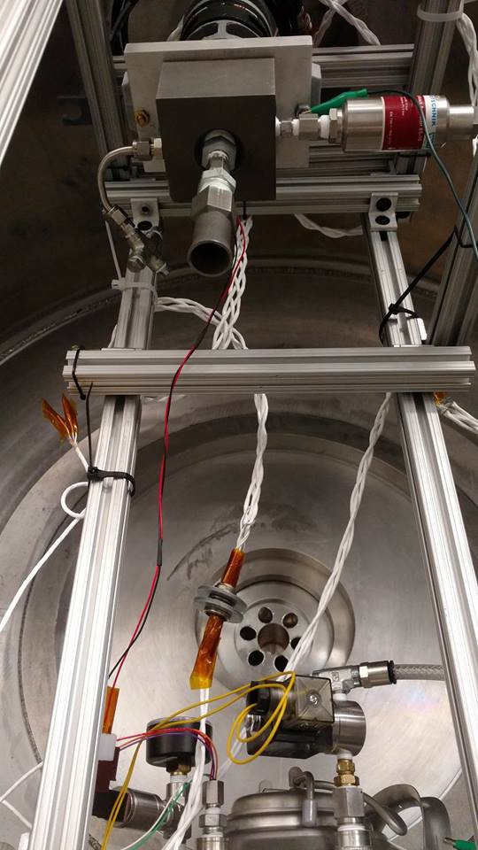
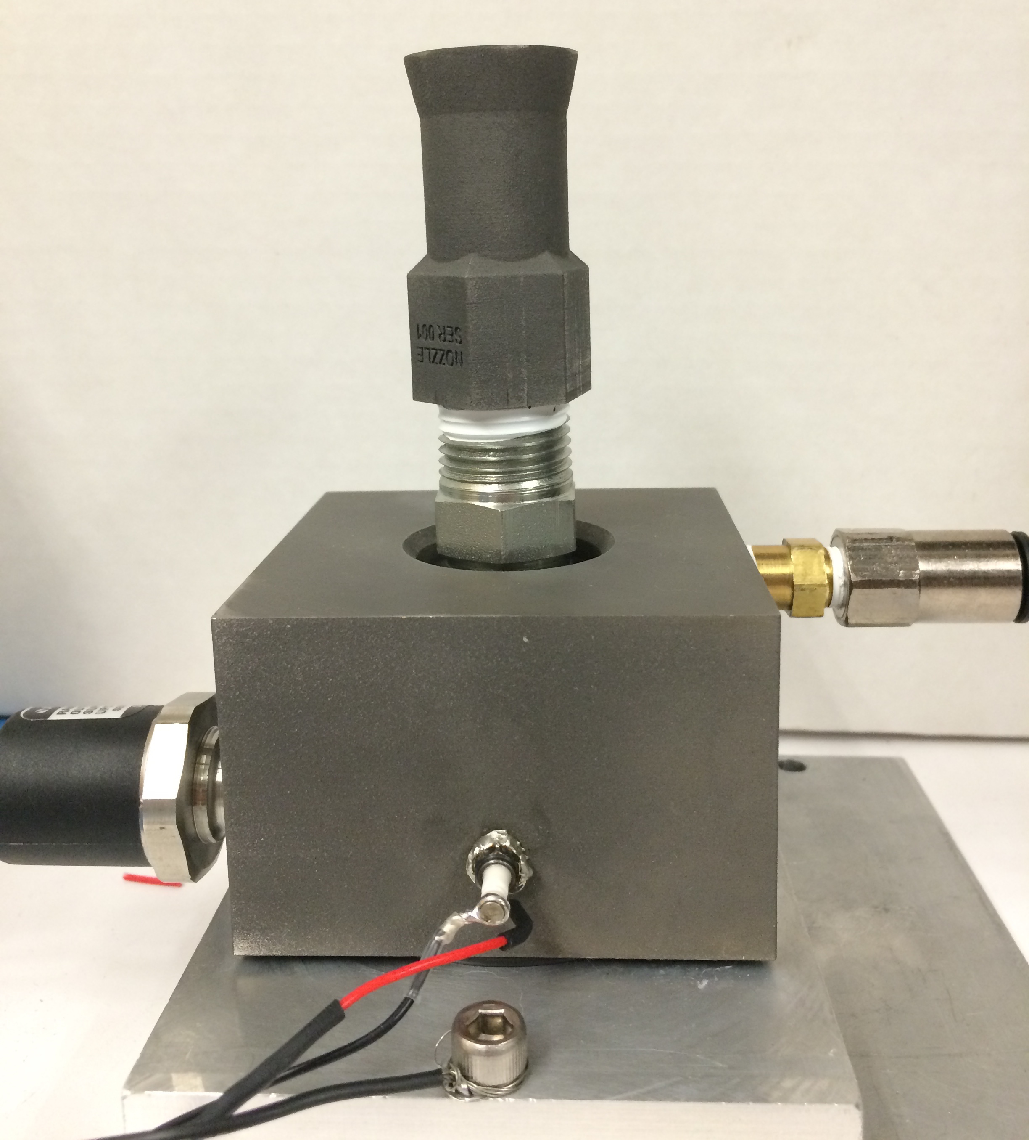
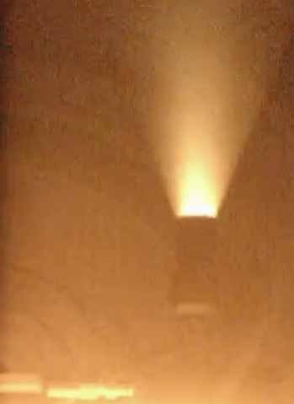
Water Electrolysis Propulsion Performance
Thruster test campaign in thermal vacuum chamber
~300 s specific impulse
Similar to other electrolysis thrusters*
Compare with cold gas (70 s) and LOX/LH2 (450 s)
Dense, green propellant storage
Simple operation with no actuated valves, low power
Subsystem synergy
Thermal
Attitude control
Structures
ISRU potential
*James, Karsten, et al. "Hydros: High Performance Water-Electrolysis Propulsion for Cubesats and Microsats." Advances in the Astronautical Sciences Guidance, Navigation and Control 159 (2017): 2017-145.

Slide 9
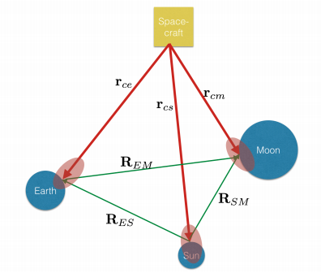
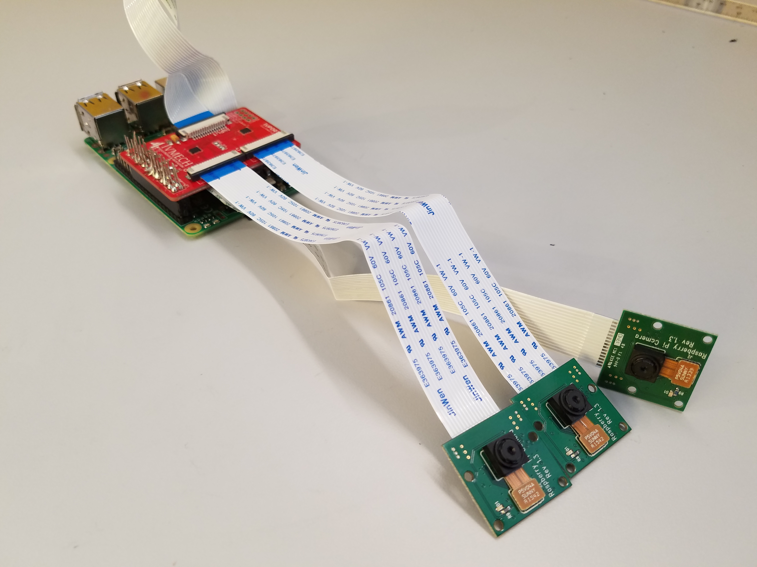
Interplanetary Optical Navigation
Adams, Van H., and Mason A. Peck. "Lost in Space and Time." AIAA Guidance, Navigation, and Control Conference. 2017.
Adams, Van H., and Mason A. Peck. "Interplanetary Optical Navigation." AIAA Guidance, Navigation, and Control Conference. 2016.

Slide 10
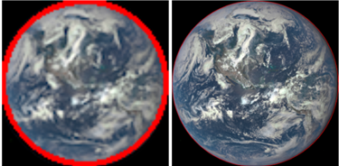
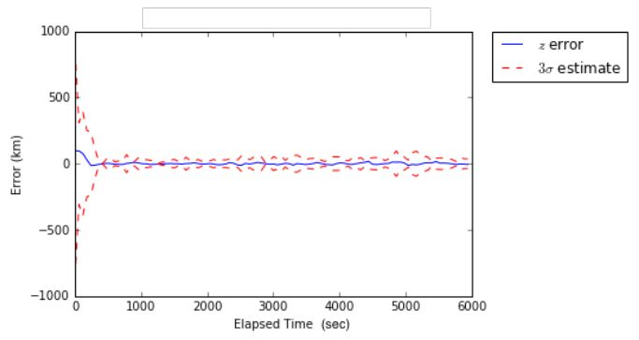
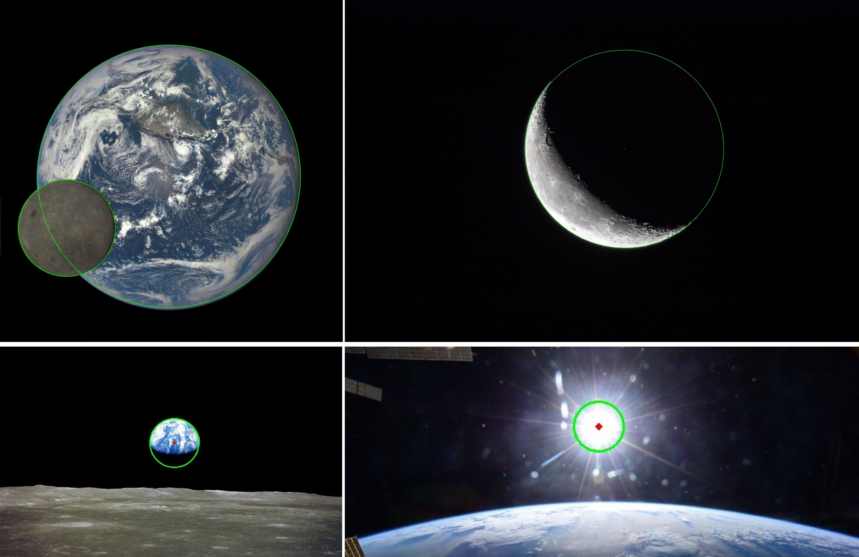
Interplanetary Optical Navigation Performance
28,000 km 369,000 km
595,000 km 1,100,000 km
Inexpensive, robust, navigation in planetary systems
Autonomous position and attitude determination from the same data
Constant comms link for tracking not needed
Accuracy within tens of kilometers
Mission simulation using rendered images from AGI STK
Testing with real-world images from past missions and new photos
Original Images: NASA

Slide 11
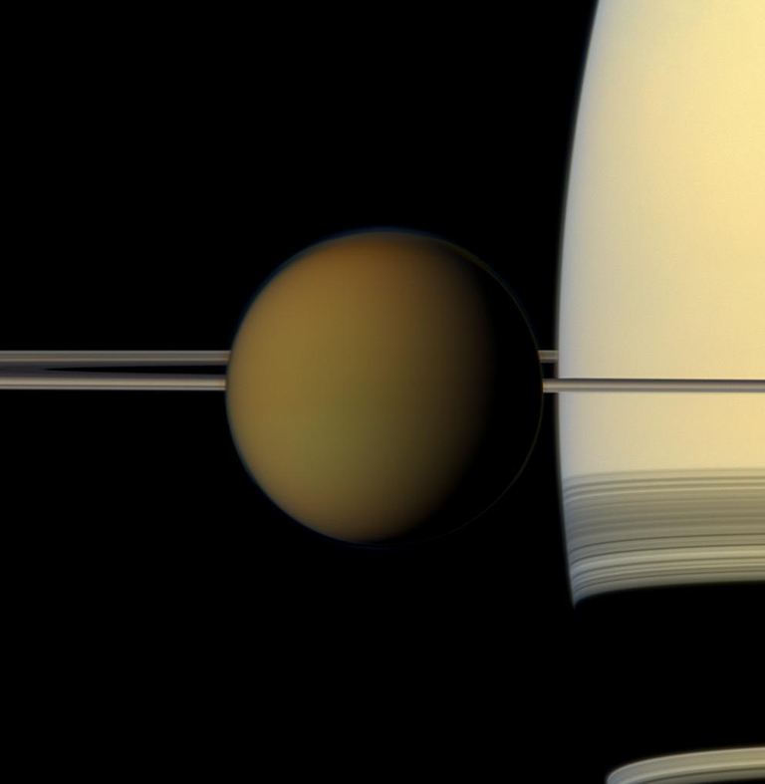
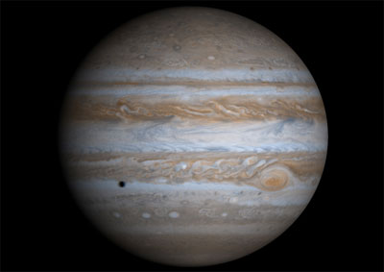
Impacts: Interplanetary Optical Navigation
Autonomous interplanetary navigation at CubeSat scale
No constant comms link for navigation/tracking
Reduces spacecraft power consumption
Reduces demands on ground segment
Applicable to other environments
Gas giant moons systems
Hardware accessible for hobbyist and educators
Raspberry Pi, multiplexer, 3 cameras: ~$200 total
Images courtesy of NASA

Slide 12
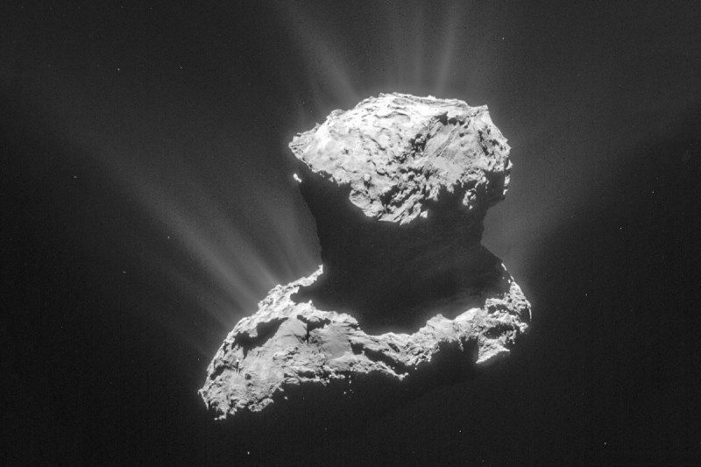
Impacts: Water Electrolysis Propulsion
In-situ resource utilization potential
Icy moon hoppers, small body sample returns
Water is abundant in the solar system
Targets with water have scientific value
Could turn delta-v limits into delta-v increments
Image: ESA
$$∆V=nv_{e}\ln{\frac{m_{0}}{m_{e}}}$$
Image: NASA
Image: NASA

Slide 13
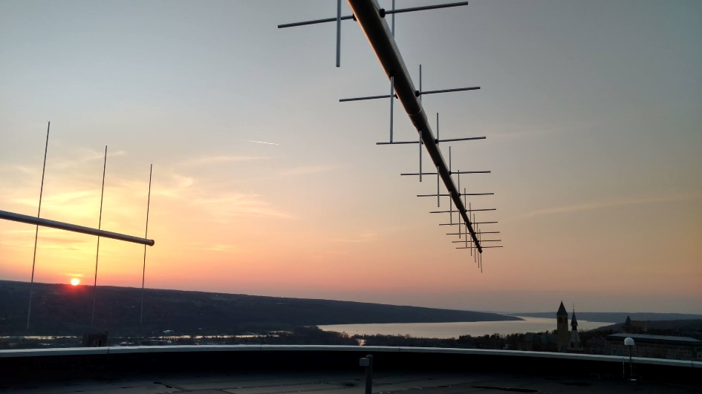
Questions?

