Slide 1
Short-Term SSI Variability and Middle Atmosphere Effects
Matthew DeLand¹
¹Science Systems and Applications, Inc. (SSAI)
Impacts of Intermediate Time Scale SSI Variability Workshop
9 December 2018, Columbia, MD
Notes:
I have been working with solar UV data and ozone measurements for 29 years.
Most discussion will be a survey of other work → Sorry for quality of some figures clipped from PDF reprints.

Slide 2
Definition of “Short-Term SSI Variability”
Focus on λ > 120 nm (Lyman alpha) to examine impact on mesosphere, stratosphere.
Presence of active regions on rotating Sun gives quasi-periodic signal during most parts of solar cycle.
No significant flare enhancements observed.
Spectral dependence of “rotational” SSI change is similar to solar cycle, with variable amplitude.
Atmospheric response has separate spectral dependence, multiple timescales to consider → “it’s complicated”.
Notes:
Understanding of actual short-term variation is important for any statistical analysis.

Slide 3
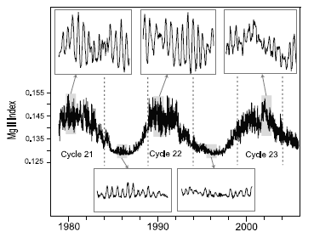
Short-Term Variability over Decades
Look at composite Mg II index over 3 solar cycles to see rotational variations at cycle maximum, minimum.
Cycle maximum (top panels) has fairly consistent signal, episodes of larger amplitude.
Cycle minimum (bottom panels) has constant baseline, persistent but smaller modulation.
Note phase shift during maximum periods.
Fioletov [2009]
Notes:
Mg II index (core-to-wing ratio) is a good proxy for solar UV variations.
Combine data from multiple instruments to cover ~30-year period shown here.

Slide 4
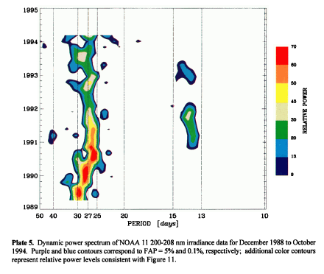
Short-Term Variability - 205 nm
Choice of wavelength for SSI variability will become clear in next two slides.
Apply power spectrum analysis to NOAA-11 SBUV/2 data (Cycle 22) with sliding 256-day window.
Rotational peak shifts from 29 days to 25 days during 1989-1990.
Episode of 13-14 day power in 1991 is not a harmonic. Two active regions are present on opposing faces of Sun simultaneously (amplitude is typically stronger in SSI than in Mg II index).
DeLand and Cebula [1998]
Notes:
Since rotational peaks shift, standard power spectrum applied to long interval could “smear” signal.
Select interval to get sufficient examples of desired period, step by T/4.

Slide 5
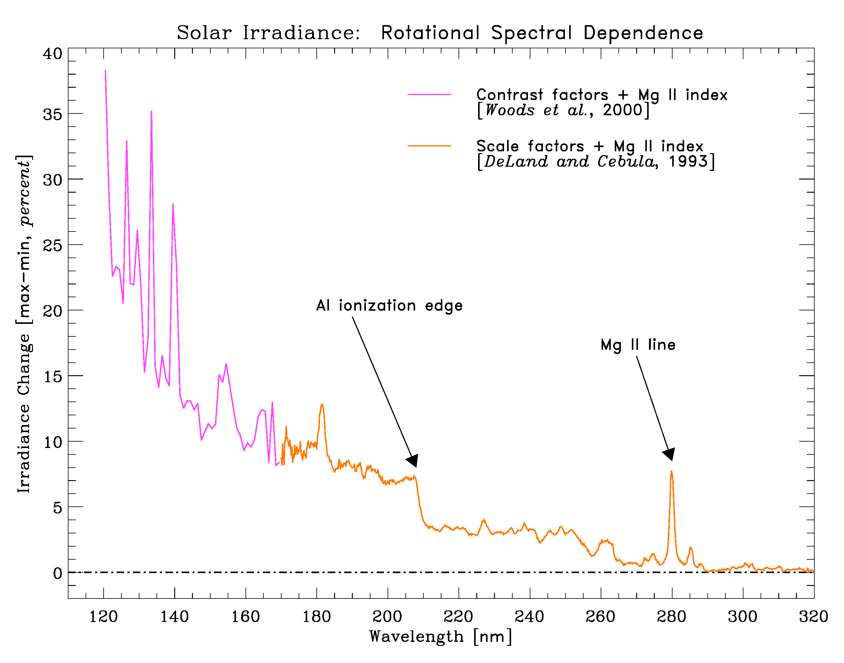
Spectral Dependence - SSI
Mg II index (280 nm) can be used as a proxy to estimate short-term SSI changes throughout UV region.
MUV region (λ > 170 nm) can be represented with linear scaling, daily Mg II values.
FUV region needs additional network component that follows smoothed Mg II index (“contrast”).
Consistent behavior observed when factors are derived for different solar cycles.
Woods et al. [2000], DeLand and Cebula [1993]
Notes:
Rotation amplitude = 6.7% in scaled Mg II index (core-to-wing ratio).
Scaling to Mg II is ~1:1 at 205 nm, much larger below ~140 nm.

Slide 6
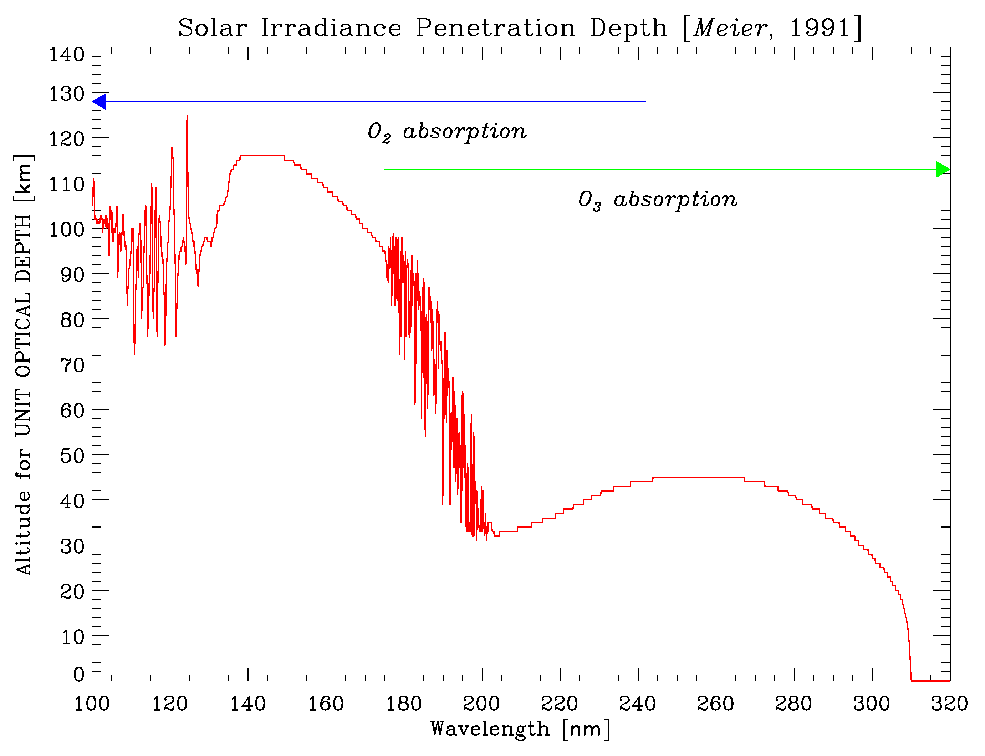
Spectral Dependence - Atmosphere
Figure shows altitude at which incoming irradiance is reduced by 1/e [τ = 1].
Fine structure caused by O₂ Schumann-Runge bands.
F(205 nm) penetrates well into stratosphere with significant rotational amplitude (shortward of Al ionization edge).
F(Lyα) penetrates well into mesosphere.
Meier [1991]

Slide 7
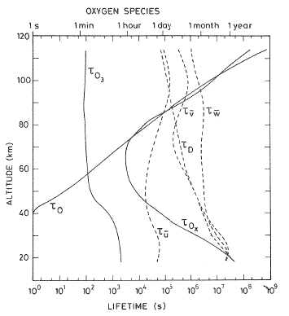
Competing Effects - Ozone
Direct effect is due to photochemistry (τ ≈ minutes)
O₃ + hν → O + O₂
Indirect effects are due to temperature-dependent reactions
O + O₃ → O₂ + O₂ rate increases by 3% for ΔT = +1 K.
ΔT due to local heating by ΔF_{UV}
ΔT also due to transport over similar time scales (τ_{zonal wind} ≈ 1 day)
Brasseur and Solomon [1986]

Slide 8
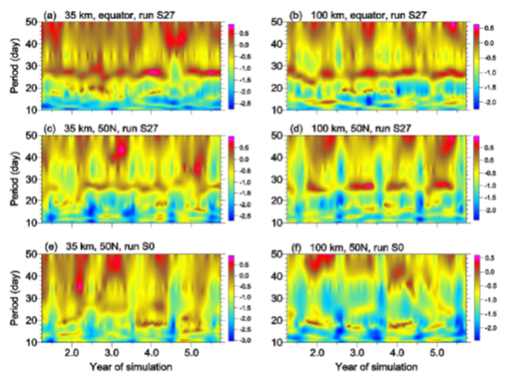
Complex Atmospheric Response
Apply 27-day sine wave forcing of F₂₀₅ in 3-D atmospheric model (HAMMONIA) over 6-year period.
ΔO₃ results for 35 km (left column) and 100 km (right column), Equator and 50 N show fairly consistent response, with variations in amplitude.
Constant F(t) (bottom row) also develops periodicity at 15-20 days.
Gruzdev et al. [2009]
Notes:
Note that strength of 27-day signal in parts (a)-(d) varies substantially, despite regular amplitude of prescribed forcing.
Do similar variations in non-forced simulations represent planetary wave effects?

Slide 9
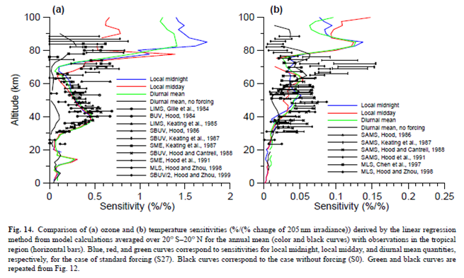
Comparison to Observations – Sensitivity
Ozone
Temperature
Selected case of model results in tropics shown together with many observational results.
ΔO₃/ΔF is consistent between model results and observations up to ~65 km. Agreement is more variable when diurnal effects become stronger above 70 km.
ΔT/ΔF has more relative spread, but small magnitude (typically < 0.5 K for single rotation).
Gruzdev et al. [2009]
Notes:
Colored lines show multiple model results, with fixed (but different) local time for each case.
Sensitivity values decrease when 3x solar forcing is applied → Non-linear response.

Slide 10
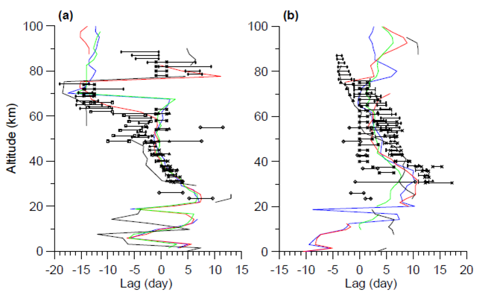
Comparison to Observations – Phase Lag
Ozone
Temperature
Similar approach to previous slide (model curves + satellite results).
ΔO₃ response lags ΔF in lower stratosphere due to chemical lifetime, transitions to leading ΔF above ~40 km (temperature response and feedback into O₃ loss).
ΔT response lags ΔF everywhere above ~10 km.
Gruzdev et al. [2009]
Notes:
Analysis uses data from tropics (20 S → 20 N).
Agreement between observations and models is somewhat worse for temperature than for ozone.

Slide 11
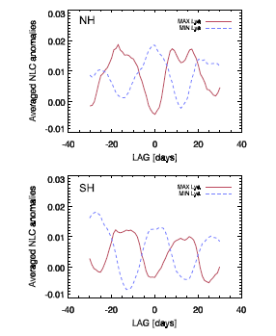
Polar Mesospheric Cloud Response
PMCs occur at 80-85 km during polar summer (latitude > 50°).
Composed of ice particles with radius ≈ 20-80 nm.
Occurrence frequency and brightness are very sensitive to local temperature, water vapor.
Direct analysis for each season (~3 rotations used) gives variable results.
Superposed epoch analysis (SEA) gives clearer signature in occurrence frequency (time lag less than expected from H₂O photolysis).
Robert et al. [2010]
Notes:
- Solid lines show PMC response to Lyman alpha peaks, dashed lines show PMC response to Lyman alpha minima.

Slide 12
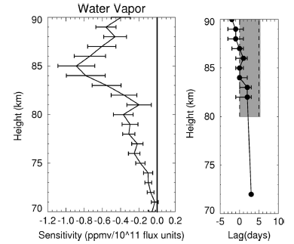
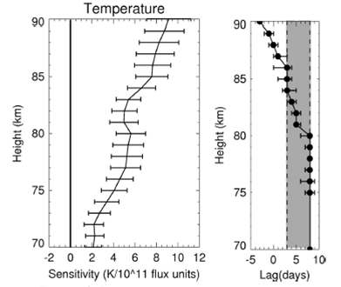
Mesospheric T, H₂O Response
Examine T, H₂O response vs. altitude using SOFIE occultation measurements from AIM satellite.
H₂O sensitivity increases above 81 km where “freeze-drying” is occurring.
T sensitivity is greater than model or MLS results.
Thomas et al. [2015]
Notes:
Gray region is uncertainty in phase lag from HAMMONIA model.
HAMMONIA sensitivity results derived in tropics vs. SOFIE data taken in polar regions.
MLS has broad contribution function (~10 km) in this altitude region.

Slide 13
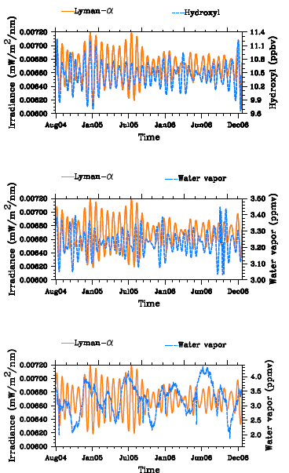
Mesospheric OH Response
Top panel shows 2 years of Lyman alpha flux and OH anomalies at 78 km. Note that OH amplitude decreases relative to F_{Lyα} modulation during some periods (e.g. late 2004, late 2005).
Similar situation is observed for H₂O anomaly (middle panel).
Raw H₂O data (bottom panel) shows longer time scale fluctuations due to semi-annual oscillation (SAO). This behavior modulates short-term amplitude of ΔOH caused by solar forcing.
Shapiro et al. [2012]
Notes:
Anomaly data based on 20-35 day pass filter.
OH produced by photolysis of H₂O → Expect positive correlation to rotational variations of Lyman alpha flux.
SAO gives downward transport of O₃, leading to more OH production (seasonally).

Slide 14
Standard Phase Height Response
Radio emission at fixed frequency and solar zenith distance from one station, picked up at second station, reflects from D-region of ionosphere.
50+ years of data shows long-term trend (stratospheric cooling), solar cycle variation.
Short-term variations (~27-day) suggest more NO photoionization (→ increased [e⁻]).
Negative phase lag, dependence on solar cycle level and season require additional factors (e.g. planetary waves).
von Savigny et al. [2018]
Notes:
Blue line = F10.7 anomaly
Thin grey line = unsmoothed phase height anomaly
Red line = 5-day running mean of SPH anomaly

Slide 15
Summary
Short-term solar UV irradiance forcing is quasi-periodic, but not stationary over longer intervals.
Atmospheric response convolves spectral dependence of ΔSSI with properties of many constituents.
Time scale of responses ranges from seconds to days, introducing phase lags that vary with altitude.
Verifying any single response (observations or models) is challenging because multiple processes are happening simultaneously, with feedbacks.

Slide 16
Bibliography (as presented)
Brasseur, G., and S. Solomon (1986). Aeronomy of the middle atmosphere (2nd ed). D. Reidel, 452 pp.
DeLand, M. T., and R. P. Cebula (1993). Composite Mg II solar activity index for solar cycles 21 and 22. J. Geophys. Res. 98, 12,809-12,823.
DeLand, M. T., and R. P. Cebula (1998). NOAA 11 Solar Backscatter Ultraviolet model 2 (SBUV/2) instrument solar spectral irradiance changes in 1989-1994. 2: Results, validation, and comparisons. J. Geophys. Res. 103, 16,251-16,273.
Fioletov, V. E. (2009). Estimating the 27-day and 11-year solar cycle variations in tropical upper stratospheric ozone. J. Geophys. Res. 114, D02302.
Gruzdev, A. N., et al. (2009). The effect of the solar rotational irradiance variation on the middle and upper atmosphere calculated by a three-dimensional chemistry-climate model. Atmos. Chem. Phys. 9, 595-614.
Meier, R. R. (1991). Ultraviolet spectroscopy and remote sensing of the upper atmosphere. Space Sci. Rev. 58, 1-185.
Robert, C. E., et al. (2010). Evidence of a 27-day signature in noctilucent cloud frequency. J. Geophys. Res. 115, D00I12.
Shapiro, A. V., et al. (2012). Signature of the 27-day rotation cycle in mesospheric OH and H₂O observed by the Aura Microwave Limb Sounder. Atmos. Chem. Phys. 12, 3181-3188.
Thomas, G. E., et al. (2015). Solar-induced 27-day variations of mesospheric temperature and water vapor from the AIM SOFIE experiment: Drivers of polar mesospheric cloud variability. J. Atmos. Solar-Terr. Phys. 134, 56-68.
von Savigny, C., et al. (2018). Solar 27-day signatures in standard phase height measurements above central Europe. Atmos. Chem. Phys. Discuss., acp-2018-799.
Woods, T., et al. (2000). Improved solar Lyman α irradiance modeling from 1947 through 1999 based on UARS observations. J. Geophys. Res. 105, 27,195-27,215.

