Slide 1
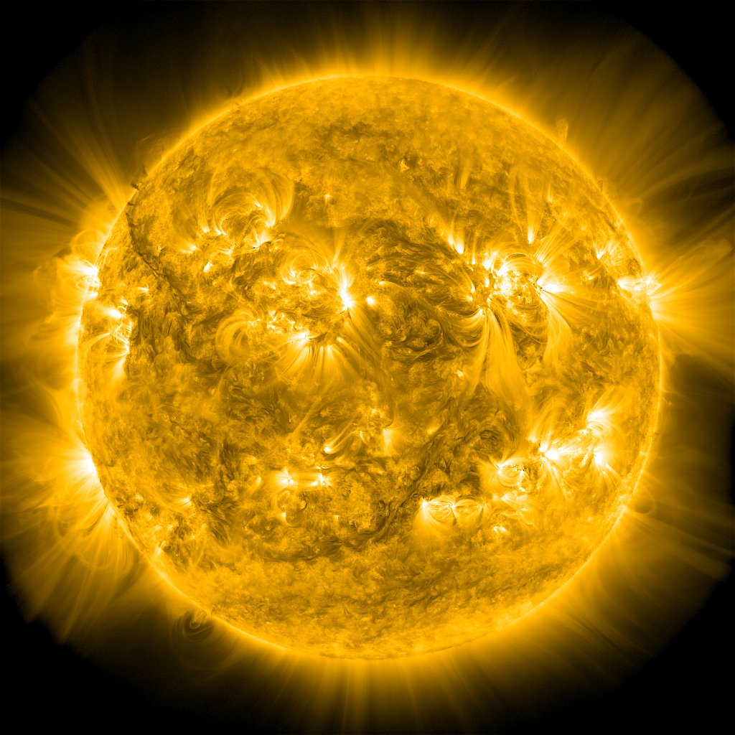
Modeling Solar Active Regions
and Their Emission
James A. Klimchuk
Samuel Schonfeld, Nicholeen Viall
NASA Goddard Space Flight Center
Gelu Nita, Gregory Fleishman, Dale Gary
New Jersey Institute of Technology
0

Slide 2
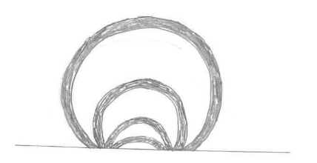
Populating a Magnetic “Skeleton” with Plasma
Start with a nonlinear force-free extrapolation of a photospheric vector magnetogram
Usual approach is to model flux tubes emanating from a grid at the photosphere
(can lead to giant gaps in the corona)
Instead, we model every voxel in the 3D volume
Consider a bundle of sub-resolution strands passing through the voxel
Heated by identical out-of-phase nanoflares:
(Q_{nano} , L) grid of EBTEL solutions (lookup table): DEM(T) in corona and transition region
= Q_{nano} f(t)

Slide 3
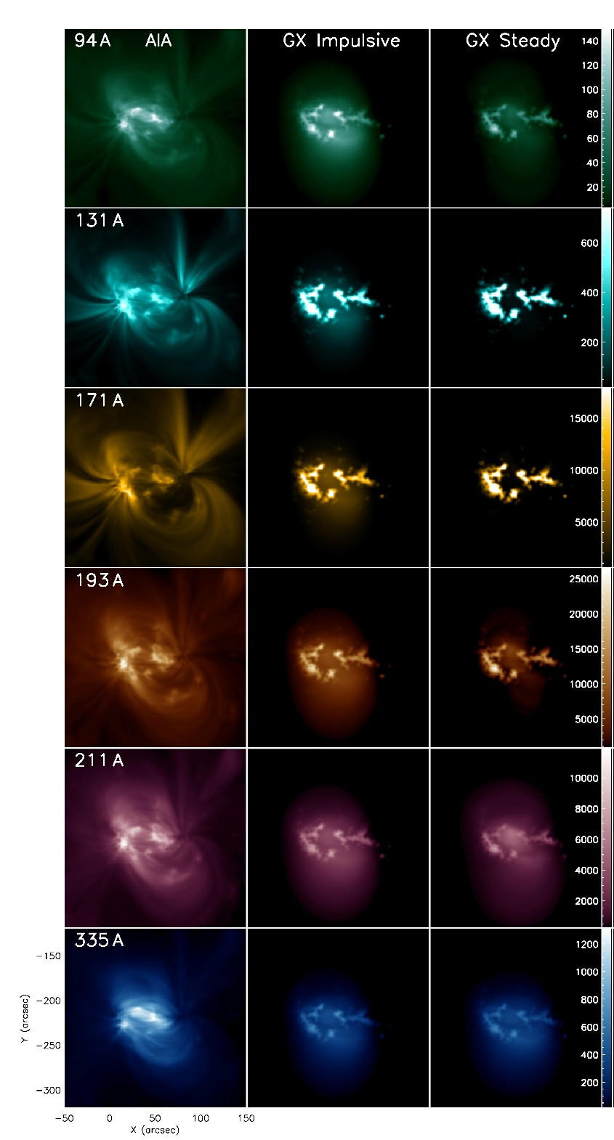
Q_{nano} ~ B ² / L
The transition region extends
to hot temperatures
~ 3 MK
Nita, G. et al. (2018)

Slide 4
Dipole field, Q_{nano} ~ L ⁻⁴

Slide 5
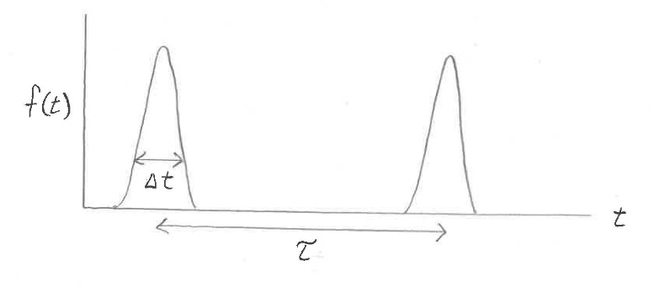
Multiple Coronal Heating Parameters
Q₀, a, b, Δt, τ
N(τ) = N₀ τ^{γ}

Slide 6
