Slide 1
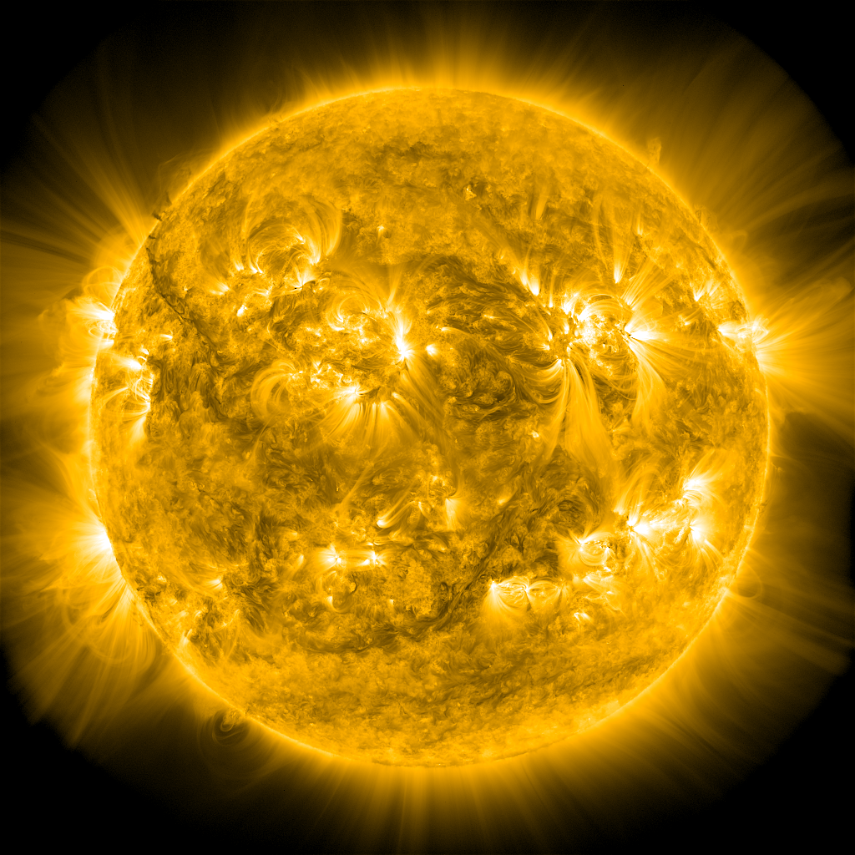
Thermal Non-equilibrium (TNE)
In the Presence of Asymmetries
James A. Klimchuk
NASA Goddard Space Flight Center
Manuel Luna
Instituto de Astrofisica de Canarias
0
Notes:
TNE, or TNE for short, is a truly fascinating phenomenon in which a cold condensation, a blob, forms in the hot corona.
If there is dip in the magnetic field, it can act like a hammock and suspend the cool material above the solar surface. This is widely accepted as the explanation of prominences.
If there is no dip, the condensation slides down along the loop leg. This is thought to be the cause of coronal rain.
There is also a newly discovered phenomenon, called pulsating loops, that is likely explained by TNE, though it doesn’t necessarily involve the formation of a condensation.
What causes TNE?
It occurs when coronal heating is steady and sufficiently highly concentrated at low altitudes.
Under these conditions, no static equilibrium solution exists.
As a loop searches for a non-existent equilibrium, it goes through periodic convulsions.
Let’s look at an example.
Note that this is different from thermal instability.
Instability applies to equilibria, and as I’ve said, there is no equilibrium in this case.
However, the convulsions, as I’ve called them, involve a thermal runaway, and people often mistake this for an instability.

Slide 2
Notes:
Case 1
LHS / RHS = 12 (eqn 1)
Show example.
Movie of temperature as function of distance along a semi-circular loop.
Heating increases exponentially with distance from the footpoints. Same on both sides.
Condensation forms at apex.
Would stay indefinitely due to symmetry, but falls to one side or other due to numerical round-off errors.
Why does TNE occur?

Slide 3
Coronal Loop in Static Equilibrium
heating
radiation
thermal
cond.
Uniform
Heating
Notes:
Let’s start by considering a symmetric loop that is uniformly heated.
If the loop is in static equilibrium, there is an
energy balance is between the input heating, radiative losses, and losses from downward thermal conduction.
True along the entire length of the corona; top portion and bottom portion.
Blue represents conductive cooling: the divergence of conduction flux.
The flux itself is growing in magnitude from the top to the bottom.
It is very large by the time it reaches the bottom and gets radiated away in the transition region.

Slide 4
Coronal Loop in Static Equilibrium
heating
radiation
thermal
cond.
Mild
Footpoint
Concentration
Uniform
Heating
Notes:
Let’s redistribute the heating, take some form the top portion of the loop and transferring it to the bottom portion.
To maintain equilibrium, need to reduce some of the energy losses at the top.
Radiation is globally unchanged in the loop, since the total heating is unchanged.
Turns out that the radiation in largely unchanged all along the loop.
The loop reduces the cooling at the top by decreasing the conduction flux.
Does this by flattening of the temperature profile.

Slide 5
Coronal Loop in Static Equilibrium
heating
radiation
thermal
cond.
Mild
Footpoint
Concentration
Strong
Footpoint
Concentration
Uniform
Heating
Notes:
Now transfer even more heating from the upper to lower section.
Temperature profile flattens further,
But there is a limit as to how far this can go.
Eventually, if we remove enough heating from the top, there is no way to balance the radiation.
A static equilibrium is not possible, and a catastrophic cooling ensues.

Slide 6
Coronal Loop with Steady End-to-End Flow
enthalpy
Excess radiation at the top is powered by $− ∇∙\left(\frac{5}{2}Pv\right)$
Notes:
What if we relax the requirement of static equilibrium?
What if there are flows?
Is an equilibrium possible,
In which the excess radiation at the top is balanced by an energy input associated with a steady flow?
If the flow is subsonic, then the heating is given approximately by the divergence of the enthalpy flux.

Slide 7
Loop Scaling Laws
L
$T_{a}$ ∝ $Q^{2/7}L^{4/7}$
T
P ∝ $Q^{6/7}L^{5/7}$
$$Q\left(s\right)=const.$$
s
T
λ_{s}
λ_{w}
s
$$Q\left(s\right)=Q_{s}e^{−s/λ_{s}}$$
$$T_{a,i}  Q_{i}^{2/7}_{i}^{4/7}$$
$P_{i}  Q_{i}^{6/7}$ $_{i}^{5/7}$
T
$$T_{a,s}> T_{a,w}$$
s
$P_{s}$ > $P_{w}$
2λ_{s}
2λ_{w}
Notes:
How do we produce a dynamic equilibrium?
To drive steady end-to-end flow, we need an asymmetry in the heating.
Here’s how it works.
First consider a symmetric loop with uniform heating. The loop is in static equilibrium.
Temperature profile has the well-known shape.
Scaling laws tell us how the apex temperature and pressure are related the heating rate and loop half length.
Pressure is approximately constant along the loop as long as the geometric height is comparable to or smaller than the gravitational scale height.
Temperature profile has the well-known shape
Now consider heating that decreases exponentially from the footpoint, with a scale length that is small compared to the loop length.
Most of the heating occurs in this first scale length.
The lower leg tries to adjust, through evaporation, to produce a static equilibrium.
We can still use the scaling laws to determine the approximate conditions,
But we must apply them to an imaginary loop with a length that is twice the heating scale length.
We do this separately on the two sides, since the base heating rates and possible also the scale lengths are different.
If the heating is stronger on the left side than the right,
Which I designate with the subscripts s and w for strong and weak,
The apex temperature of the imaginary loop his higher on the left.
The actual temperature profile for the real loop looks like this.
The pressure is also high on the left side, and the pressure gradient drives a left-to-right flow.
If the asymmetry in the heating is large enough, the enthalpy in the flow can power the radiation from the loop top,
And a steady equilibrium is possible.

Slide 8
$\frac{Q_{s}}{Q_{w}}$ = 3
Notes:
Case 8
LHS / RHS = 1.46 (eqn 2)

Slide 9
$\frac{λ_{s}}{λ_{w}}$ = 2
Notes:
Case 10
LHS / RHS = 1.94 (eqn 2)
Steady flow predicted, but TNE observed.

Slide 10
Conditions for Thermal Non-equilibrium
$$2 \frac{Q_{a}}{Q_{s}} {\left(1+ \frac{c_{1}}{Γ_{s}}\right)}^{}< 1$$
$$\left(\frac{Q_{s}}{Q_{w}}\right){\left(\frac{λ_{s}}{λ_{w}}\right)}^{2}\left(\frac{Γ_{s}}{Γ_{w}}\right)\left(\frac{Γ_{w}+2}{Γ_{s}+2}\right){\left[1−0.054 c_{1}^{−1/2}\left(1−δ\right)\frac{L}{λ_{s}}\right]}^{7/2}< 1$$
where
$$= \left(1+ \frac{c_{1}}{Γ_{s}}\right)\left(\frac{Q_{a}}{Q_{s}}\right)$$
Q_{s} , Q_{w} = heating rates at the base (strongly and weakly heated sides)
λ_{s} , λ_{w} = heating scale lengths
Γ_{s} , Γ_{w} = area expansion factors
Q_{a} = apex heating rate
L = loop half length
c₁ ≈ 2

Slide 11
Conclusions
TNE is often prevented by quasi-steady flows driven by asymmetries in the heating and/or cross sectional area expansion.
Formulae giving the conditions required for TNE are being tested with simulations.
(also a formula for the period of the condensation cycle)
So far, the results are encouraging, though some tweaking may be necessary.
Stay tuned!

Slide 12
$\frac{λ_{s}}{λ_{w}}$ = 1.6
Notes:
Case 12
LHS / RHS = 1.24 (SF predicted, but TNE observed)

