Slide 1
Magnetic Element Motions
Alfred de Wijn
NSF NCAR

Slide 2
Jim’s Question
We’re interested in the basic characteristics of magnetic element motion: translation vs. rotation, step sizes, velocity magnitudes, etc.
We also would like to know how these characteristics vary with the general magnetic field strength: strong plage, weak plage, sunspots. We want to use this information to drive our active region simulations.
Click to add footer

Slide 3
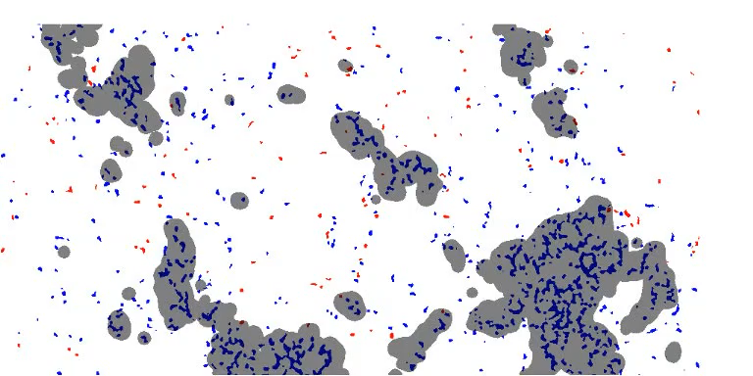
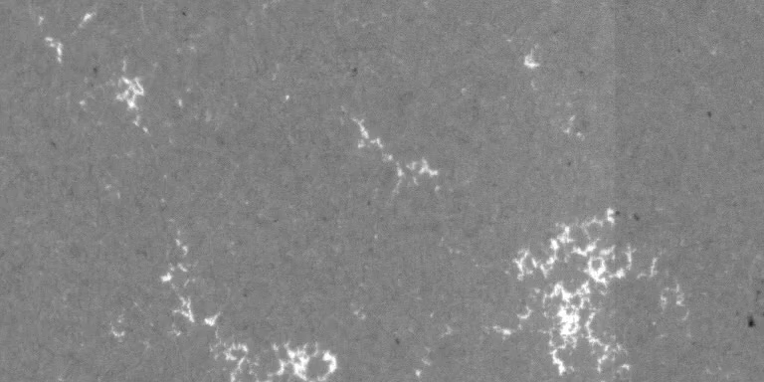
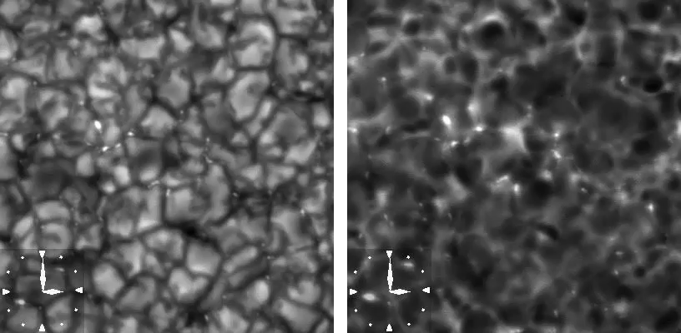
Diagnostics of Solar (Photospheric) Magnetic Fields
Two broad categories of diagnosing magnetic field exist:
Qualitative measurements such as proxy-magnetometry and magnetograms
Quantitative measurements through “inversion” of spectral line profiles
Proxy-magnetometry relies on knowledge that certain features in the solar atmosphere are magnetic in nature.
Examples: sunspots, faculae, and G-band bright points.
Magnetograms are “Stokes-V” images that rely on the Zeeman effect to show line-of-sight magnetic field.

Slide 4
Track Features, Calculate Properties

Slide 5
Track Features, Calculate Properties

Slide 6
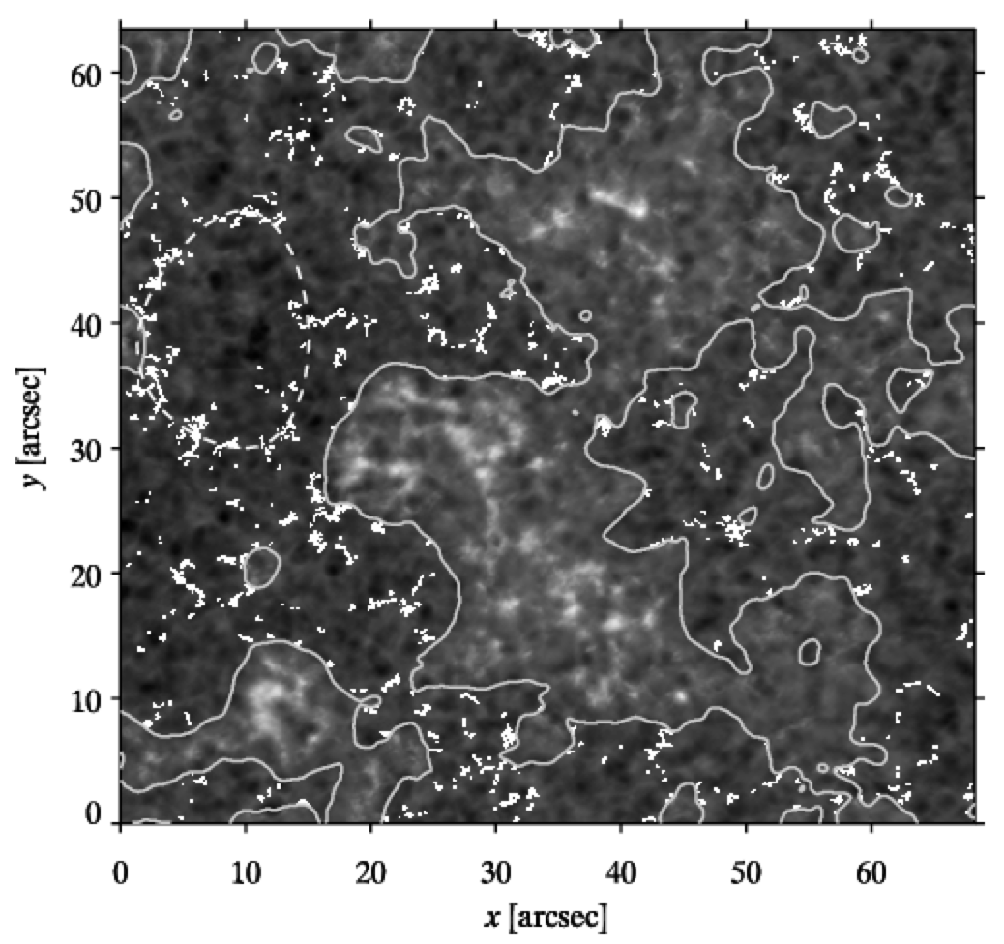
Patterns at Many Scales

Slide 7
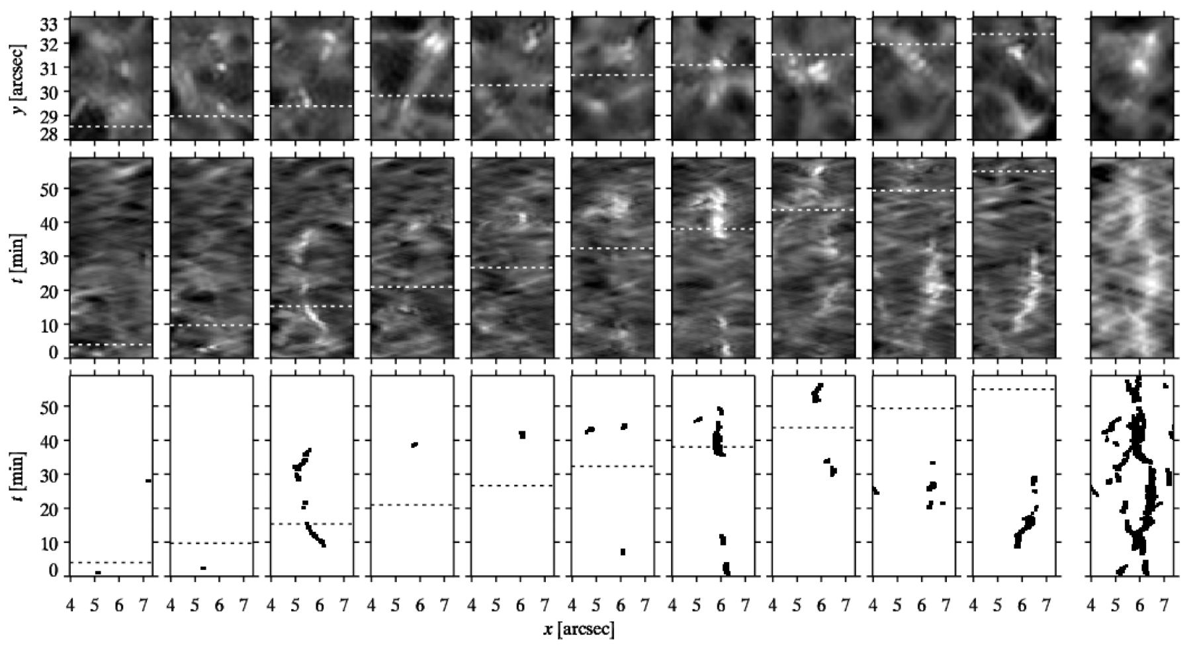
Patterns at Many Scales

Slide 8
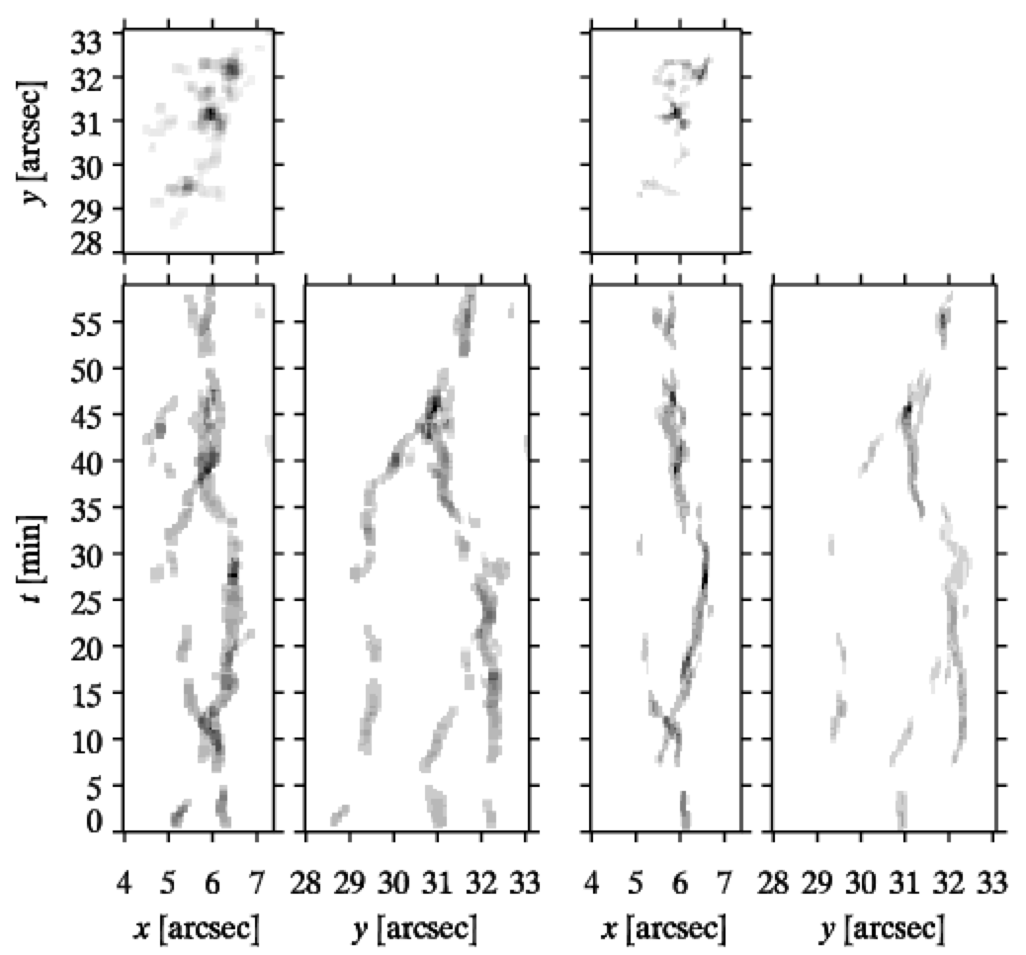
“Patches” of BPs

Slide 11
Some Disappointing Conclusions
Tracking Bright Points or “Magnetic Elements” is hard but possible (to some extent)
Tracking magnetic flux is rather difficult
Understanding interactions between MEs is consequently also difficult
Internetwork < Network < AR
Individual case studies may be possible
“Discrete elements” description is hard to maintain

