Slide 1
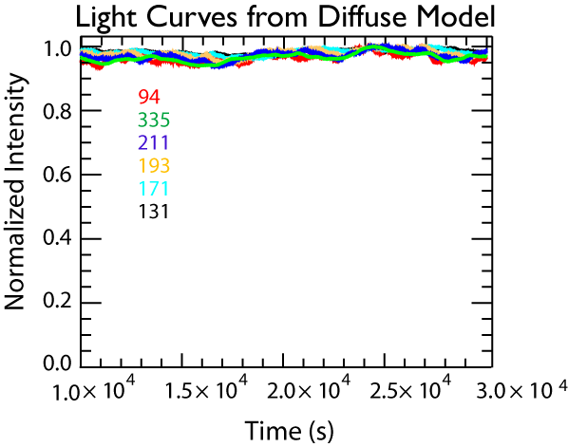
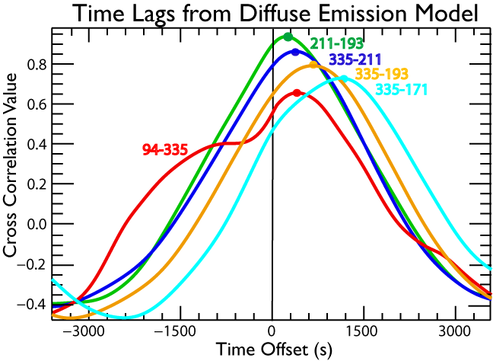
Stochastic Nanoflares Also Produce Post-Nanoflare Timelag Signature
Viall & Klimchuk 2013
Though small, the fluctuations produce very high cross correlation values (e.g. 0.95 for 211-193) because each one follows the same hot-to-cool progression
Time lags = cooling time
Channel pairs that are further apart in temperature have longer time lags
Without the time lag test, this 100% impulsive situation could be mistaken for steady heating

Slide 2
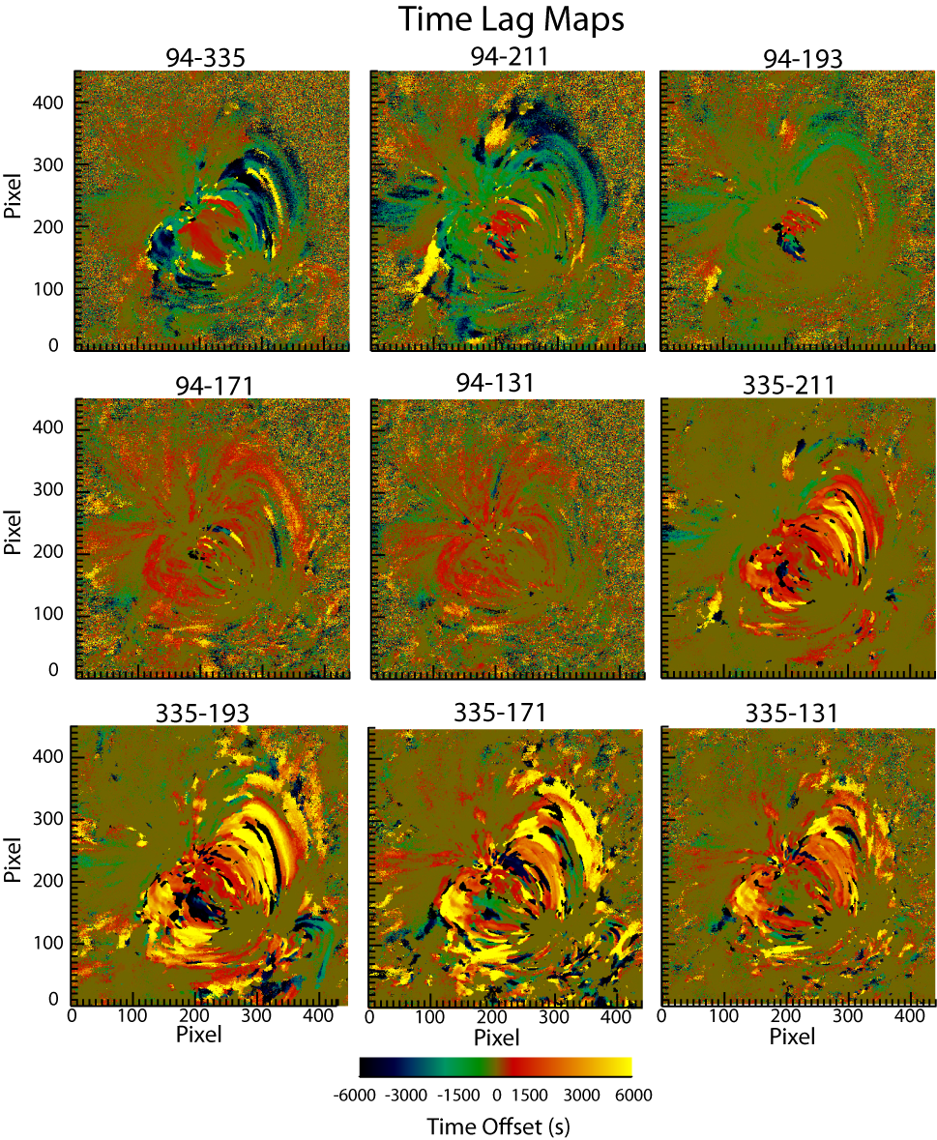
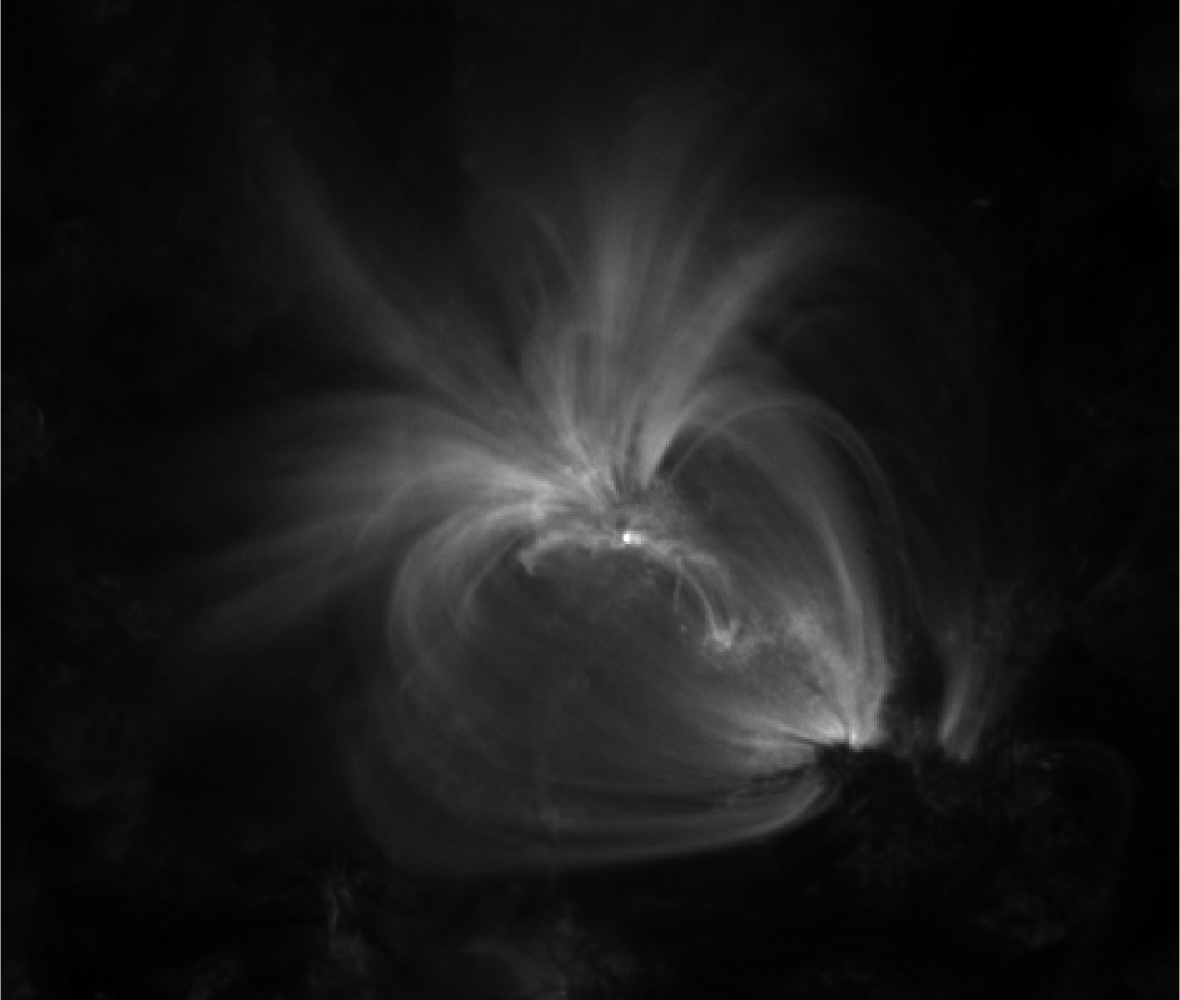
Nanoflare Time Lag Map
(~3 MK-~2 MK)
SDO/AIA 171
0.8 MK
Apply test on pixel-by-pixel basis to 12-hr and 2-hr timeseries
Almost exclusively positive time lags (and transition region)
Not just at a few discrete loops, but everywhere
Persistent pattern of cooling throughout active region
Negative time lags: noise; slow heating
Positive time lags: post-nanoflare cooling
zero time delay: transition region/moss
Notes:
Perform time lag test at every pixel and tag that pixel with the time lag; create time lag maps; here is one pair of channels

Slide 3
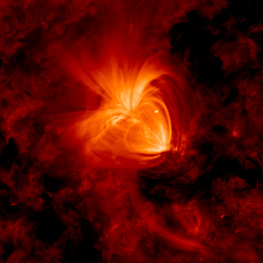
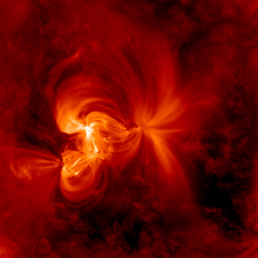
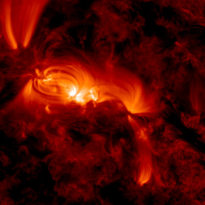
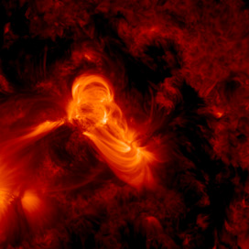
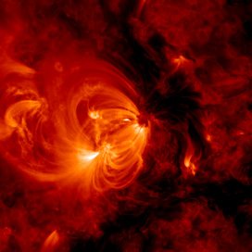
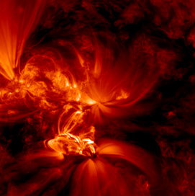
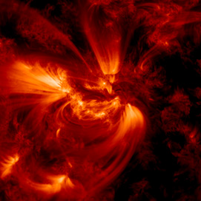
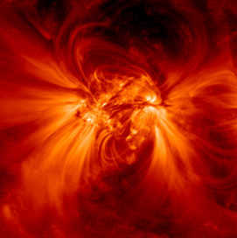
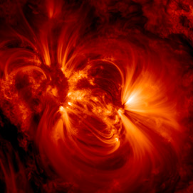
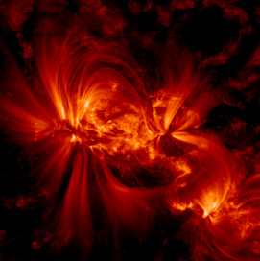
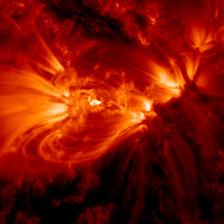
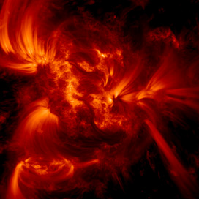
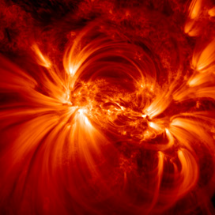
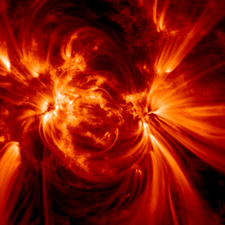
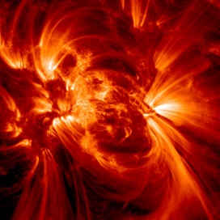
We Test 15 Quiescent AR with Different Properties
VK2012 AR
Warren et al. 2012
Notes:
Different total unsigned magnetic flux, different complexities, different ages, different DEM slopes

Slide 4
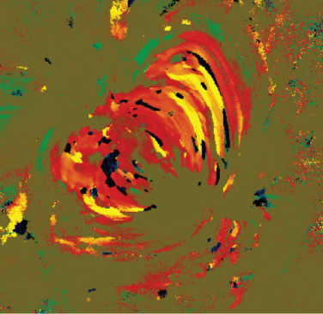
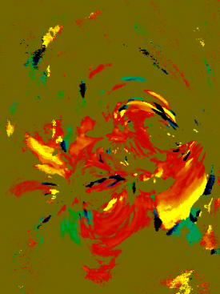
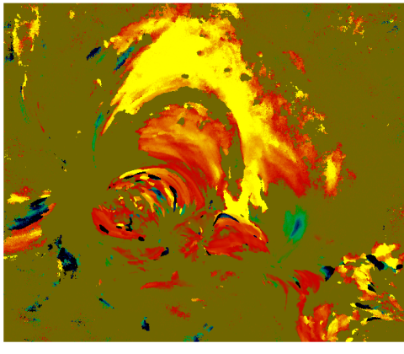
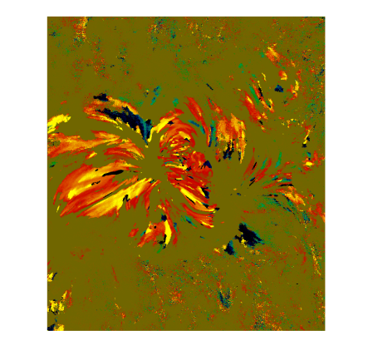
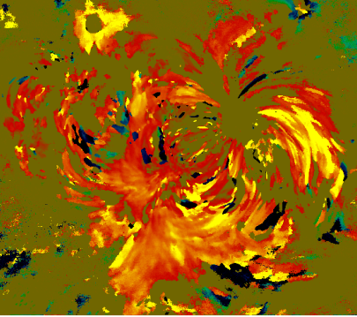
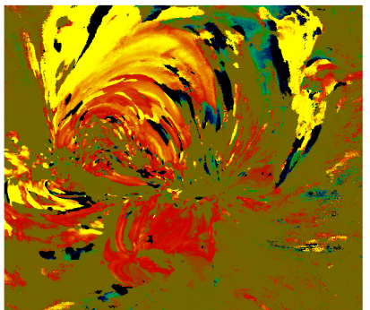
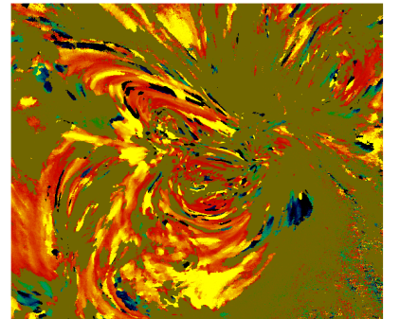
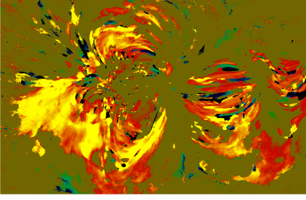
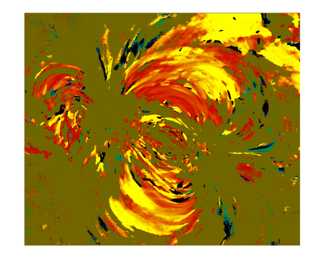
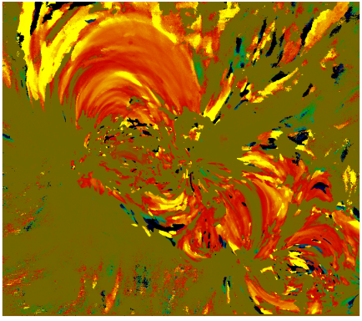
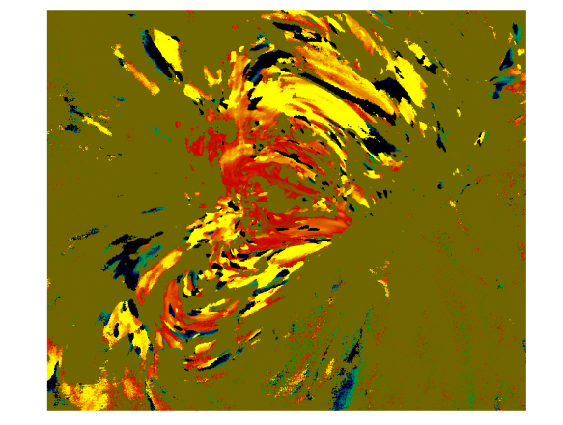
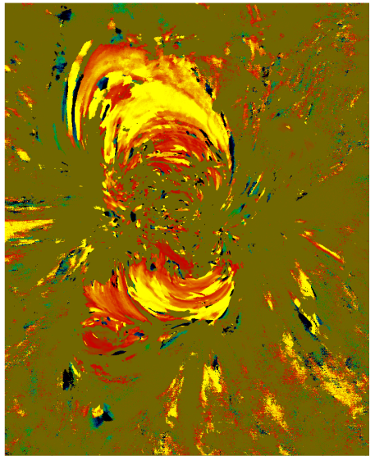
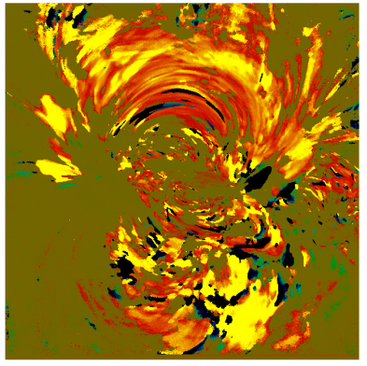
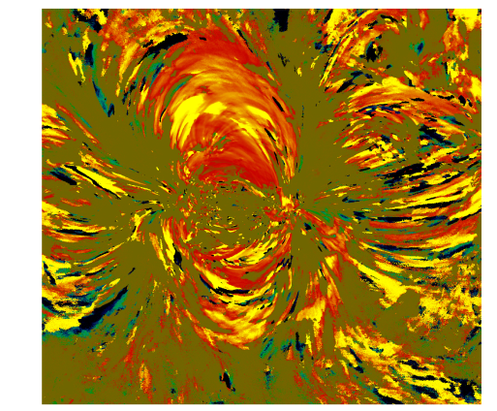
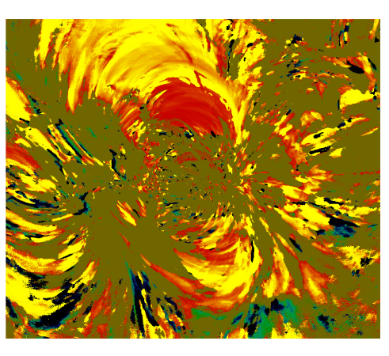
All 15 Time Lag Maps
VK2012 AR
Cooling patterns as in original study persist throughout every single AR… *between 335-211Å*
Controversy!
Notes:
Only showing you one channel pair for brevity but also because other pairs are the key to reconciling this seeming discrepency

Slide 5
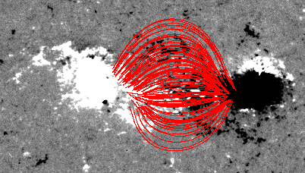
Hydrad Model Active Region
Bradshaw & Viall 2016
HMI magnetogram of a dipolar, simple AR (NOAA active region #11640; not on the Warren list)
PFSS to get distribution of flux tube lengths
Build model of AR populating each of 400 field lines with a new Hydrad model result
Ran three tests: pure cooling following a single nanoflare, an ‘intermediate frequency’ nanoflare train, and a ‘high frequency’ nanoflare train

Slide 6
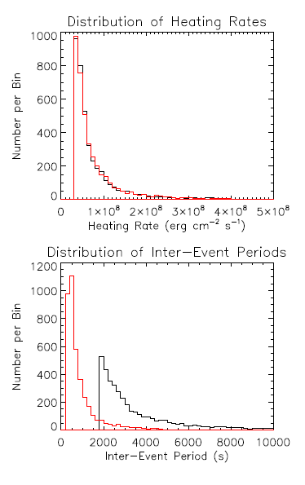
Cargill 2014 showed that all of the observed DEM slopes of Warren et al. 2012 could be explained with a train of ‘intermediate’ frequency nanoflares, where the inter-event period is proportional to the energy of the next event
Chose power-law distribution of slope -2.5 (Hudson 1991)
The constant of proportionality determines whether it is an intermediate- or a high-frequency train
The intermediate frequency train has a most probable inter-event period of ≈ 2000 s, with very occasional delays of 10,000 s.
The high frequency train has most probable inter-event periods of ≈ 500 s, with occasional delays extending to 5000 s.
Simulated three hours of AIA emission and ran timelag test

Slide 7
335
Intermediate Frequency Nanoflare Train Experiment
211
171
131

Slide 8
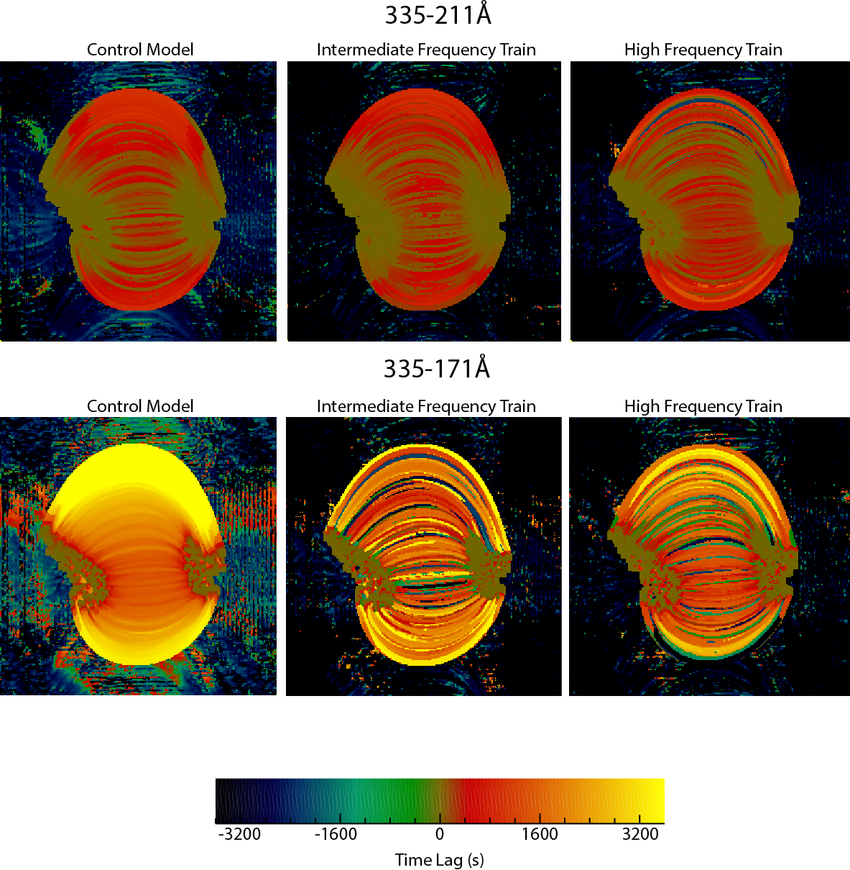
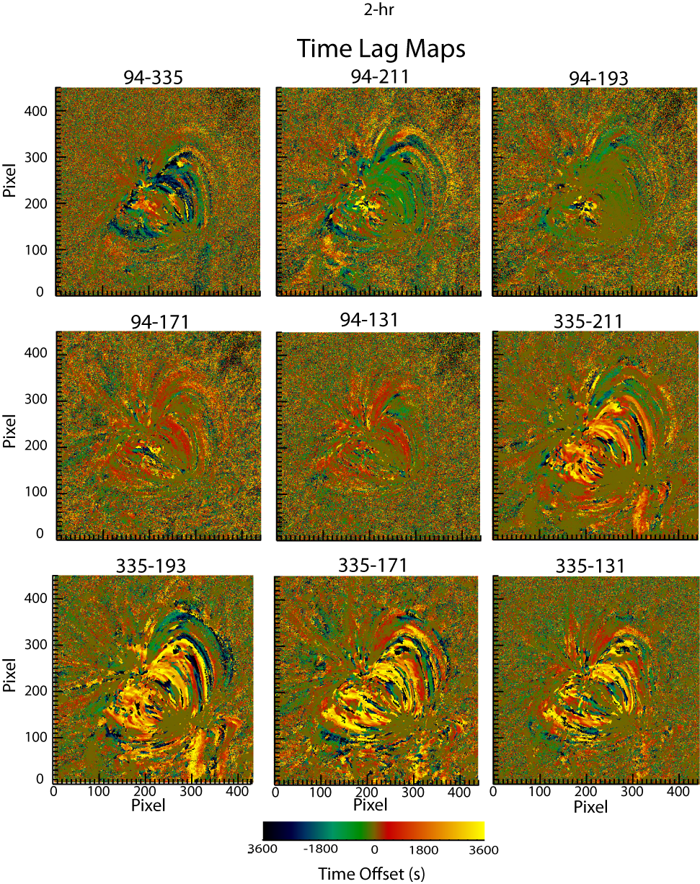
All three experiments show post-nanoflare cooling and zero time lags in the TR, as observed
2-hr
12-hr

Slide 9
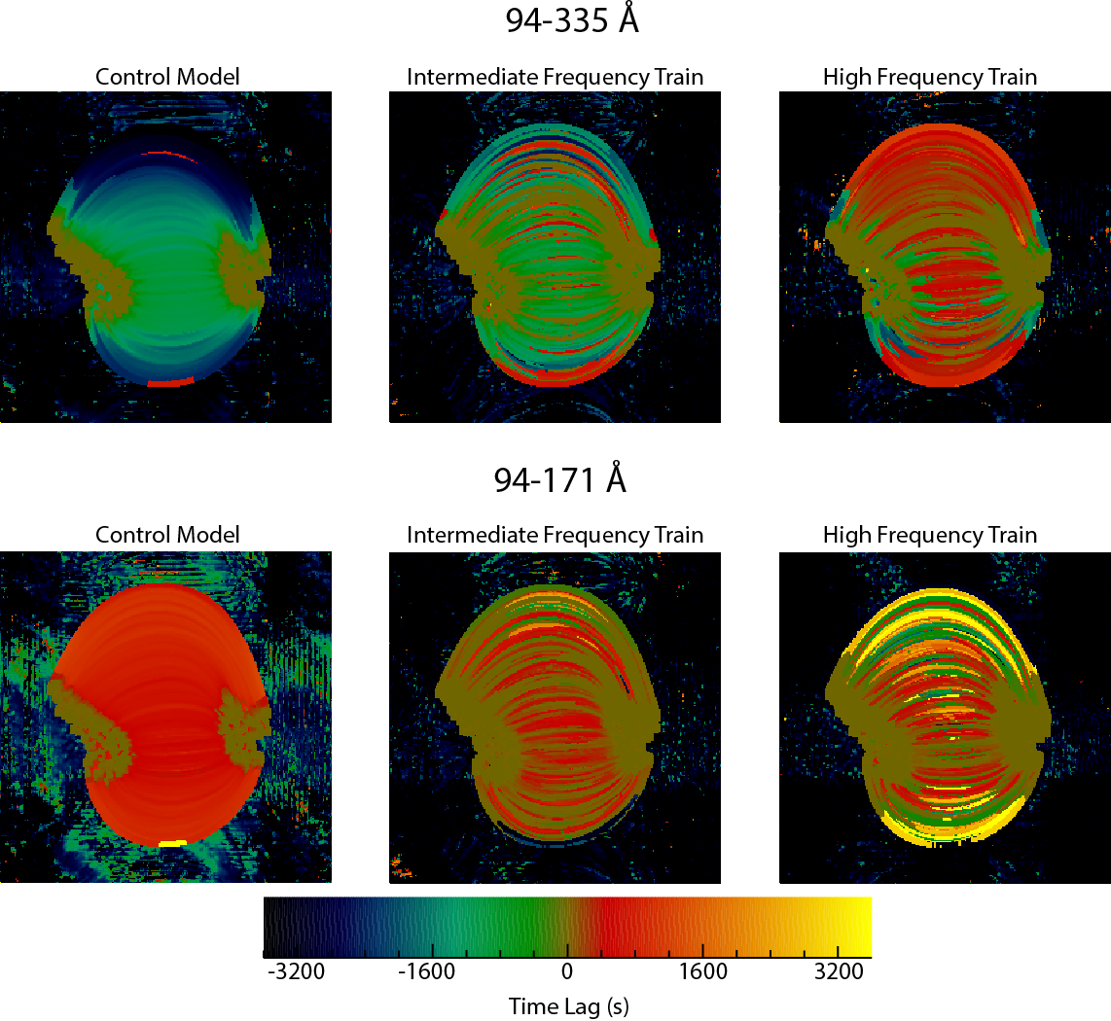
Nanoflare trains reproduce observed timelags while full cooling cannot
Intermediate matches longer flux tubes but high frequency matches core better
2-hr
12-hr

Slide 10
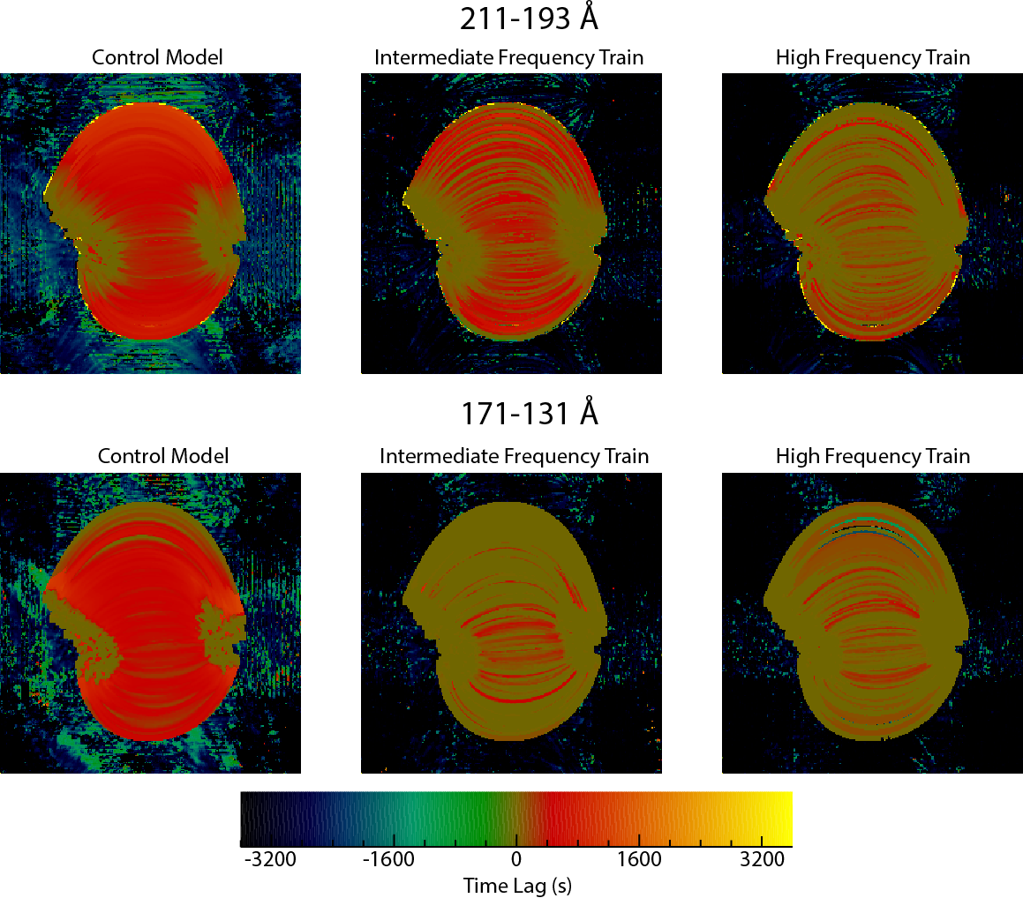
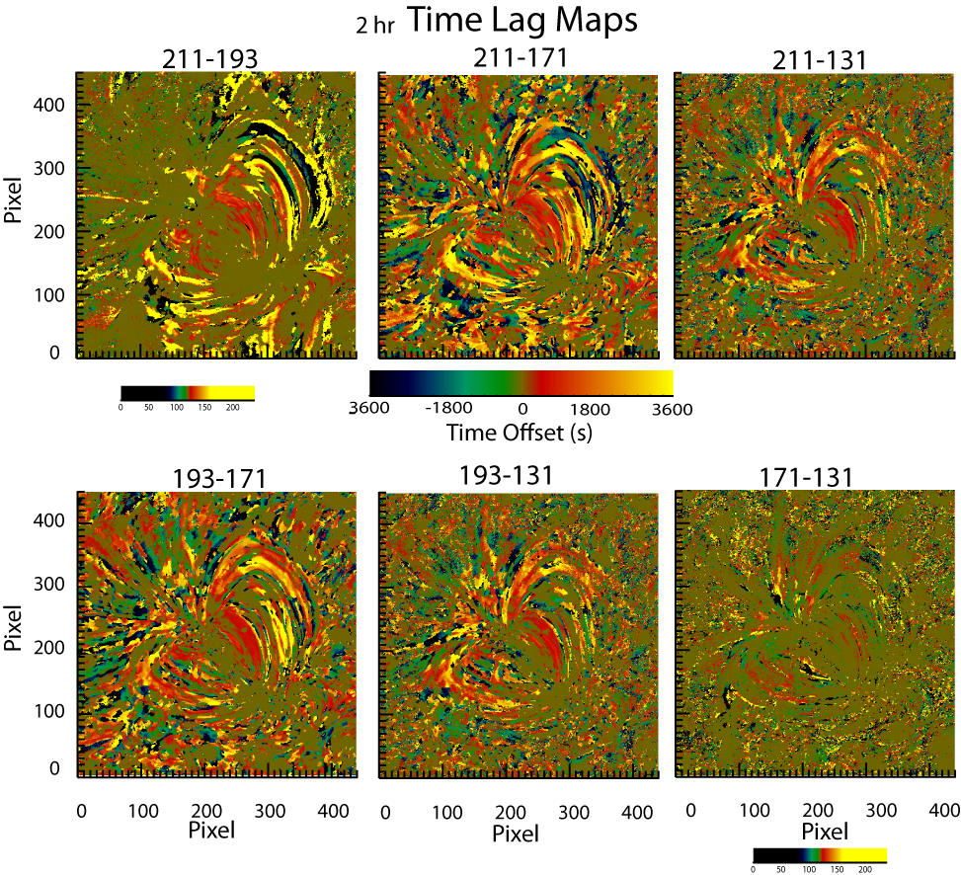
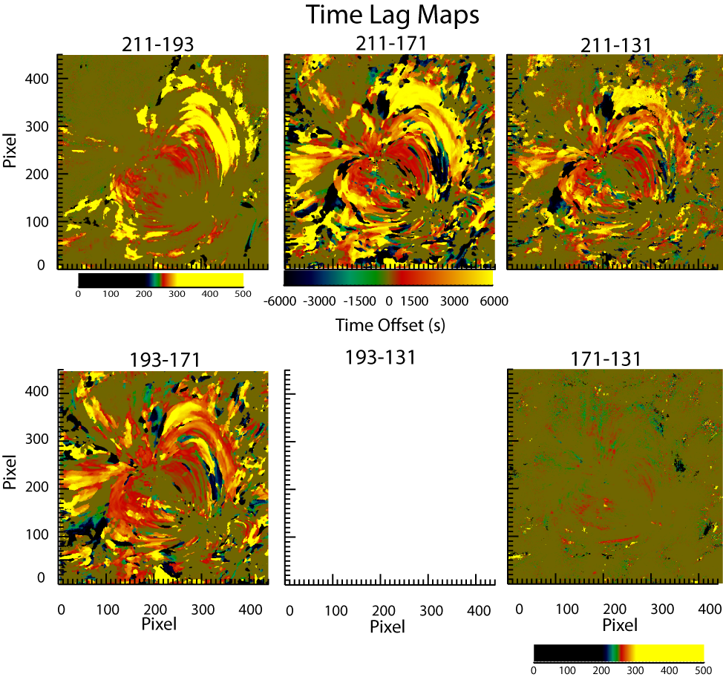
Nanoflare trains reproduce observed timelags while full cooling cannot
2-hr
12-hr

Slide 11
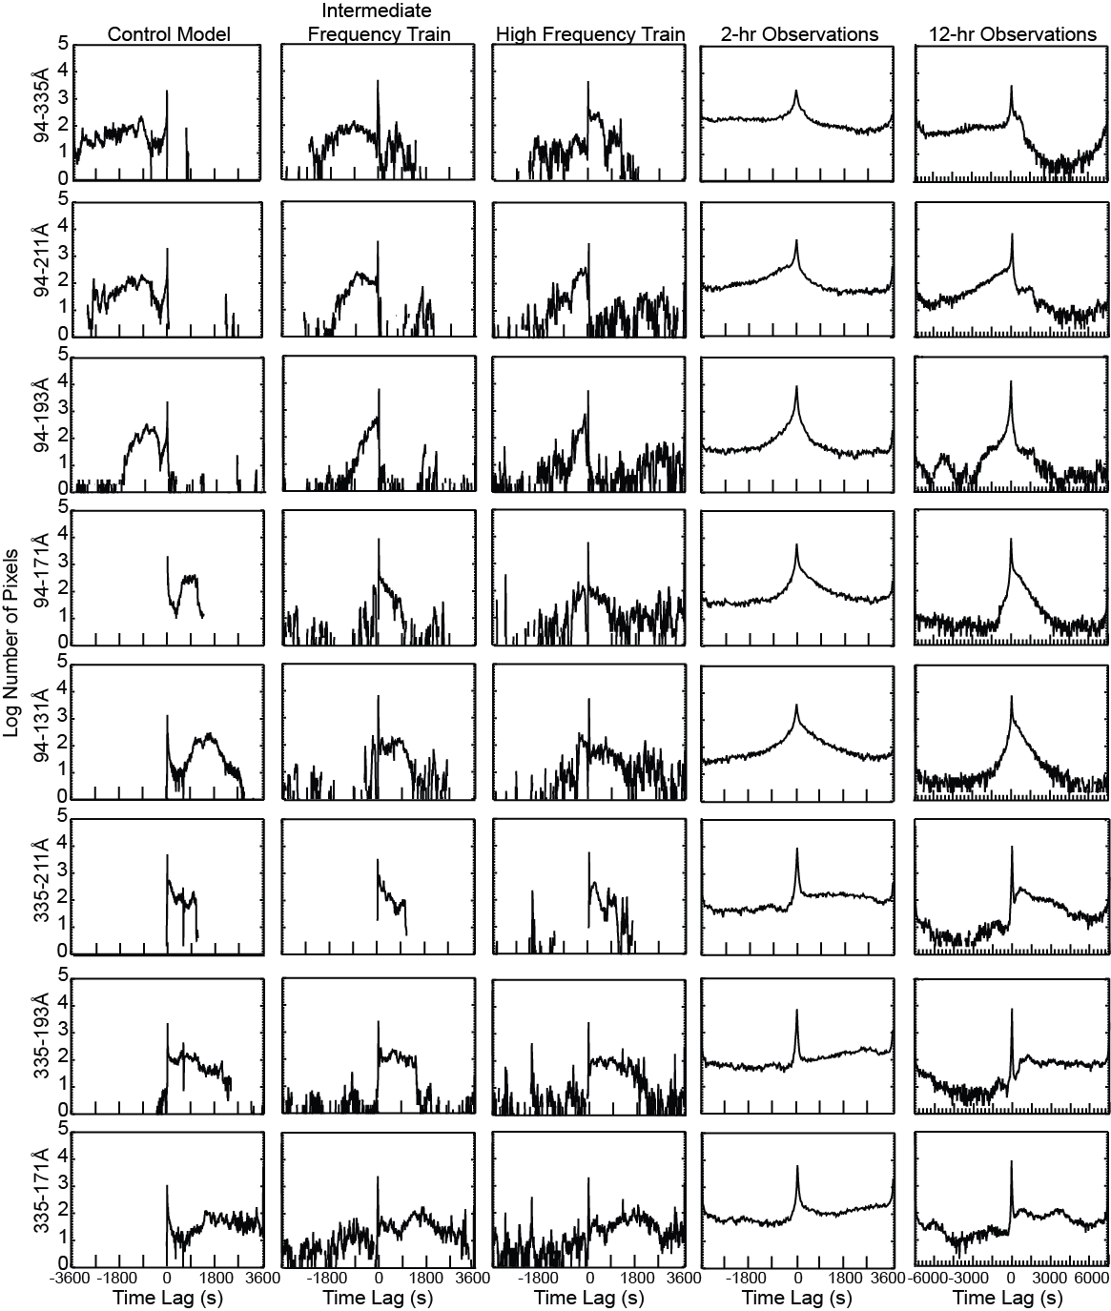
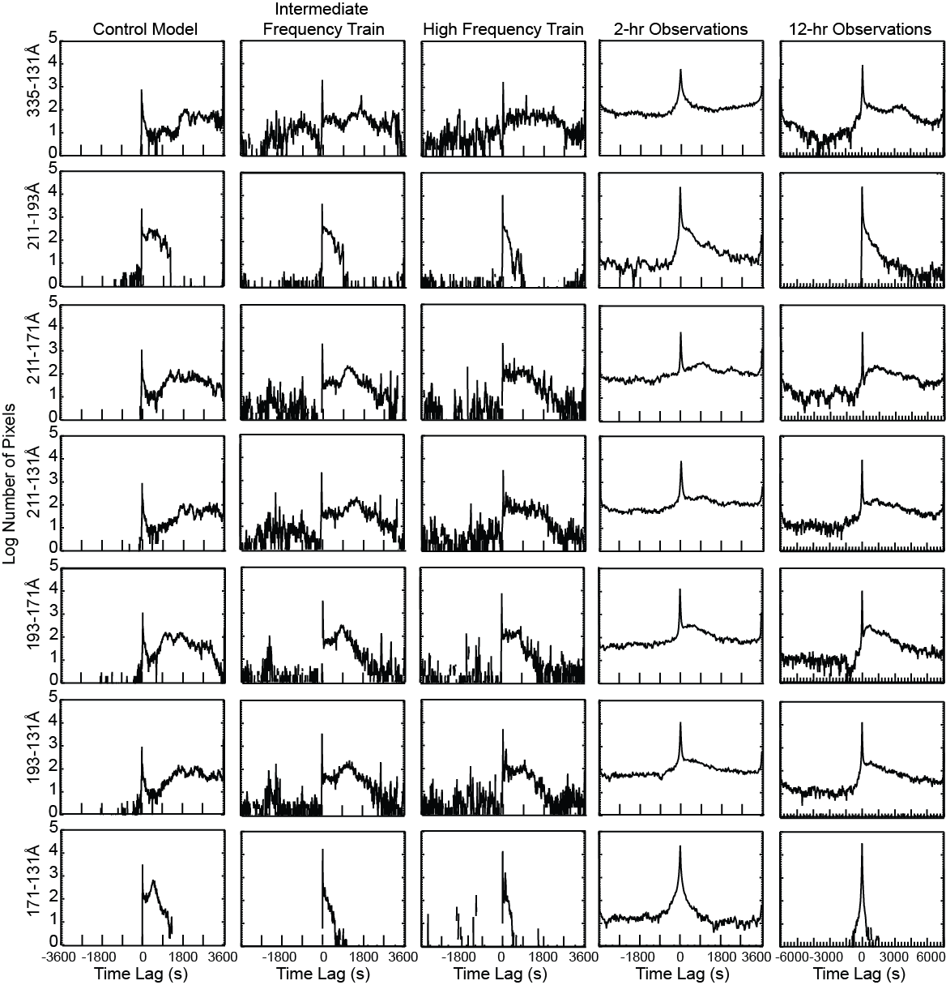
Nanoflare trains reproduce observed timelags while full cooling cannot; intermediate matches closest

Slide 12
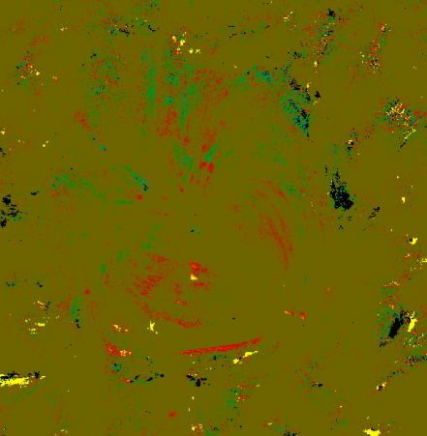
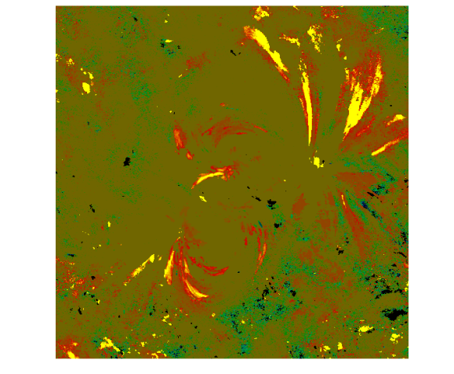
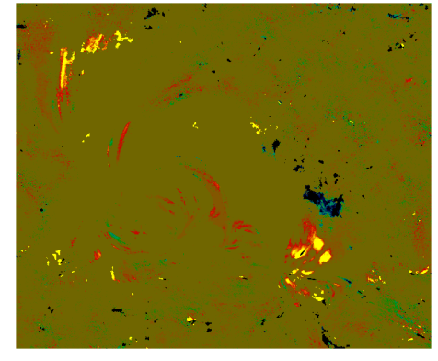
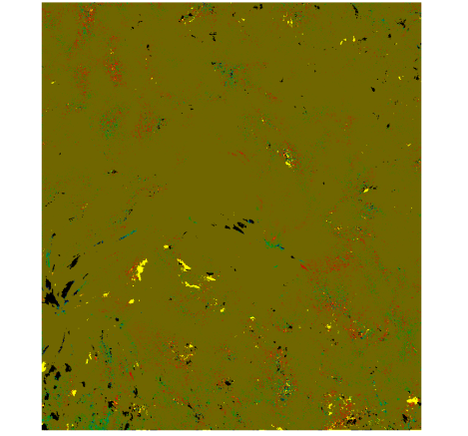
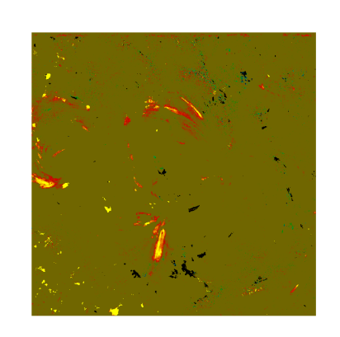
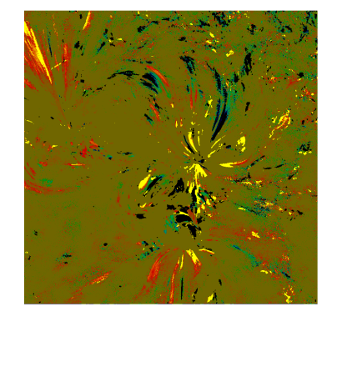









171-131

Slide 13



Slide 14



Slide 15


Simple measures ->not sufficient

Slide 16
Barnes, Bradshaw & Viall, under review for ApJ
NOAA 1158
Oblique PFSS of Schmidt (1964)
5000 field lines between 20-300 Mm
Populate each field line temperature and density from the two-fluid (protons and electrons) version of EBTEL from (Barnes et al. 2016) as a function of time.
Paper II will be to use machine learning and train a random19 forest classiﬁer on these predicted diagnostic

Slide 17
‘High ’, ‘Intermediate’, and ‘low’ are defined by the average wait time relative to the cooling time for that flux tube length, and is not an absolute value. 0.1, 1, and 5

Slide 20
1. As the heating frequency decreases, the emission measure slope, a, becomes increasingly shallow, saturating at a ≈ 2. As the heating frequency increases, the distribution of slopes over the active region is shifted to higher values and broadens.
2. The timelag becomes increasingly spa-tially coherent with decreasing heating frequency. When strands are allowed to cool without being reenergized, the spatial distribution of timelags is largely determined by the distribution of loop lengths over the active region.
3. The distribution of timelags becomes in-creasingly broad and approaches a uniform distribution as the heating frequency increases, consistent with the results of Viall & Klimchuk (2016).
4. Negative timelags in channel pairs where the second (“cool”) channel is 131 ˚A pro-vide a possible diagnostic for ≥ 10 MK plasma

Slide 21
Neither ‘low’ frequency (i.e. full cooling and draining) nor steady heating are consistent with observations.

