Slide 1
Using SDO/AIA to Understand the Thermal Evolution of Solar Prominence Formation
Nicholeen Viall
with Terry Kucera and Judy Karpen
NASA GSFC

Slide 2
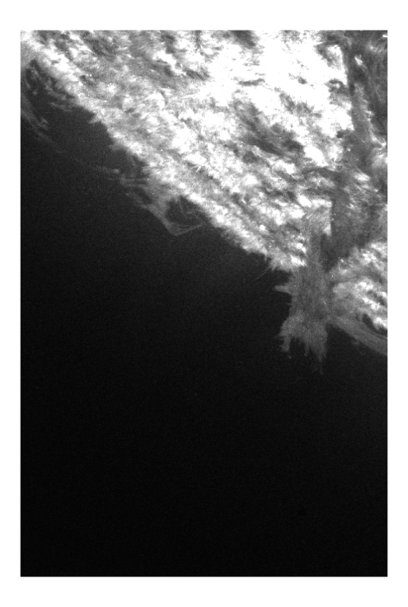
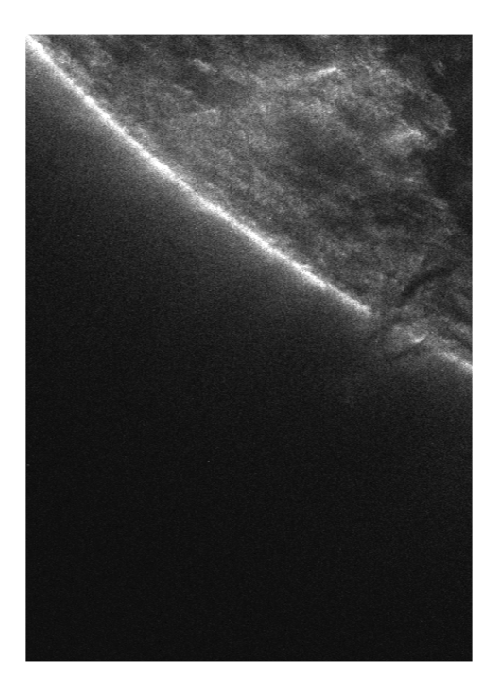
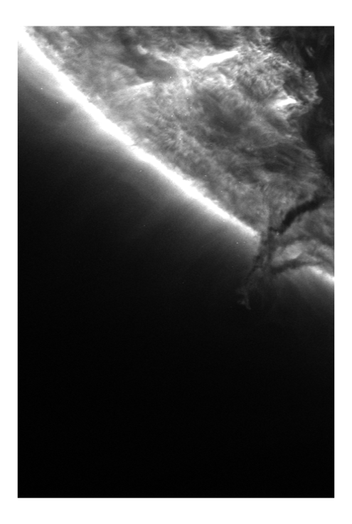
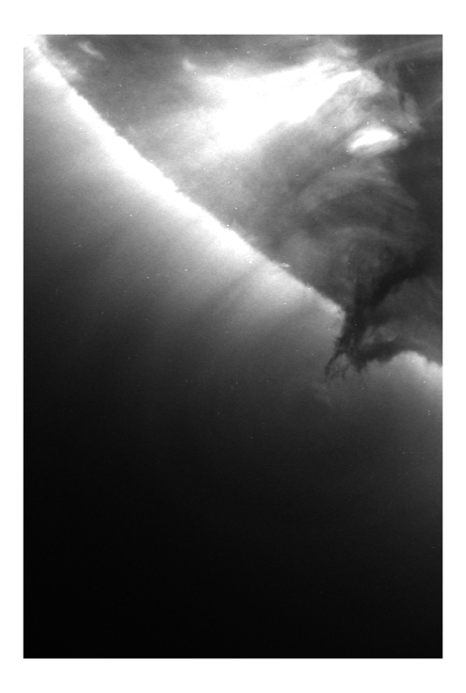
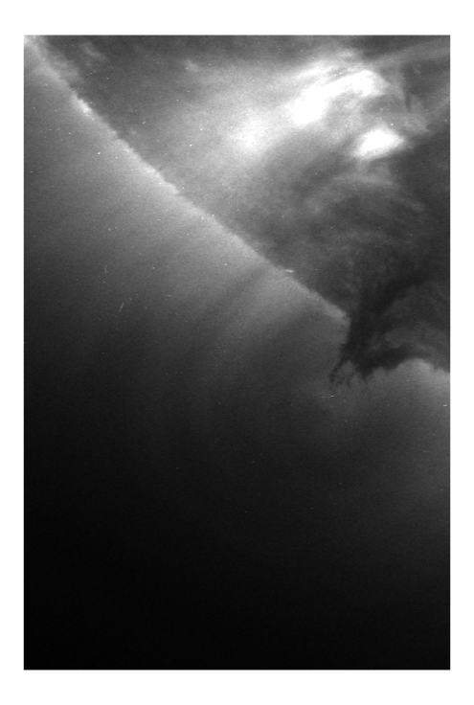
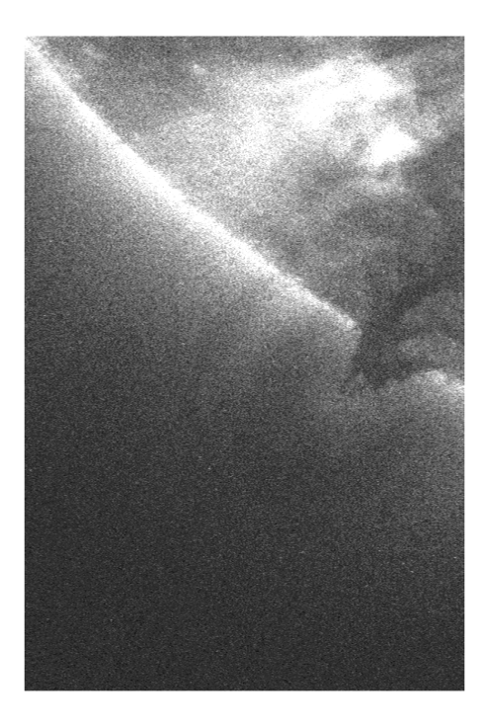
How do prominences acquire cold material?
-Option 1, cold material lifted/injected
-Option 2, hot material cools forming cold condensates (e.g. Liu talk earlier)
Is it related to the coronal heating?
304
131
171
193
211
335
Dec 14 2010
Notes:
If its option 2, then is it coronal heating? TNE?

Slide 3
‘Hot’ (~2 MK) cavity surrounds prominence
Consistent with previous work e.g. Reeves et al.
304
131
171
Little emission in cavity <1 MK
193
211
335
>1MK emission in cavity
Notes:
If its option 2, then is it coronal heating? TNE?

Slide 4
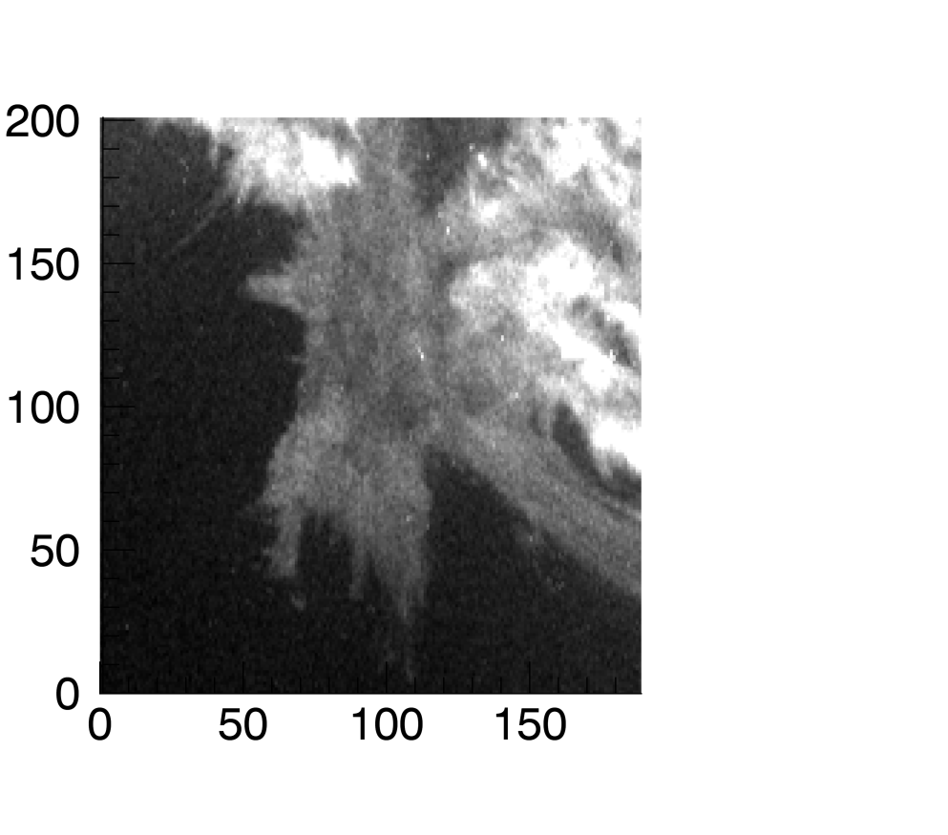
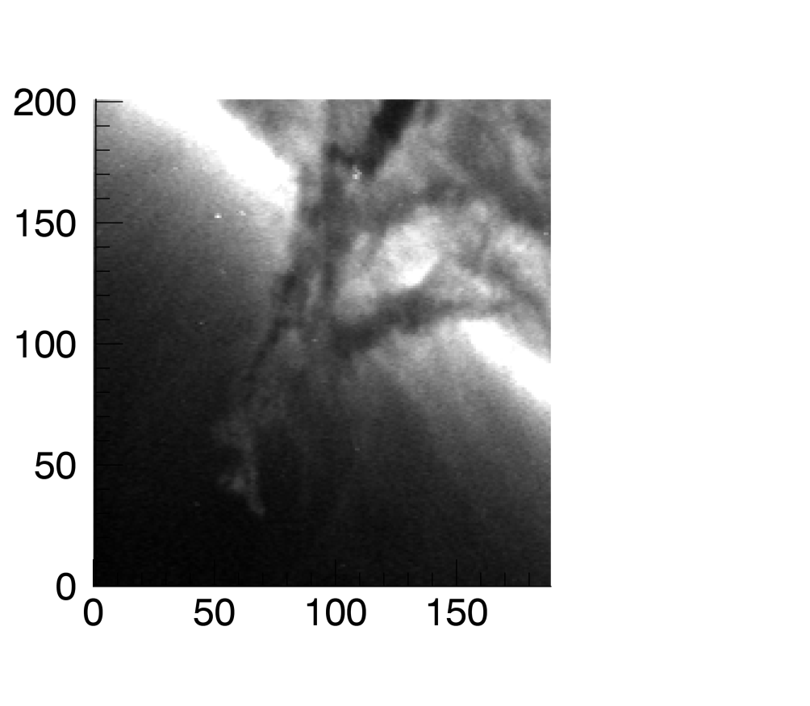
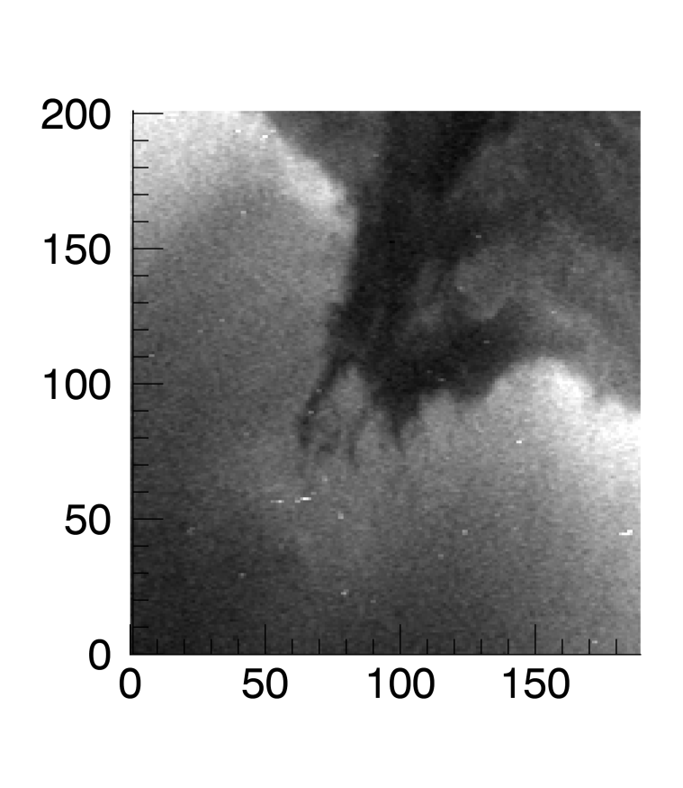
Cold prominence material surrounded by hot emission
304
171
211
Enhanced ‘nougat’ emission at ~ 2 MK
Surrounds little cold blob in 171 and 304Å
Sits on top of cold prominence

Slide 5
What is relationship between different temperatures of plasma?
Does hot plasma cool to become the cool prominence material?
More generally, is hot nougat and cavity heated like other locations in corona?
Apply time lag method of Viall & Klimchuk 2012

Slide 6
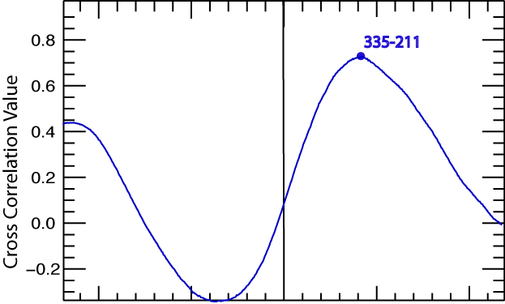
Cross Correlation = Cooling or Heating Time
Δt, Time Lag between 335 Å and 211 Å
Cooling time from
335 Å (~3 MK) to 211 Å (~2 MK)
-1000 -500 0 500 1000
SDO/AIA light curves predicted from single nanoflare
Time Offset (s)
Time lag method of Viall & Klimchuk 2012 cross correlates lightcurves in different AIA channels
Cross correlate two wavelengths (temperatures) at different temporal offsets: peak cross correlation = time lag between light curves
Key: in a single nanoflare, heating is invisible, and slow cooling dominates all coronal emission
Notes:
We allow for slow heating too

Slide 7
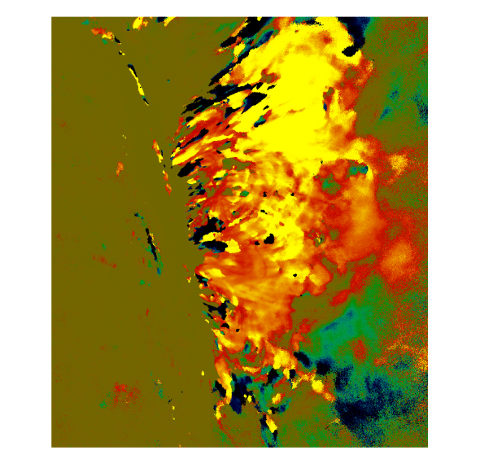
AR Time Lag Maps Shows Post-nanoflare Cooling and TR dynamics
(~3 MK-~2 MK)
Off limb AR
Viall & Klimchuk 2015
Negative time lags: slow/bright heating
Positive time lags: cooling
zero time delay: transition region/flows
All other channel pairs show self consistent picture of cooling plasma
Viall & Klimchuk 2012

Slide 8
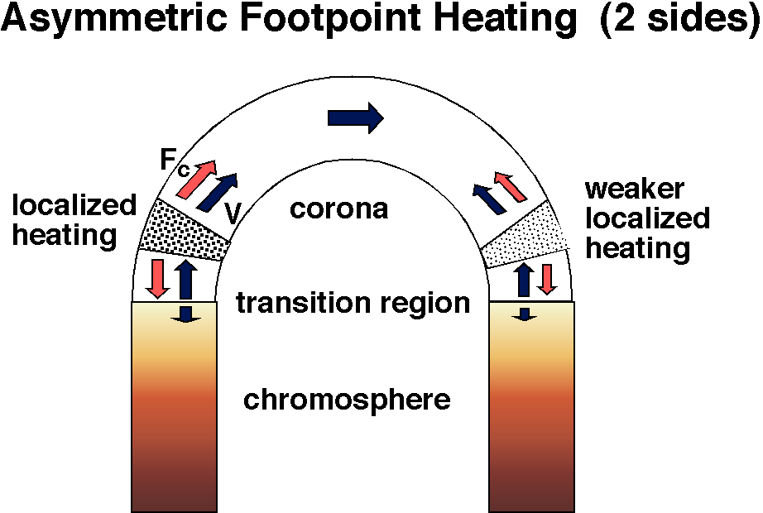
Assymetric, Steady, Footpoint heating on 2 sides -> TNE
Karpen flux tube model of thermal non equilibrium
Heating drives evaporation from both footpoints

Slide 9
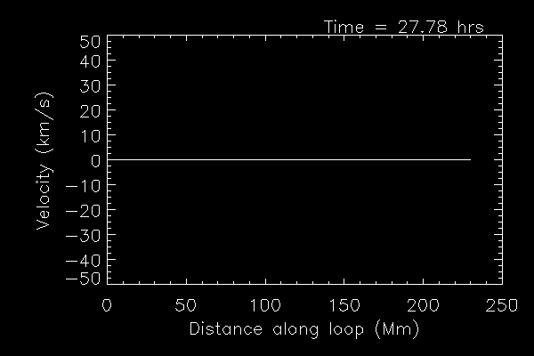
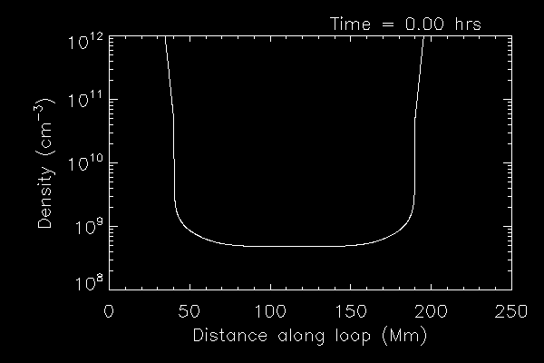
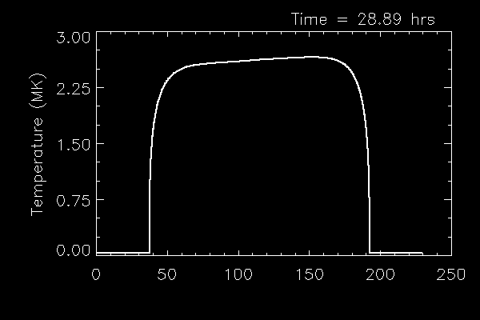
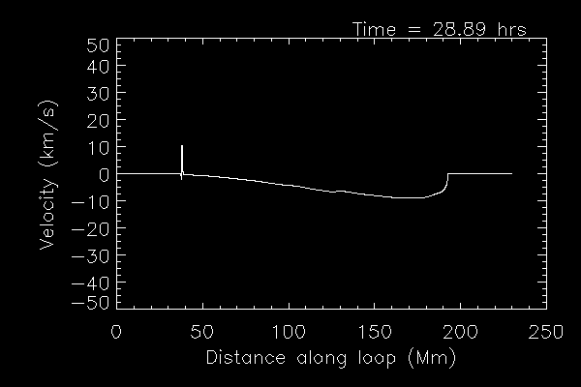
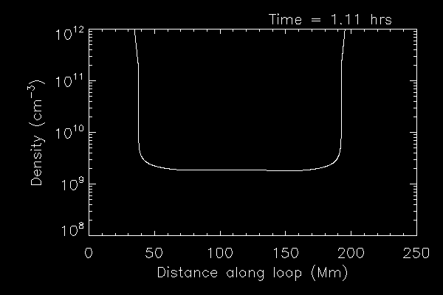
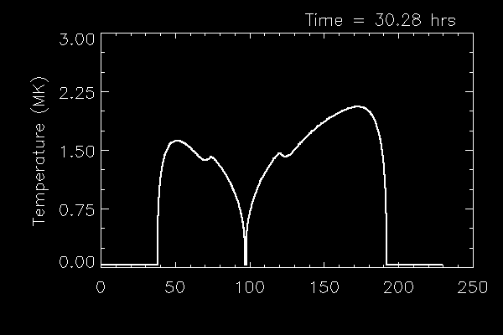
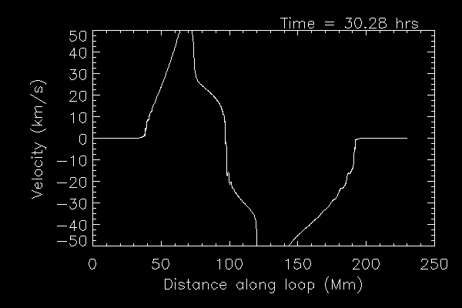
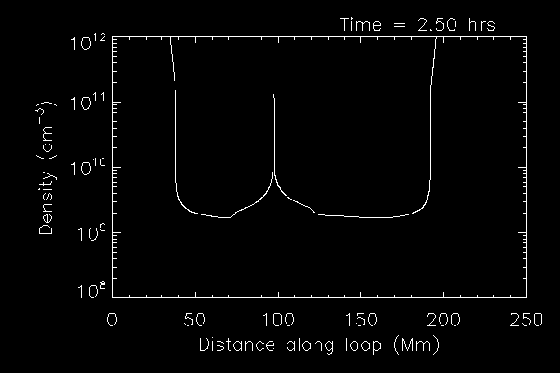
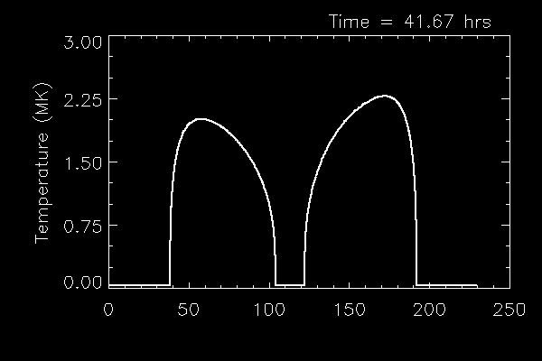
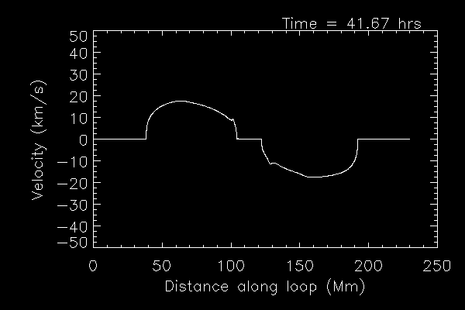
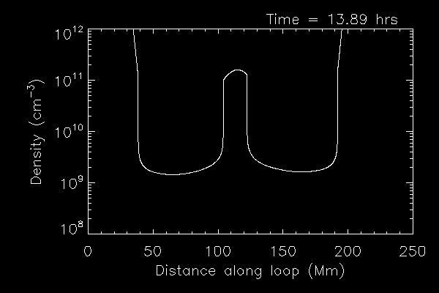
Thermal Non Equilibrium Simulation With Condensate
Temperature
Velocity
Density
Asymmetric Heating
Loop Length
Loop Length
Loop Length

Slide 10
Cooler channel pairs
Hotter channel pairs
171-131 193-131 193-171 211-131 211-171 211-193 335-131 335-171 335-211
Stronger heating
Condensate
Weaker heating
Negative time lags: noise; slow/bright heating
Positive time lags: cooling
zero time delay: transition region/motions
Loop length
Unlike observed AR corona, heating phase can dominate emission (greens and blues) in thermal non equilibrium
Stronger heated side shows heating phase most often
Complex signatures near condensate
Some complexity due to cold (100,000K) emission
Specifics depend on time window
Loop length
Loop length

Slide 11
It’s messy (very complex)! Consistent with TNE prediction, and in contrast to nanoflare prediction and observed AR, which are dominated by positive time lags, and zero time lag in TR
zero time delay: transition region/motions
Negative time lags: noise; slow/bright heating
Positive time lags: cooling

Slide 12
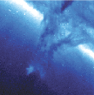
171 Image

Slide 13
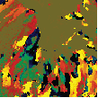
Zero time lags generally encompass cold prominence material (TR between condensate and corona
Hot surrounding cavity has heating and cooling signatures
Features visible in images exhibit coherent timelags e.g. the horns, the cold blob, and he nougat
193-171 Map

Slide 14
zero time delay: transition region/motions
Negative time lags: noise; slow/bright heating
Positive time lags: cooling

Slide 15
‘Horns’ exhibit both heating and cooling cycles -well above cold prominence material, and in region with good signal to noise
Hot nougat is cooling from ~2.5
zero time delay: transition region/motions
Negative time lags: noise; slow/bright heating
Positive time lags: cooling

Slide 16
Conclusions
Time lag maps statistically identifies thermal evolution in plasmas; takes full advantage of unique SDO/AIA capabilities. Complements e.g. DEMs.
TNE with full condensates produces complex time lag signatures. Sometimes heating phase dominates, sometimes cooling phase dominates emission.
In contrast to impulsive heating where cooling phase dominates emission
Inconsistent with observed ARs
Time lag results strongly depend on time window
Asymmetric heating shows up in time lag maps
Off-limb prominence sees heating and cooling phases consistent with TNE
‘Hot’ ~ 2 MK nougat and cavity where heating phases are visible, consistent with TNE
Future work
Model full LOS emission with many out-of-phase magnetic strands undergoing TNE
Compute time lags prominences with other projections
Test condensates from nanoflare heating (instead of steady - following Karpen & Antiochos 2008) where nanoflare repeat time <2000 s

Slide 17
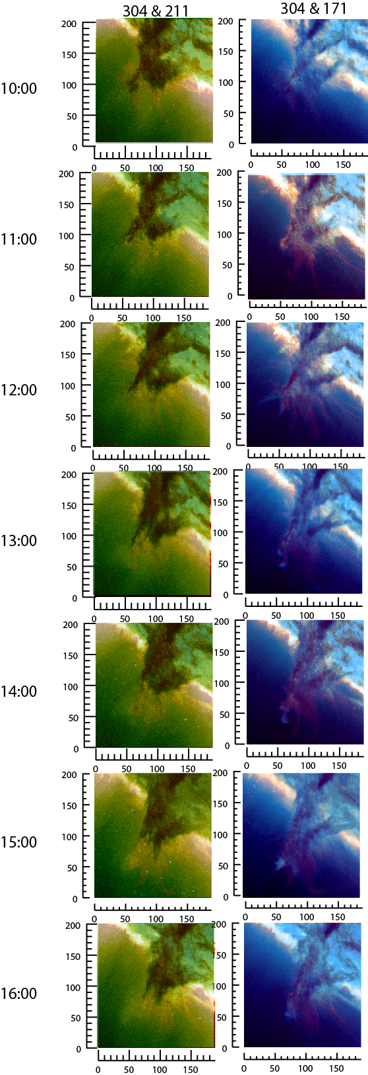
Images for 6 hour analysis time
Hot (2 MK) nougat sits on cold barbs and around them
171 blob/condensates collocated with cold 304

Slide 19
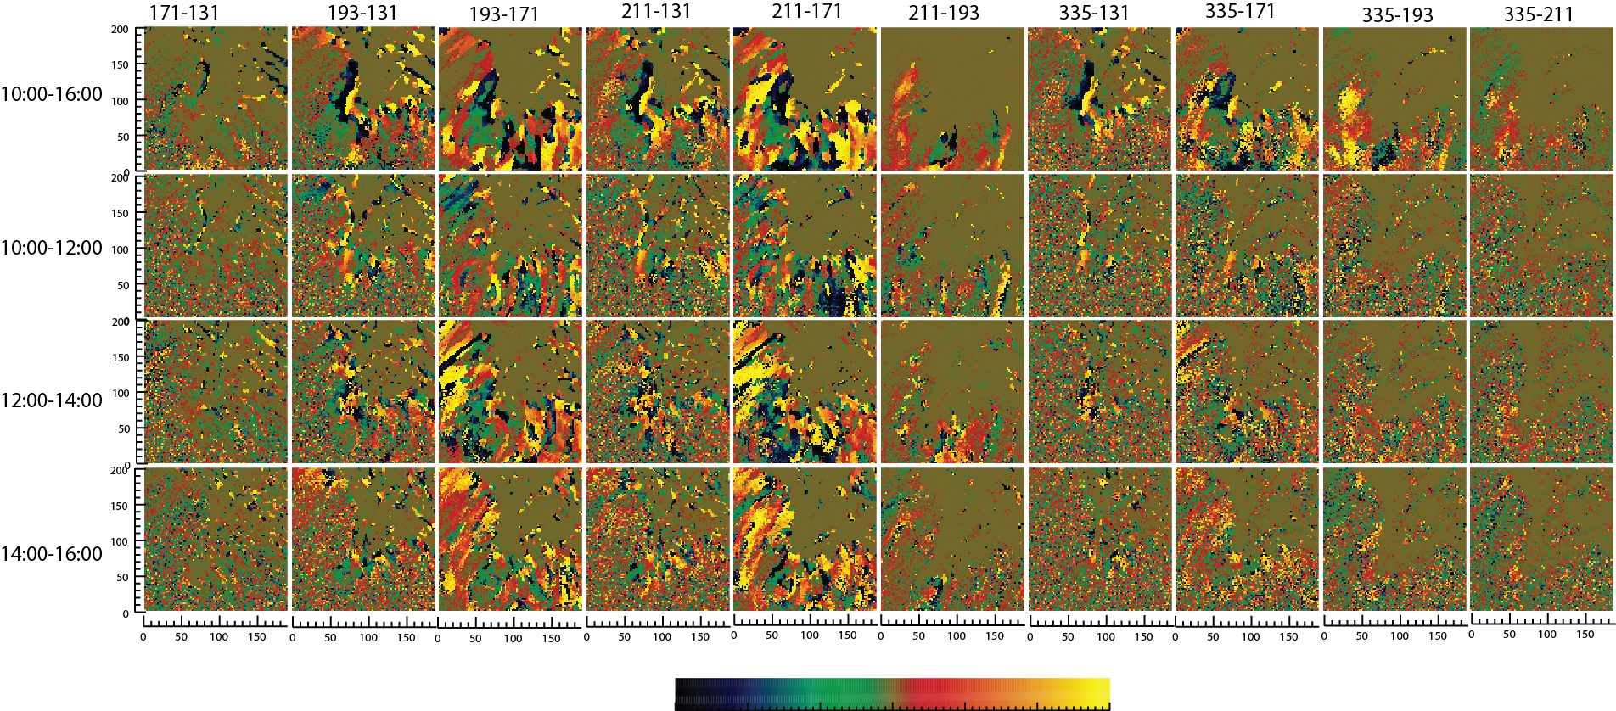

Slide 20
335-211
211-193
193-171
171-131
12/14/2010
10-16 UT
10-12
12-14
14-16

Slide 21
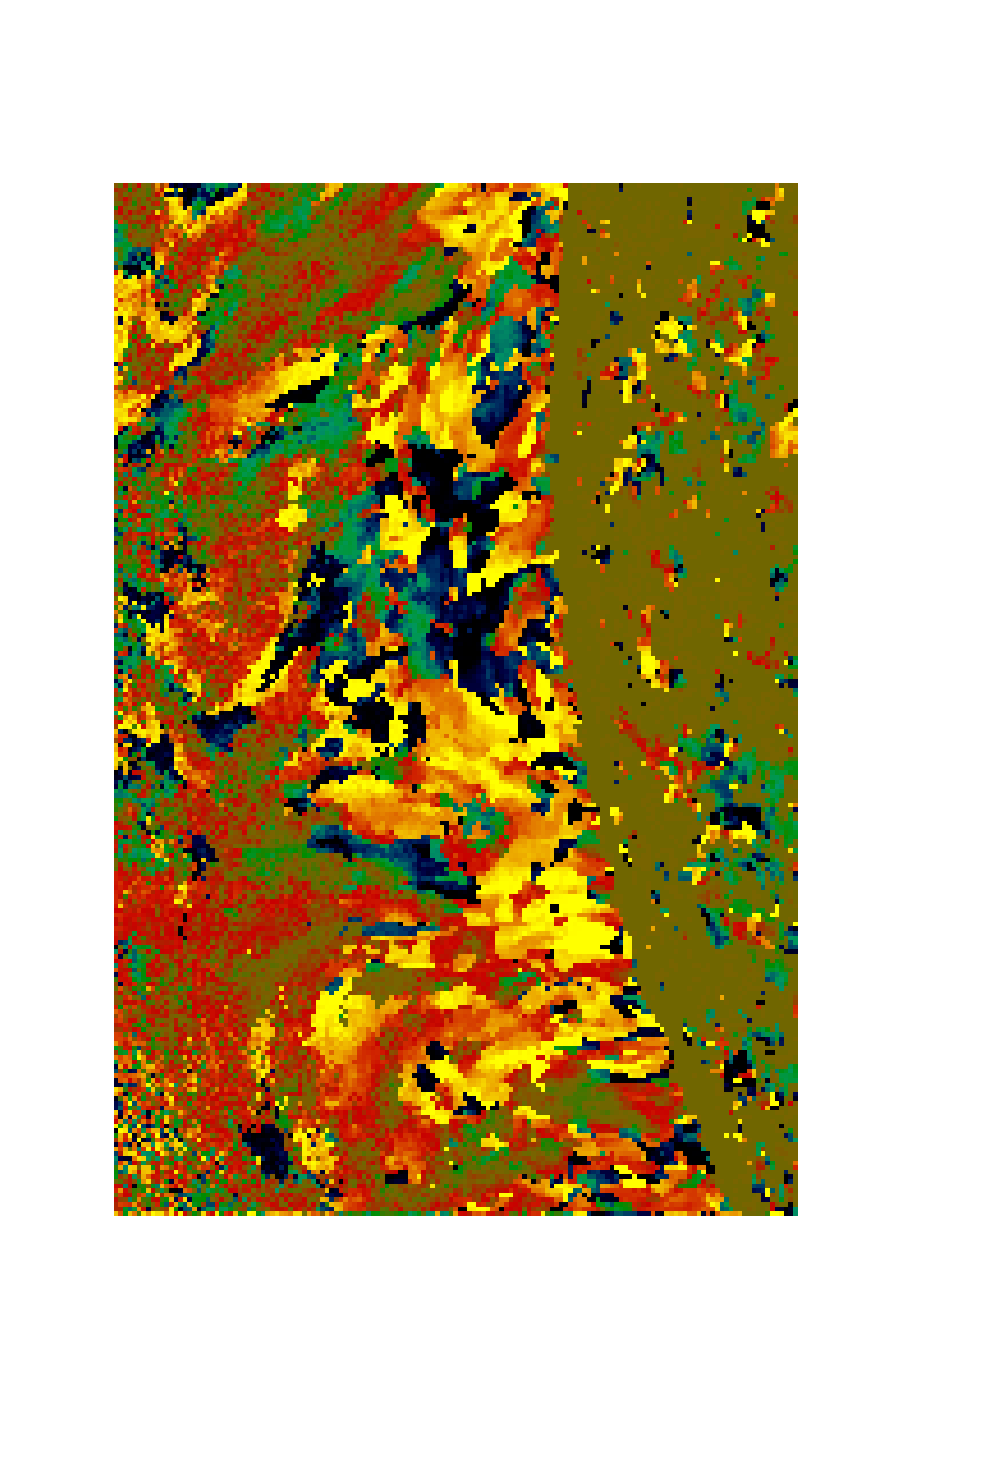
193-171 Å (1.6 MK-0.9 MK)
Detrended Time Lag Map
Dominated by Cooling Time lags
Timelags consistent with post-nanoflare cooling of individual flux tubes
noise; slow heating
cooling

Slide 22
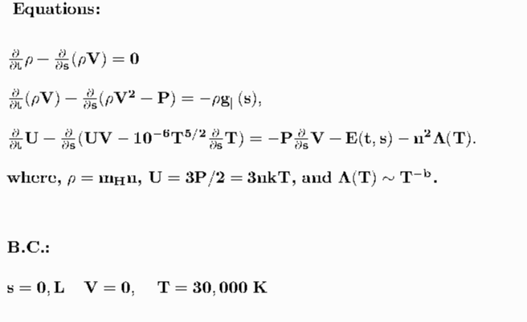
“No meaningful inferences on the heating process can be obtained from static models.” - Chiuderi et al. 1981

Slide 23
335

Slide 24
211 193

Slide 25
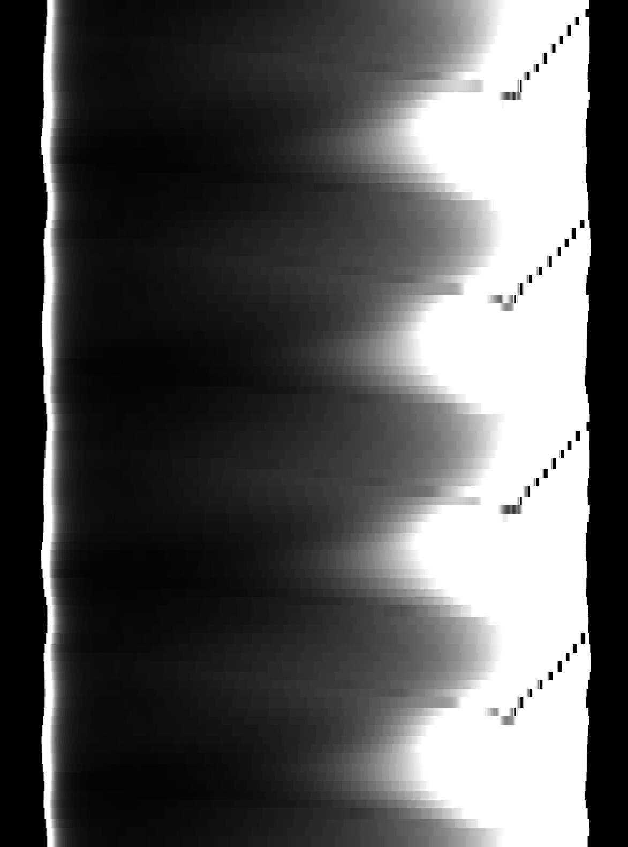
171 131

Slide 26
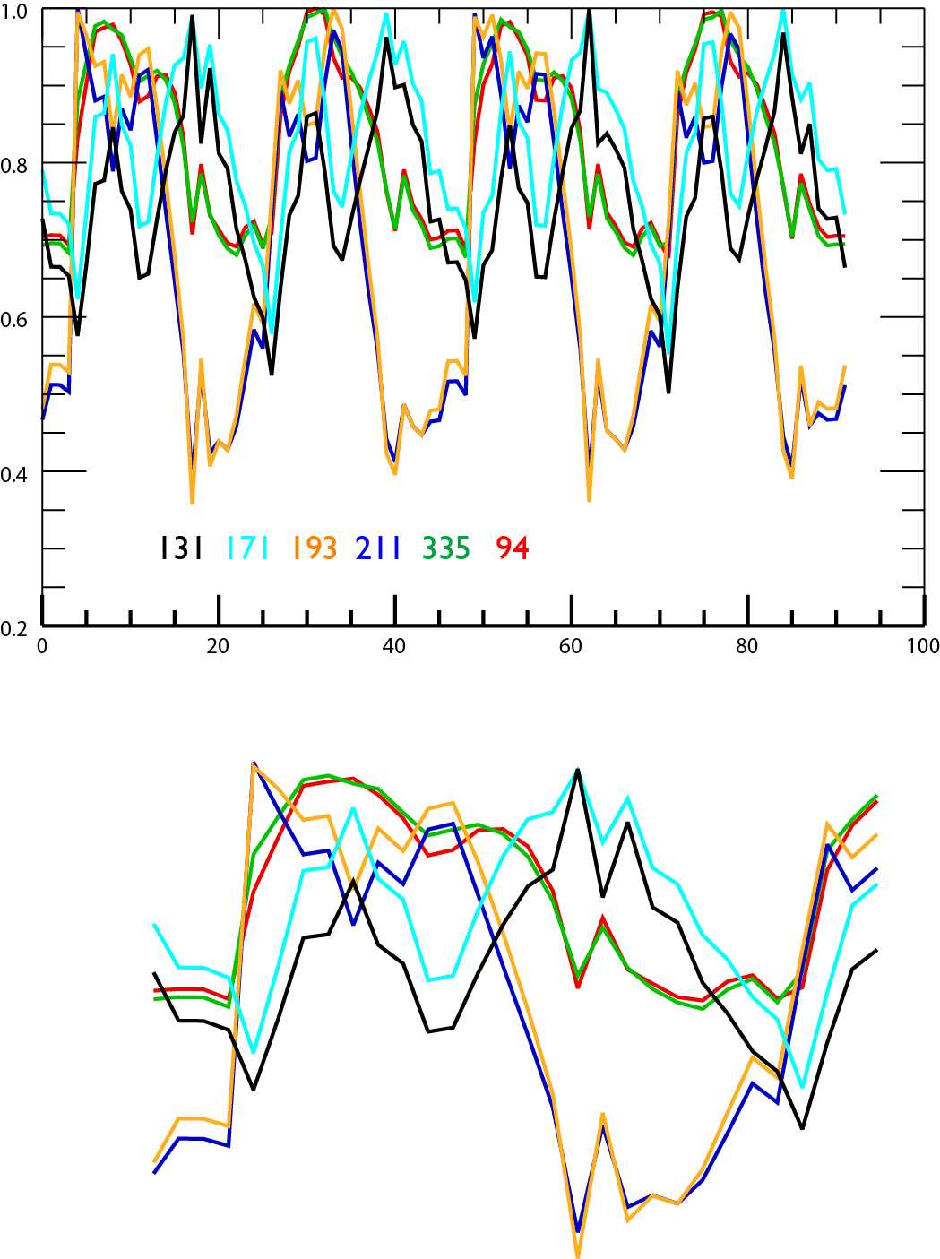
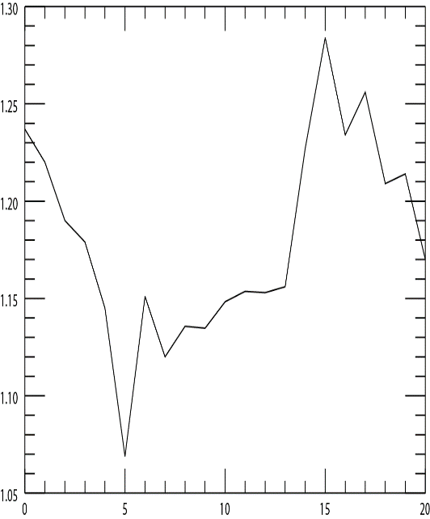

Slide 27
