Slide 1
Answering the Outstanding Questions of Solar Wind Physics using Ultraviolet Measurements of the Solar Corona
Nicholeen Viall (NASA Goddard Space Flight Center)
Nicholeen.M.Viall@nasa.gov
NASA Goddard Space Flight Center Heliophysics Internal Scientist Funding Model

Slide 2
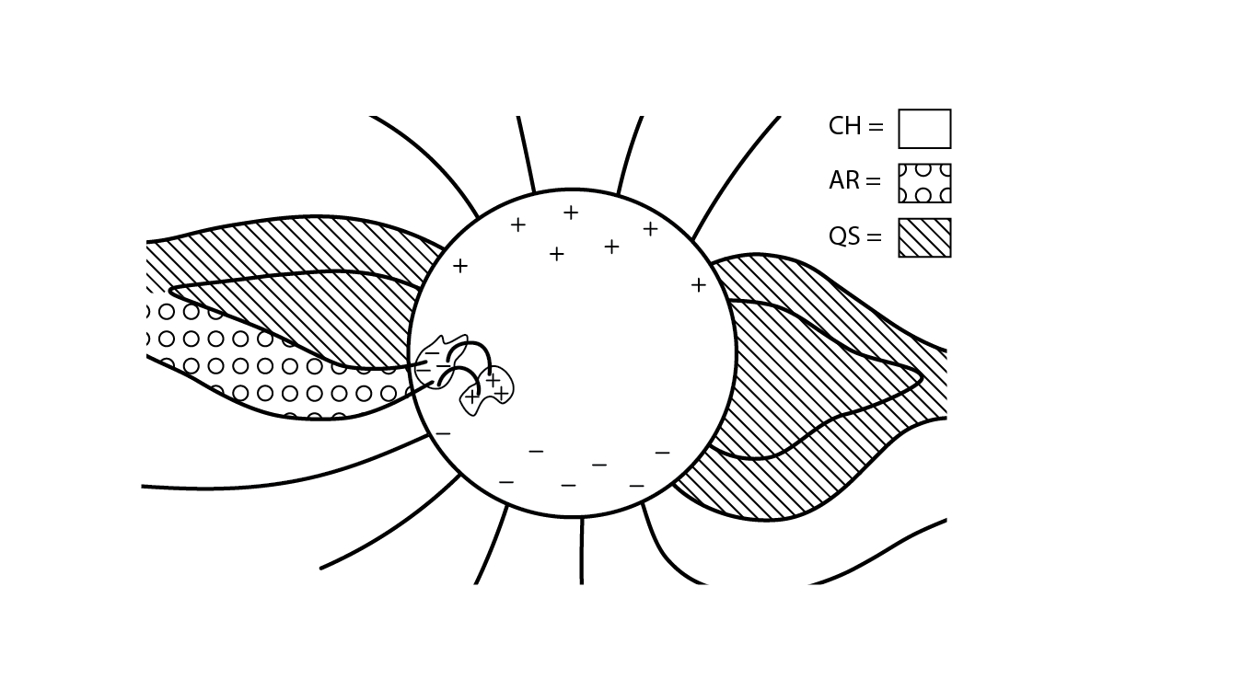
Each step along the solar wind formation pathway corresponds to unique observables
Step1
Step 2
Step 3
Viall & Borovsky 2020, “Nine Outstanding Questions of Solar Wind Physics”, JGR, Grand Challenges in the Earth and Space Sciences
Notes:
OK, Back to the Sun. One thing our team has shown obs and models is the dynamic and structured way that the solar wind is formed, and reconnection at the open closed boundary is a leading creation mechanism of what we have been calling mesoscale structures. Remind open-closed. Wal through the 3 steps. Key is that each piece is a step in the time history of the plasma, and so leaves unique sets observables, in particular in compositional signatures FIP. Goes beyond fast and slow wind. Wrote this in previous ISFM, continues to be impactful.

Slide 3
Q1 From where on the Sun does the solar wind originate?
Different parts of the Sun are heated differently, and thus are comprised of plasma of different temperatures, densities, the relative abundance of elements with low first ionization potential
The solar wind from each will be different

Slide 4
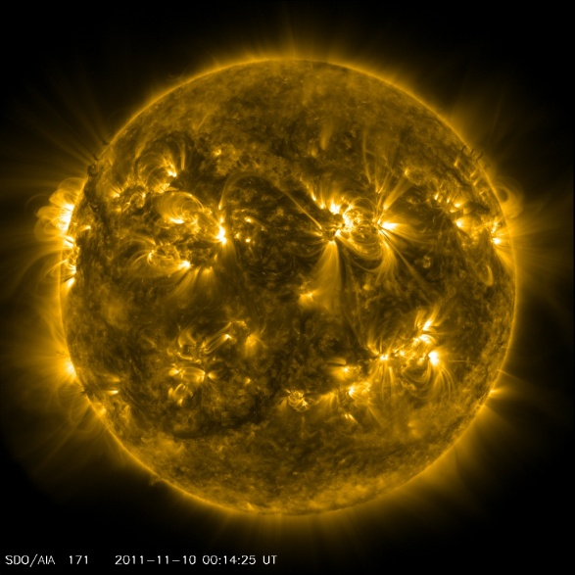
What Heats the Solar Corona?
Energy release in the corona
Giant black box of processes that are not well-measured
What we observe: Thermal emission long after the energy release (spectral lines and EUV images).
(Not directly observable with current resolution)
Viall, De Moortel et al. 2021, ‘The Heating of the Solar Corona’ in Solar Physics and the Solar Wind
Notes:
Or said differently, Q1 about the solar wind is really the cornal heating problem, which you heard about Brosius, an d Terry Doug Natalia

Slide 5
Q1 From where on the Sun does the solar wind originate?

Slide 6
Q2 How is the solar wind released?
The plasma may already be on open fields, or it may be on closed‐fields, requiring one or more reconnection events for it to be released into the solar wind.
Closed-field plasma has different relative abundance of low FIP abundances than open fields (Hinode EIS, Solar Orbiter SPICE measurements – Peter Young)
Reconnection produces magnetic and plasma structures in the solar wind (Sometimes observed directly with EUV imagers SDO/AIA, GOES/SUVI)
The reconnection may (e.g. coronal hole jets and jetlets) or may not (e.g. helmet streamer blobs) be energetically important.

Slide 7
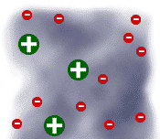
Q3 How is the solar wind accelerated?
Ambipolar E field
Cartoon representation of the four different mechanisms of acceleration: closed‐flux reconnection, interchange reconnection, component reconnection, ambipolar diffusion and wave/turbulence heating (latest PSP results show upper limit).
Charge state and temperature anisotropies higher up leave imprint of this

Slide 8
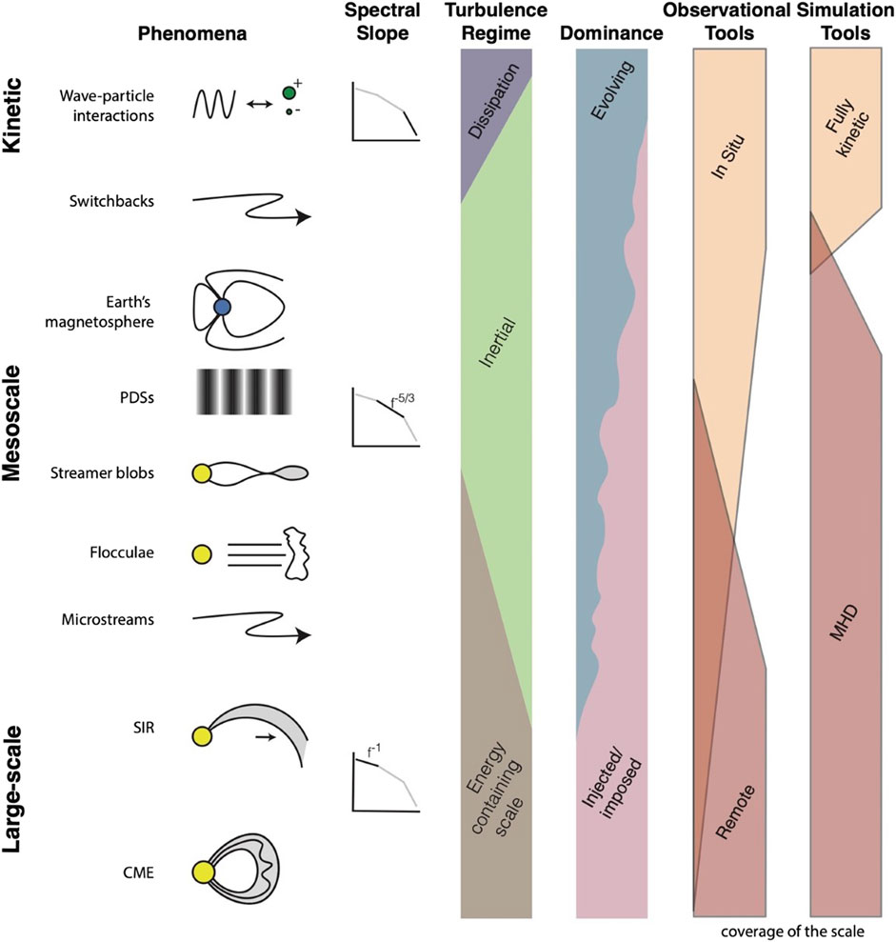
Large scale structures in the solar wind are all imposed (spatial structure) or injected (time dynamics) from the Sun
Kinetic scale structures are all due to evolution and processing en route
Mesoscales are created by both evolution en route and also directly imposed/injected – mesoscales are messengers of solar wind formation
EUV measurements of the elemental abundances (Peter Young) crucial for linking coronal structure and dynamics with L1
Earth’s magnetosphere is ~ the same size as solar wind mesoscale structures
Need to understand mesoscale solar wind structures to understand solar wind driving of Geospace
Viall, DeForest and Kepko, Mesoscale Structure in the Solar Wind
Front. Astron. Space Sci., 25 August 2021 | https://doi.org/10.3389/fspas.2021.735034
Notes:
Here point out CMEs, Sun-to-mud modeling and data; we are doing it for the mesocsales. Really at the edge of what we can do measurement and modeling. But it matters because look at the magnetosphere.

Slide 9
Some solar wind structures are periodic dynamic pressure structures, and they drive oscillations in Earth’s magnetosphere
Notes:
Understanding the dynamic space environment in general –these waves come all the way down to the ground - specifically Radiation Belts

Slide 10
Periodic mesoscale density structures that drove Geospace dynamics came from the AR on the right; left AR created different solar wind structures resulting in different Geospace dynamics
Di Matteo et al. 2022
DOI: 10.1029/2021JA030144
Samantha Wallace ADAPT/WSA mapping geo-effective L1 events, and PSP events
Notes:
Andother is the mapping, WSA beta testing heard from Nick. We are taking those tools and applying them here, and helping define science need for future tools. Also for energetic particle from jets low on the Sun; Simone work; PSP events; and then connecting the EIS to ACE AND/OR SPICE to SO HIS. (and iterations therin)

Slide 11
Answering the outstanding solar wind questions requires UV measurements of the Sun, in particular: elemental composition, DEM, temperature anisotropies, and charge state measurements
The way that coronal heating occurs-> creates different types of solar wind structures -> that drive dynamics in the Earth’s magnetosphere

