Slide 1
Coronal Heating ISFM 12/01/2021
Understanding Heating in Active Region Cores through Machine Learning. II. Classifying Observations
W. T. Barnes^{1,2}, S. J. Bradshaw², and N. M. Viall³
Published 2021 October 4 • © 2021. The American Astronomical Society. All rights reserved. The Astrophysical Journal, Volume 919, Number 2
Citation W. T. Barnes et al 2021 ApJ 919 132

Slide 2
Which set of coronal heating parameters best reproduces the observables?
Coronal heating parameter of focus was heating frequency per flux tube (high/intermediate/low defined relative to the cooling time)
SDO/AIA per pixel EM slope, the peak temperature of the EM, and Time lags and cross correlation values of those time lags
Random forest classification model on forward modeled observables
Then use trained model on NOAA 1158 to map most likely heating frequency
‘We find that high-frequency heating dominates in the inner core of the active region while intermediate-frequency dominates closer to the periphery of the active region. ’

Slide 3
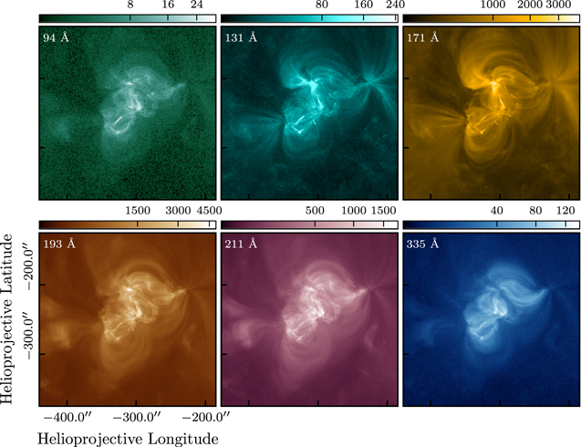
We analyze 12 hr of AIA observations of active region NOAA 1158 in six EUV channels, 94, 131, 171, 193, 211, and 335 Å, beginning at 2011 February 12 12:00:00 UTC and ending at 2011 February 13 00:00:00 UTC (From the Warren et al 2012 and then Viall and Klimchuk 2017 list)
Figure 1. Active region NOAA 1158 as observed by AIA on 2011 February 12 15:32 UTC in the six EUV channels of interest. The data have been processed to level 1.5, aligned to the image at 2011 February 12 15:33:45 UTC, and cropped to the area surrounding NOAA 1158. The intensities are in units of DN pixel⁻¹ s⁻¹. In each image, the color bar is on a square root scale and is normalized between zero and the maximum intensity. The color tables are the standard AIA color tables as implemented in sunpy.

Slide 4
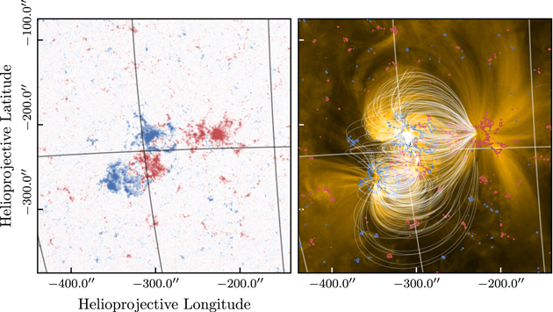
Barnes, Bradshaw, and Viall 2019
Figure 1. Active region NOAA 1158 on 2011 February 12 15:32:42 UTC as observed by HMI (left) and the 171 Å channel of AIA (right). The gridlines show the heliographic longitude and latitude. The left panel shows the LOS magnetogram and the colorbar range is ±750 G on a symmetrical log scale. In the right panel, 500 out of the total 5000 field lines are overlaid in white and the red and blue contours show the HMI LOS magnetogram at the +5% (red) and −5% (blue) levels.

Slide 5
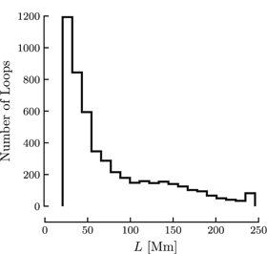
Barnes et al. 2019
Each heat pulse is triangular lasting 200 s
Peak heating rate and waiting time between events
Followed Cargill 2014: Wait time prior to the event and event energy are proportional.
For each strand, we choose N_{l} events each with energy E_{i} from a power-law distribution with slope −2.5
Integrated energy flux follows Withbroe and Noyes 1977
Figure 2. Distribution of footpoint-to-footpoint lengths (in Mm) of the 5000 field lines traced from the field extrapolation computed from the magnetogram of NOAA 1158.

Slide 6
We forward-modeled emission from active region NOAA 1158 as observed by the six EUV channels of AIA
Using a potential field extrapolation combined with 5 × 10³ separate instances of the Enthalpy-based Thermal Evolution of Loops model
We predicted time-dependent intensities in each pixel of the active region for a range of nanoflare heating frequencies. Three simulated ARs (a high, intermediate, and low)
Frequency is twait/tcool:
0.1 is high
1 is intermediate
5 is low
for the shortest loop in our simulated active region, ≈ 20 Mm, the high-, intermediate-, and low-frequency values of 〈t_{wait}〉 are approximately 90 s, 930 s, and 4700 s, respectively. For the longest loop, ≈ 245 Mm, the approximate values of 〈t_{wait}〉 for the three frequencies are 850, 8500, and 42,500 s.
Within a given heating frequency category, there is a spread in the distribution of heating frequencies that meet the dependence of the waiting time on the energy of the event
We use a random forest classifier, to identify the most probable heating frequency in each pixel of active region NOAA 1158 using the predicted emission measure slopes and peak temperatures, time lags, and maximum cross-correlations from Paper I

Slide 7
Figure 4. Snapshots of intensity, in DN pixel⁻¹ s⁻¹, across the whole active region at t = 15 × 10³ s. The rows correspond to the three different heating frequencies and the columns are the six EUV channels of AIA. In each column, the colorbar is on a square-root scale and is normalized between zero and the maximum intensity in the low-frequency case. The color tables are the standard AIA color tables as implemented in SunPy (SunPy Community et al. 2015).

Slide 8
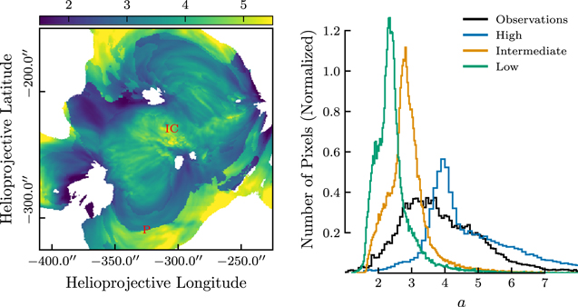
No single heating frequency works for the entire AR; mix of all seems to be required – for a given location, what is the probability of a given heating frequency distribution?
Figure 2. Left: map of emission measure slope, a, in each pixel of active region NOAA 1158. The EM(T) is computed from the observed AIA intensities in the six EUV channels time-averaged over the 12 hr observing window. The EM(T) in each pixel is then fit to Tª over the temperature interval 8 × 10⁵ K ≤ T < T_{peak}. Any pixels with r² < 0.75 are masked and colored white. "IC" and "P," marked in red, denote the inner core and periphery of the active region, respectively. Right: distribution of emission measure slopes from the left panel (black) and from Paper I (blue, orange, and green). Each histogram is normalized such that the area under the histogram is equal to unity.

Slide 9
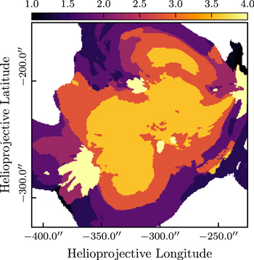
Figure 3. Map of observed T_{peak}, the center of the temperature bin at which the emission measure distribution peaks, in MK, in each pixel of active region NOAA 1158. Any pixels with total emission measure < 10²⁷ cm⁻⁵ are masked and colored white. The color bar is linearly spaced between 1 and 4 MK.

Slide 10
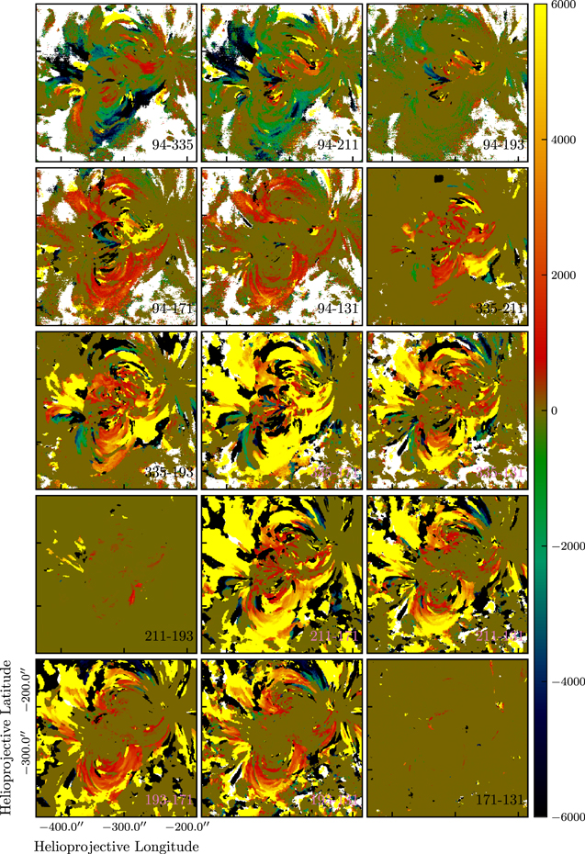
Time-lag maps of active region NOAA 1158 for all 15 channel pairs. The value of each pixel indicates the temporal offset, in seconds, which maximizes the cross-correlation (see Appendix C of Paper I). The range of the color bar is ±6000 s. The pixel is masked and colored white if the cross correlation value is less than 0.01. Each map has been cropped to emphasize the core of the active region such that the bottom left corner and top right corner of each image correspond to ( − 440'', − 380'') and ( − 185'', − 125''), respectively.

Slide 11
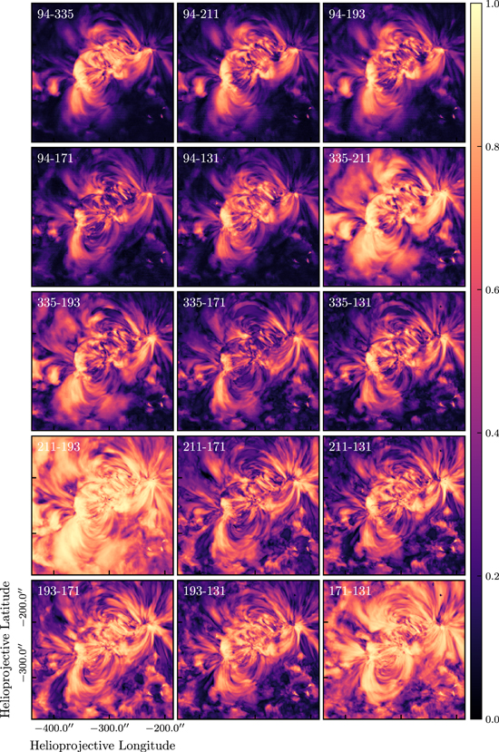
Max cross correlation values observed for each channel pair. Cross correlation values can get low as different dynamic behavior competes along LOS; they get very low (0.02 or lower) when the emission is steady and the variability is dominated by instrument noise.

Slide 12
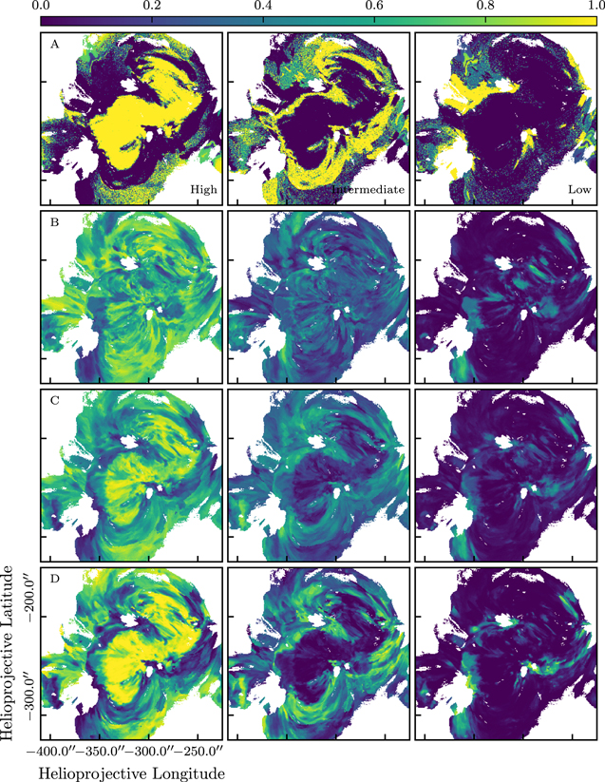
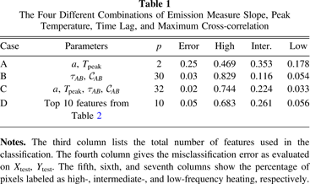
Figure 7. Classification probability for each pixel in the observed active region. The rows denote the different cases in Table 1 and the columns correspond to the different heating frequency classes. If any of the 32 features is masked in a particular pixel, the pixel is colored white. Note that summing over all heating probabilities in each row gives 1 in every pixel.

Slide 13
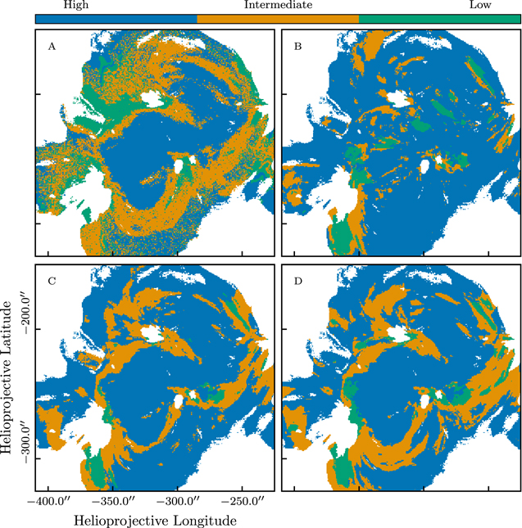
Figure 8. Predicted heating frequency classification in each pixel of NOAA 1158 for each of the cases in Table 1. The classification is determined by which heating frequency class has the highest mean probability over all trees in the random forest. Each pixel is colored blue, orange, or green depending on whether the most likely heating frequency is high, intermediate, or low, respectively. If any of the 32 features is masked in a particular pixel, the pixel is colored white.

Slide 14
Conclusions
1. The distribution of observed emission measure slopes overlaps with the distributions of predicted emission measure slopes for high-, intermediate-, and low-frequency heating, suggesting a range of heating frequencies across the active region.
2. High-frequency heating dominates in the center of active region and is coincident with loops whose footpoints are rooted in strong magnetic field.
3. Intermediate-frequency heating is more likely in longer strands surrounding the center of the active region. In most pixels, low-frequency heating, as defined in Equation (1), is not needed to explain the observed diagnostics.
4. The emission measure slope is the strongest single-measure predictor of the heating frequency. Radiative cooling and draining around 1–2 MK as manifested in the maximum cross-correlation also appears to be a strong indicator relative to the time lags. However, the feature importance as determined by the classifier should be interpreted carefully.

