Slide 1
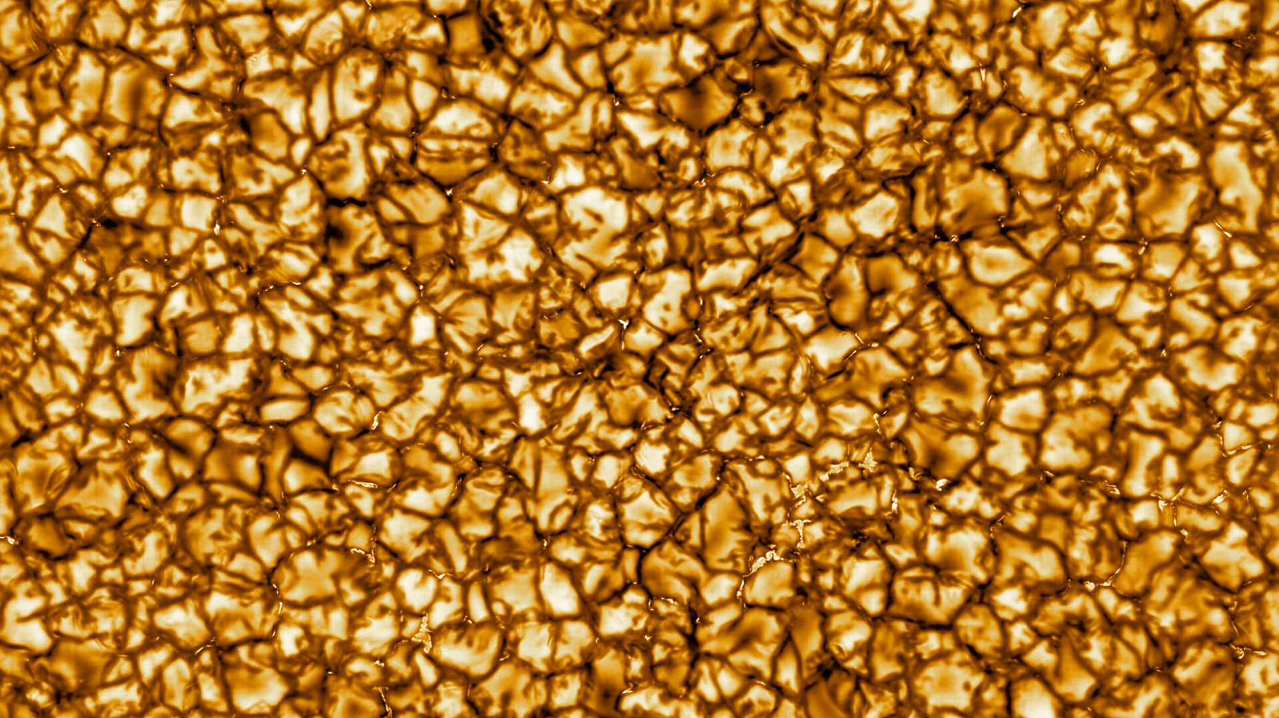
Tracking bright points with shape-resolved observations
Sam Van Kooten
& Steve Cranmer
SwRI, CU Boulder
Aug 23, 2023
Image: DKIST first light (NSO/AURA/NSF)

Slide 2
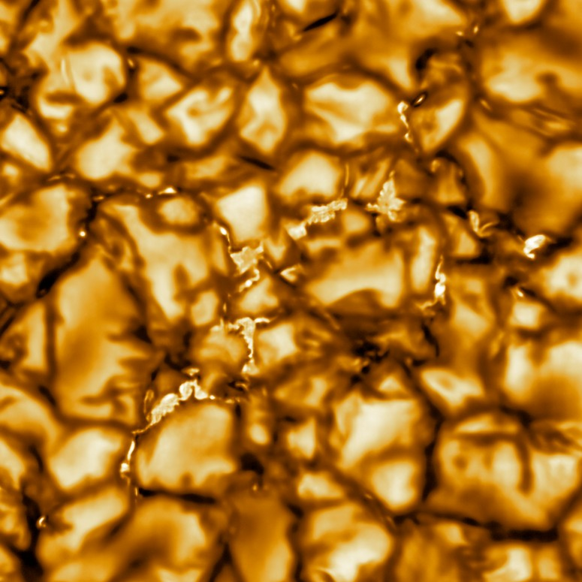
Photospheric Bright Points
~ 100 km across
Magnetic field: 1000 Gauss
~1000 × average solar field
~2000 × average Earth field
Bases of magnetic flux tubes
Or observational proxy for those bases
DKIST first light (NSO/AURA/NSF)

Slide 3
Photospheric Bright Points
~ 100 km across
Magnetic field: 1000 Gauss
~1000 × average solar field
~2000 × average Earth field
Bases of magnetic flux tubes
Or observational proxy for those bases

Slide 4
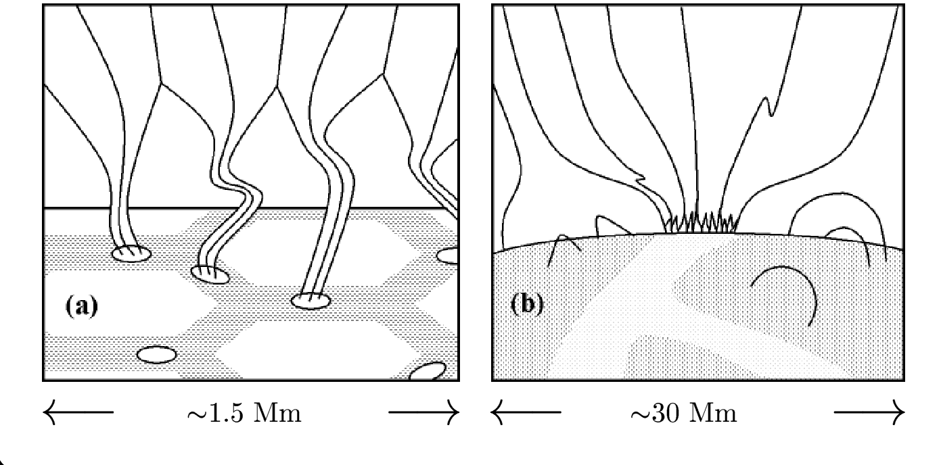
BPs are flux-tube footpoints
Flux tubes
Bright points
Cranmer & van Ballegooijen (2005)

Slide 5
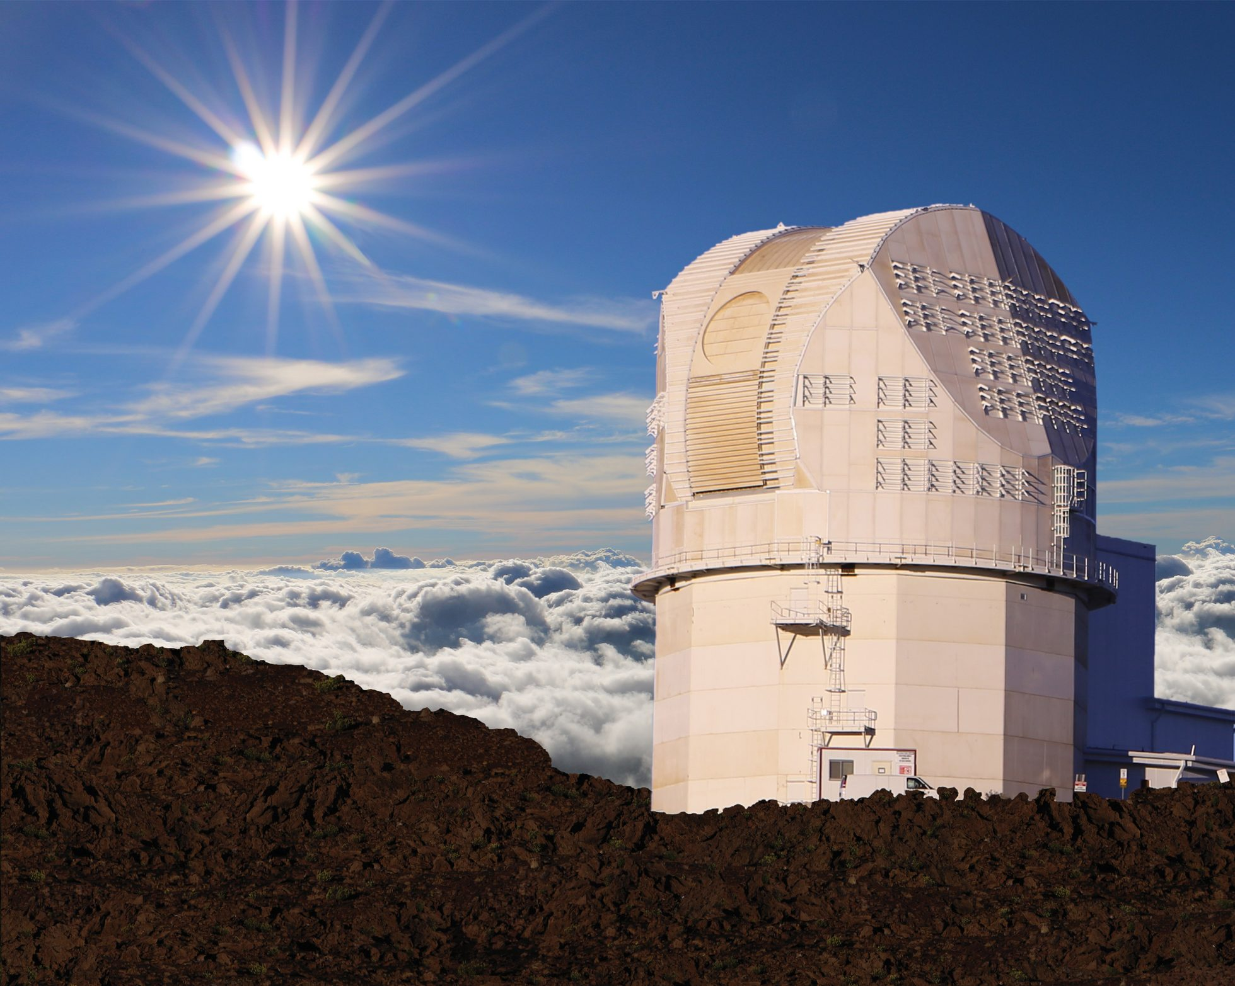
The Promise of DKIST

Slide 6
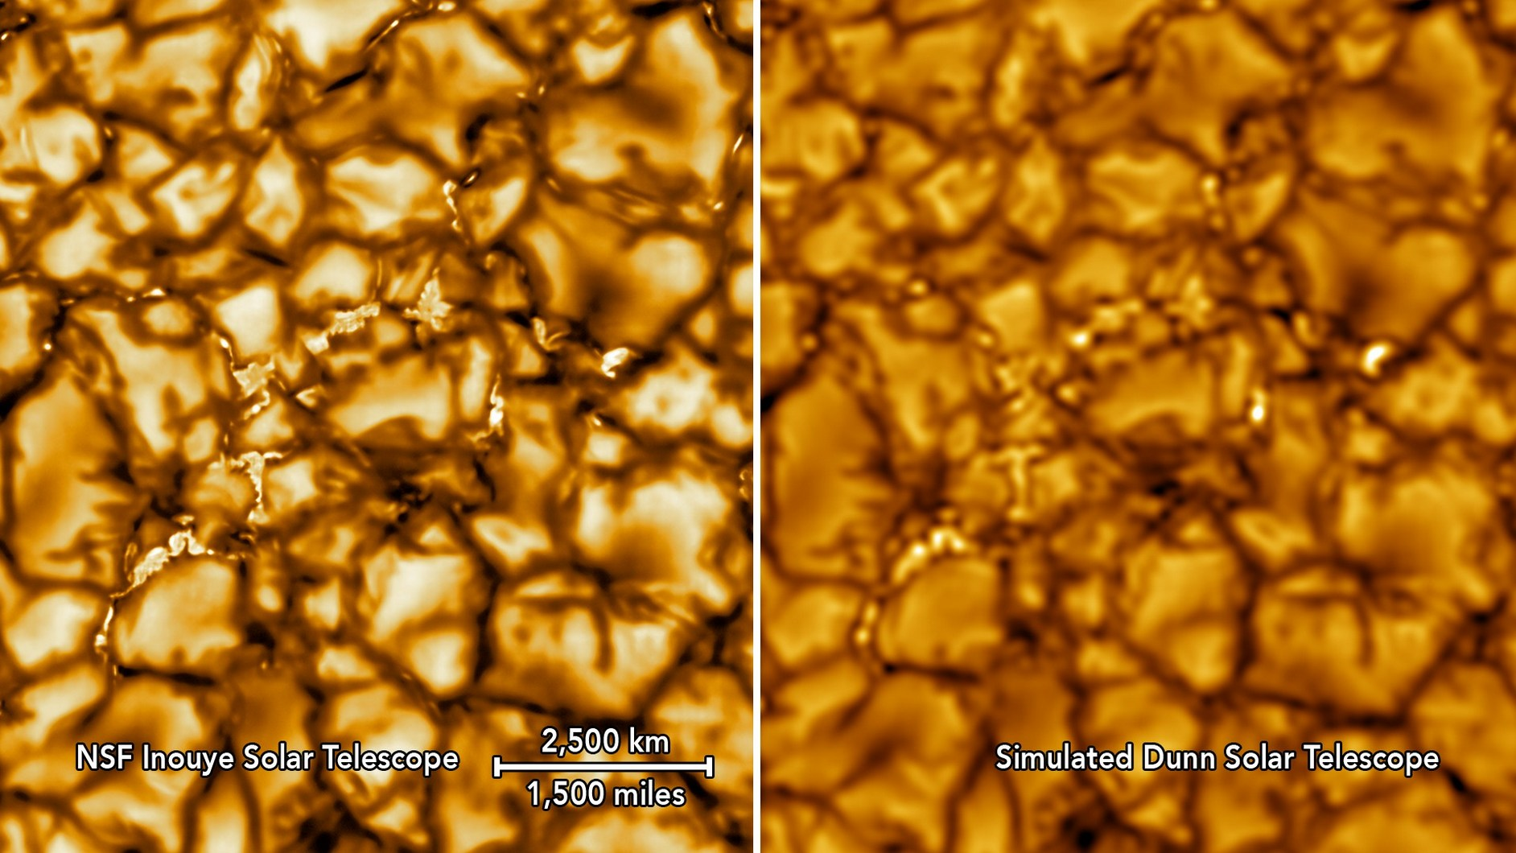
DKIST will resolve BPs
NSO/AURA/NSF

Slide 7
My work: bright points & waves
Goals:
Measure BP shape changes
Connect to wave driving
Connect to braiding/tangling models
Previous goal: Demonstrate & test on simulations
Next goal: Use data!
Image: DKIST first light (NSO/AURA/NSF)

Slide 8
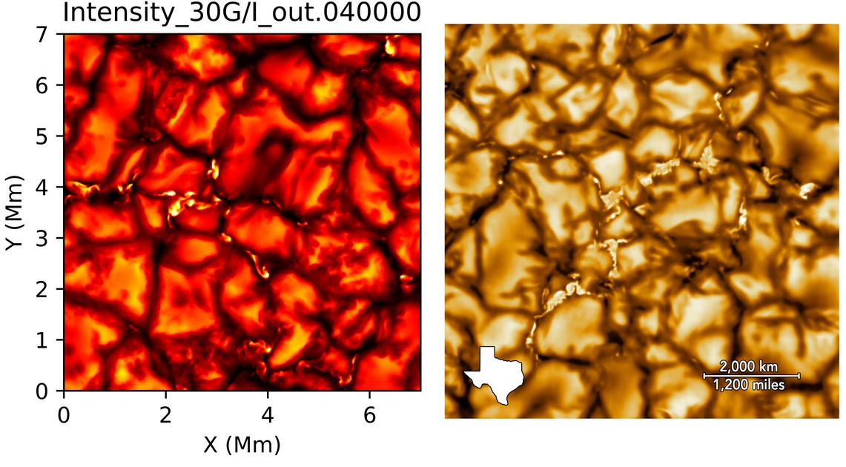
MURaM simulation as DKIST stand-in
From Matthias Rempel
16 km grid spacing (c.f. ~15 km DKIST resolution)
20 s and 2 s cadence
MURaM
DKIST first light

Slide 9
Automatic tracking of BPs
Intensity
Intensity
Vertical magnetic field

Slide 10
An appetizer: centroid tracking

Slide 11
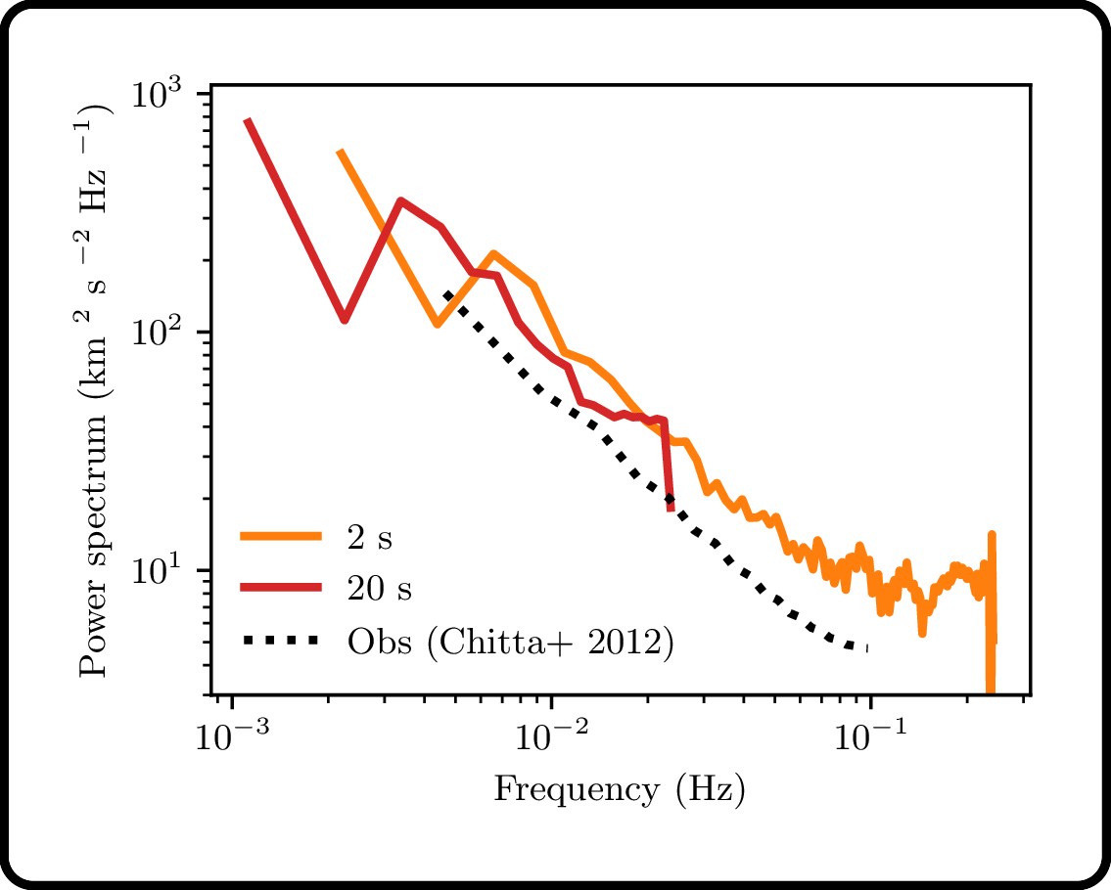
Higher resolution resolves more motion
Power spectrum of wave flux
Van Kooten & Cranmer (2017)

Slide 12
Bright-point shape changes
Plan:
Fit BP boundaries w/ sum of sinusoids
Depend only on shape outlines
Little information is available inside BPs
Image: DKIST first light (NSO/AURA/NSF)

Slide 13
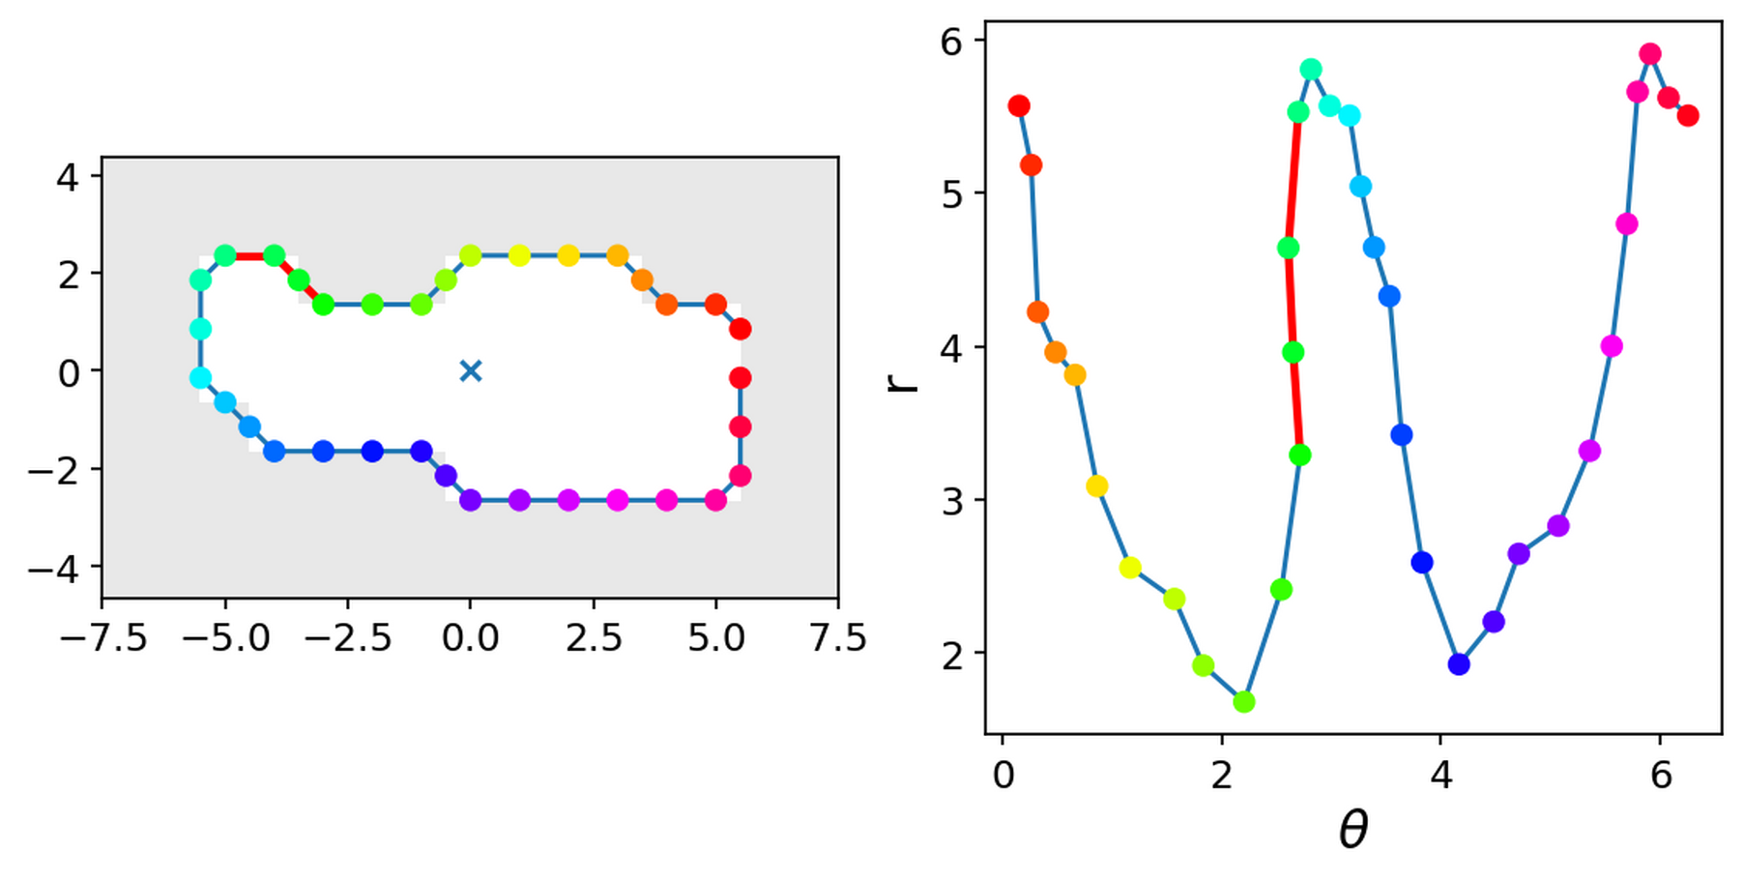
BP outlines “unrolled” into r–θ
Polar coords
Linear coords

Slide 14
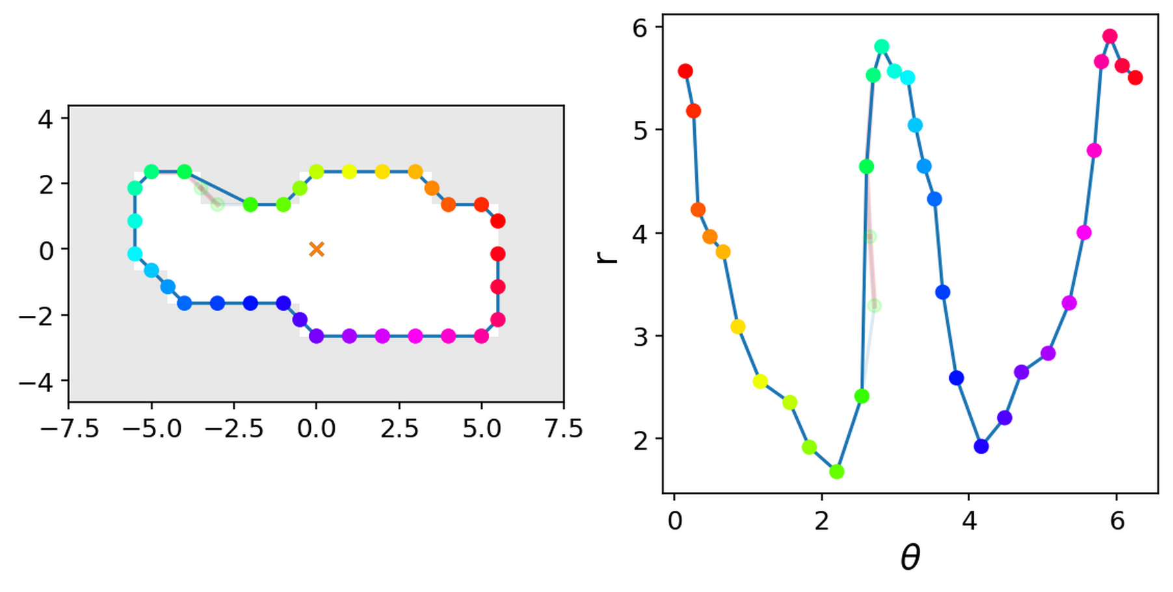
“Back-tracking” points adjusted
Polar coords
Linear coords

Slide 15
Outlines are fit w/ sum of sinusoids
$r_{fit}\left(θ\right)=r_{0}+\sum_{n}{r_{n}}cos\left(nθ+ψ_{n}\right)$

Slide 16
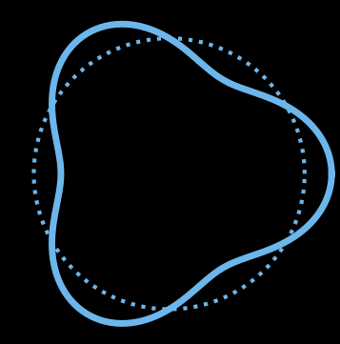
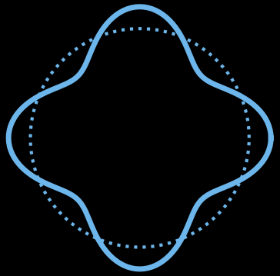
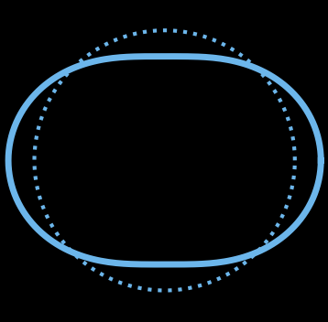
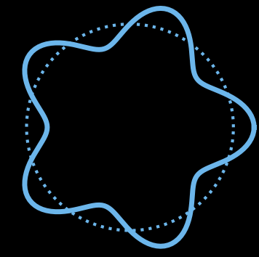
n>2 modes drop off rapidly
n=0
n=3
n=1
n=4
n=2
n=5

Slide 17
Sum of n≠1 is significant!
n=0
n=3
Sum of n≠1
n=1
n=4
n=2
n=5

Slide 18
Wrap-up
Image: DKIST first light (NSO/AURA/NSF)

Slide 19
Importance of resolution
MURaM res
~Pre-DKIST obs res (100 km)

Slide 20
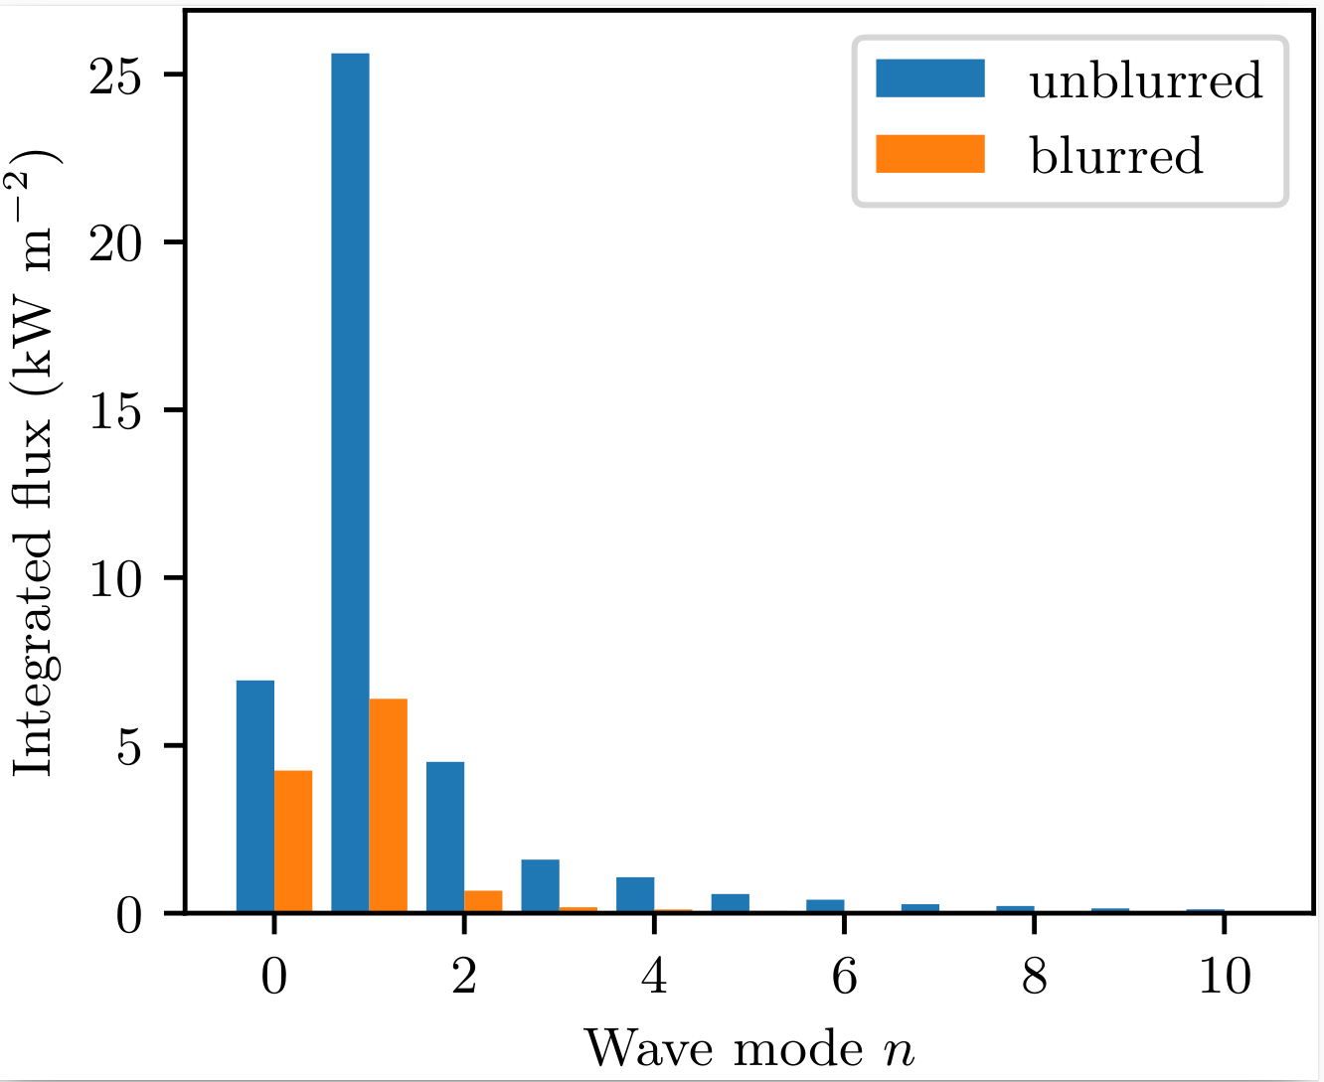
Pre-DKIST resolution significantly reduces fluxes

Slide 21
Tracking bright points versus flux elements
i.e. white light or magnetograms
MURaM data practicality—currently no LOS magnetograms
With DKIST instruments, magnetograms still require small trade-offs in resolution, FOV, or cadence

Slide 22
BP tracking with DKIST
It works!

Slide 23
Next steps
Use DKIST data!
n≠1 wave propagation & dissipation should be modeled
Further investigate FE–BP comparison
Are there other places to apply this tracking?
Field line braiding!

Slide 24
Summary
Laid initial groundwork for wave-driving analysis of resolved bright points
Preliminary results suggest it will be a fruitful line of inquiry (50% increase in energy budget for wave/turbulence!)
I want to extend my tracking to twisting/tangling models as well!
Image: DKIST first light (NSO/AURA/NSF)

