Slide 1
Statistical modeling
of multi-stranded coronal loops
V. Uritsky

Slide 2
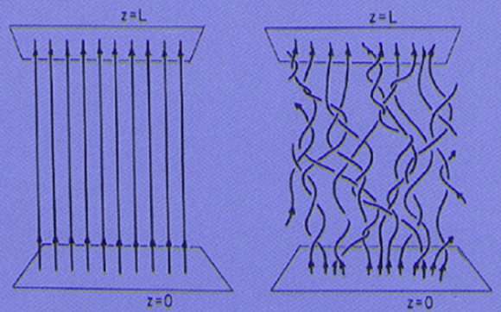
Parker, 1972

Slide 3
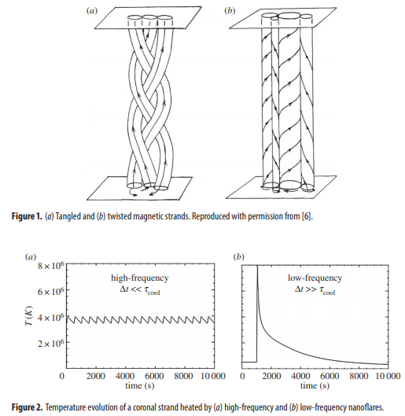
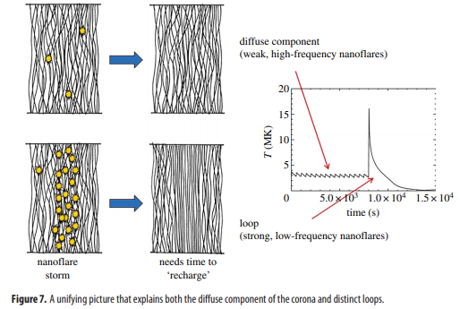
J. Klimchuk, Phil Trans A 2015

Slide 4
???

Slide 5
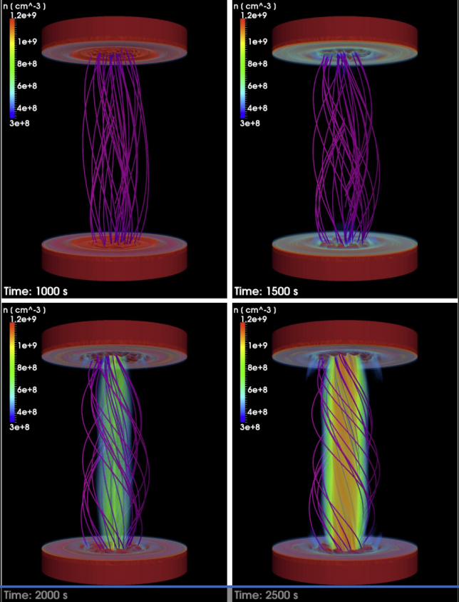
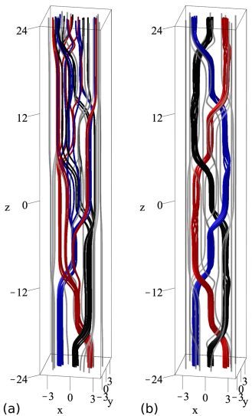
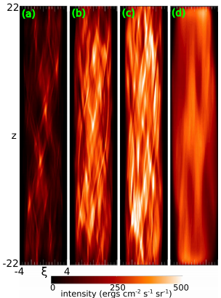
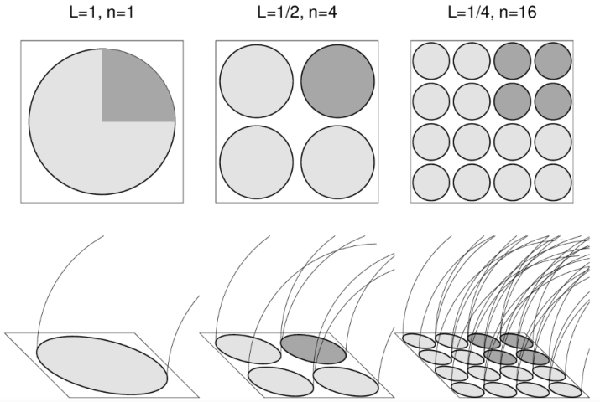
Pontin et al., ApJ 2017
Reale et al., ApJ 2016
Aschwanden & Peter, ApJ 2017

Slide 6
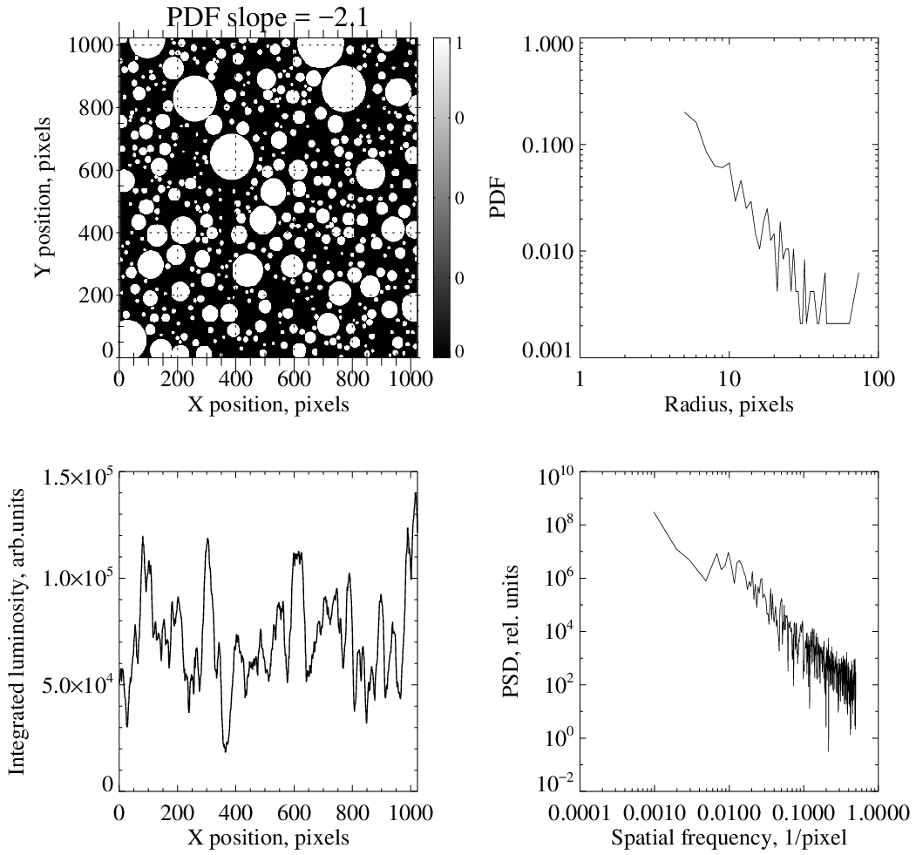

Slide 7
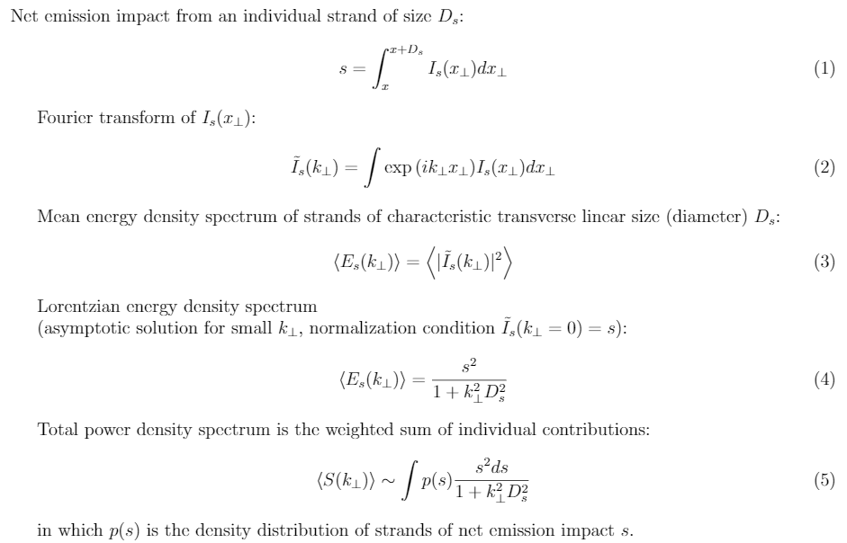
(Based on: Jensen at al., Phys Rev B 1989; Kertesz & Kiss, J Phys A 1990; Manna et al., J Stat Phys 1990)

Slide 8
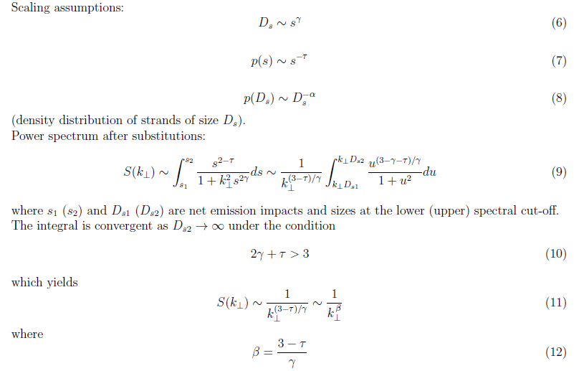

Slide 10
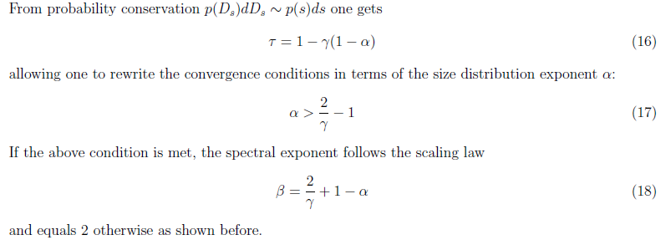

Slide 11
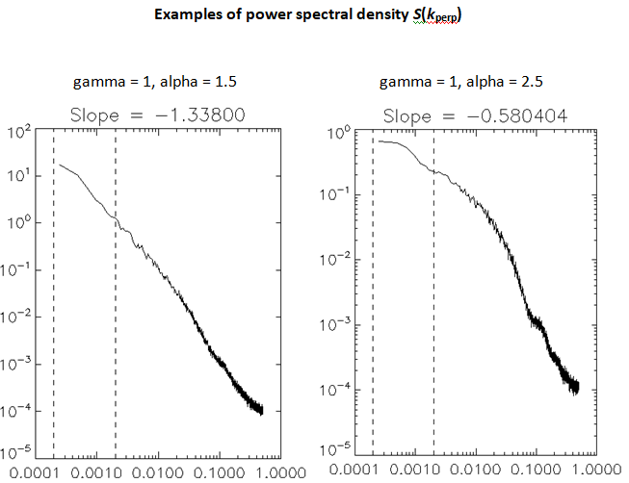
Np = 100*10000LL ; number of strands
T_range = [10.0,5000.0] ; min and max strand size
Nt = 100*4096LL + 2*T_range[1] ; length of resulting 1D array

Slide 12
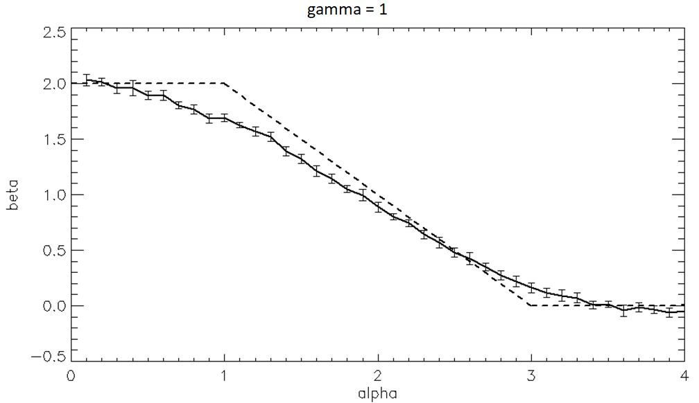

Slide 13
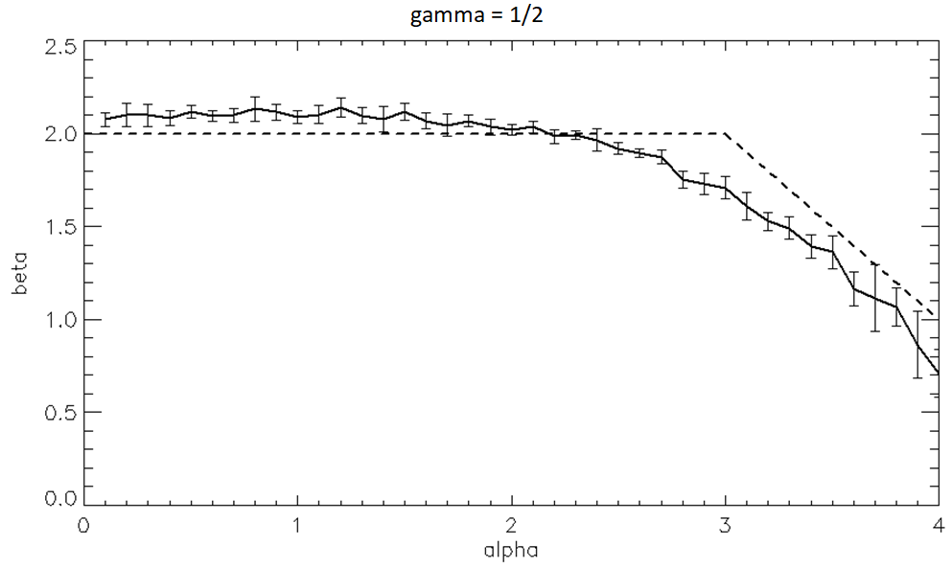

Slide 14
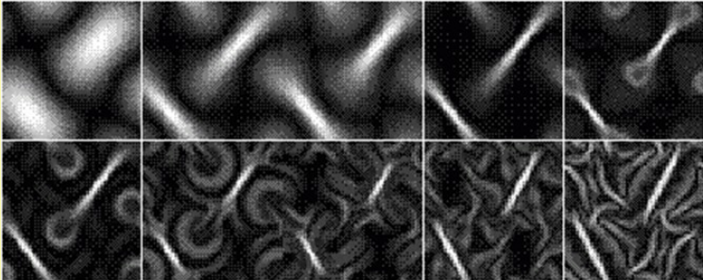
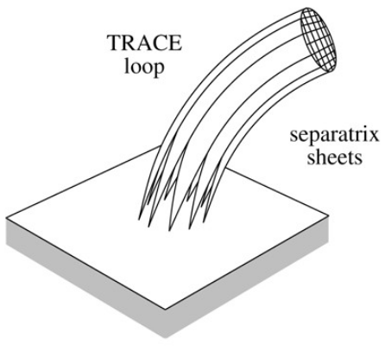
Glasgaard: braiding -> current sheets glow -> turbulent reconnection
d = 2, n_{e} ~ const
For 1D cuts D ~ s
→ gamma = 1 ?
(from E. Priest’s talk)

