Slide 1
Scale-invariance and scale-dependence in impulsive coronal loop heating
V Uritsky, K Knizhnik & J Klimchuk

Slide 2
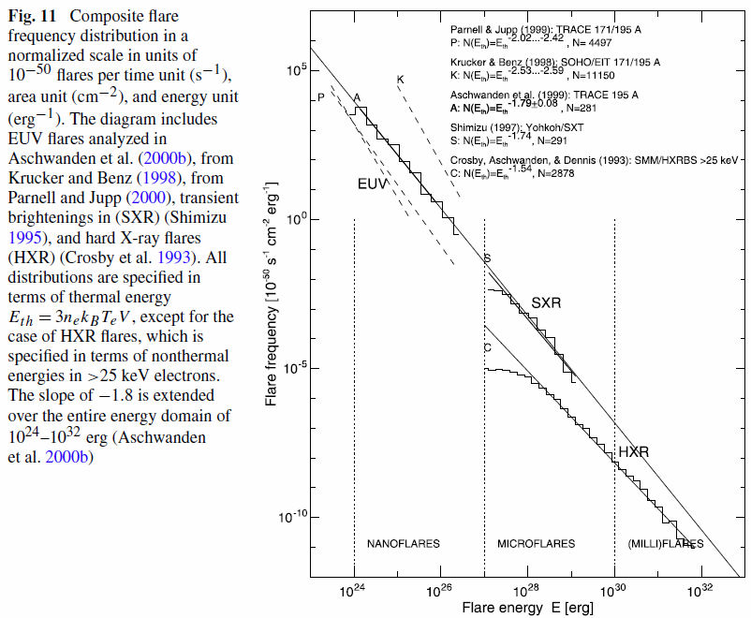
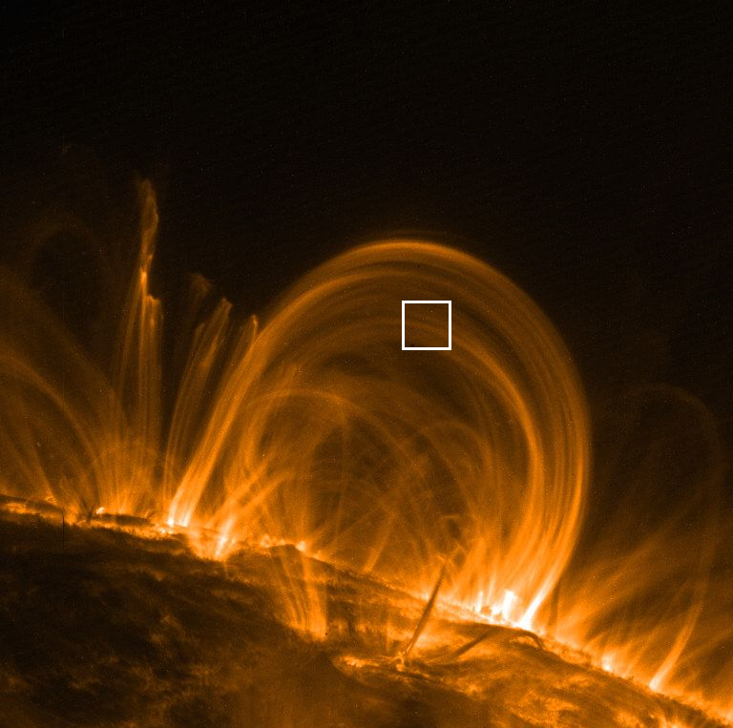

Scale-invariance vs scale-dependence in solar corona
Aschwanden at al., 2016

Slide 3
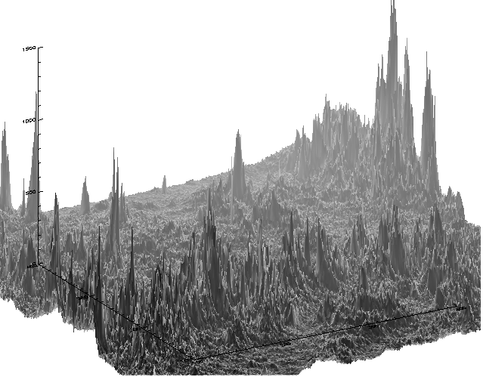
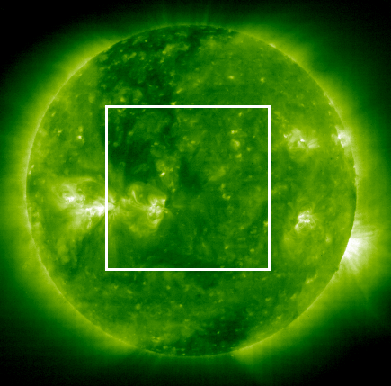
Multiscale intermittency in the solar corona
SOHO EIT, 195 A
Uritsky, V.M., M. Paczuski, D. Davila, and S. I. Jones, PRL, 99(2), Art. No. 025001, 2007.

Slide 4
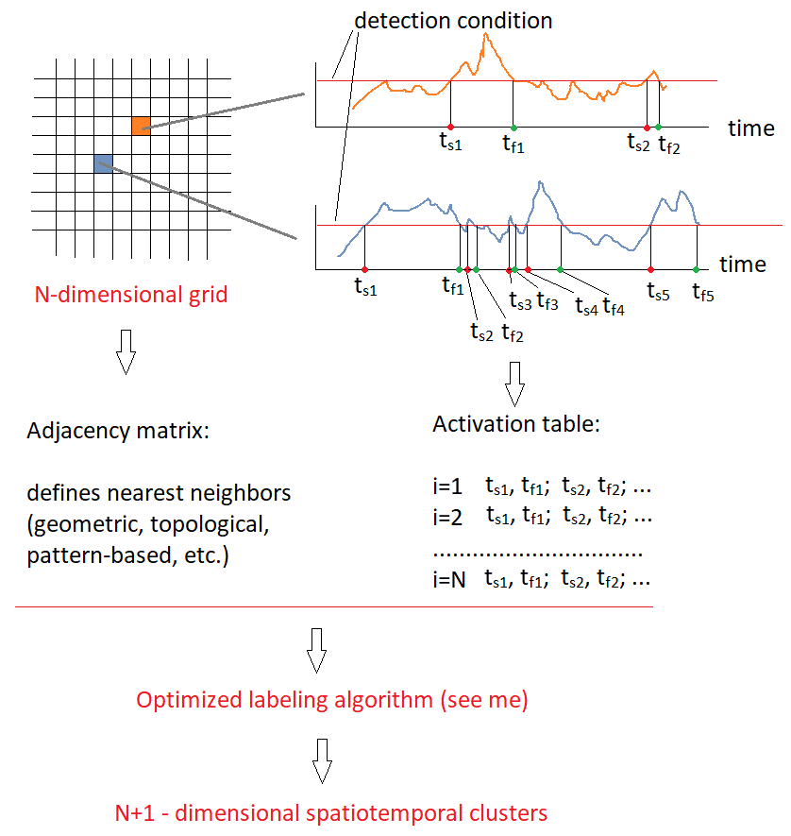
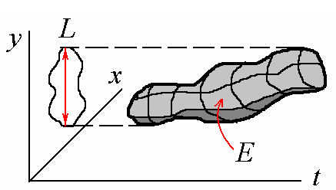
Detecting complex structures in data & simulations

Slide 5
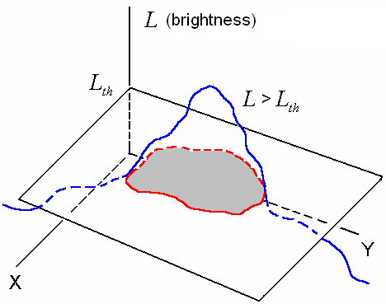
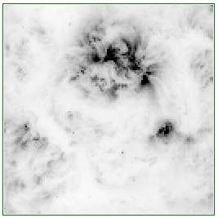
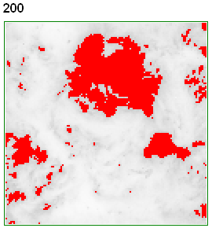
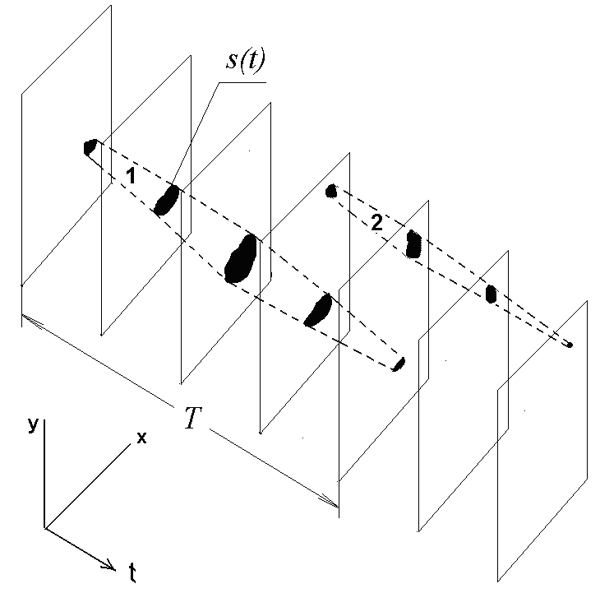
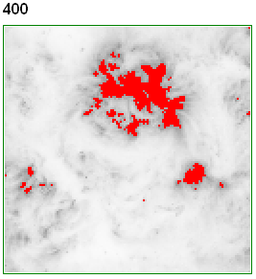
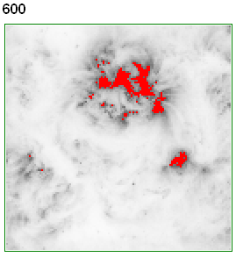
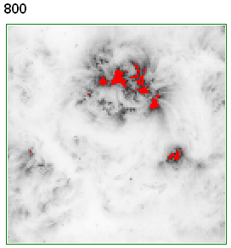
Spatiotemporal tracking of multiple active regions in SOHO EIT images (195 A)
A view of active regions’ geometry
at different activity thresholds

Slide 6
Probability distributions of coronal active regions over integrated luminosity
τ_{E} = 1.73

Slide 7
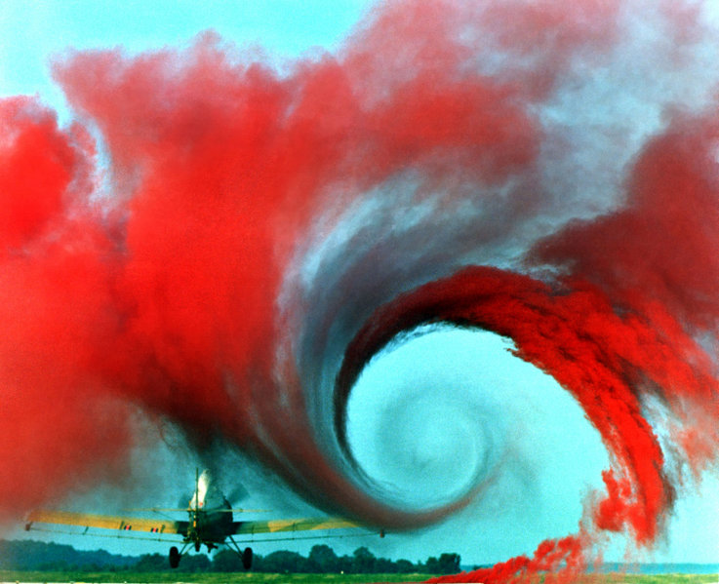
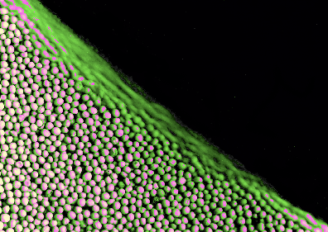
Two paradigms for understanding multiscale complexity
Turbulence
Complexity emerges as a result of fluid instabilities which typically propagate from large to small (dissipative) scales.
The intermediate (inertial) range exhibits
scale-free correlations in space and in time
Self-organized criticality
Complexity results from cascades of discrete “toppling” events creating inverse cascades of energy transport called avalanches. The statistics of these events are scale-free, but the background can be uncorrelated.

Slide 8
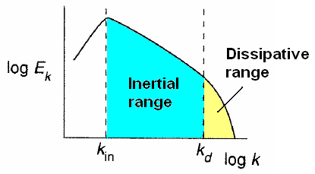
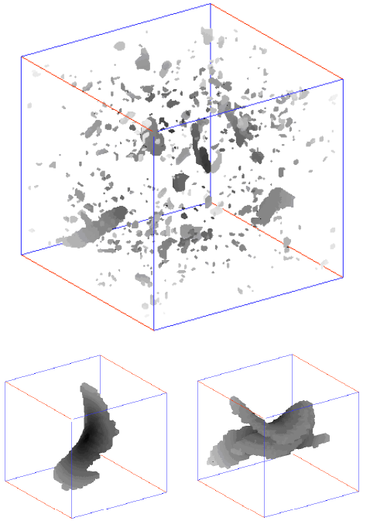
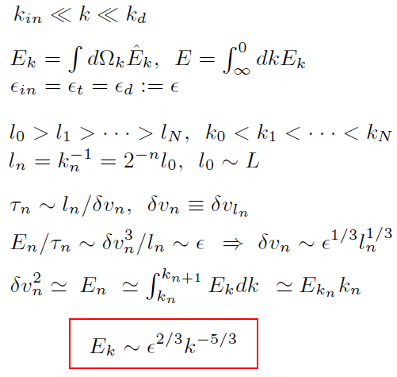
Phenomenology of the turbulent spectrum
HOMOGENEOUS FLUID CASCADE (Kolmogorov, 1941)
INTERMITTENCY
3D incompressible MHD
(Uritsky et al., PRE, 2010)

Slide 9
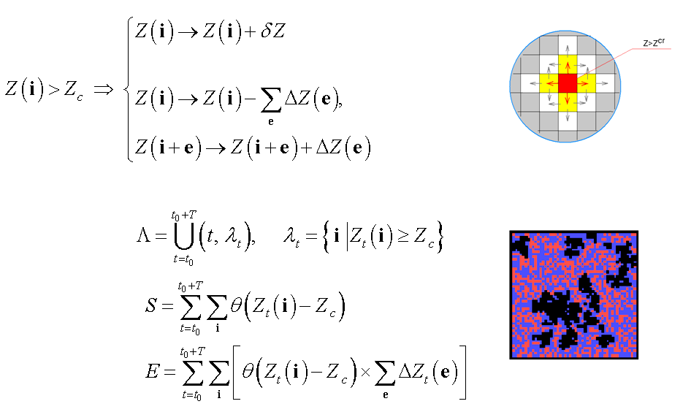
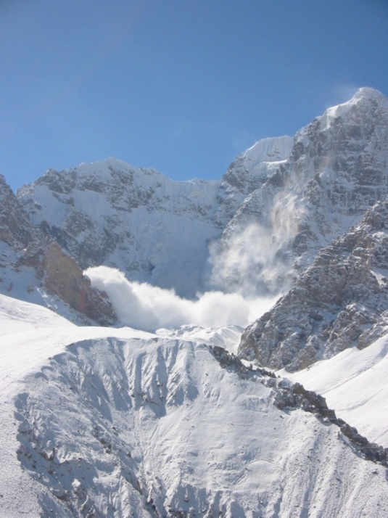
Scaling and avalanches in SOC models

Slide 10
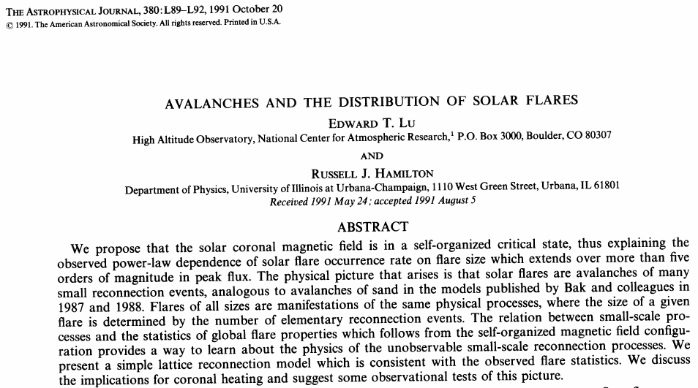
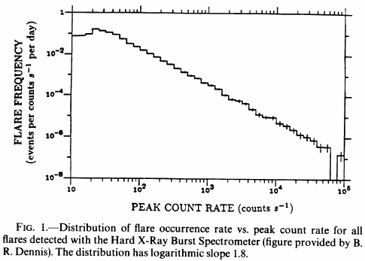
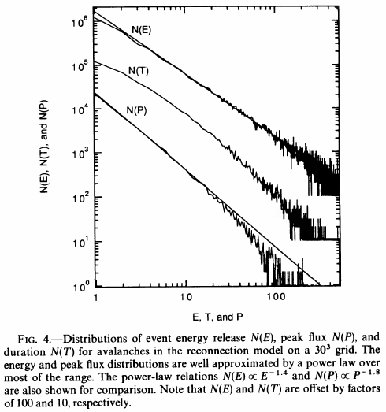
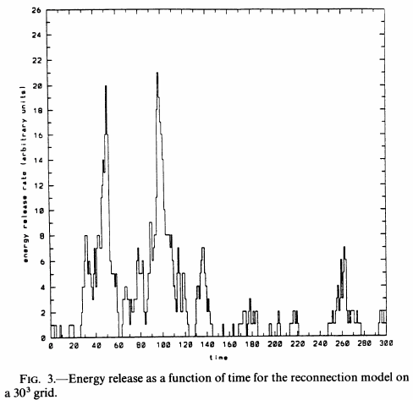
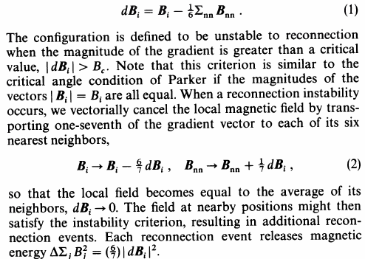

Slide 11
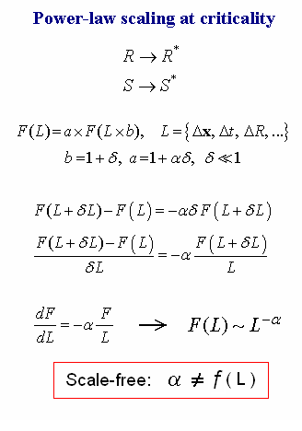
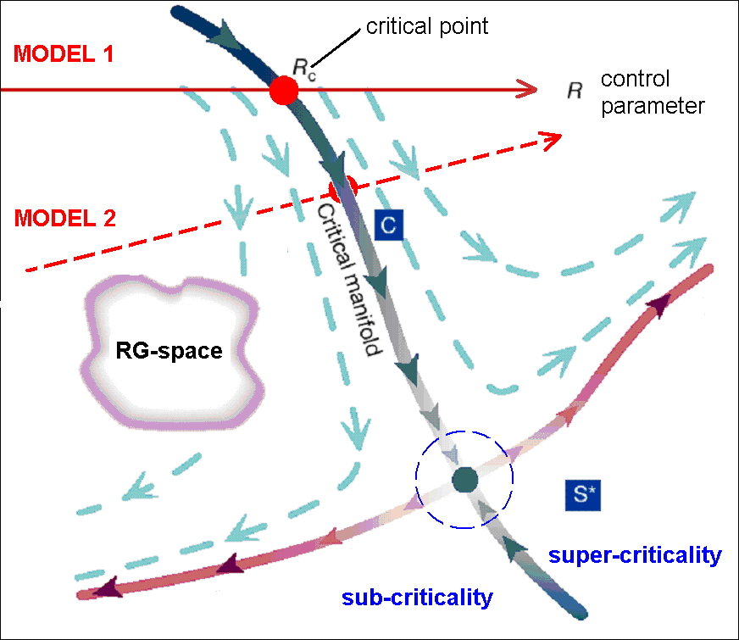
Criticality, renormalization group,
and the universality of multiscale complexity
Sethna et al., Nature 410, 242-250, 2001

Slide 12
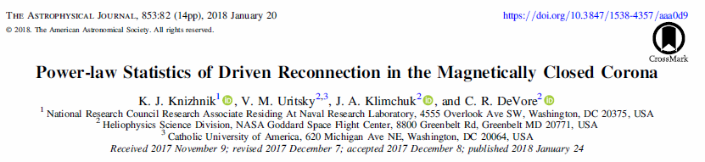
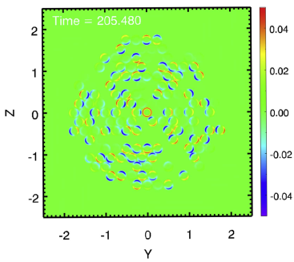
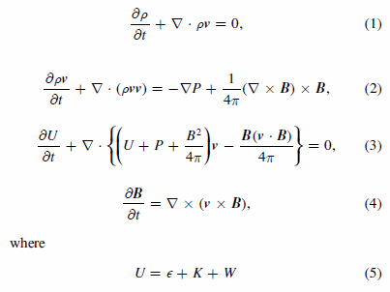
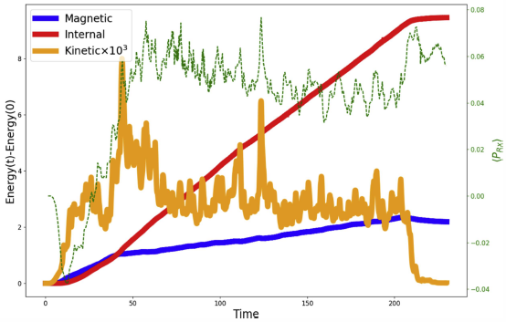

Slide 13
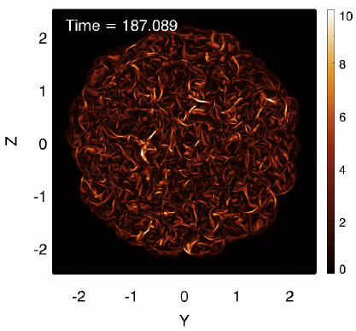
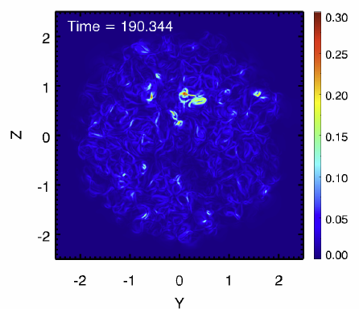
Knizhnik et al., Power-law Statistics of Driven Reconnection in the Magnetically Closed Corona,
ApJ 2018
Current density in the midplane
Poynting flux in the midplane

Slide 14
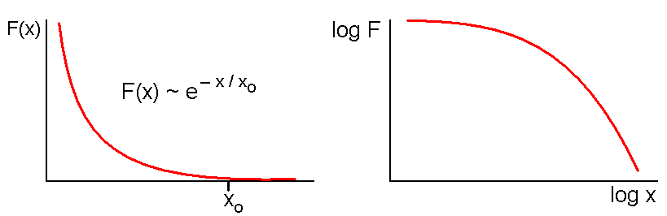
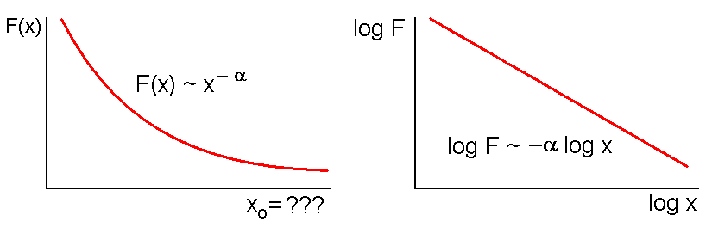
Exponential versus power-law (scale-free) scaling

Slide 15
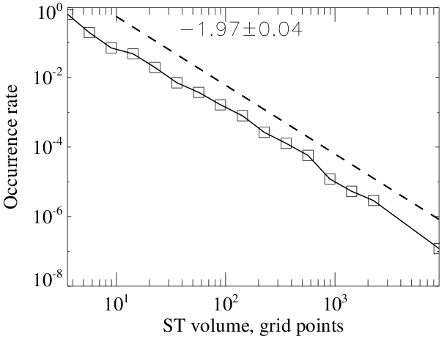
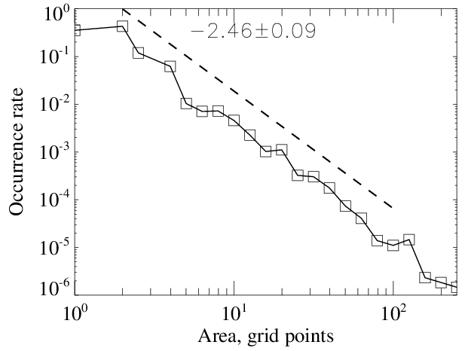
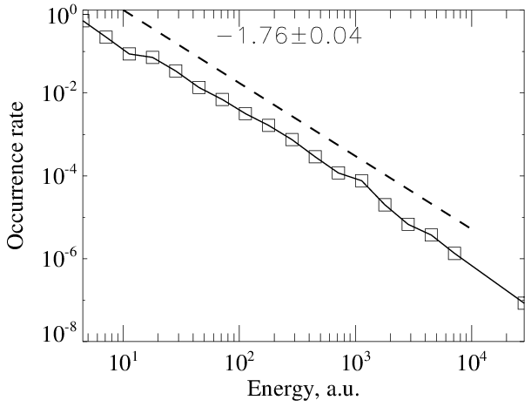
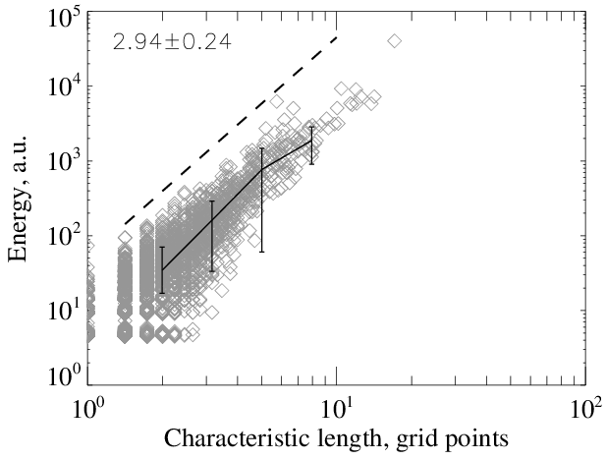

Slide 16
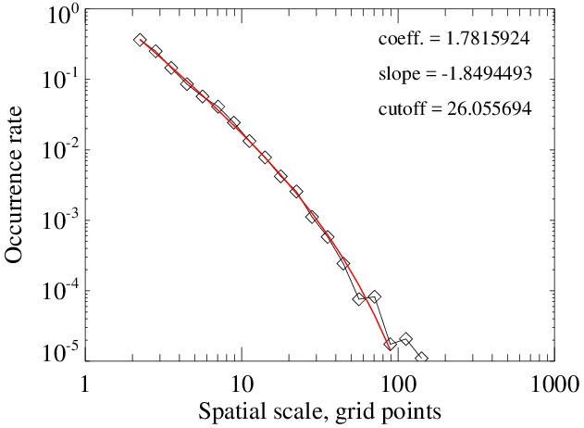

Slide 17
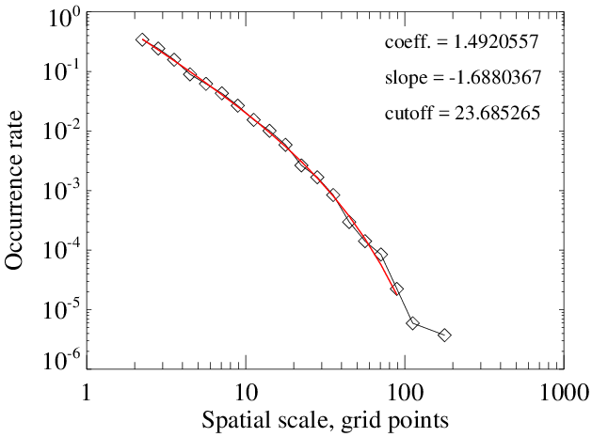

Slide 18
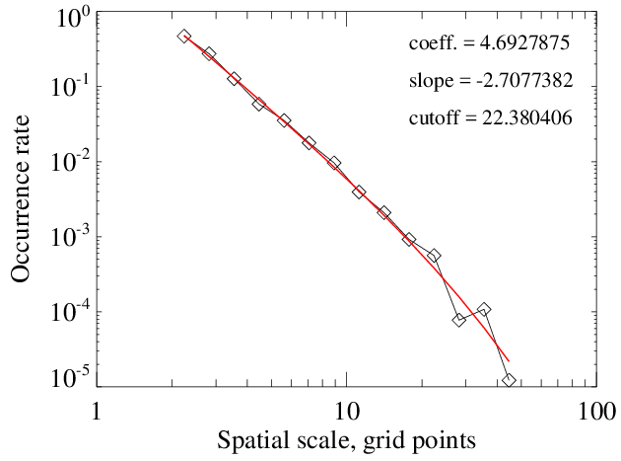
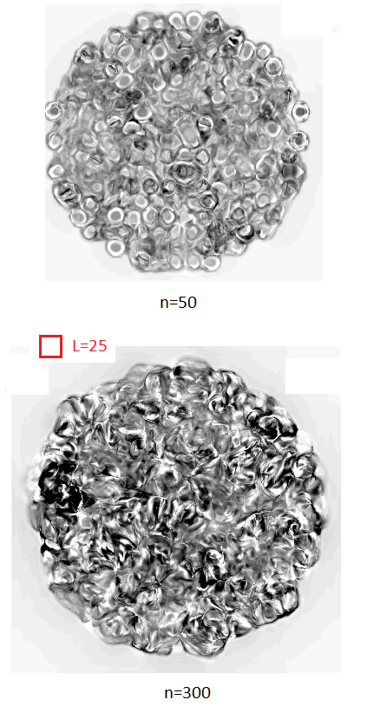

Slide 19
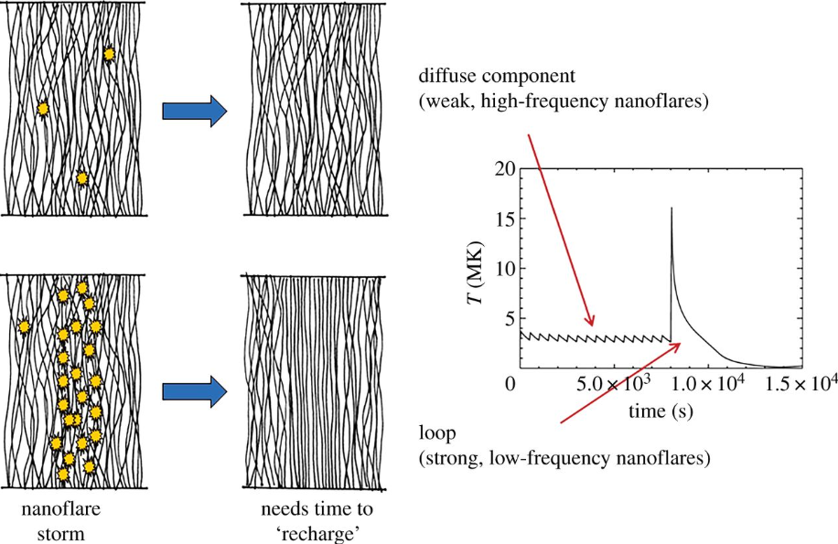
J Klimchuk, 2015

