Slide 1
Detecting current sheets in turbulent reconnecting plasmas
V Uritsky

Slide 2
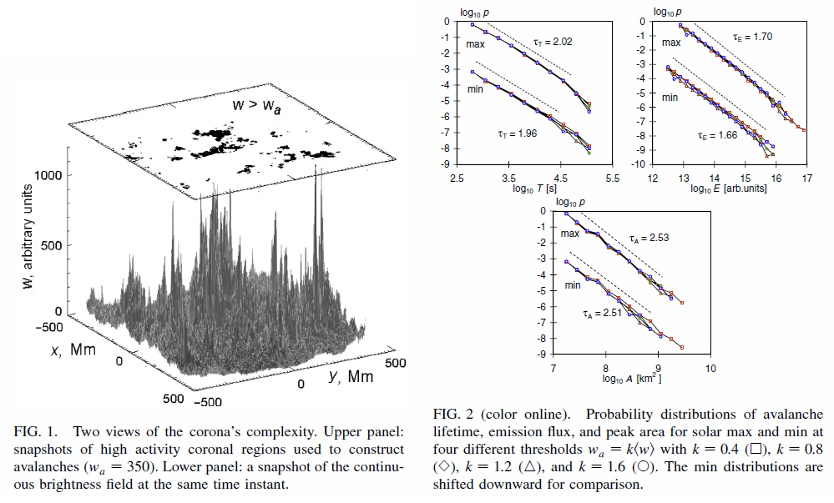
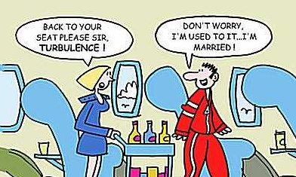
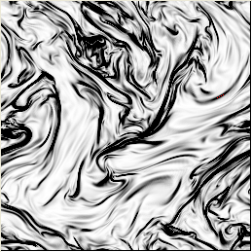
Turbulence: why should we care ?
Uritsky et at, PRL 2007
Uritsky et at, PRE 2010

Slide 3
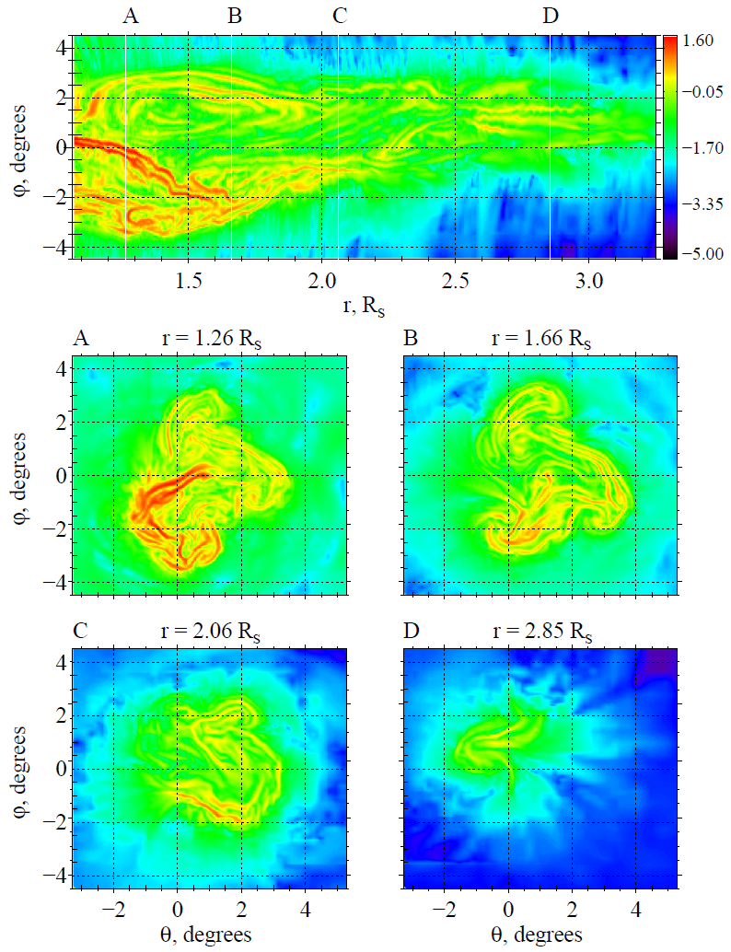
Multiscale current sheets formed by coronal hole jets (Uritsky et al, ApJ 2017)
Radial and transverse cross-sections of the logarithmic current density magnitude revealing multiple
complex-shaped current sheets of various sizes.

Slide 4
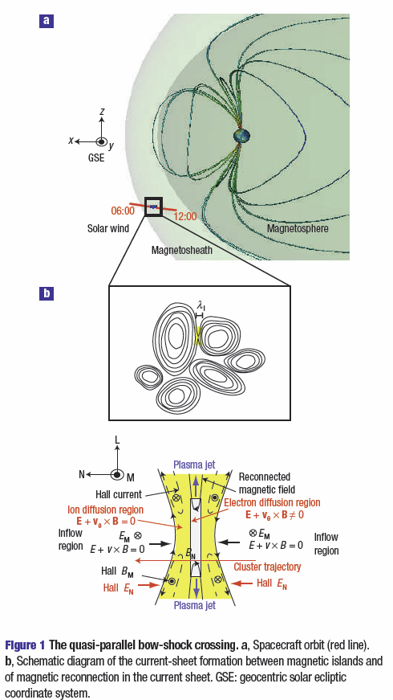
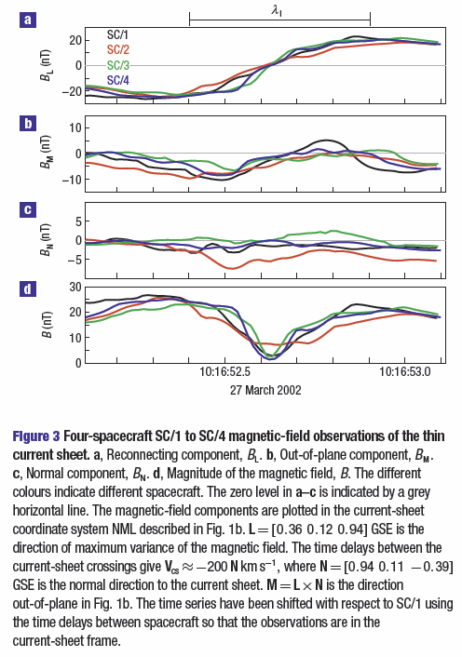
A. Retino et al, In situ evidence of magnetic reconnection
in turbulent plasma, Nature Physics 2007

Slide 5
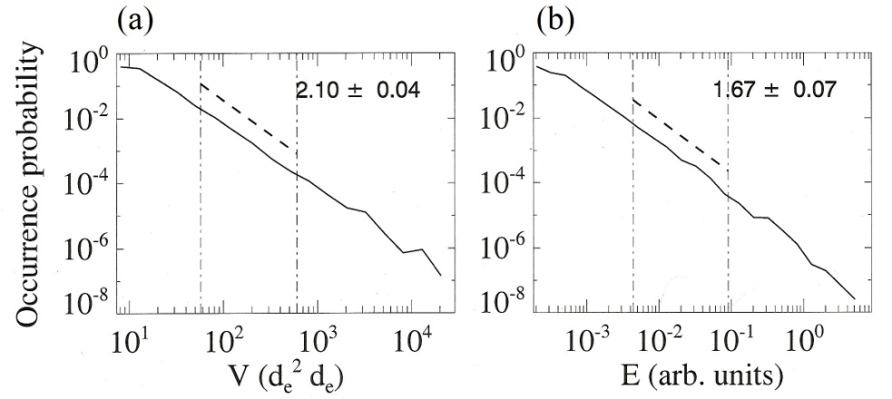
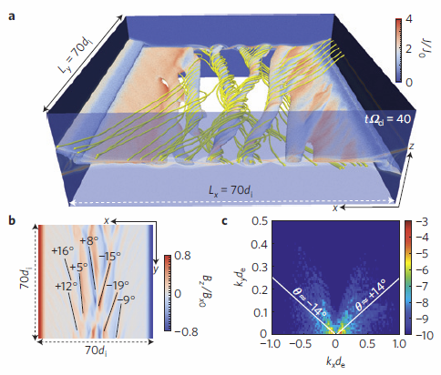
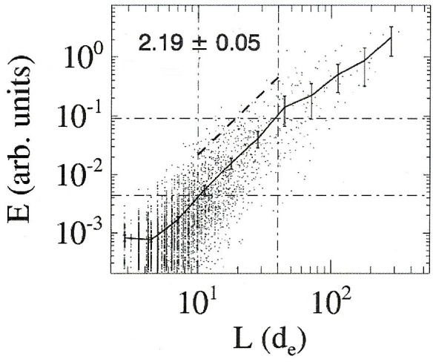
W. Daughton et al, Role of electron physics in the development of turbulent magnetic reconnection in
collisionless plasmas, Nature Physics 2011
Probability distributions of the reconnection-controlled dissipative structures over volume (a) and dissipation rate (b). The power-law slopes of the distributions are computed for the range of linear spatial scales 10 d_{e} < L<40 below the ion skin depth.
Scatterplot showing the dependence of the volume-integrated energy dissipation rate versus the linear size of the cluster in the studied simulation run. The power-law slope is given for the same range of L scales as in the previous Figure.

Slide 6
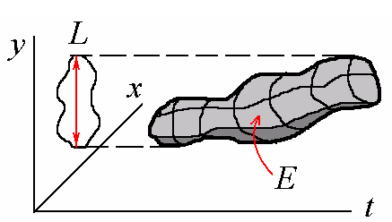
Detecting complex structures in data & simulations

Slide 7
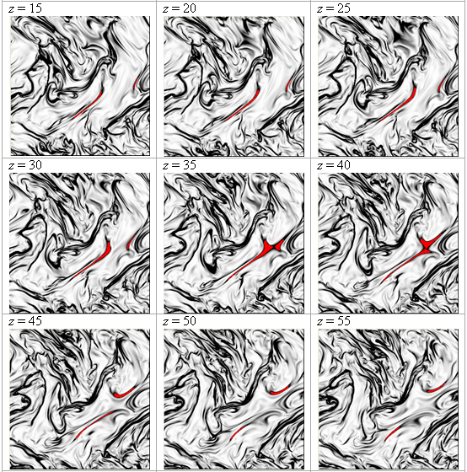
Cross-sections of 3D turbulent J² field with a detected complex CS (Uritsky et ., PRE 2010)

Slide 8
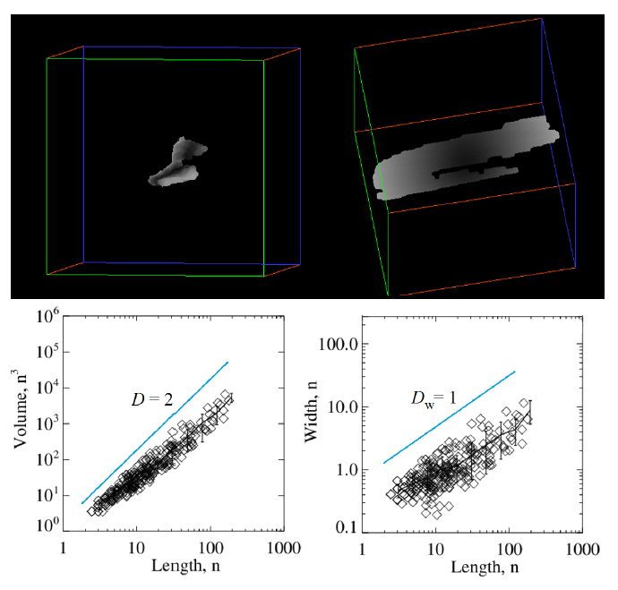
Confirming the 2D geometry of the dissipative structures
Top: one of the 3560 current sheets identified using cluster detection algorithm using an altitude-adjusted threshold set at 2 standard deviations above the local mean current density. Bottom: Scatterplots showing the dependence of current sheet volume and width on the linear size.

Slide 9
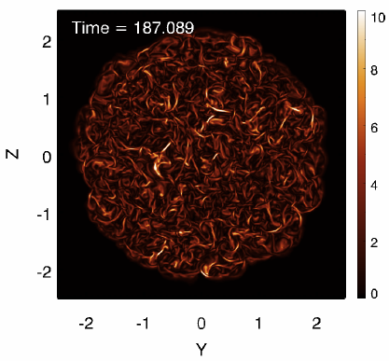
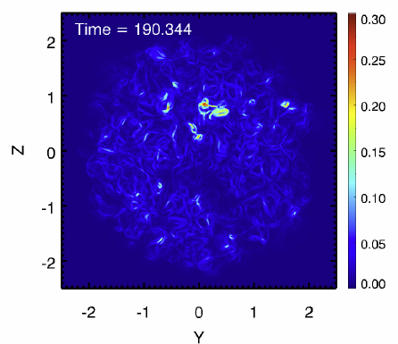
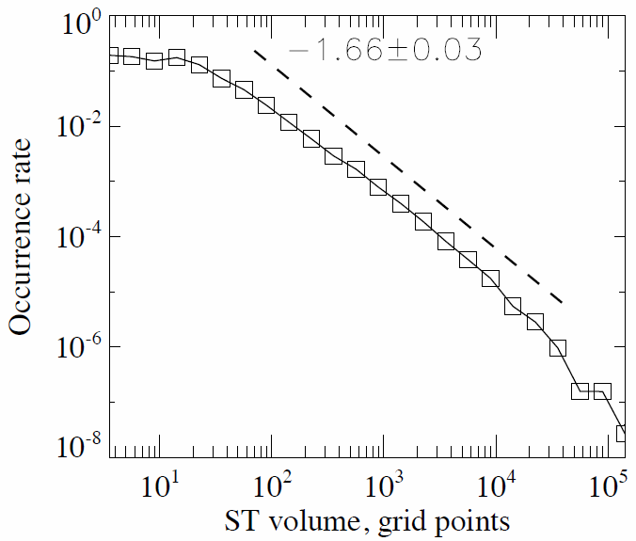
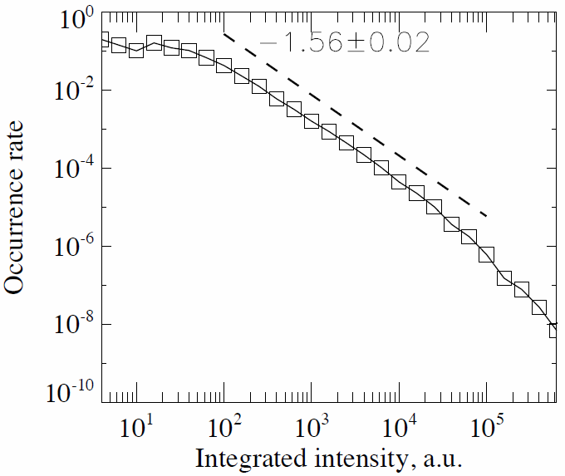
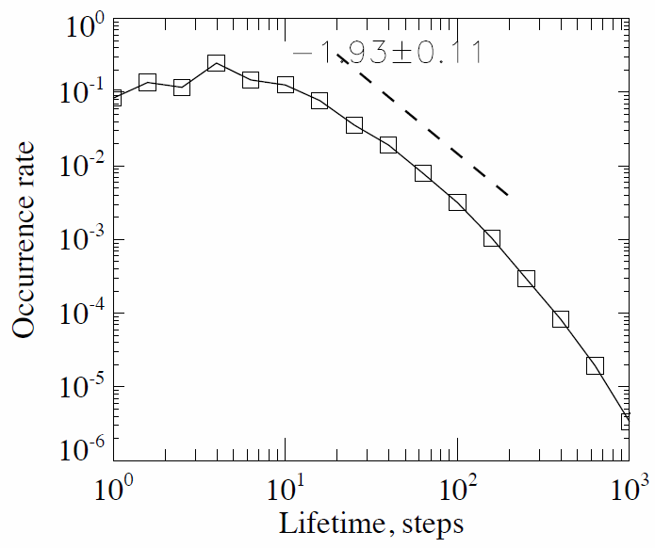
Knizhnik et al., Power-law Statistics of Driven Reconnection in the Magnetically Closed Corona, ApJ 2018
Current density in the midplane
Poynting flux in the midplane

