Slide 1
Reconstructing the cross-sectional geometry of a thin closed corona
V. Uritsky

Slide 2
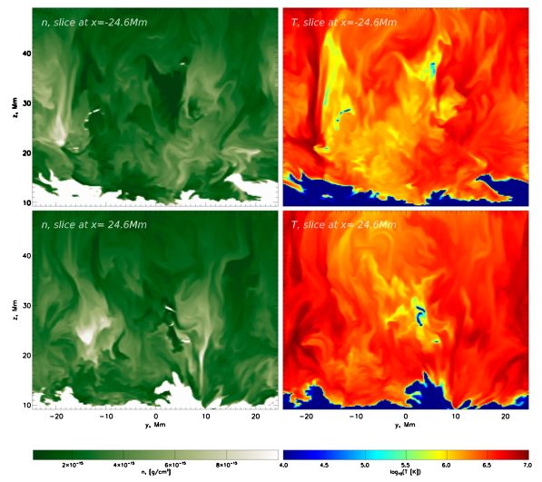
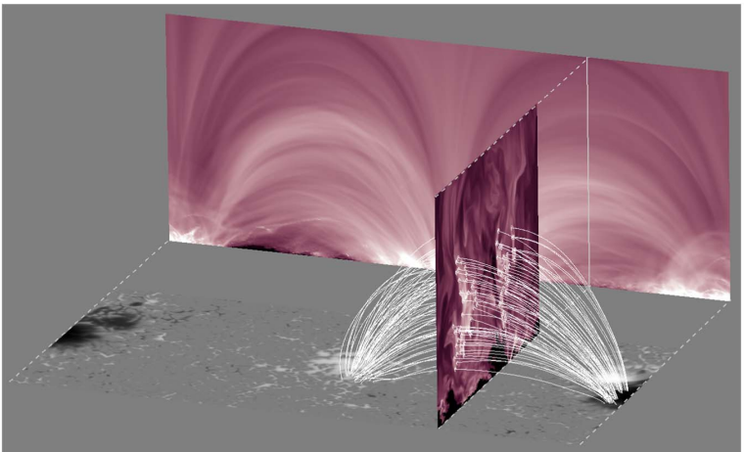
Malanushenko et al., ApJ 2022
MURaM MHD code (Vogler et al, 2005)

Slide 3
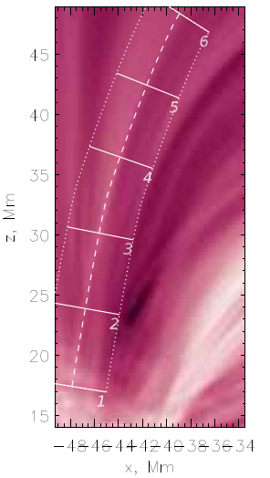
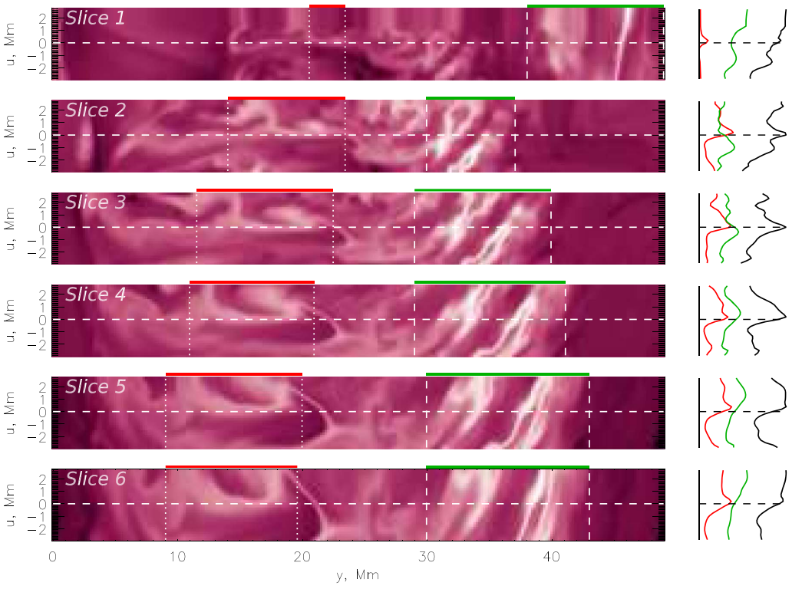
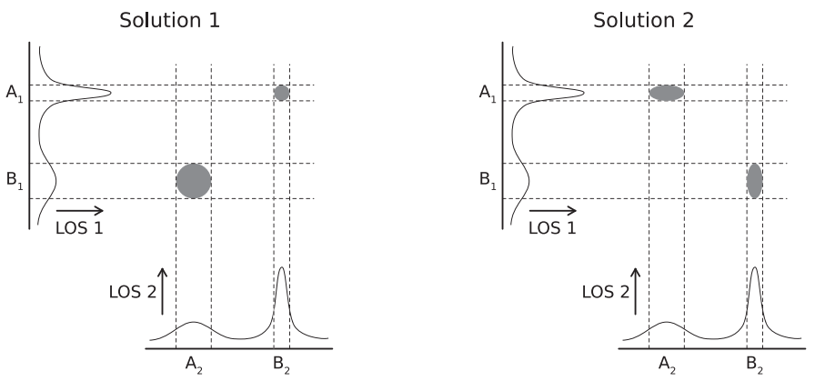
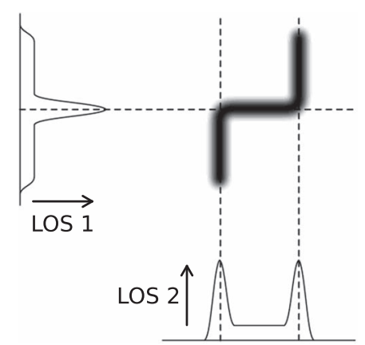
Malanushenko et al., ApJ 2022

Slide 4
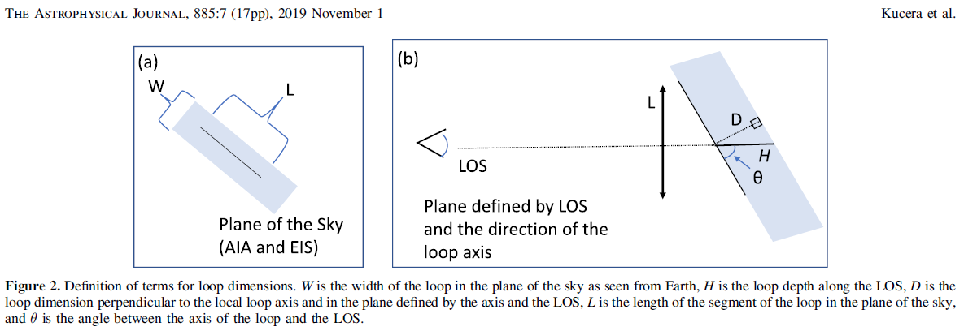
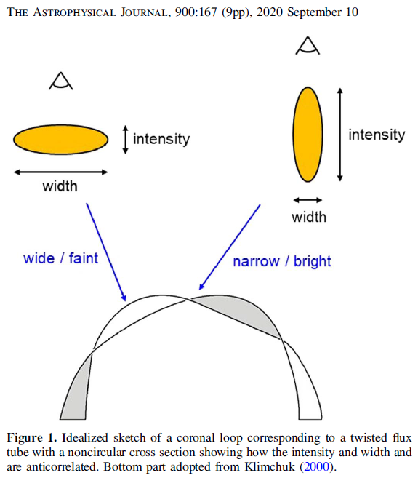
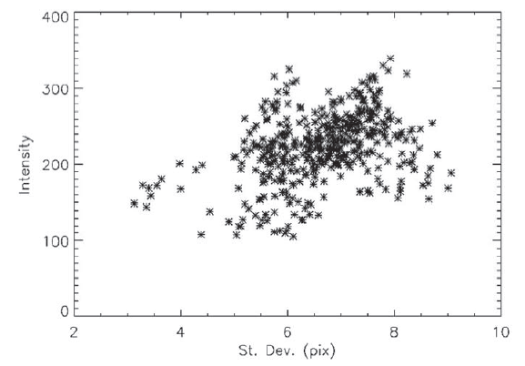

Slide 5
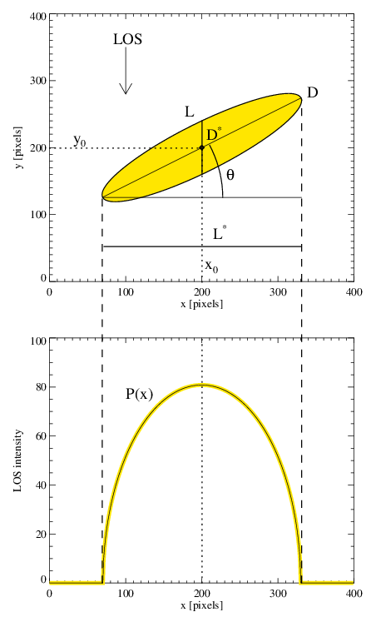
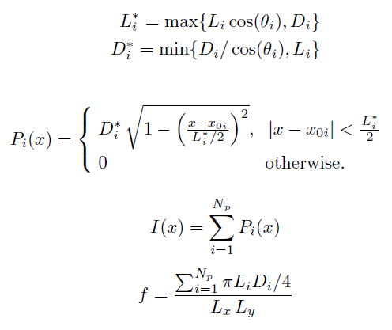
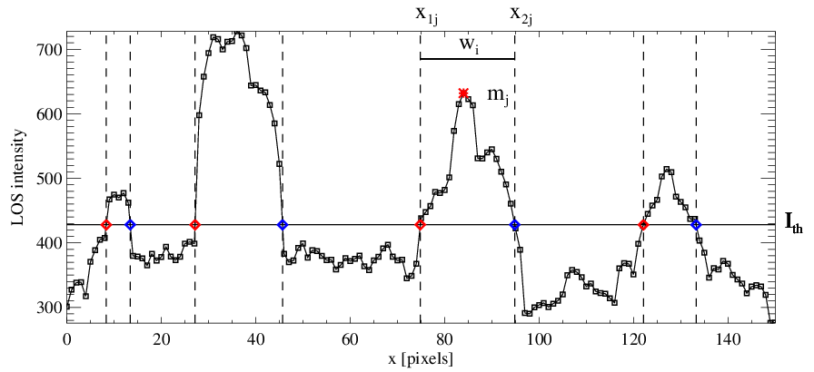
The Stochastic Pulse Superposition (SPS) model

Slide 6
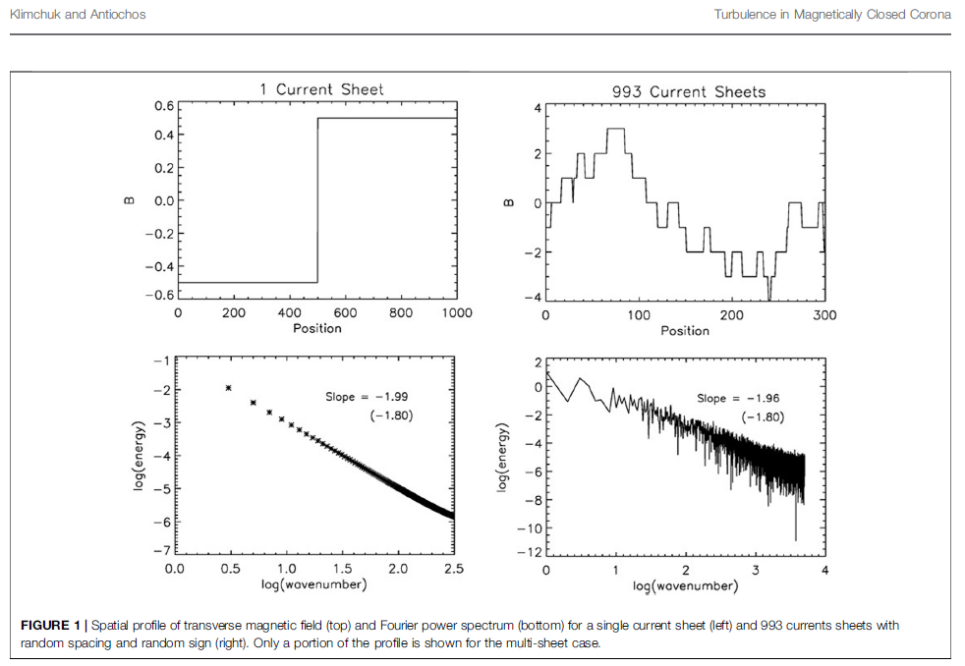
Spectral analysis alone is ambiguious

Slide 7
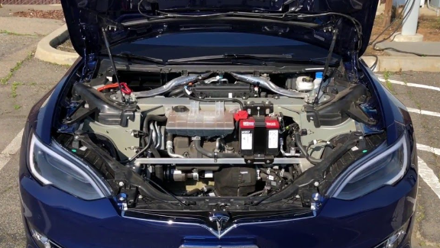
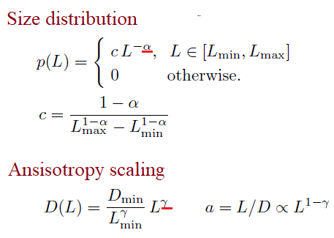
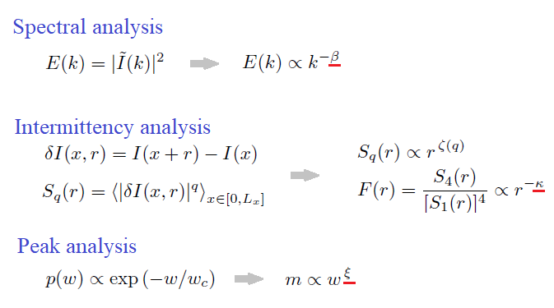
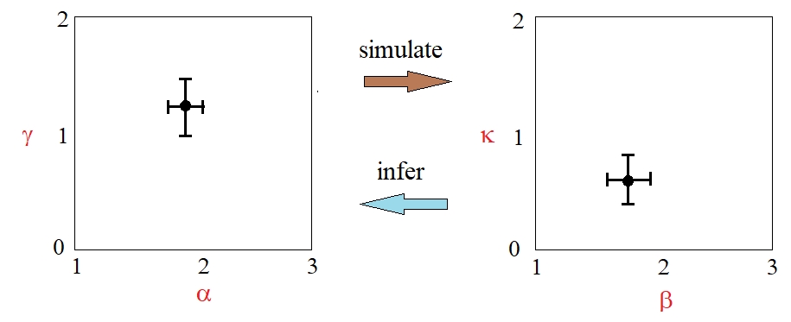
SPS control parameters and diagnostics
“Under the hood” “The dashboard”

Slide 8
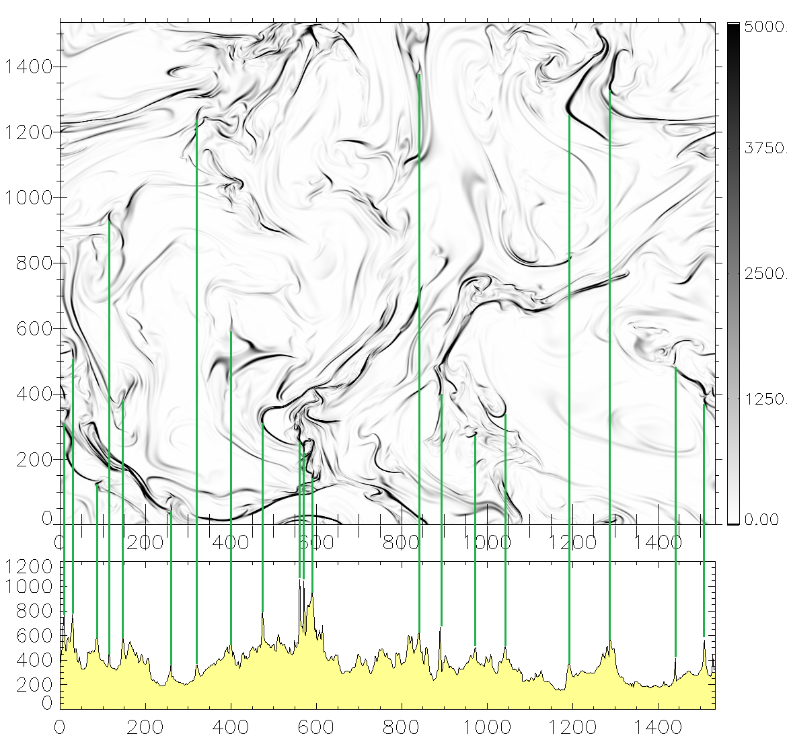
Auxiliary model: 3D incompressible MHD turbulence

Slide 9
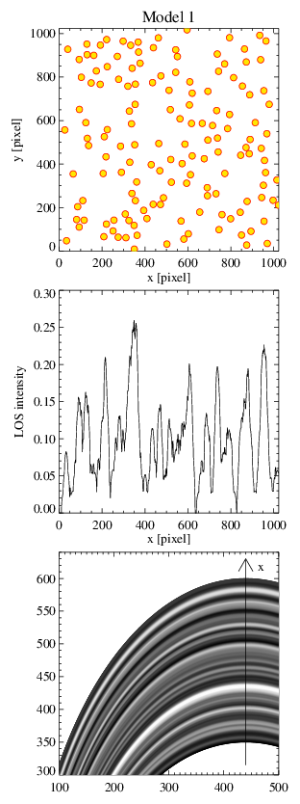
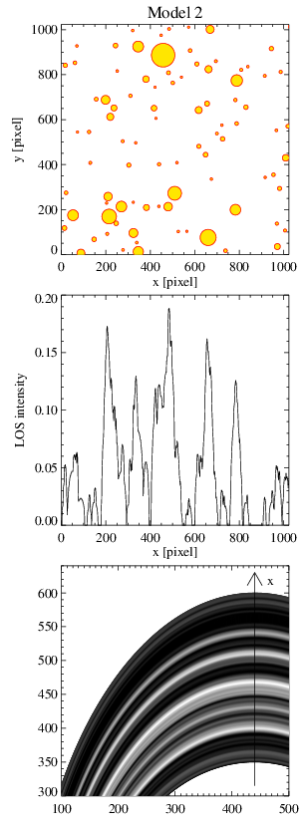
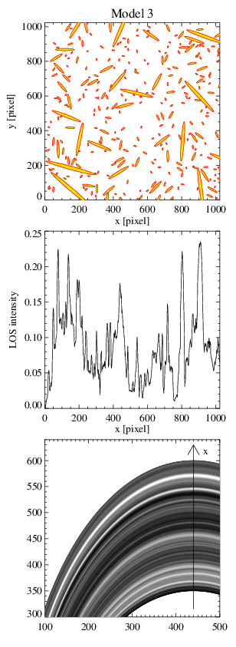
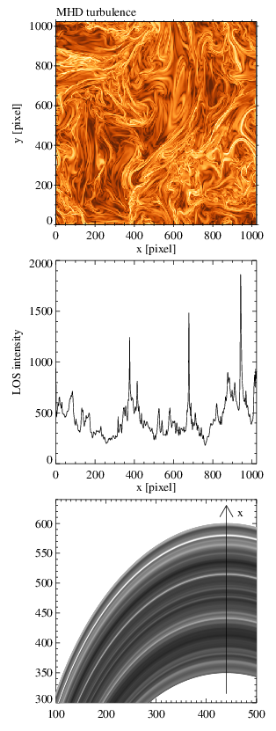
Four paradigmatic models compared

Slide 10
Statistical diagnostics

Slide 11
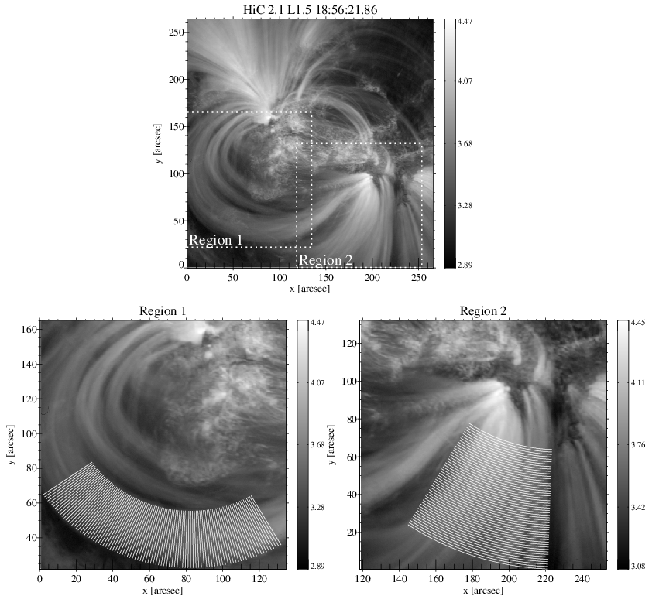
HiC 2.1 images (36 frames, 100 (50) slits for R1 (R2))

Slide 12
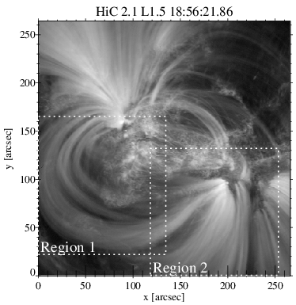
HiC statistics

Slide 13
HiC loops vs models: Model 1 and MHD turbulence ruled out

Slide 14
HiC loops vs models: Models 2 and 3 confirmed

Slide 15
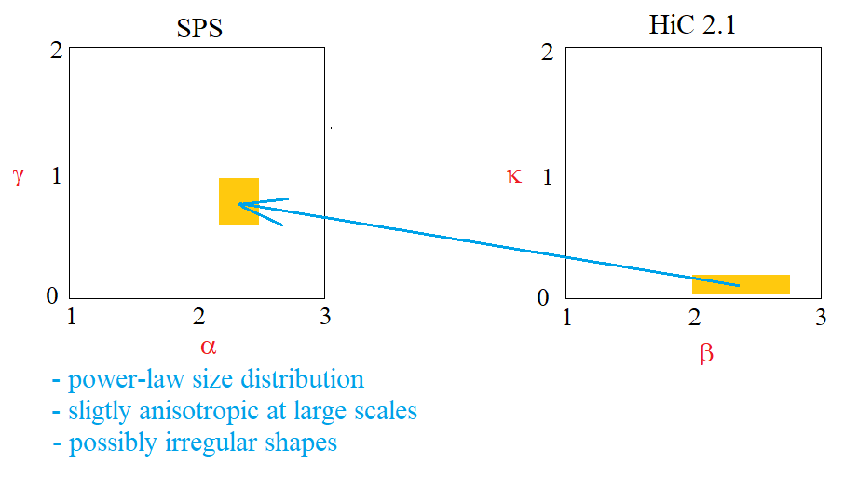
HiC vs models mapping & summary

Slide 16
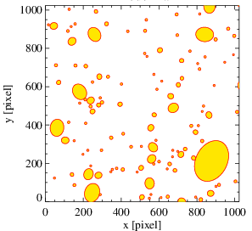
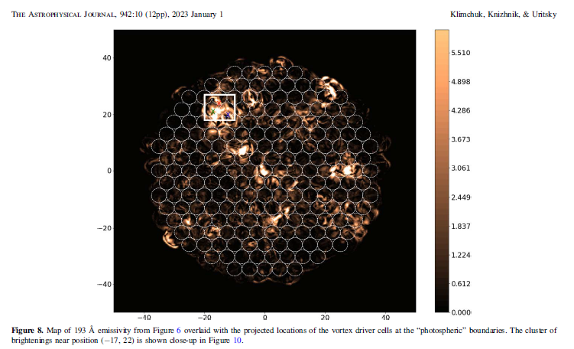
Inferring the
loop geometry:
Quisi-circular clusters
of bright transient
strands / sheets
TBD.

Slide 18
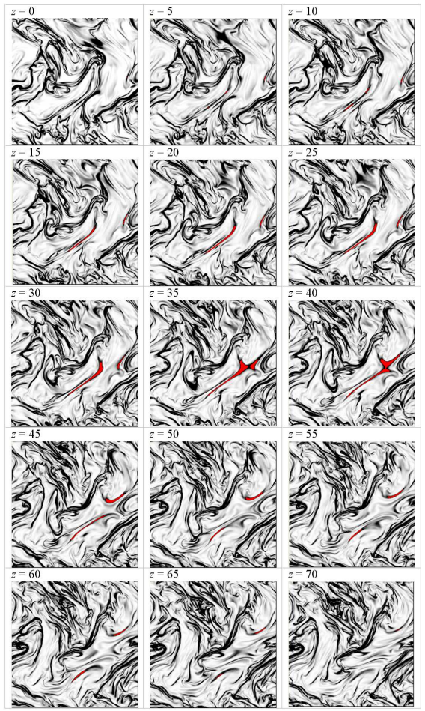
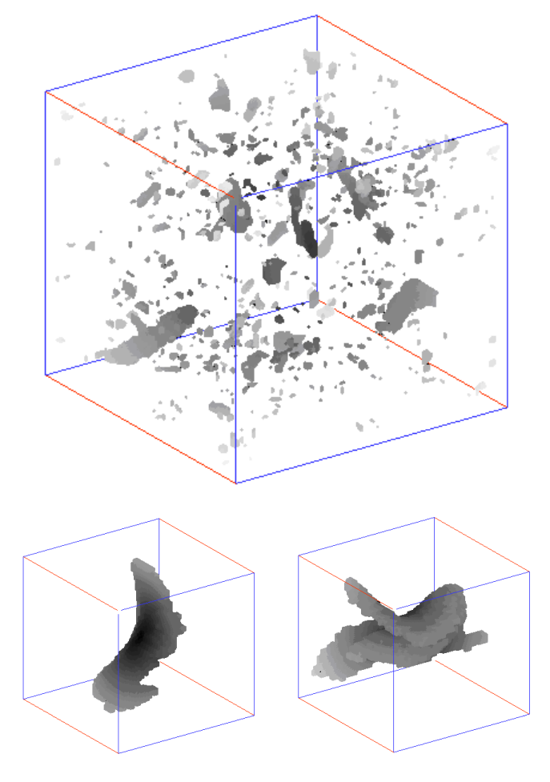
Uritsky et al., PRE 2010

