Slide 1
Are rotational motions / velocity swirls in the photosphere
a significant coronal driver?
Part 2: plage analysis,
driver model
V. Uritsky
(CUA/NASA Goddard)
Acknowledgments: Irina Kitiashvili and our ISFM team

Slide 2
Initial results: quiet Sun simulation
1. Velocity swirls are not easy to detect
2. They are concentrated at junction points
of intergranular lanes
3. Their contribution to Poynting flux
may be small

Slide 3
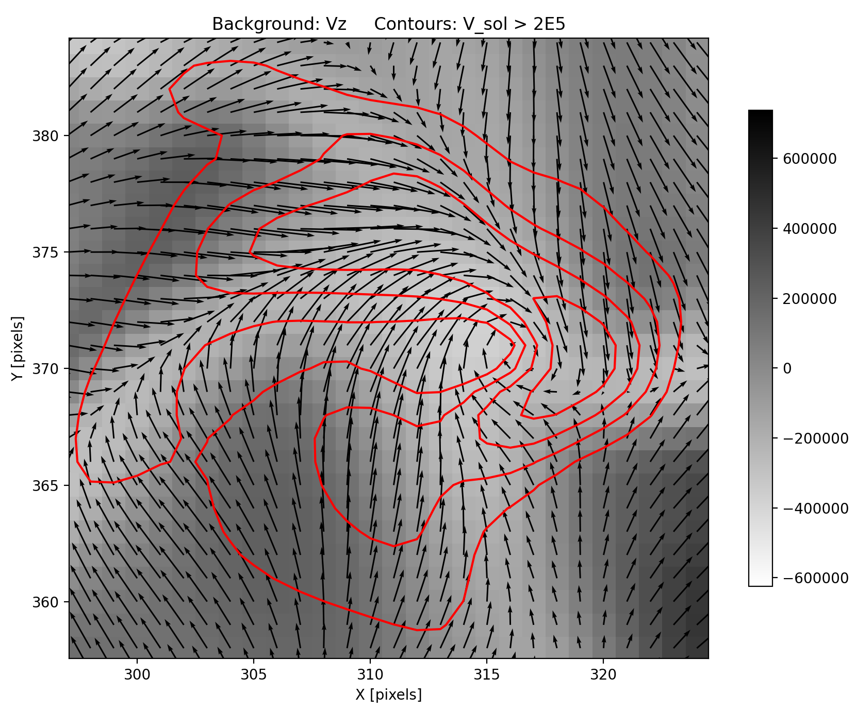
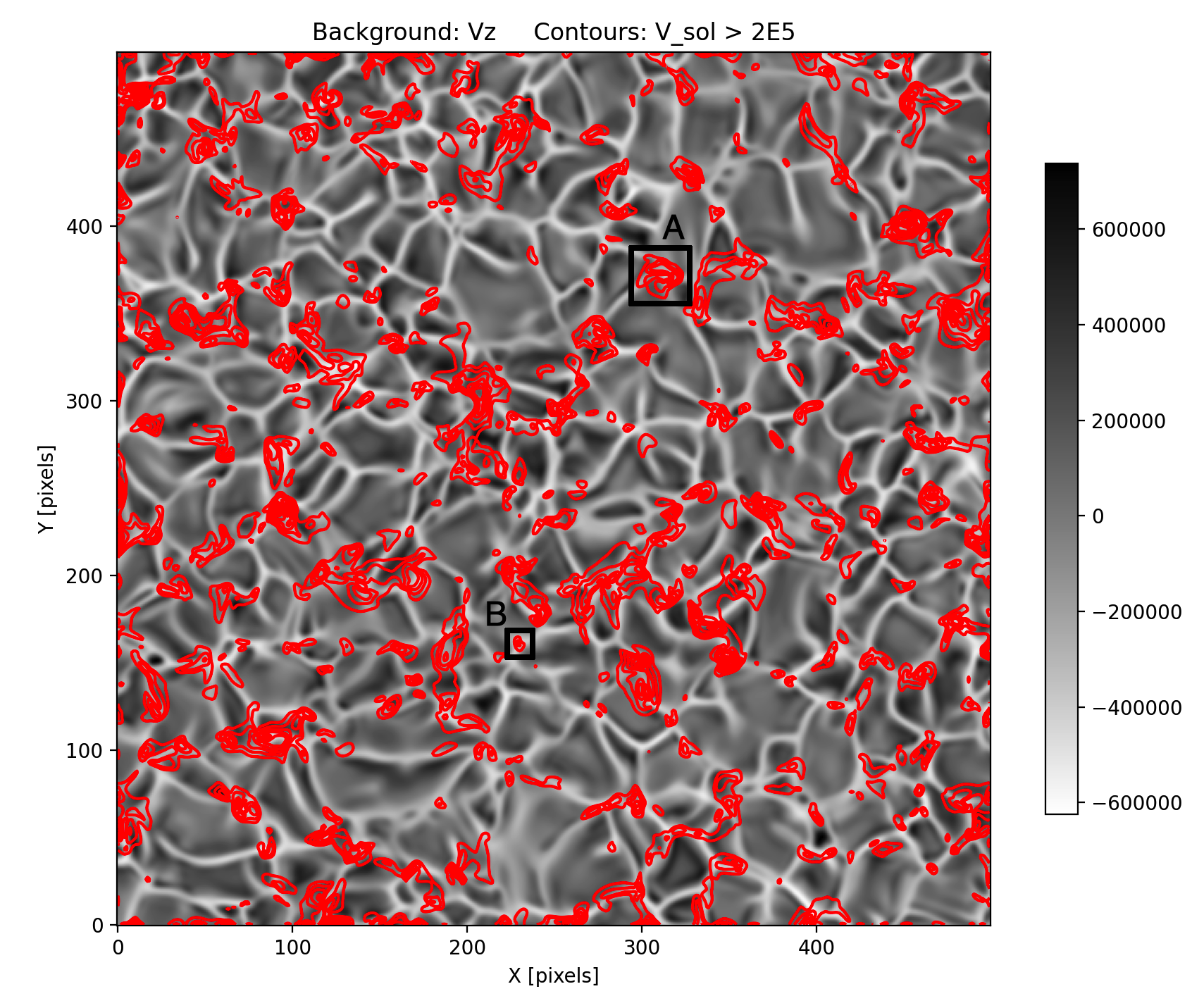
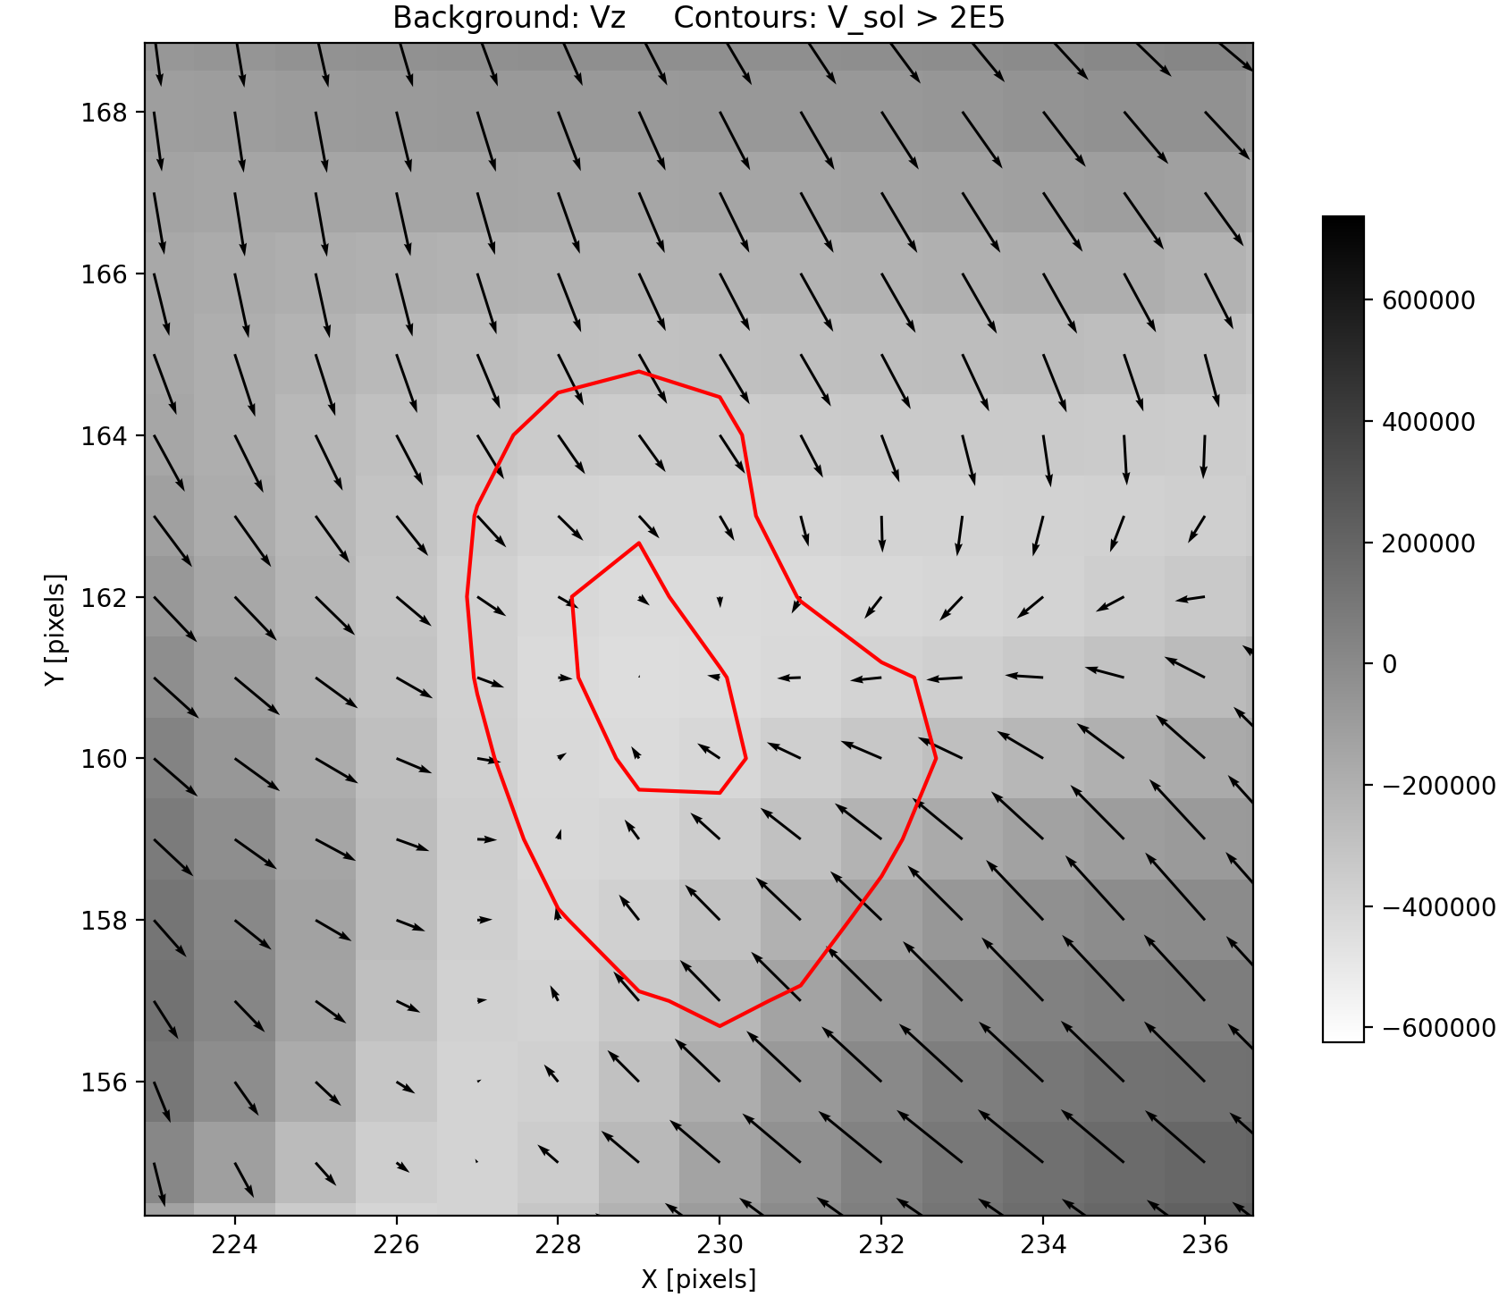
Granular flow structure in magneto-convective
simulation run (quiet Sun, close-up)
V_sol is not a reliable marker of v rotation
A
B

Slide 4
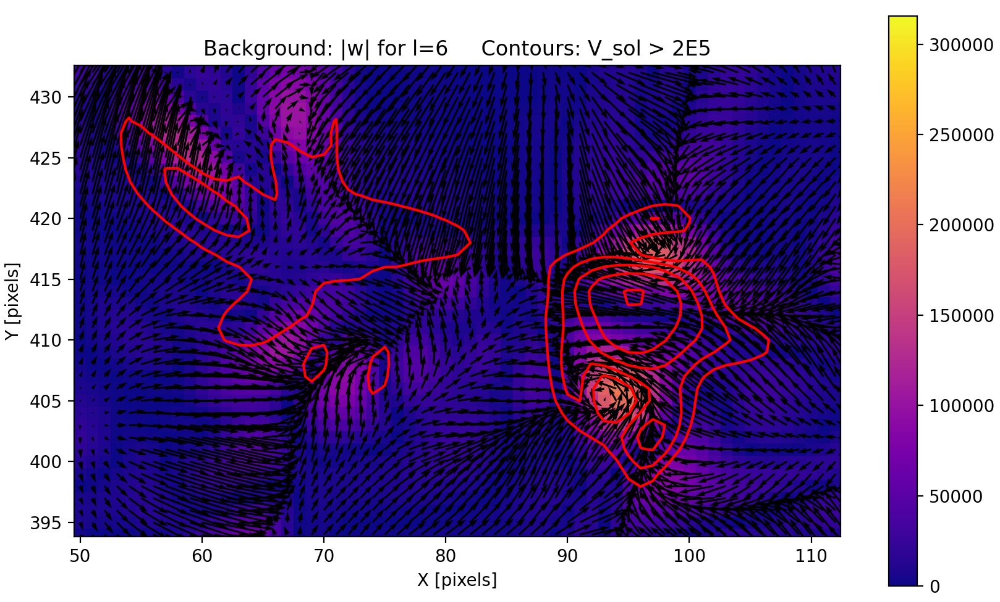
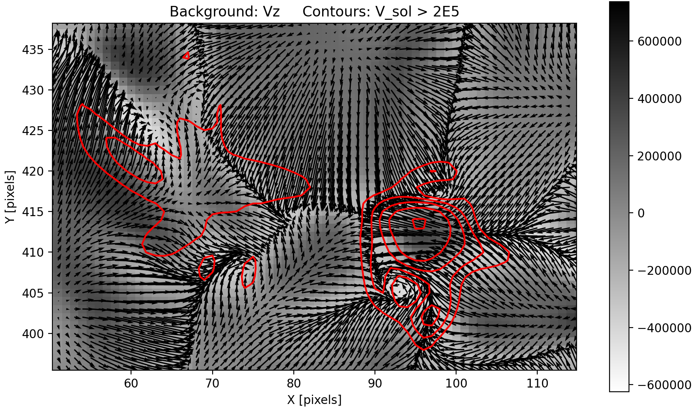
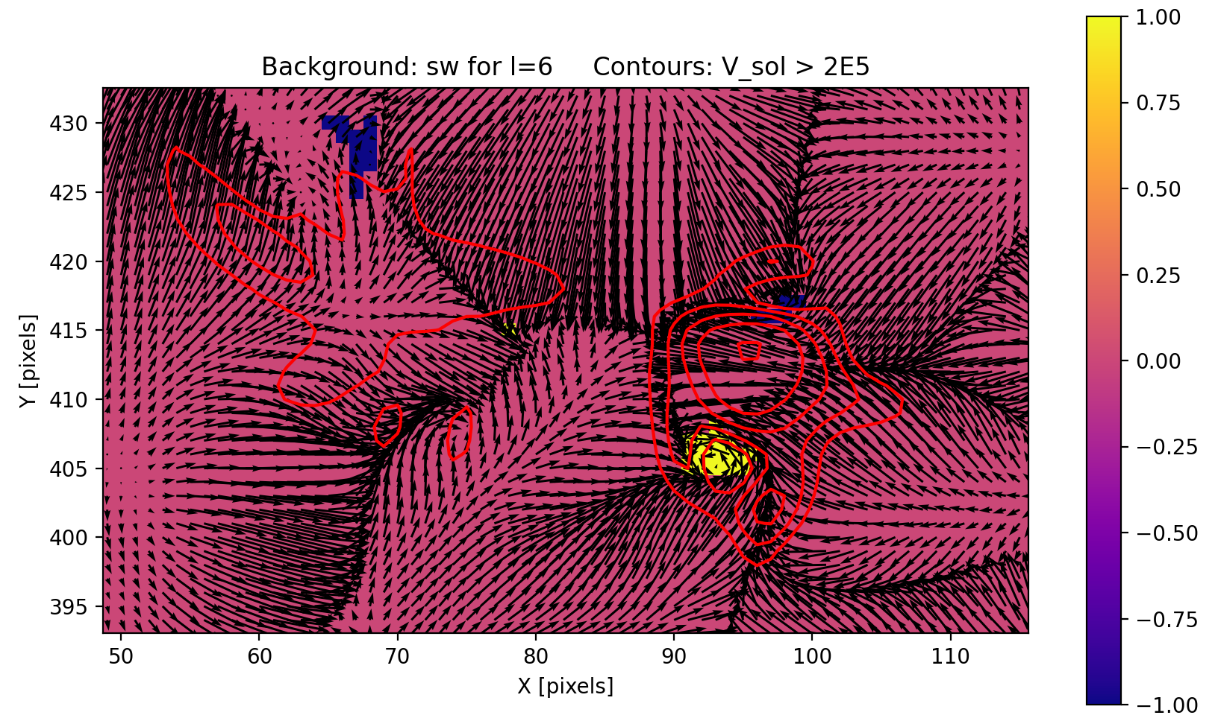
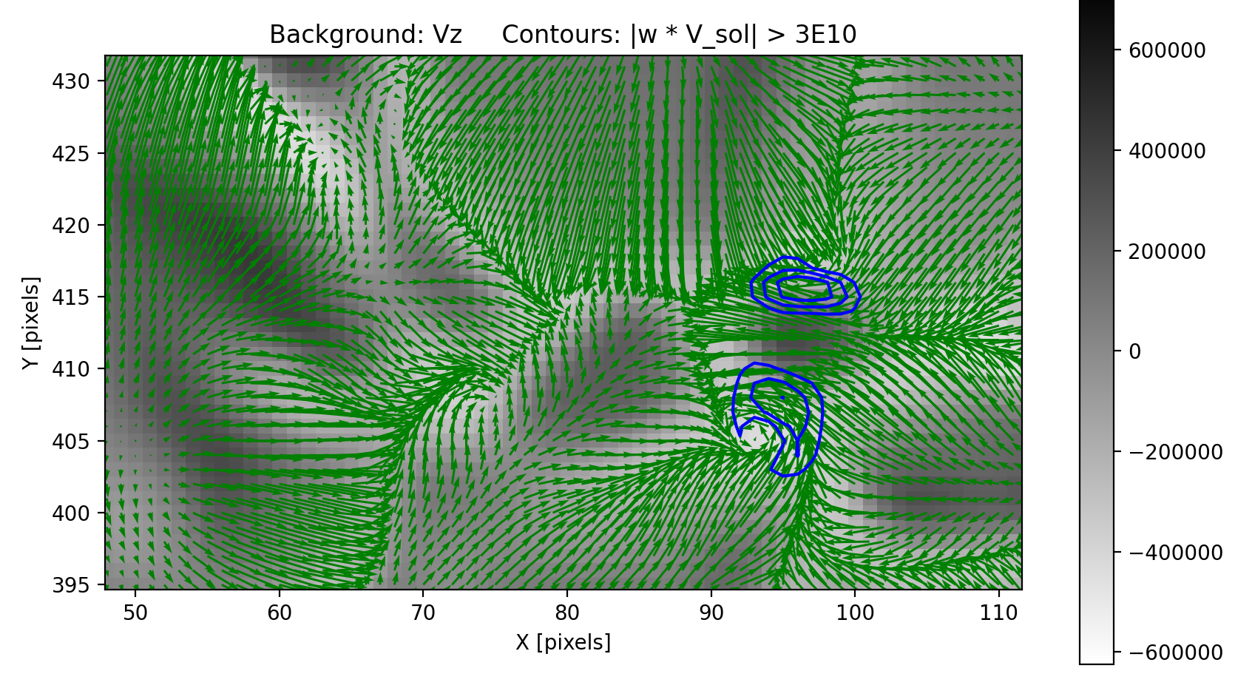
In search for more reliable markers of velocity swirls
Scale-dependent vorticity
?
?
?
“Swirliness”
Combined indices

Slide 5
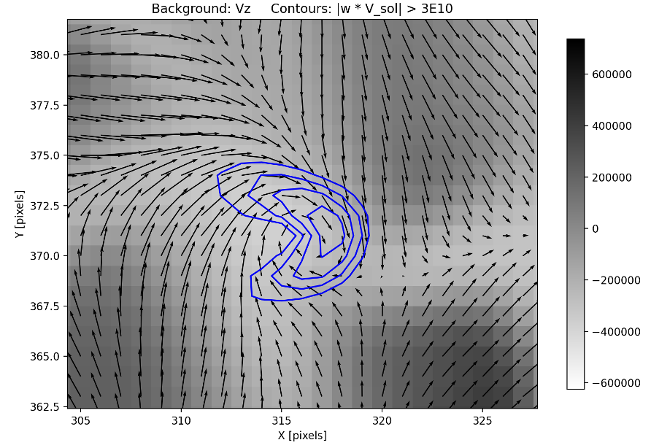
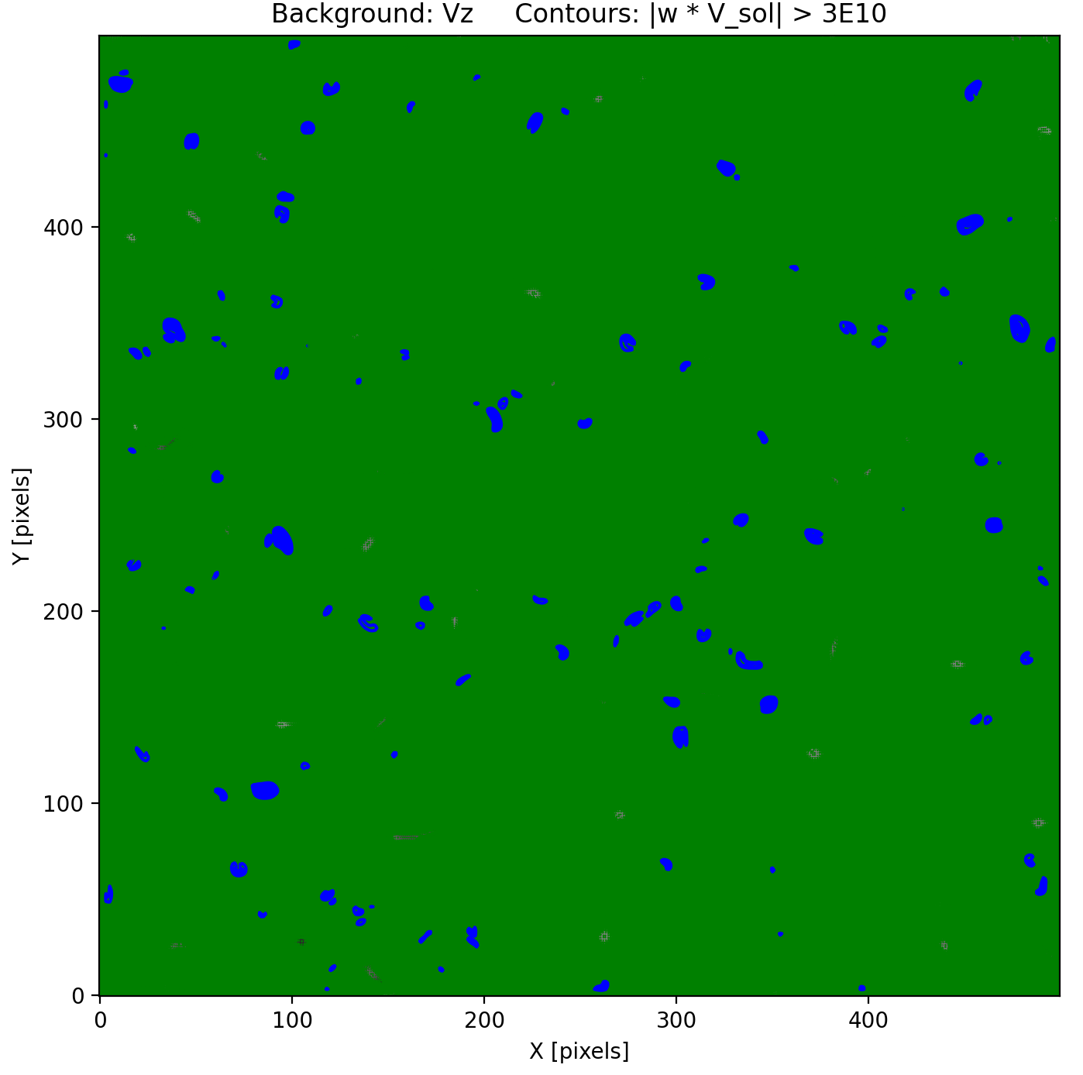
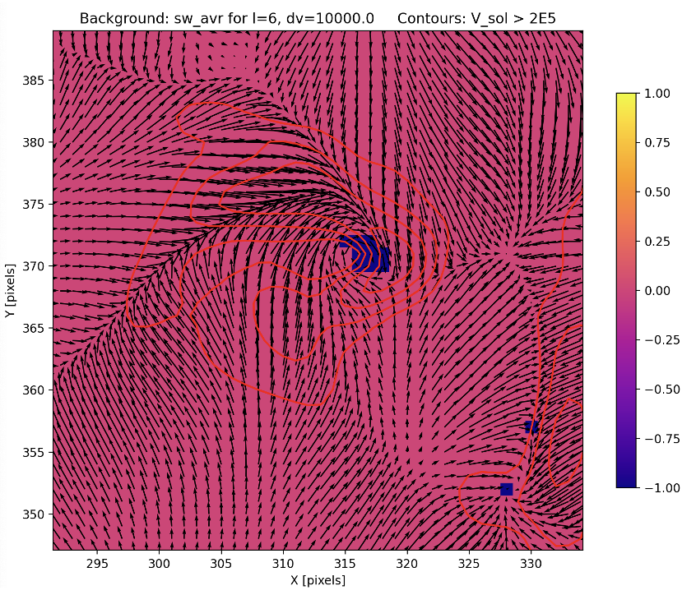
In search for more reliable markers of velocity swirls (cont-d)
Vorticity clustering

Slide 6
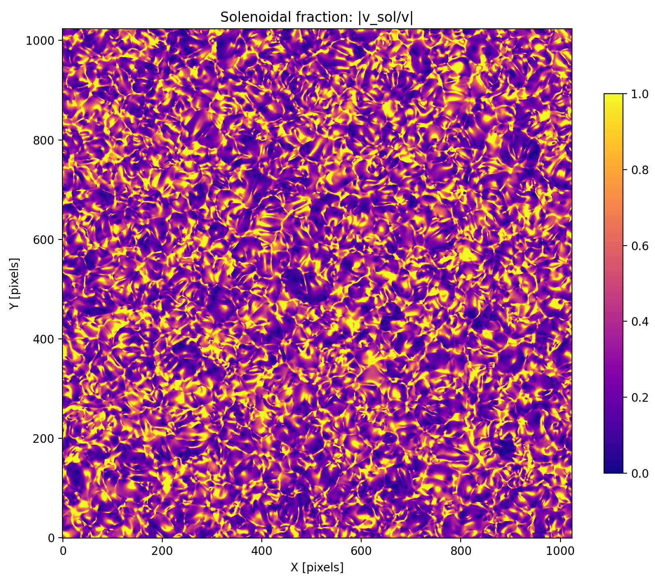
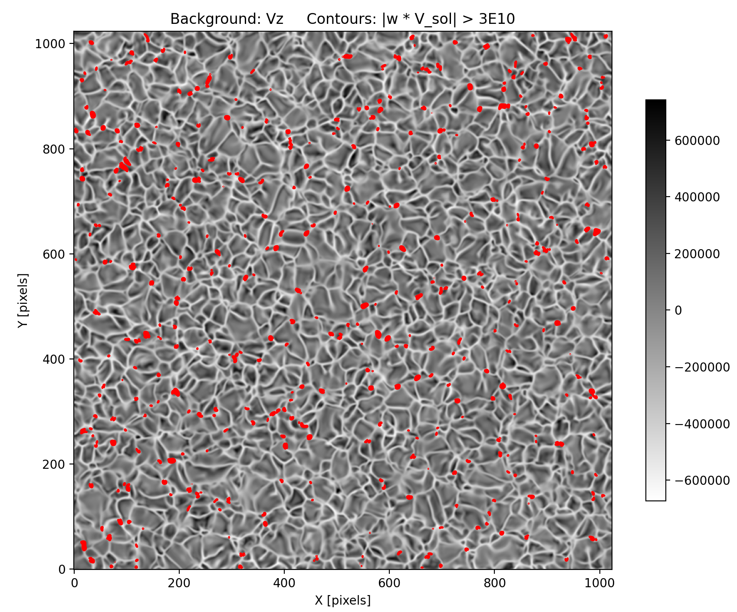
Swirling flow regions are a small subset of solenoidal flow

Slide 7
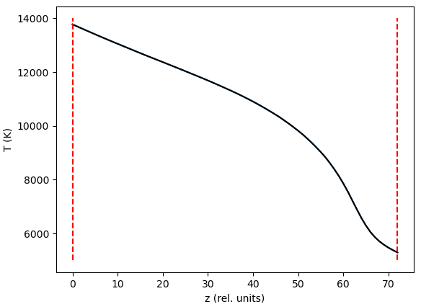
New analysis: plage simulation

Slide 8
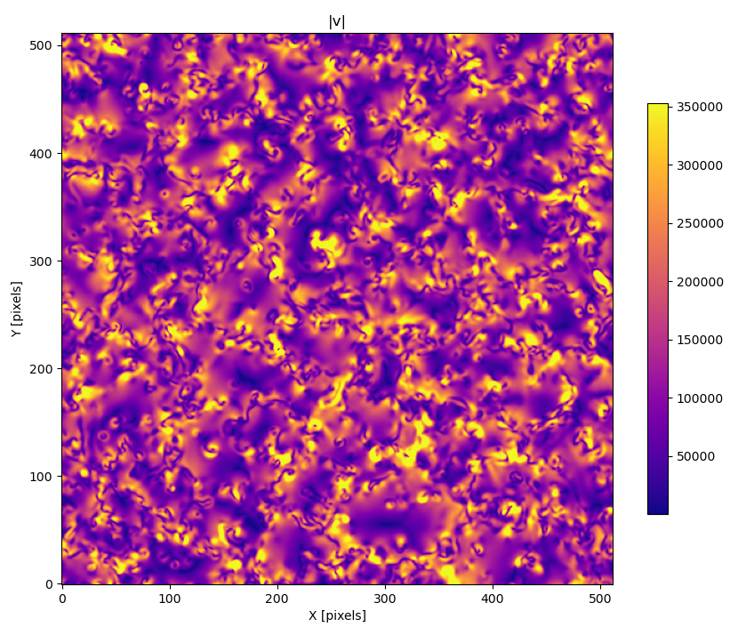
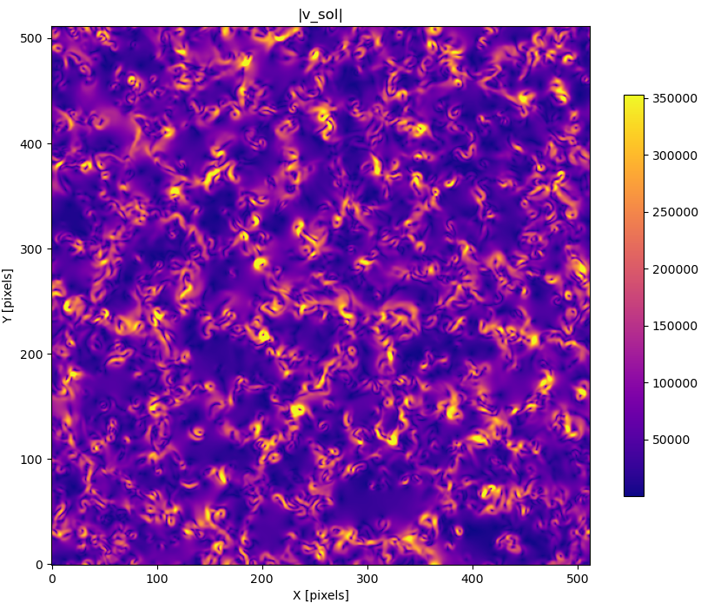
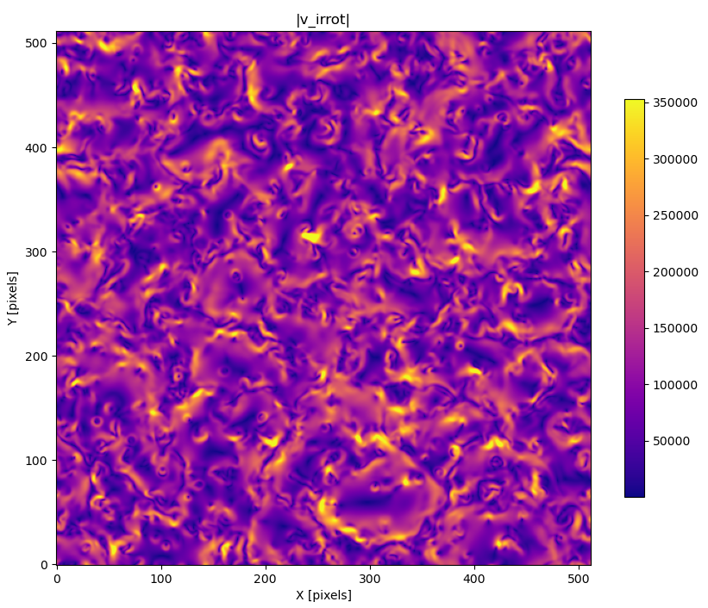
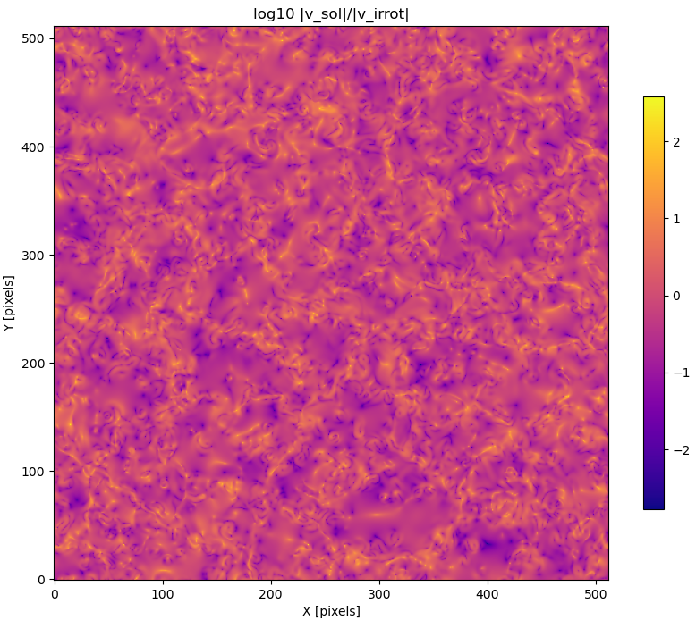
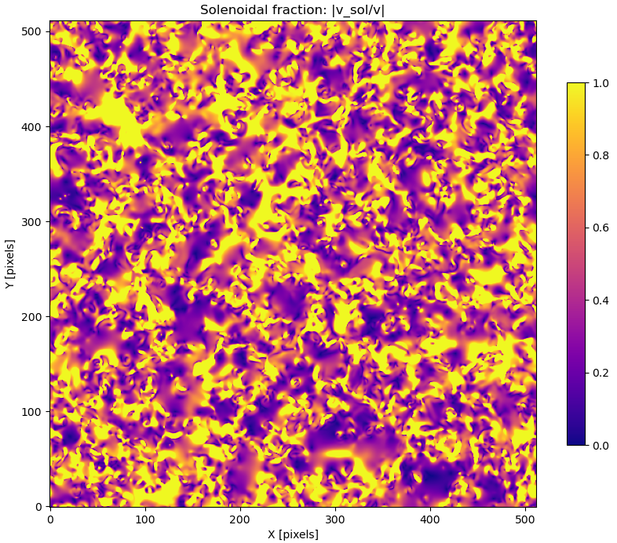
Z = 0, t = 01955

Slide 9
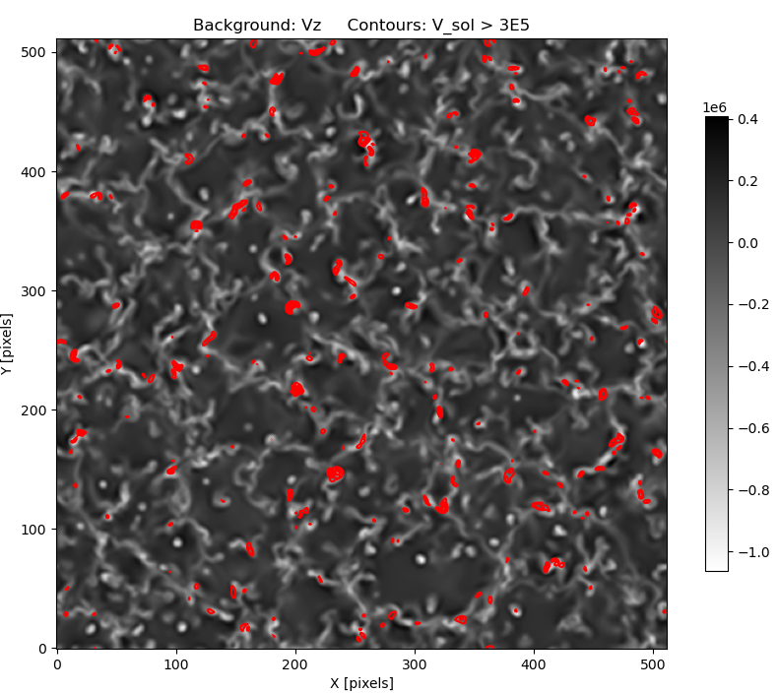
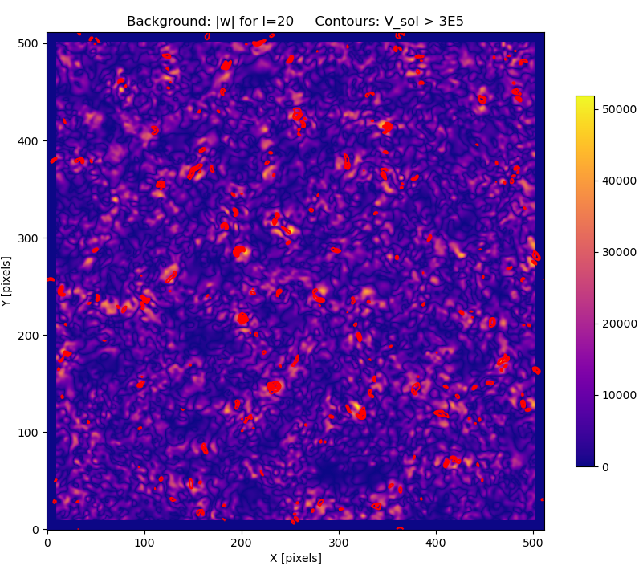
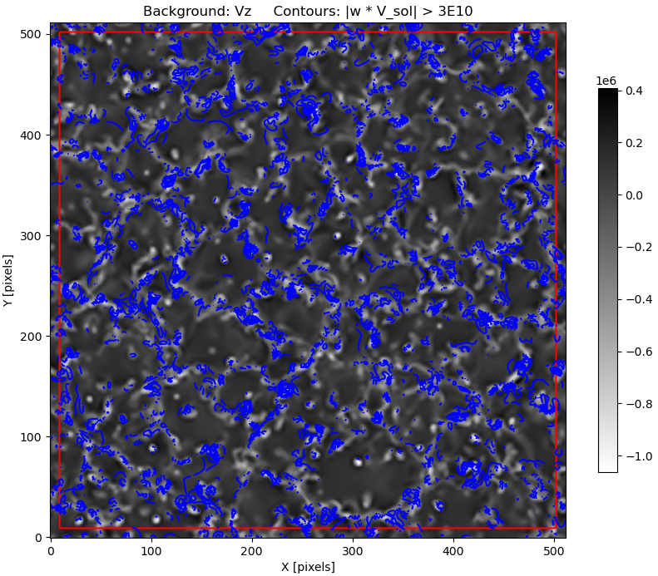
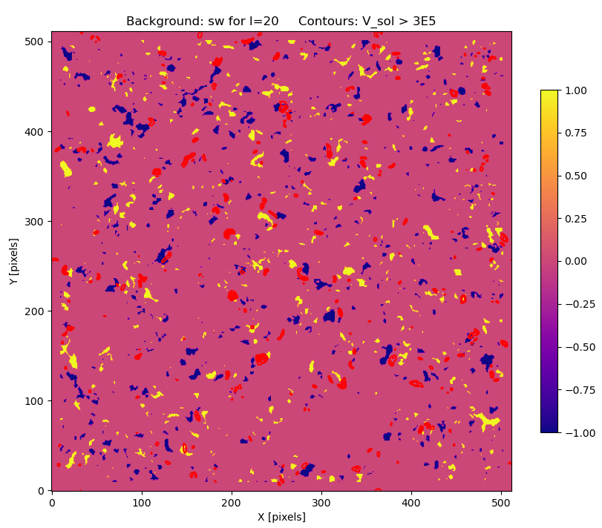

Slide 10
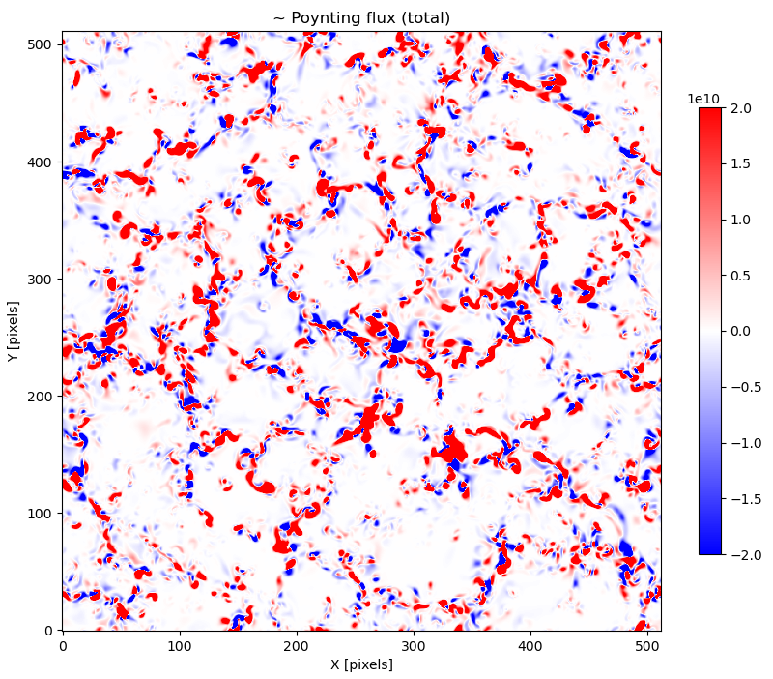
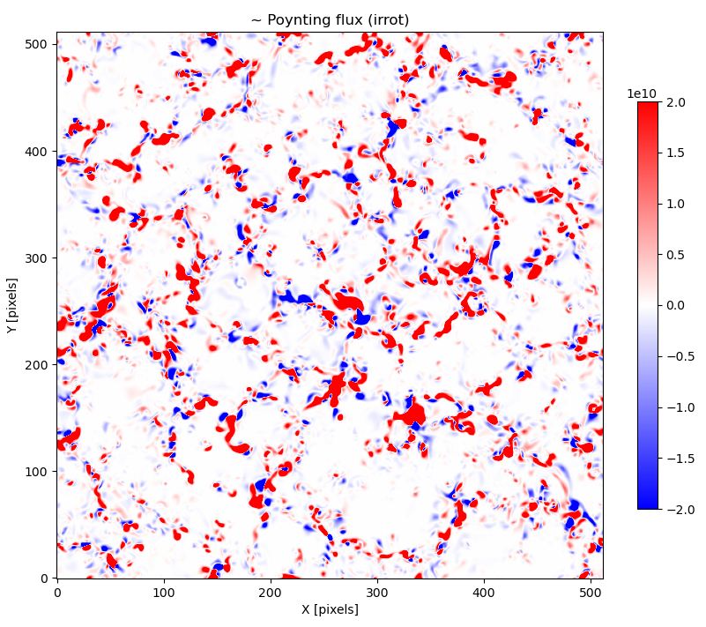
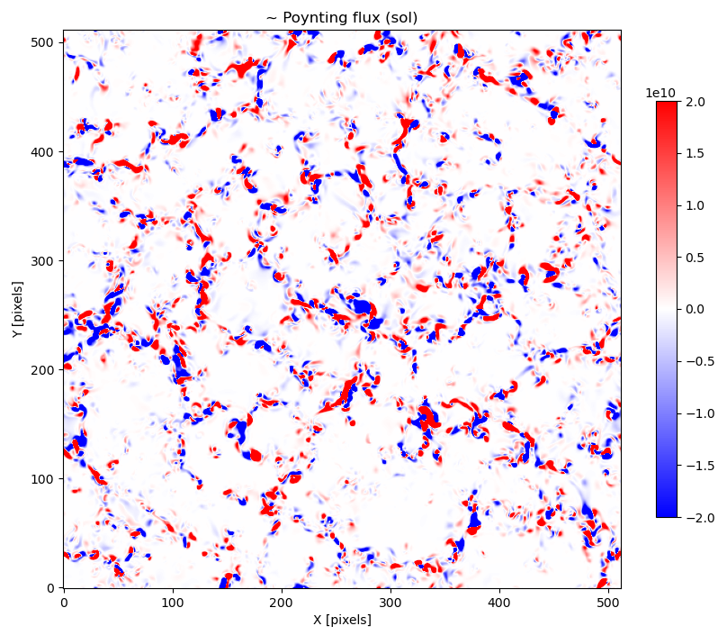
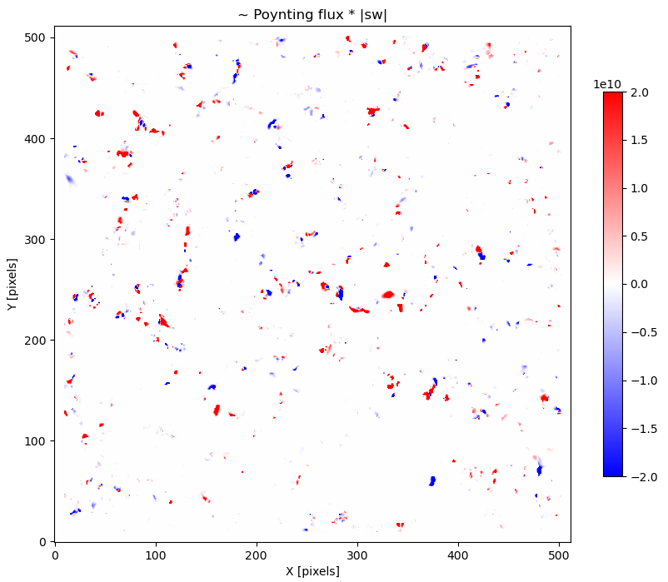

Slide 11
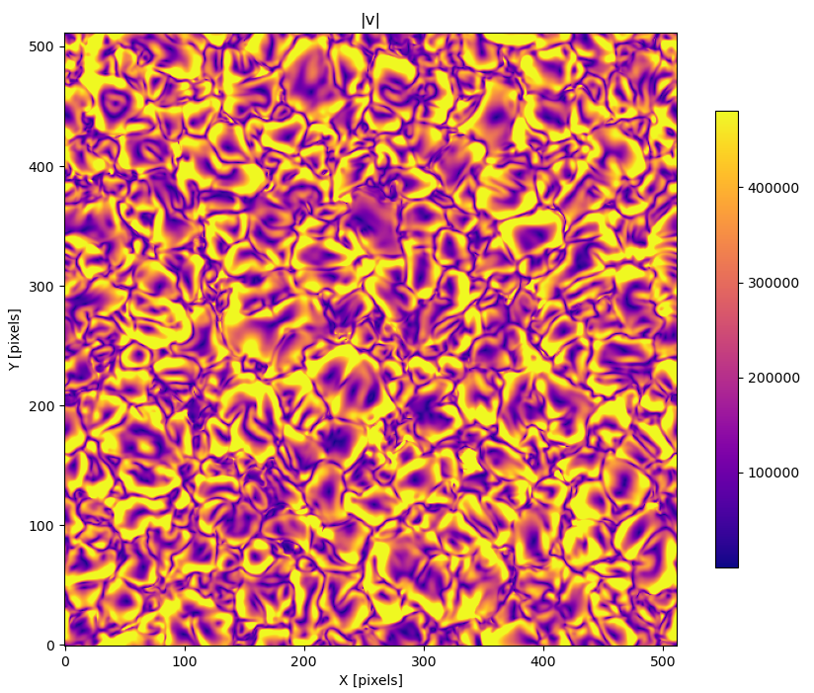
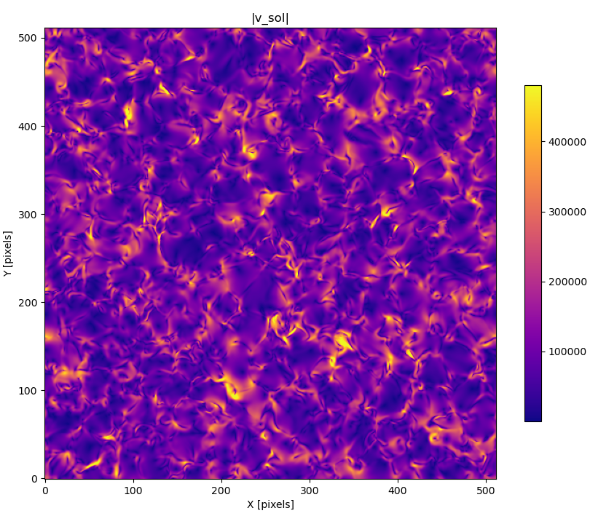
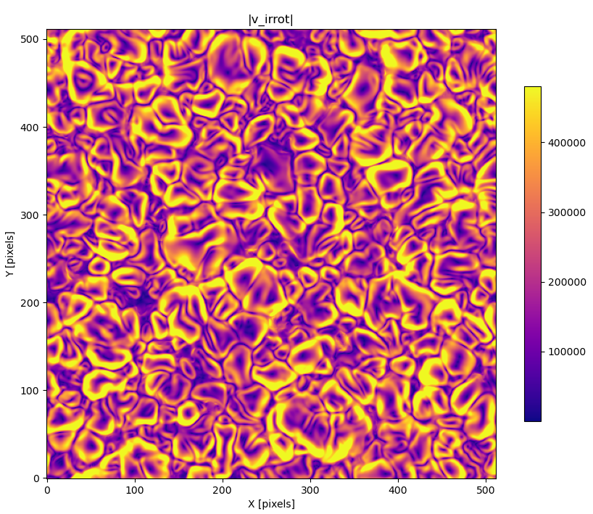
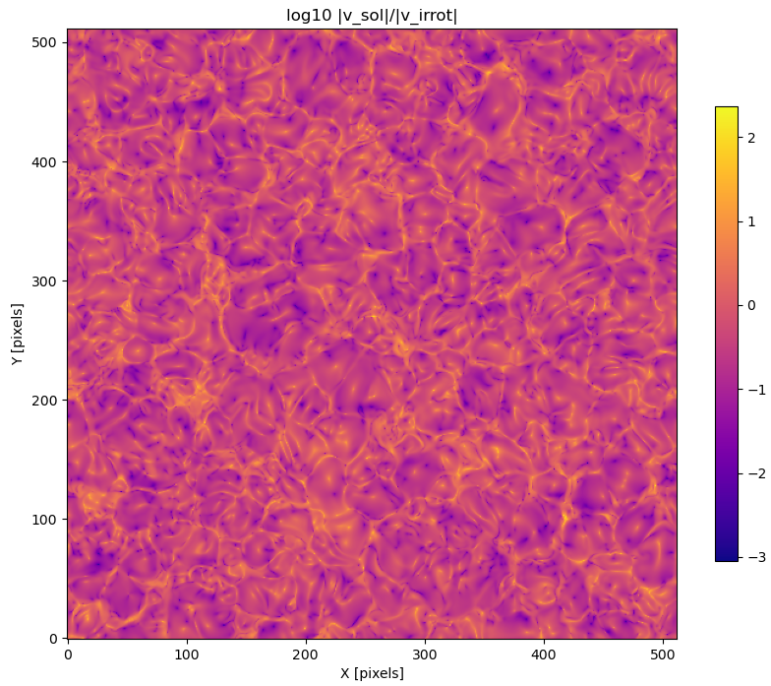
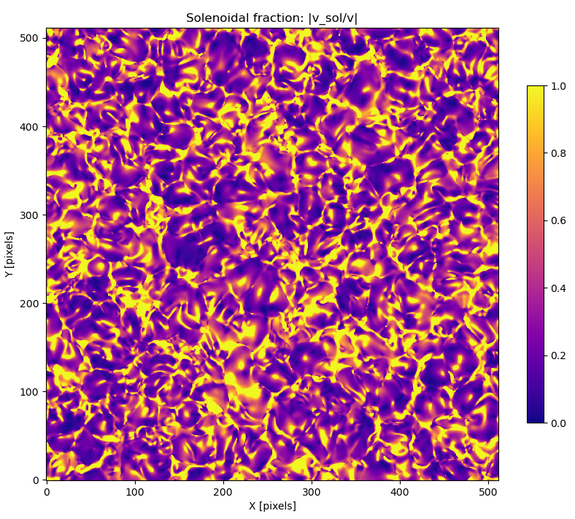
Z = 72, t = 01955

Slide 12
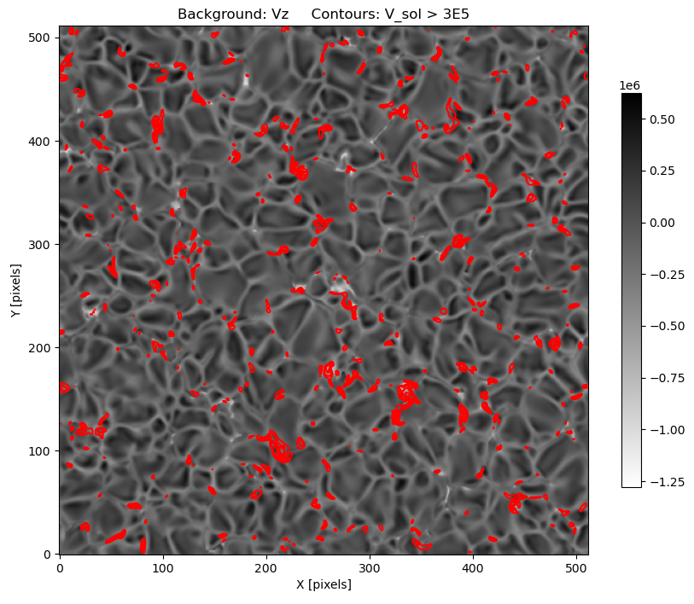
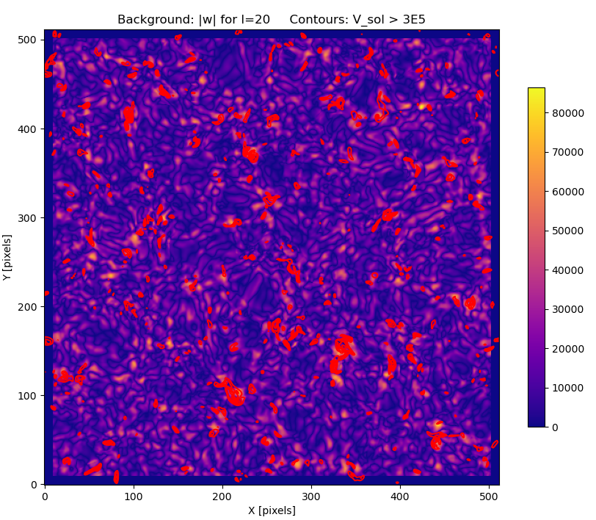
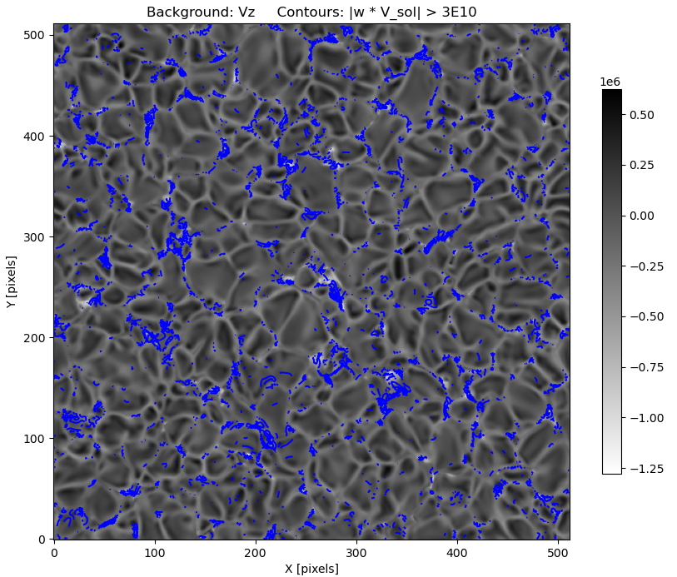
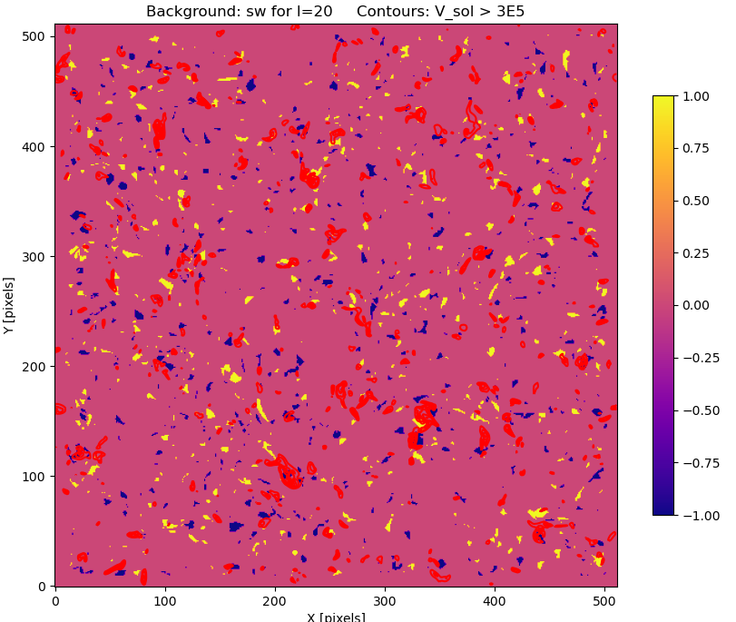

Slide 13
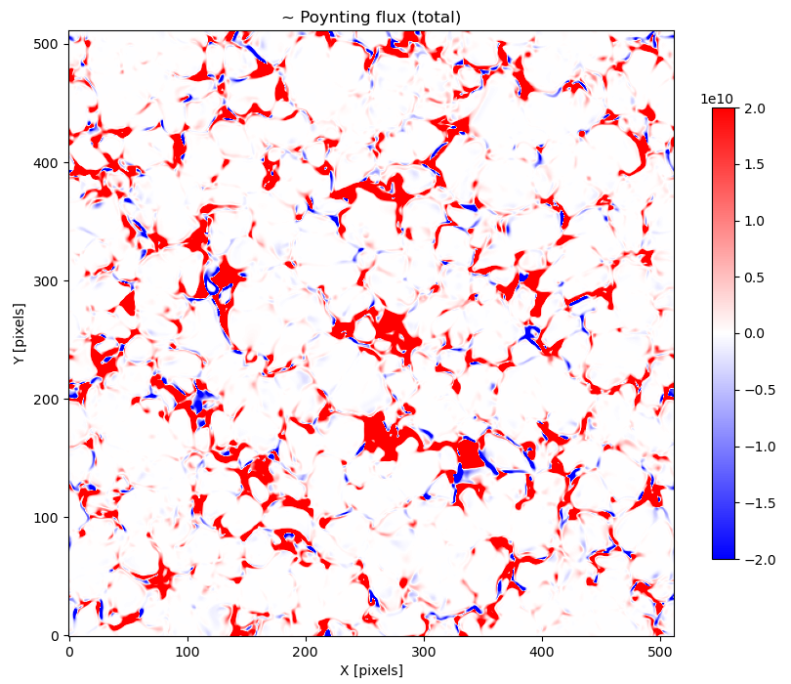
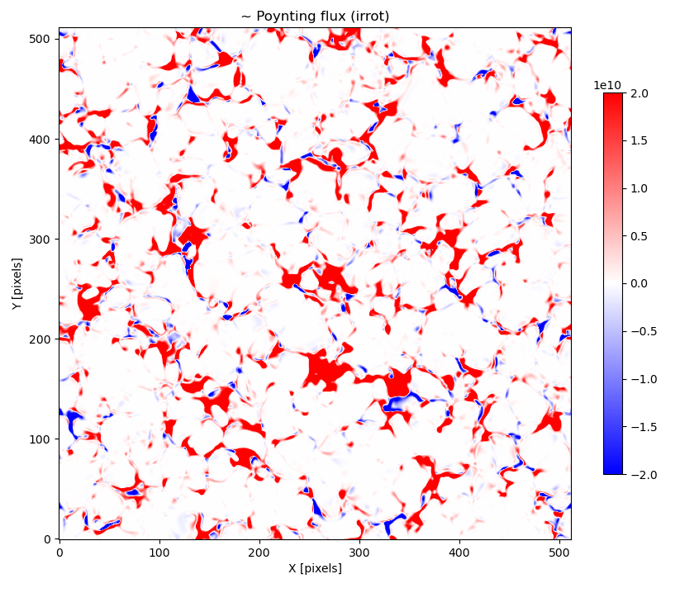
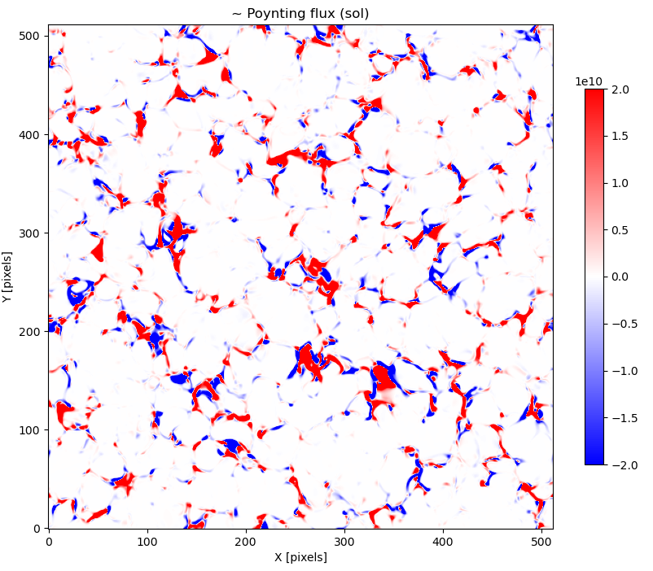
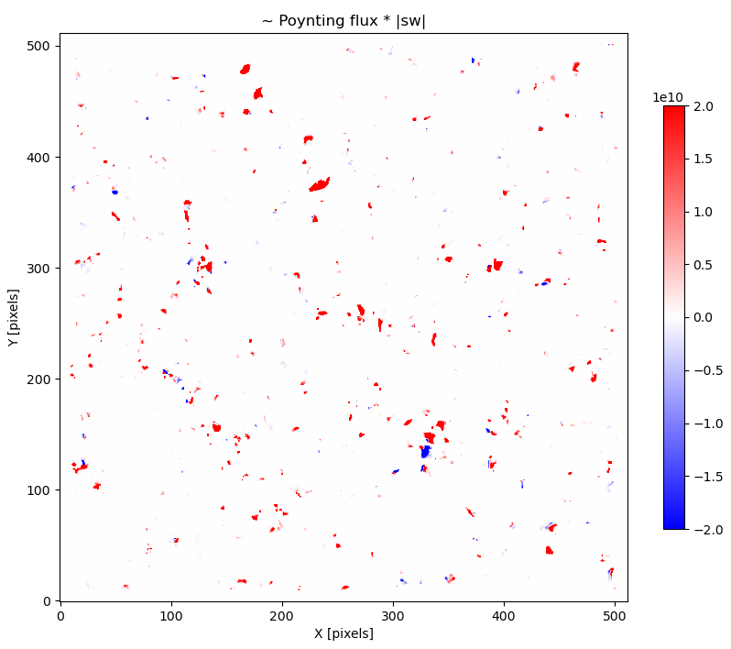

Slide 14
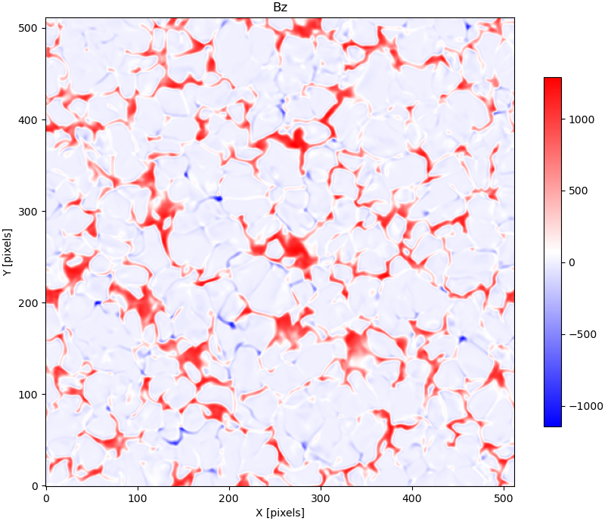
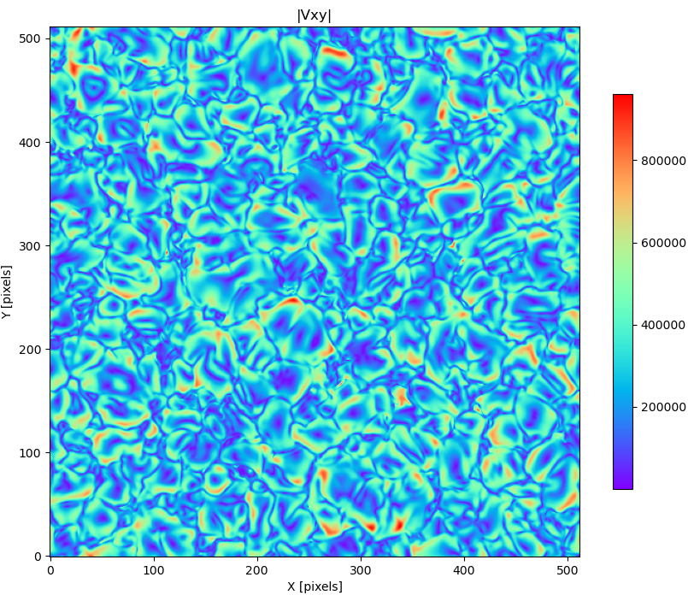
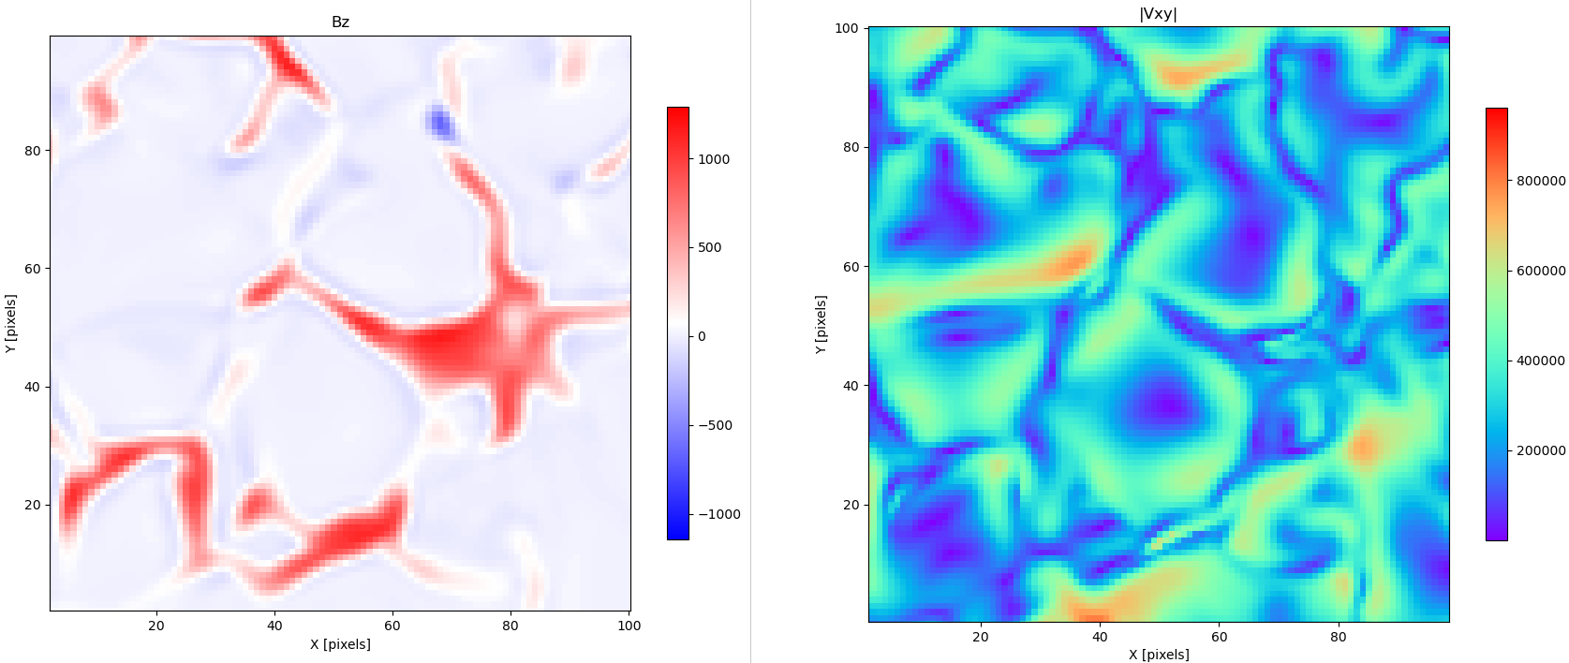
R= -0.18

Slide 15
Z = 0
< > <| |>
P 1.5x10⁵ 2.4x10⁵
P_{irrot} 1.3x10⁵ 1.9x10⁵
P_{sol} 2.3x10⁴ 1.5x10⁵
P_{irrot}*sw 1.0x10³ 1.2x10⁴
P_{sol}*sw 1.1x10³ 1.2x10⁴
Z = 72
< > <| |>
P 1.5x10⁵ 1.8x10⁵
P_{irrot} 1.0x10⁵ 1.3x10⁵
P_{sol} 4.4x10⁴ 1.1x10⁵
P_{irrot}*sw 2.5x10³ 1.1x10⁴
P_{sol}*sw 1.1x10³ 9.5x10³

Slide 16
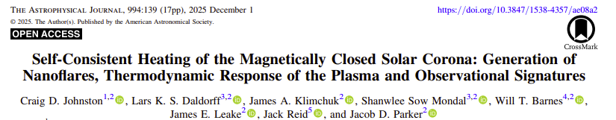
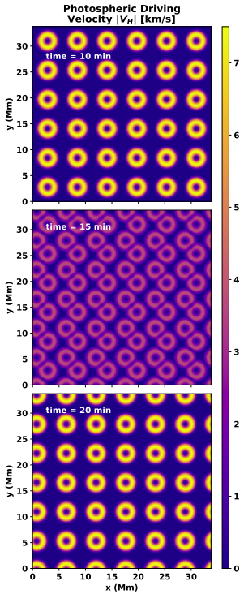
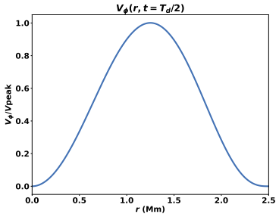


Photospheric Driving Velocity

Slide 17
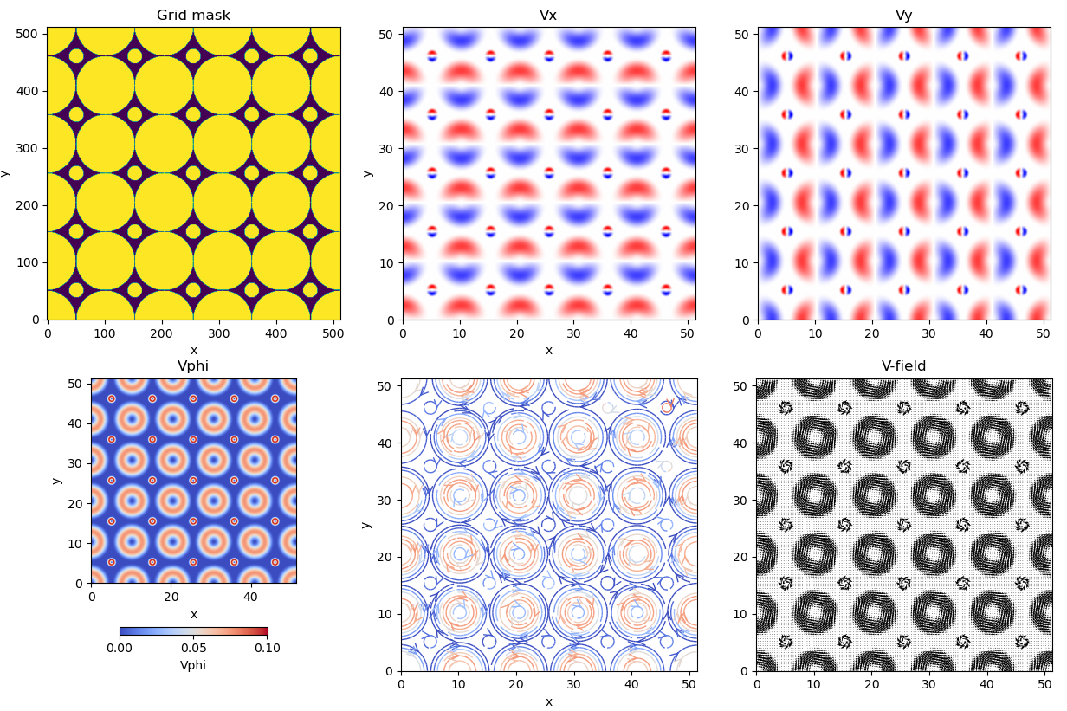

Slide 18
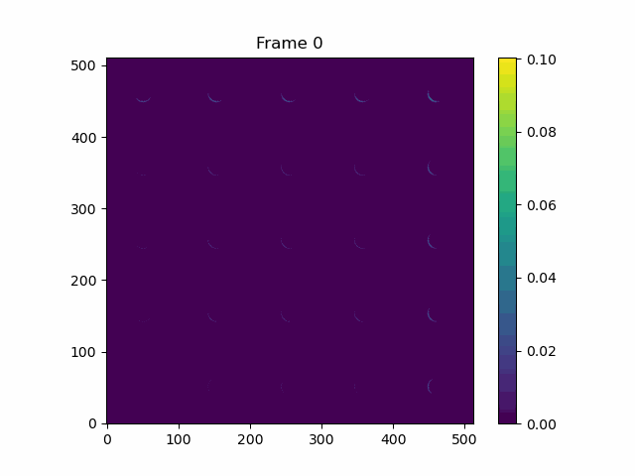

Slide 19
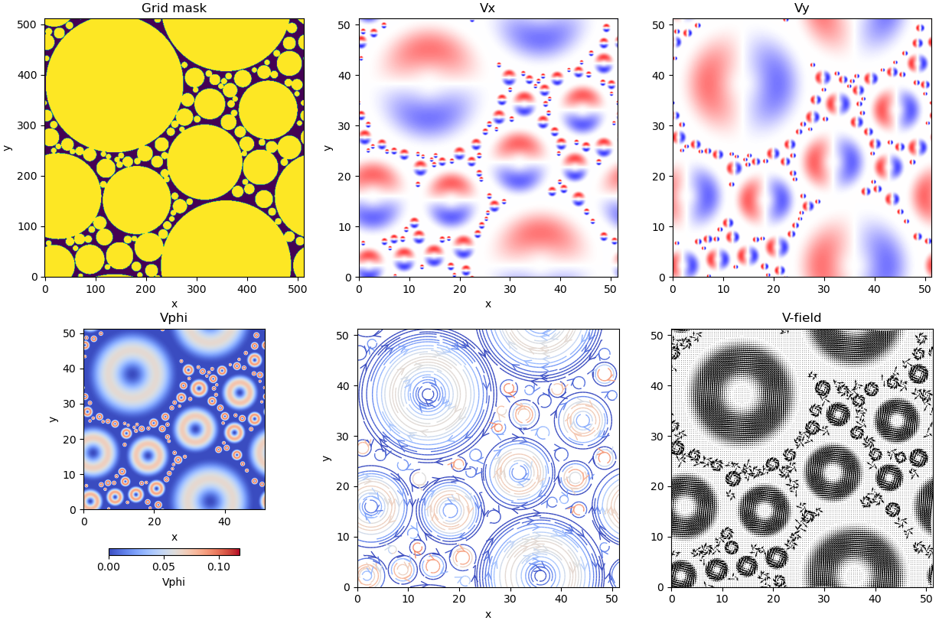

Slide 20
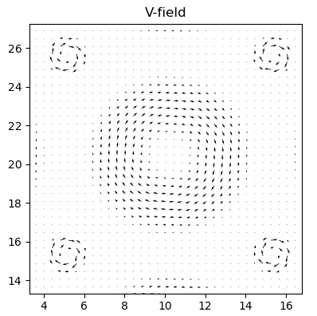
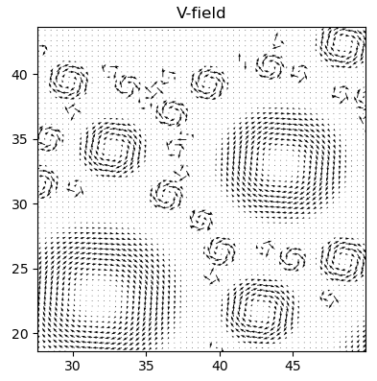

Slide 21


Slide 22


Slide 23


