Slide 1
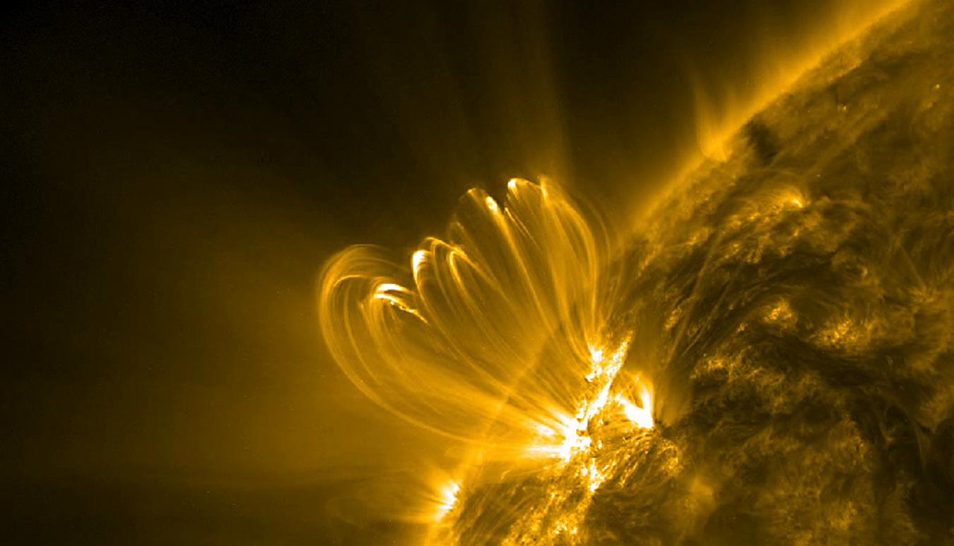

Nanoflare Energy-Delay Correlation in the Closed Solar Corona
Shanwlee Sow Mondal, J. A. Klimchuk, C. D. Johnston, & L. K. S. Daldorff
January 21, 2026

Slide 2
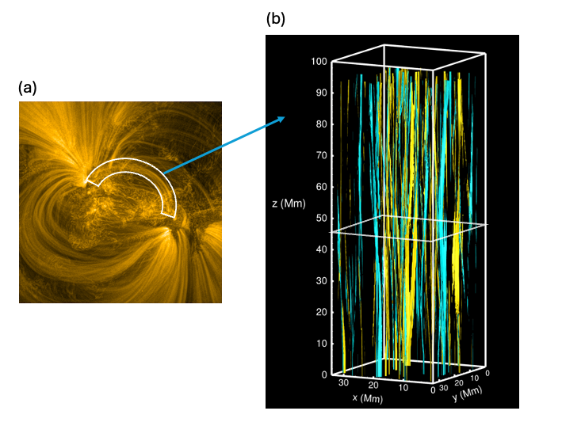
Simulation of a subset of an Active Region

Slide 3
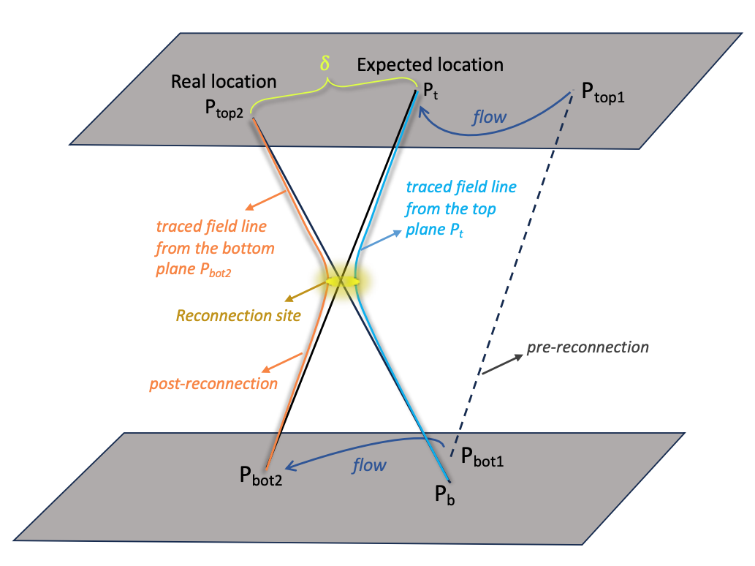
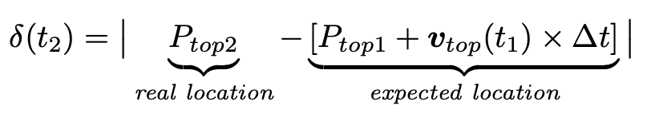
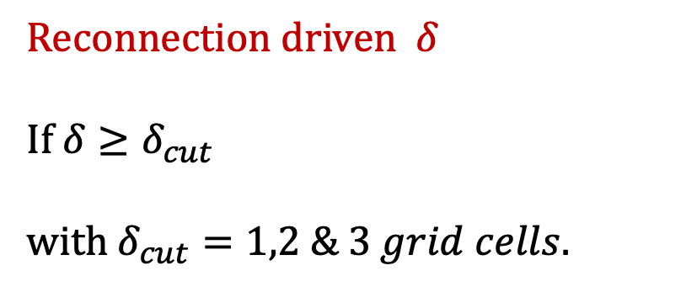
Identify reconnections
Reconnection driven $δ$
If $δ≥δ_{cut}$
with $δ_{cut}=1,2 \& 3 grid cells.$
Notes:
To answer when did the reconnection happen, we follow this method to identify reconnections.

Slide 4
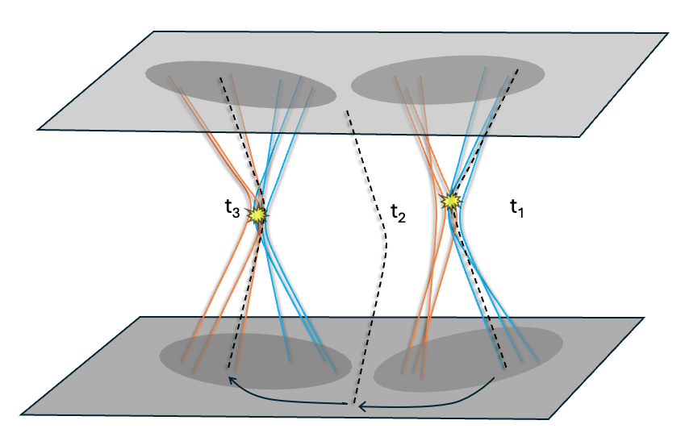
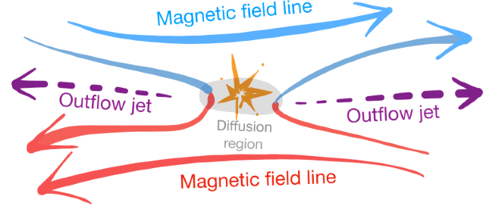
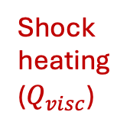
Quantify energy released in reconnection events
Shock heating
($Q_{visc}$)
Notes:
High velocity gradient at the shock front leads to viscous heating which the simulation identifies as primary source of heating associated with reconnection.
Q_visc along the field line. Maximum Q_visc at what height?
If \delta condition is satisfied, find the height of reconnection, if it is in corona, we move forward to quantify nanoflare energy.

Slide 5
Reconnection signatures

Slide 6
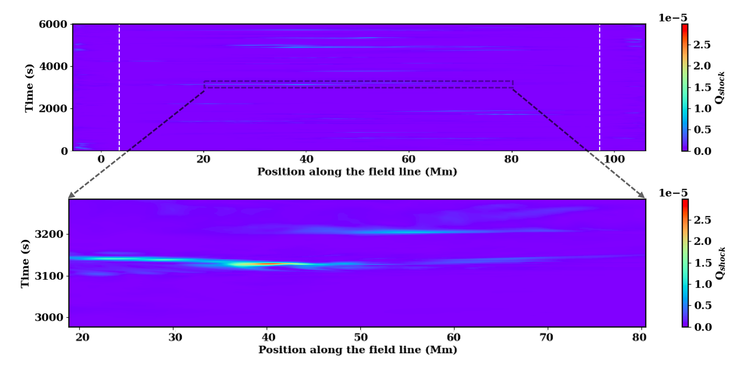
Shock heating along the field line

Slide 7
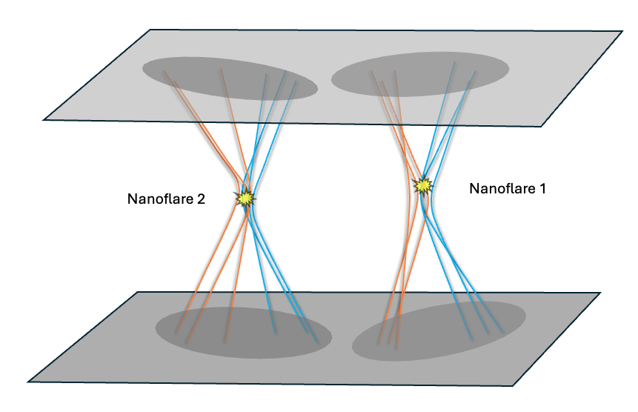
Uniqueness of this study
This study
Previous studies from literature
Energy per unit area ---Heating integrated along the field line
Heating integrated over the volume
Notes:
We track multiple filed lines – say I am tracking the black field line. At t1 it has undergone reconnection, then it gets advected by the flow, at t3 it again undergoes reconnection.
So, nanoflare energy in this scenario is defined as the sum of these fractions of heating the field line experiences as it passes through multiple reconnection sites.
Heating is the heating integrated along the field line, so we express nanoflare energy as energy per unit area.
Whereas, in previous studies, everything was from volume perspective, so the nanoflare energy is energy integrated of the volume over which the energy is released.

Slide 8
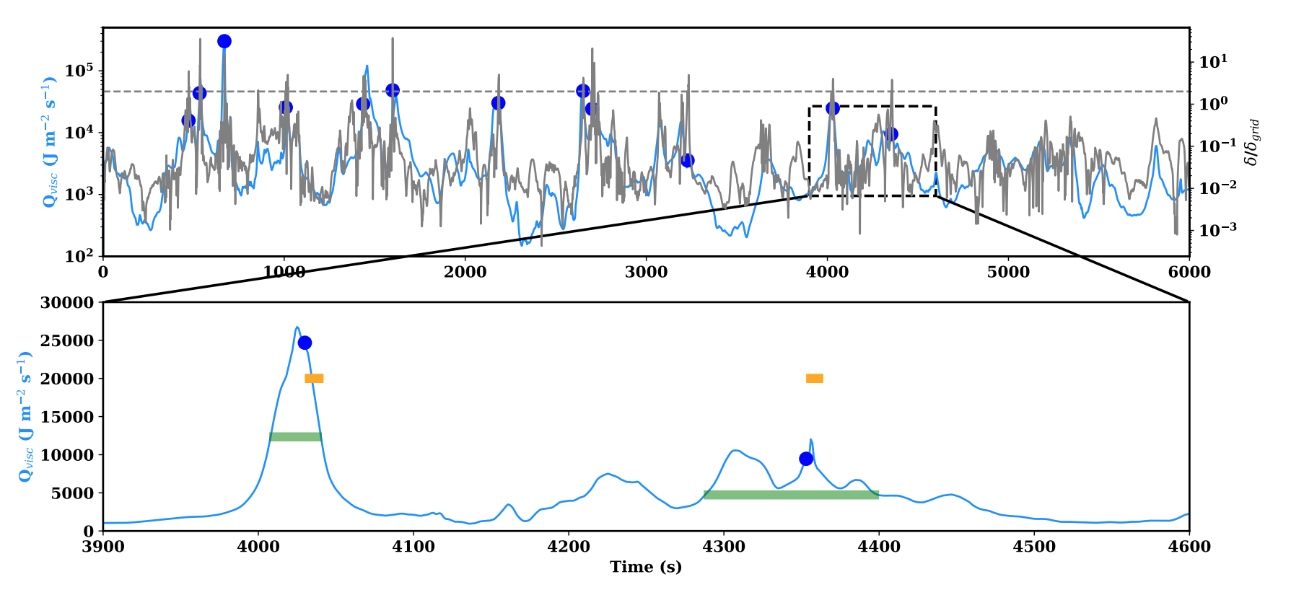
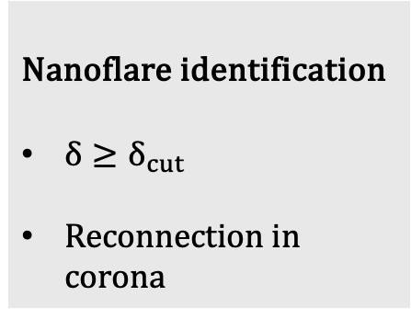

Define nanoflare: Method B
Nanoflare identification
$δ≥δ_{cut}$
Reconnection in corona
Nanoflare duration = FWHM of $Q_{visc}$
The ‘maximum’ of FWHM is the strongest $Q_{visc}$ within nanoflare duration from Method A
Notes:
Within this yellow bar, find the maximum Q_visc. FWHM of this maximum Q_visc give the nanoflare duration in Method B.

Slide 9
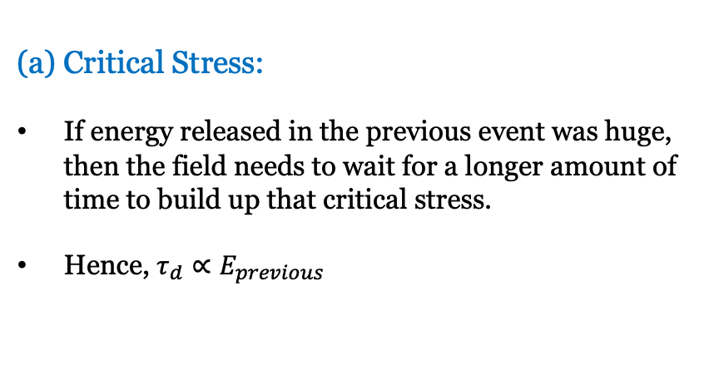
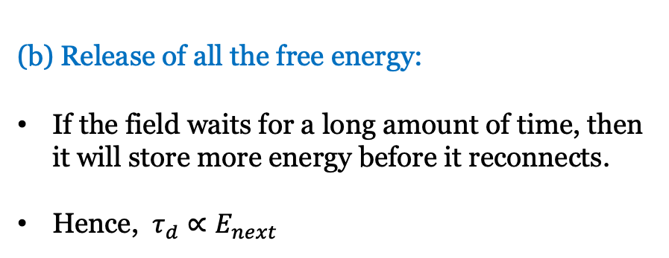
Correlation between Nanoflare Energies(E) & Delays($τ_{d})$
Critical Stress:
If energy released in the previous event was huge, then the field needs to wait for a longer amount of time to build up that critical stress.
Hence, $τ_{d}∝E_{previous}$
(b) Release of all the free energy:
If the field waits for a long amount of time, then it will store more energy before it reconnects.
Hence, $τ_{d}∝E_{next}$

Slide 10
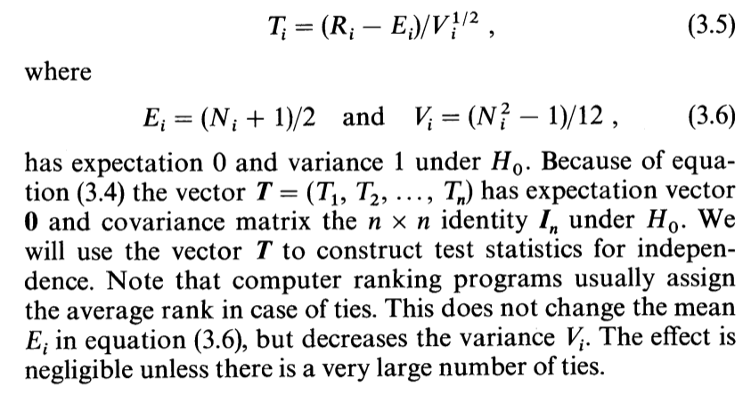
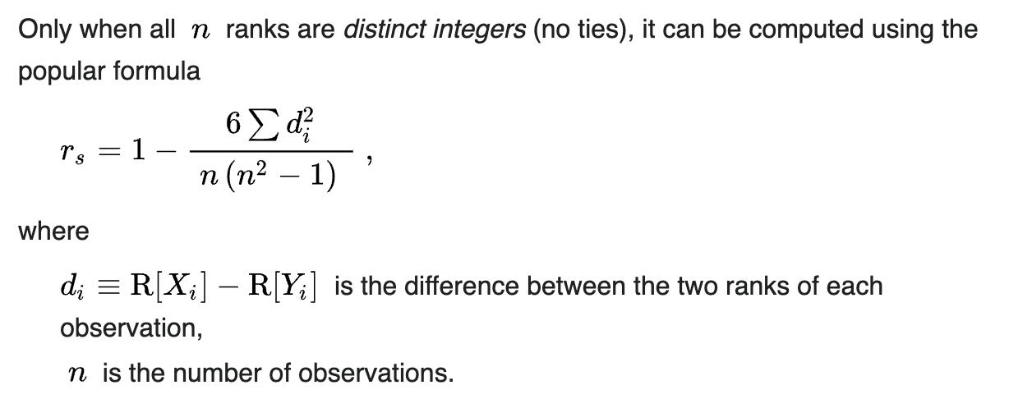
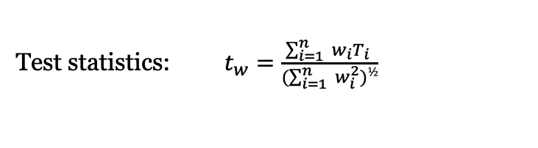
Non-parametric tests of whether the two data sets are correlated
1. Weighted t-test
Non-parametric statistical tests
Based on rank ordering of data
Robust to outliers
No assumption about underlying distribution of the data
Test statistics: $t_{w}=\frac{\sum_{i=1}^{n}{ w_{i}T_{i} }}{(\sum_{i=1}^{n}{ w_{i}^{2})½}}$
2. Spearman rank correlation test

Slide 11
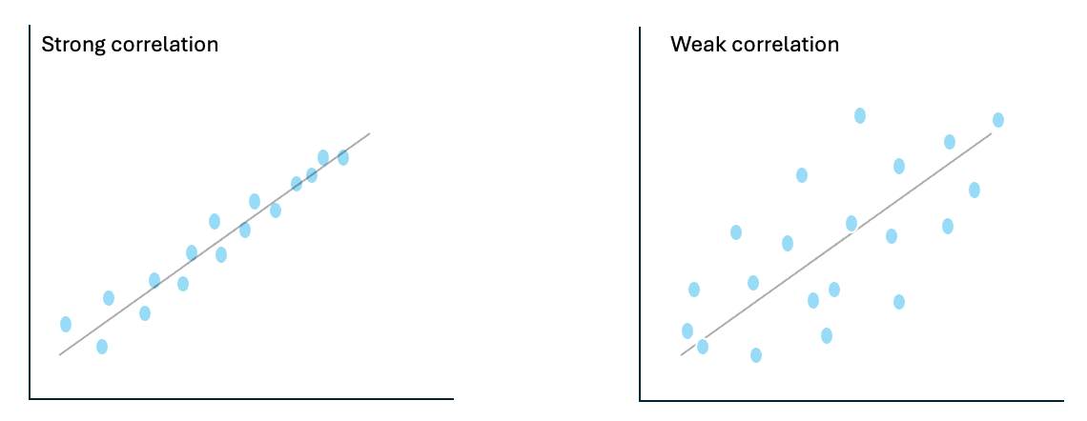
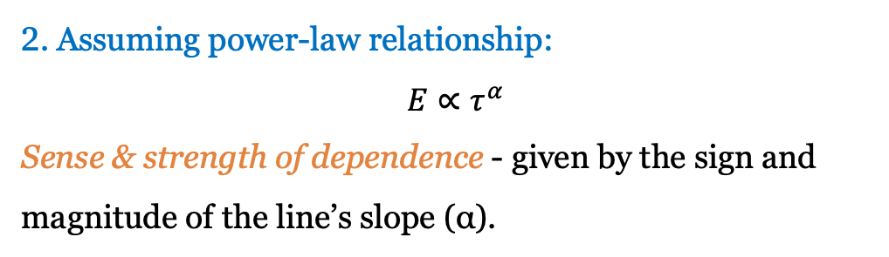
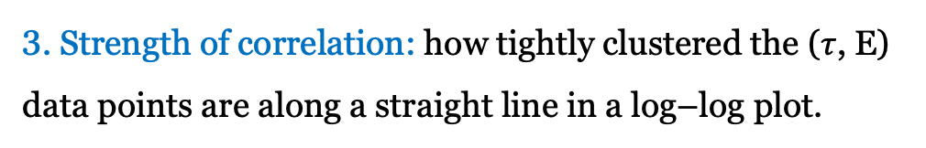



Three steps of the analysis
1. Null hypothesis test: probability of uncorrelation between $E \& τ$
2. Assuming power-law relationship:
$$E∝τ^{α}$$
Sense & strength of dependence - given by the sign and magnitude of the line’s slope (α).
Positive α : direct correlation
Negative α : inverse correlation
3. Strength of correlation: how tightly clustered the ($τ$, E) data points are along a straight line in a log–log plot.
$$E$$
$$E$$
$$τ$$
$$τ$$

Slide 12
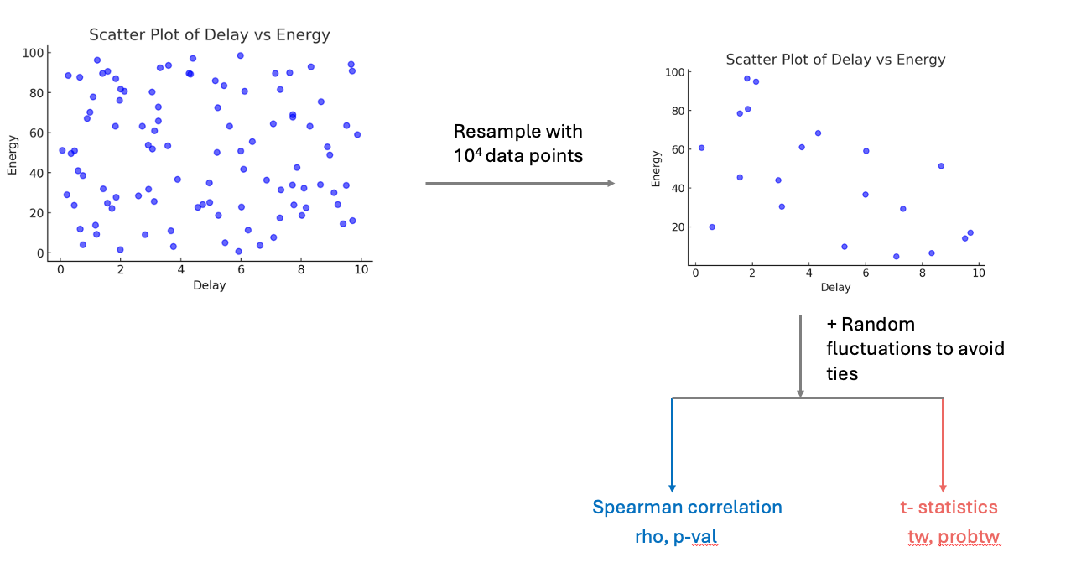
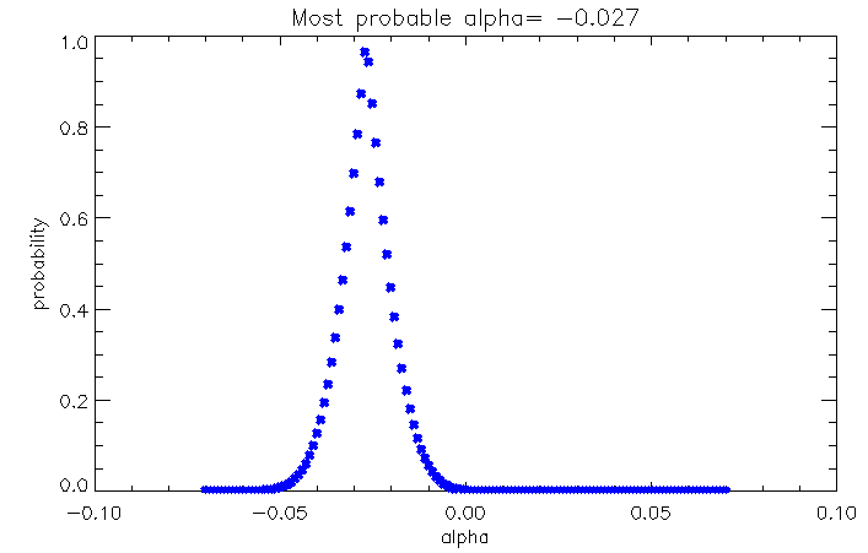


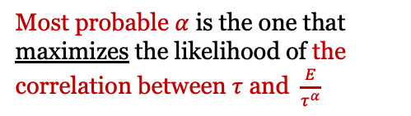

Original data
Resampled data
Finding $α$
Most probable $α$ is the one that maximizes the likelihood of the correlation between $τ$ and $\frac{E}{τ^{α}}$
Finding correlation
Lower the probability, more confident we are that the data are correlated.
$$E∝τ^{α}$$
$×$ 1000 resampling
Probability of uncorrelation

Slide 13
Nanoflare Energy & Delay from different methods

Slide 14
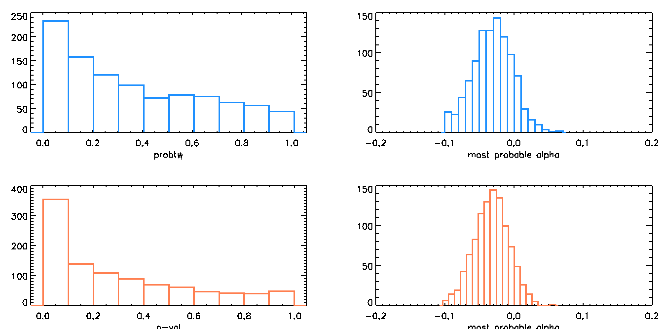






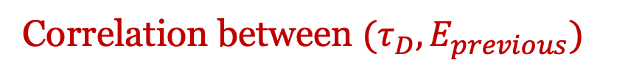
Correlation between ${(τ}_{D}, E_{previous})$
Method B
$$(τ_{D},E_{previous})$$
$$E_{previous}∝ τ_{D}^{α}$$
$$t_{w} statistics$$
$$t_{w} statistics$$
Probability of uncorrelation
Most probable 𝛼
$$Spearman Correlation$$
$$Spearman Correlation$$
Probability of uncorrelation
Most probable 𝛼

Slide 15
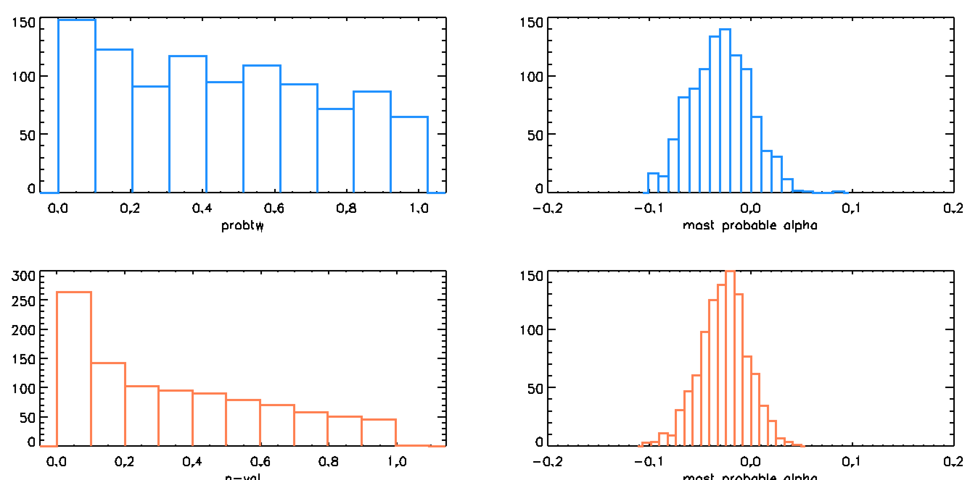




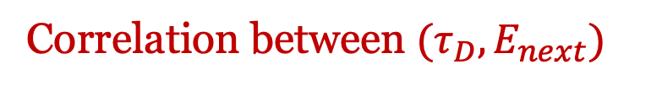


Correlation between ${(τ}_{D}, E_{next})$
Method B
$$(τ_{D},E_{next})$$
$$E_{next}∝ τ_{D}^{α}$$
$$t_{w} statistics$$
$$t_{w} statistics$$
Probability of uncorrelation
Most probable 𝛼
$$Spearman Correlation$$
$$Spearman Correlation$$
Probability of uncorrelation
Most probable 𝛼

Slide 16
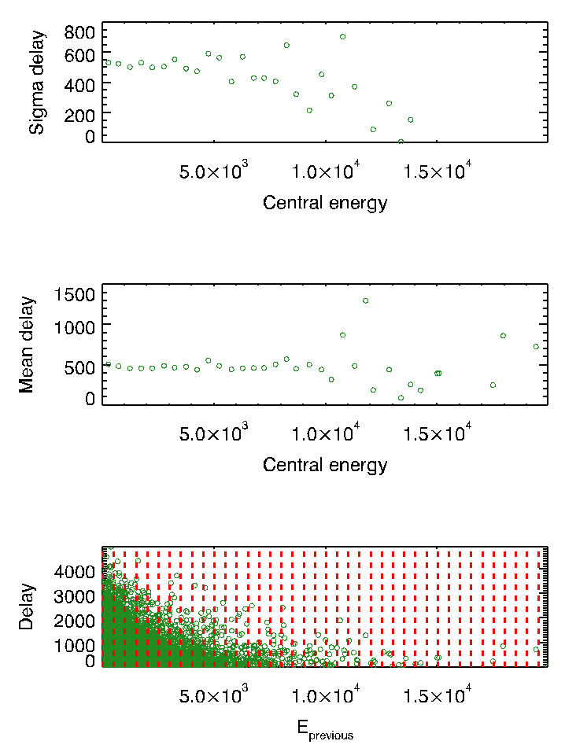
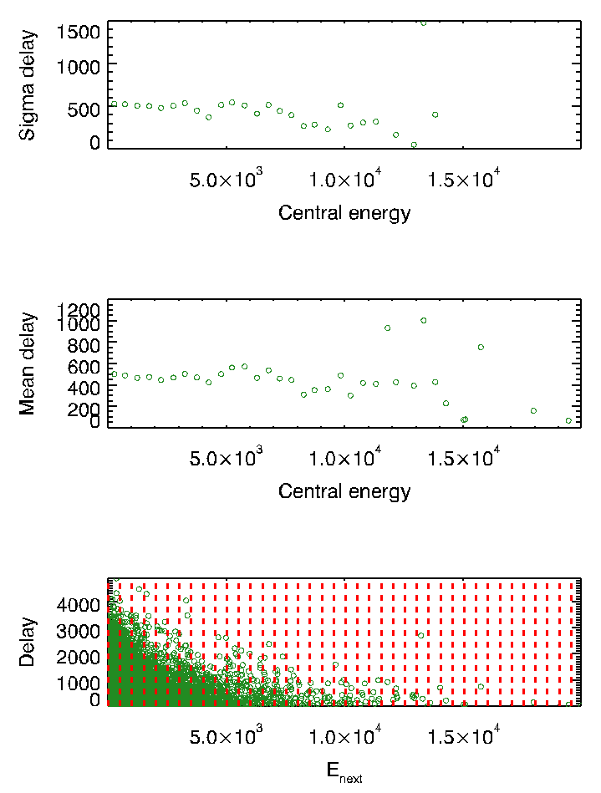
Spread in the data
Method B
E_{previous}
E_{next}

Slide 17
Possible scenario

Slide 18
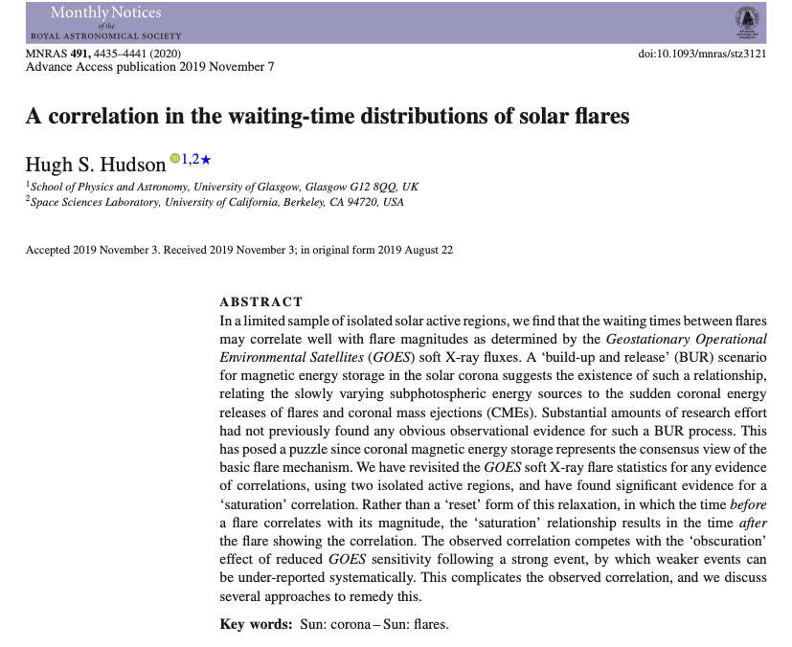
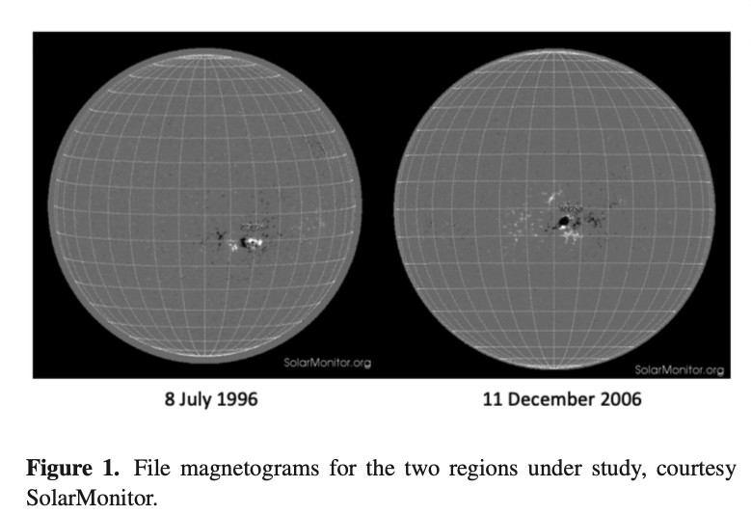

Slide 19
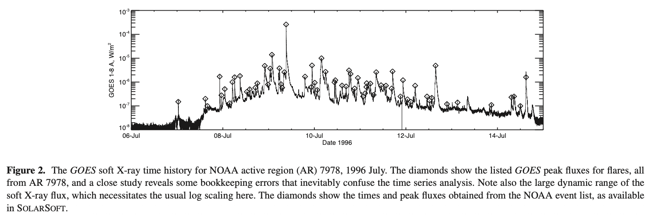
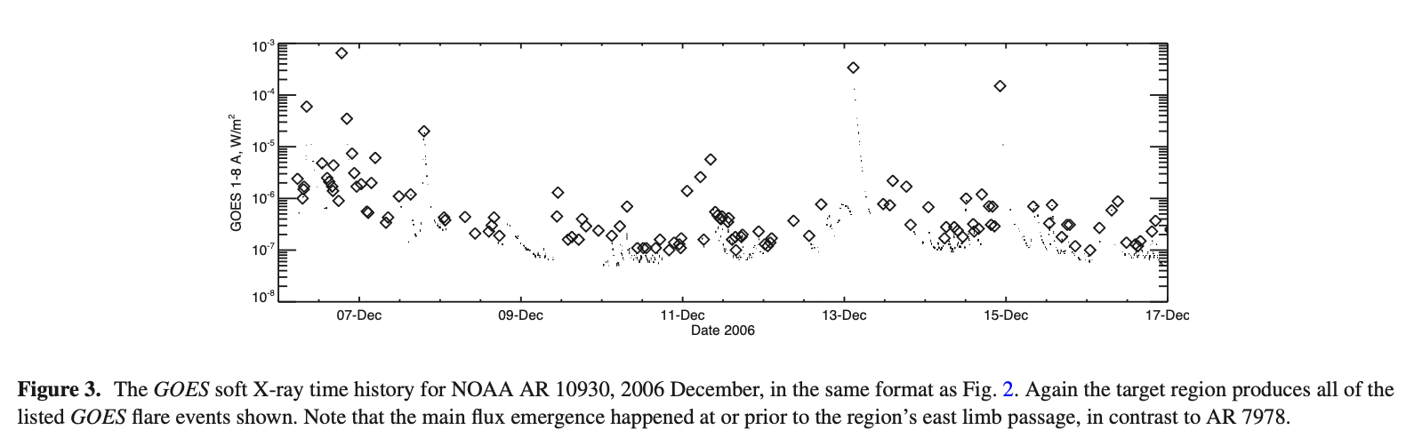
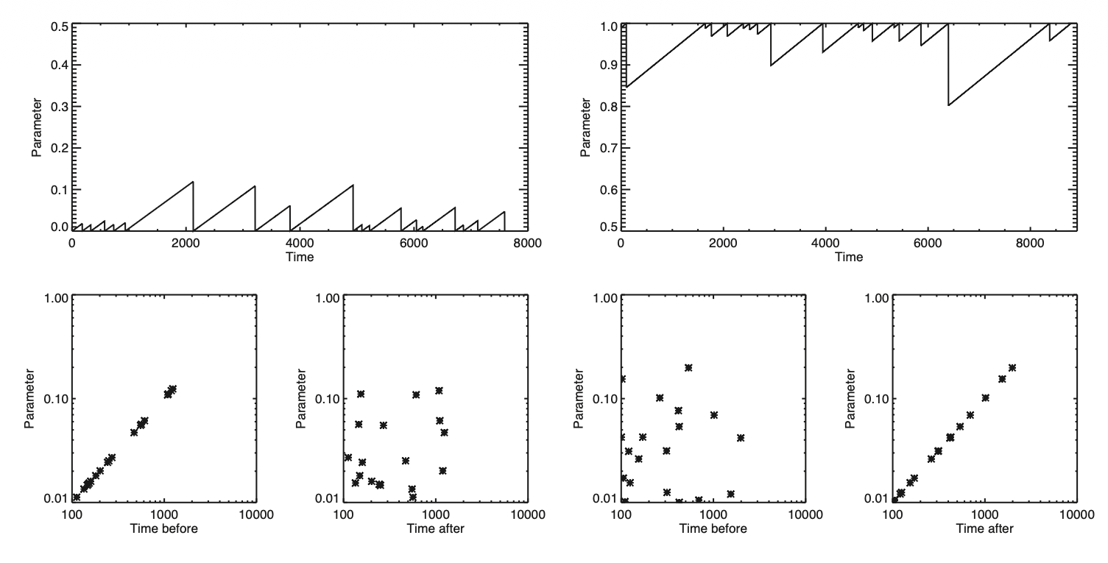
‘Reset’ case
E ∝ time before the event
‘Saturation’ case
E ∝ time after the event

Slide 20


$$E∝t_{before}, t_{after}$$
‘Reset’ case
E ∝ time before the event
‘Saturation’ case
E ∝ time after the event
$$τ_{D}∝E_{before}, E_{after}$$

Slide 21
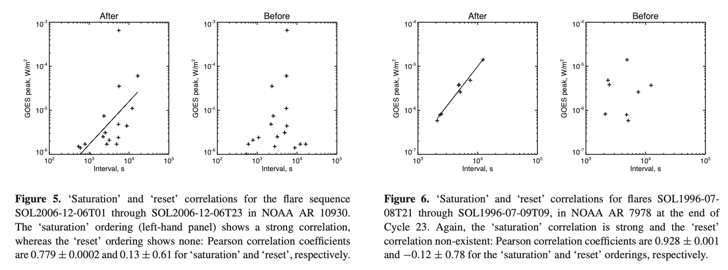

Slide 22
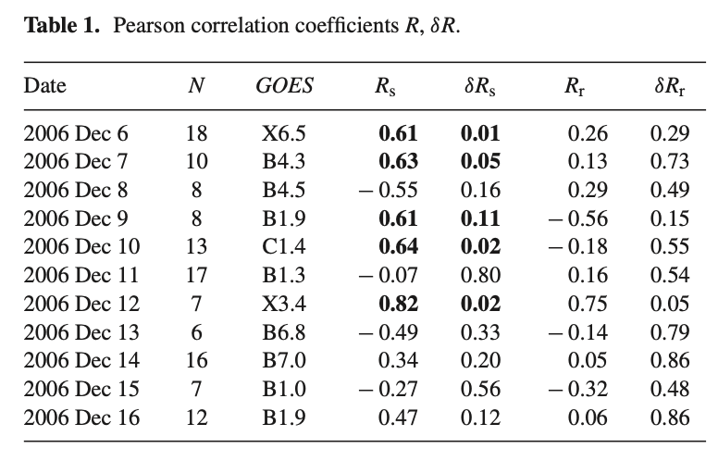

Slide 23
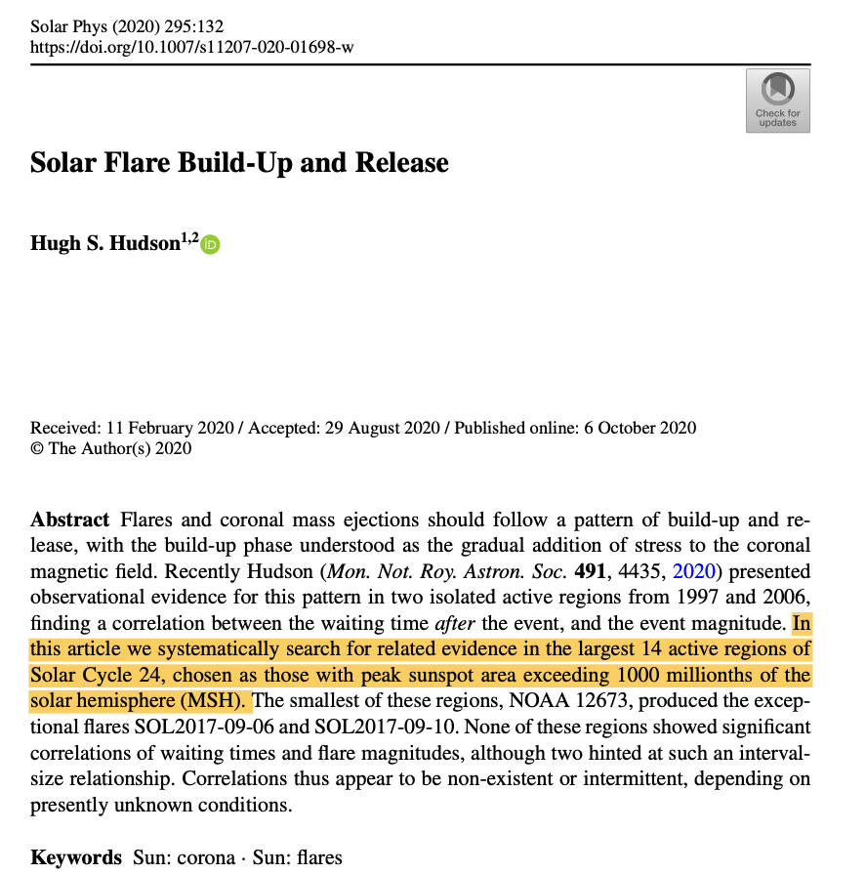
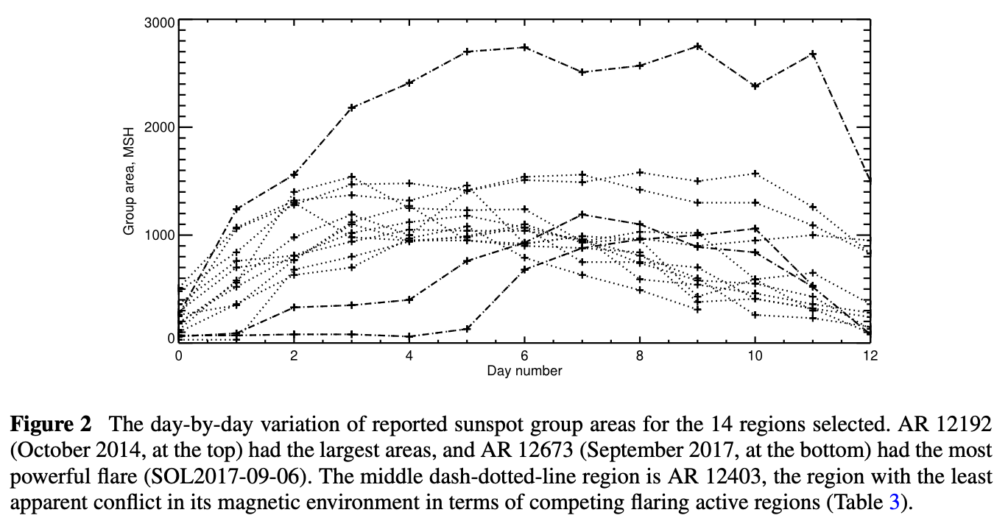
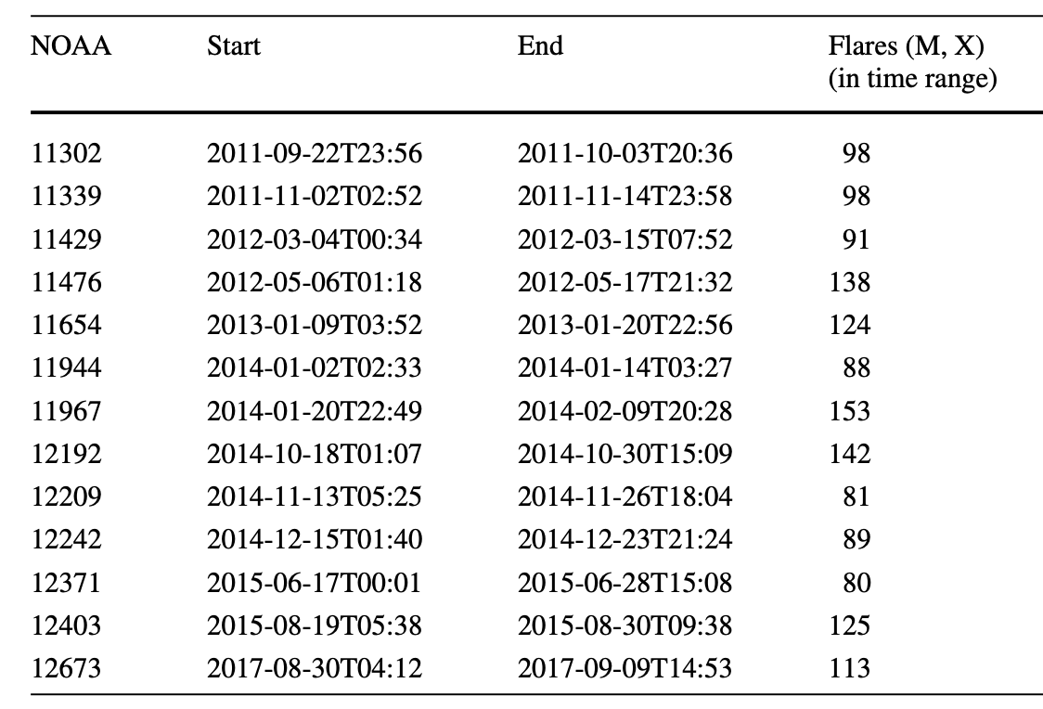
Table 1 Active regions: Time spans (indicated as year-month-day-time) and flare occurrences

Slide 24
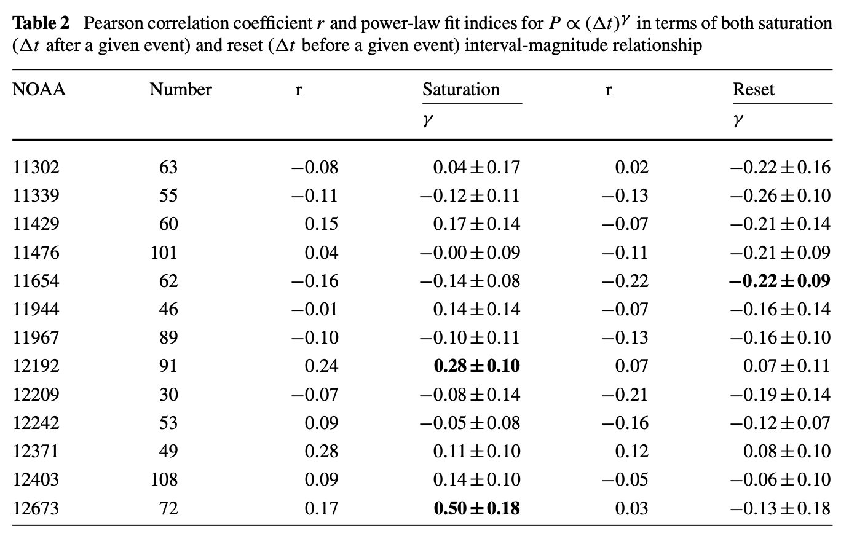
Also examined the correlation for one-day interval– no correlation found!

Slide 25
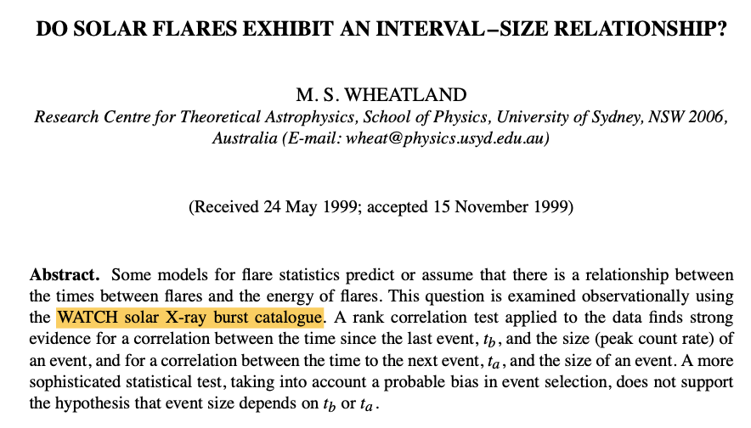
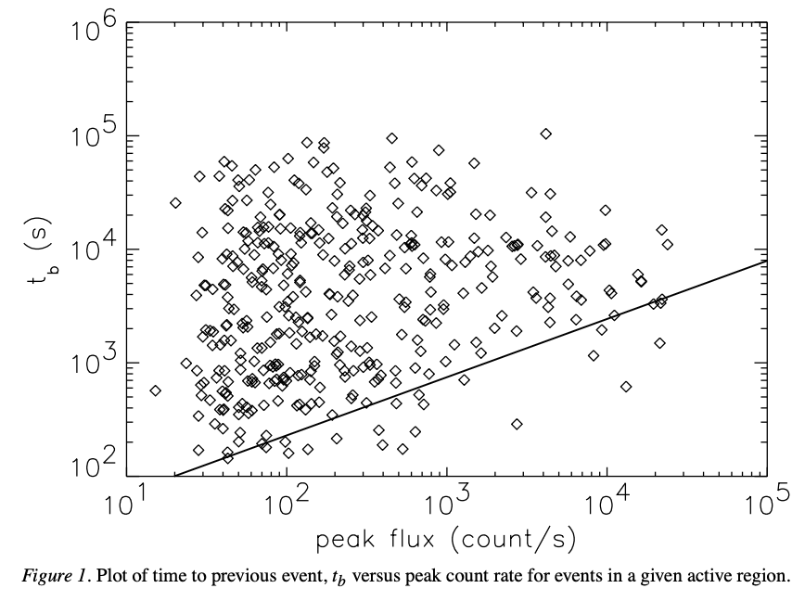
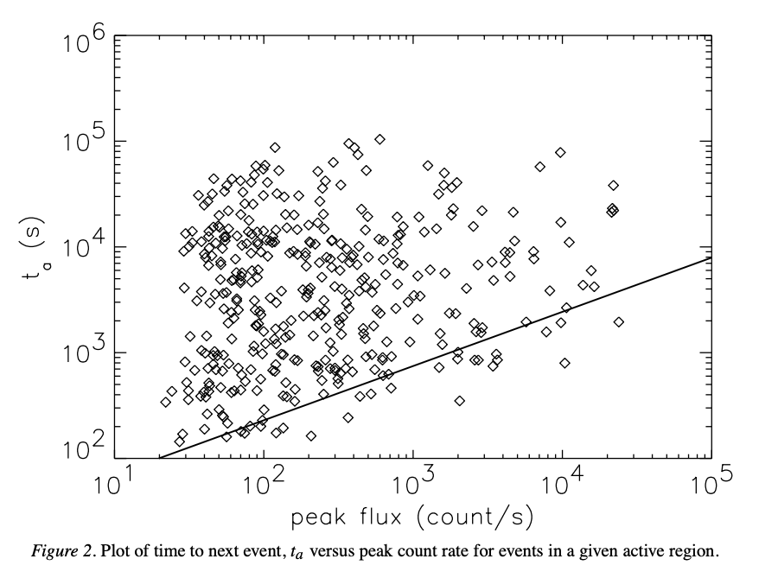
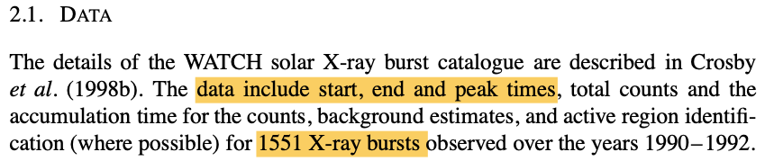
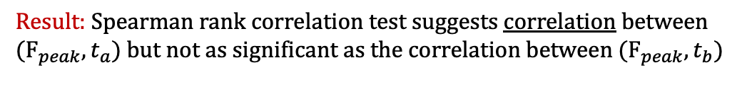
Result: Spearman rank correlation test suggests correlation between $(F_{peak}, t_{a})$but not as significant as the correlation between $(F_{peak}, t_{b})$

Slide 26
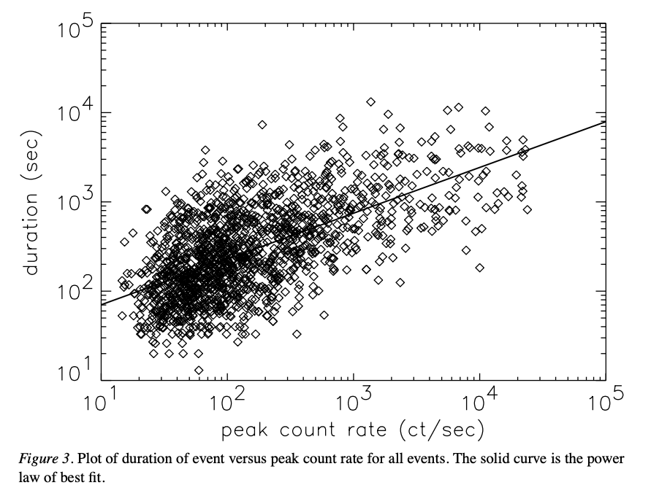

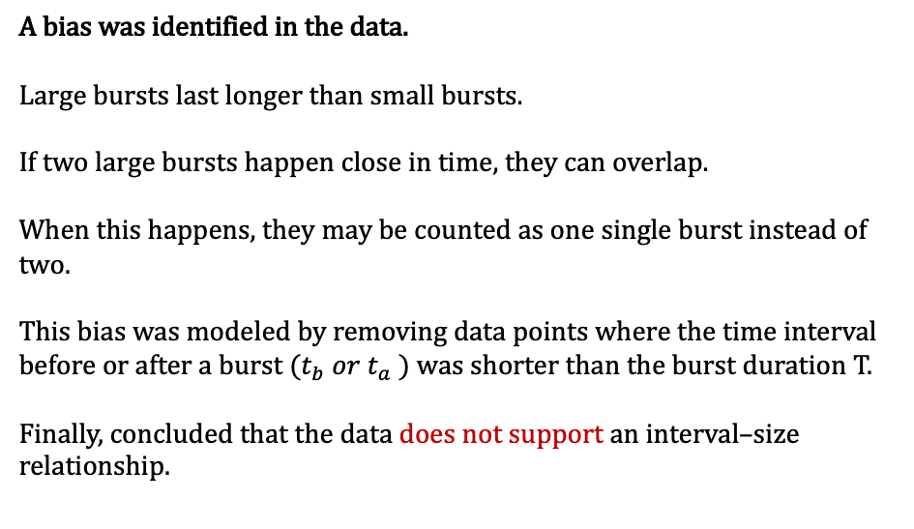
A bias was identified in the data.
Large bursts last longer than small bursts.
If two large bursts happen close in time, they can overlap.
When this happens, they may be counted as one single burst instead of two.
This bias was modeled by removing data points where the time interval before or after a burst ($t_{b} or t_{a}$) was shorter than the burst duration T.
Finally, concluded that the data does not support an interval–size relationship.
Two possible interpretations of the result:
There is an interval-size relationship and it is being masked by various effects
There is no interval- size relationship in flares.
Possible masking scenarios:
An AR contains a number of independent flaring elements.
Each element has a characteristic energy–delay relationship.
Combining flares from the entire AR suppresses this relationship.
The relationship can be best examined using homologous flares recurring at the same location within an AR.
(2) Missing of small events due to instrumental sensitivity, a threshold for detection, or because of background emission.
Avalanche model does not exhibit energy–delay relationship

