Slide 1
Characterizing Nanoflare Energy and Frequency through Field Line Analysis
Shanwlee Sow Mondal, Lars. K. S. Daldorff, James A. Klimchuk, & Craig. D. Johnston

Slide 2
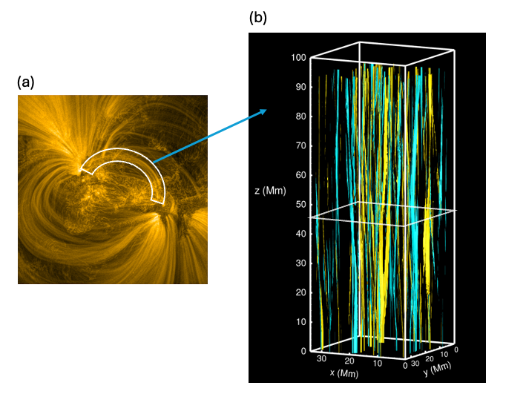
Simulation of a subset of an Active Region
From Jim’s ISFM talk

Slide 3
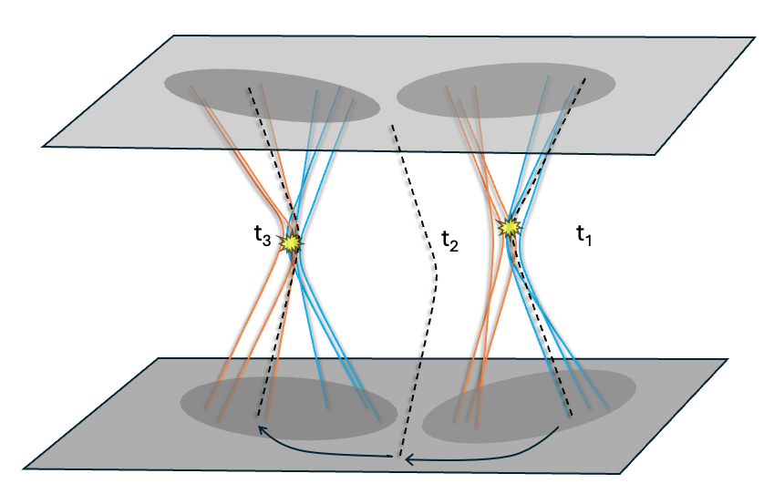
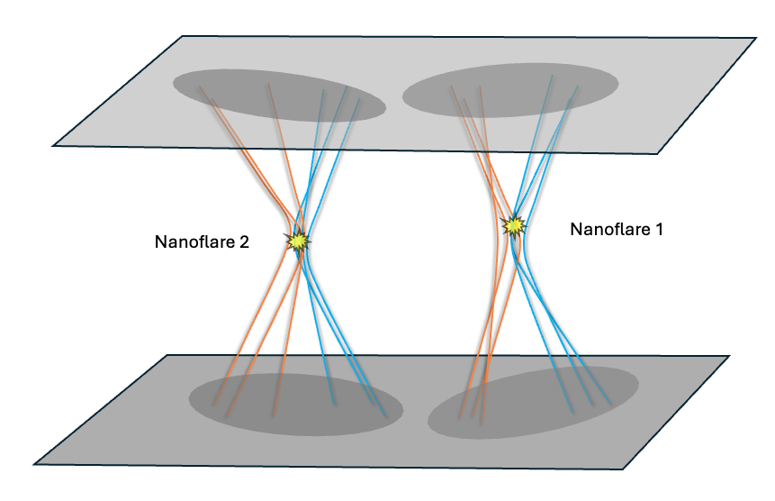
Uniqueness of this study
This study
Previous studies from literature
Energy per unit area ---Heating integrated along the field line
Heating integrated over the volume
Notes:
We track multiple filed lines – say I am tracking the black field line. At t1 it has undergone reconnection, then it gets advected by the flow, at t3 it again undergoes reconnection.
So, nanoflare energy in this scenario is defined as the sum of these fractions of heating the field line experiences as it undergoes through multiple reconnection sites.
Heating is the heating integrated along the field line, so we express nanoflare energy as energy per unit area.
Whereas, in previous studies, everything was from volume perspective, so the nanoflare energy is energy integrated of the volume over which the energy is released.

Slide 4
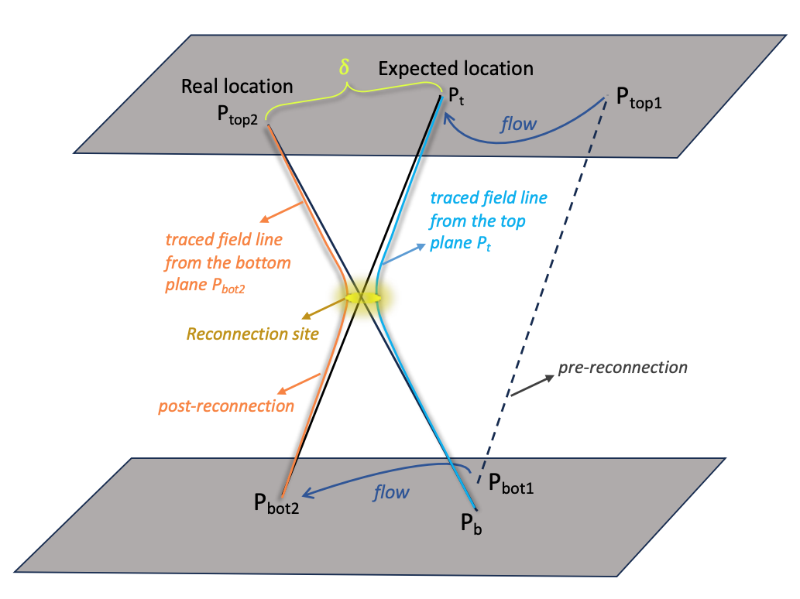
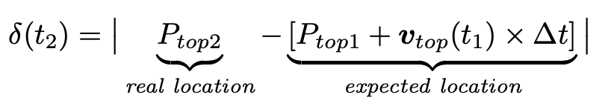
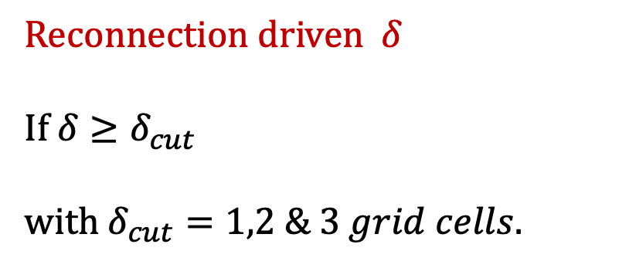
Identify reconnections
Reconnection driven $δ$
If $δ≥δ_{cut}$
with $δ_{cut}=1,2 \& 3 grid cells.$

Slide 5
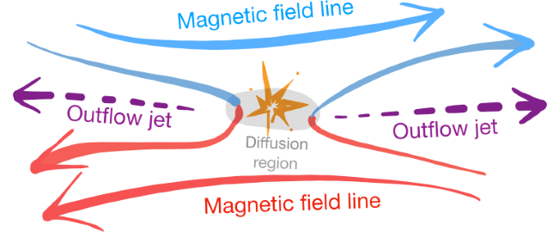
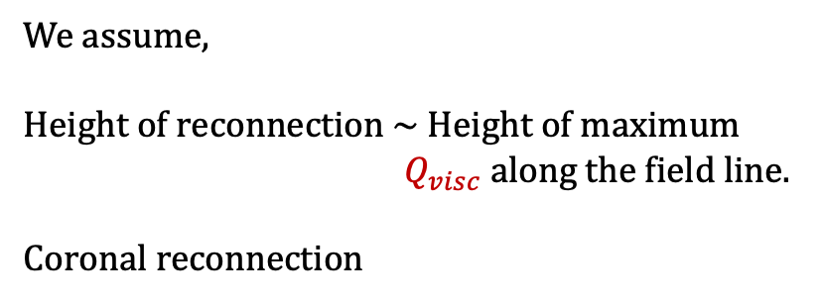

Quantify energy released in reconnection events
Shock heating
($Q_{visc}$)
We assume,
Height of reconnection ~ Height of maximum
$Q_{visc}$ along the field line.
Coronal reconnection
Notes:
High velocity gradient at the shock front leads to viscous heating which the simulation identifies as primary source of heating associated with reconnection.
Q_visc along the field line. Maximum Q_visc at what height?
If \delta condition is satisfied, find the height of reconnection, if it is in corona, we move forward to quantify nanoflare energy.

Slide 6
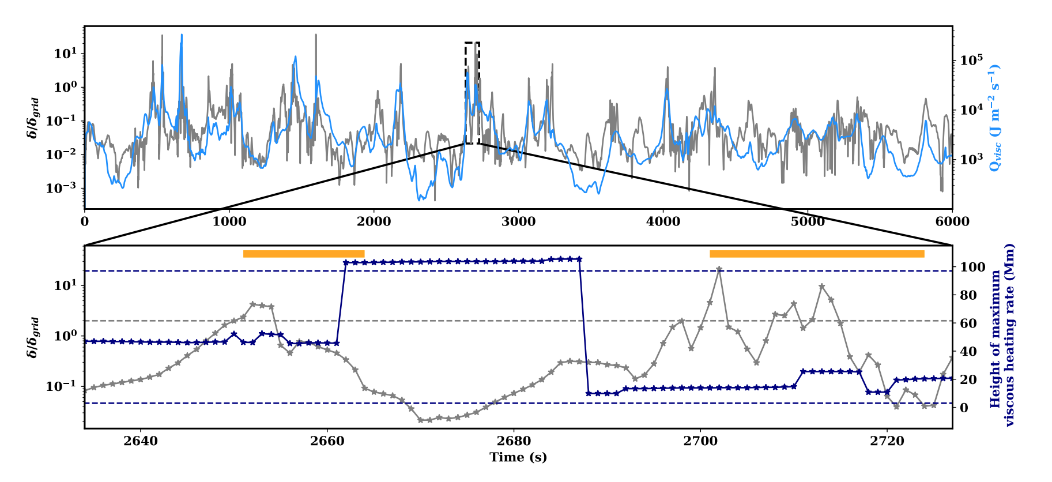

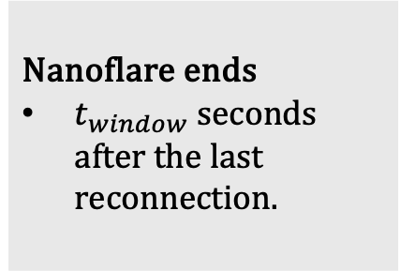
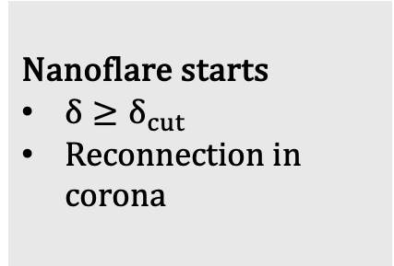
Define nanoflare: Method A
$$t_{window}=10s$$
Nanoflare starts
$δ≥δ_{cut}$
Reconnection in corona
Nanoflare ends
$t_{window}$seconds after the last reconnection.
Nanoflare duration = (End – Start ) of the nanoflare
Notes:
We employ a waiting time of t_window to account for this finite duration and define the end of the nanoflare to be the end of the waiting time if no other reconnection occurs.
If another reconnection does occur during the waiting time, we extend the waiting time to t_window after that reconnection. This continues until there is no additional reconnection during the last t_window.
The duration of the nanoflare thus extends from the time of the first reconnection to t_window seconds after the last reconnection.

Slide 7
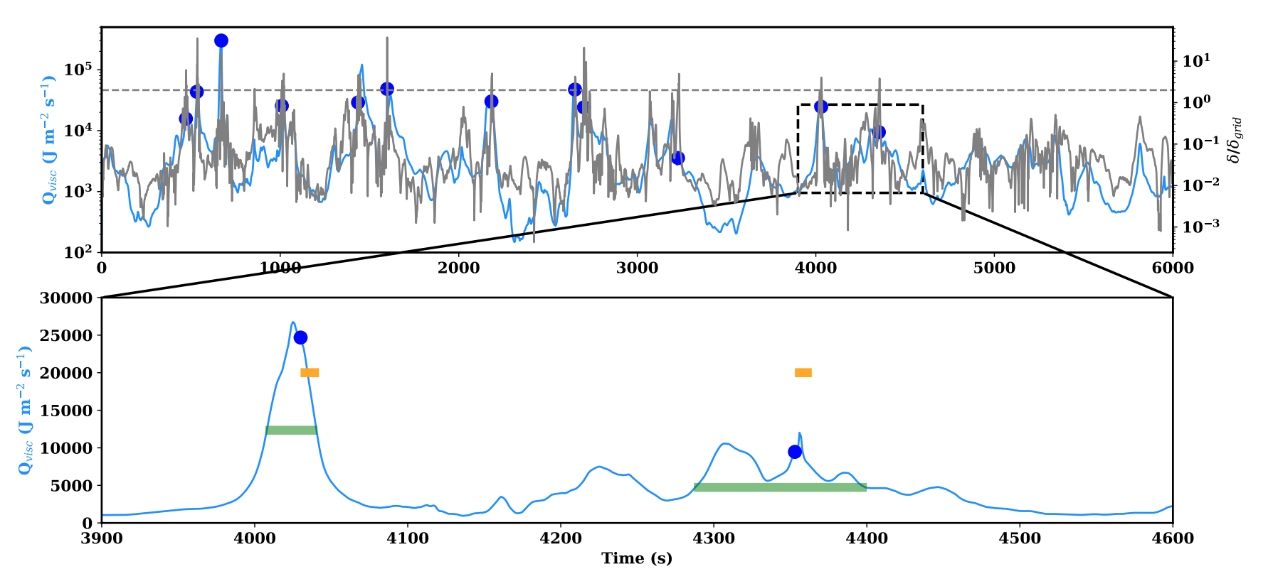
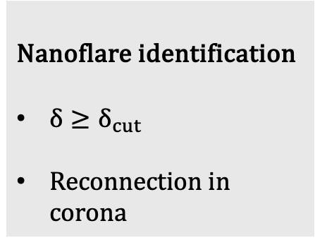

Define nanoflare: Method B
Nanoflare identification
$δ≥δ_{cut}$
Reconnection in corona
Nanoflare duration = FWHM of $Q_{visc}$
The ‘maximum’ of FWHM is the strongest $Q_{visc}$ within nanoflare duration from Method A
Notes:
Within this yellow bar, find the maximum Q_visc. FWHM of this maximum Q_visc give the nanoflare duration in Method B.

Slide 8
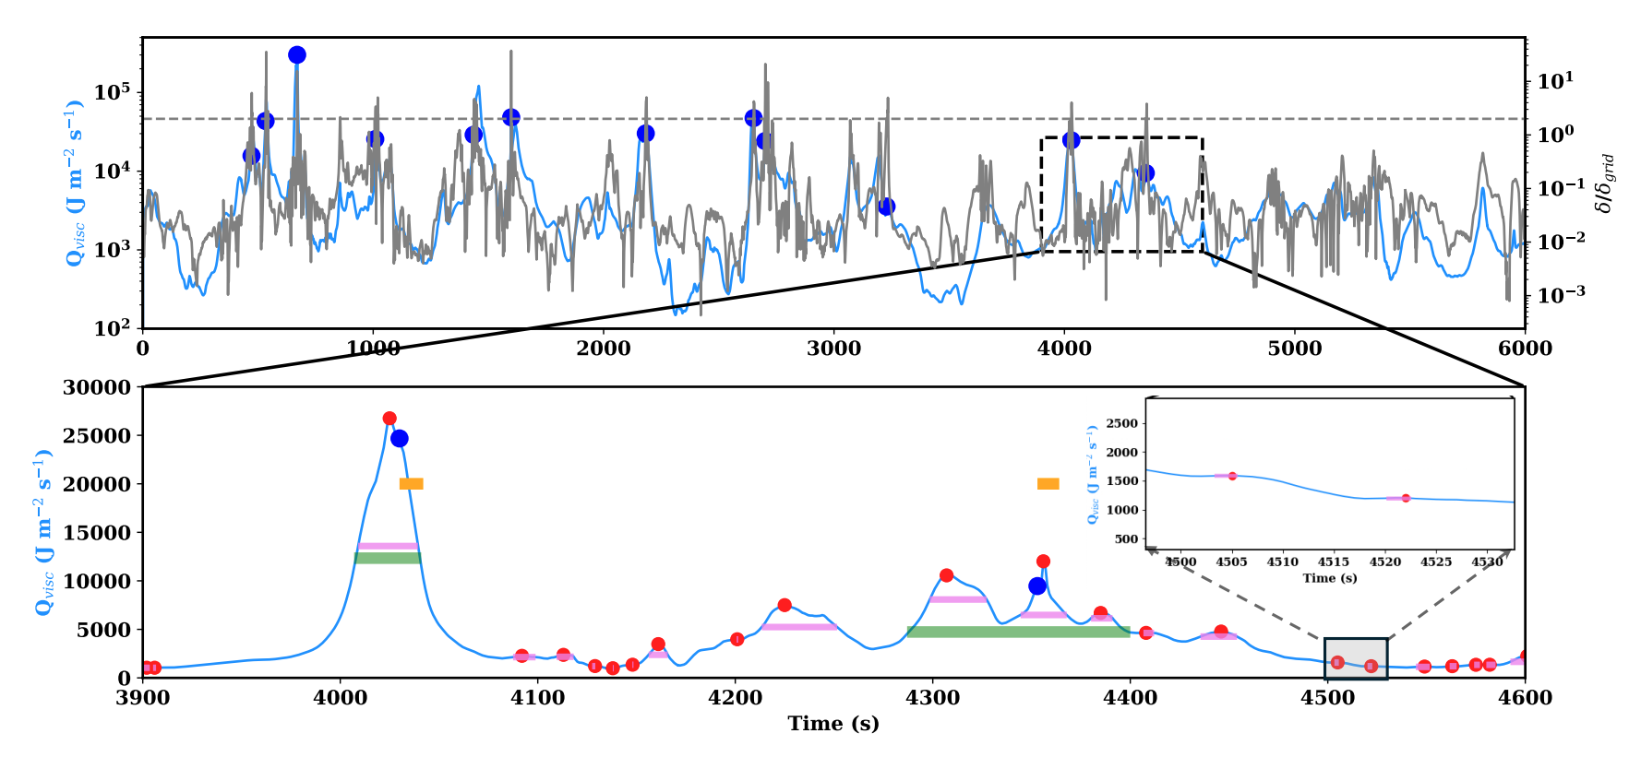
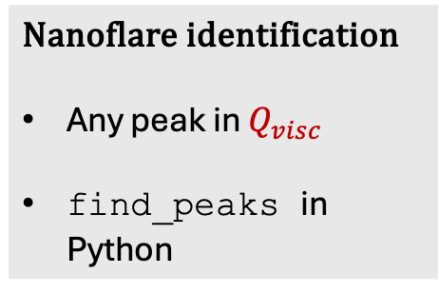
Define nanoflare: Method C
Nanoflare identification
Any peak in $Q_{visc}$
find_peaks in Python
Nanoflare duration
peak_widths in Python

Slide 9
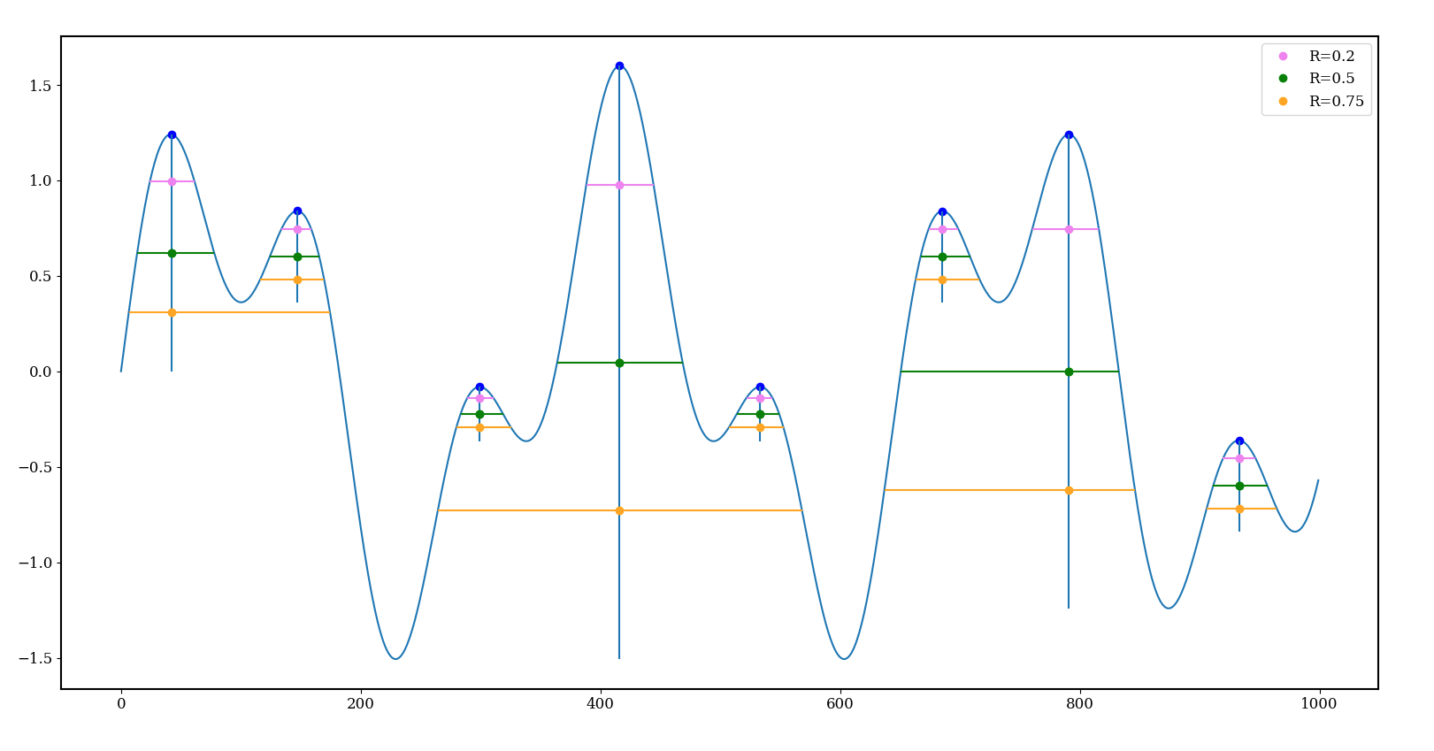
Nanoflare duration: Method C
Merge if overlap
Notes:
The ‘maximum’ of FWHM is the strongest $Q_{visc}$ within nanoflare duration from Method A

Slide 10
Define nanoflare: Method C
Nanoflare identification
Any peak in $Q_{visc}$
find_peaks in Python
Nanoflare duration
peak_widths in Python
Notes:
The ‘maximum’ of FWHM is the strongest $Q_{visc}$ within nanoflare duration from Method A

Slide 11
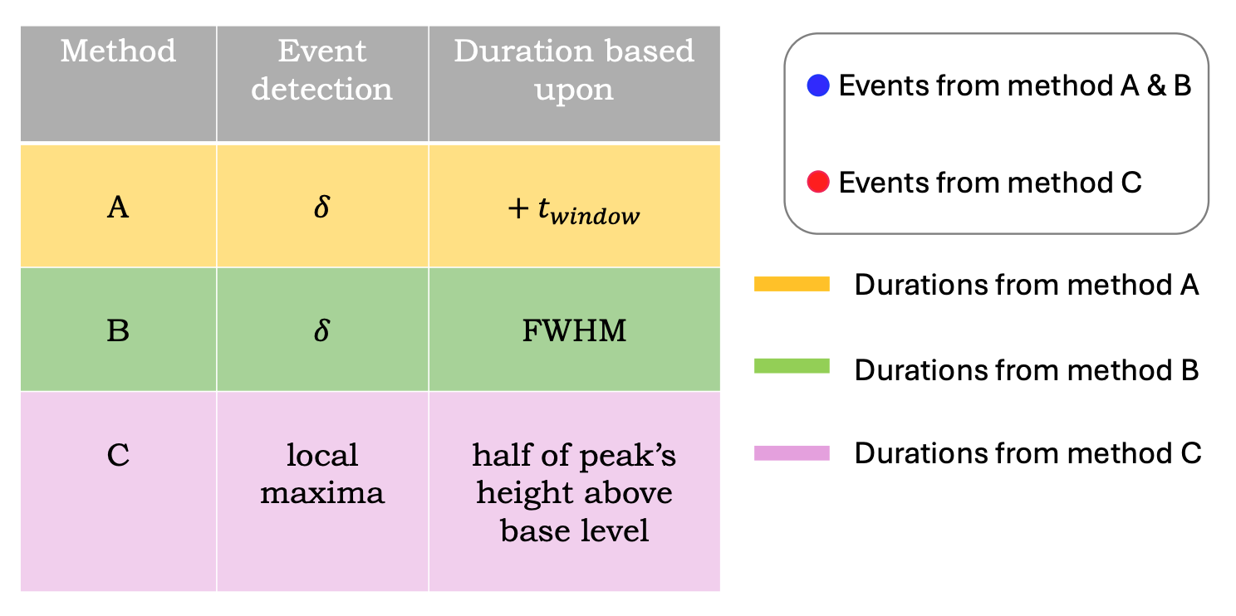

Table summarizing the three methods
Nanoflare energy = $\int_{duration}{Q_{visc}}dt$
Num. of footpoints tracked = 3136
Total time = 6000 s

Slide 12
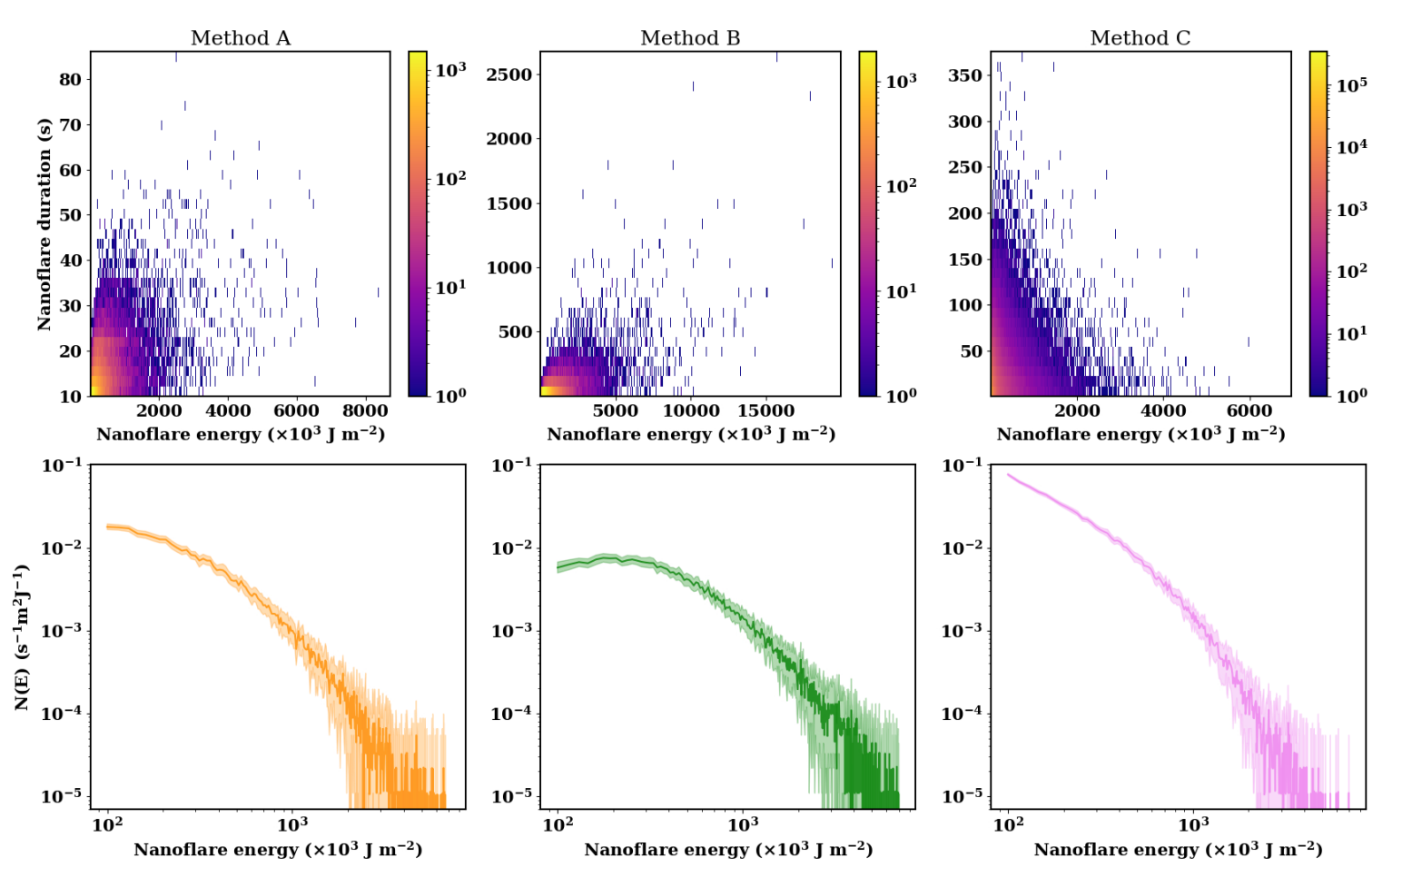
Results: Nanoflare energy distributions

Slide 13
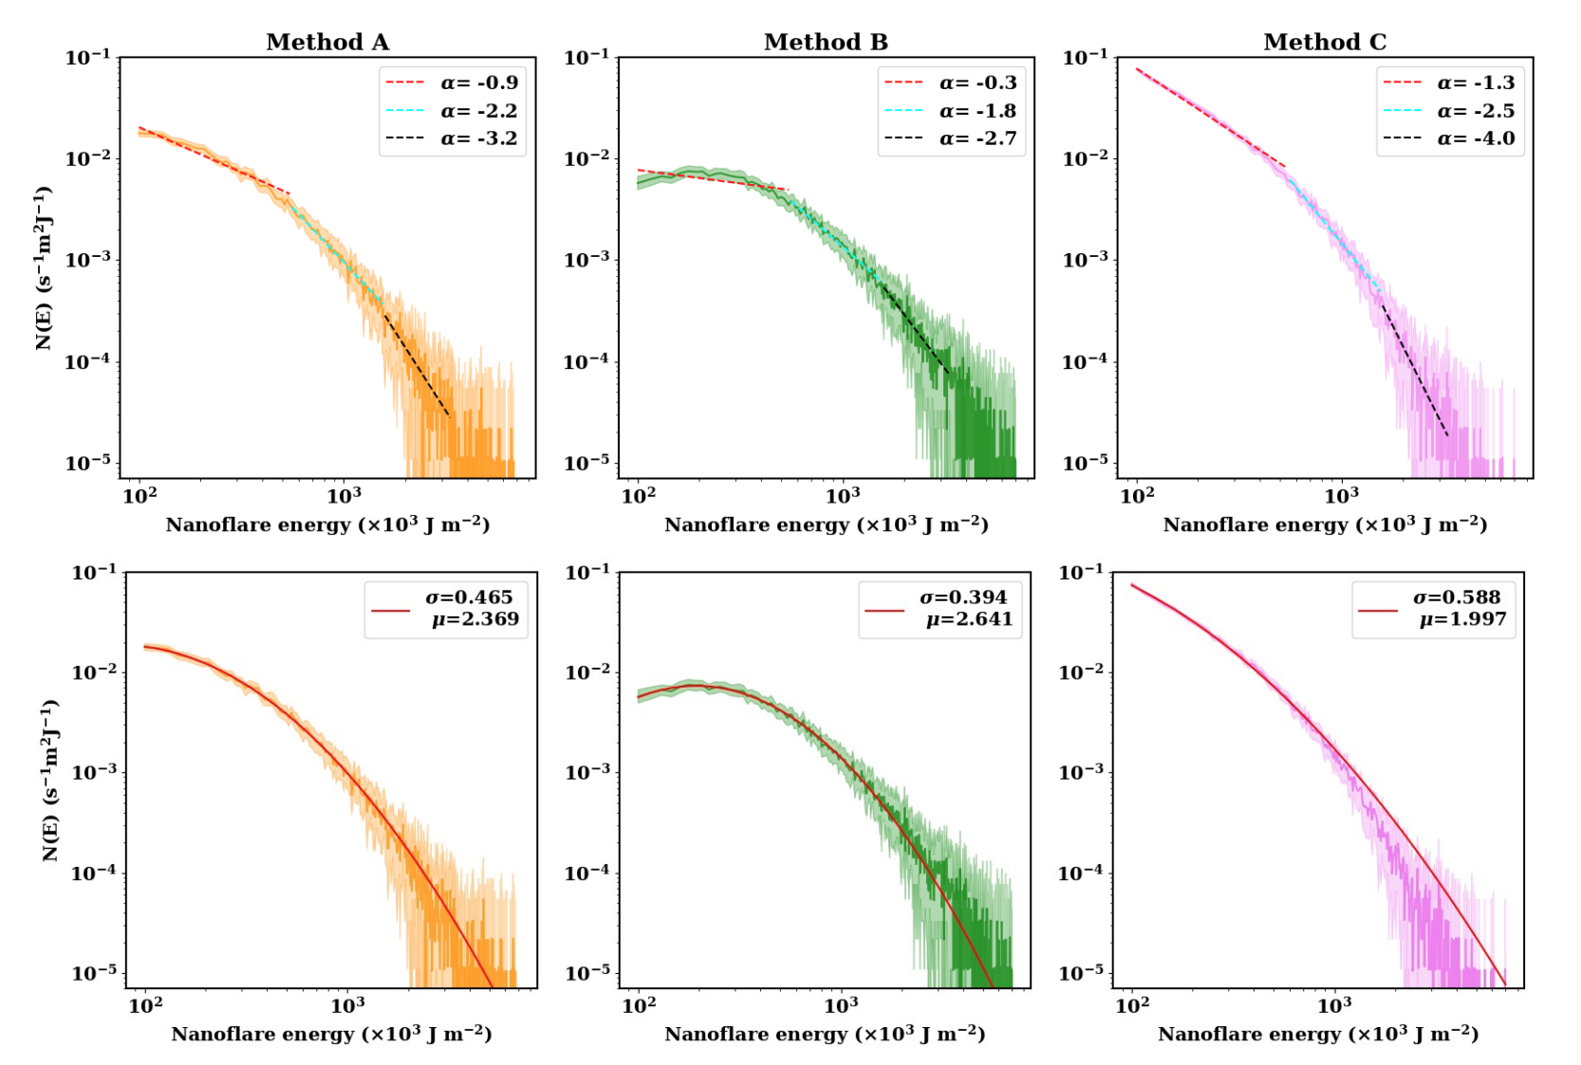

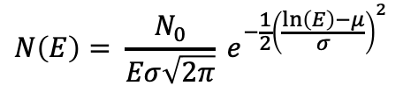
Nanoflare energy distributions: Power-law vs log-normal fit
Power-law
$$N\left(E\right)∼E^{α}$$
Log-normal
$$N\left(E\right)= \frac{N_{0}}{Eσ\sqrt{2π}} e^{−\frac{1}{2}{\left(\frac{\ln\left(E\right)−μ}{σ}\right)}^{2}}$$

Slide 14
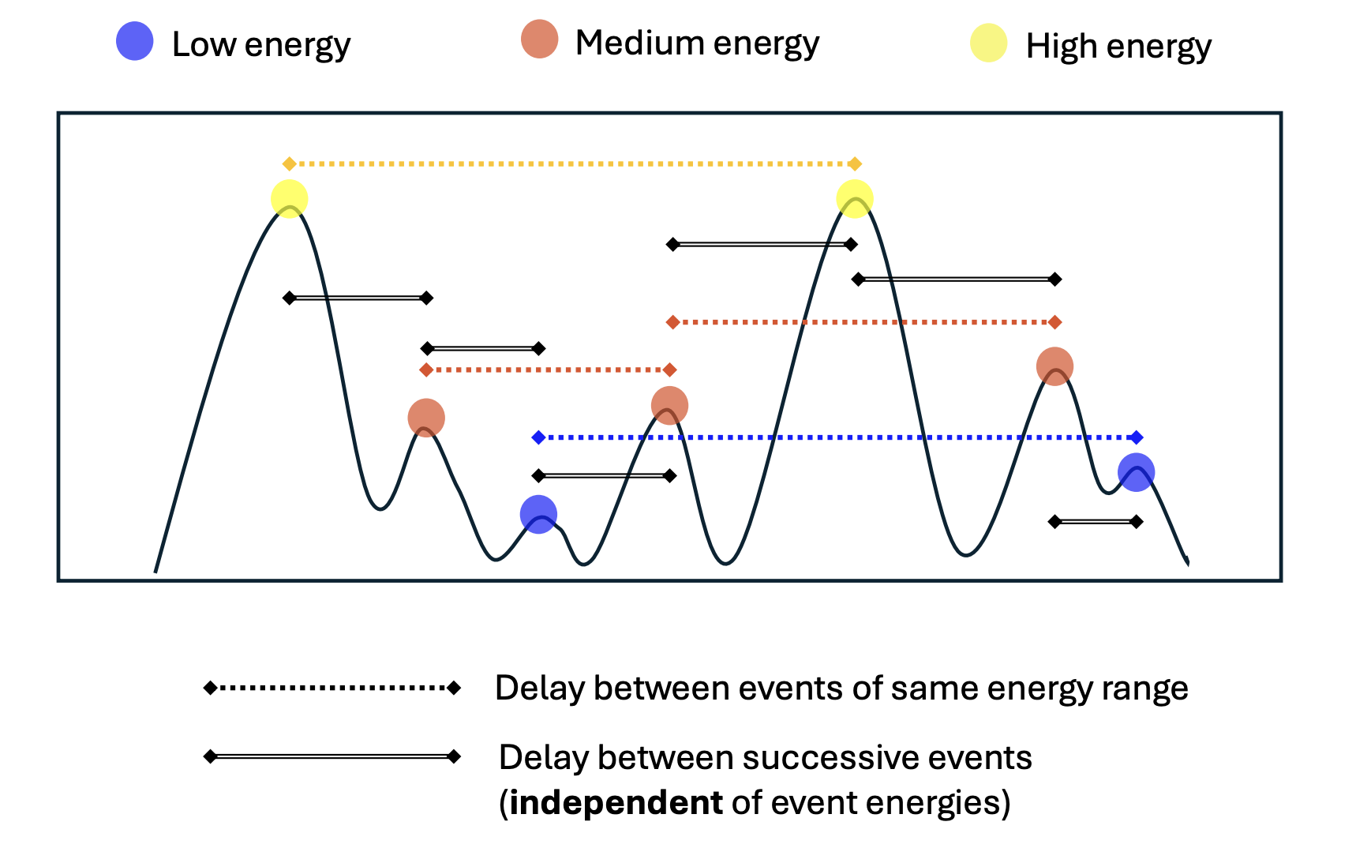
Nanoflare frequencies
Nanoflare frequencies:
Energy-dependent repetition frequency
Energy-independent repetition frequency

Slide 15
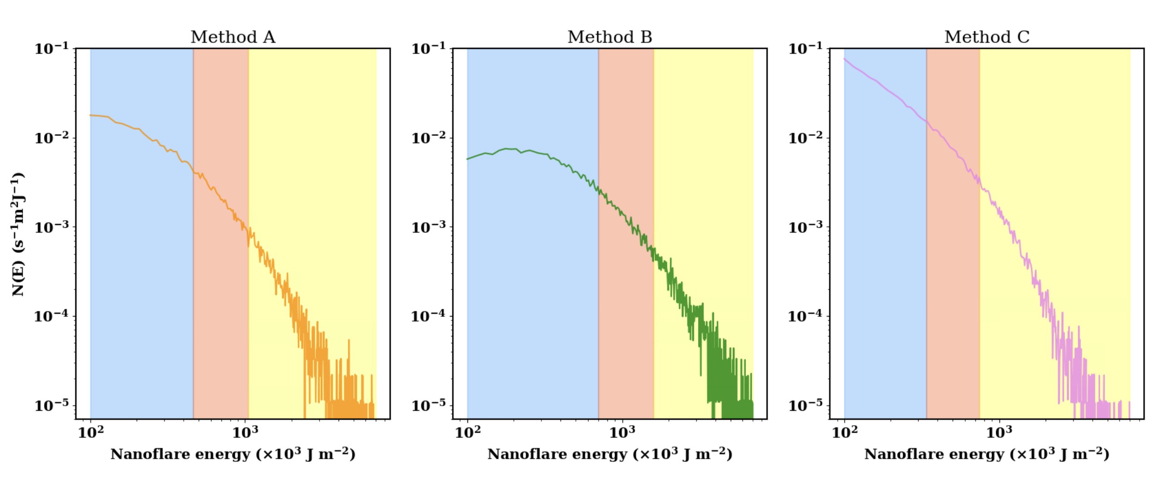
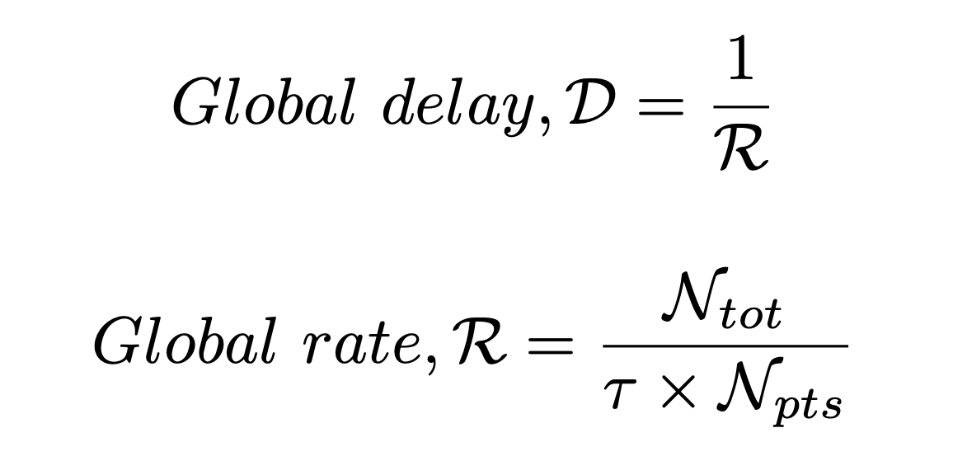
Global delays
low med high
low med high
low med high

Slide 16
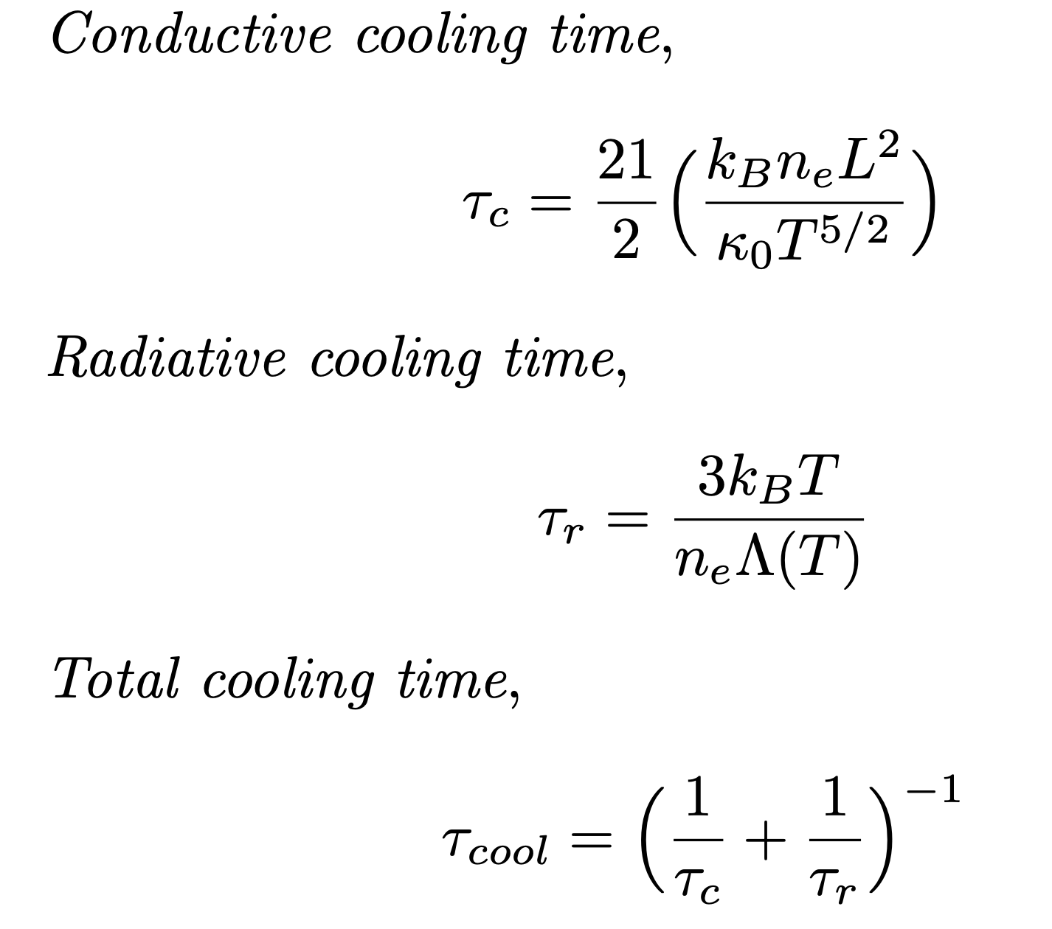
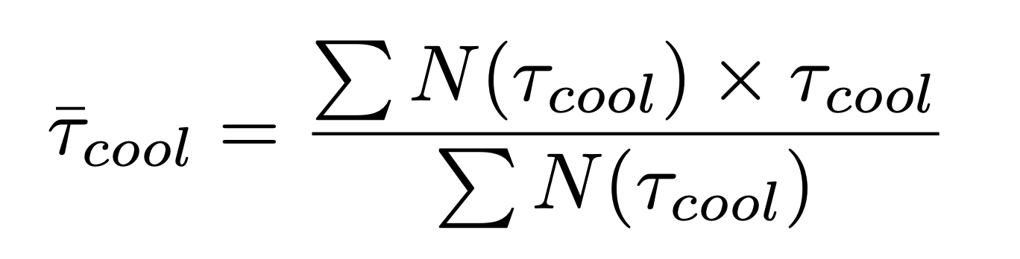
Plasma Cooling Time

Slide 17
Global delays & average cooling time

Slide 18
Overall temperature evolution

Slide 19
Key takeaways
Log-normal energy distribution of the nanoflares instead of power-law.
Nanoflares of varying energies recur at different frequencies –
high energy nanoflares repeat at lower frequencies
low energy nanoflares repeat at higher frequencies.
This agrees with the previously reported broad range of heating frequencies in active regions.

