Slide 1
Considering the transition region when studying coronal heating
Sam Schonfeld
Jim Klimchuk
3/4/2020, Work Package meeting

Slide 2
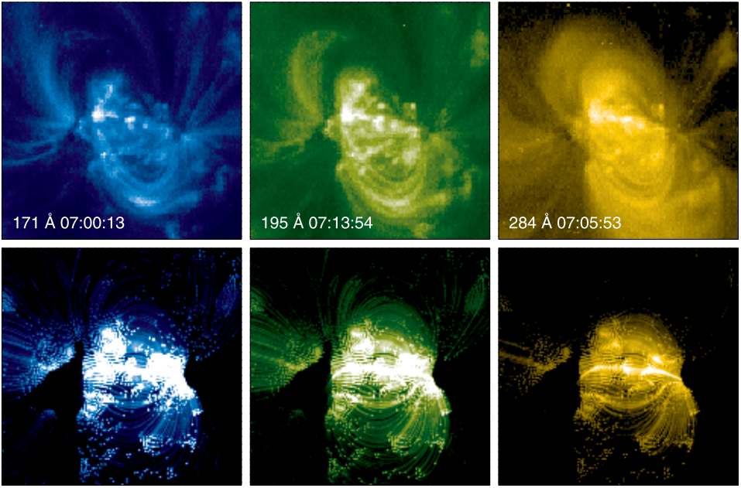
Modeling Active Regions in EUV
Warren and Winebarger 2007

Slide 3
Complications Including the Transition Region
171 Å
Steep gradients
Leads to strong dynamics
Magnetic field expansion
Overproduced in models
With TR
No TR
211 Å
Nita et al. 2018

Slide 4
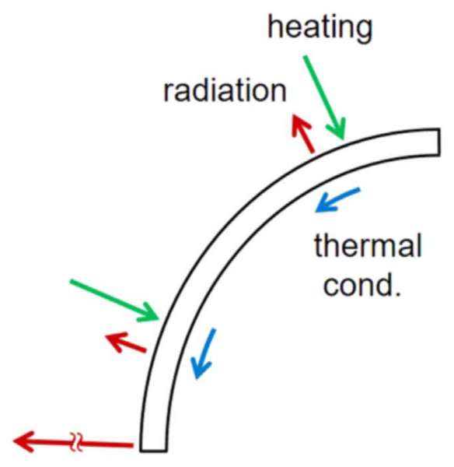
The transition region in EBTEL
EBTEL defines $C_{1}={R_{TR}}/{R_{C}}$
Ratio of total radiated emission
$C_{1}= \frac{2C_{1,eq}+C_{ var}\left({\left({n_{eq}}/n\right)}^{2}−1\right)}{1+{\left({n_{eq}}/n\right)}^{2}}; C_{1,eq}=2$
$C_{var}=\left\{\begin{aligned}C_{1,cond}=6 ;n<n_{eq} \\ C_{1, rad} =2 ;n>n_{eq}\end{aligned}\right.$
$C_{1}=2$ in equilibrium
Emission in different channels determined by atomic physics and plasma conditions
Klimchuk and Luna 2019

Slide 5
Exploring Distribution of Heating Events
Parameter | Low | High
Loop half-length [Mm] | 30 | 100
Heating flux [erg cm⁻² s⁻¹] | 5x10⁶ | 2x10⁷
Minimum delay time [s] | 100 | 1000
Heating distribution slope | -2.5 Lopez Fuentes and Klimchuk 2015 | -1 Knizhnik and Reep 2020

Slide 6
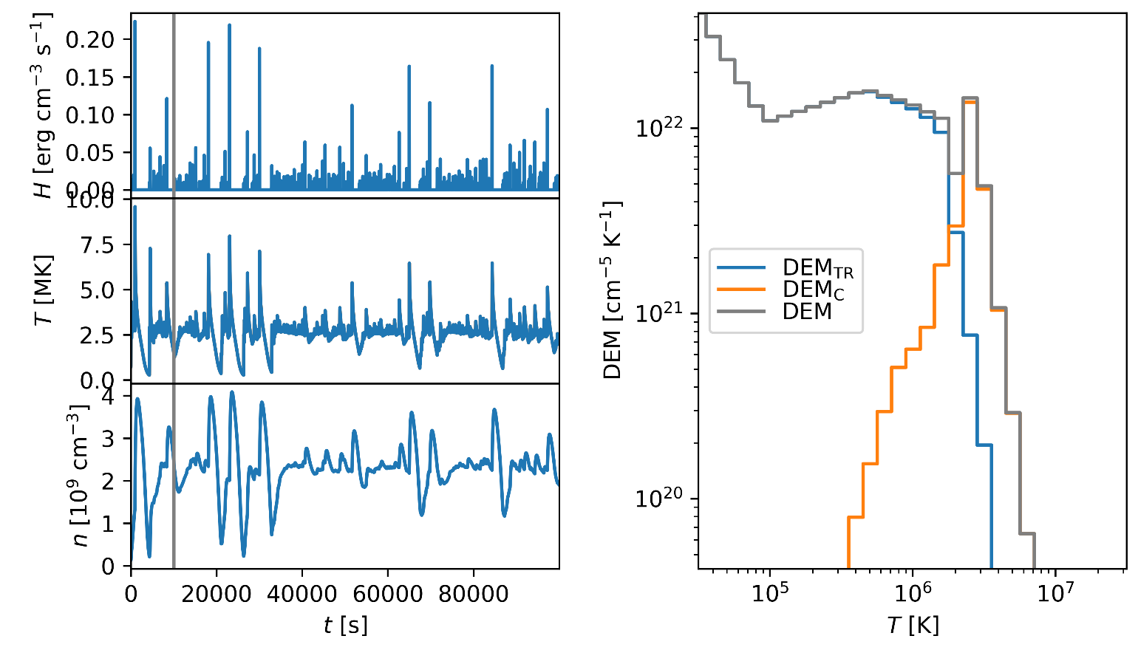
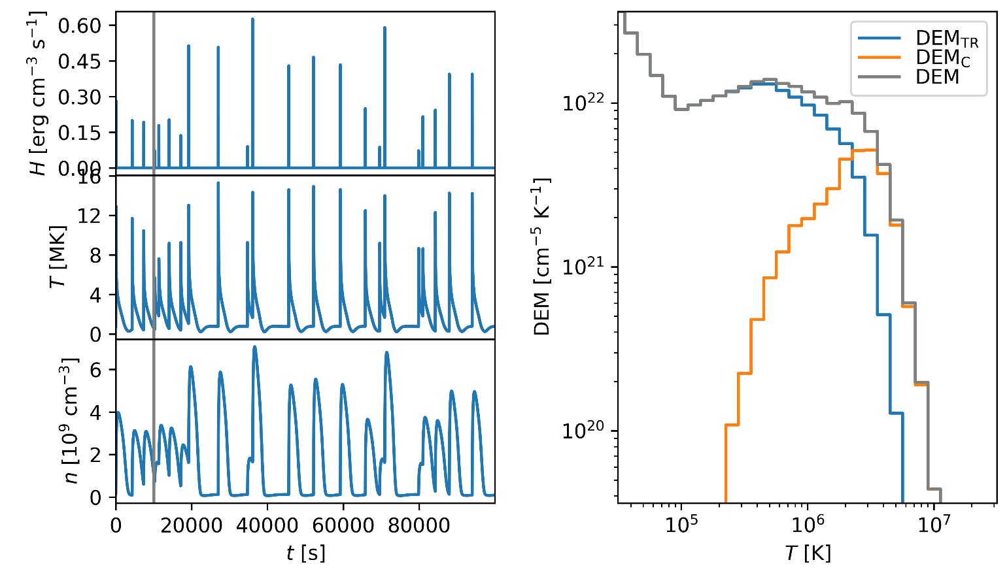
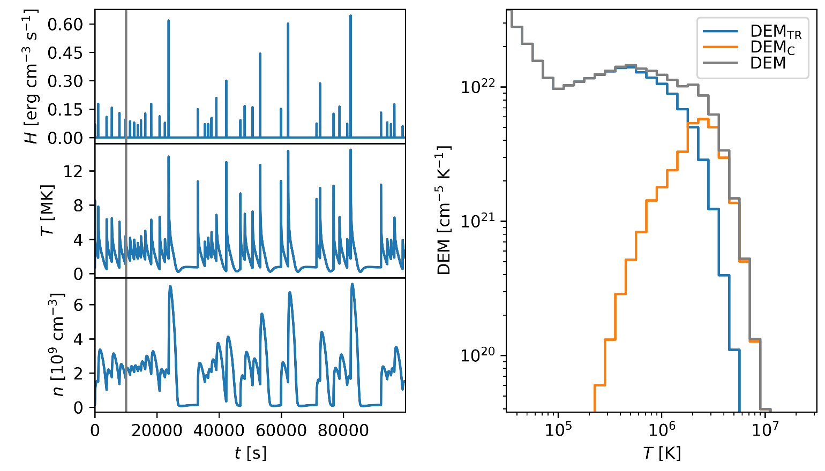
30 Mm, 5x10⁶ erg cm⁻² s⁻¹, 100 s, -1
30 Mm, 5x10⁶ erg cm⁻² s⁻¹, 100 s, -2.5
30 Mm, 5x10⁶ erg cm⁻² s⁻¹, 1000 s, -1
30 Mm, 5x10⁶ erg cm⁻² s⁻¹, 1000 s, -2.5

Slide 7
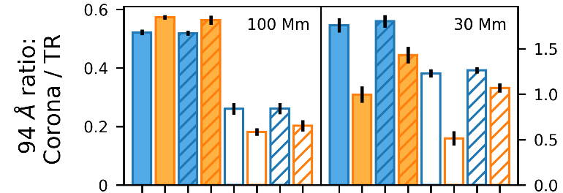
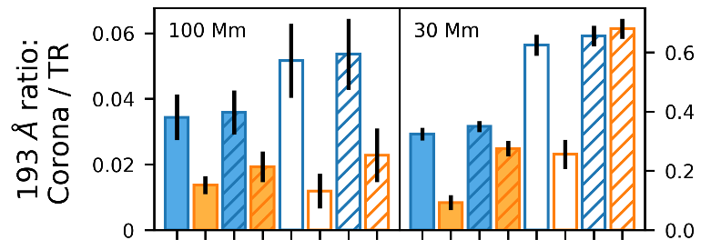
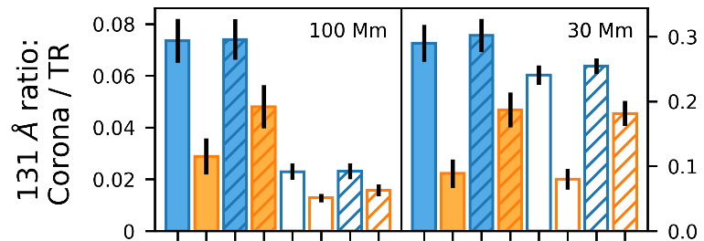
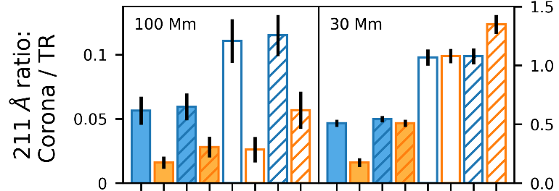
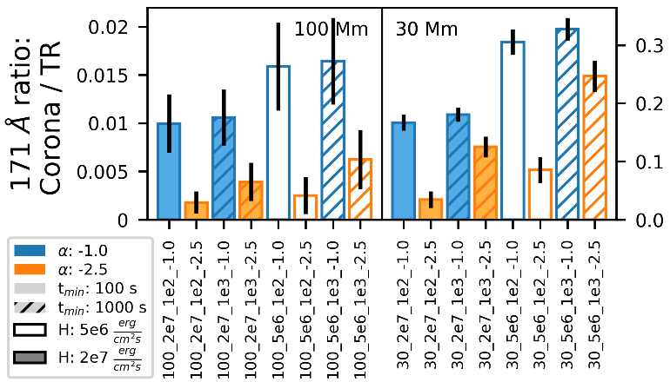
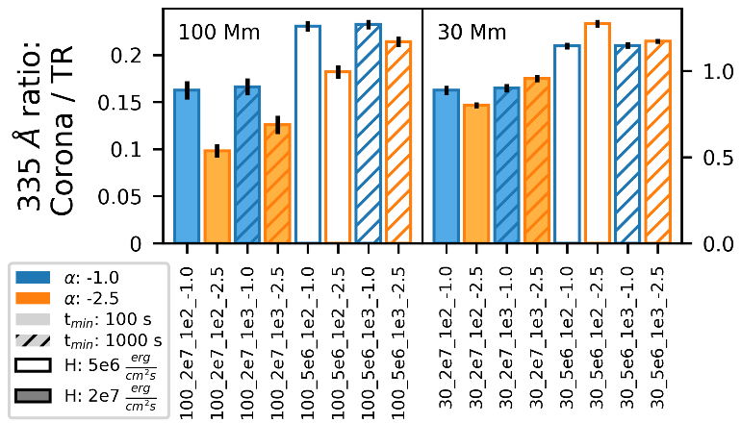

Slide 8
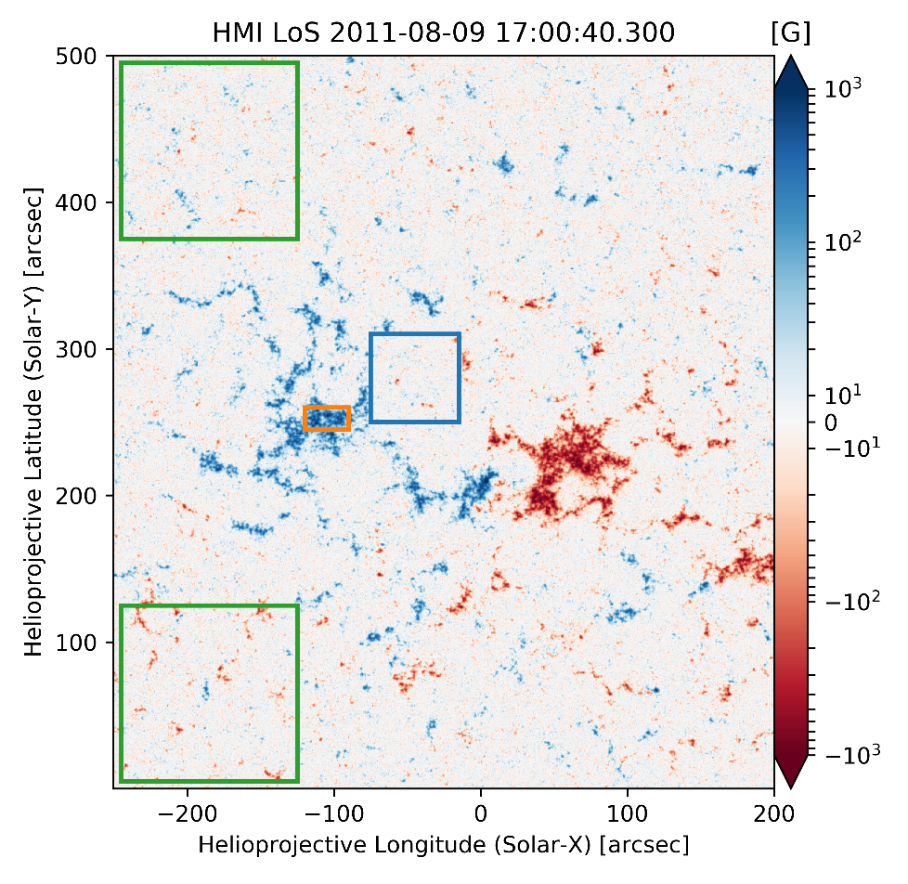
Measuring AIA Transition Region and Corona

Slide 9
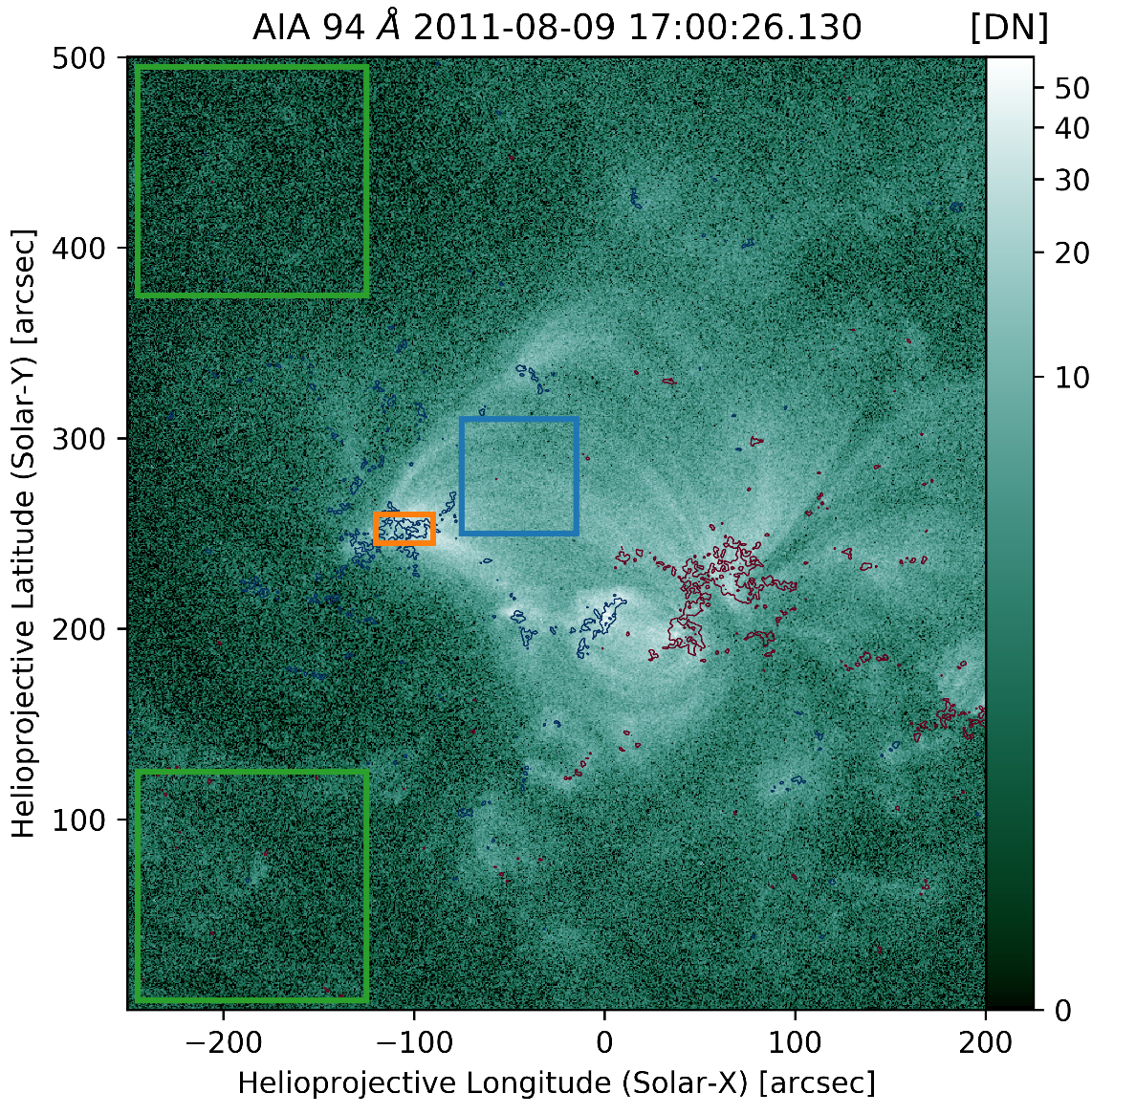
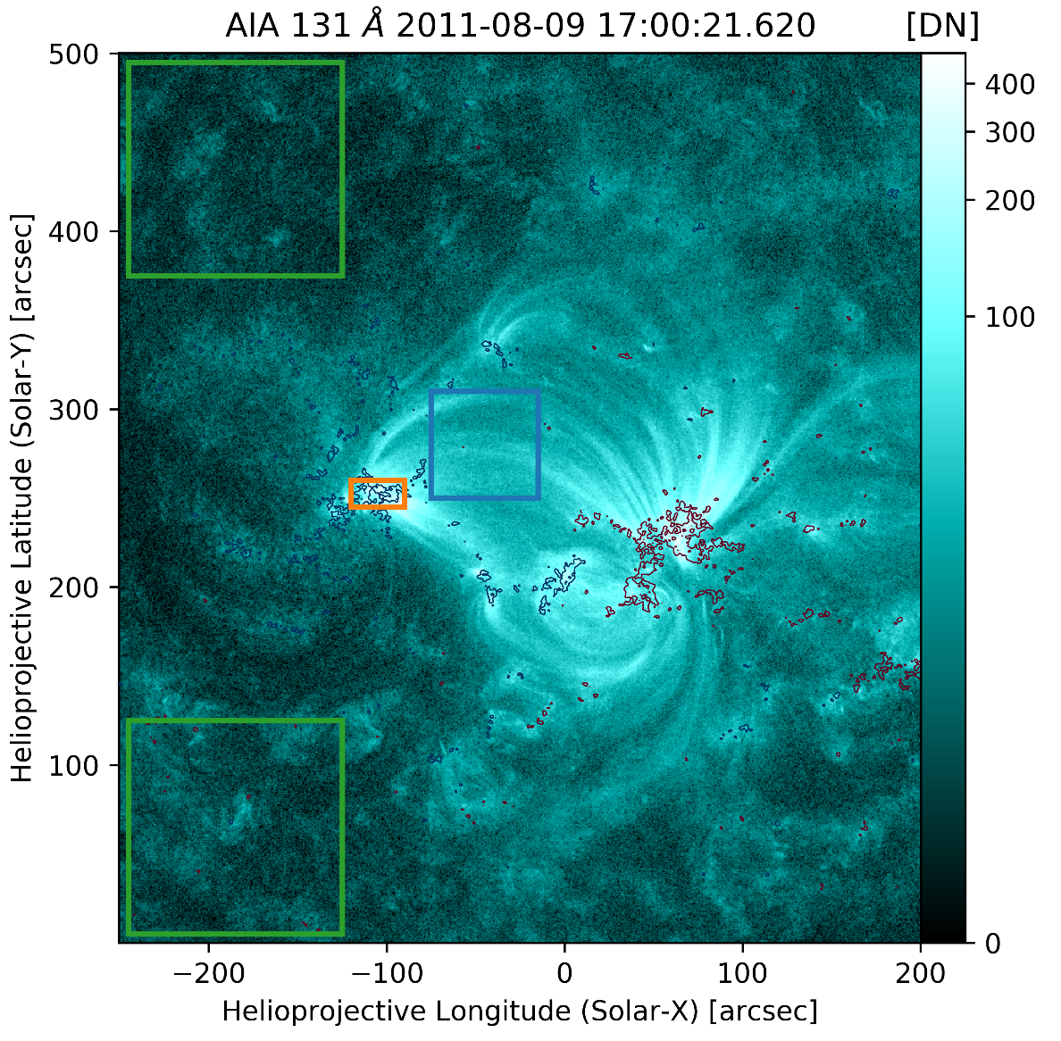
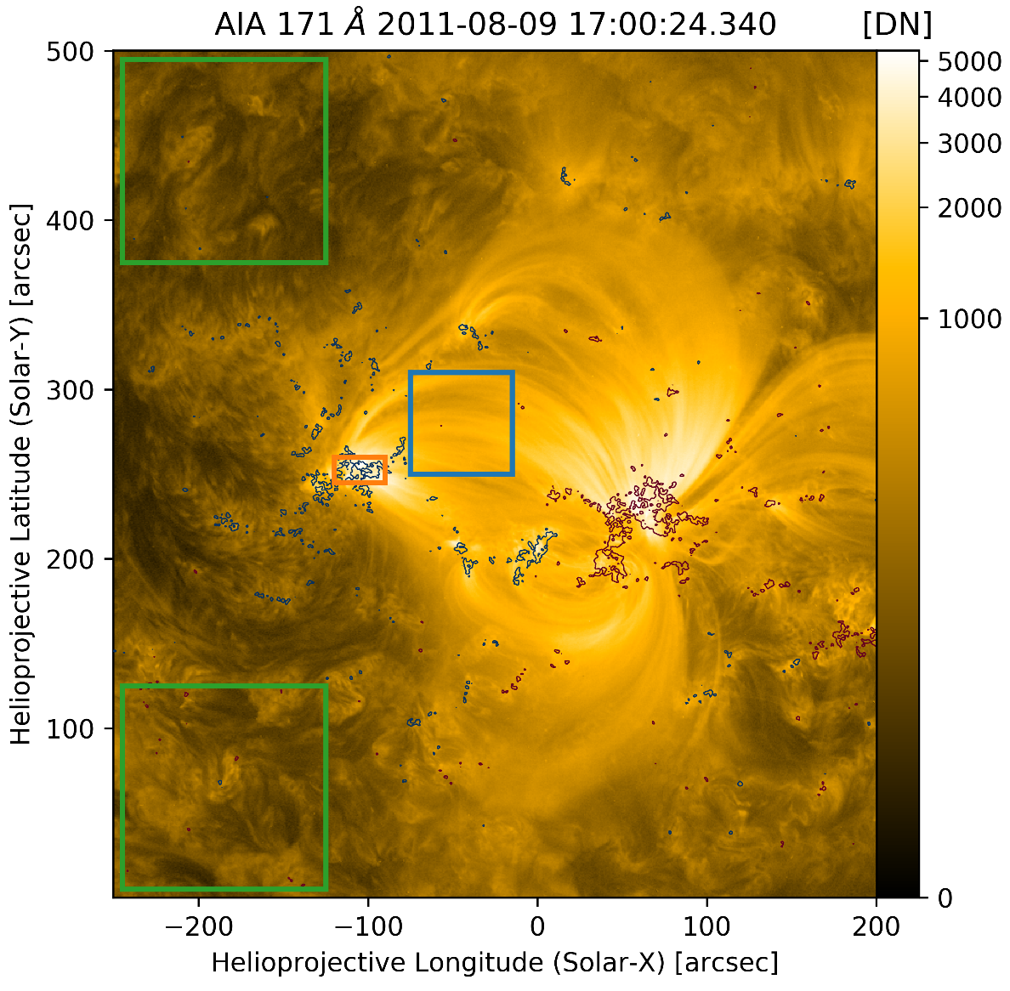
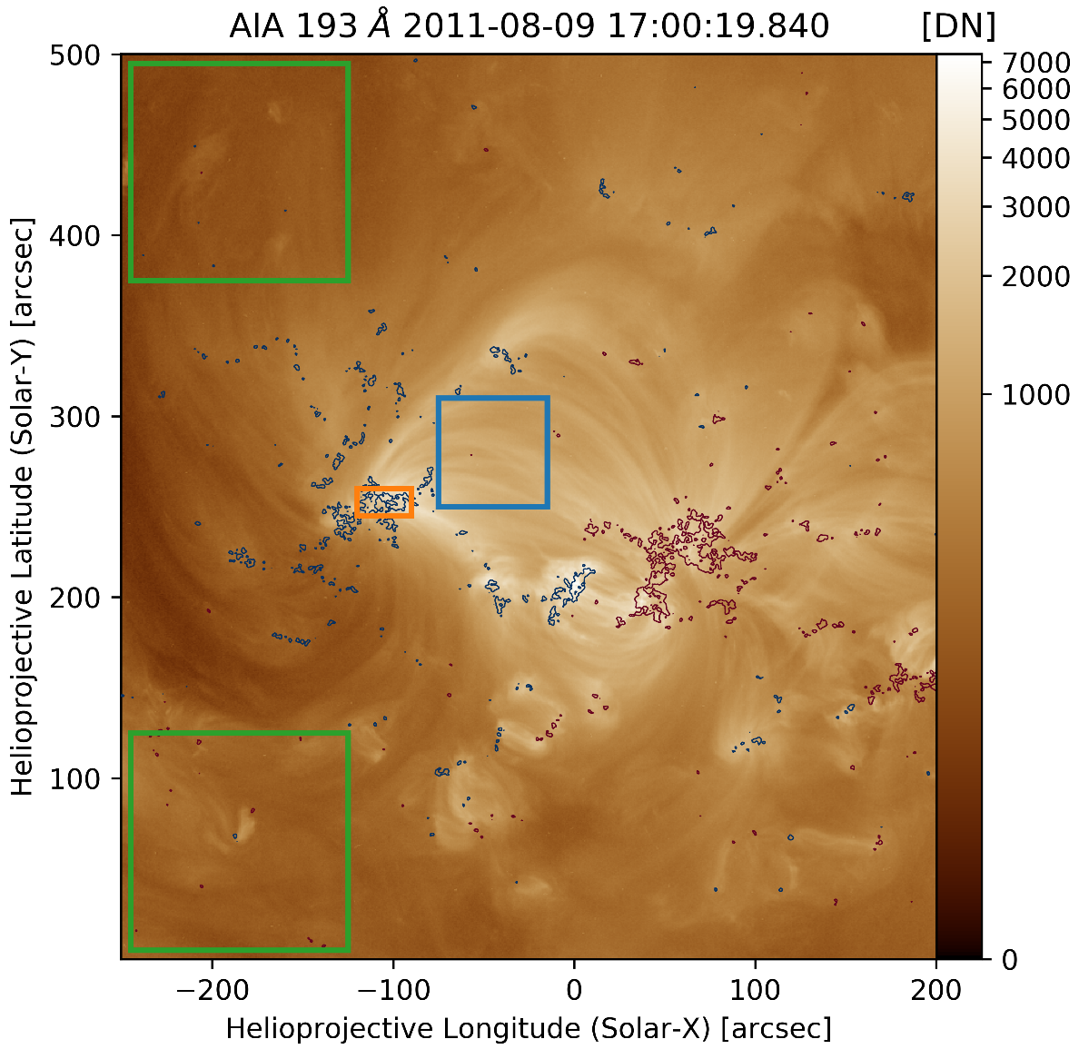
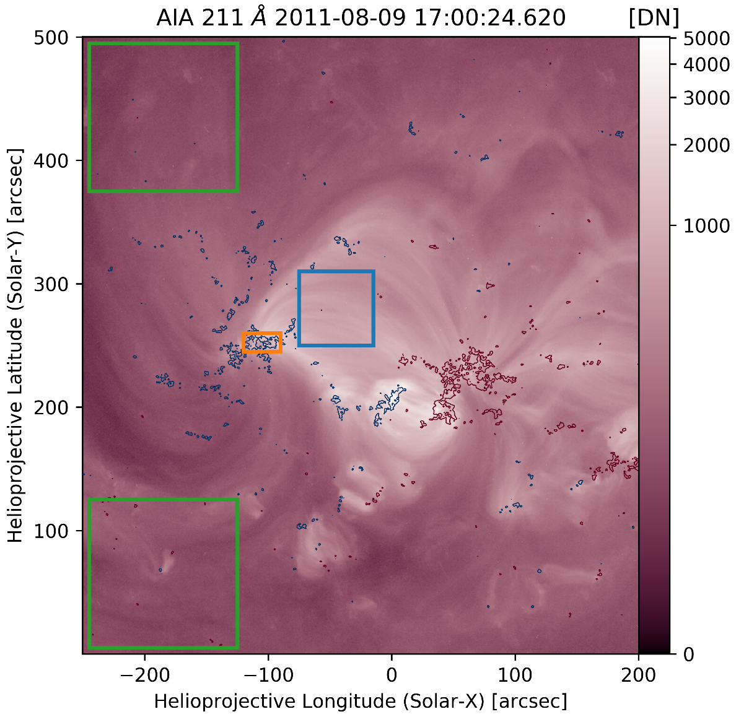
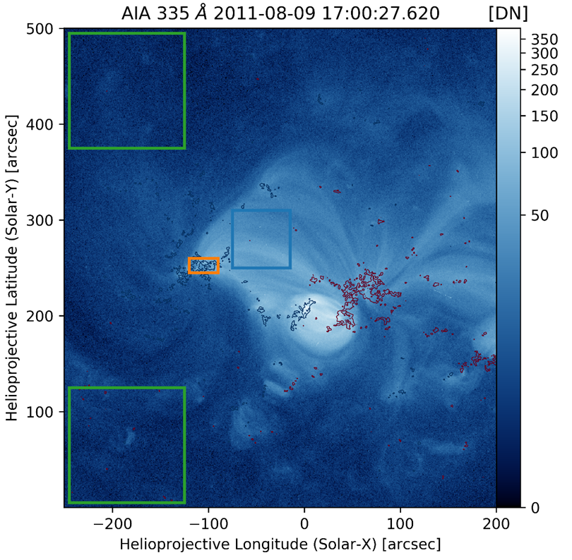

Slide 10
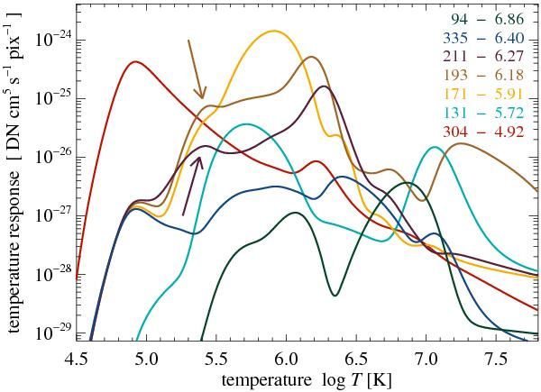
Peter, Bingert, and Kamio 2010
30 Mm, 5x10⁶ erg cm⁻² s⁻¹, 100 s, -1
30 Mm, 2x10⁷ erg cm⁻² s⁻¹, 1000 s, -1
100 Mm, 5x10⁶ erg cm⁻² s⁻¹, 1000 s, -2.5

Slide 11
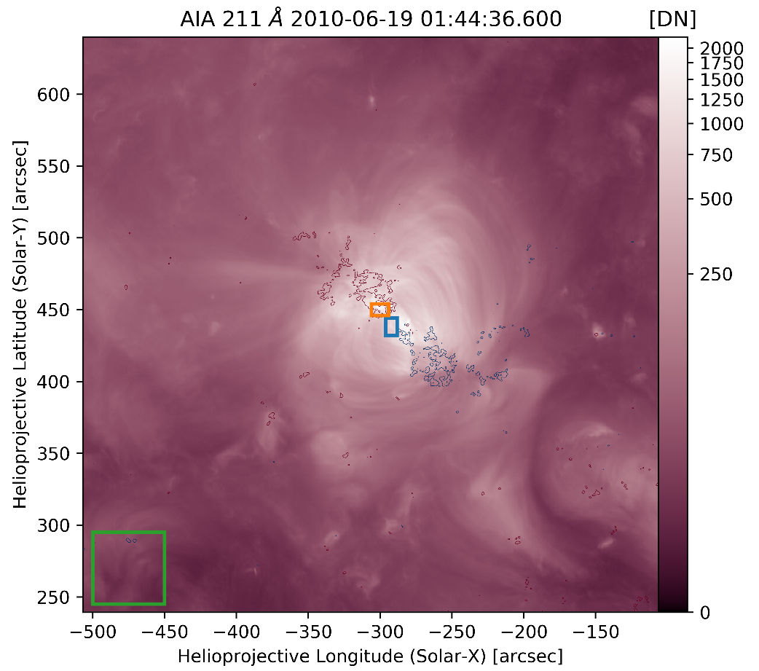
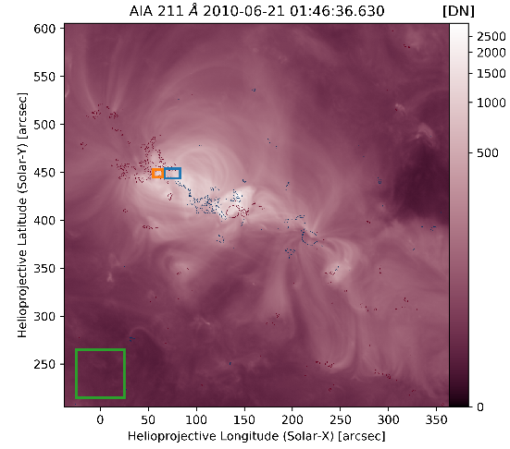
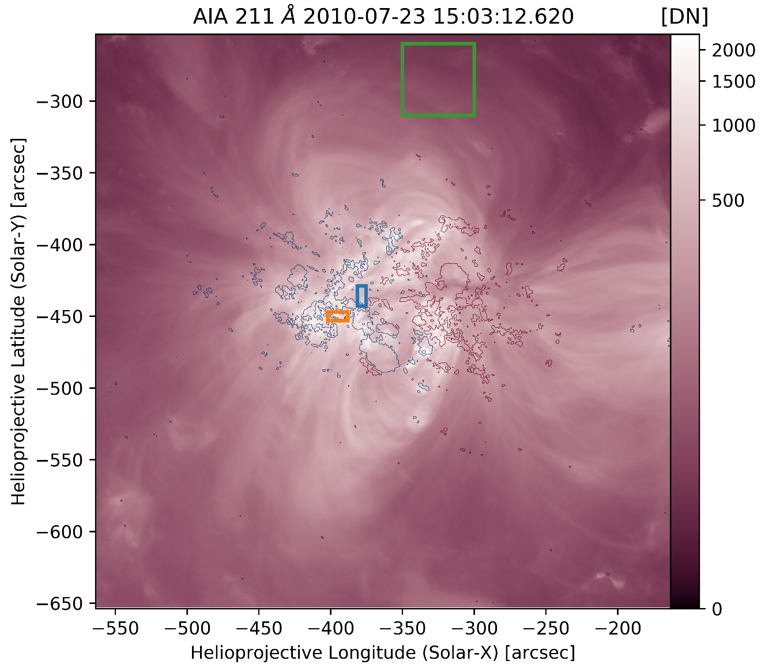
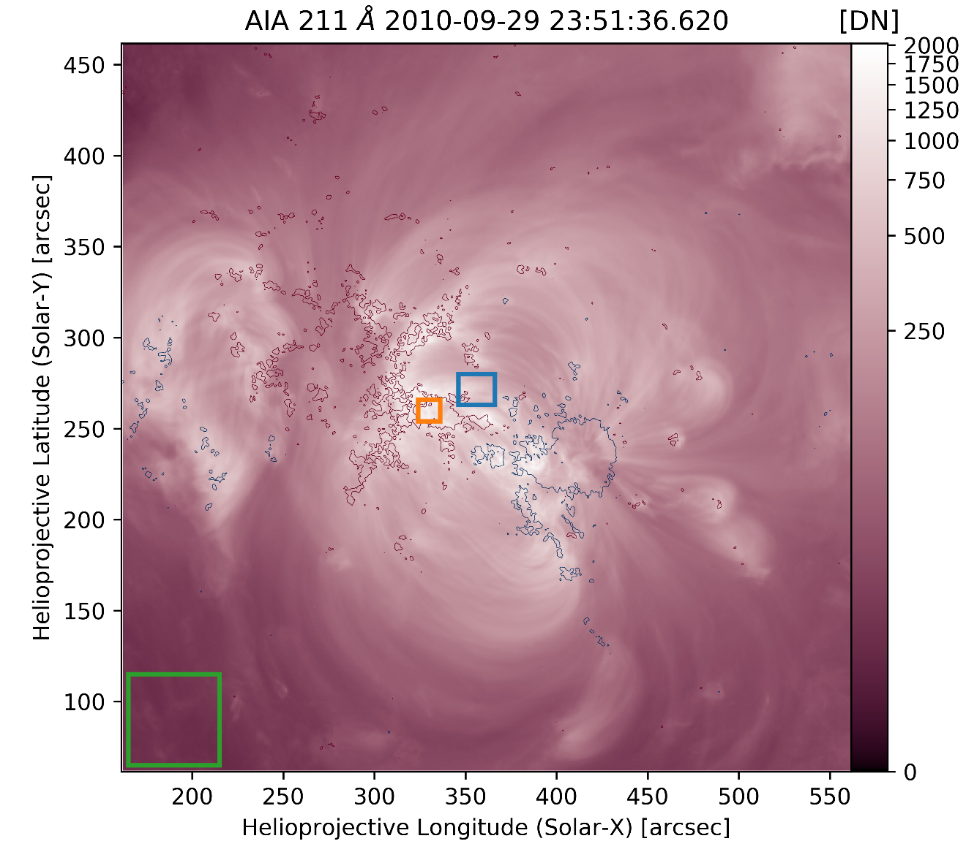
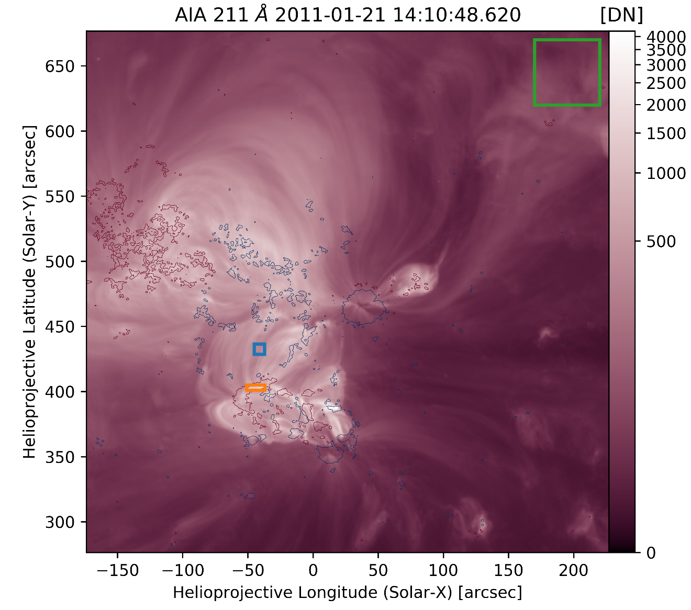
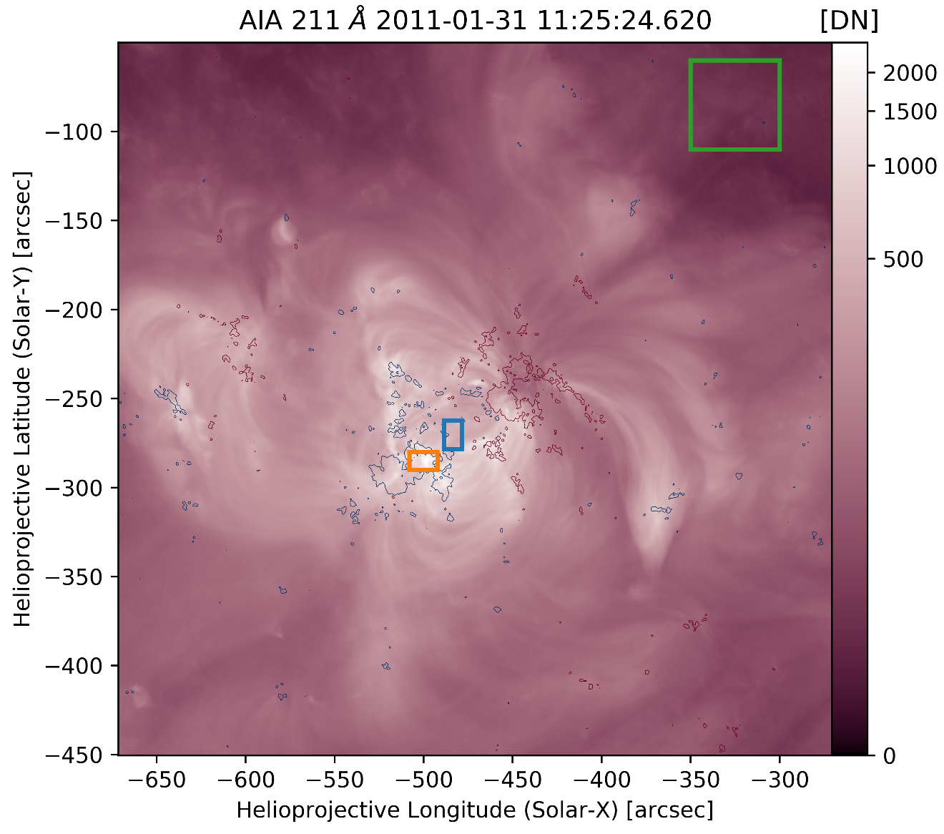
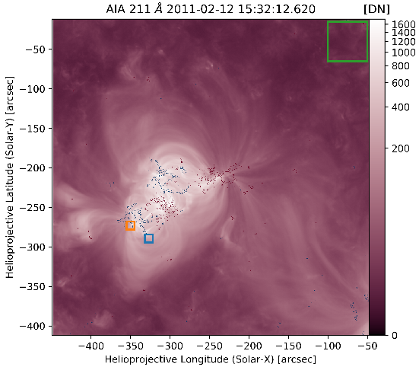
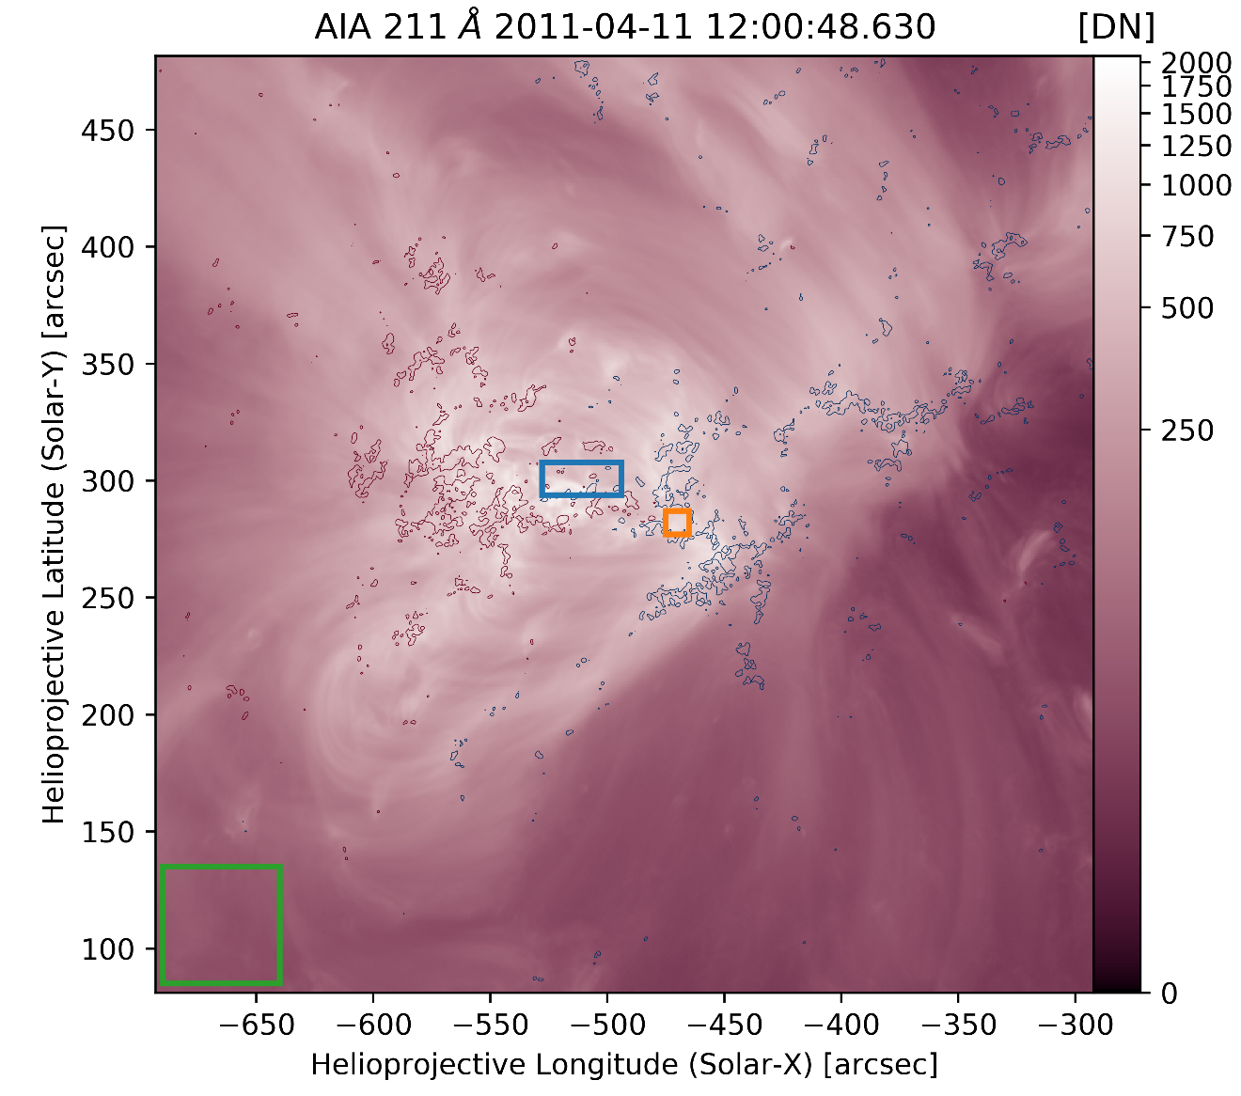
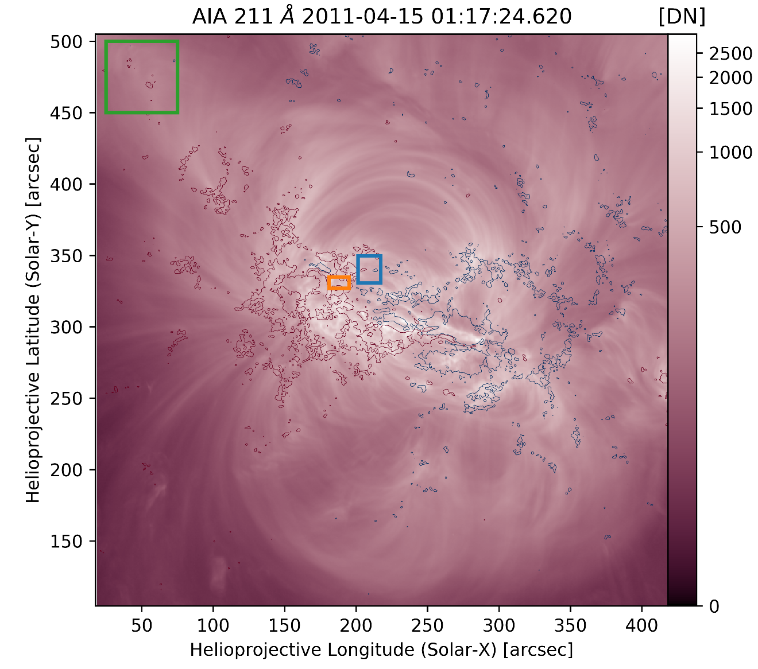
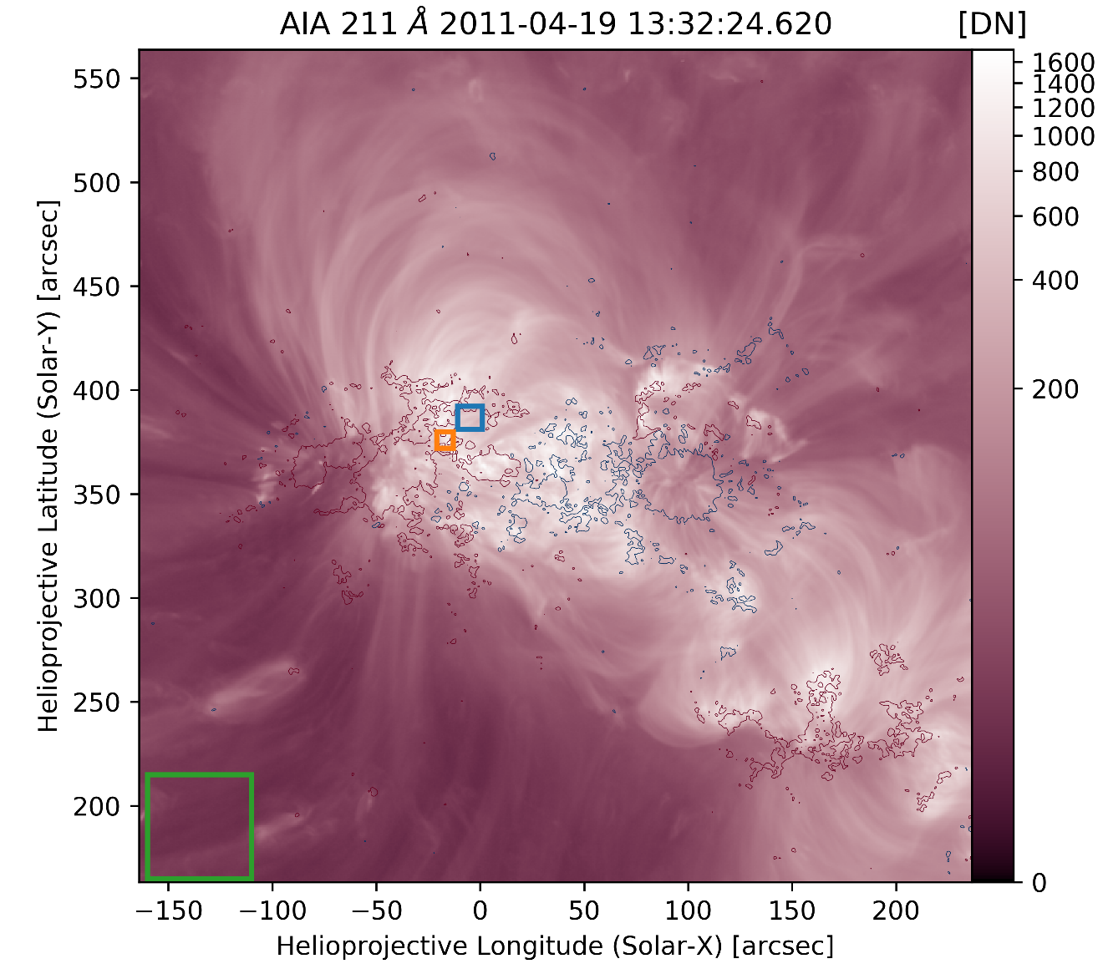
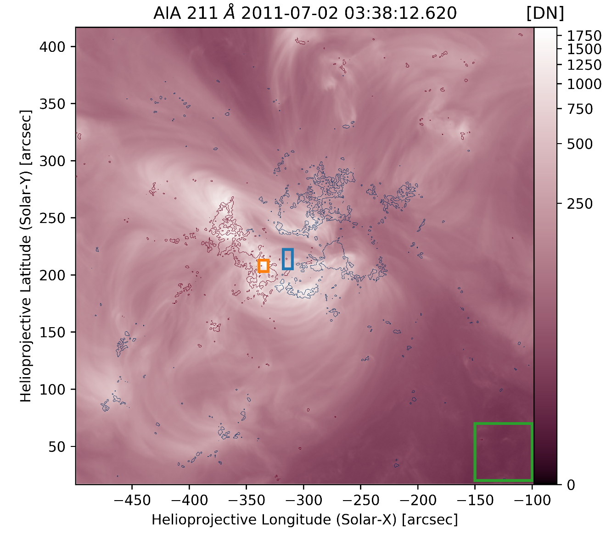
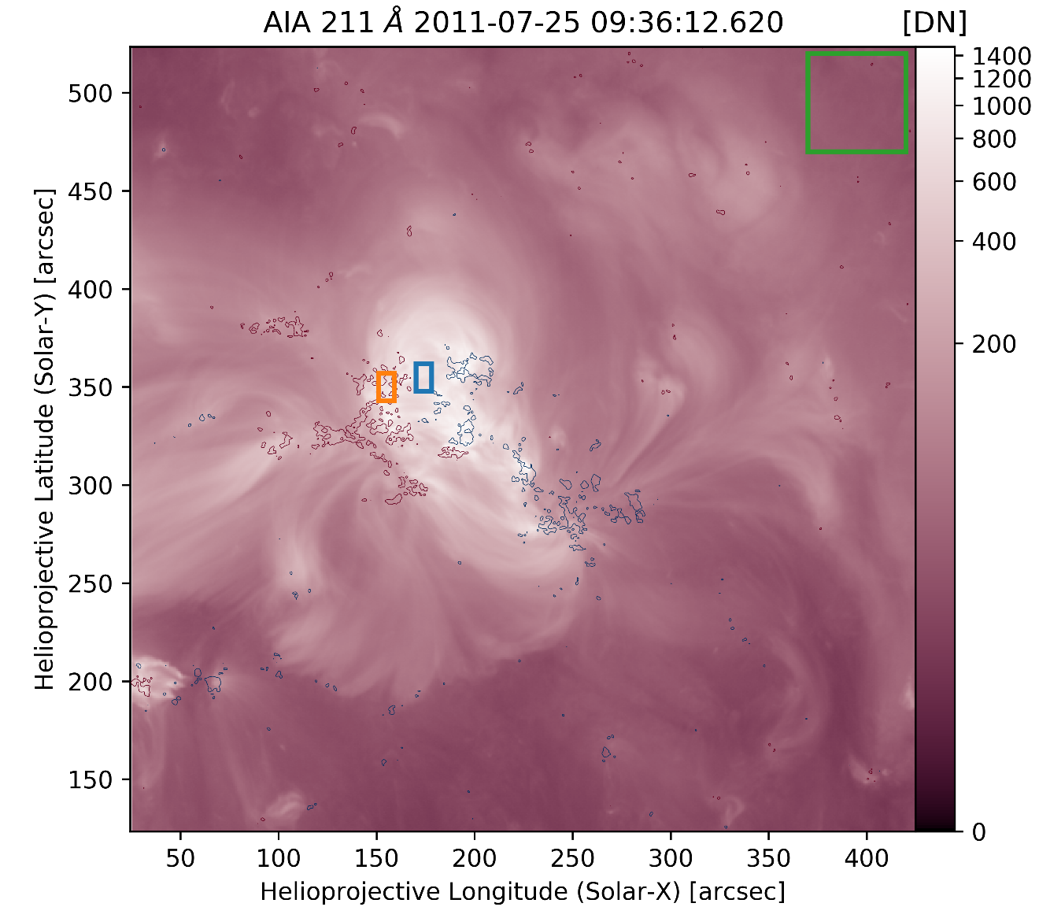
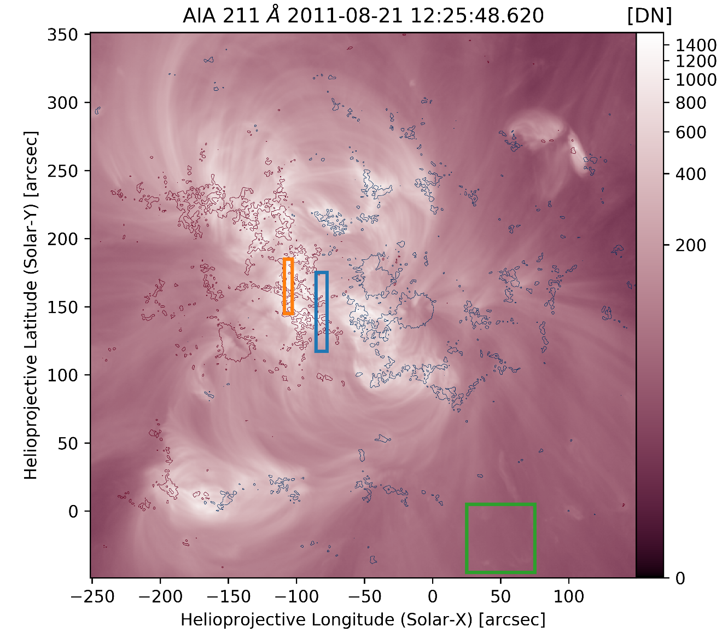
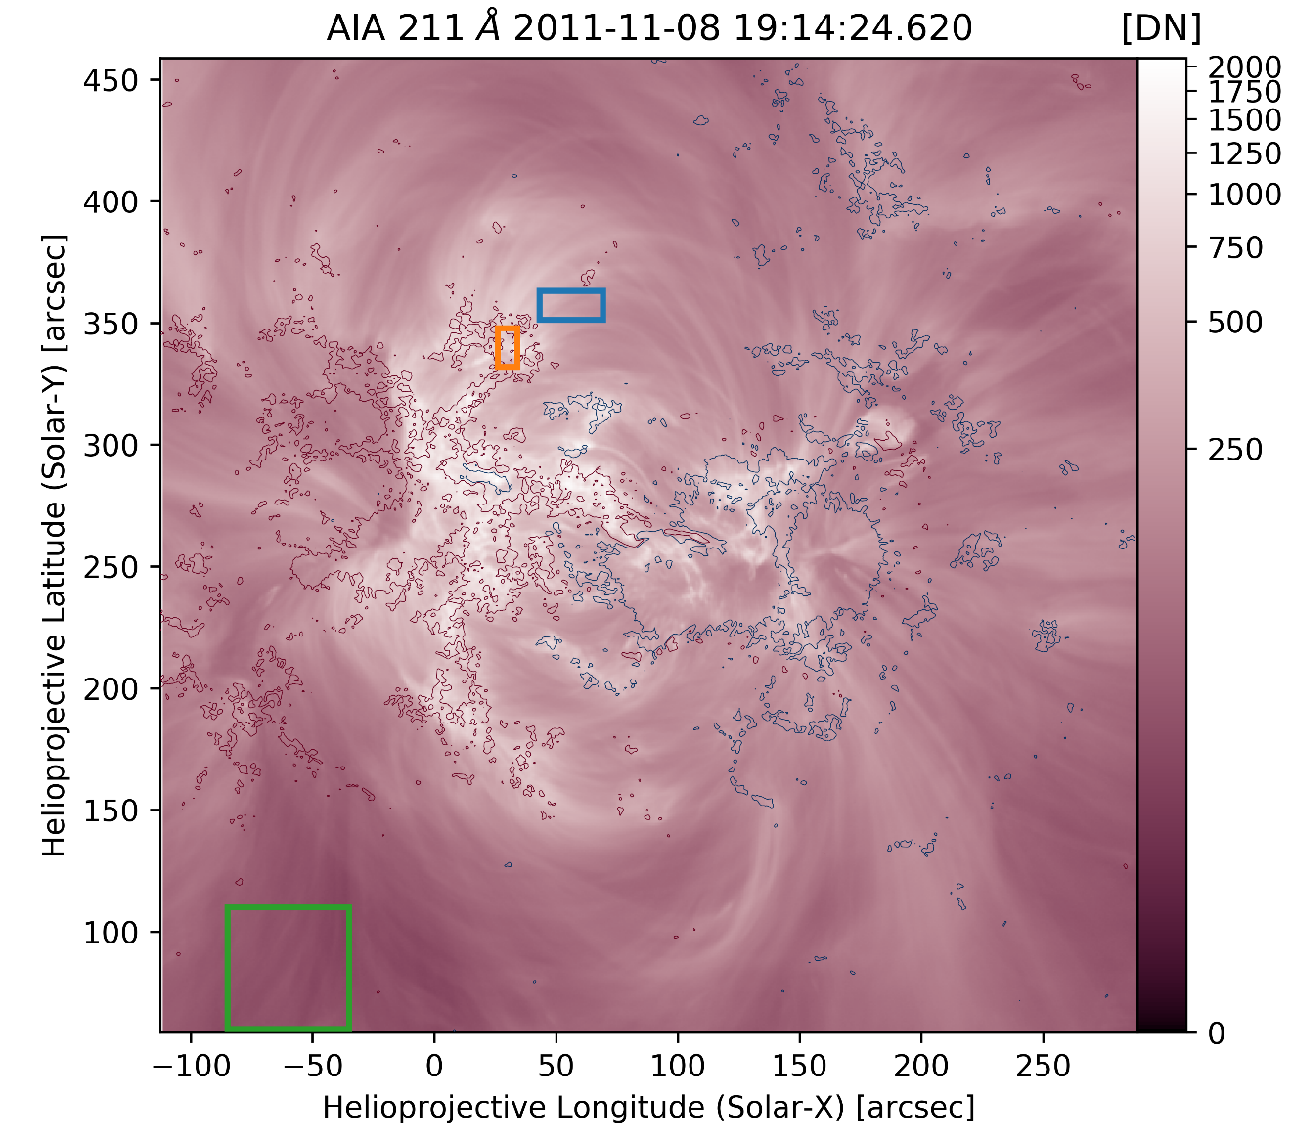
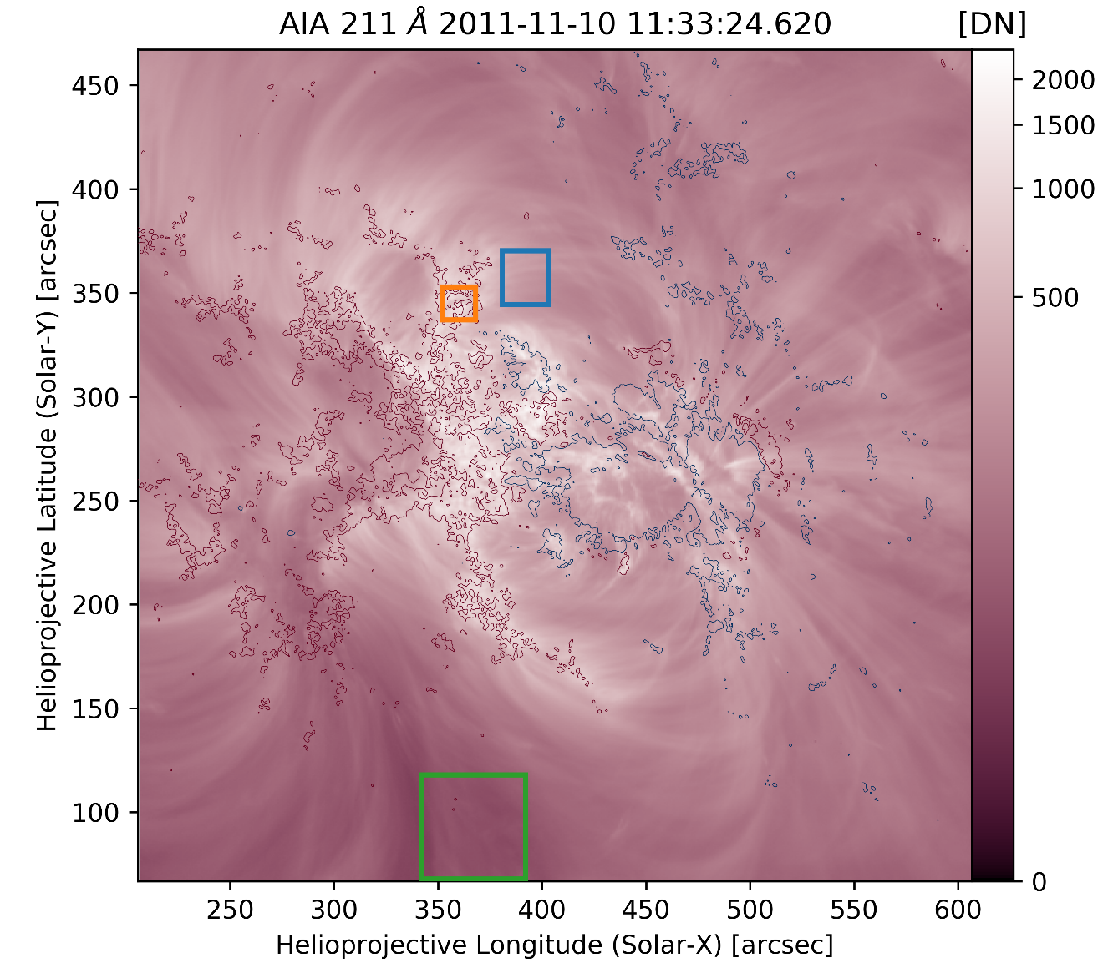

Slide 12
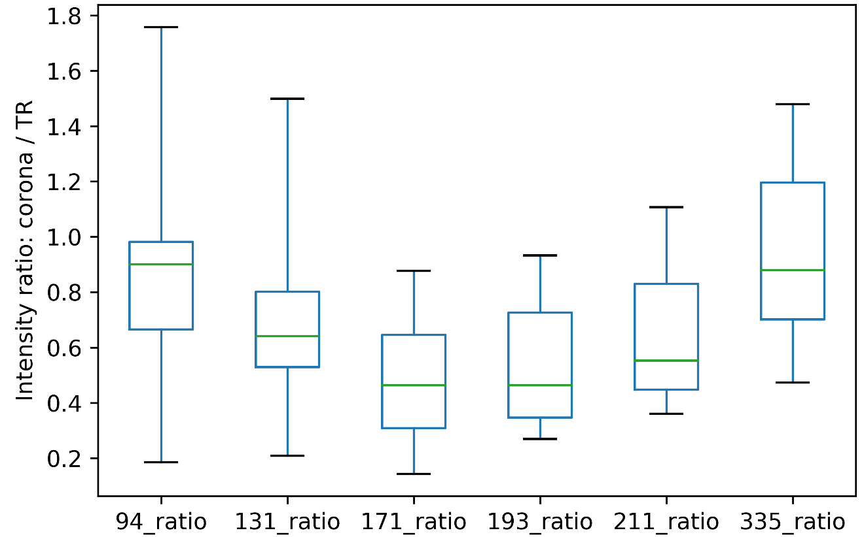
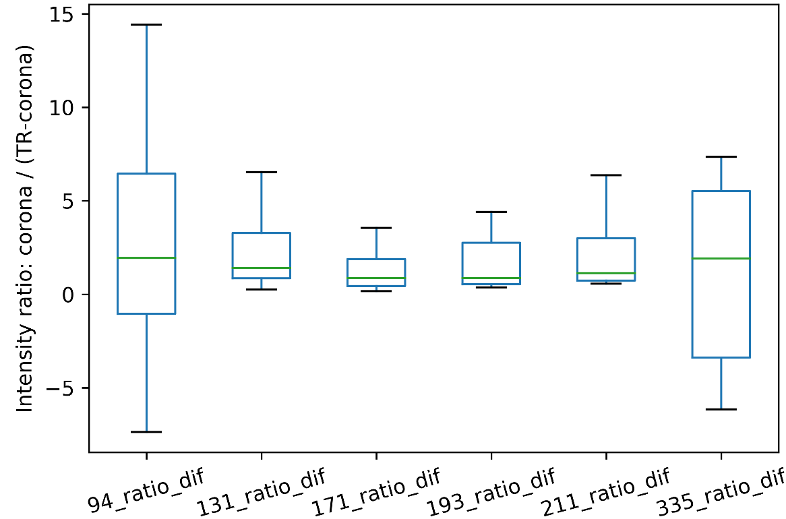
Corona / TR
Corona / (TR – Corona)
30 Mm, 5x10⁶ erg cm⁻² s⁻¹, 100 s, -1
30 Mm, 2x10⁷ erg cm⁻² s⁻¹, 1000 s, -1
100 Mm, 5x10⁶ erg cm⁻² s⁻¹, 1000 s, -2.5

Slide 13
Results
Combination of slope of heating event distribution have detectable impacts on average plasma state
As expected, high-frequency heating scenarios cause narrower DEMs
For this set of parameters, distribution slope is more important than minimum delay time
Coronal / Transition Region emission ratio has diagnostic properties
Transition region contributes a significant fraction of AIA intensity
Active regions observed in AIA display similar Corona / TR trend
Assuming components are isolated correctly-ish
Effects such as spicular absorption could reduced observed AIA TR emission

