Slide 1
Impacts of Intermediate Time Scale SSI Variability
Workshop Recap
Sam Schonfeld, Jim Klimchuk
3/13/2019

Slide 2
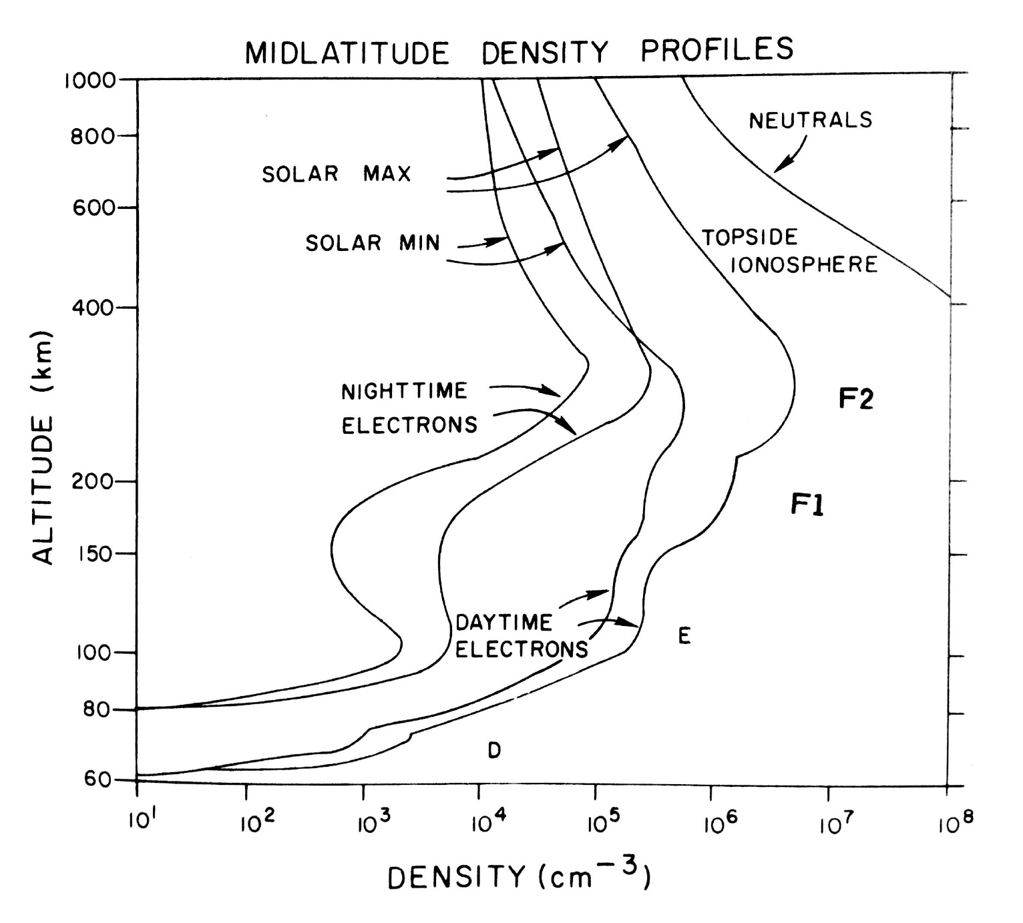
Workshop Details
Sunday, 12/9/18
USRA Headquarters in Columbia, MD
~25 participants (most onsite, a few remote)
10 presentations
Significant discussion throughout the day
Highlights from the presentations and discussion
Science.nasa.gov/670/variability_workshop/index.html

Slide 3
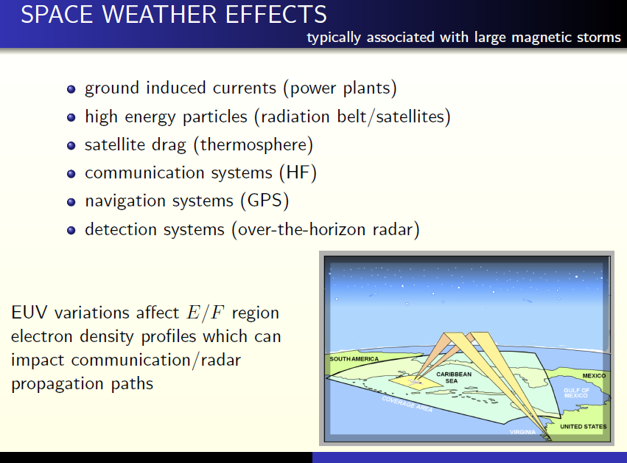
Slide: Joe Huba

Slide 4
Axes of SSI to consider
Time
Wavelength
Amplitude
Wavelength
  Solar sources
  Atmospheric interaction
Time
  Response
  Duration
Amplitude
  Absolute
  Variability
Observability
  Available proxies

Slide 5
Time Scales for Forcing of the Terrestrial Upper Atmosphere
Geological
Solar Cycle
Solar Rotation
Biogenic
Solar Evolution
Geomagnetic
Solar Cycle Variation
Seasonal
Relative Amplitude
Earth Rotation
Anthropogenic
Earth Orbit
Flares
Terrestrial Magnetic Field
Waves and Tides
10¹ 10² 10³ 10⁴ 10⁵ 10⁶ 10⁷ 10⁸ 10⁹ 10¹⁰ 10¹¹ 10¹² 10¹³ 10¹⁴ 10¹⁵ 10¹⁶ 10¹⁷
Seconds
Solar Irradiance
Solar Wind / IMF
Earth
Slide: Stan Solomon
Notes:
Stan Solomon’s slide

Slide 6
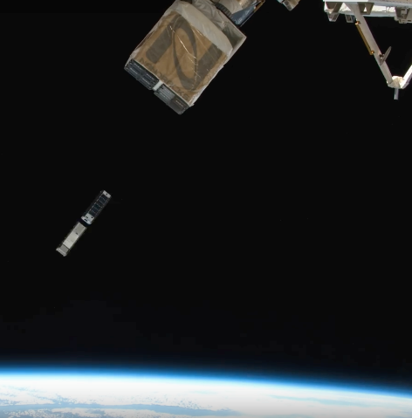
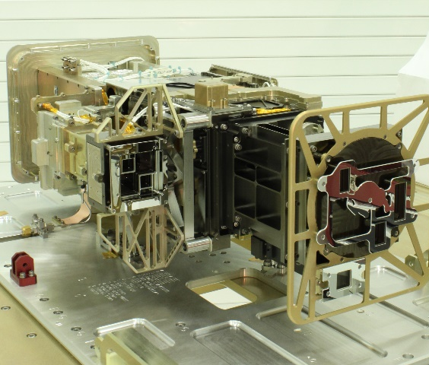
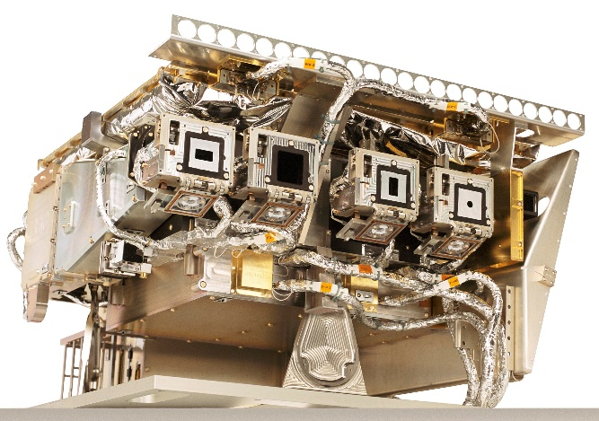
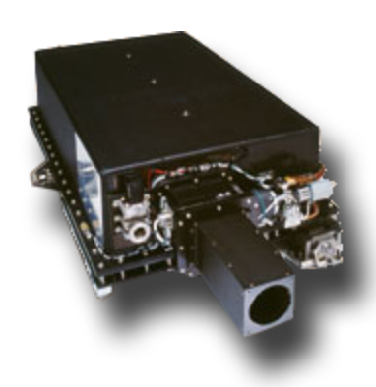
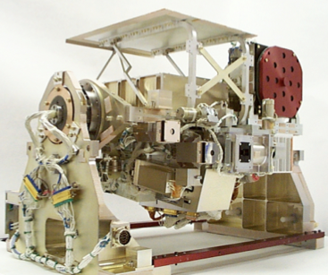
Solar UV Irradiance Measurements
There are many past, present, and future measurements of solar ultraviolet irradiance variations
MinXSS-1 | MinXSS-2 FAILED | XPS/ESP/ EUVS/ESP | SDO EVE MEGS | TIMED SEE EGS | SORCE SOLSTICE | UARS SOLSTICE
0-2.5 nm | 0-2.5 nm | 0-27 nm | 6-105 nm | 27-190 nm | 119-320 nm | 119-420nm
2016-2017 | 2018-Pres. | 2001-Pres. | 2010-Pres.* | 2001-Pres. | 2005-Pres. | 1996-2006
0.15 keV | 0.12 keV | 5-7nm | 0.1 nm | 1.0 nm | 0.1 nm | 0.1 nm
MinXSS-1 and -2
GOES XRS, EUVS
SDO EVE
TIMED SEE
SOLSTICE
Slide: Phil Chamberlin
Notes:
Phil Chamberlin’s slide
James Mason 3/11/19, lost contact with MinXSS-2 in January. Presumed dead.
-XUV measurements have strong impact (particularly on the D and E regions)
-Instruments have good long term stability, lack spectral resolution
-Current broadband measurements don’t even accurately measure total energy because they are reliant on assumed spectrum

Slide 7
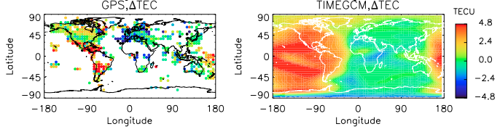
Flare Irradiance Spectral Model - FISM
Solar spectral irradiance empirical model, released in 2005
Modeled both daily average irradiances from 1947-Present
Modeled flare irradiances from 1981-Present, based on 27 flares
1.0 nm bins, 0-190 nm, 1 minute cadence
  20-40% uncertainties in Daily, 40-90% uncertainties in Flare
Led to many published studies showing the effects of solar flares on the ITM of Earth and Mars.
Available on LISIRD:
http://lasp.colorado.edu/lisird/
Change in TEC from pre-flare to peak flare for the X6.2 solar flare on 9 September 2005 (Qian et al., 2012). Left shows the measured flare-preflare TEC as measured by the GPS network, while the right is the comparable model results of the flare-driven TEC enhancement using TIMEGCM driven by FISM1.
Slide: Phil Chamberlin
Notes:
Phil Chamberlin’s slide
Models like FISM can fill in some observational data gaps.

Slide 8
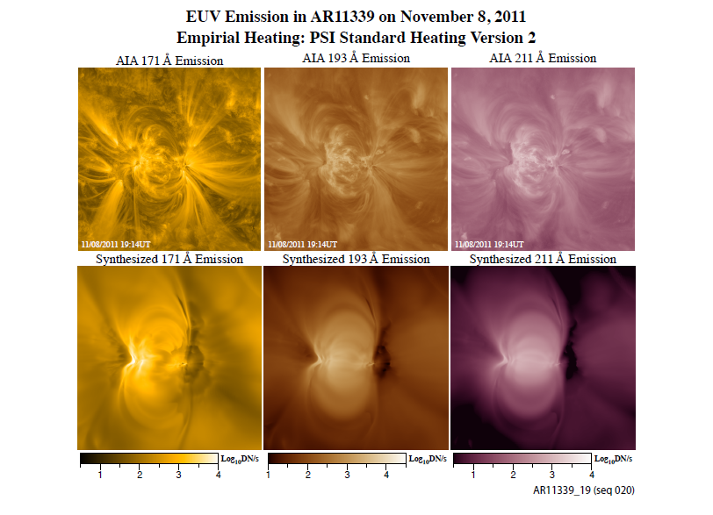
Slide: Zoran Mikić
Notes:
Zoran Mikić’s slide
-PSI’s full-Sun eclipse coronal simulation
-There have been numerous studies trying to explore the parameterization of coronal heating by populating magnetic models with plasma

Slide 9
Slide: Angelos Vourlidas
Slide courtesy S. Bruinsma
Notes:
Angelos Vourlidas’ slide
Now let’s get back to the satellite drag equation, which was given on slide 4. The thermosphere model error is one of several contributors to the drag model error. The aerodynamic coefficient is often not well- known, and in case of space debris mass and shape are also not accurately known. These errors can all be as large as the thermosphere model error. However, the density model error is not necessarily an offset (the model can be unbiased with a standard deviation of 20%), whereas errors under bullet #2 are. As stated earlier, these systematic errors are most harmful to orbit precision.
The table lists the total in-track position effect of atmospheric drag at 3 altitudes and for low and high solar activity for an imaginary satellite, as well as the effect of a 50% bias. The last line presents the maximum differences between 3 semi-empirical models. At 250 km, the total effect can be hundreds of kilometers, and the error also in worst cases, which can result in failing to acquire the target by a tracking radar. For higher altitudes the errors become much smaller. Notice that the relative model differences are smallest at 250 km, and largest at 850 km.

Slide 10
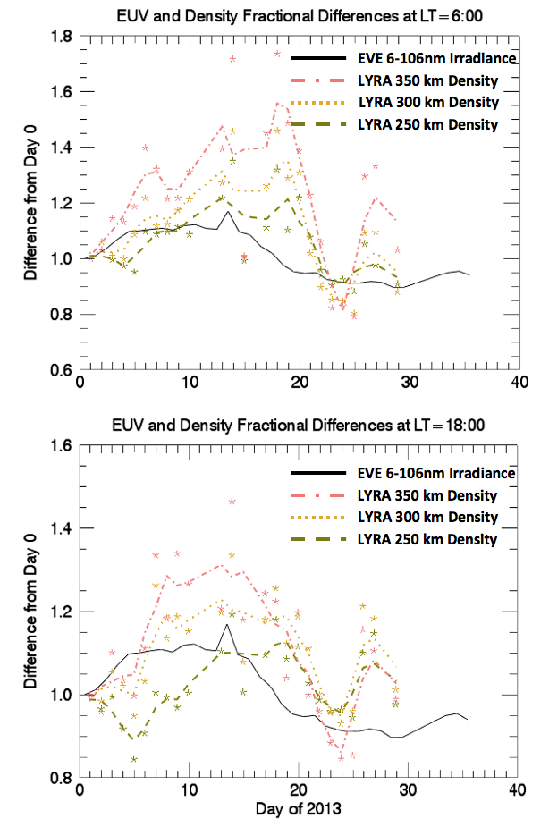
Investigating Density Variability using Solar Occultations
EUV solar occultations can probe neutral density from ~130-400 km
PROBA2 LYRA can be used to retrieve N₂+O sum (Thiemann+ SW 15 2017)
  Data publicly available online through the PROBA2 Science Center
Comparison of densities during strong solar rotation show that a 10% EUV increase in 5 days...
  Increases 350 km density by 40% (30%) at dawn (dusk).
  Relative Enhancement less at lower altitudes
  Slight Lag time for thermospheric response
  Additional variability caused by geomagnetic effects
25% EUV decrease and in 5 days along with quiet geomagnetic conditions decreases dusk (dawn) density by 35% (53%) at 350 km.
Slide: Ed Thiemann
Notes:
Ed Thiemann’s slide
-Forward model atmosphere and tune densities for a spatially extended Sun
-incorporate EUV images to account for active regions
-Also has an occultation cubesat (OWLS)
-Characterize thermosphere response to gravity waves
-Vertical wavelength and energy
-Thermosphere density and temperature

Slide 11
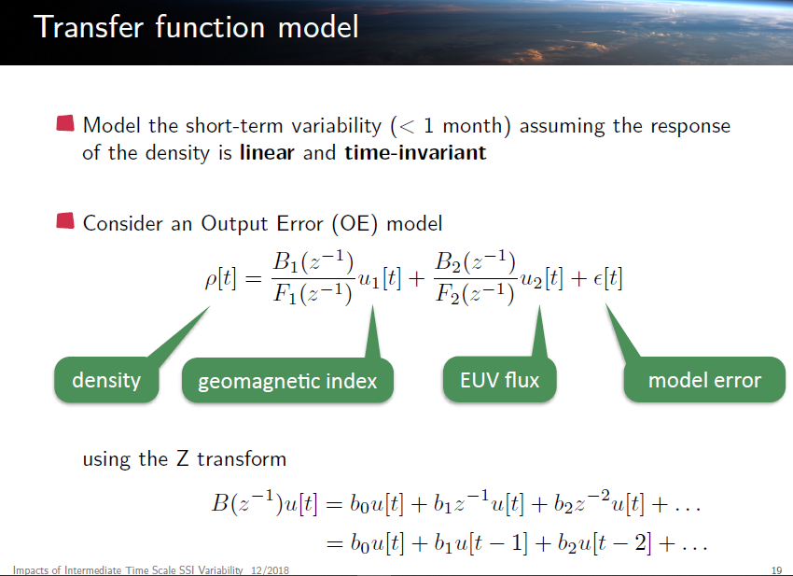
Slide: Thierry Dudok de Wit
Notes:
Thierry Dudok de Wit’s slide
-Output error transfer function method

Slide 12
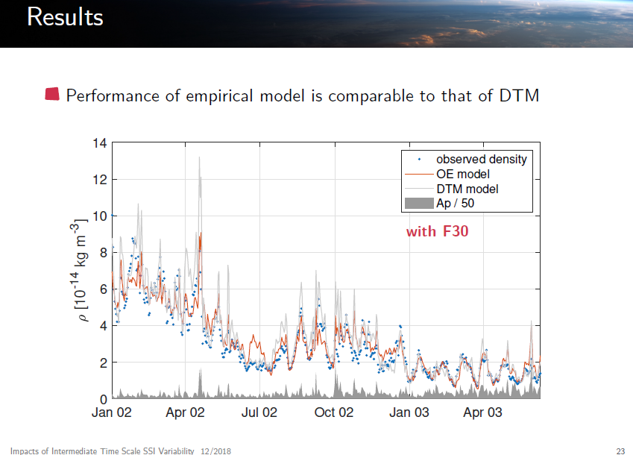
Slide: Thierry Dudok de Wit
Notes:
Thierry Dudok de Wit’s slide
-Output error transfer function method
-DTM=Drag Temperature Model
-Semi-empirical
-STELLA (1993-2010), 800 km

Slide 13
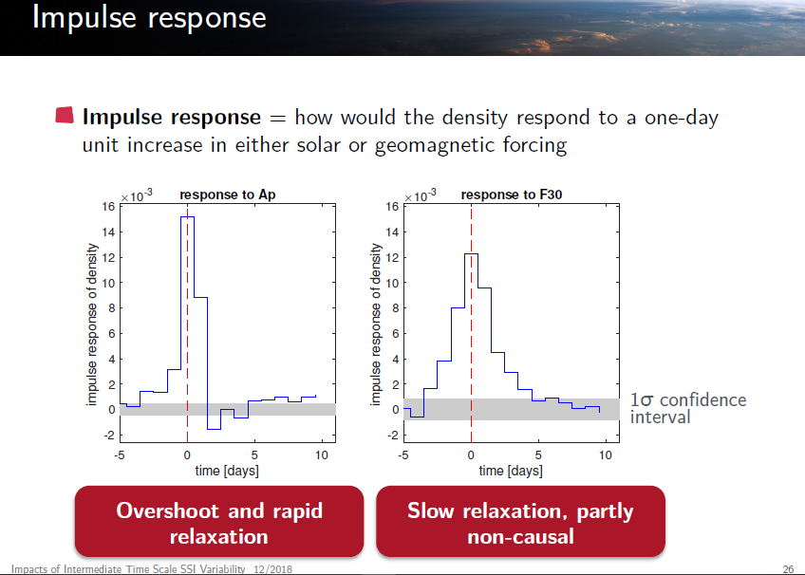
Slide: Thierry Dudok de Wit
Notes:
Thierry Dudok de Wit’s slide

Slide 14
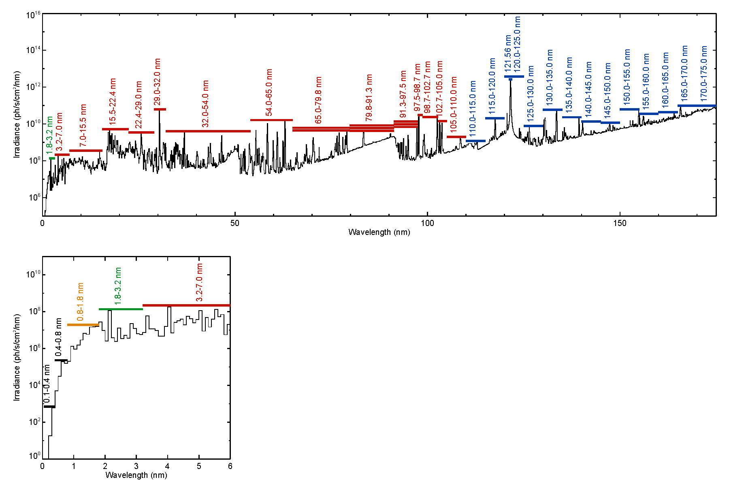
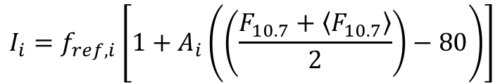
Solar Input into TIE-GCM
Solar input proxy model in TIE-GCM using F10.7:
$$I_{i}=f_{ref,i}\left[1+A_{i}\left(\left(\frac{F_{10.7}+\left\langle F_{10.7}\right\rangle }{2}\right)−80\right)\right]$$
Slide: Eric Sutton
0.05-0.8 nm: GOES XRS
0.8-1.8 nm: From various rockets
1.8-5 nm: Hinteregger model (SC21REFW based on AE-E)
5-105 nm: EUVAC model (F74113 reference spectrum + variability from AE-E and rockets)
105-175 nm: Woods and Rottman model (UARS SOLSTICE + 1994 rocket)
Notes:
Eric Sutton’s slide

Slide 15
Thermospheric Density Variation
Slide: Stan Solomon
Qian et al., Space Science Reviews, 2012
Notes:
Stan Solomon’s slide

Slide 16
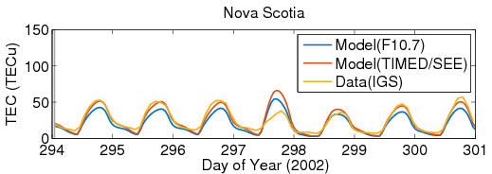
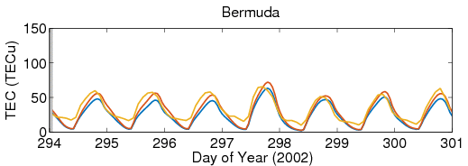
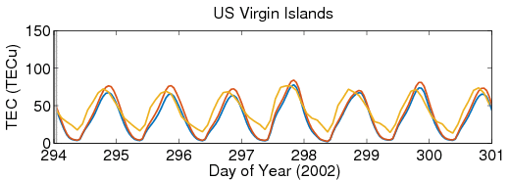
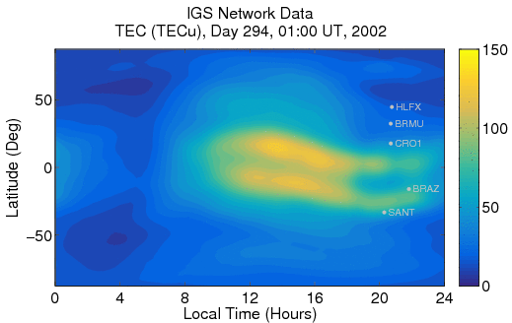
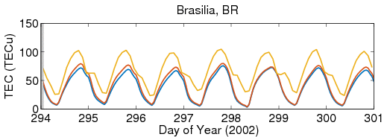
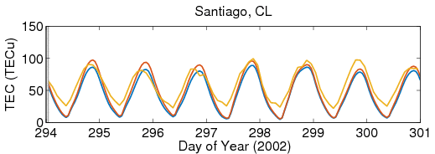
Data/Model Comparison
F10.7 proxy-driven vs. EUV/FUV observation-driven
Case Studies:
2002: 7 – 27 Oct.
2008: 25 Mar. – 14 Apr.
2014: 15 Jan. – 5 Feb.
2015: 20 Feb. – 12 Mar.
0
0
IGS Network Observed TEC
0
Slide: Eric Sutton
0
Notes:
Eric Sutton’s slide
-According to Stan Solomon, there are a huge number of free parameters when returning a model like this to use TIMED/SEE vs. F10.7
-EUV scaling
-Auroral input
-Lower boundary (eddy diffusivity)

Slide 17
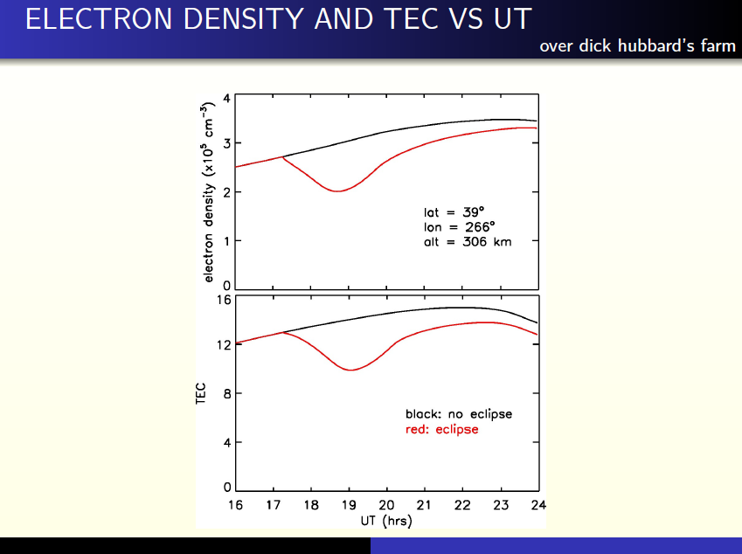
Slide: Joe Huba
Notes:
Joe Huba’s slide

Slide 18
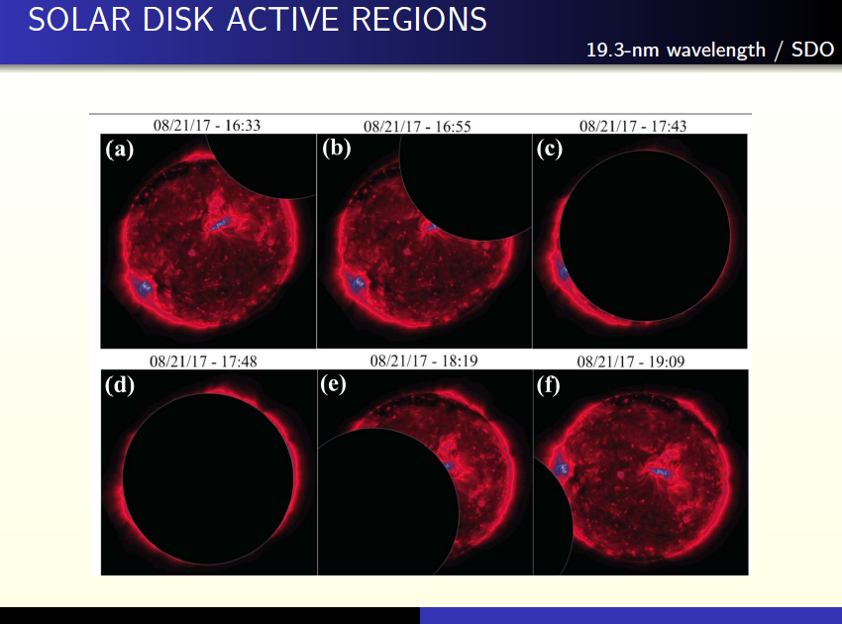
Slide: Joe Huba
Notes:
Joe Huba’s slide

Slide 19
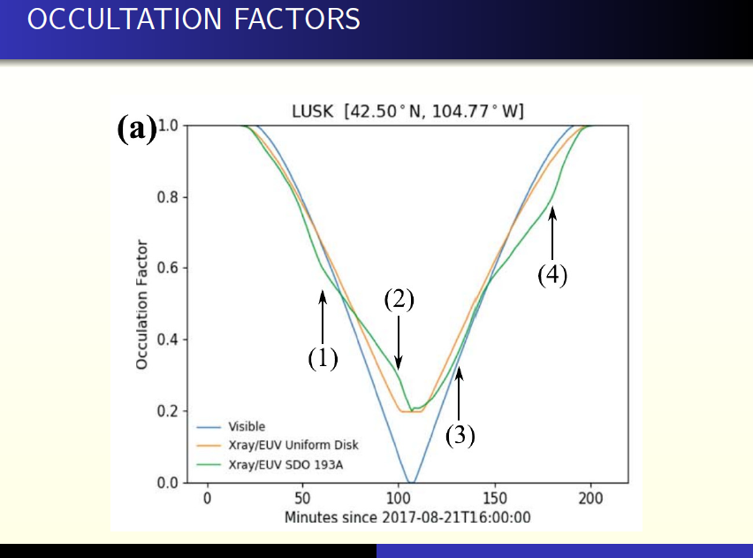
Slide: Joe Huba
Notes:
Joe Huba’s slide

Slide 20
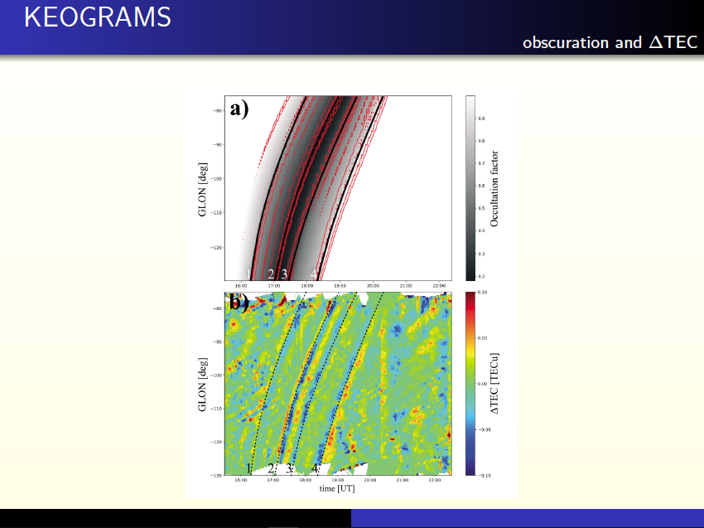
Slide: Joe Huba
Notes:
Joe Huba’s slide
-Active region scale only contributes ~1% to TEC
-Minimal effect of HF and OTH (high frequency and over the horizon) waves
-Smaller effect than e.g. gravity waves and TIDs (traveling ionospheric disturbances)
-Might still be valuable to use EUV to determine height of D-region

Slide 21
Matthew DeLand: Short-Term SSI Variability and Middle Atmosphere Effects
λ > 120 nm (Ly-α) for mesosphere/stratosphere effects
No significant flare enhancements observed
Rotational and cycle SSI variability on similar scales
Atmospheric response has spectral response as a function of altitude
  Chemical reactions important
    “It’s complicated”

Slide 22
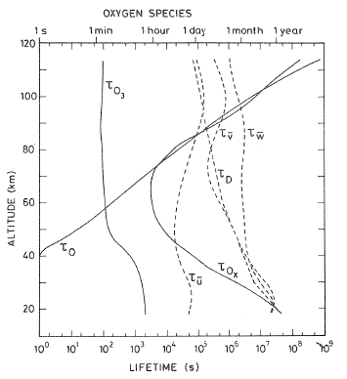
Competing Effects - Ozone
Direct effect is due to photochemistry (τ ≈ minutes)
  O₃ + hν → O + O₂
Indirect effects are due to temperature-dependent reactions
  O + O₃ → O₂ + O₂ rate increases by 3% for ΔT = +1 K.
  ΔT due to local heating by ΔF_{UV}
  ΔT also due to transport over similar time scales (τ_{zonal wind} ≈ 1 day)
Brasseur and Solomon [1986]
Slide: Matt DeLand
Notes:
Matt DeLand’s slide

Slide 23
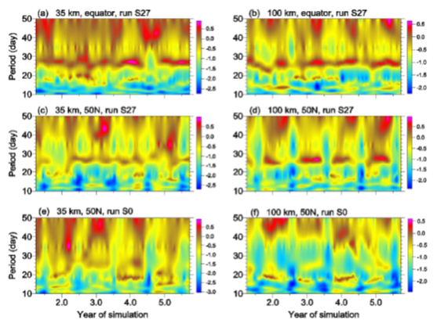
Complex Atmospheric Response
Apply 27-day sine wave forcing of F₂₀₅ in 3-D atmospheric model (HAMMONIA) over 6-year period.
ΔO₃ results for 35 km (left column) and 100 km (right column), Equator and 50 N show fairly consistent response, with variations in amplitude.
Constant F(t) (bottom row) also develops periodicity at 15-20 days.
Gruzdev et al. [2009]
Slide: Matt DeLand
Notes:
Matt DeLand’s slide
Note that strength of 27-day signal in parts (a)-(d) varies substantially, despite regular amplitude of prescribed forcing.
Do similar variations in non-forced simulations represent planetary wave effects?

Slide 24
Rachel Hock-Mysliwiec: End User Perspective
How does ionosphere/thermosphere evolve on few-day timescales?
  Is this a large impact to their system?
  If they can compensate for the effect on the fly, forecasting isn’t necessary.
If the forecasting is necessary, what are the specific solar drivers?
  Can these be forecast?

Slide 25
DoD Perspective
Air Force runs Space Weather Operations Center (SWOC)
SSI variability is potentially important for three types of systems
  High frequency radio propagation
    Over the Horizon radar, requires knowledge of D and E regions and bottom of ionosphere
  GNSS, Satcom, GPS signals impacted by TEC and atmospheric scintillation
  LEO Satellites influenced by thermospheric density
    Lifetime planning, position tracking, collision avoidance
    Can be measured on-spacecraft
Much of this can be measured directly
Forecasting solar irradiance out to 3-4 days would help DoD plan operations, specifically for HF communication
AFRL is moving towards incorporating SSI into Ionosphere models
Notes:
-Forecasting solar irradiance out to 3-4 days would help DoD plan operations, specifically for HF communication
-Initial communications plan made 72 hours before operation
-Need very accurate prediction by about 6 hours out
-Probabilistic forecasts are useful, but must be actionable with quantifiable uncertainties
-No study has been able to show that using operationally available SSI improves ionosphere models over F10.7
-The issues is that operational models are complicated and use data assimilative methods.
-Have been tuned for current inputs
-Just slotting in a new solar data source is never as effective.
-Might require building an entire end-to-end model which is extremely difficult/expensive.
-DoD reluctant to release exact requirements due to perceived security risk
-Don’t even confirm which models are in operational use
-They are looking into ways to release this, but it’s going to be awhile before they get to SSI
-Could improve operations with smaller error ellipses from reduced Thermosphere density errors, but it’s not a high priority
-If FAA or SWPC develops a better, physics based model, DoD might consider using it, but probably won’t fund it.
-Three requirements to demonstrate SSI can improve operational baseline
1. Physics-based model with data assimilation outperforms operations for AF (classified) satellites
-Only AF can do this due to classification constraints
2. Physics-based model with data assimilation of reference satellites (GRACE, CHAMP) outperforms empirical model
-DRAGSTER model does this
3. Physics-based model driven by SSI outperforms physics-based model driven by F10.7, without data assimilation
-Basic research problem
-Needs to outperform F10.7 driven physics models and data assimilative empirical models
-Continue to do this even when data assimilation is added

Slide 26
Issues with Solar Inputs
Vourlidas & Bruinsma (2018)
Compile or collect (if such requirements exist) a set of requirements on EUV irradiance measurement accuracy, including forecast accuracy for specific horizons (e.g. 1-3 days for density specification or 7-days for LEO object CARA) specific to the needs of operational thermospheric modeling.
Develop a set of benchmarks for the consistent testing of the performance of new indices, proxies, and EUV reference spectra.
Develop a ‘rules of the road’ for the development and maintenance of indices/proxies/spectra used in thermospheric models. The rules should describe how and when these inputs are updated, the calibration and assumptions that have gone into them and how this information should be disseminated in the user community.
Maintain EUV irradiance monitoring and ensure sufficient overlap between successive missions to allow for cross-calibration (e.g. between SDO/EVE and GOES-R/EXIS).
  Future measurements should follow GOES-R/EXIS.
  When this is not possible, the absolute minimum EUV monitoring should include at least three spectral bands: HeII (26-34 nm), MgII (280 nm) and Lyman alpha (118-122 nm). The combination of these spectral bands can provide quite accurate irradiance models (in lieu of the full spectrum)
Slide: Angelos Vourlidas
Notes:
Angelos Vourlidas’ slide

Slide 27
Issues with Solar Inputs
Vourlidas & Bruinsma (2018)
Address instrument degradation in space with technology development for current designs (more resilient entrance and interference filter, for example), support investigation into its causes (carbonization vs. oxidation) through the HTIDeS program, and encourage the development of new instrument designs resilient to degradation and with in-flight calibration capabilities.
Support research on physics-based models of solar EUV irradiance and their transition to operational status.
Investigate how the forecast accuracy of EUV irradiance is improved via observations over the eastern solar limb from off Sun-Earth viewpoints (e.g. from the Lagrangian L₅ point). The degree of improvement, the nature of the sensors (EUV radiometers, EUV imagers, photospheric magnetic field observations) and the range of angular distances most beneficial to the operational community.
Slide: Angelos Vourlidas
Notes:
Angelos Vourlidas’ slide

