Slide 1
GX Simulator as a tool for studying coronal heating and solar irradiance
Sam Schonfeld
7/30/2024

Slide 2
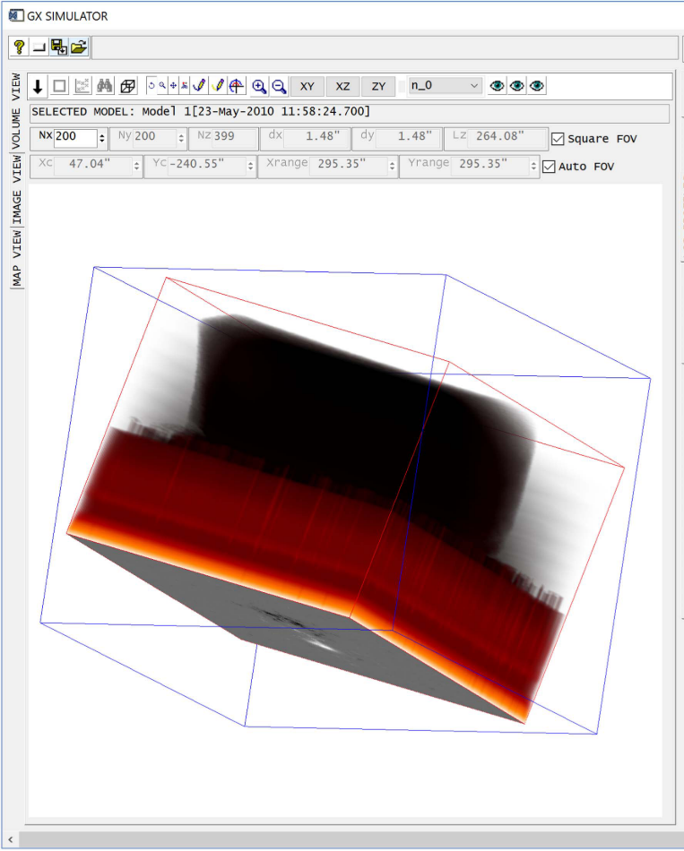
GX Simulator overview
Developed by Gelu Nita at NJIT
  IDL package
  Plans to re-implement in python
Originally designed to model non-thermal flare emission (Nita et al. 2015)
Augmented to model static, non-flaring active region emission (Nita et al. 2018)
  Considers the chromosphere, transition region, and corona
Optimizes coronal heating implementation to best-fit observations (Nita et al. 2023)
Produces physics based and dependent images of active regions
Nita et al. 2018

Slide 3
GX Simulator: data-driven active region models
ROI properties
  Location, time
  Model size and resolution
Optimize to observations
  X-ray / EUV / radio
HMI vector magnetograms
Input
Model Setup
Create model volume
Download data
Magnetic field
Potential / NLFFF extrapolation
Volume fill
Plasma heating
Create images
Arbitrary imager
Any* observer
Interpolate EBTEL solutions
GX processing
Output
Plasma model
  Coronal heating properties
Coronal magnetic field model
Active region spectral emission

Slide 4
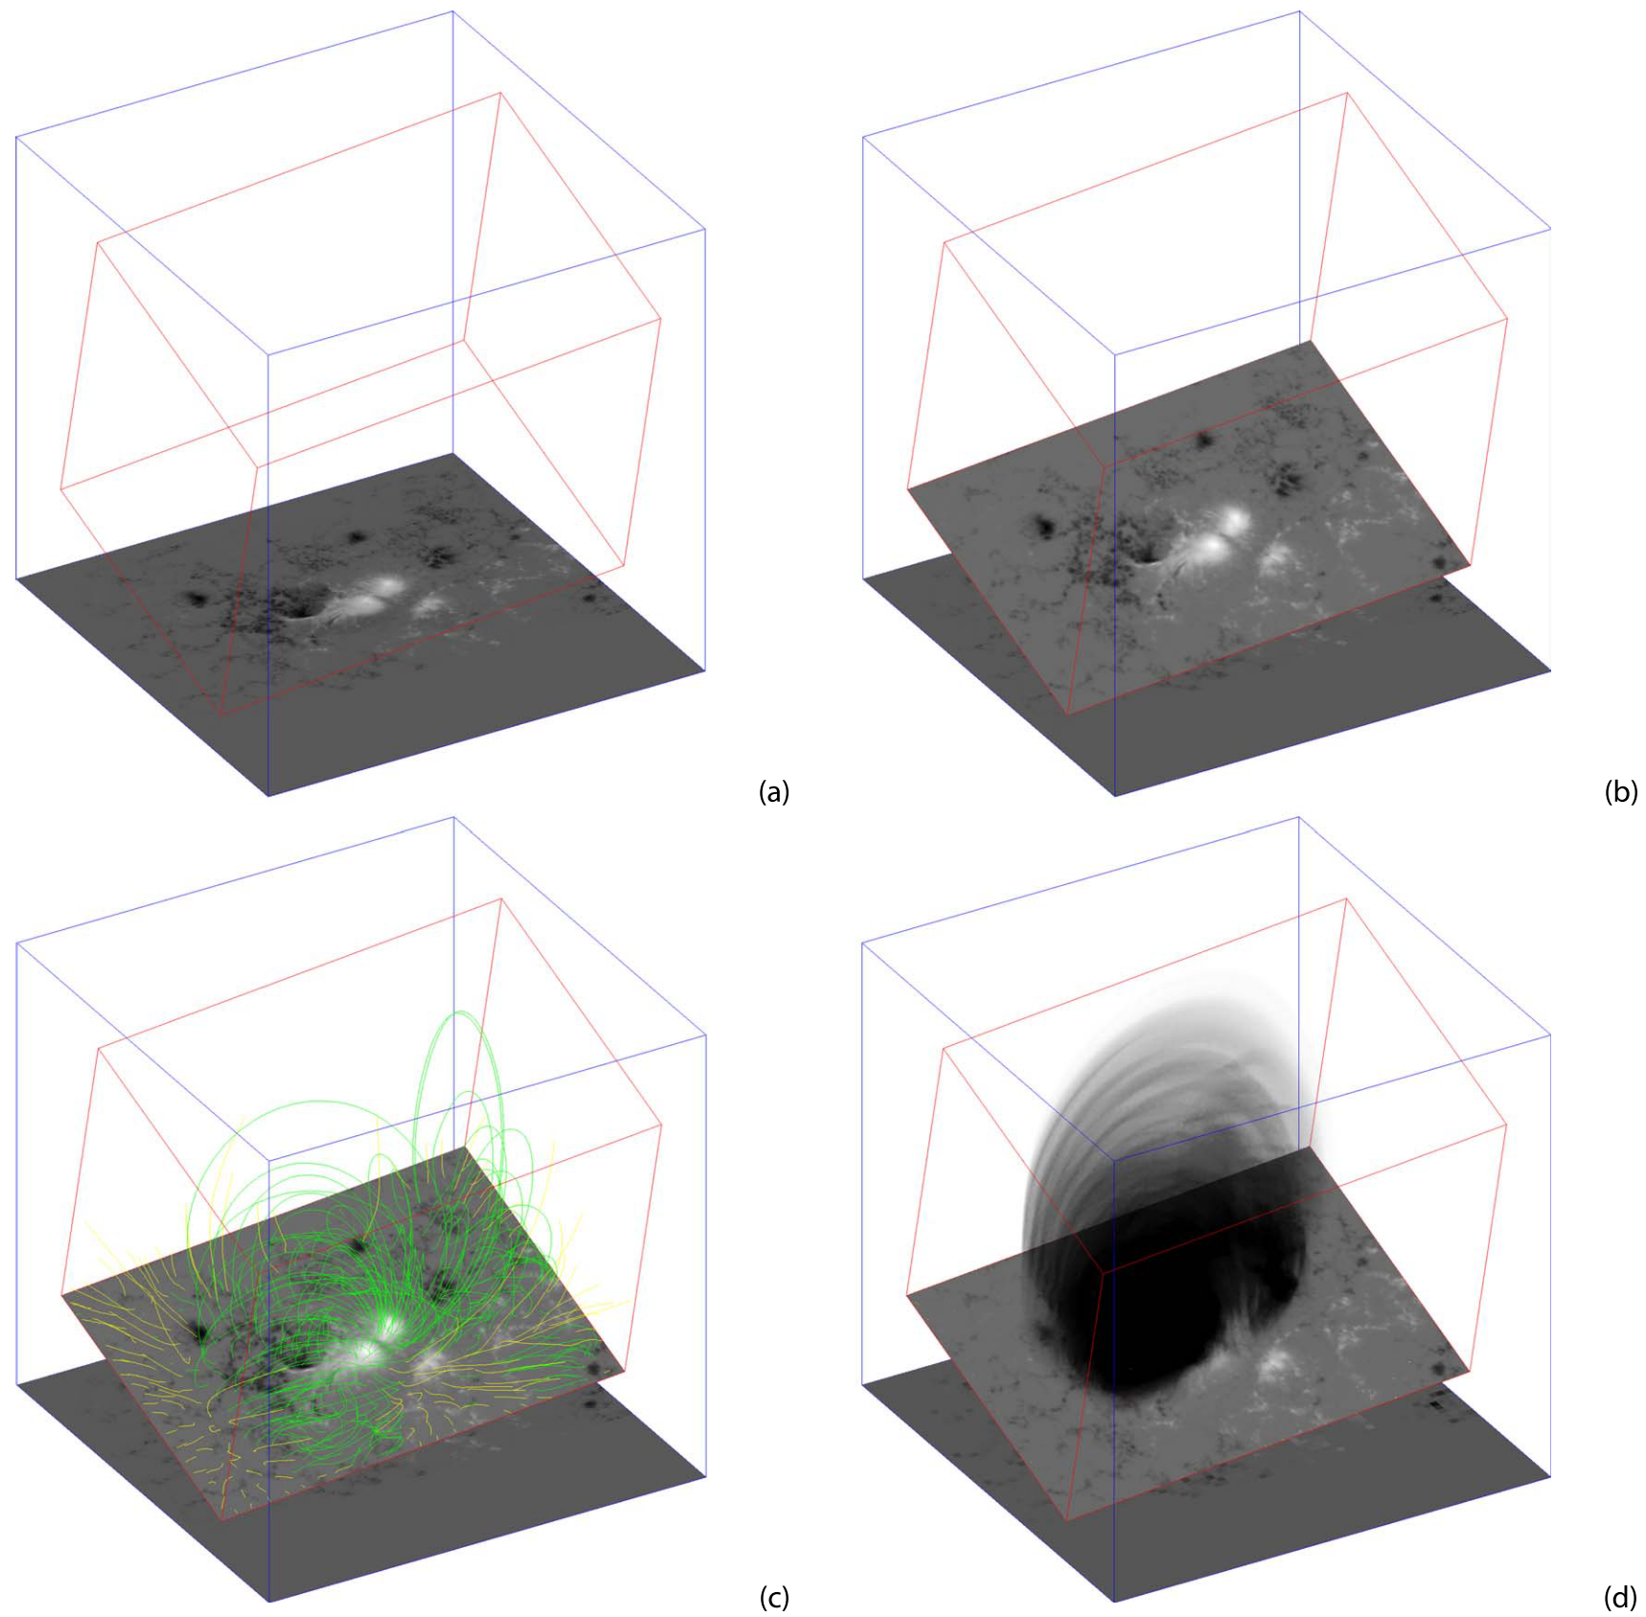
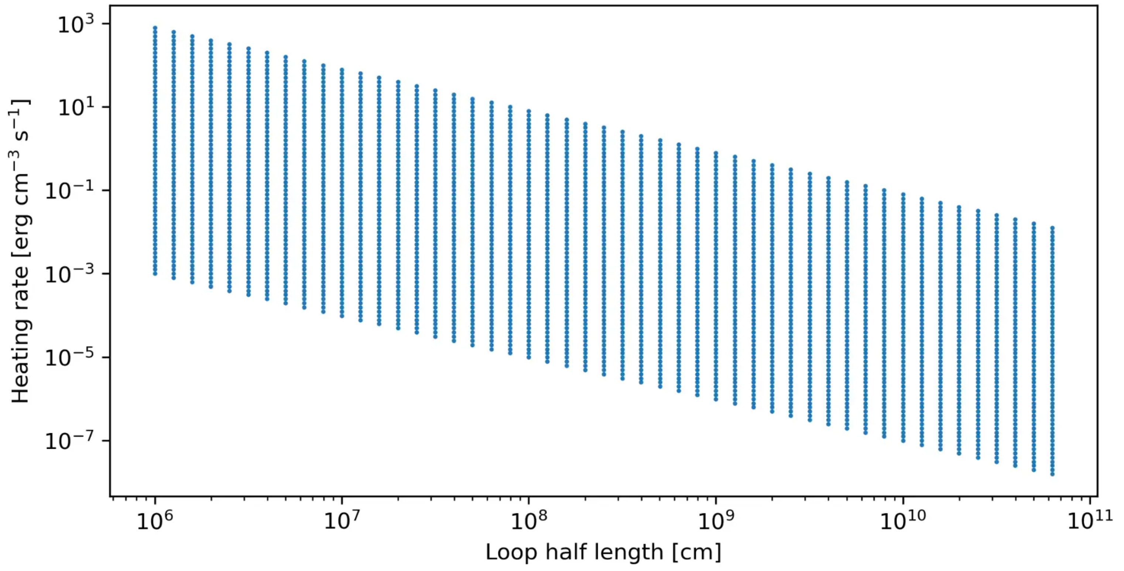
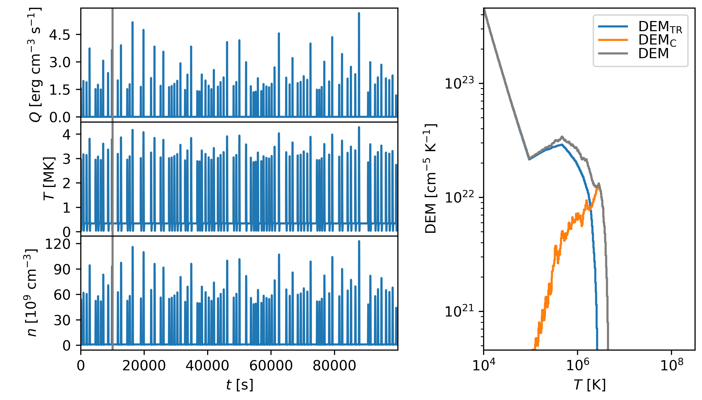

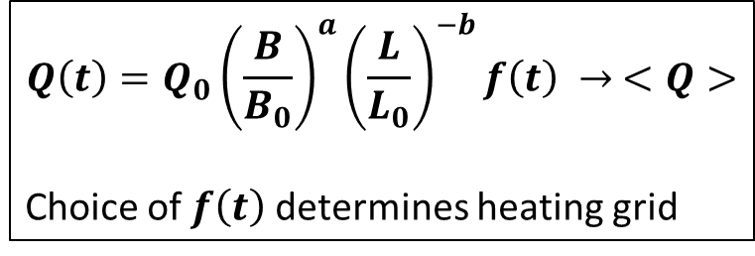
Filling GX Simulator with plasma
Nita et al. 2023
$$Q\left(t\right)=Q_{0}{\left(\frac{B}{B_{0}}\right)}^{a}{\left(\frac{L}{L_{0}}\right)}^{−b}f\left(t\right) → <Q>$$
Choice of $f\left(t\right)$ determines heating grid
<B>, L
<$Q$>, L

Slide 5
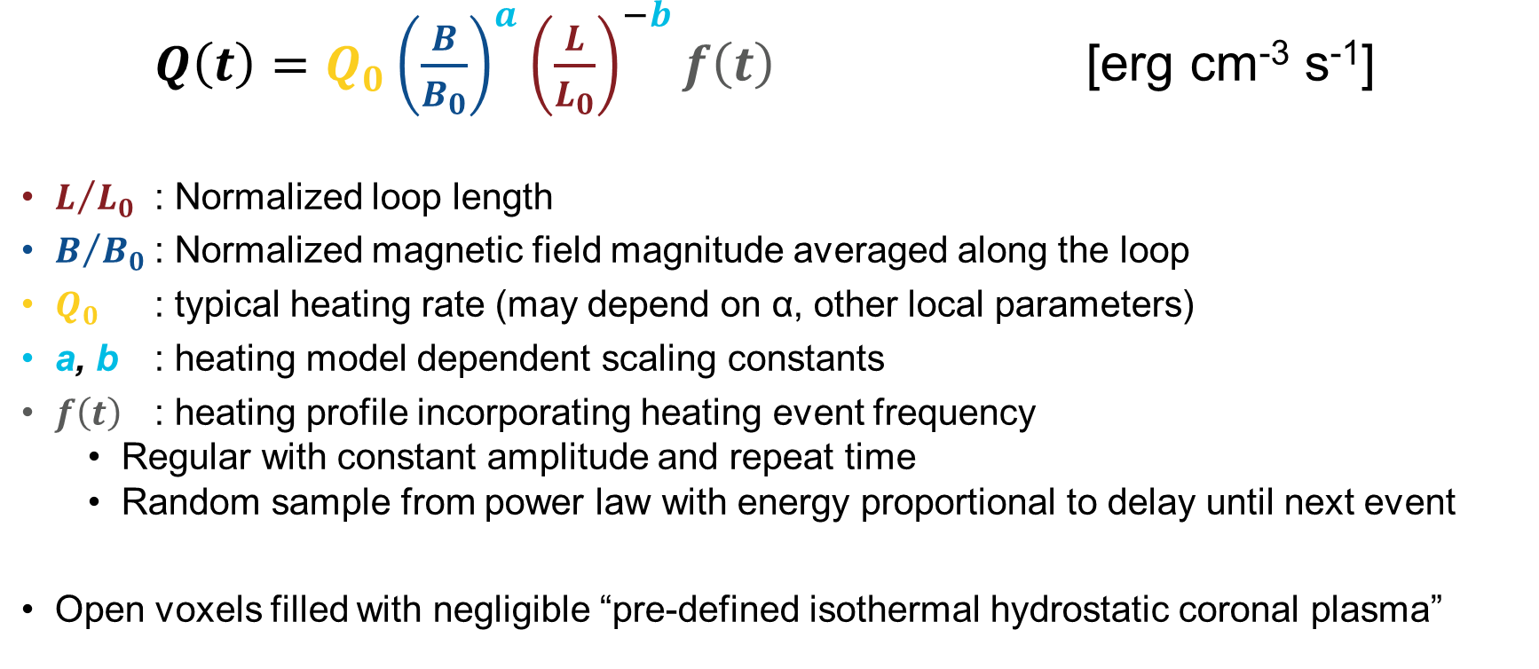
GX Simulator heating parameterization in “closed” voxels
$Q\left(t\right)=Q_{0}{\left(\frac{B}{B_{0}}\right)}^{a}{\left(\frac{L}{L_{0}}\right)}^{−b}f\left(t\right)$ [erg cm⁻³ s⁻¹]
$L/{L_{0}}$ : Normalized loop length
$B/{B_{0}}$ : Normalized magnetic field magnitude averaged along the loop
$Q_{0}$ : typical heating rate (may depend on α, other local parameters)
a, b : heating model dependent scaling constants
$f\left(t\right)$ : heating profile incorporating heating event frequency
  Regular with constant amplitude and repeat time
  Random sample from power law with energy proportional to delay until next event
Open voxels filled with negligible “pre-defined isothermal hydrostatic coronal plasma”

Slide 6
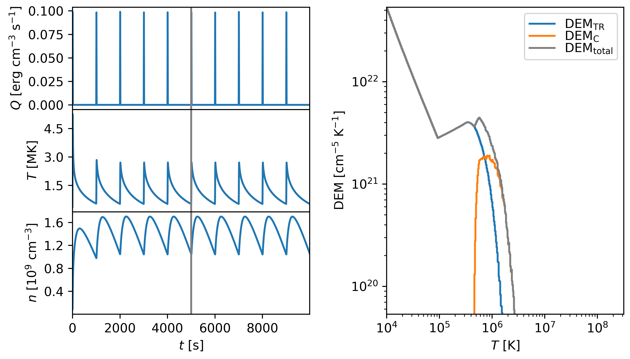
EBTEL (Enthalpy-Based Thermal Evolution of Loops)
“0D” hydrodynamic loop model
  Klimchuk et al. 2008, Cargill et al. 2012a, 2012b
Arbitrary, user-defined heating function
  Typically impulsive heating events
Balances emission, thermal conduction, and enthalpy flux via bulk plasma flow
Finds average T, P, and n along closed coronal loop
Includes the transition region
Using EBTEL++ python/c implementation (Barnes et al. 2016a, 2016b)

Slide 7
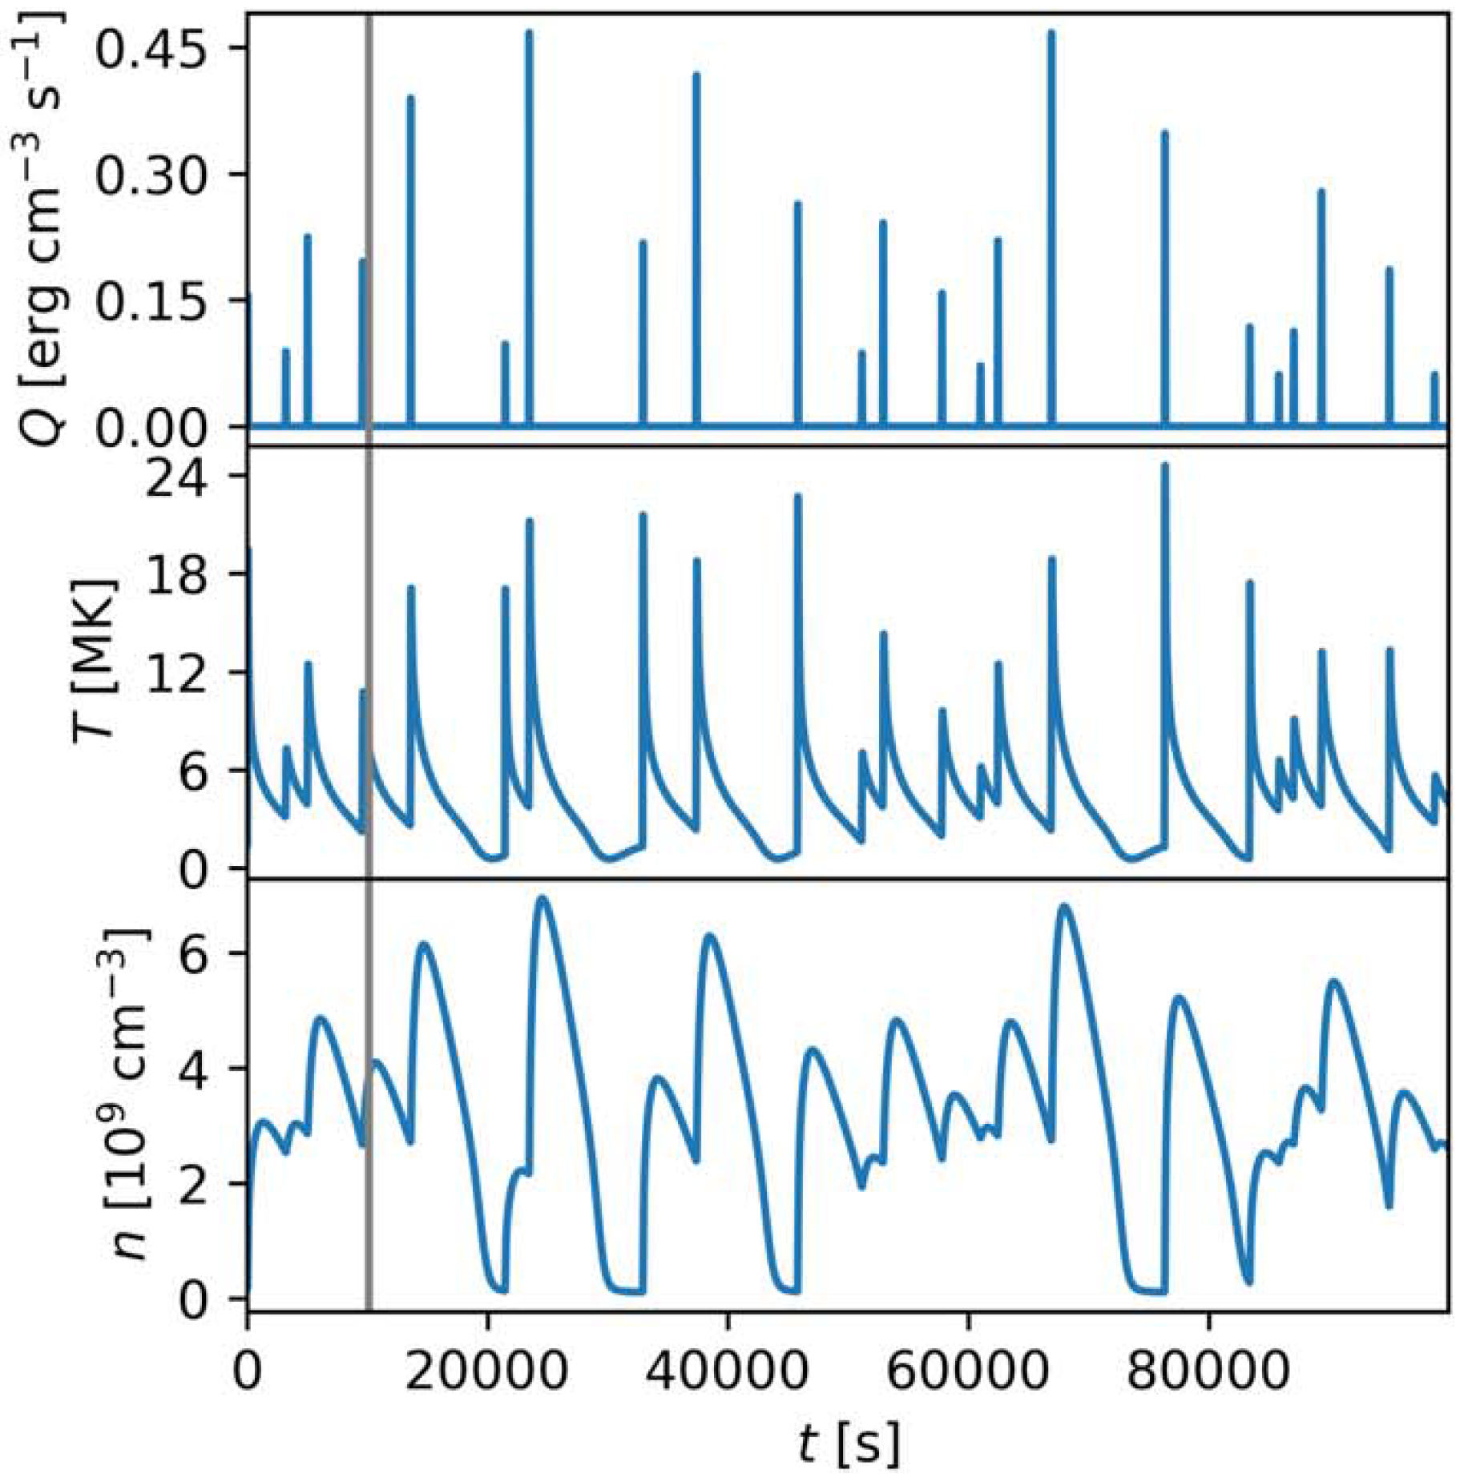
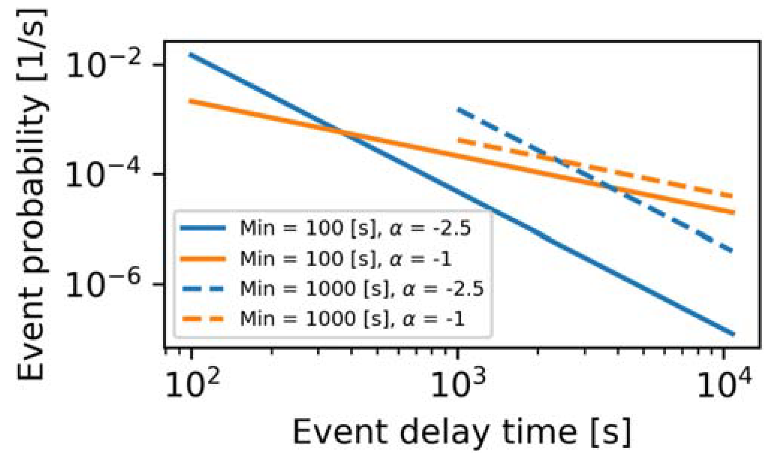
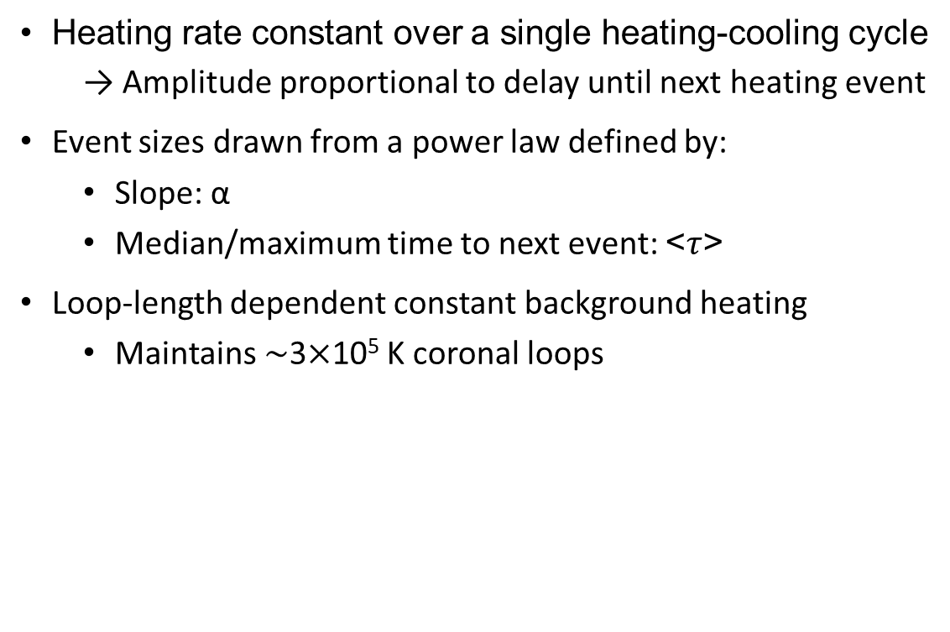
GX Simulator implementation of EBTEL random heating
Heating rate constant over a single heating-cooling cycle
  → Amplitude proportional to delay until next heating event
Event sizes drawn from a power law defined by:
  Slope: α
  Median/maximum time to next event: <$τ$>
Loop-length dependent constant background heating
  Maintains $\sim$3$×$10⁵ K coronal loops
Schonfeld and Klimchuk 2020

Slide 8
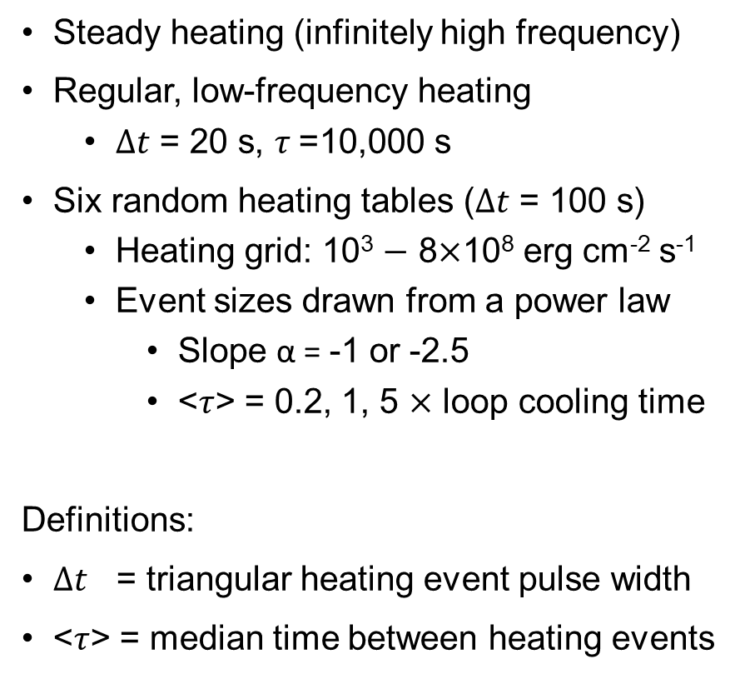
EBTEL in GX Simulator: eight pre-computed heating grids
Steady heating (infinitely high frequency)
Regular, low-frequency heating
  $∆t$ = 20 s, $τ$=10,000 s
Six random heating tables ($∆t$ = 100 s)
  Heating grid: 10³ $−$ 8$×$10⁸ erg cm⁻² s⁻¹
  Event sizes drawn from a power law
    Slope α = -1 or -2.5
    <$τ$> = 0.2, 1, 5 $×$ loop cooling time
Definitions:
$∆t$ = triangular heating event pulse width
<$τ$> = median time between heating events

Slide 9
Filling GX Simulator with plasma
Nita et al. 2023
$$Q\left(t\right)=Q_{0}{\left(\frac{B}{B_{0}}\right)}^{a}{\left(\frac{L}{L_{0}}\right)}^{−b}f\left(t\right) → <Q>$$
Choice of $f\left(t\right)$ determines heating grid
<B>, L
<$Q$>, L

Slide 10
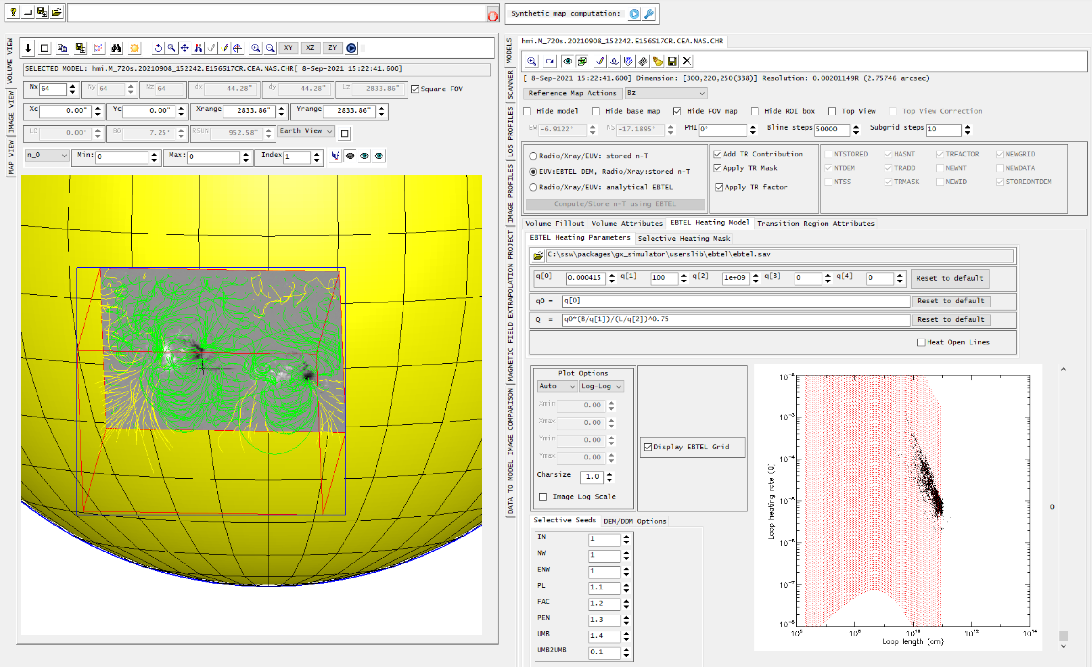
Courtesy of Terry Kucera

Slide 11
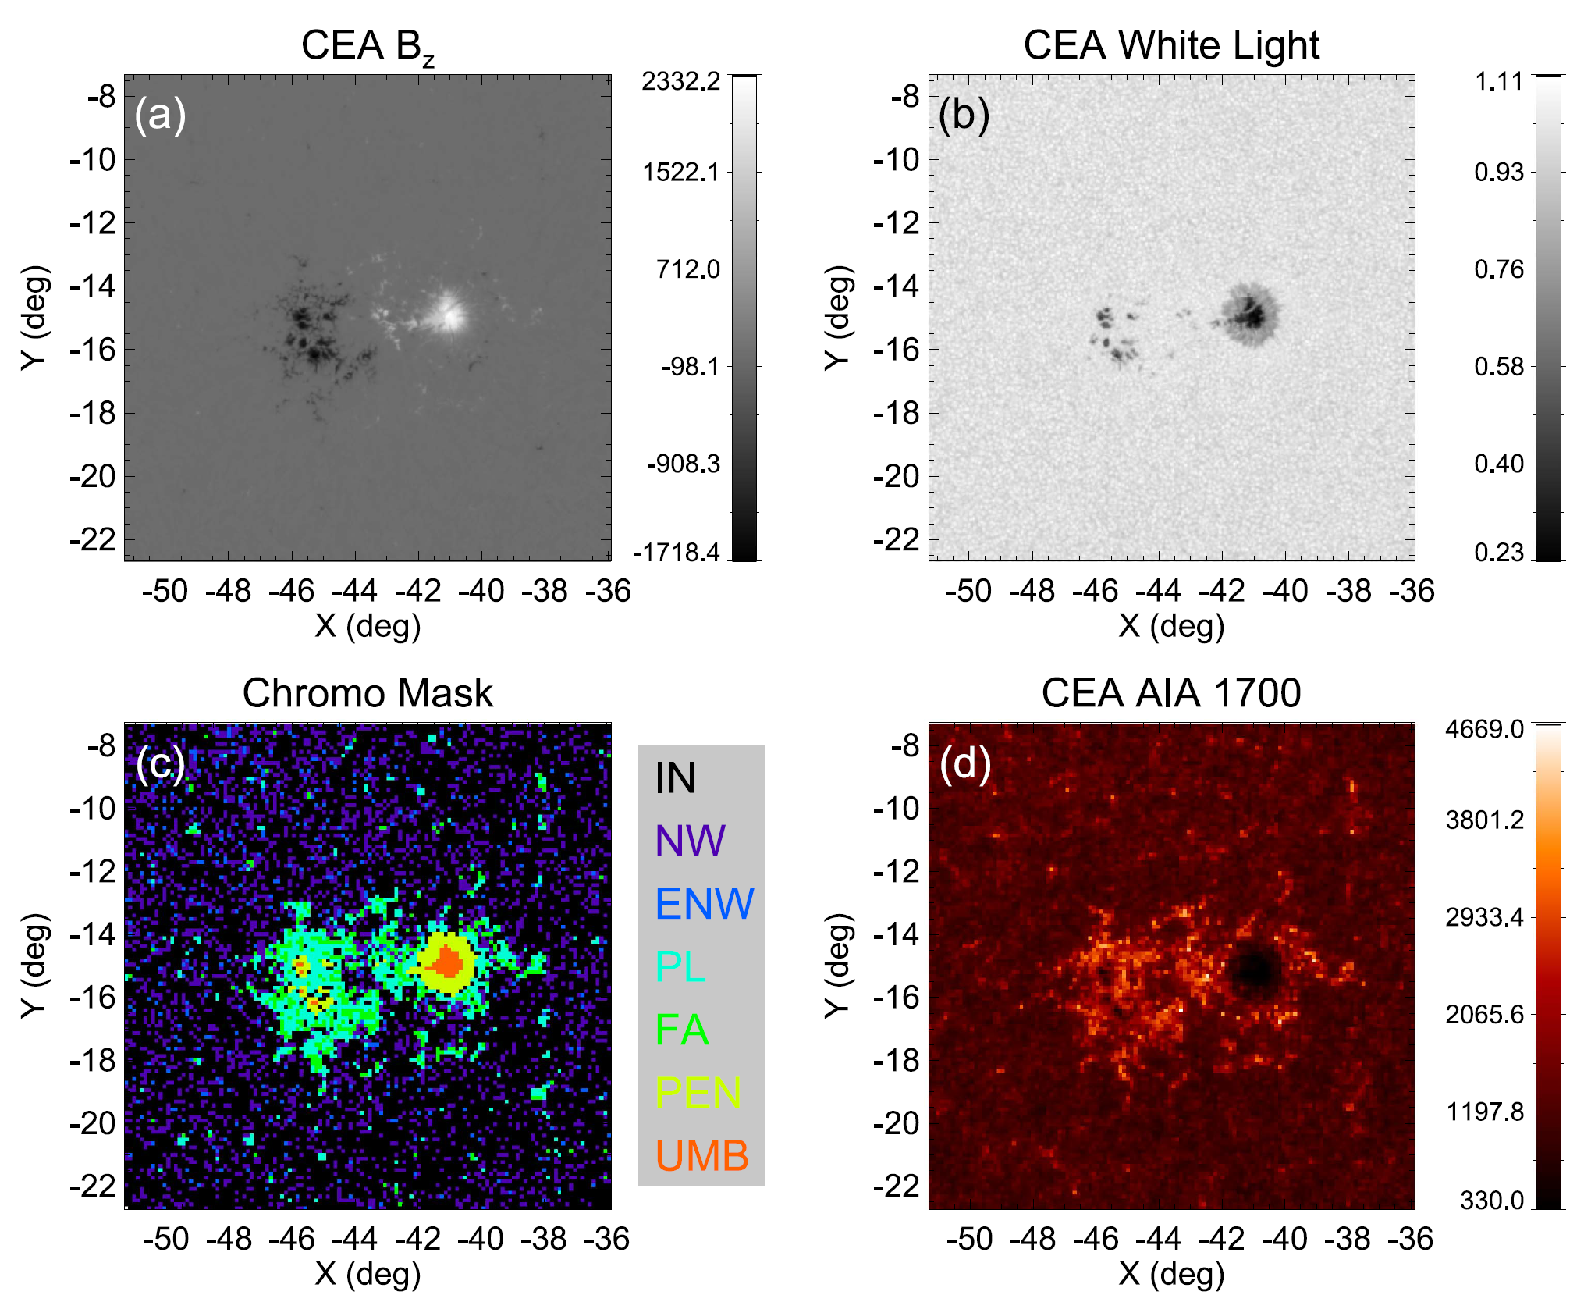
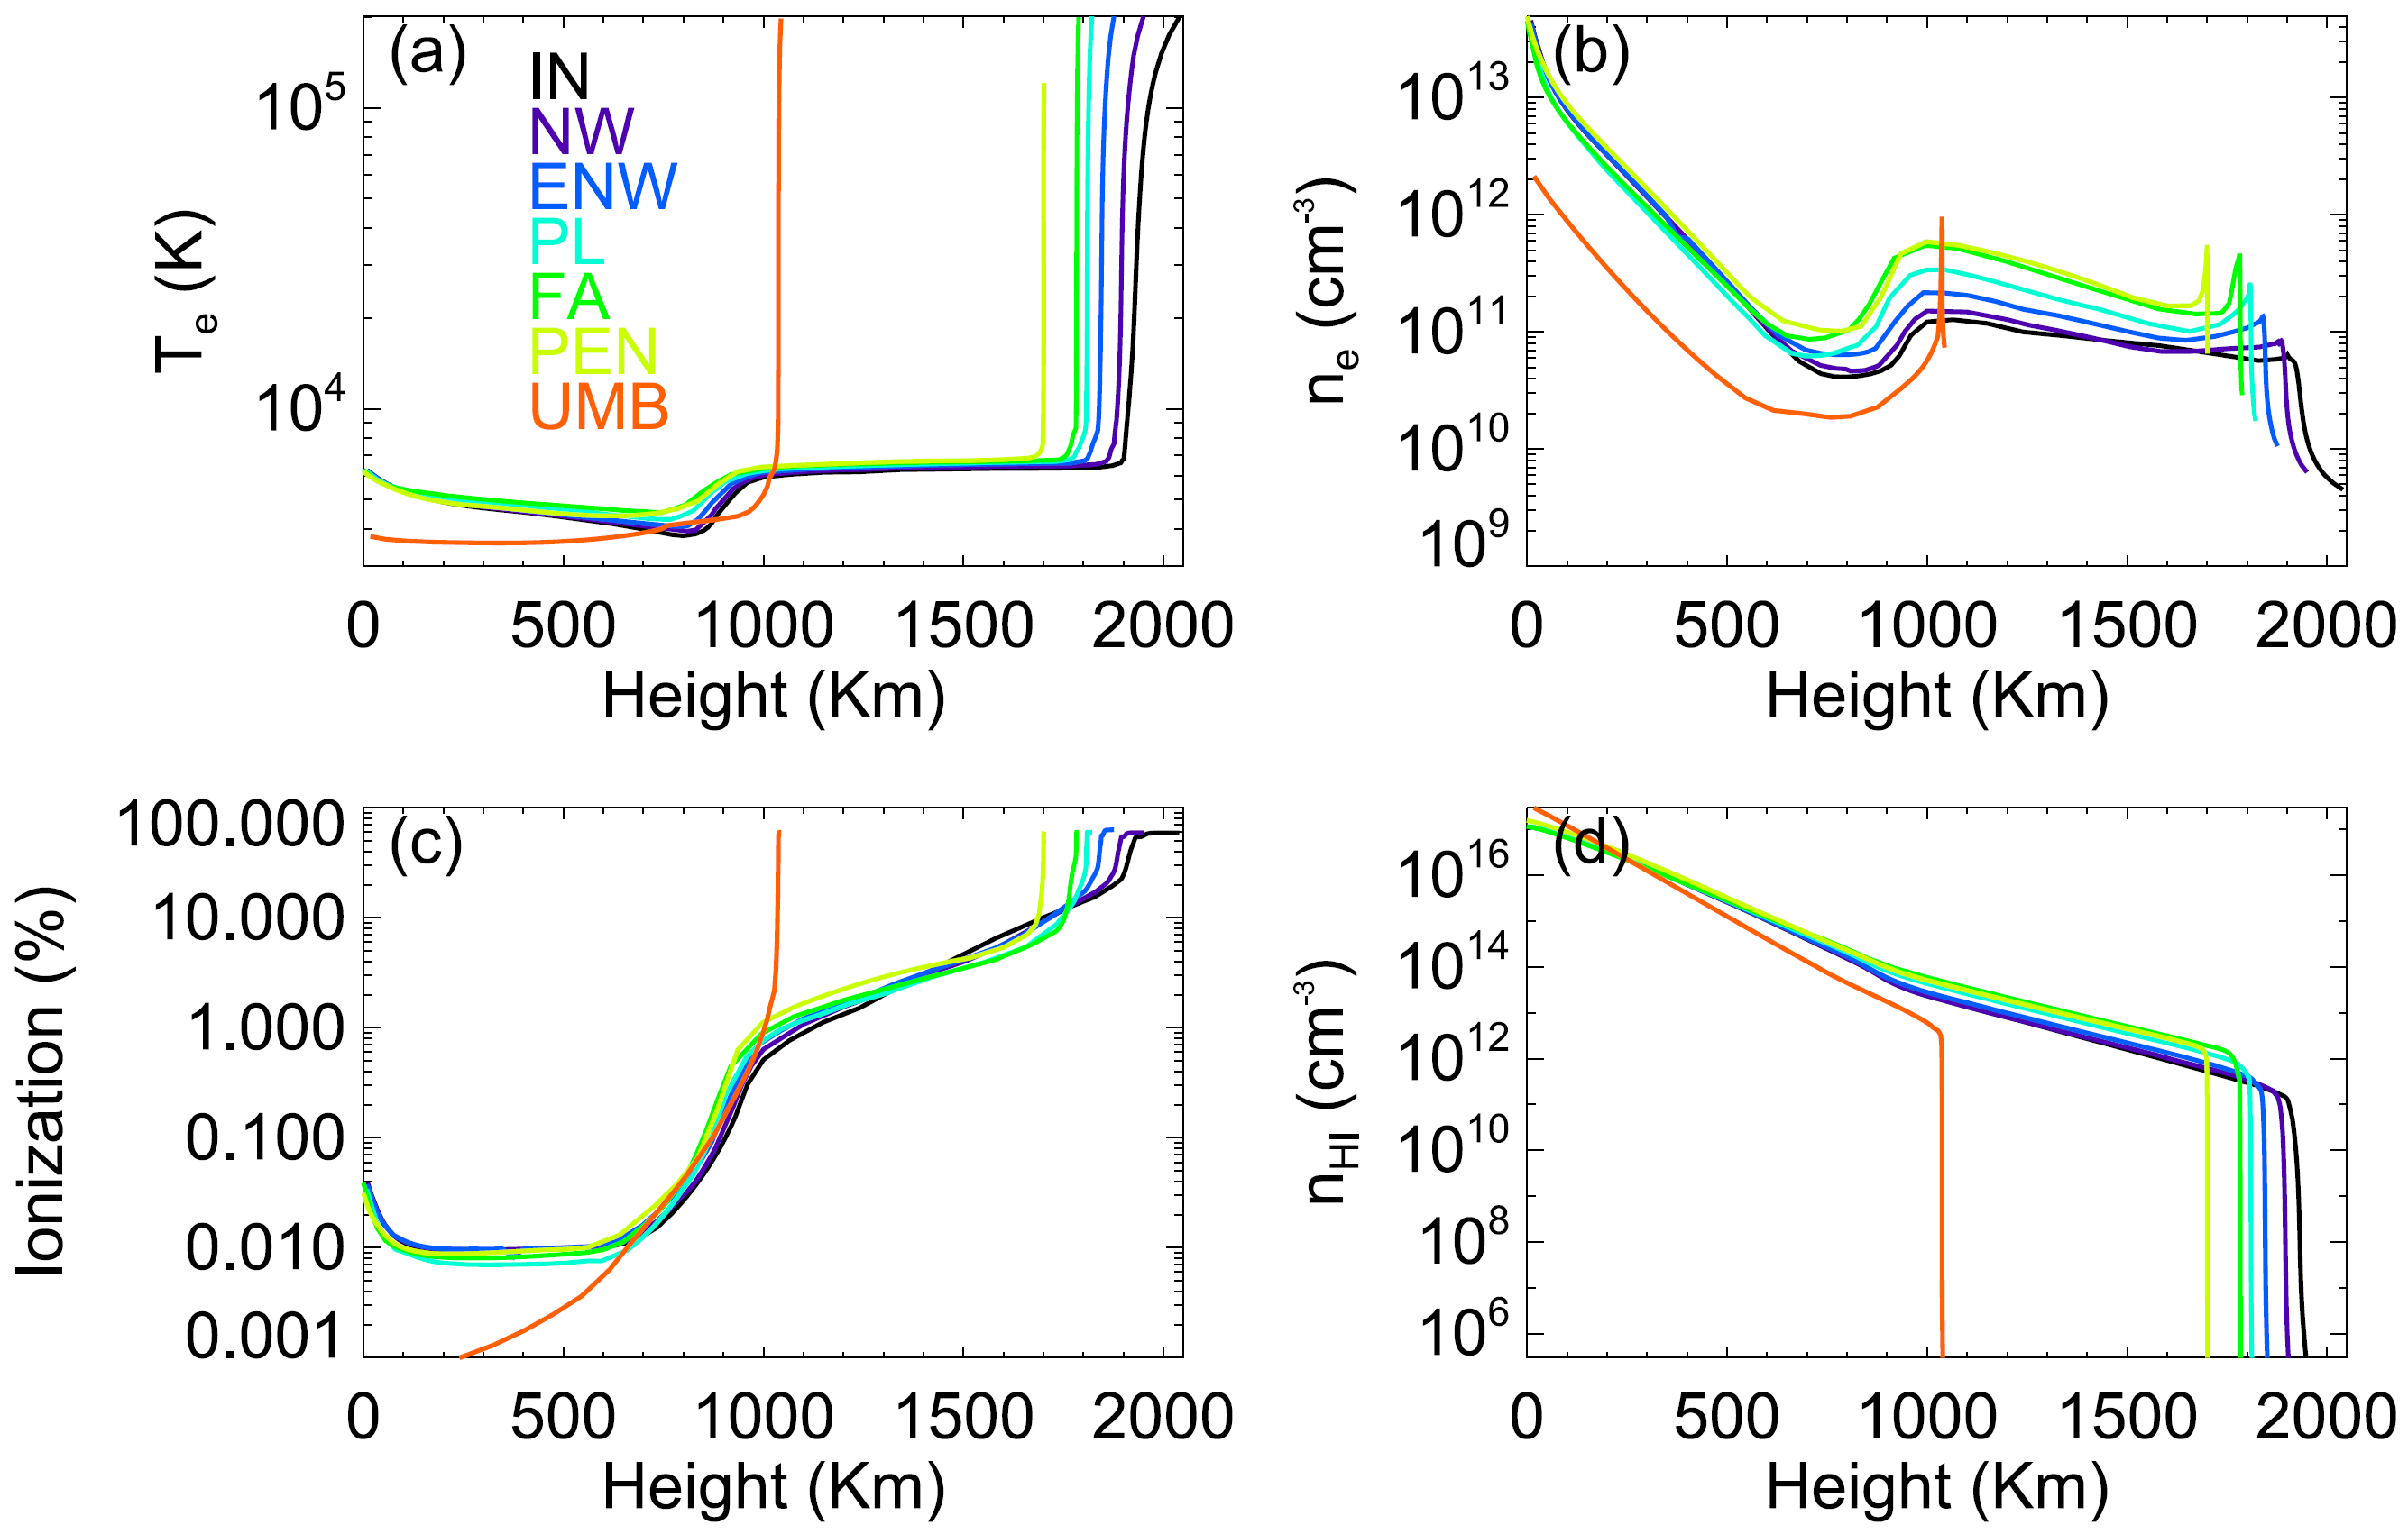
GX simulator: chromospheric emission (Fontenla et al. 2009)
Nita et al. 2018

Slide 12
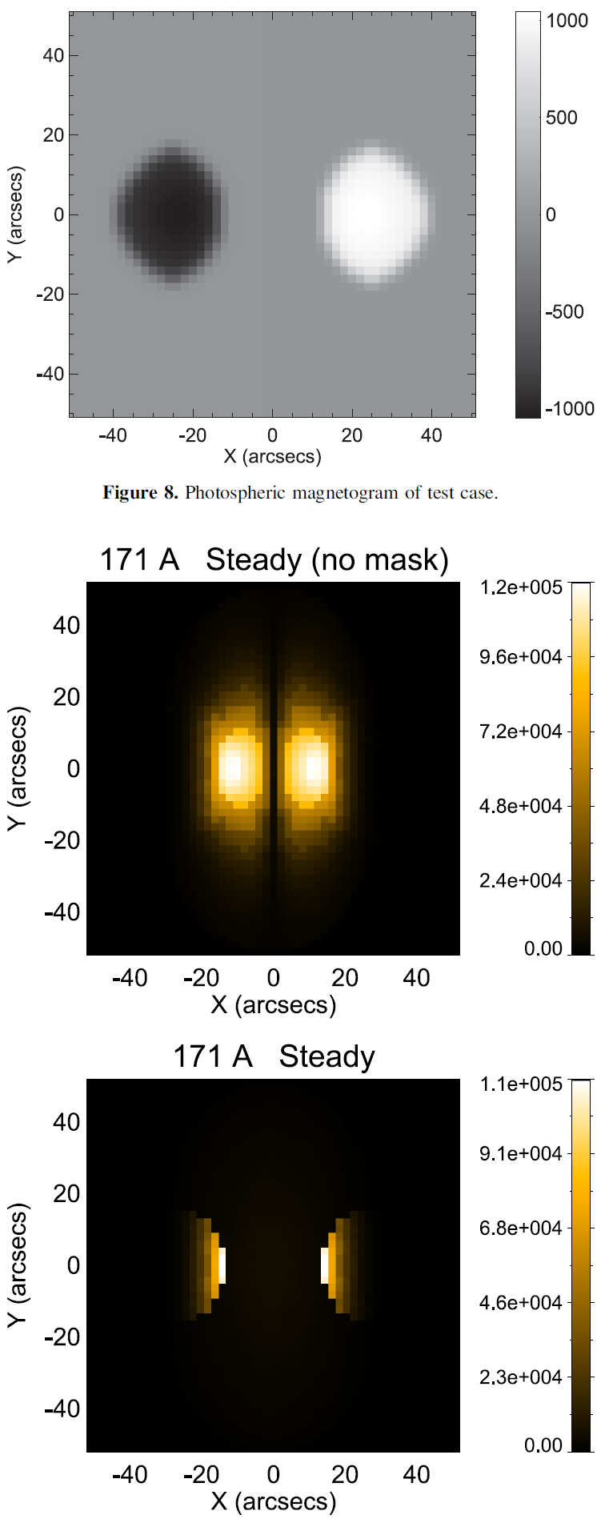
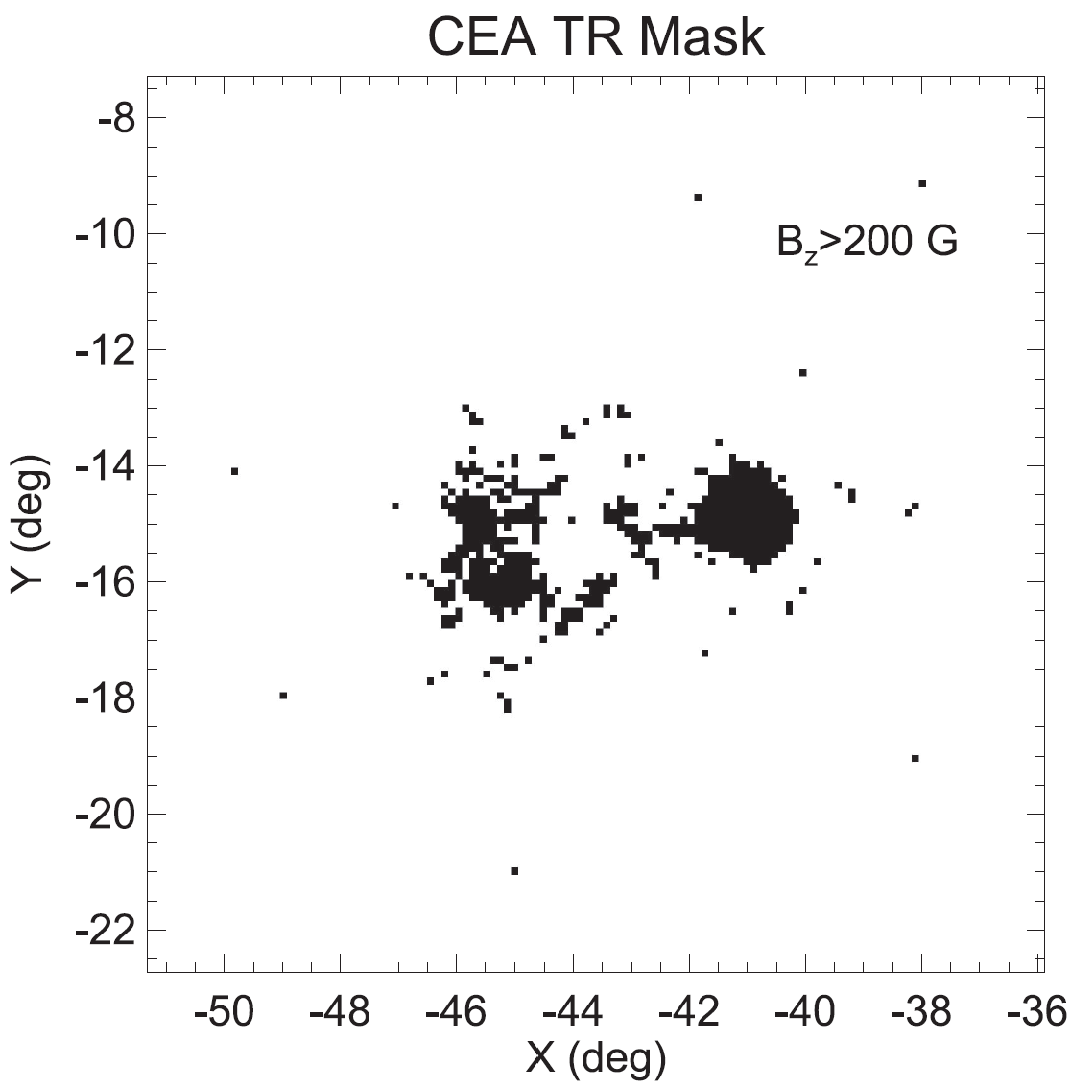
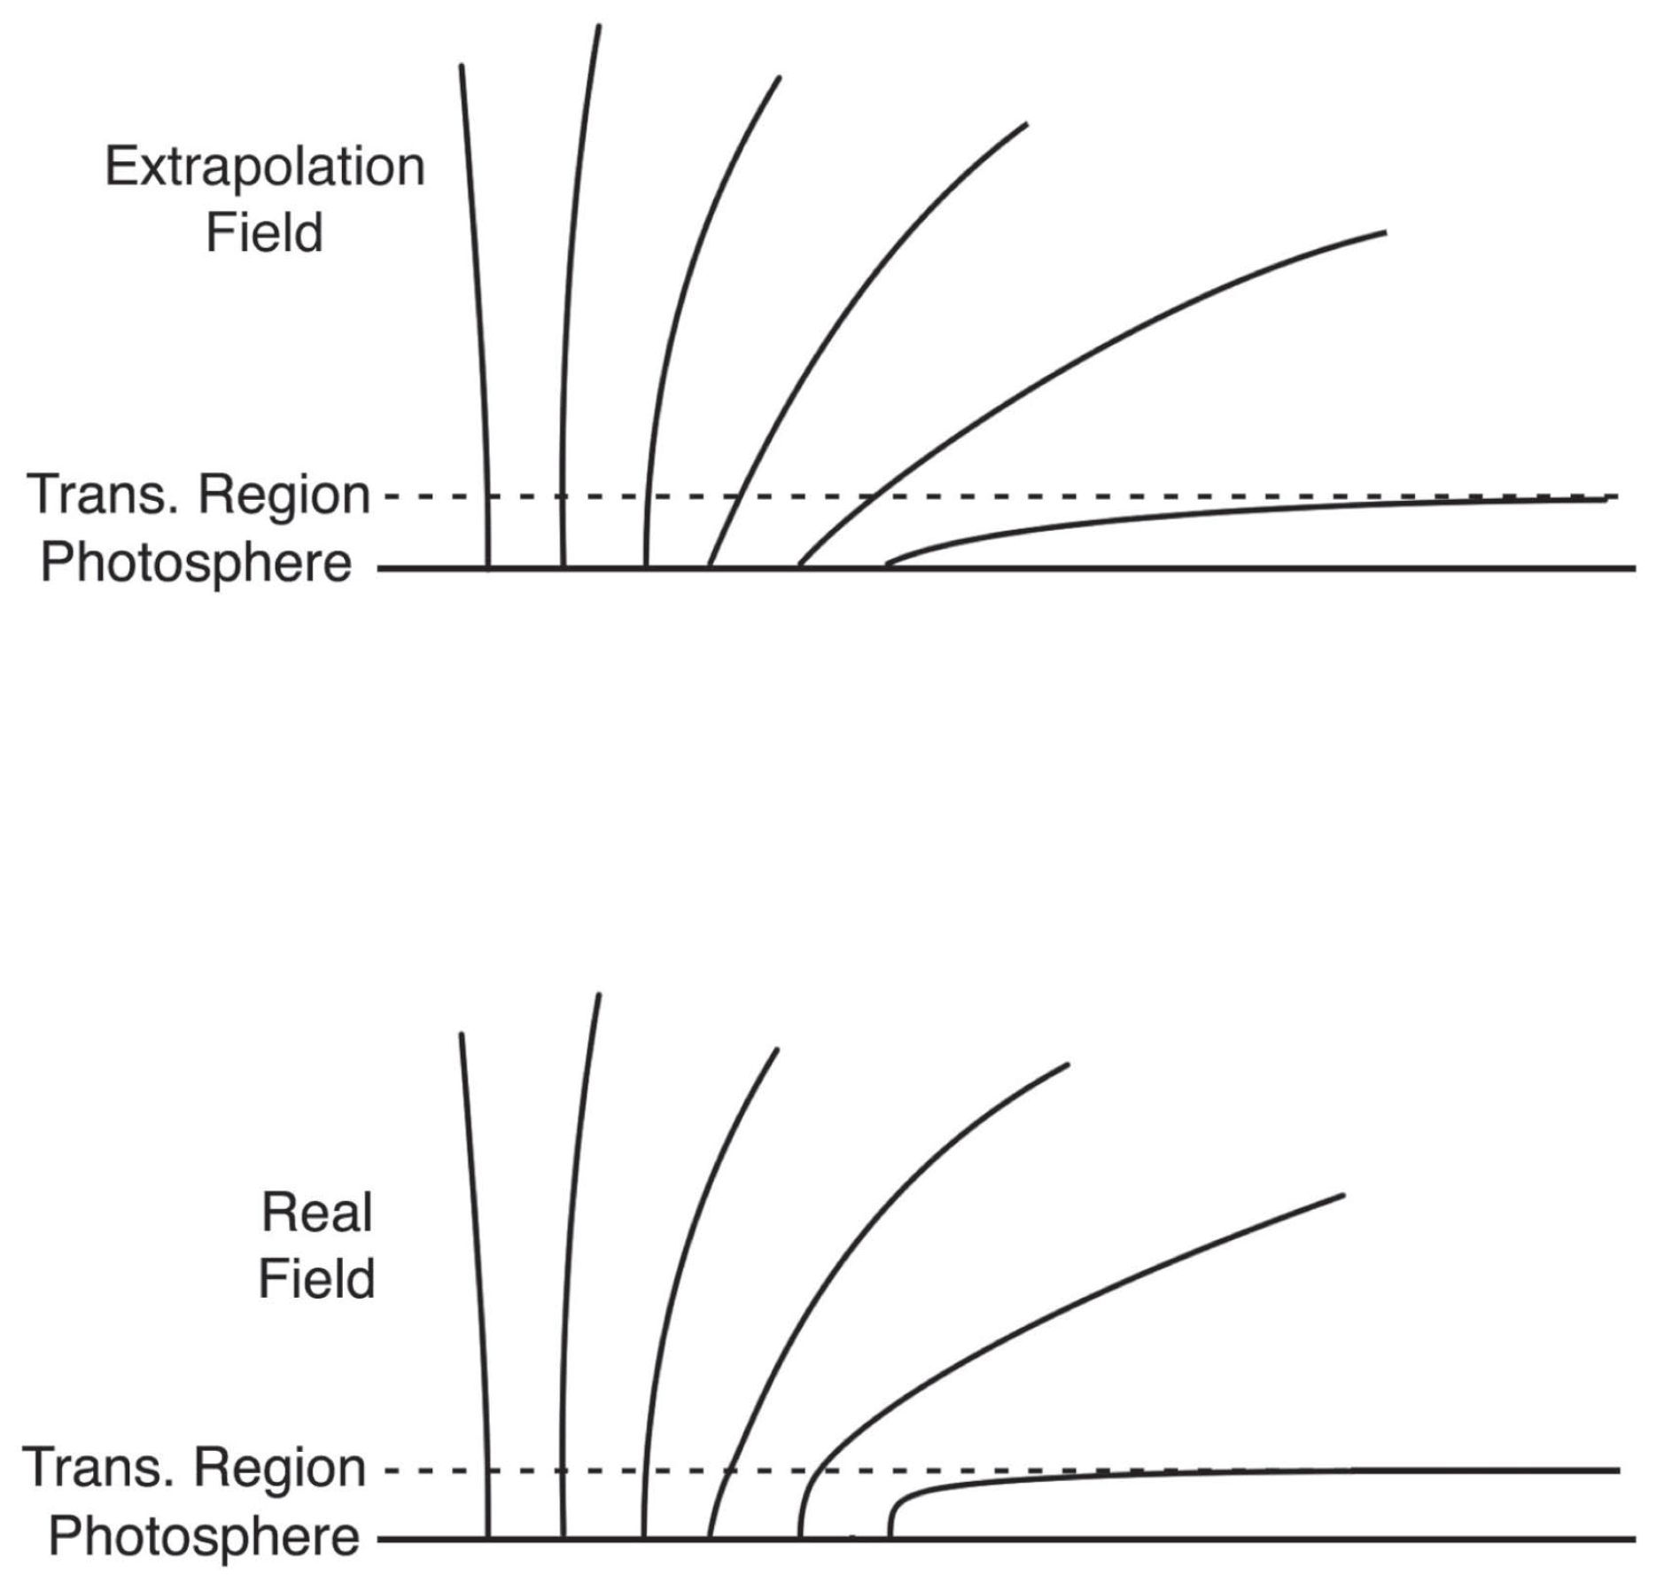
GX Simulator: transition region emission
TR plasma only included in the bottom layer of the coronal model
Geometric correction factor to scale sub-grid TR contribution based on LOS angle to the local magnetic field
Can apply a mask so TR is only included in strong-field pixels
  Ad-hoc fix to limitations of magnetic field extrapolation
In practice, can dominate coronal emission
Nita et al. 2018

Slide 13
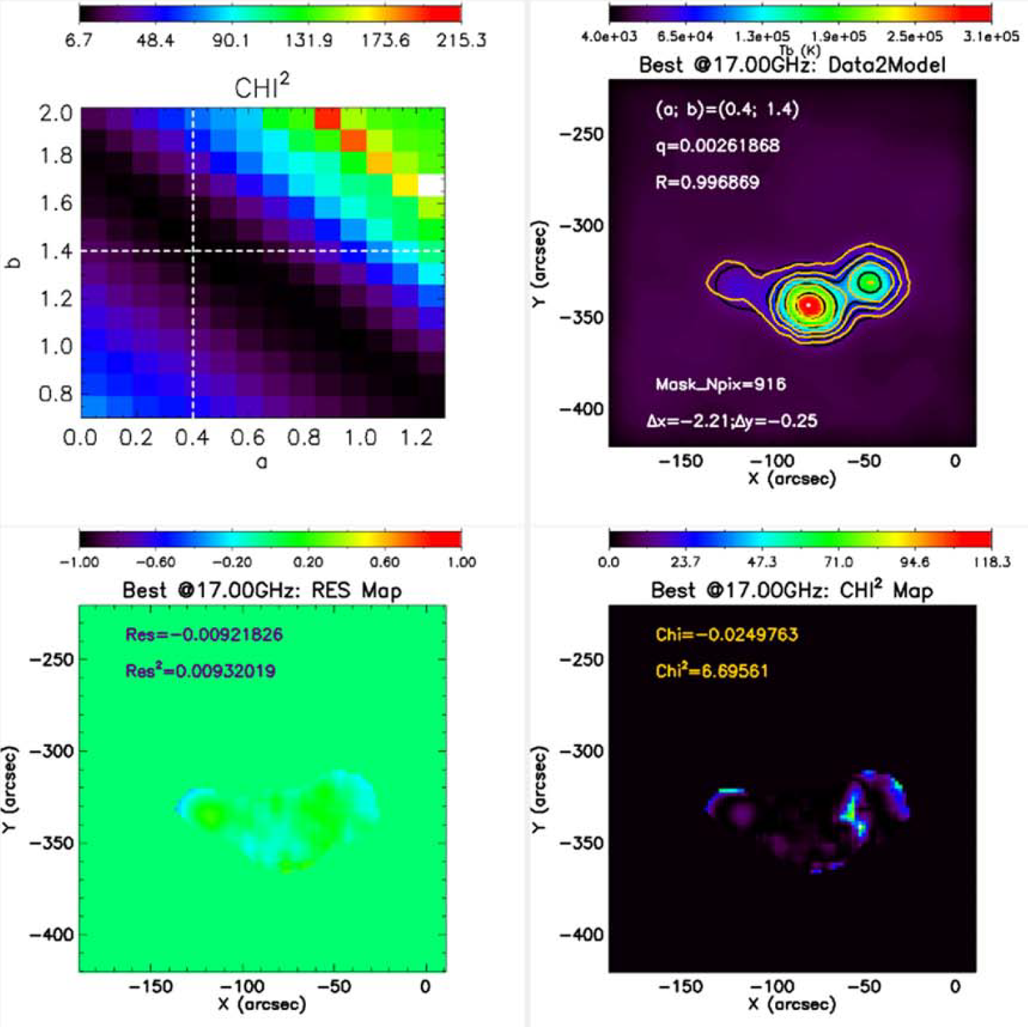
Heating model optimization
Searches for best heating function
  Tests a, b parameter space
Determines heating function that produces synthetic images most consistent with a particular observation
Needs more testing using EUV and X-ray observations
  Higher spatial resolution
  More heating model sensitivity

Slide 14
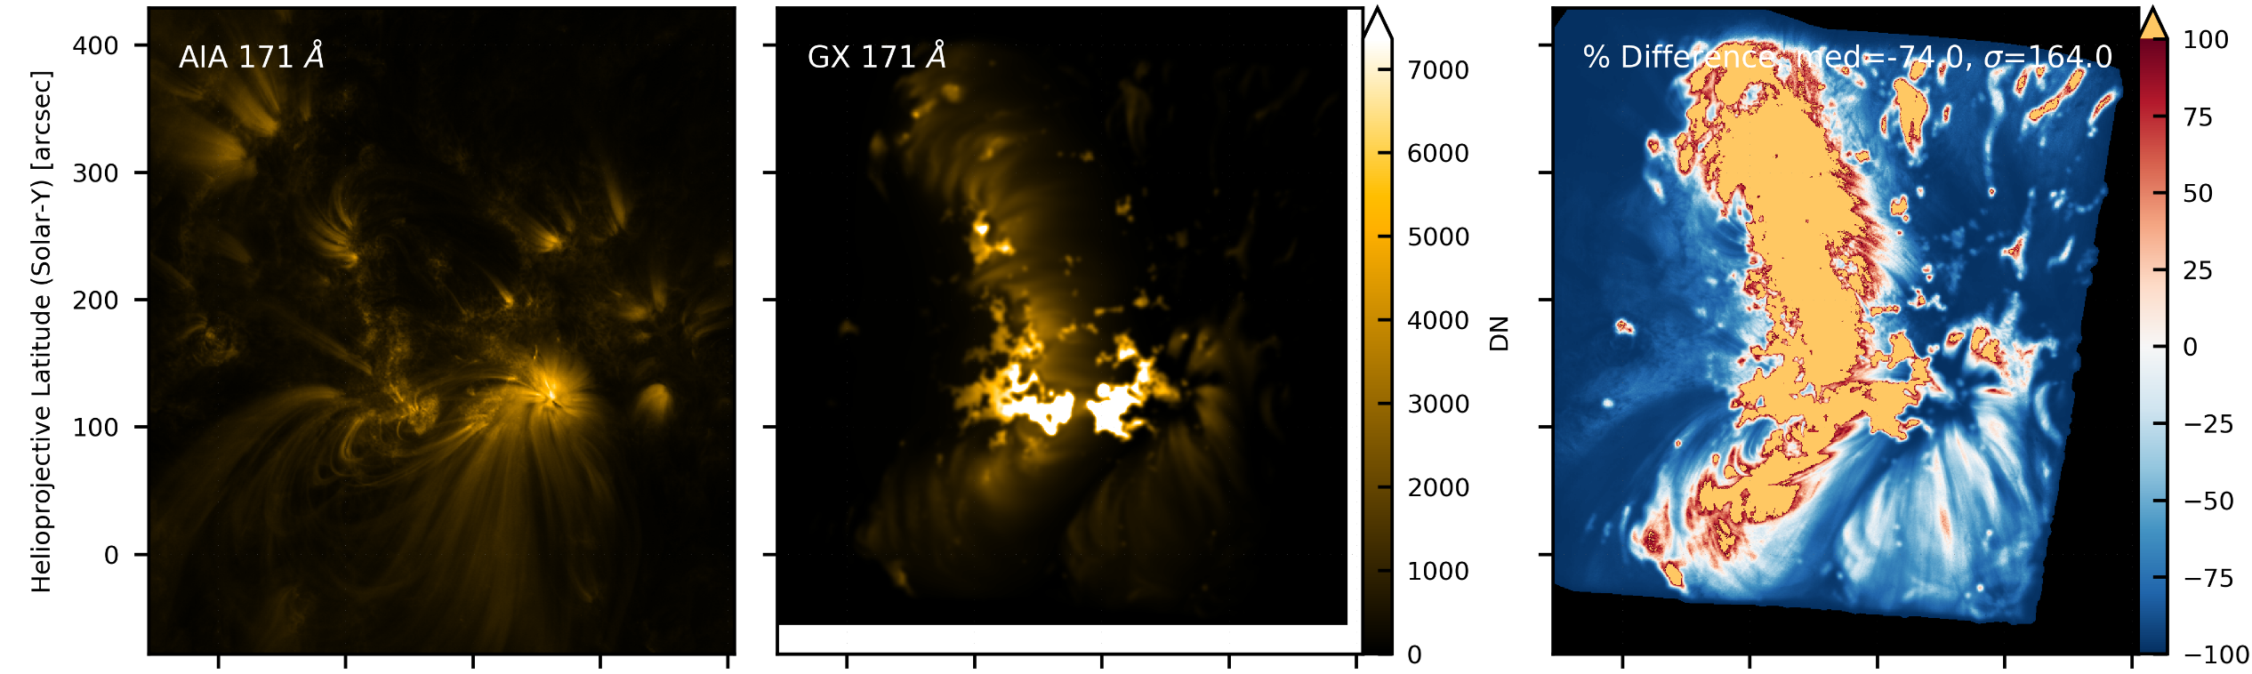
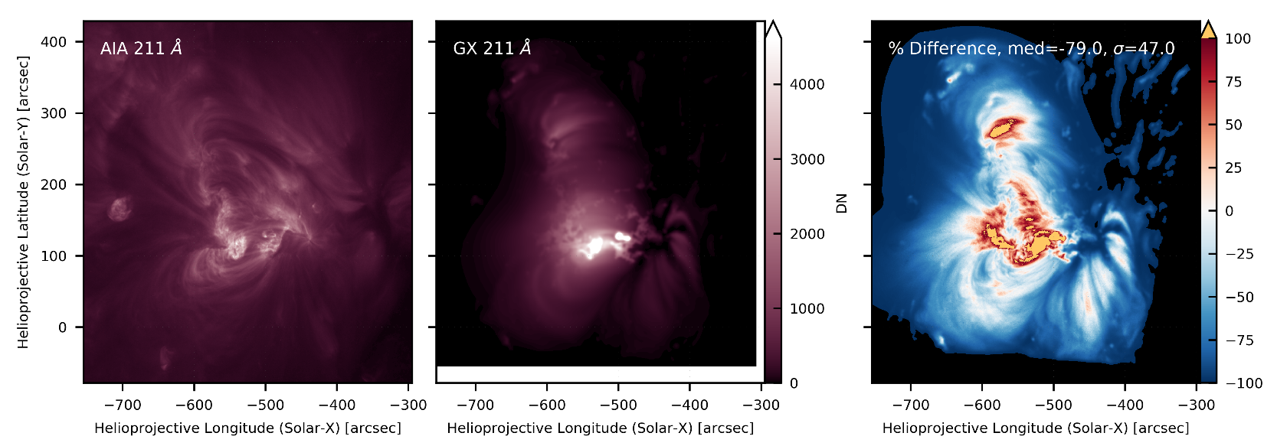
Unoptimized model results: older EBTEL implementation
171 Å
Note: comparing AIA snapshots with “time averaged” GX
211 Å

Slide 15
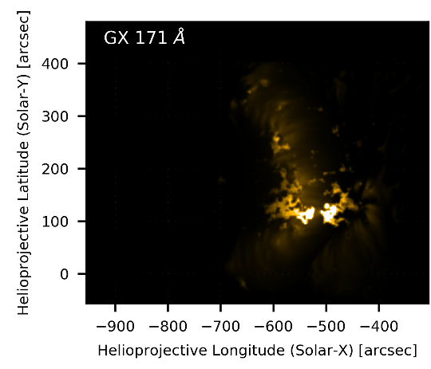
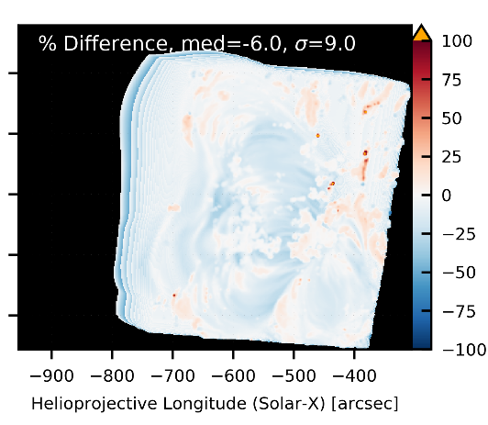
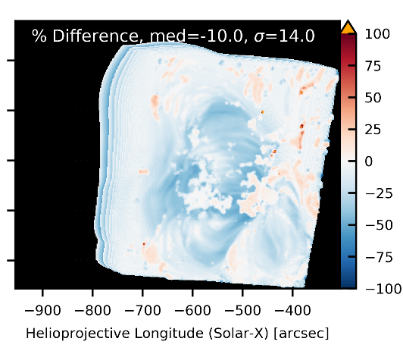
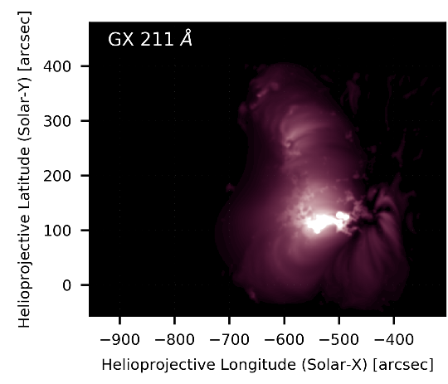
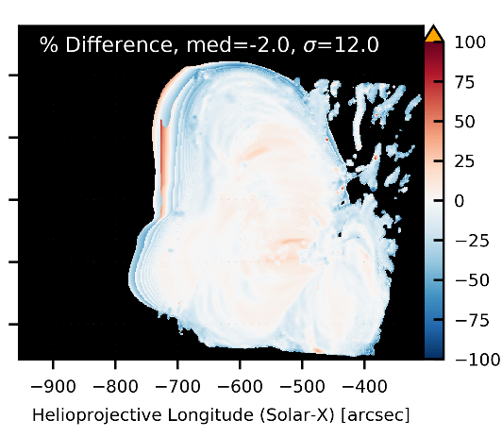
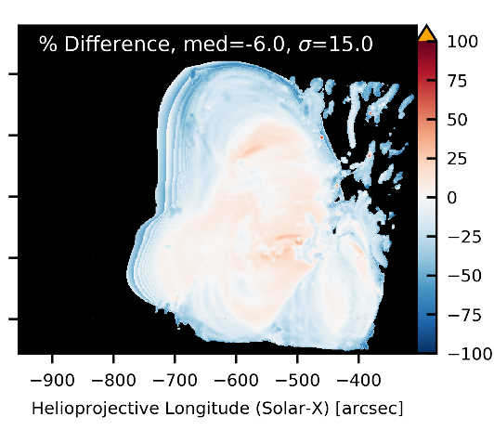



Low Freq. <$τ$> ≈3,000s
Med. Freq. <$τ$> ≈ 1,000s
High Freq. <$τ$> ≈ 300s
171 Å
Power Law Heating, α=-2.4
211 Å

Slide 16
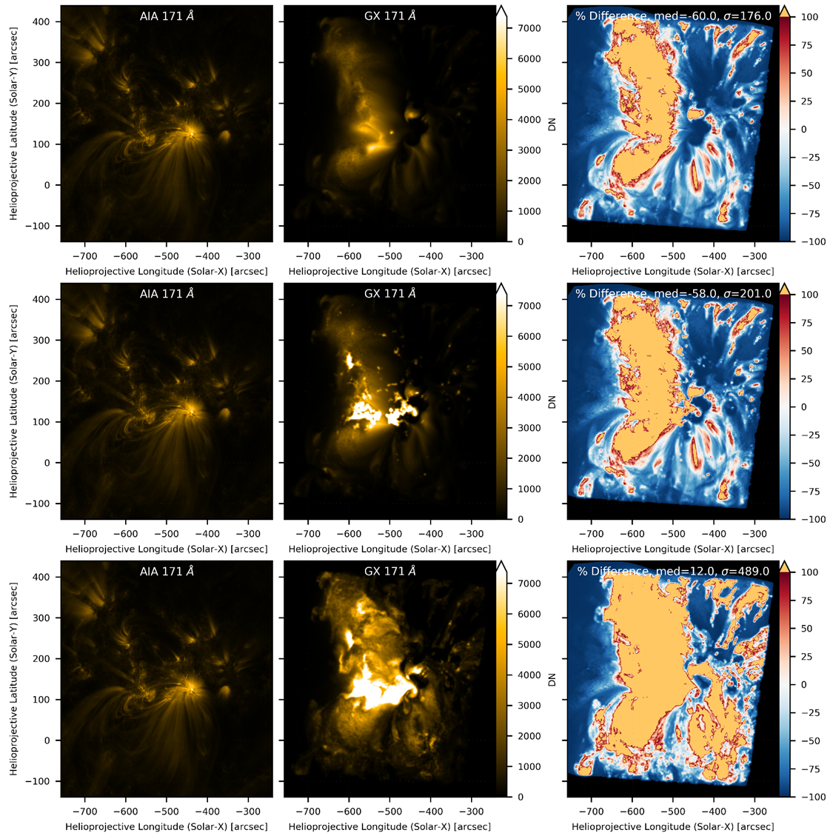
Transition Region in 171 Å
No TR
TR: B > 200 G
Full TR

Slide 17
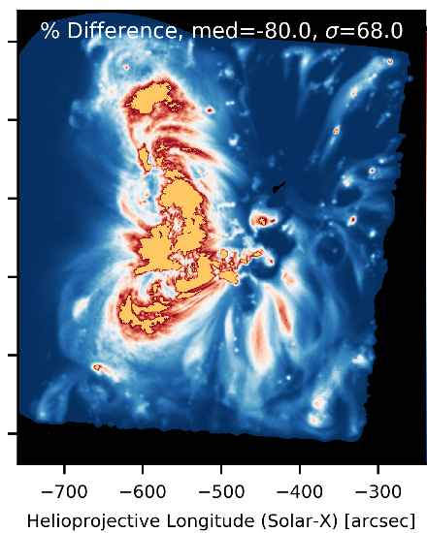
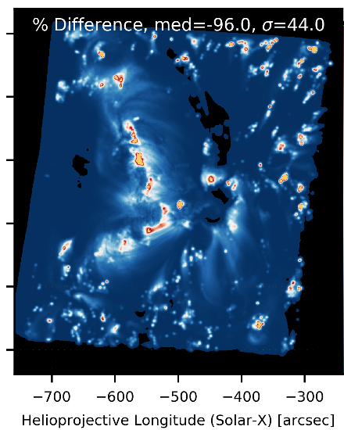
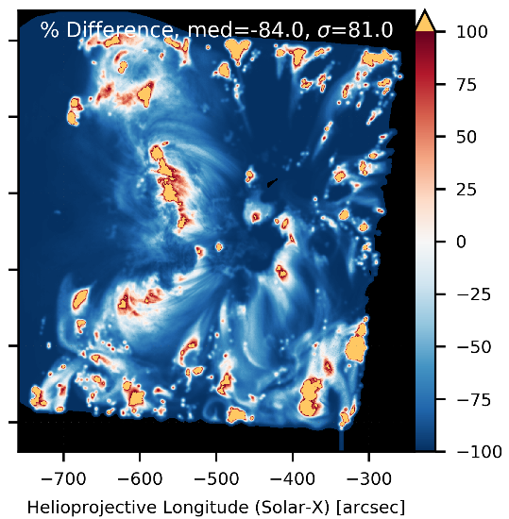
193 Å with low frequency heating
Critical Angle: B²/L Critical Twist: B²/L² Resonant Absorption: 1/L²

Slide 18
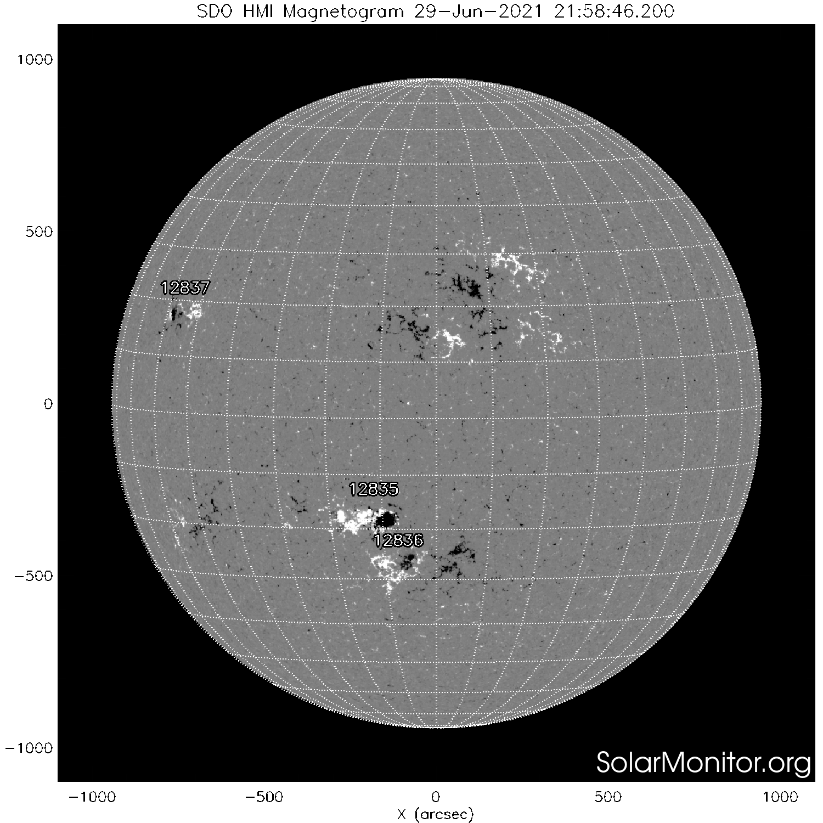
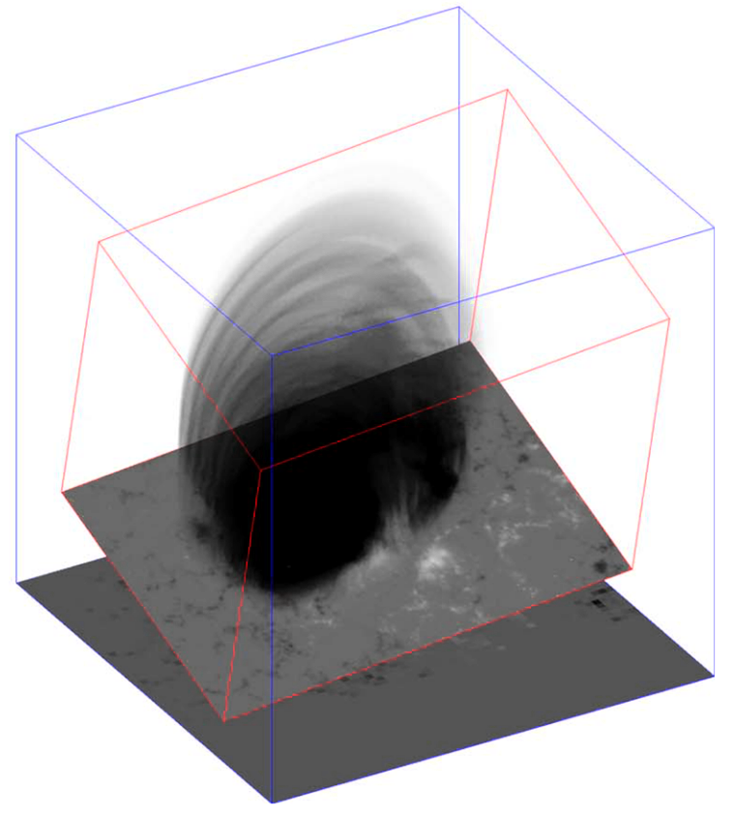
Prospects
Opportunity to study coronal heating properties in active regions
Generate models of active region emission in arbitrary channels
Model active regions across the disk to simulate irradiance variability
Possible to expand with more complex heating implementations
  Dependence on:
    α helicity parameter in NLFFF
    Loop cross section
    Etc.
  Solution grids based on 1D, 2D, or 3D heating models

Slide 19

QUESTIONS?

