Slide 1
The COronal Density and Temperature (CODET) model, improvements and new perspectives
Dr. Jenny Marcela Rodríguez Gómez
Postdoctoral Research
Solar Physics Laboratory (671)
NASA Goddard Space Flight Center and The Catholic University of America
Jenny.m.rodriguezgomez@nasa.gov
rodriguezgomez@cua.edu

Slide 2
The COronal Density and Temperature (CODET) model
Search the best fit parameters
Surface Flux Transport (SFT-LMSAL)
Schrijver & De Rosa 2003
Rodríguez Gómez et al. 2018

Slide 3
Density and Temperature profiles
The density and temperature distribution are described as a function of the magnetic field using scaling laws (Emisle, 1985)
$$B=\sqrt{B_{r}^{2}+B_{θ}^{2}+B_{φ}^{2}}$$
Where $b_{f0}$ [G] and $τ_{bf}[R_{⨀}]$ are constant values and R is the height
through the solar corona
It is used to describe two different temperature regimes related to strong and weak magnetic field
$γ$ and $α$ are power-law indices, $\left(\frac{B}{B_{s}}\right)$ is the factor related to the flux amount in each pixel, $B_{s}[G]$ is a constant value of magnetic field, $N_{o }[{cm}^{−3}]$ and $T_{o}\left[K\right]$ are background density and temperature
Rodríguez Gómez et al. 2018

Slide 4
Density and Temperature profiles
The density and temperature distribution are described as a function of the magnetic field using scaling laws (Emisle, 1985)
$$B=\sqrt{B_{r}^{2}+B_{θ}^{2}+B_{φ}^{2}}$$
Where $b_{f0}$ [G] and $τ_{bf}[R_{⨀}]$ are constant values and R is the height
through the solar corona
It is used to describe two different temperature regimes related to strong and weak magnetic field
$γ$ and $α$ are power-law indices, $\left(\frac{B}{B_{s}}\right)$ is the factor related to the flux amount in each pixel, $B_{s}[G]$ is a constant value of magnetic field, $N_{o }[{cm}^{−3}]$ and $T_{o}\left[K\right]$ are background density and temperature
Rodríguez Gómez et al. 2018

Slide 5
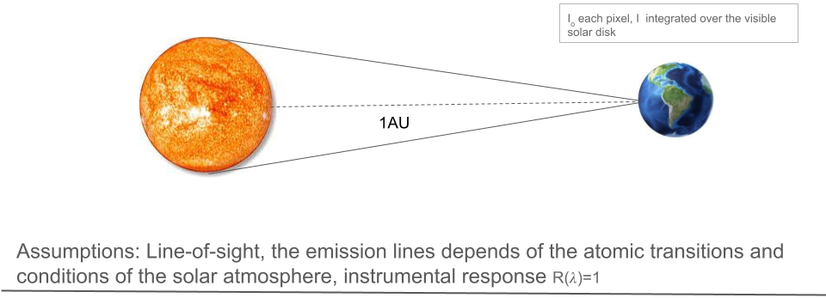
Emission model
Assuming that the emission lines are optically thin, it is possible to measure the integrated emission along the line of sight, but it necessary to consider the contribution function $G(λ,T)$ to obtain the solar spectra for a specific wavelength. This is obtained from the CHIANTI atomic database.
$$I_{o}\left(λ\right)=\iint{R\left(λ\right)G\left(λ,T\right)dλN^{2}ds}$$
Where $R\left(λ\right)$ is the instrumental response, $dλ$ is the differential element in wavelength and $ds$ is the differential distance along the line of sight. The intensity (I) corresponds to SSI. It is the intensity full-disk average measured at D=1 AU. $I=I_{O}/D^{2}$

Slide 6
19.3 nm
21.1 nm
Rodríguez Gómez et al. 2018

Slide 7
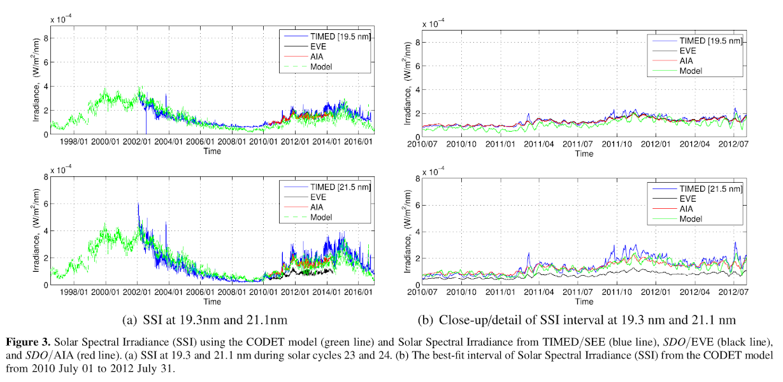
SSI at 19.3 nm and 21.1 nm
Rodríguez Gómez et al. 2018

Slide 8
Average density and temperature during solar cycles 23 and 24
Rodríguez Gómez et al. 2018

Slide 9
CODET model Consistency
Rodríguez Gómez et al. 2019
Plotted over Figure 3 Gary 2001

Slide 10
CODET model Consistency and Thermodynamic interpretation
Consistency of density and temperature estimates with independent remote sensing solar corona observations, e.g., EIT/SOHO
Density and temperature relationship from CODET model and a possible interpretation of the polytopic index $ξ$
$N_{e}∝T_{e}^{ξ−1}$ (1)
Where the thermodynamic parameter$ξ$ depends on the CODET model parameters $γ$ and $α$
$$ξ≃1/6$$
Therefore, Equation (1) describes and adiabatic process when the gas density decreases and the gas heats up (e.g., $ξ$<1)
Berdichevsky D., and Rodríguez Gómez J., 2022 (a) and (b) AAST

Slide 11
EUV Flux and its Impact on the Ionosphere – Thermosphere – Mesosphere (ITM) System
Living with a Star Program - Looking beyond F10.7
“Investigating the Forecast Capabilities of the Modeling of the Solar Spectral Irradiance from the Solar Surface Magnetic Flux”
Collaborators:
Laura Balmaceda and Charles N. Arge

Slide 12
Investigating the Forecast Capabilities of the Modeling of the Solar Spectral Irradiance from the Solar Surface Magnetic Flux
Notes:
Existing infrastructure CODET model

Slide 13
The Spectral Imaging of Coronal Environment (SPICE)

Slide 14
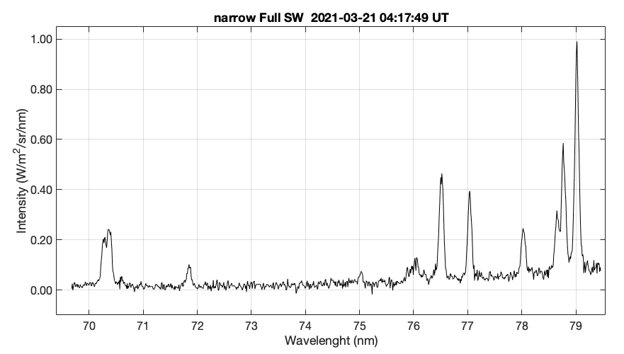
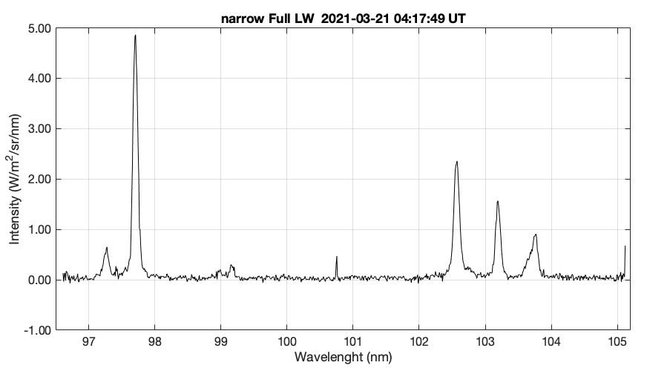
The Spectral Imaging of Coronal Environment (SPICE)
It is a high-resolution imaging spectrometer that observes the Sun in two extreme ultraviolet (EUV) wavelength bands, 70.4 - 79.0 nm and 97.3 - 104.9 nm.
O IV 79.01
C III 97.70
6” slit
O IV 78.77
H I 102.5
N IV 76.51
Ne VIII 77.04
O III multiple 70.39
S V 78.65
O VI 103.2
O V multiplet ~76.03
H I 97.25
O VI 103.76
Ne VIII 78.03
N III 99.16
O II 71.85
S IV 75.02
Figure. SPICE Altas-slit (6”) at 04:17:49. The Short Wavelength (SW) band (left) and the Long Wavelength (LW) band (right).

Slide 15
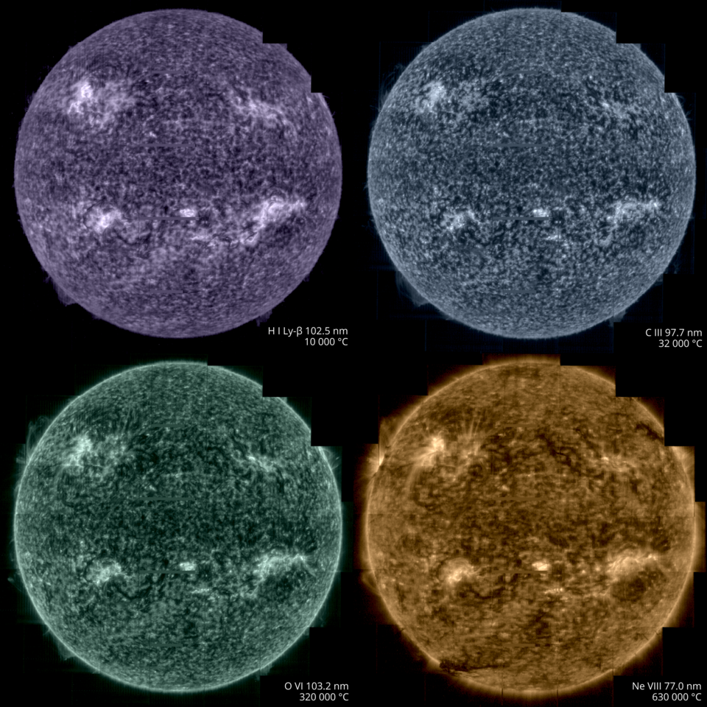
The Spectral Imaging of Coronal Environment (SPICE)
Notes:
The ideal case will be having a full disk intensity however we do not have magnetic field because this data was far side

Slide 16
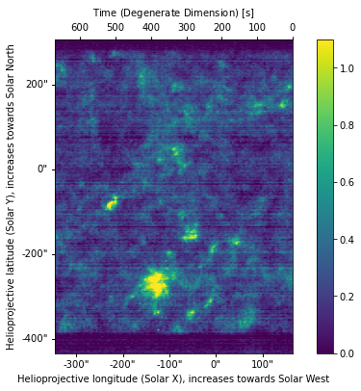
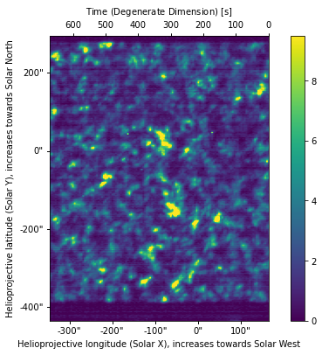
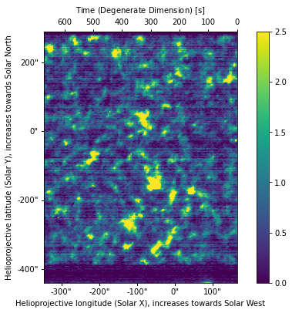
The Spectral Imaging of Coronal Environment (SPICE)
(a)
Ne VIII 770 A
(b)
(b)
CIII 977 A
(c)
OVI 1032 A
$$\log_{10}T=4.8K$$
$$\log_{10}T=5.4K$$
$$\log_{10}T=5.8K$$
SPICE narrow-slit (4”) context images 2021-03-21 at 08:42:21. (a) Ne VIII 770 Å, (b) CIII 977 Å and (c) OVI 1032 Å. X_{c} = -82.28” and Y_{c} = -66.07”.
Y [arcsecs]
Wavelength
X [arcsecs]

Slide 17
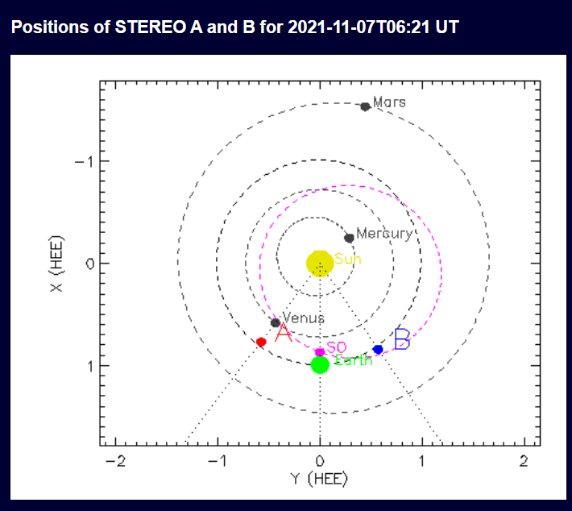
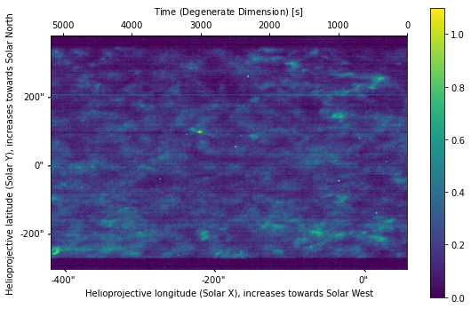
SPICE-context images 2021-11-07 at 06:21:45
Ne VIII 770 A
0.8674 AU
Intensity ($W/m^{2}/nm/sr$)
Notes:
Some cases aligned with SDO to have magnetic field
Time to obtain a complete image 1.44 hrs

Slide 18
CODET model to modeling EUV SPICE context images
Strong hypothesis is that the emission coming from TR can be described using the magnetic field at the coronal base at $1.014R_{⨀}$ (from PFSS)
Ne VIII 770 A from SPICE is the only line that can be modelled because it is located at the top of TR ($\log_{10}T=5.8 K$)
A different approach is necessary to modeling the emission through chromosphere O VI, C III and Ly$β$

Slide 19
Schematic description
Photospheric magnetic field B
Model parameters
$$γ, α, N_{o},$$
$$T_{o}, B_{s}$$
From
Rodríguez Gómez et al. 2018
Emission model
$$G(λ,T)$$
From Chianti atomic database
Ne VIII 770A
Intensity integrated at different heliocentric distances
SSI modeled
time series
Flux Transport model (LMSAL)
Density and Temperature
Magnetic Field extrapolation
(PFSS)

Slide 20
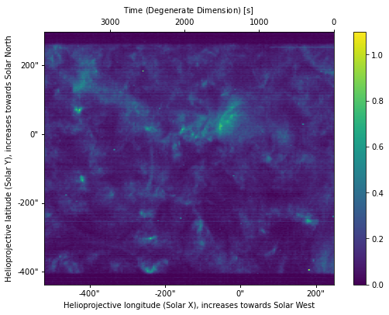
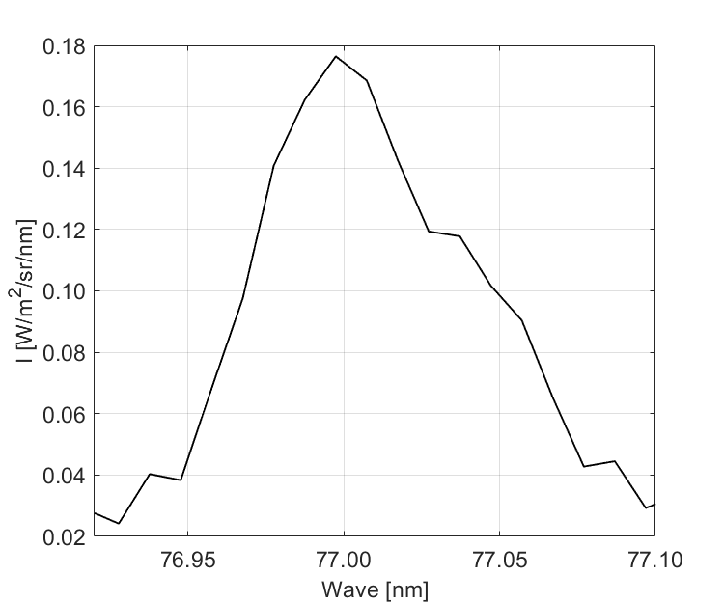
SPICE-context images 2022-03-11 at 17:24:21
Ne VIII 770 A
Integrate intensity
I = 0.0167 $W/m^{2}/nm/sr$ Gaussian fit
I = 0.0176 $W/m^{2}/nm/sr$ Trapezium
CODET
I = 0.0169 $W/m^{2}/nm/sr$ integrate intensity at 0.4413 AU
${1.014 R}_{⨀}$(coronal base-TR)
$$N=5.476×{10}^{9} {cm}^{−3}$$
$$T=1. 516× {10}^{6} K$$

Slide 21
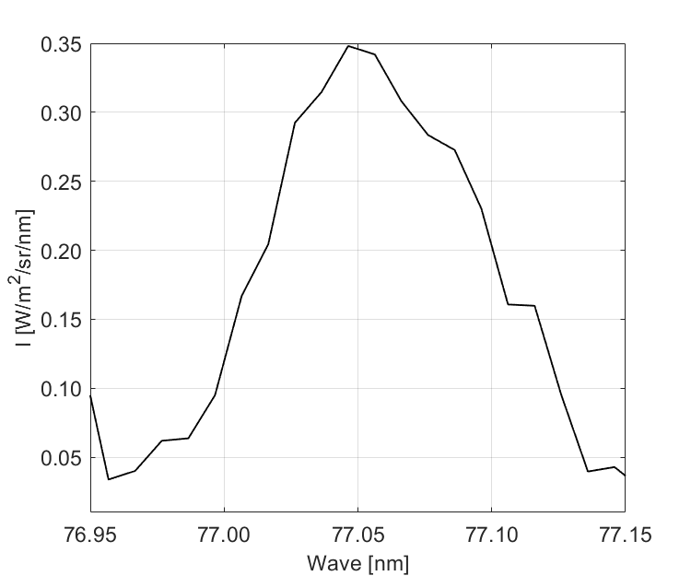
SPICE-context images 2021-11-07 at 06:21:45
Ne VIII 770 A
CODET
Integrate intensity
I = 0.0353 $W/m^{2}/nm/sr$ Gaussian fit
I = 0.0355 $W/m^{2}/nm/sr$ Trapezium
I = 0.0121 $W/m^{2}/nm/sr$ integrate intensity at 0.8674 AU
${1.014 R}_{⨀}$(coronal base-TR)
$$N=1.042×{10}^{9} {cm}^{−3}$$
$$T=1.572 × {10}^{6} K$$
Notes:
Mean density and temperature at coronal base

Slide 22
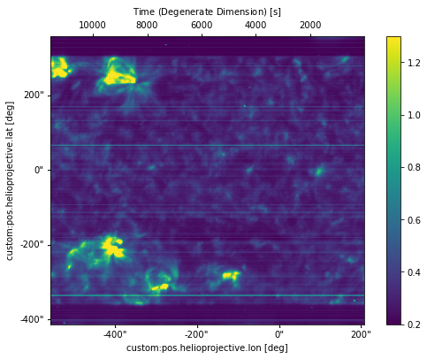
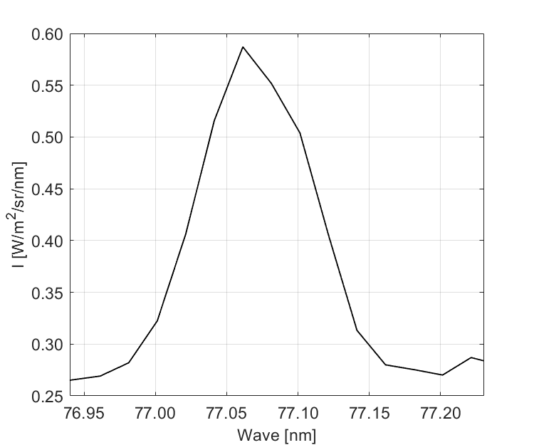
SPICE-context images 2021-12-22 at 11:05:31
Ne VIII 770 A
Integrate intensity
I = 0.1156 $W/m^{2}/nm/sr$ Gaussian fit
I = 0.1038 $W/m^{2}/nm/sr$ Trapezium
I = 0.014 $W/m^{2}/nm/sr$ integrate intensity at 1.0124 AU
${1.014 R}_{⨀}$(coronal base-TR)
$$N=2.865×{10}^{9} {cm}^{−3}$$
$$T=1.551 × {10}^{6} K$$

Slide 23
Alternative approaches-SSI
Pikaia algorithm at TR heights ($\log_{10}T=5.8K$)
Include different scaling laws
loop lenghts
Similar approach described Rodríguez Gómez et al. 2016. ARs coronal density and temperature using NLFFF

