Slide 1
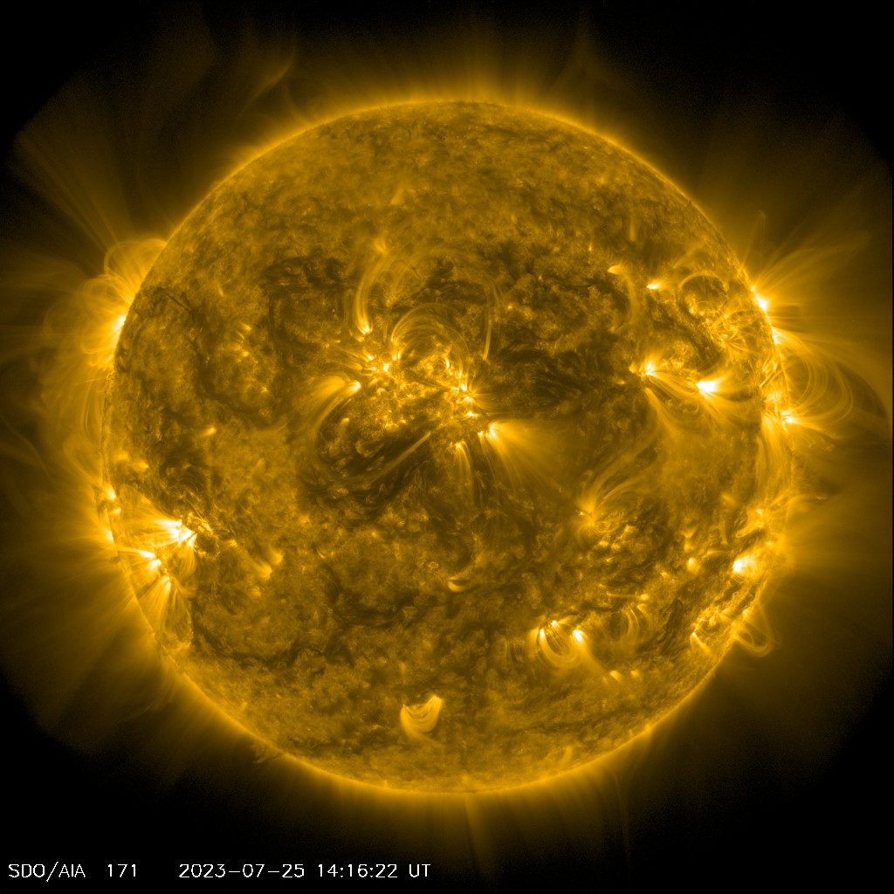
Atmospheric Impacts of X-ray and EUV irradiance
Joshua Pettit
NASA GSFC/GMU
10/18/2023

Slide 2
Outline
Overview of spectral wavelengths are important for the atmosphere
What timescales are important (flares vs solar rotation vs solar cycle)
Impacts on atmosphere (communication, satellite drag, chemistry)
FISM2
My recent work
Moving forward with a physics-based solar spectral model

Slide 3
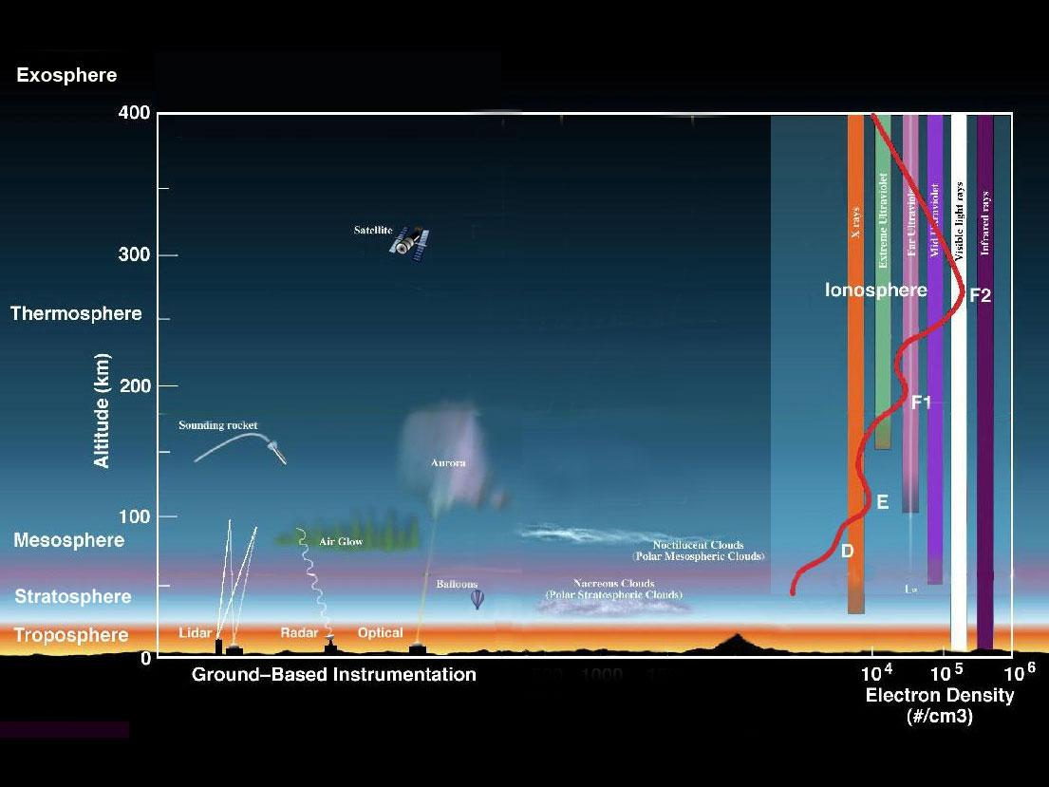

Slide 4
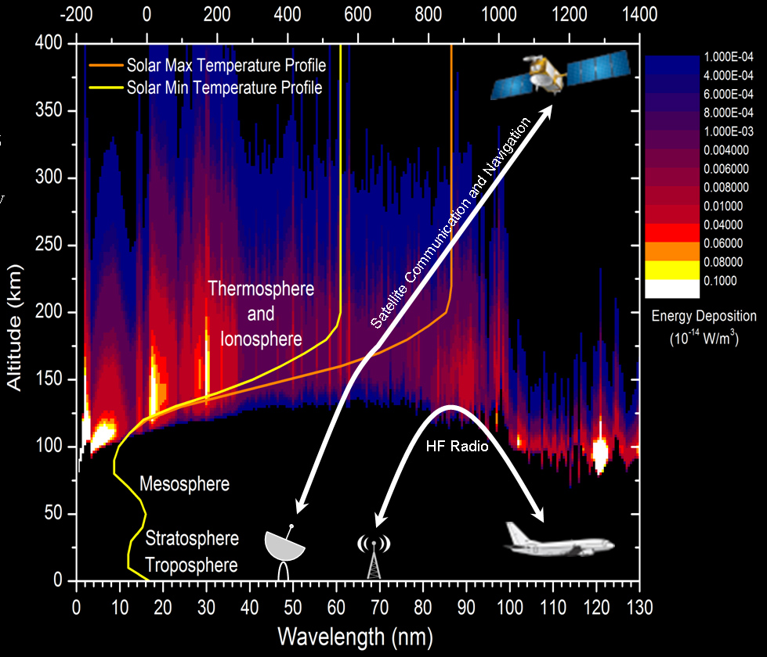
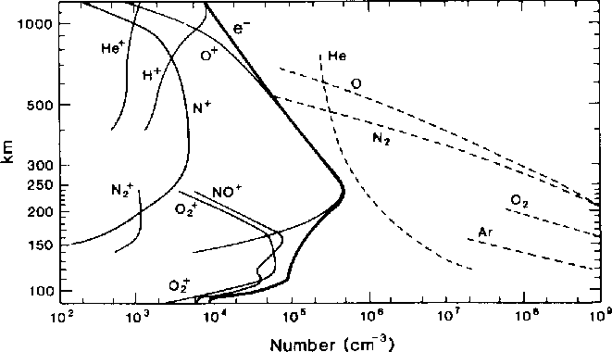
http://www.physics.usyd.edu.au/~cairns/teaching/lecture16/node2.html
NOAA/SWPC
Notes:
reported that the mean variability of Lyα due to the 27-day solar rotation across Solar Cycles 18–22 was 9%, dropping to 5% at solar minimum and increasing to 11% at solar maximum. Solar Lyα variability over the course of a solar cycle varied between a factor of 1.5 and 2.1.

Slide 5
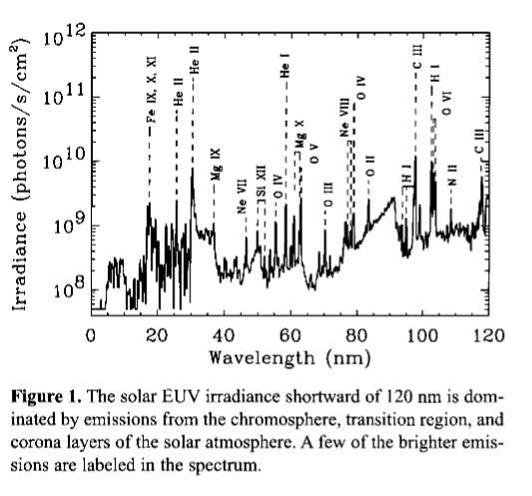
Important Emission lines
Woods et al., 2004

Slide 6
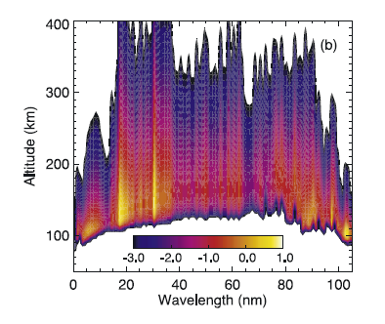
Soft x-ray and EUV has a strong impact on the mesosphere/thermosphere/ionosphere
Deposition of solar EUV energy in the thermosphere as a function of wavelength and altitude in log10(Wm4) for low solar activity. Solomon and Qian (2005).

Slide 7
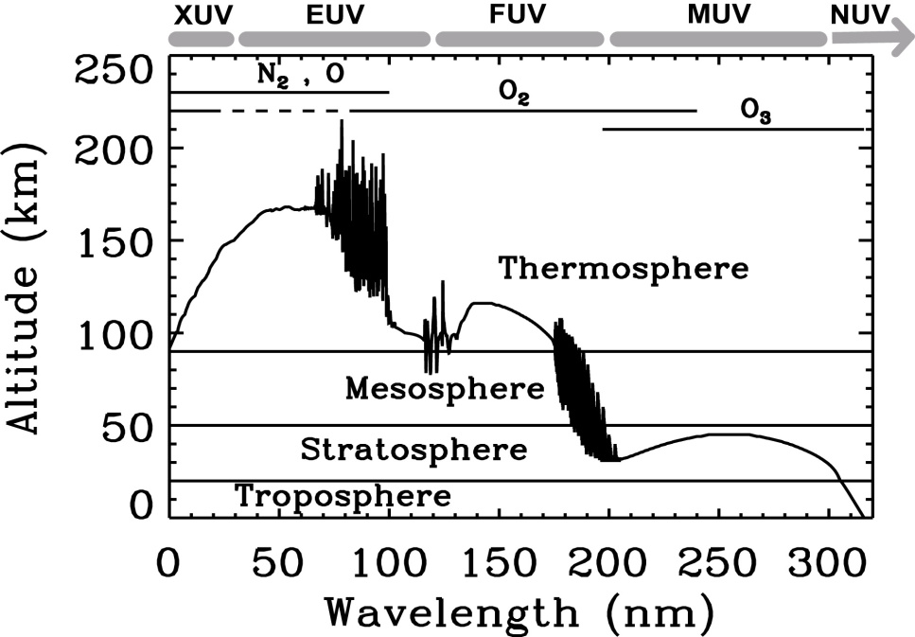

Slide 8
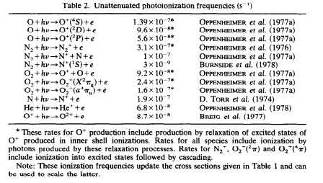


Photoionization Chemistry!
$e^{∗}+ N_{2}→ N_{2}^{+}+2e$
$e^{∗}+ N_{2}^{+}→ N(^{2}D)+ N(^{4}S)$
$N(^{2}D)+ O_{2}→NO+O$
$NO+ O_{3}→NO_{2}+O_{2}$ $NO_{2}+O→NO+ O_{2}$
${ O}_{3} + O→2 O_{2}$
$$e^{∗}+ O_{2}→O_{2}^{+}+2e$$
$$O_{2}^{+}+ 2H_{2}O→ H_{3}O^{+}∙OH+O_{2}$$
$$OH+ O_{3}→H+ O_{2}$$
$$H+ O_{3}→OH+ O_{2}$$
$$OH+O→H+ O_{2}$$
$O_{3}+O→2 O_{2}$
NO_{x}
HO_{x}
Notes:
Larger fonts on the bullets. Show the pac man figure. Consider Charles Barth chart.

Slide 9
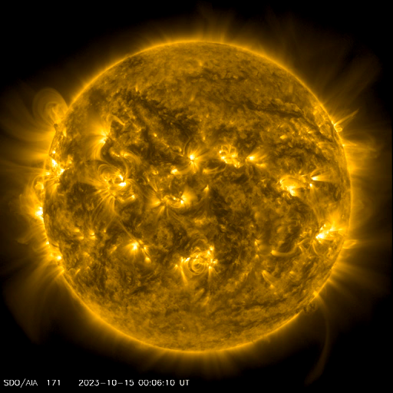
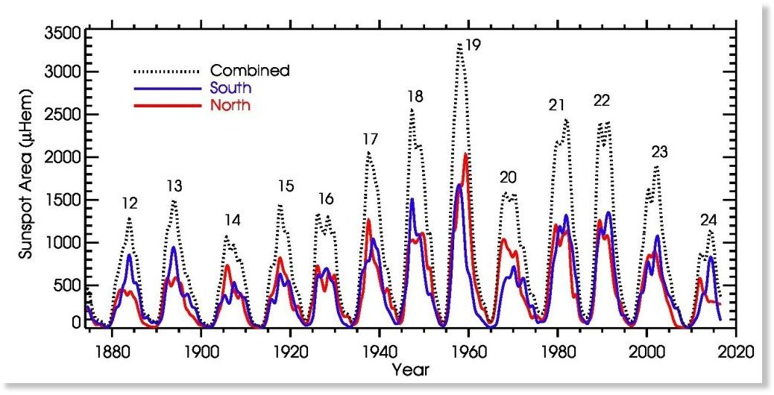
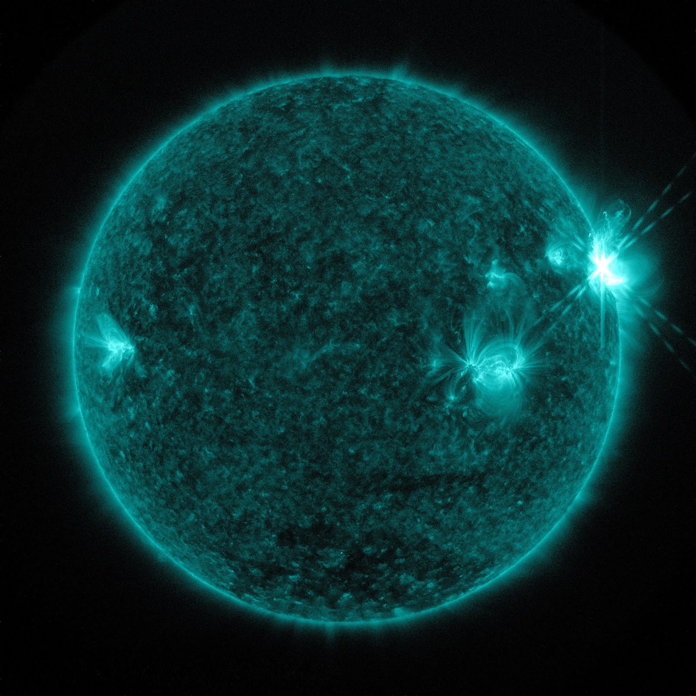
Solar Irradiance Variations based on Timescales

Slide 10
Solar Flare Impacts

Slide 11
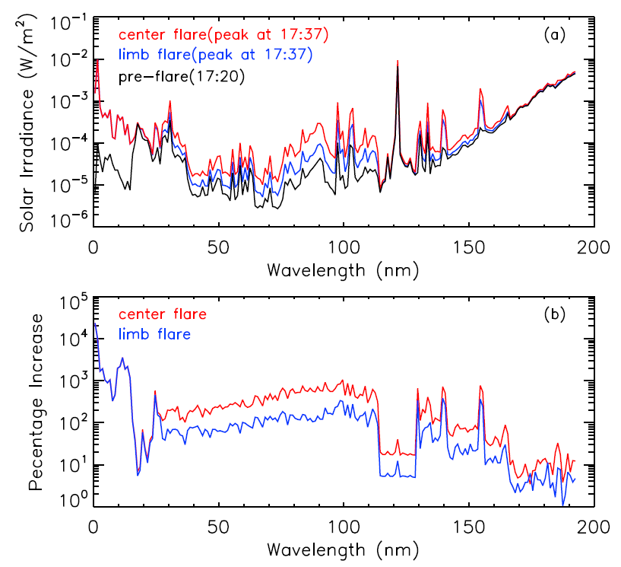
X-ray and EUV increase the most during flares
The flare location changes the flare spectra
Qian et al. (2010a)
Notes:
Spectra is plural. REMOVE THIS SLIDE.

Slide 12
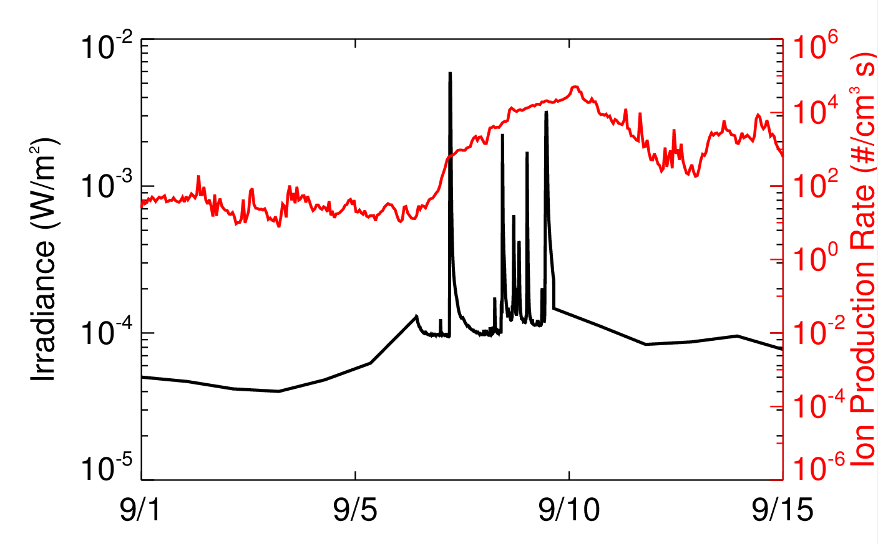
Solar storms in September 2005
Solar flares: September 7th and September 9th
Solar proton events (SPEs): September 10th and September 15th
Previous studies on flare effects in ionosphere and thermosphere: (e.g. Qian et al. 2010; Enell et al. 2008; Afraimovich et al. 2001a,b; Liu et al. 2006)
Investigate flare effects with WACCM using improved temporal resolution and spectral range
X17
2
X6.2
1.3 nm

Slide 13
Altitudes where photons from solar flares can influence the atmosphere
WACCM Domain
Courtesy of Peter Pilewskie

Slide 14
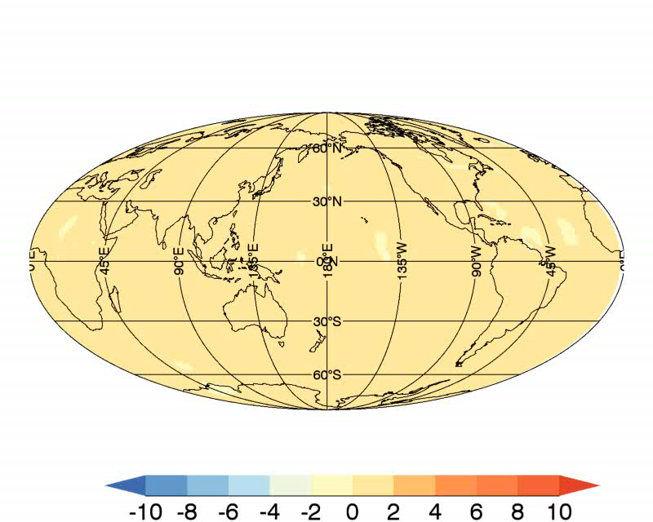
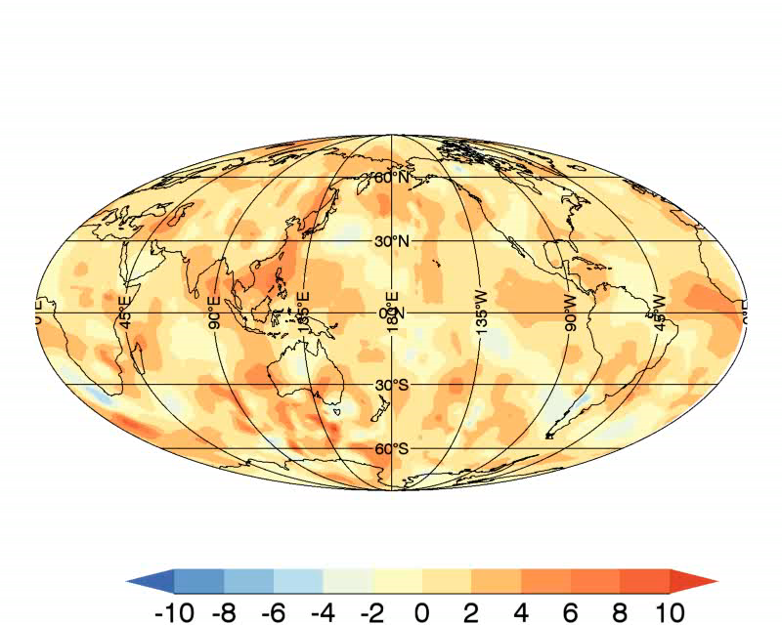
Flares cause temperature increases in lower thermosphere (~ 120 km): X6.2 > X17
X17 Flare
X6.2 Flare
Δ Temp (K)
Δ Temp (K)

Slide 15
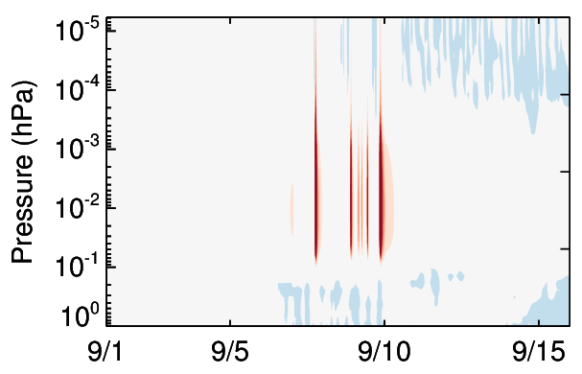
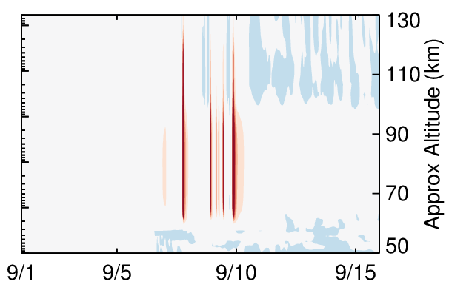

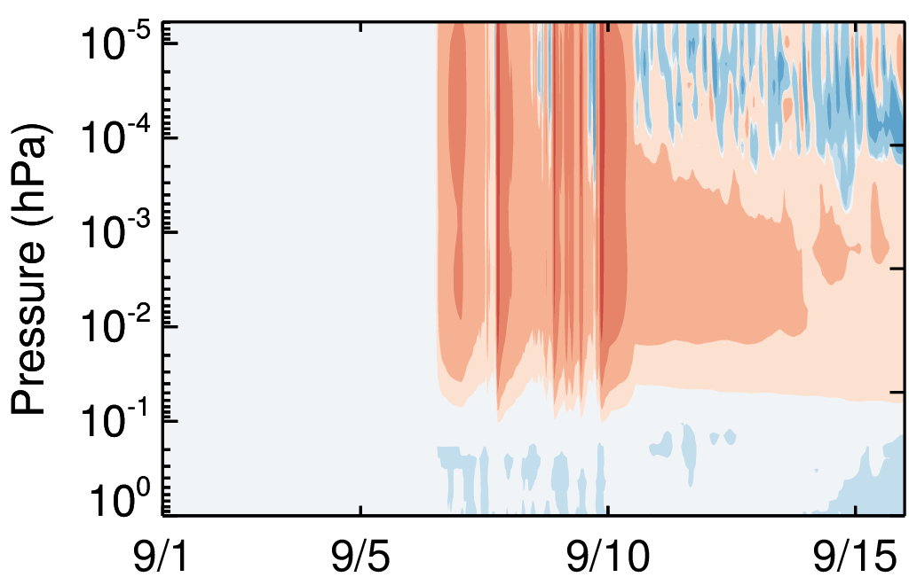
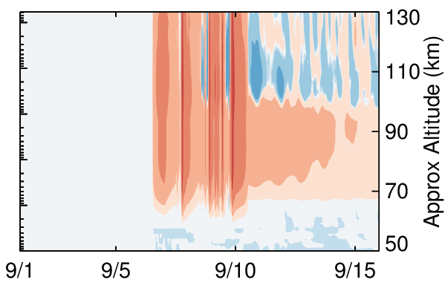
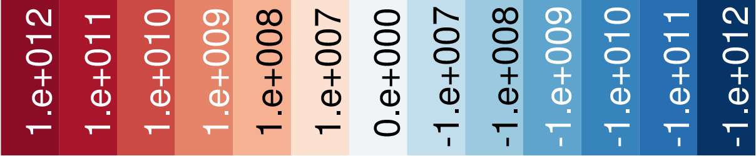
Flares cause large electron enhancements in thermosphere and mesosphere
60°N– 90°N
30°S – 30°N
∆ e⁻ (%)
Thermosphere electron increases are short-lived
Mesosphere electron increases last a few days
Equatorial region shows larger enhancements than polar region (expected)
∆ e⁻ (m⁻³)
Pettit et al. (2018)

Slide 16
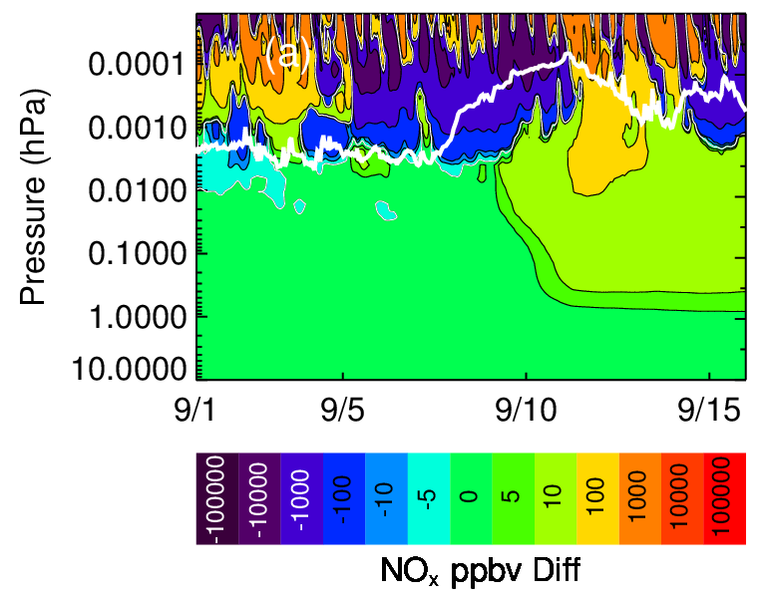
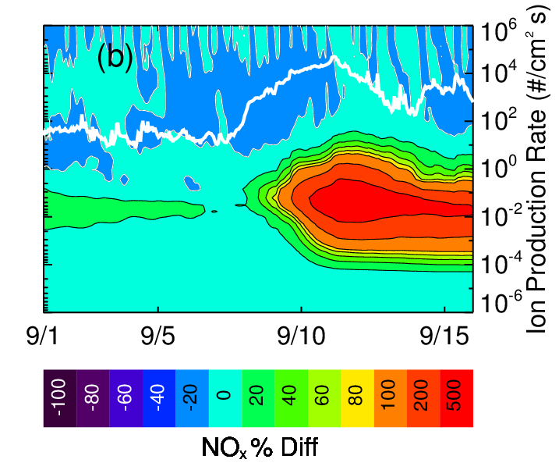
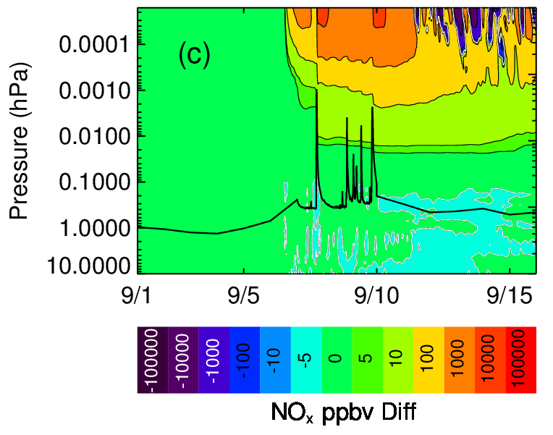
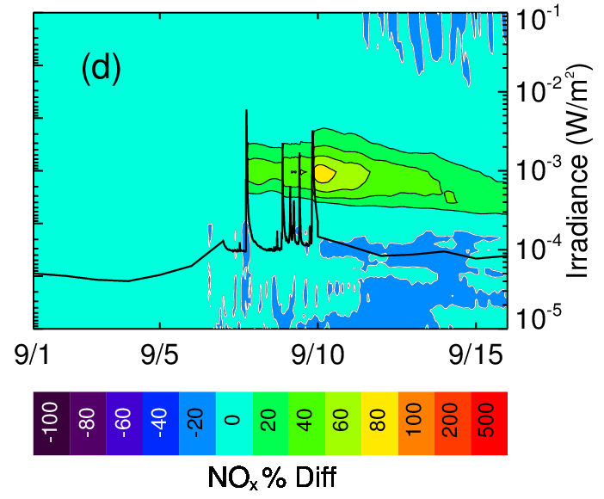
Odd nitrogen production from SPEs and solar flares in Arctic
110 km
80 km
50 km
60N – 90N average
Flare produces NO_{x} at higher altitudes
More SPE NO_{x} in middle atmosphere
  SPE: 500%
  Flare: 80%
SPE effects
SPE effects
110 km
80 km
50 km
Flare
effects
Flare
effects

Slide 17
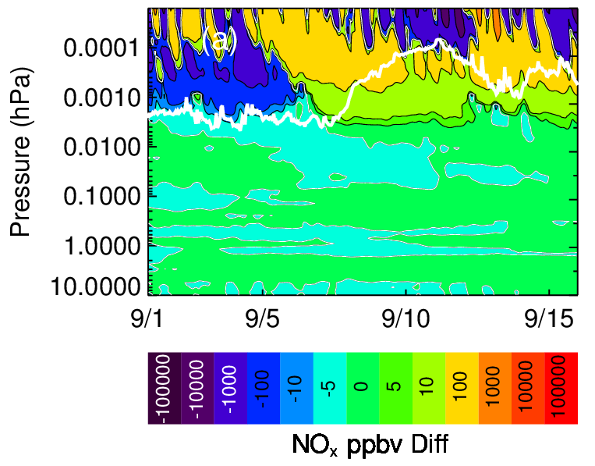
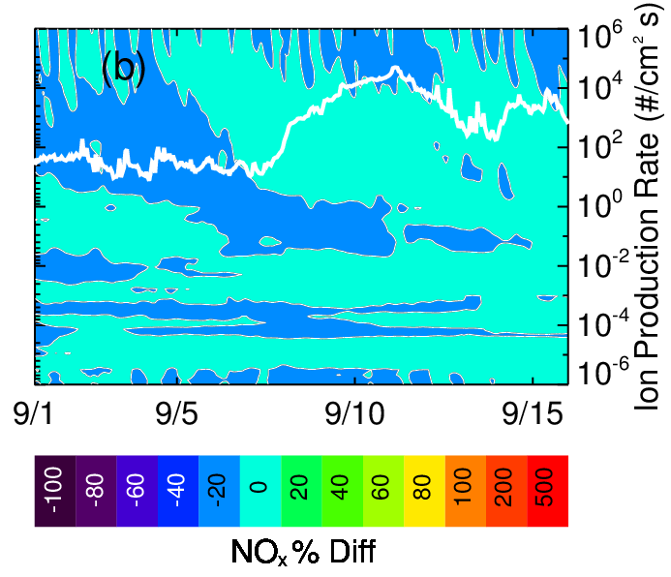
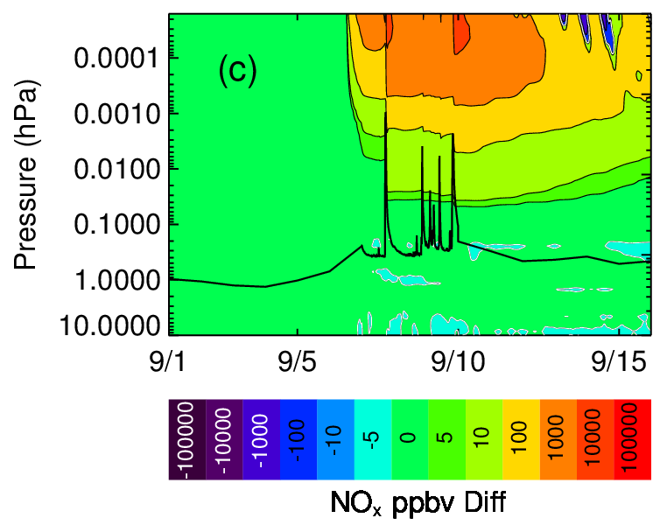
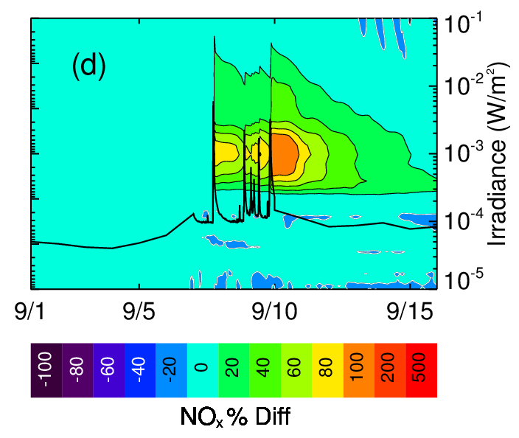
Odd nitrogen production from SPEs and solar flares at equator
110 km
80 km
50 km
30°S – 30°N average
No response from SPEs
Flare response of 100% larger than Arctic
SPE effects
SPE effects
110 km
80 km
50 km
Flare
effects
Flare
effects

Slide 18
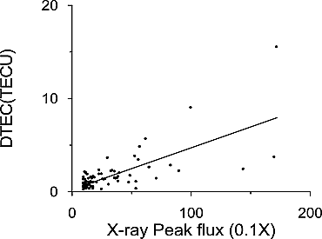
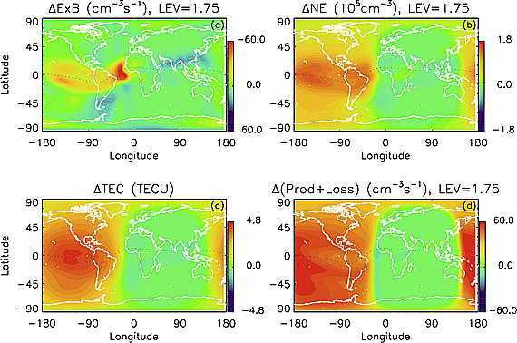
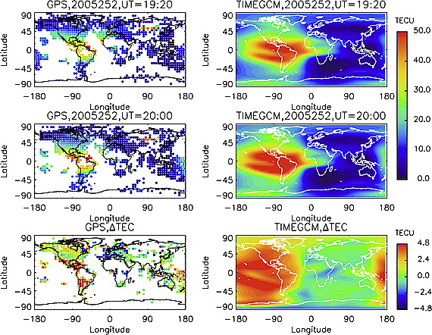
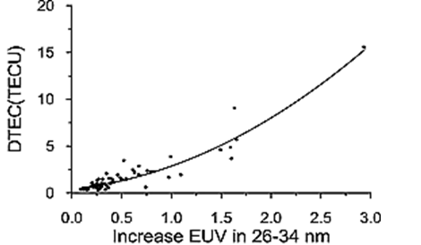
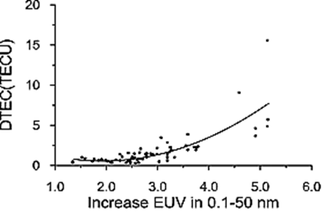
Zhang et al. (2011)
Qian et al. (2011)

Slide 19
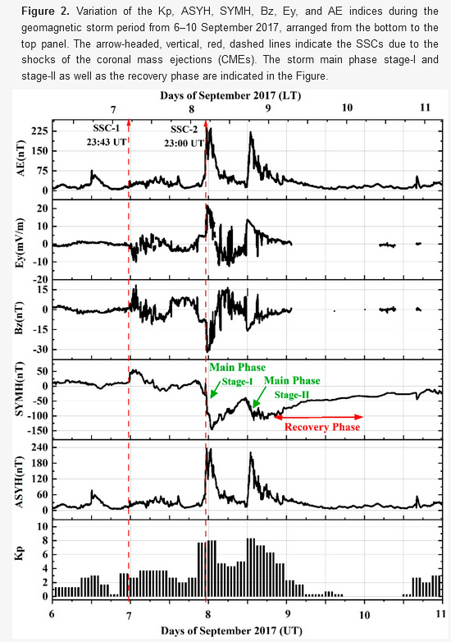
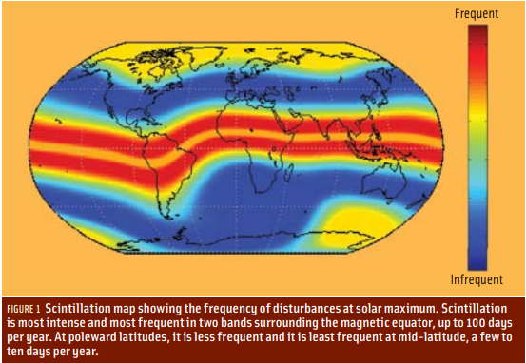
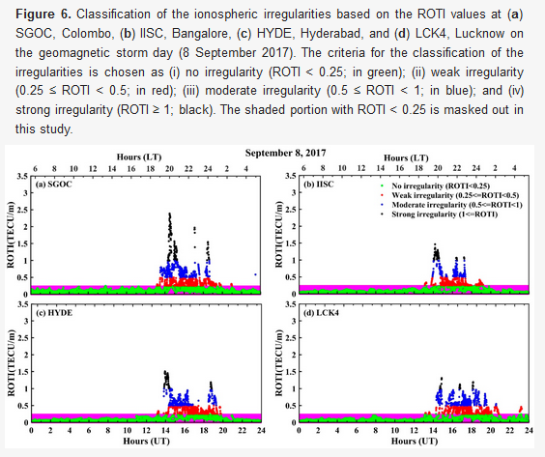
Ionospheric Scintillation Primary Caused by Geomagnetic activity and day/night equatorial boundary
Vankadara et al. 2022
Notes:
Phase speed and group speed are equal to c^2 so if the group velocity slows down, the phase velocity speeds up. Slower group velocity causes ranging errors and faster phase speeds cause phase shifts resulting in problems with tracking loops within the GPS. Diffractive scintillation is caused by ionospheric irregularities, which are much more disruptive to GPS.

Slide 20
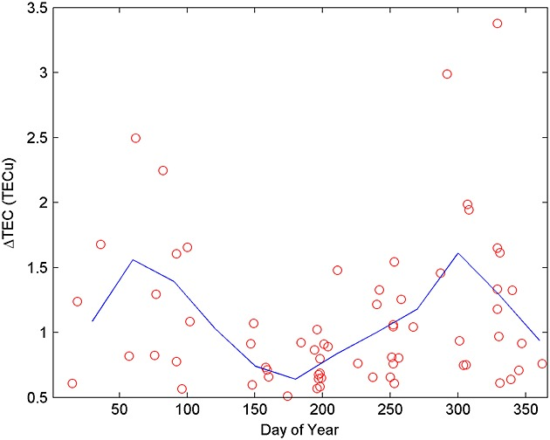
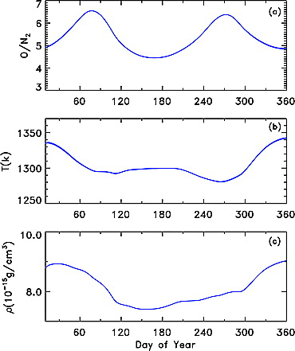
Seasonal Dependency
Le et al. (2013)
Qian et al. (2009)
Notes:
Figure 4a shows the “thermospheric spoon” effect simulated by the TIE-GCM. Stronger mixing of the atmosphere during solstices causes less diffusive separation and smaller neutral density scale height, and thus lower neutral density. Near the equinoxes, the interhemisphere circulation is much weaker because solar heating is evenly distributed on the two hemispheres. Neutral species are more diffusively separated, and neutral density is larger because of larger scale height. A semiannual variation in O/N₂ is generated by the interhemispheric large circulation

Slide 21
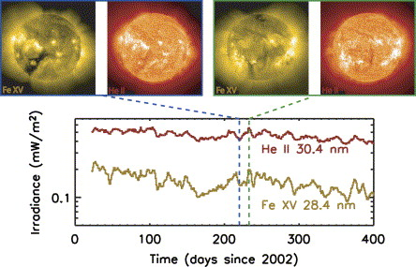
Solar Rotation can create strong, wavelength dependent variations
Notes:
As an example of the solar rotation variations observed by SEE, the variation in August 2002 indicates a particularly strong solar rotation variation. The time series of the transition region/chromospheric He II 30.4 nm emission and the coronal Fe XV 28.4 nm emission are shown in Fig. 4. While these two emissions have similar variations, each emission is uniquely different due to the different processes in the different layers of the solar atmosphere. For example, the coronal holes are more obvious in the Fe XV emission, and the active network is more obvious for the He II emission. The SOHO EIT (Delaboudiniere et al., 1995) images at those wavelengths are also shown in this figure for the dates of 2002/220 (Aug. 8) and 2002/233 (Aug. 21). Because this period is near solar maximum, there are several active regions on the solar disk even during the valley of a solar rotation.

Slide 22
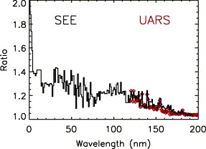
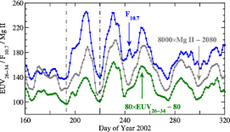
Solar Rotation can create strong, wavelength dependent variations
Chen et al. (2012)
Woods et al. (2004)

Slide 23
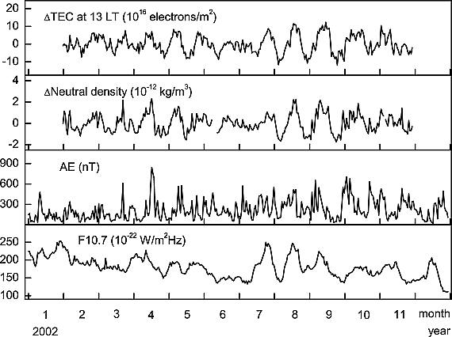
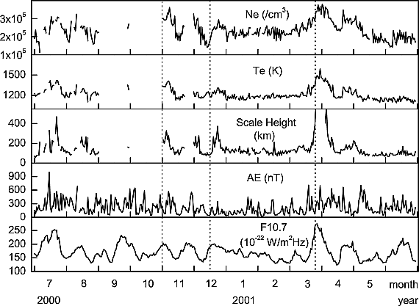
Previous studies show variation in electron density, TEC, temperature during solar rotation
Min et al. (2009)

Slide 24
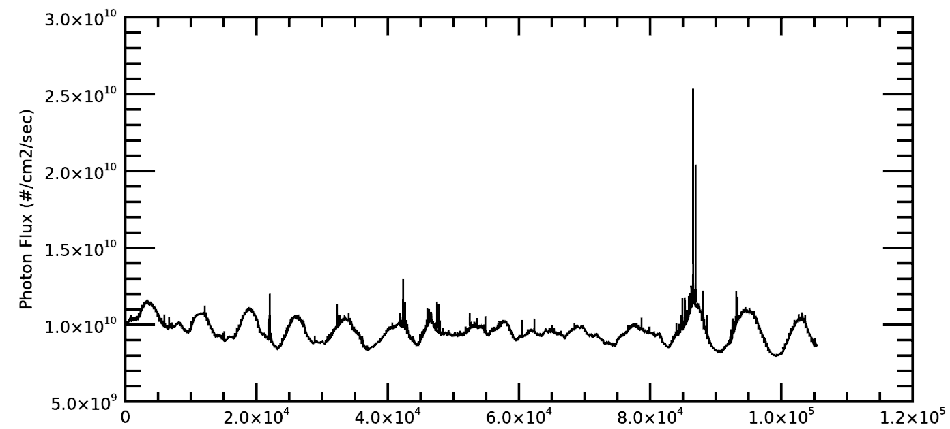
30.4 nm variation during solar rotation is on the same order as small X-class flares
Halloween Storms
Two X-1 Flares
X-3 Flare
Jan Feb Mar Apr May Jun Jul Aug Sept Oct Nov Dec
2003

Slide 25
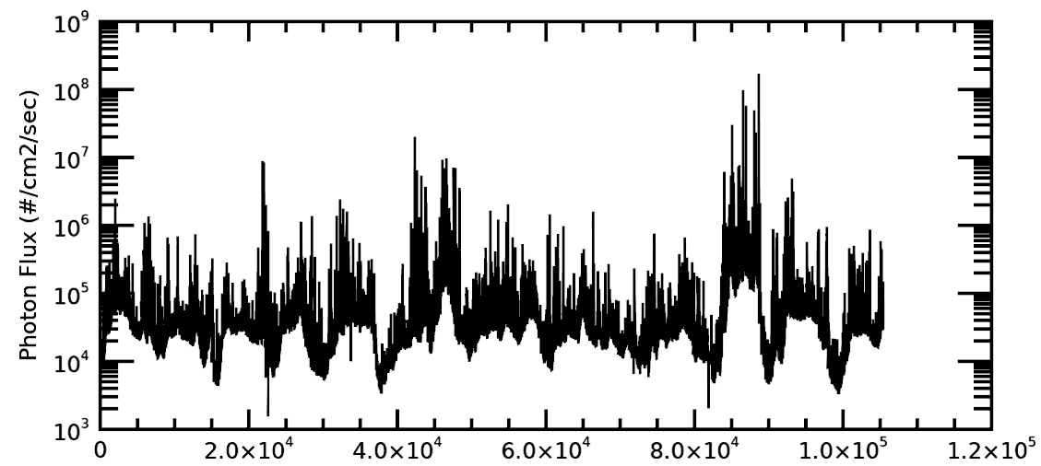
Soft x-ray (0.22 nm) varies by an order of magnitude during solar rotation
Jan Feb Mar Apr May Jun Jul Aug Sept Oct Nov Dec
2003

Slide 26
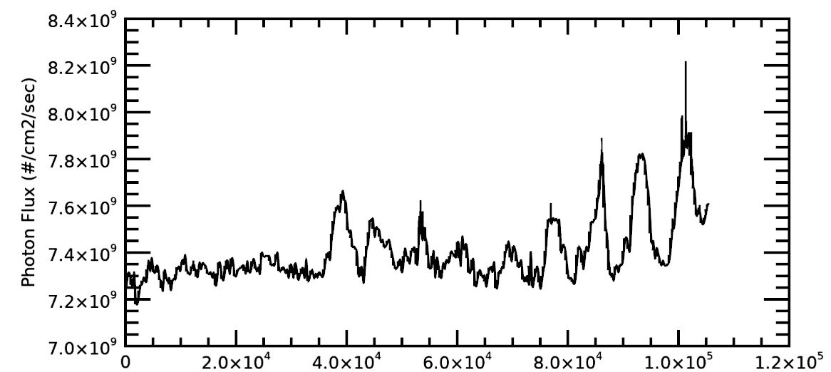
30.4 nm variation is smaller during solar minimum (less active regions)
Jan Feb Mar Apr May Jun Jul Aug Sept Oct Nov Dec
2009

Slide 27
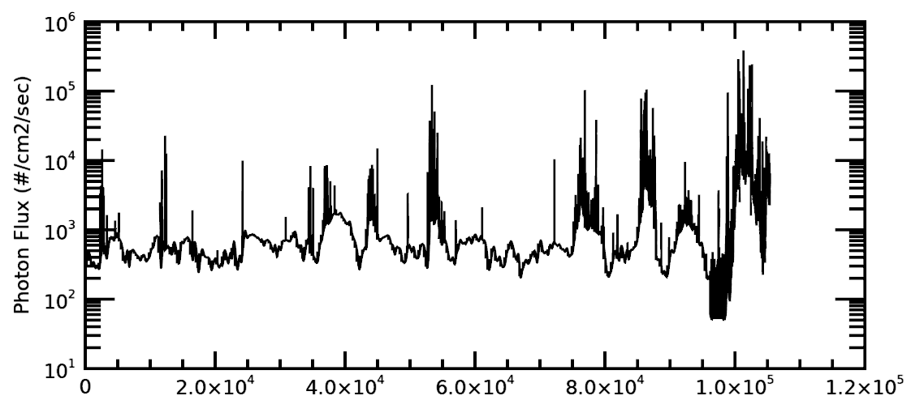
Soft x-ray (0.22 nm) varies by an order of magnitude during solar rotation
Jan Feb Mar Apr May Jun Jul Aug Sept Oct Nov Dec
2009

Slide 28
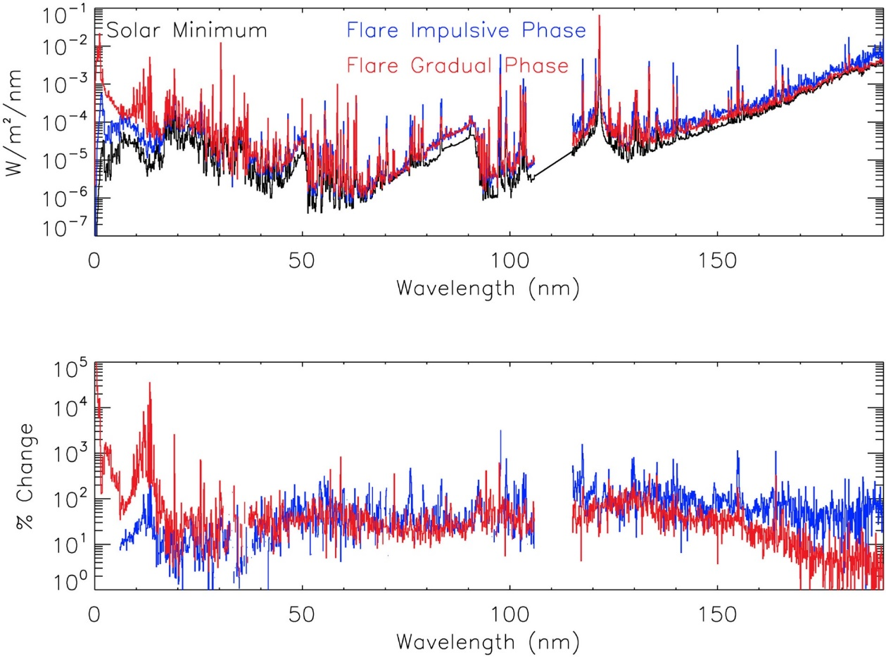
Flare Irradiance Spectral Model (FISM) Version 2
FISM2 is a solar spectral irradiance empirical model
Uses data from EVE (EUV Variability Experiment), SDO, XPS, SORCE-SOLSTICE, and TIMED-SEE instruments
Includes wavelengths from .1 nm (x-ray) through 190 nm (EUV)
Chamberlin et al., 2020

Slide 29


The Starlink Incident
On Feb 3rd, SpaceX launched 49 Starlink satellites into low-Earth orbit with a perigee altitude of 210 km.
38 of the 49 satellites were lost due to high neutral densities in the thermosphere preventing the satellites from reaching their operational orbit (~550 km).
The anomalously high neutral densities were a result of solar and geomagnetic activity prior, during and after the launch
High neutral densities → increased satellite drag

Slide 30


Starlink has a two-stage launch process
~550 km
~210 km

Slide 31
Starlink has a two-stage launch process
~550 km
~210 km

Slide 32


Slide 33
Active period extended for several days post launch
Launch
Tzu Wei Fang et al. (2022)

Slide 34

GOES X-Ray flux throughout the event shows some minor flaring
https://www.polarlicht-vorhersage.de/goes-archive

Slide 35



Coronal Hole Develops causing moderate geomagnetic activity beginning on Feb 2nd
Active solar regions moving Earthward
https://sdo.gsfc.nasa.gov/

Slide 36






FISM2 Irradiance during early Feb 2022
.55 nm
(x-ray)
5.15 nm
(x-ray)
11.25 nm
(EUV)
30.35 nm
(EUV)
59.65 nm
(EUV)
121.55 nm
(EUV)

Slide 37

The equatorial perigee latitudes reveal the solar forcing to be the dominant impact on neutral density anomalies

Slide 38



The equatorial perigee latitudes reveal the solar forcing to be the dominate impact on neutral density anomalies

Slide 39


Solar and geomagnetic impacts on neutral density (satellite drag) are comparable
Geomagnetic: 37.9%
Solar: 26.2%
Geomagnetic: 39.3%
Solar: 24.7%

Slide 40
What does the atmospheric community need?
Do we need a fully resolved spectrum?
What spectral resolution would we like to have?
What temporal resolution do we need?
What are the most important spectral lines to capture accurately?
What can a physical model do that data driven models cannot?

Slide 41
References
https://agupubs.onlinelibrary.wiley.com/doi/full/10.1029/2011JA016704
https://doi.org/10.1016/j.asr.2004.10.006
https://agupubs.onlinelibrary.wiley.com/doi/10.1029/141GM23
https://agupubs.onlinelibrary.wiley.com/doi/abs/10.1029/JA081i025p04745
https://agupubs.onlinelibrary.wiley.com/doi/10.1029/141GM11
https://agupubs.onlinelibrary.wiley.com/doi/full/10.1029/2010JA015576
https://agupubs.onlinelibrary.wiley.com/doi/full/10.1029/2010JA016089
https://agupubs.onlinelibrary.wiley.com/doi/full/10.1029/2004GL019571
https://agupubs.onlinelibrary.wiley.com/doi/full/10.1029/2011JA016961
https://agupubs.onlinelibrary.wiley.com/doi/full/10.1029/2018JA025294
https://doin.org/10.1134/S1028334X07080223
https://rnl.ae.utexas.edu/images/stories/files/papers/gnss_and_iono_scint_for_distributionW.pdf
https://doi.org/10.1515/jag-2022-0053

Slide 42




Slide 43


Slide 44

F10.7 and F10.7a Radio Flux throughout 2009
F10.7a

Slide 45

FISM shows and more variability at short wavelengths (soft x-ray)
FISM
EUVAC (F10.7)
Wavelength = 11.5 nm

Slide 46

FISM shows higher solar flux at the Helium II line
FISM
EUVAC (F10.7)
Wavelength = 30.4 nm

Slide 47

FISM shows 3 times greater flux at 113 nm
FISM
EUVAC (F10.7)
Wavelength = 113 nm

Slide 48








What did the Sun look like?
Jan 29th
Jan 30th
Jan 31st
Feb 1st
Feb 2nd
Feb 3rd
Feb 4th
Feb 5th
Spaceweather.com

Slide 49

Solar Cycle

