Slide 1
Disentangling the Coronal and TR EUV emission by combining EUV and MICROWAVE data with GX Simulator 3d data- constrained modeling
Gelu M. Nita & GX Simulator Team
New Jersey Institute of Technology

Slide 2
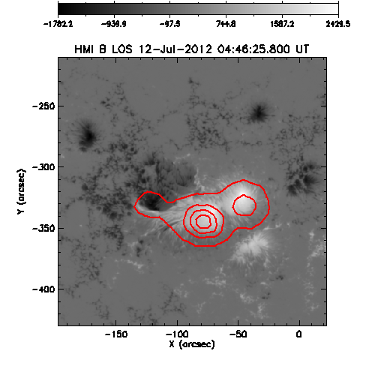
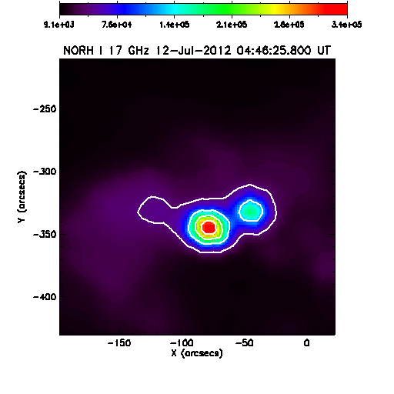
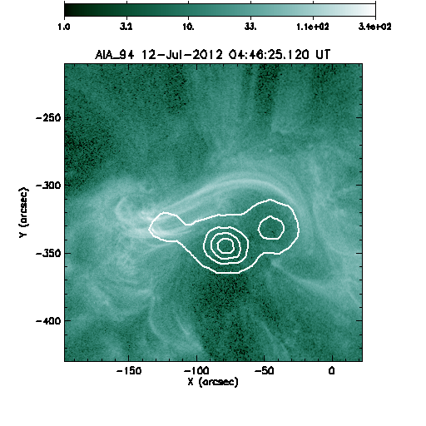
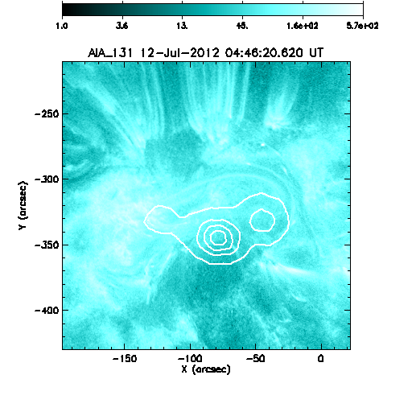
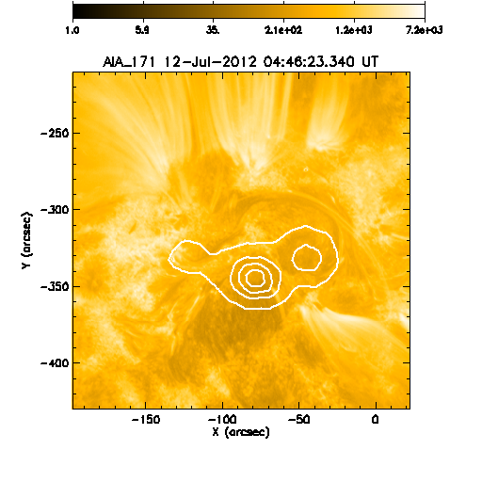
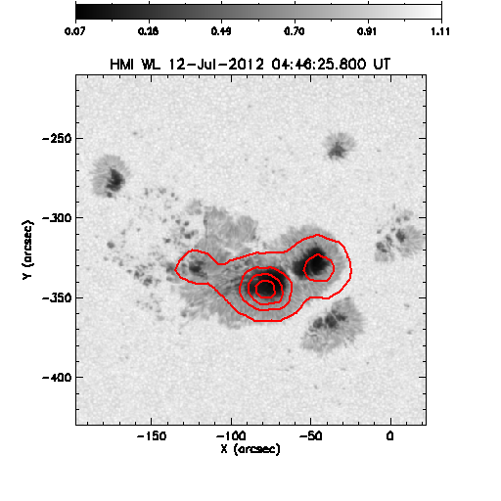
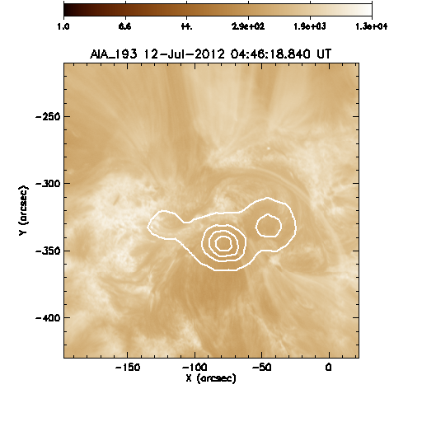
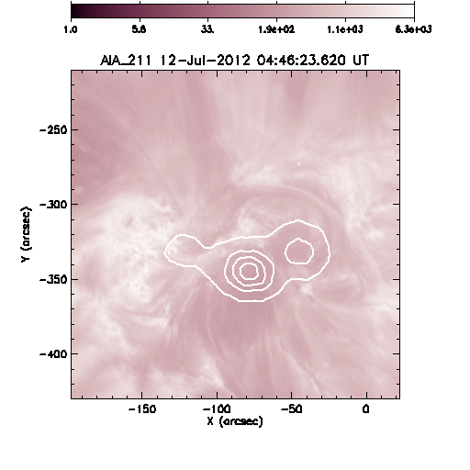
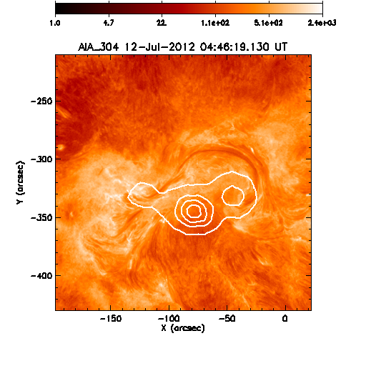
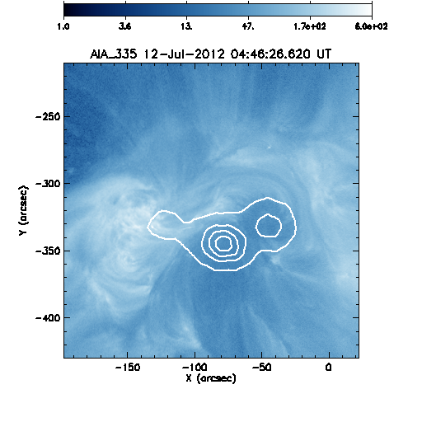
AR 11520 DATA: SDO/HMI/AIA AND NoRH 17 GHZ

Slide 3
Automatic GX Model Production Pipeline (AMPP)
Nita et al. 2023, https://arxiv.org/abs/2301.00795, ApJS in press
Selection of time, position and spatial resolution of the model
Initial potential field extrapolation
NLFFF optimization
(Windows, Unix/MAC)
Automatic download of SDO HMI/AIA data
closest to the time requested
Computation of the length and averaged magnetic field for all voxels crossed by closed magnetic field lines, to be used by GX Simulator to assign parametrized differential emission measure and density and temperature distribution models of the corona
WCS coordinate transformation of HMI data to create the base of the subsequent extrapolations
Creation of an empty-box structure containing a WCS-compatible index, LOS Bz, Ic, and the requested AIA UV/EUV reference maps
Adding non-LTE density and temperature distribution models of the chromosphere
Notes:
Another key component of the GX Simulator package is the Automatic GX Model Production Pipeline, which is a collection of scripts capable of producing GX Simulator compatible models based on a set of minimal input parameters provided by the user, to indicate the date, time, and desired size and resolution of the model. Based on these parameters, the pipeline downloads from the SDO repository all needed input maps and performs all necessary geometrical transformation to build the model box and place it in the correct location.
An essential component of the pipeline is a very fast nonlinear force free field extrapolation module that now is available on Windows and Unix/Mac platforms.
However, the modular the architecture of the pipeline allows integrations of user-provided extrapolation codes.
The next block of the pipeline computes the magnetic field lines crossing each voxel in the volume and records their lengths and average magnetic field, which may be used to assign a parameterized user-adjustable EBTEL model to the coronal part of the model
Finally, based on the line-of-sight magnetic field and white-light HMI maps, a non-LTE density and temperature model of the chromosphere is computed and added to the model

Slide 4
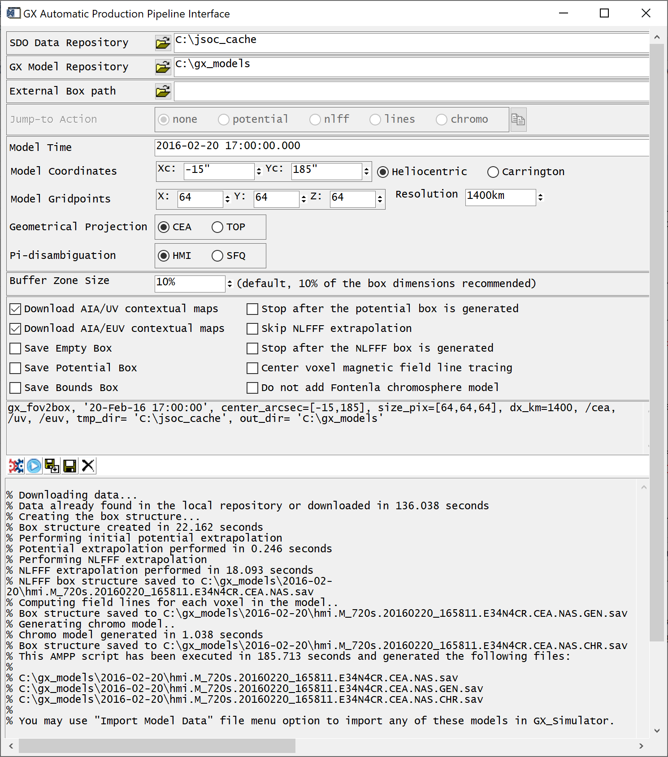
AMPP Script and GUI
;Documentation:
;\ssw\packages\gx_simulator\util\Step-by-step instructions for creating GX Simulator models.html
time='2017-09-04 20:34:42’ ;time to search for SDO data
center_arcsec=[250,-250] ;center pixel in arcseconds
size_pix=[160,120,120] ;box size in voxels
dx_km=1000 ;resolution in kilometers
tmp_dir='C:\jsoc_cache’ ;local data input repository
out_dir='C:\gx_models' ;local model output repository
;calling sequence of the top level AMPP procedure
gx_fov2box, time, center_arcsec=center_arcsec, size_pix=size_pix, dx_km=dx_km, out_dir=out_dir,tmp_dir=tmp_dir, /cea, /euv, /uv ,/nlfff_only
;IDL console output
% GX_FOV2BOX: Data not found in the local repository, downloaded in 146.127 seconds
% GX_FOV2BOX: Creating the box structure
% GX_FOV2BOX: Box structure created in 17.315 seconds
% GX_FOV2BOX: Performing initial potential extrapolation
% GX_FOV2BOX: Potential extrapolation performed in 2.928 seconds
% GX_FOV2BOX: Potential box structure saved to
C:\gx_models\2017-09-04\hmi.M_720s.20170904_202242.W119S8CR.CEA.POT.sav
% GX_FOV2BOX: Performing NLFFF extrapolation
% GX_FOV2BOX: NLFFF extrapolation performed in 252.11 seconds
% GX_FOV2BOX: NLFFF box structure saved to
C:\gx_models\2017-09-04\hmi.M_720s.20170904_202242.W119S8CR.CEA.NAS.sav

Slide 5
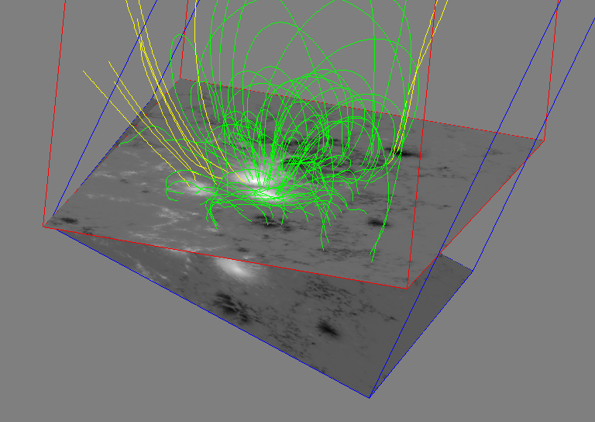
GX Simulator Model Produced by AMPP
Earth LOS
Solar Radius

Slide 6
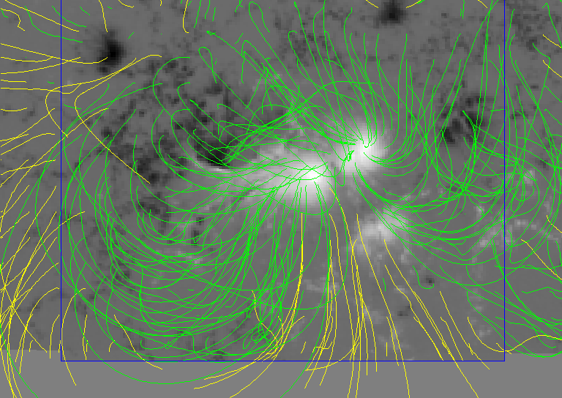
Use HMI vector magnetic field measurements to generate a 3D NLFFF magnetic field model and compare its topology with available Earth-LOS multiwavelength data

Slide 7
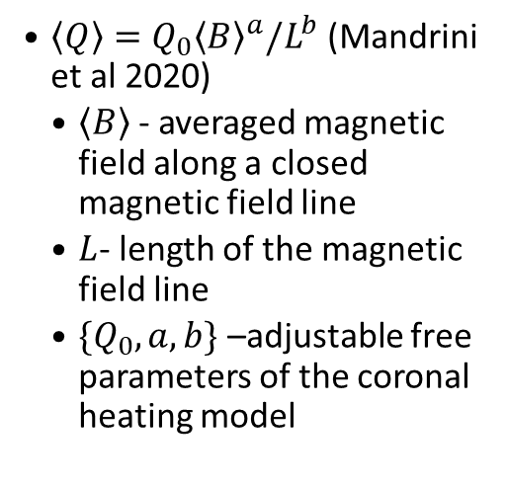
GX Workflow: Magneto-Thermal Coronal Models
Uses measured boundary conditions to compute the magnetic field model
Assigns parametrized heating rates along each individual field line
Assigns precomputed field-aligned hydrodynamic models
  Fast NLFFF extrapolation codes (Fleishman et al. 2017), which employ a modified version of the weighted optimization algorithm (Wiegelmann 2004).
  $\left\langle Q\right\rangle =Q_{0}{\left\langle B\right\rangle }^{a}/L^{b}$ (Mandrini et al 2020)
    $\left\langle B\right\rangle$- averaged magnetic field along a closed magnetic field line
    $L$- length of the magnetic field line
    ${\{Q}_{0}, a, b\}$ –adjustable free parameters of the coronal heating model
  Enthalpy-Based Thermal Evolution of Loops (EBTEL; Klimchuk et al. 2008)
    Assign Differential Emission Measure (DEM )and Differential Density Measure (DDM) distributions to each volume element (voxel)
    Assign {n-T} pairs to each voxel, computed as moments of the DDM or DEM distributions

Slide 8
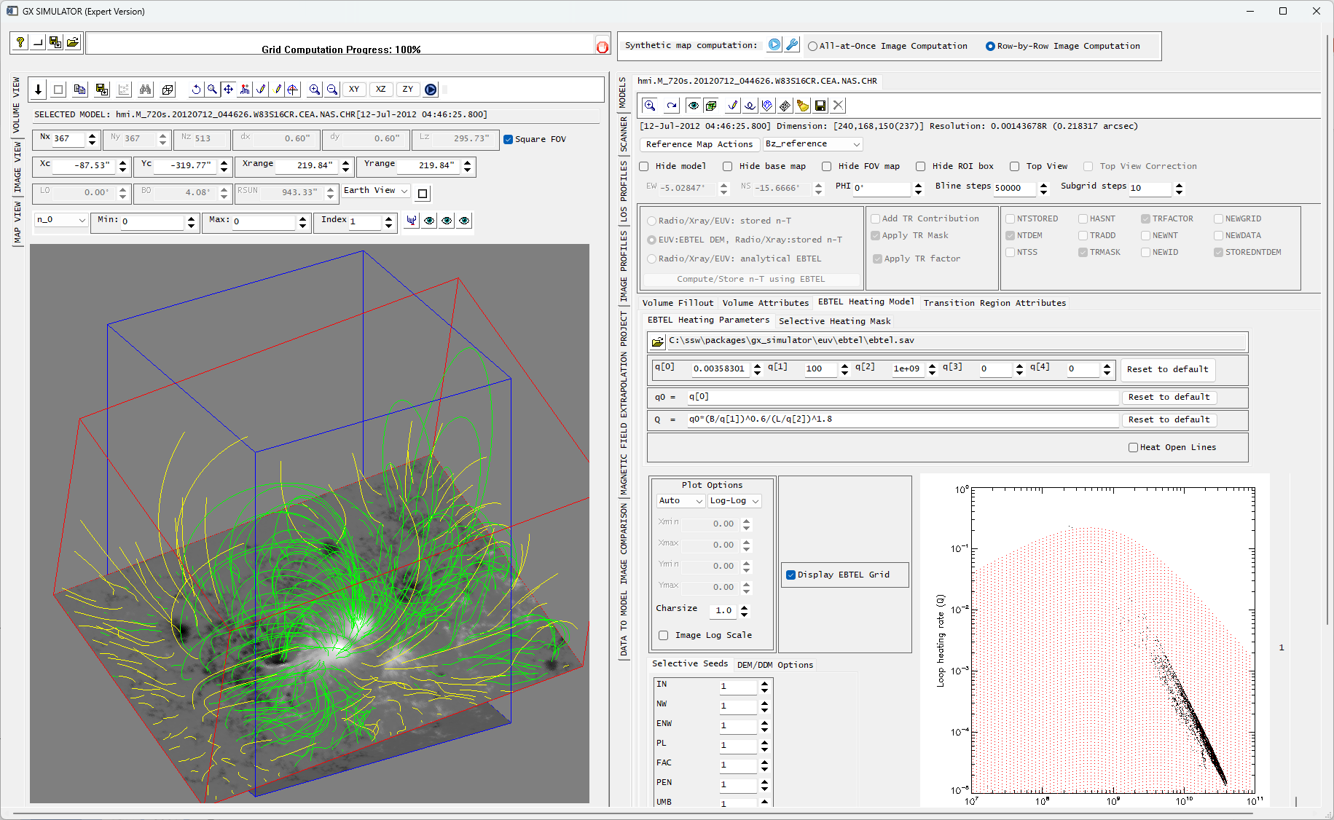
GX Simulator:
EBTEL Magneto-Thermal Model
GUI

Slide 9
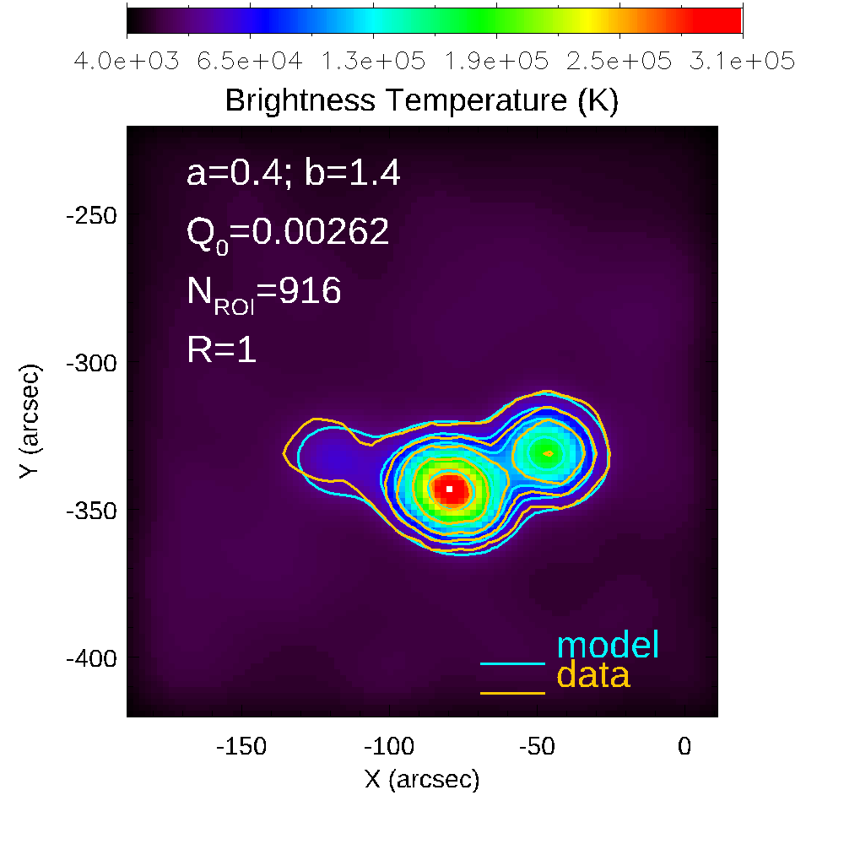
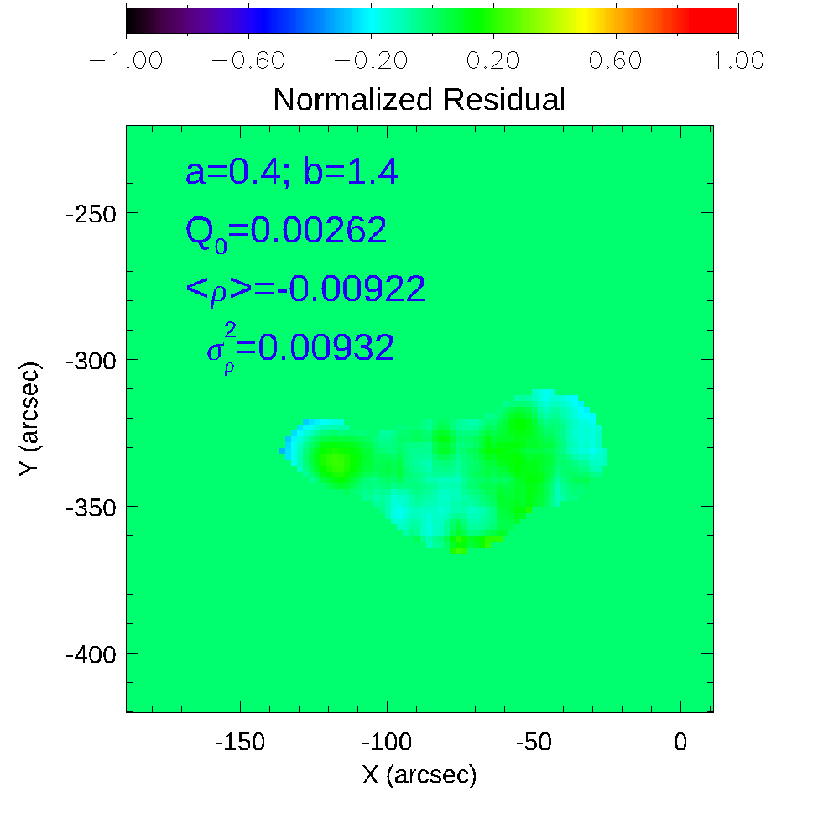

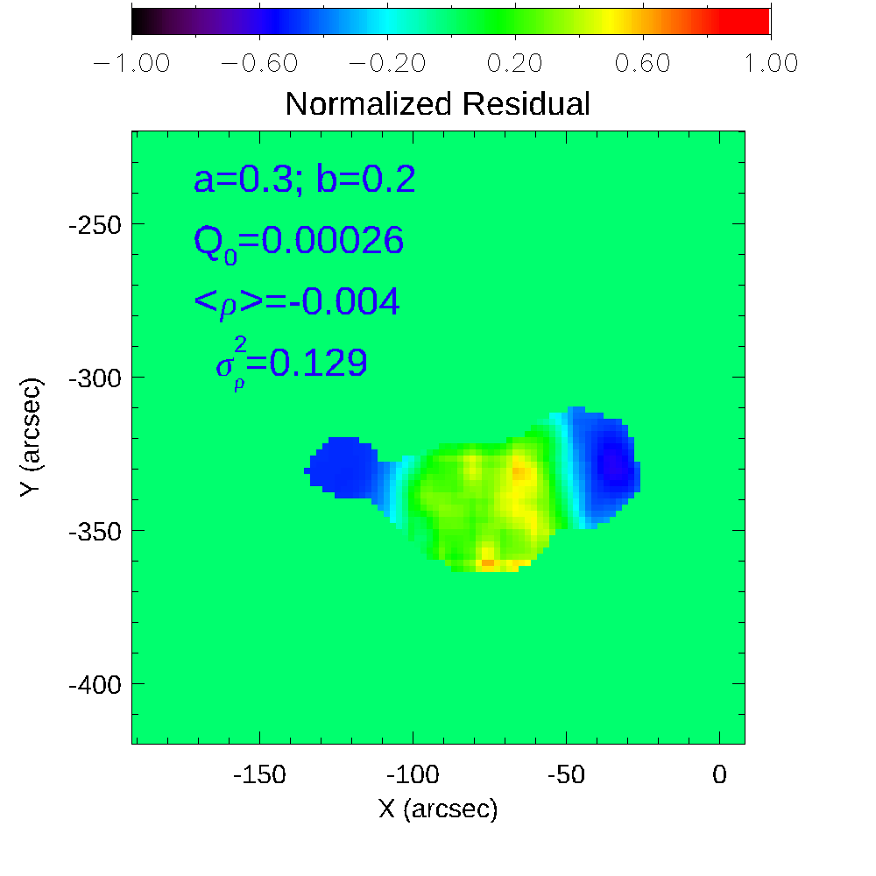
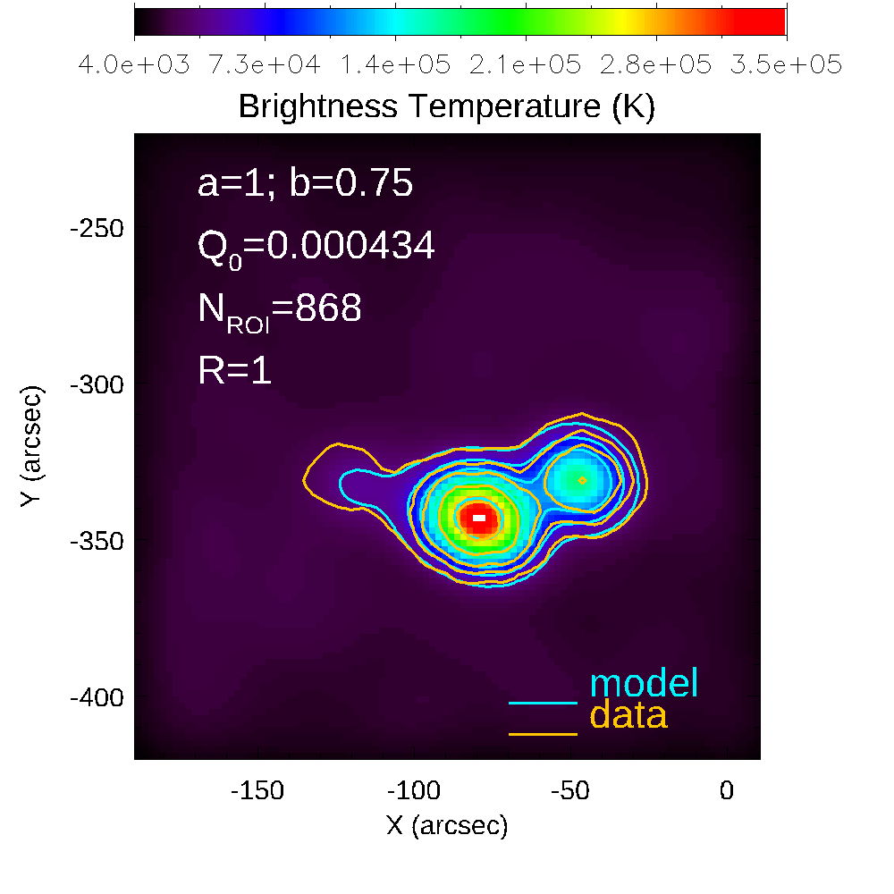
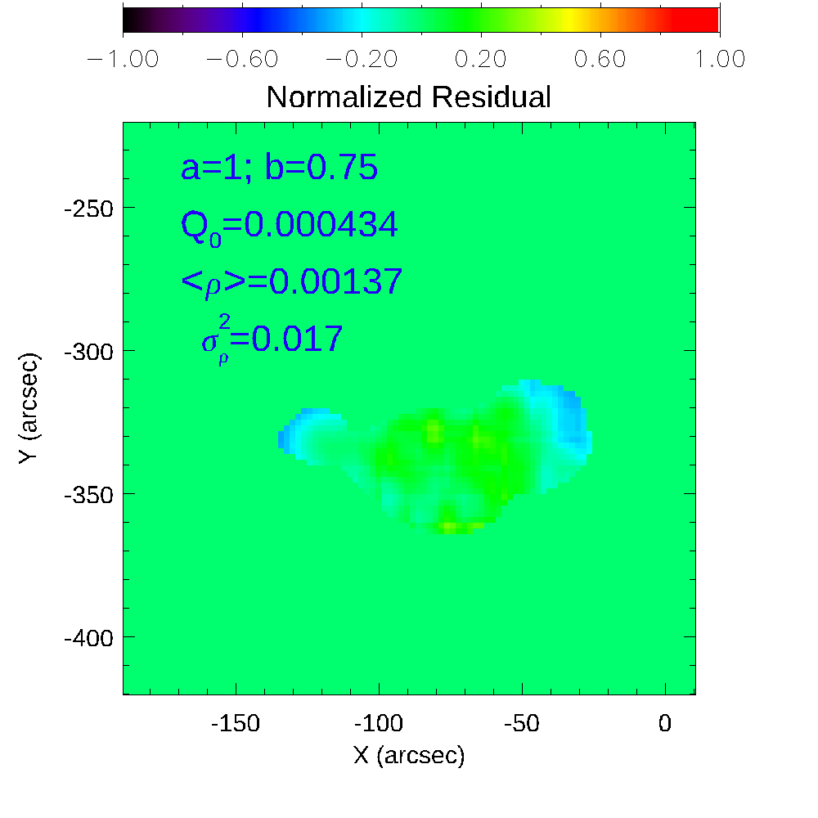


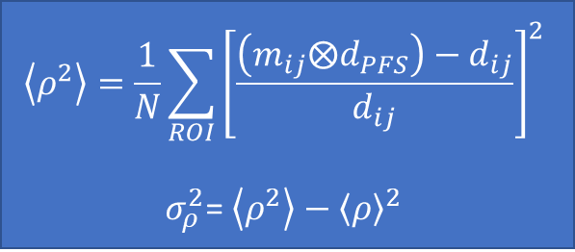


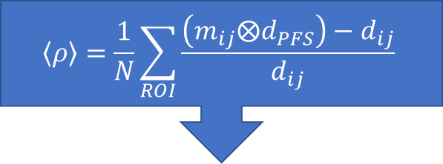

Fine Tunning of the EBTEL model using Model to Data Comparison Metrics
$$\left\{a,b\right\}$$
$${\left\{Q_{0}\right\}\underset{→}{\text{Model} \text{Image}}m}_{ij}$$
$$\left\langle ρ\right\rangle =\frac{1}{N}\sum_{ROI}{\frac{\left(m_{ij}⨂d_{PFS}\right)−d_{ij}}{d_{ij}}}$$
MW: Fleishman et al. (2021)
EUV: Ugarte-Urra et al. (2019)
New, Better $σ_{ρ}^{2}$ Metrics
Automatic Parameter Search
$\left|\left\langle ρ\right\rangle \right|<ε$ ?
$$\left\langle ρ^{2}\right\rangle =\frac{1}{N}\sum_{ROI}{{\left[\frac{\left(m_{ij}⨂d_{PFS}\right)−d_{ij}}{d_{ij}}\right]}^{2}}$$
$σ_{ρ}^{2}$= $\left\langle ρ^{2}\right\rangle −{\left\langle ρ\right\rangle }^{2}$
$$\underset{→}{\text{Min}\left\{σ_{ρ}^{2}\right\}}\left\{Q_{0},a,b\right\}$$
MW: Fleishman et al. (2021)
Trial and Error

Slide 10
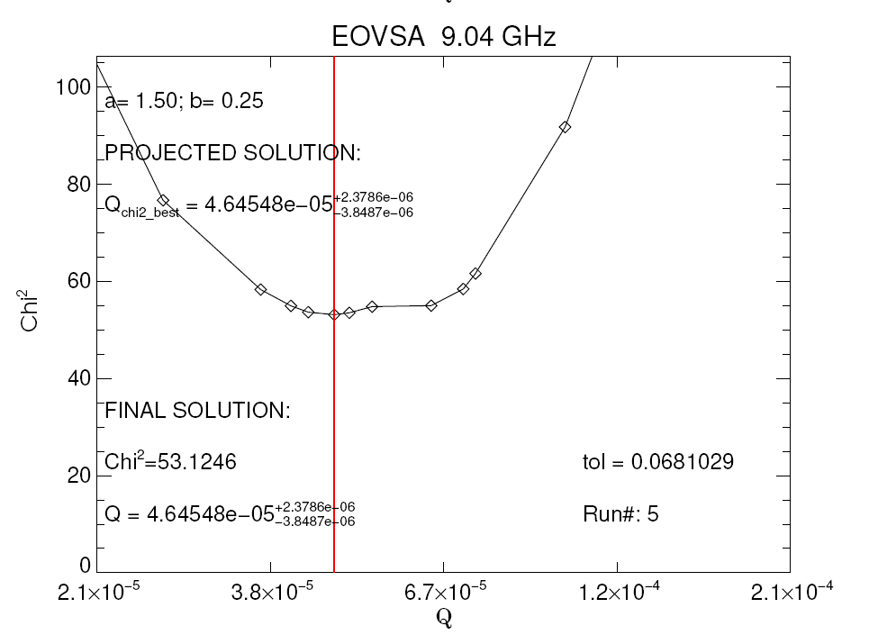


GX Automated Coronal Heating Modeling Framework
Automated Coronal Heating Modeling Pipeline (CHMP)
Automated Model Production Pipeline (AMPP)
$$\left\{Q_{0},ρ\right\}$$
{𝑄_0,𝜌}
$$σ_{ρ}^{2}$$
𝜎_𝜌^2
$$\left\{a,b\right\}$$
{𝑎,𝑏}
Data Request
Extrapolation
$\left\{\left\langle B\right\rangle , L\right\}$ Computation
Adaptive
$Q_{0}$ step
Data Validated EBTEL Coronal Heating Model

Slide 11
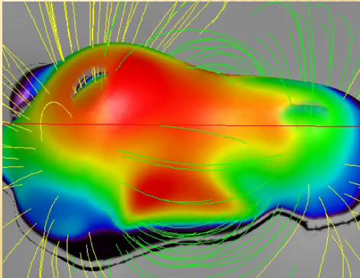
COMPLEMENTAREITY OF EUV AND MICROWAVE EMISSIONS
“Open” Coronal Fileld Lines
Closed Field Lines
TR Emission
EUV emission coming from coronal loops and TR footpoints
Microwave emission coming from isogauss gyroresonance surfaces
Microwave gyroresonance coronal emission

Slide 12
Proposed TR-Corona disentanglement workflow
Use microwave emission to fine tune the EBTEL coronal model.
Use the fine tunned EBTEL parameters , {q₀, a, b}, to generate EUV synthetic maps with no TR contribution added.
Subtract the coronal-only synthetic maps from the SDO/AIA maps to produce residual maps that may indicate where the TR emission may come from.
Use these multichannel residual maps to generate a TR mask to be applied to the EUV TR synthetic map computation block and generate full Coronal + TR synthetic maps to be compared with observation.
Reiterate the fine-tuning process as needed until the best possible model-to-data agreement is achieved.

Slide 13
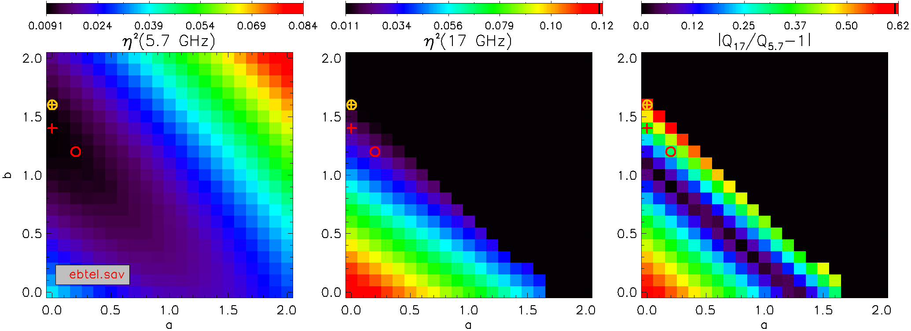
Microwave CHMP Solutions based on the DEM/DDM table ebtel.sav (impulsive heating)
+ Best Metrics 5.4 GHz
+ Best Metrics 17 GHz
Best Correlation 5.4 GHz
Best Correlation 17 GHz

Slide 14
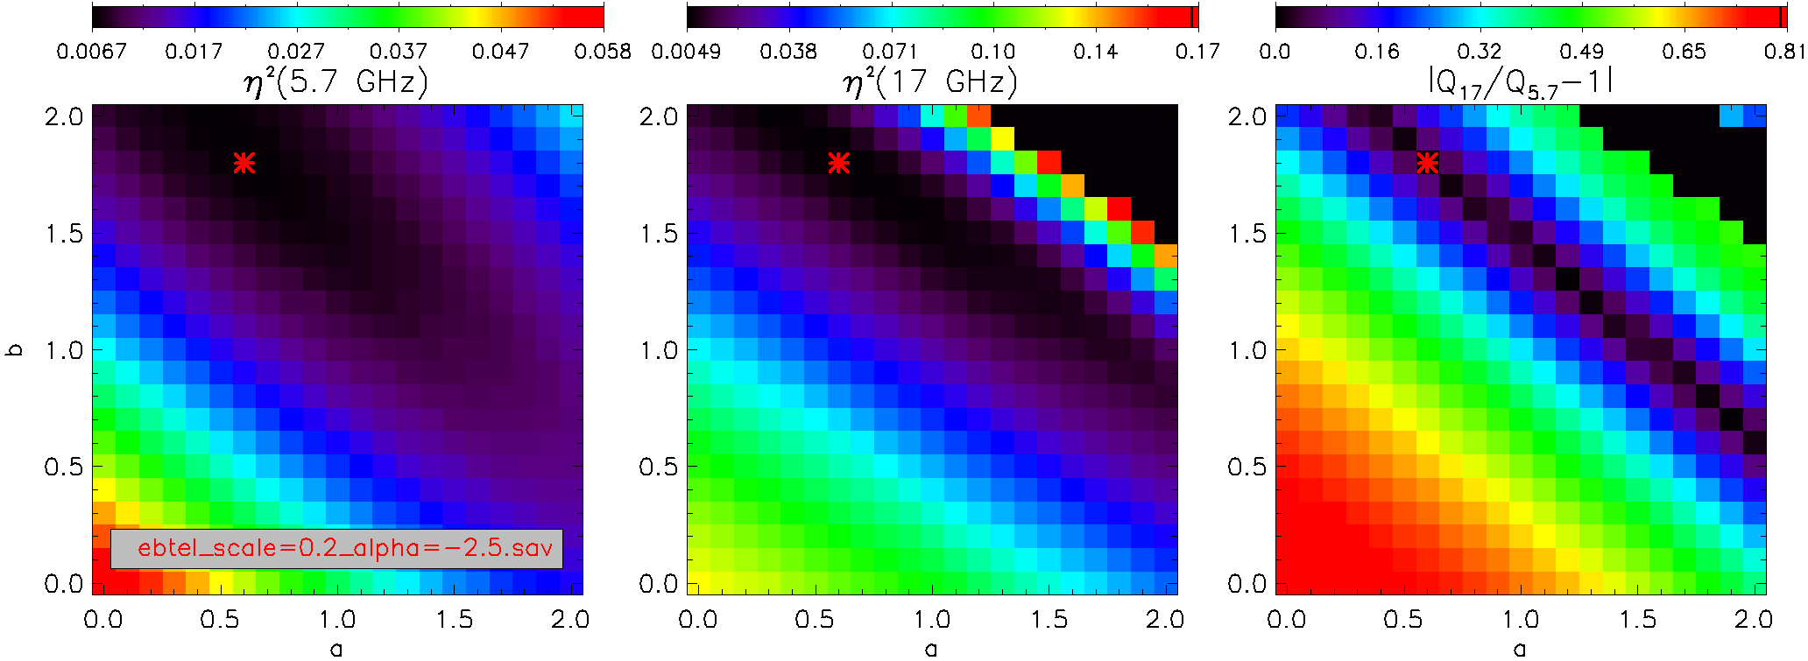
Microwave CHMP Solutions based on the DEM/DDM table ebtel_scale=0.2_alpha=-2.5.sav
* Best Metrics 5.4 GHz
* Best Metrics 17 GHz
* Best Correlation 5.4 GHz
* Best Correlation 17 GHz
a = 1.28 and b = 1.34

Slide 15
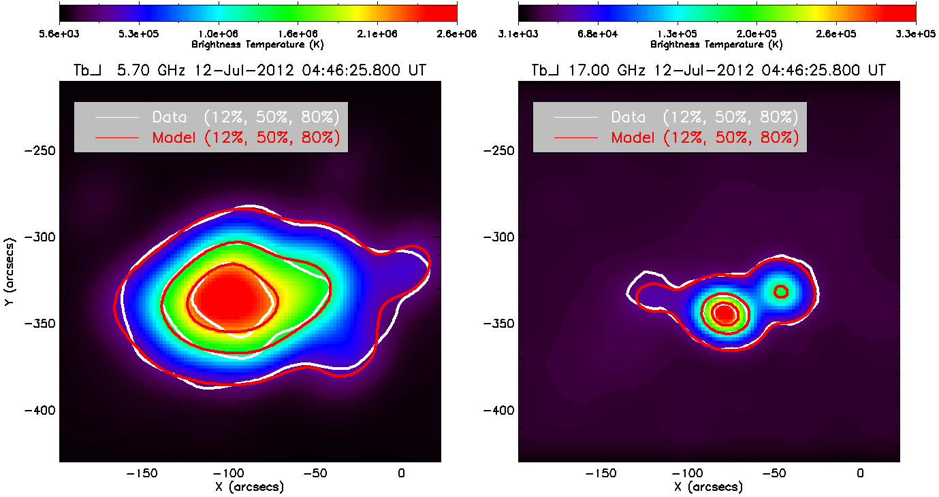
EBTEL MODEL FINE-TUNED USING MICROWAVE IMAGE DATA at 5.7 GHz (SSRT) and 17 GHz (NORH)
Fleishman, Kuznetsov & Nita, 2025, ApJ (under review)
EBTEL Table:
ebtel scale=0.2 alpha=-2.5.sav
(close to steady-state heating)
EBTEL fine-tunned parameters:
a = 1.28 and b = 1.34

Slide 16
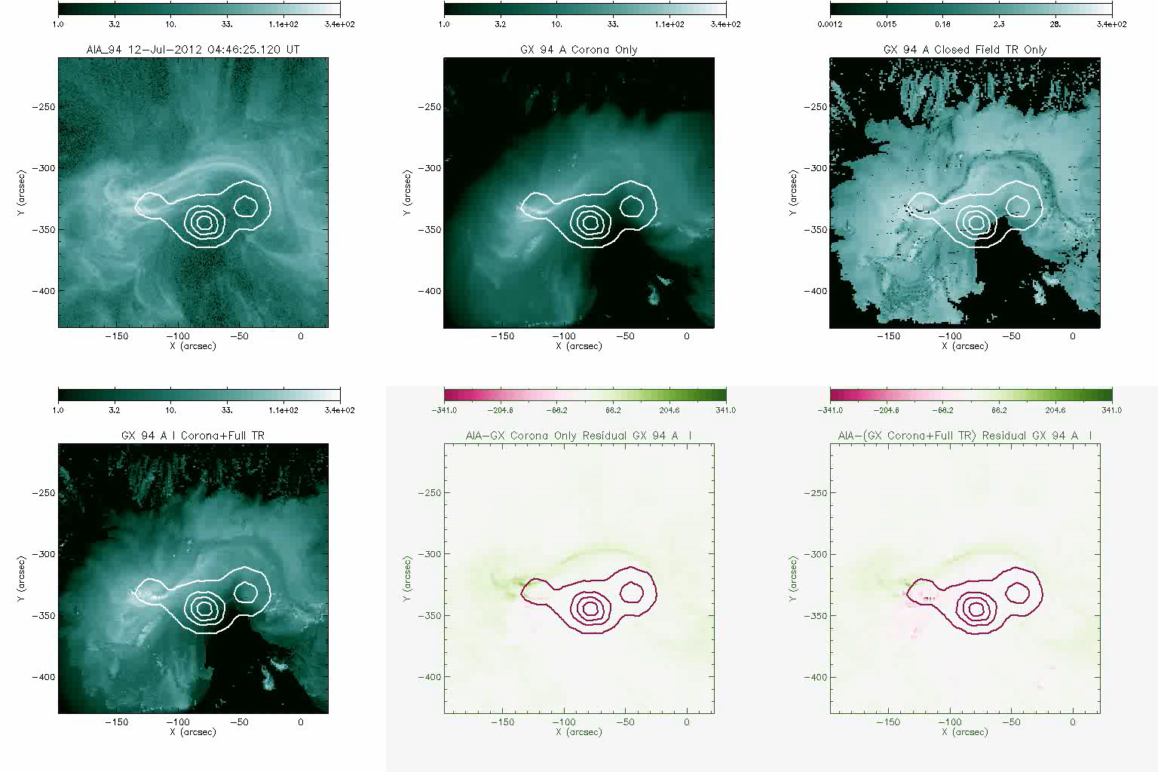
EUV Synthetic Maps a = 1.28 b = 1.34
Combination of data to model mismatch due to
Open field lines and/or selective loop heating
Overestimation of TR emission

Slide 17
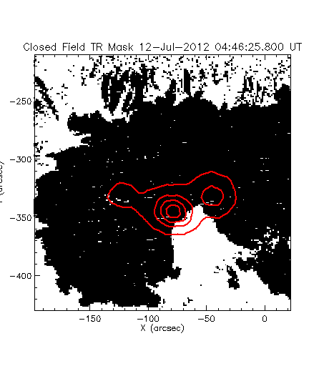
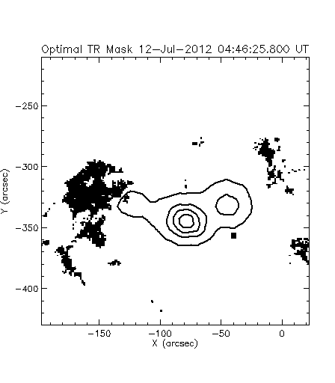
TR Emission Mask
Map of all TR voxels crossed by closed field lines, to which EBTEL DEMs may be assigned
TR Emission Mask inferred from Multichannel AIA-GX Corona Only Residuals

Slide 18
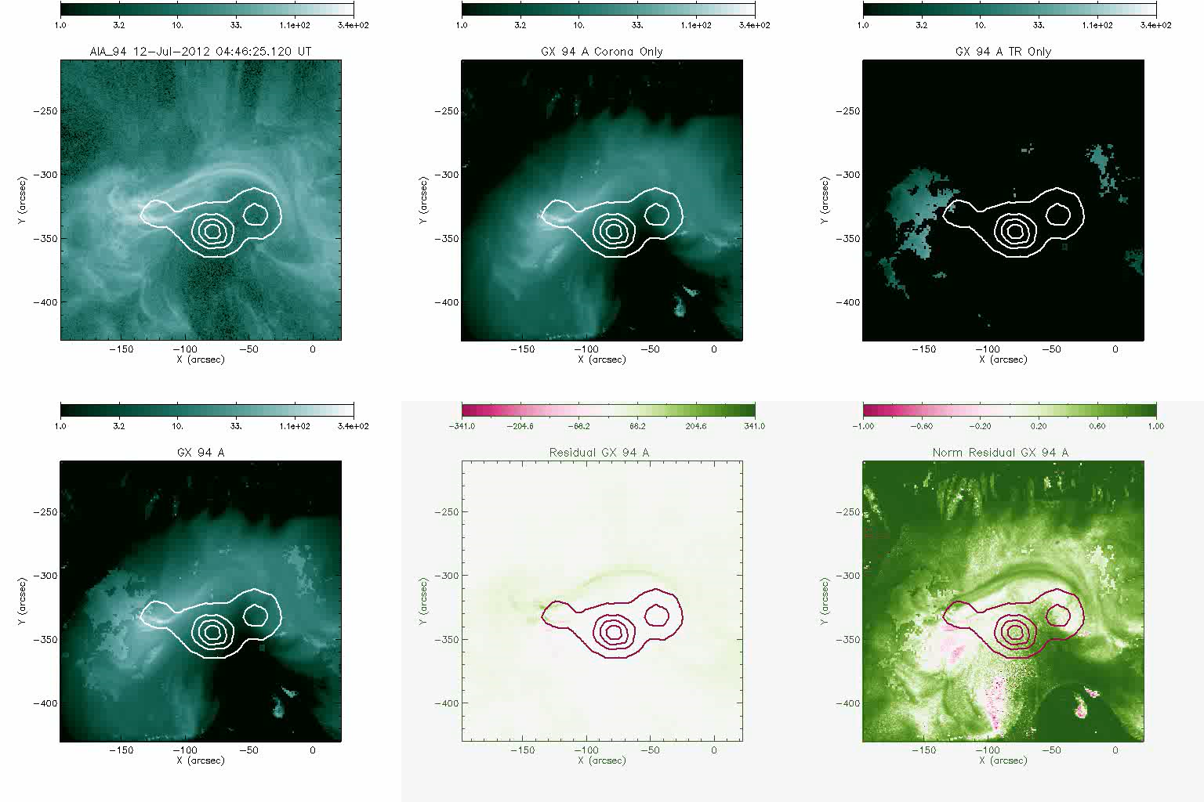
Masked TR EUV Synthetic Maps a = 1.28 b = 1.34
Mismatches still to be understood, particularly in some bands
Coronal DEMs?
TR DEMs?
Open Field Lines?
Selective Heating based on footpoints connectivity?

