Slide 1

The Onset of Magnetic Reconnection in the Solar Corona
408-04
James Leake [1]
Lars Daldorff [2]
James Klimchuk [1]
1. NASA Goddard Space Flight Center
2. Catholic University of America
JL was funded by:
NASA Living With a Star
NASA Internal Scientist Funding Model
Triennial Earth Sun Summit, Dallas, TX, April 2024

Slide 2
Do we need an onset criteria for coronal reconnection?
1
Coronal reconnection is not continuous but sporadic
Energy released on much faster timescale than build-up
Need to build up enough energy in B fiel before release to power observed phenom.
Parker (1972,1983) convective motions entangle field – free magnetic energy
Consider Energy balance -> B_{perp} ~ 0.25 B_{axial}→ angle of 14º
Klimchuk+(2015): Amount of energy injected depends on angle
Perpendicular (or shear) magnetic field a possible switch on parameter
When and how do current sheets (locations of magnetic reconnection) breakup?
Leake+(2020)
Phan+(2013), Nitta+(2021)

Slide 3
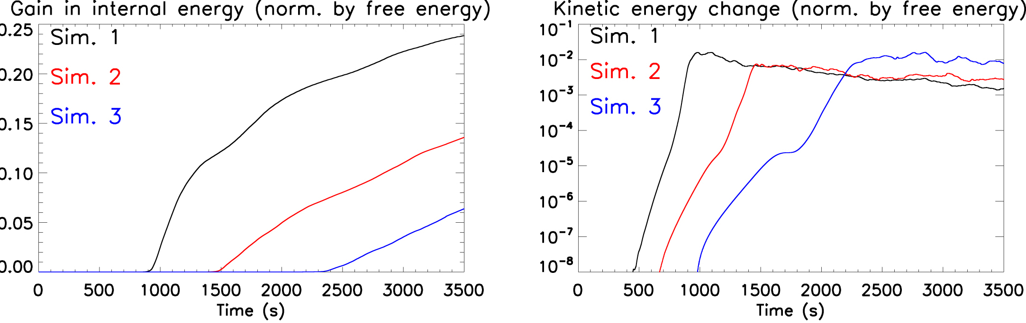
Do we need an onset criteria for coronal reconnection?
2
Coronal reconnection is not continuous but sporadic
Energy released on much faster timescale than build-up
Need to build up enough energy in magnetic field before release
Parker (1972,1983) convective motions entangle field – free magnetic energy
Consider Energy balance -> B_{perp} ~ 0.25 B_{axial}→ angle of 14º
Klimchuk+(2015): Amount of energy injected depends on angle
Perpendicular (or shear) magnetic field a possible switch on parameter
When and how do current sheets (locations of magnetic reconnection) breakup?
Leake+(2020): Look at onset of tearing instability in static coronal sheets
‘Long sheet’- weak dependence on shear (high/med/low)

Slide 4
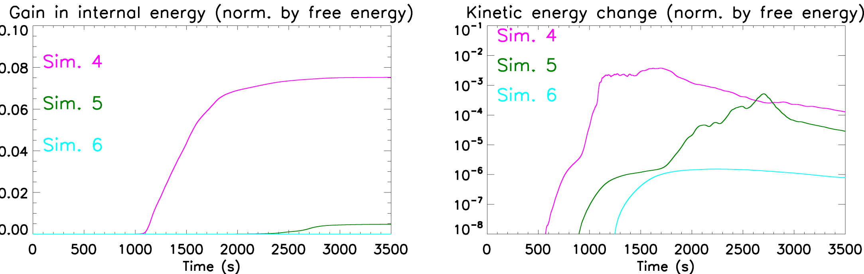
Do we need an onset criteria for coronal reconnection?
2
Coronal reconnection is not continuous but sporadic
Energy released on much faster timescale than build-up
Need to build up enough energy in magnetic field before release
Parker (1972,1983) convective motions entangle field – free magnetic energy
Consider Energy balance -> B_{perp} ~ 0.25 B_{axial}→ angle of 14º
Klimchuk+(2015): Amount of energy injected depends on angle
Perpendicular (or shear) magnetic field a possible switch on parameter
When and how do current sheets (locations of magnetic reconnection) breakup?
Leake+(2020): Look at onset of tearing instability in static coronal sheets
‘Short sheet’- Strong dependence on shear (high/med/low)

Slide 5
Do we need an onset criteria for coronal reconnection?
2
Coronal reconnection is not continuous but sporadic
Energy released on much faster timescale than build-up
Need to build up enough energy in magnetic field before release
Parker (1972,1983) convective motions entangle field – free magnetic energy
Consider Energy balance -> B_{perp} ~ 0.25 B_{axial}→ angle of 14º
Klimchuk+(2015): Amount of energy injected depends on angle
Perpendicular (or shear) magnetic field a possible switch on parameter
When and how do current sheets (locations of magnetic reconnection) breakup?
Leake+(2020): Look at onset of tearing instability in static coronal sheets
Magnetic shear is possibly an ‘onset parameter’ – but depends on regime
‘Short sheet’- Strong dependence on shear (high/med/low)

Slide 6
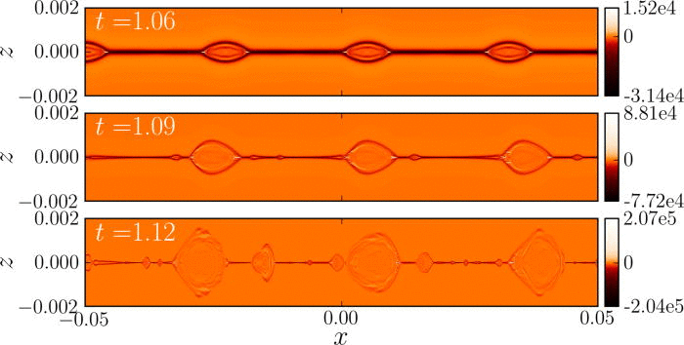
Aside: Tearing Instability
3
Plasmoid instability - invoked for fast recon in fluid regime (Loureiro+ 2007)
Low conductivity – fast, many plasmoids!
Scaling - magnetic tearing instability applied to thin current sheets undergoing steady-state reconnection (Sweet-Parker) – Pucci & Velli (2014,2017)
‘Ideal tearing’ – thinning sheets will disrupt via tearing before they get to S-P scales
What is the tearing instability?
Huang+(2013)

Slide 7
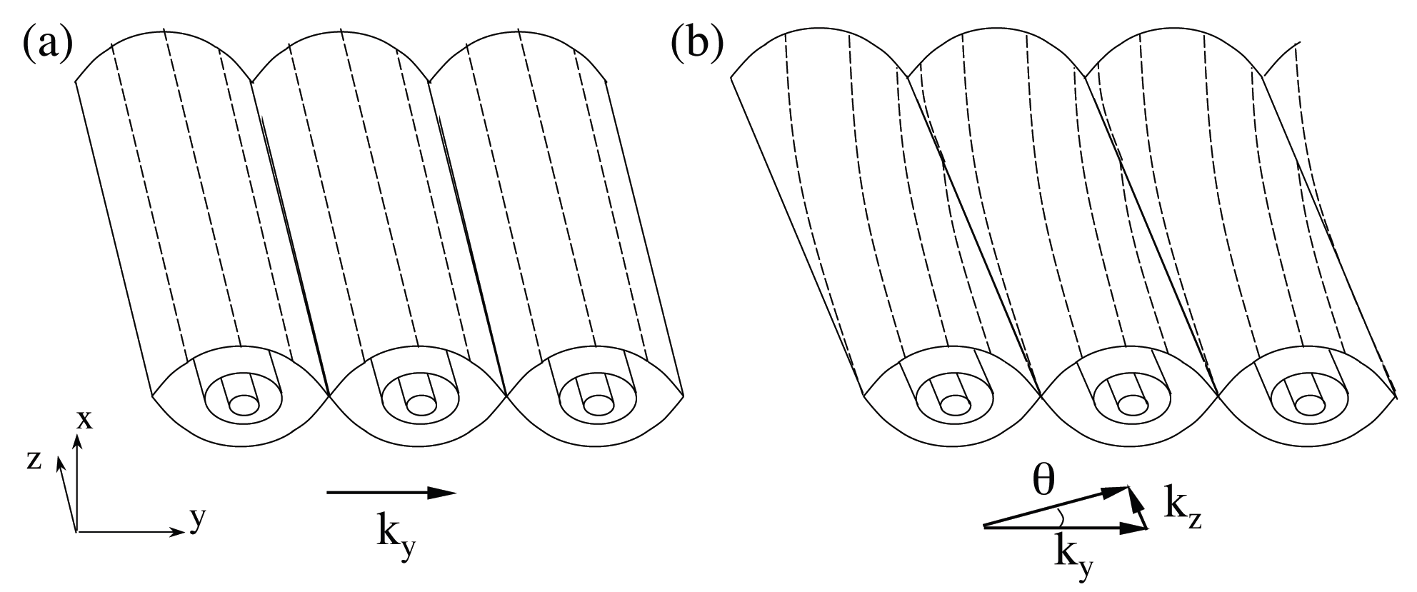
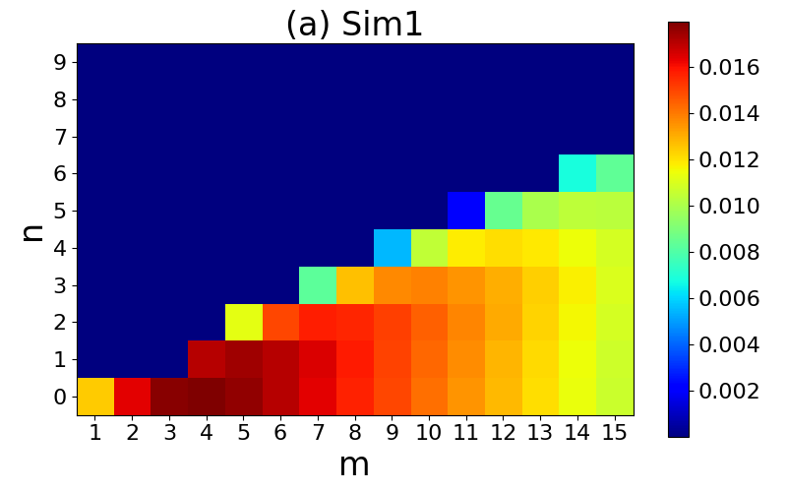
Aside: Tearing Instability
3
Plasmoid instability - invoked for fast recon in fluid regime (Loureiro+ 2007)
Low conductivity – fast, many plasmoids!
Scaling - magnetic tearing instability applied to thin current sheets undergoing steady-state reconnection (Sweet-Parker) – Pucci & Velli (2014,2017)
‘Ideal tearing’ – thinning sheets will disrupt via tearing before they get to S-P scales
What is the tearing instability?
Baalrud (2016)
Leake et al. (2020)

Slide 8
Aside: Tearing Instability
3
Plasmoid instability - invoked for fast recon in fluid regime (Loureiro+ 2007)
Low conductivity – fast, many plasmoids!
Scaling - magnetic tearing instability applied to thin current sheets undergoing steady-state reconnection (Sweet-Parker) – Pucci & Velli (2014,2017)
‘Ideal tearing’ – thinning sheets will disrupt via tearing before they get to S-P scales
What is the tearing instability?
Baalrud (2016)
Leake et al. (2020)
Dominant
modes

Slide 9
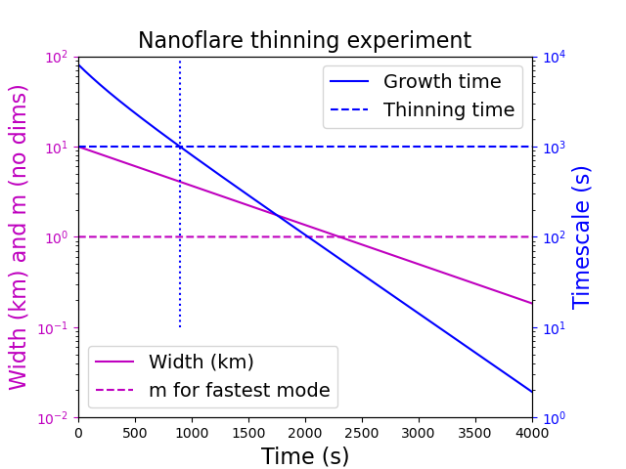
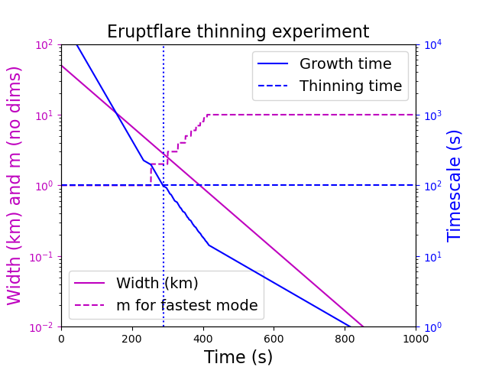
Dynamically Thinning Sheets in the Solar Corona
4
Realistic Lundquist number, Alfven speed (density and field), initial width and length
Look at growth of linear tearing instability as system thins – what are dominant modes?

Slide 10
Dynamically Thinning Sheets in the Solar Corona
4
Realistic Lundquist number, Alfven speed (density and field), initial width and length
Look at growth of linear tearing instability as system thins – what are dominant modes?
Nanoflares: m=1 – wavelength~ box `short-sheet’

Slide 11
Dynamically Thinning Sheets in the Solar Corona
4
Realistic Lundquist number, Alfven speed (density and field), initial width and length
Look at growth of linear tearing instability as system thins – what are dominant modes?
Eruptive flares: m>1
wavelength<< box `long-sheet’

Slide 12
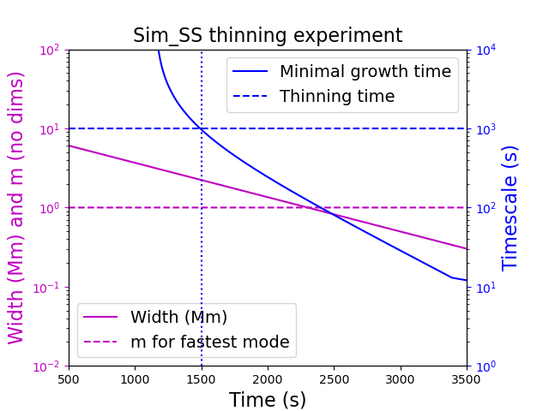
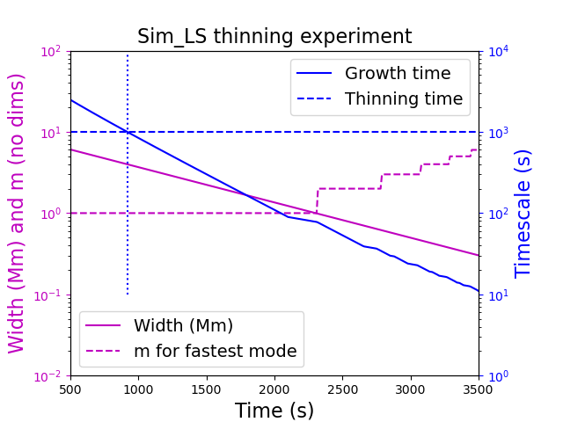
Simulating Thinning Sheets in the Solar Corona
5
Very different Lundquist number, but can reach same regimes in terms of timescales

Slide 13
Simulating Thinning Sheets in the Solar Corona
5
Very different Lundquist number, but can reach same regimes in terms of timescales
Nanoflares: m=1 – wavelength~ box `short-sheet’

Slide 14
Simulating Thinning Sheets in the Solar Corona
5
Very different Lundquist number, but can reach same regimes in terms of timescales
Eruptive flares: m>1
wavelength<< box `long-sheet’

Slide 15
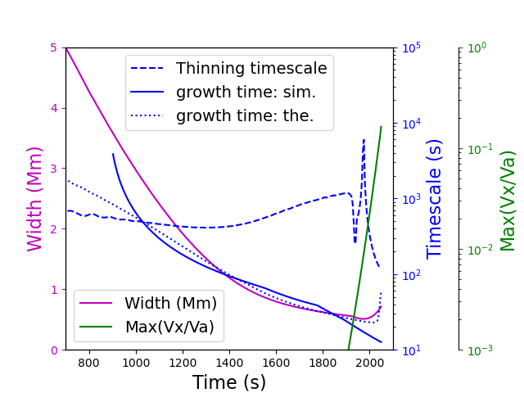
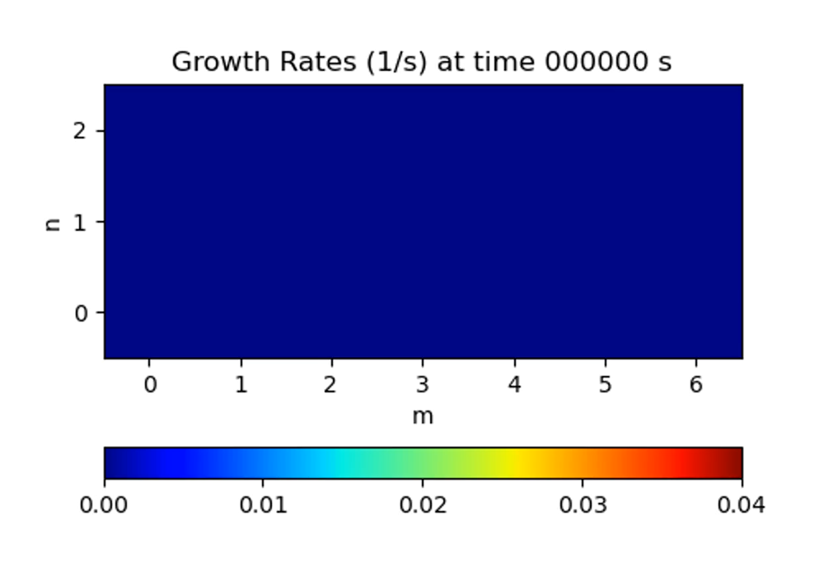
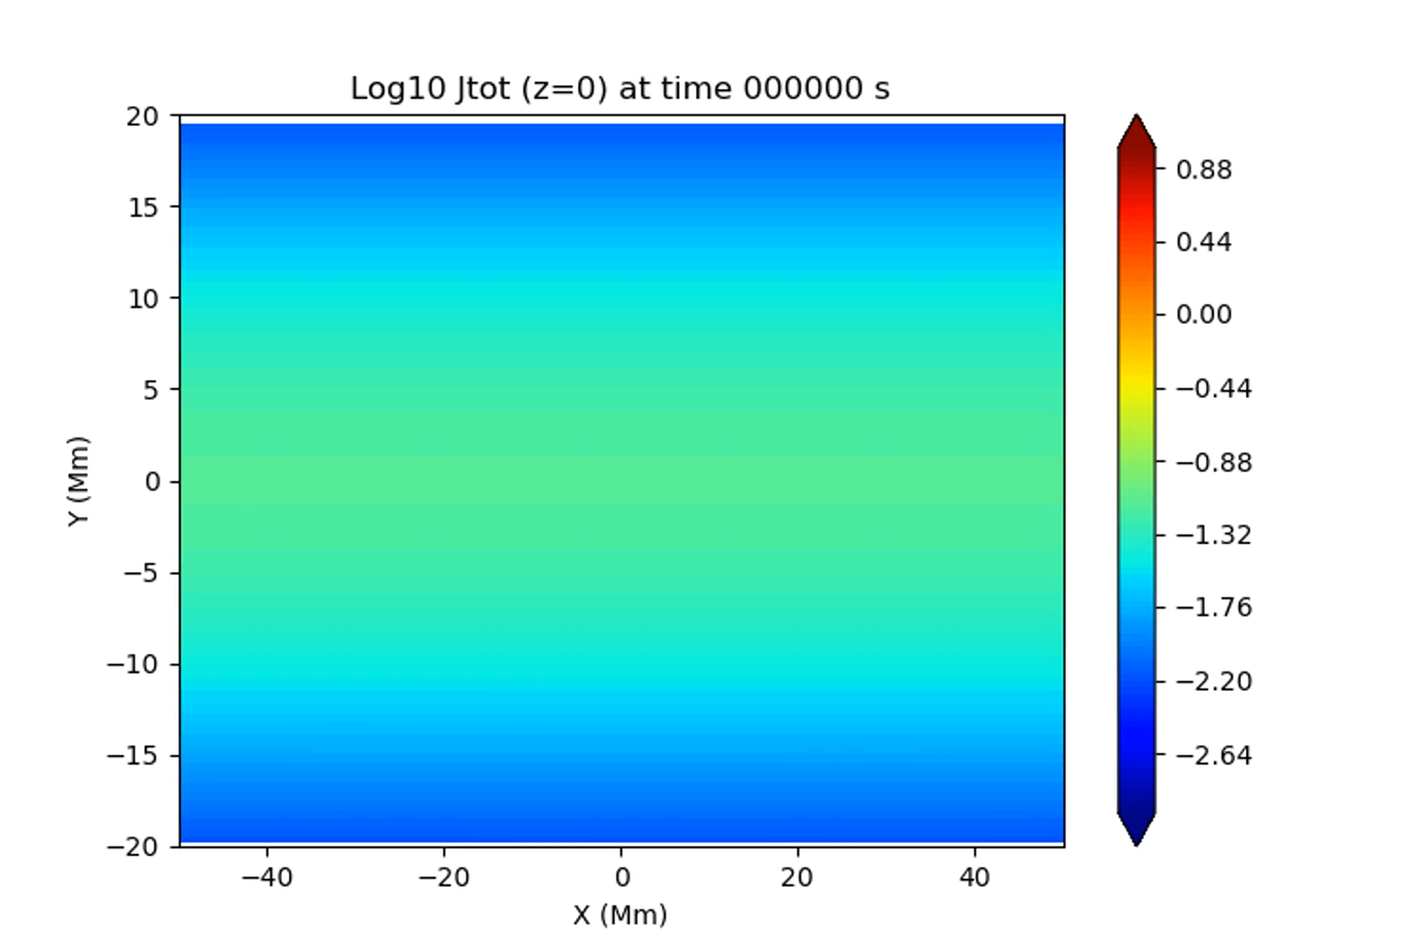
Example of break-up (long-sheet high shear)
6
Cross-over
Breakup
Breakup after cross-over (growth time = thin time)

Slide 16
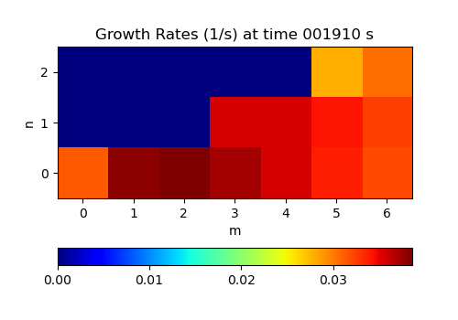
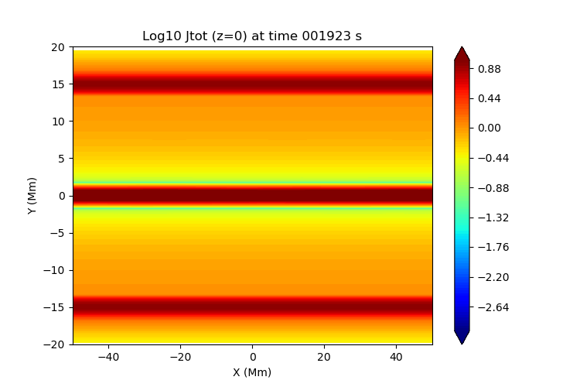
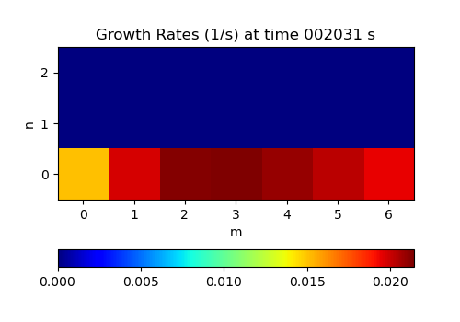
The “Long Sheet” Regime – shear not important
7
Modes just after time of cross-over
Weak & strong shear very similar (diff is oblique modes)
m~3,4 long sheet regime
Energy release dominated by coalescence (Leake+2020)
High shear
Low shear

Slide 17
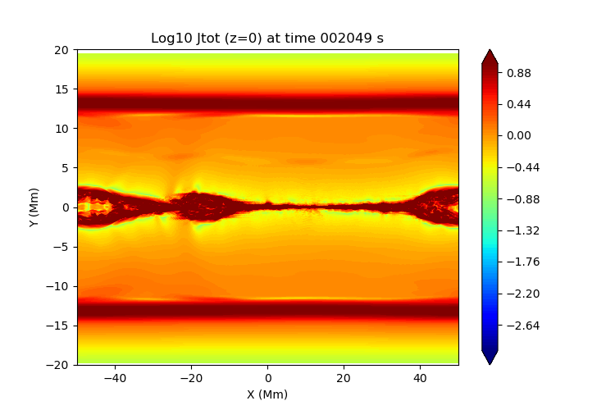
The “Long Sheet” Regime – shear not important
7
Modes just after time of cross-over
Weak & strong shear very similar (diff is oblique modes)
m~3,4 long sheet regime
Energy release dominated by coalescence (Leake+2020)
High shear
Low shear

Slide 18
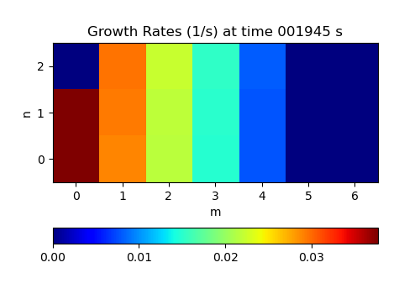
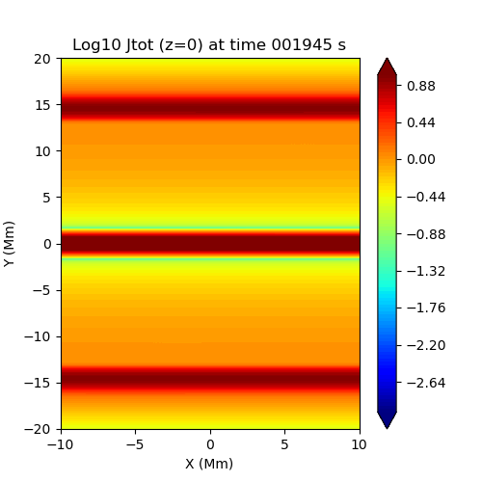
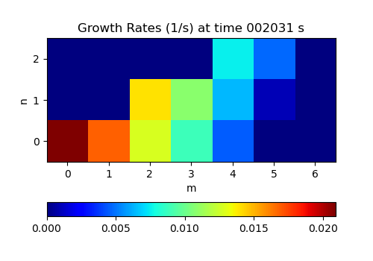
The “Short Sheet” Regime – shear is vital
8
Modes just after time of cross-over
m=1 short-sheet
No coalescence
High shear – interaction with strong (1,1) mode
High shear
Low shear

Slide 19
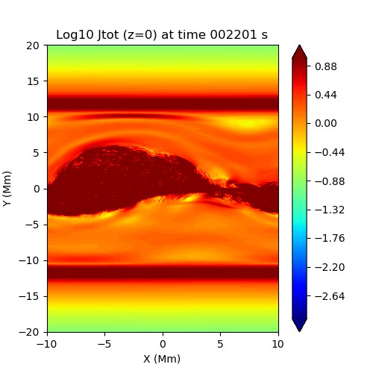
The “Short Sheet” Regime – shear is vital
8
Modes just after time of cross-over
m=1 short-sheet
No coalescence
High shear – interaction with strong (1,1) mode
High shear
Low shear

Slide 20
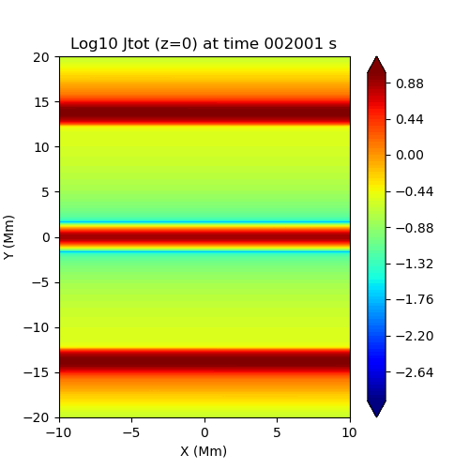
The “Short Sheet” Regime – shear is vital
8
Modes just after time of cross-over
High shear
m=1 short-sheet
No coalescence
Low shear – no oblique mode interaction
saturates
Low shear

Slide 21
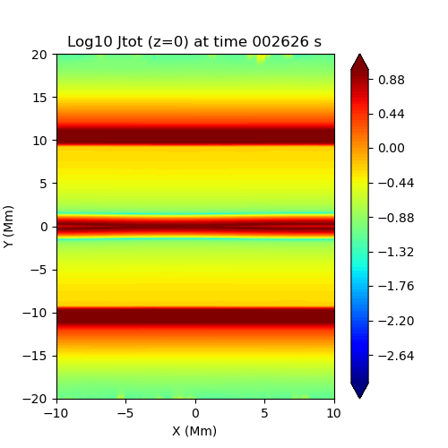
The “Short Sheet” Regime – shear is vital
8
Modes just after time of cross-over
High shear
m=1 short-sheet
No coalescence
Low shear – no oblique mode interaction
saturates
Low shear

Slide 22
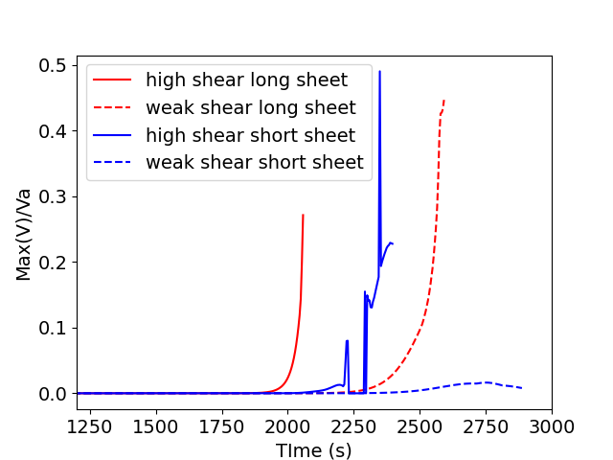
Summary
9
Strength of outflows/Va
Dynamically thinning sheets
Onset of reconnection occurs when instability becomes faster than driving
Whether sheet breaks up depends on regime and shear
Is shear a possible switch-on?
In short-sheet regime (nanoflares) – YES
Caveats
Periodic BCs in guide field direction – See Daldorff talk on effect of line-tying
Infinite in extent along current sheet – See Klimchuk talk on finite sheets
Klimchuk (2023) – loss of equilibrium of finite current sheets depends on shear
How does this relate to the switch-on seen here?
Need studies of dynamically shearing/thinning finite length sheets line-tied to surface
Short sheet – strong dependence on shear

Slide 23
Effect of resolution on onset of reconnection in thinning current sheets
December 2025

Slide 24
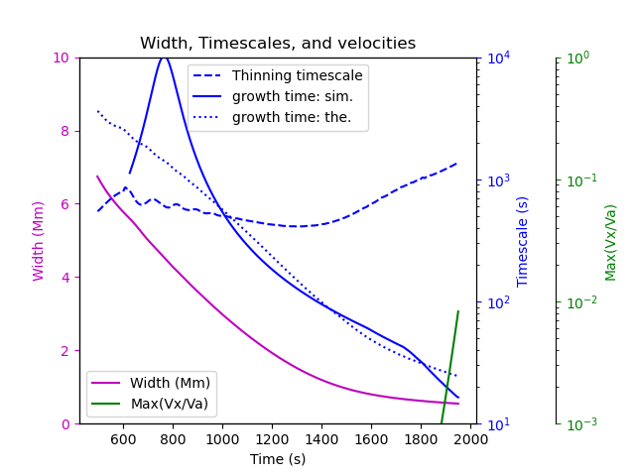
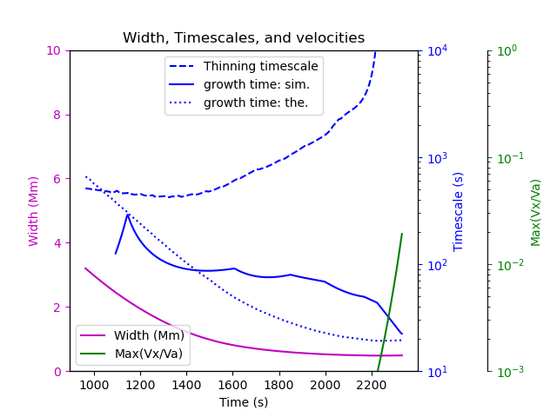
Regular resolution
Low resolution (10 times worse)

Slide 25
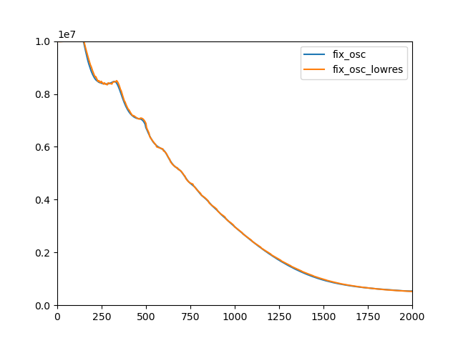
Change in width vs time – little difference
Instigated test down to very very poor resolution (few points pre current sheet) – akin to multi-strand models

