Slide 1
Onset of Reconnection in Dynamically Evolving Coronal Current Sheets
James Leake
Lars Daldorff
James Klimchuk
ISFM Working Group
March 23rd 2022
Notes:
Cdsjklcfsdjflkdsjfdslkfjsdajfdjsklfjdsklgjkldfsjgkldjfsgl;jfgj;fd
Gfdgdfgfd

Slide 2
Motivation
How does reconnection suddenly ‘switch on’ (seconds to minutes) after long (hours to days) periods of energy build-up in corona?
Critical break-up of laminar sheets?
Sudden onset of turbulence (and hence faster magnetic reconnection)?
Ideal instability driving magnetic reconnection?
Investigate dynamically evolving laminar sheets with respect to the development of the resistive tearing instability
Thinning as two flux systems are pushed/attracted to each other
Thinning and lengthening (think flare current sheet beneath a CME)
Shearing and twisting (Parker entanglement)

Slide 3
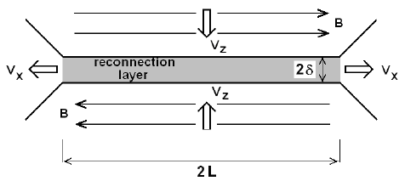
Quick Reminder - Sweet-Parker Reconnection
Sweet-Parker reconnection
Small region where frozen-in condition is broken, connectivity changes, and lower energy state is found
Resistivity η (collisions) cause of flux -breaking
Consider steady state resistive MHD and use conservation laws to derive scaling
$R= \frac{v_in}{v_out}=\frac{δ}{L}\sim {\frac{η}{V_{a}.L}}^{\frac{1}{2}}={SL}^{−\frac{1}{2}}$
$Lundquist number SL= \frac{V_{a}.L}{η}$
For large $SL$ as in corona, very slow
Petcheck model
Hall and Kinetic effects

Slide 4
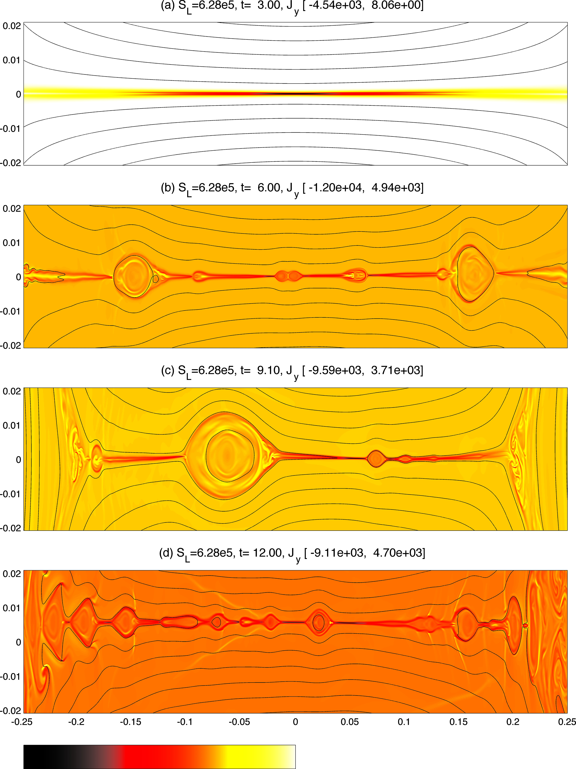
The `plasmoid instability`
But reconnection is fast because ‘plasmoids’ right?
At very high Lundquist numbers or very large aspect ratios current sheets breaks up into plasmoids (Loureiro 2006)
$R= γ.τL \sim {SL}^{\frac{1}{4}}$so increases with S_{L}
This is just the application of a linear instability (resistive tearing instability) to a current sheet that scales based on S-P (previous slide)
Resistive Tearing instability (see later discussion)
$R= γ.τL \sim {Sδ}^{−\frac{1}{2}}, Sδ=\frac{V_{a}.δ}{η}$
Plug in S-P scaling $\frac{δ}{L} \sim {SL}^{−\frac{1}{2}}$
Get $γ.τL \sim {SL}^{\frac{1}{4}}$
We’ll come back to the resistive tearing instablity

Slide 5
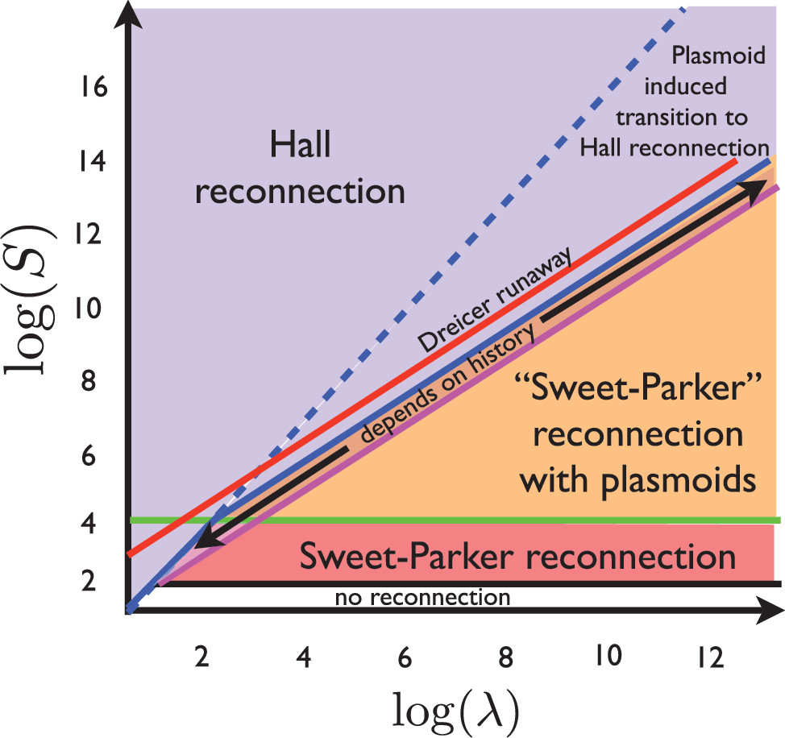
2D Reconnection Phase Diagram
Corona
Cassack and Drake (2013)
Corona likely collision-less reconnection (kinetic effects)
Note - this is 2.5D only (see 3D later)
What about the onset of reconnection in dynamically evolving sheets?
Operate under paradigm where current sheets are being dynamically forced (sheared, thinned, lengthened)

Slide 6
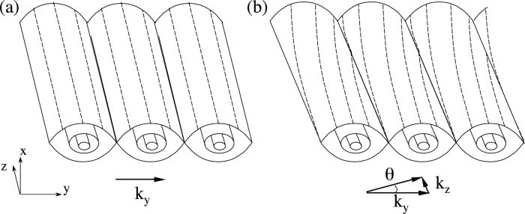
Tearing Instability (Furth, Killeen, Rosenbluth)
Interface between magnetic field of opposite direction (current sheet of width 𝞭)
E.g., By = By0.tanh(x/ 𝞭)
Unstable for finite resistivity, breaking of connectivity and transition to lower energy system
Consider linear perturbations to MHD equilibrium with wavenumber k = (ky,kz)~(m,n)
In 2D Resonant surface is at x=0
$R= γ.τL \sim {Sδ}^{−\frac{1}{2}}, Sδ=\frac{V_{a}.δ}{η}$
Consider 3D evolution with a guide field Bz
Resonant surfaces at k.B=0
Not just at x=0
Parallel modes (kz,n=0) plasmoids
Oblique modes (kz,n>0) are titled flux ropes
What is role of oblique modes in 3D?
Baalrud (2012)

Slide 7
Tearing Instability in thinning sheets
Recall that plasmoid instability $growth rate γ.τL \sim {SL}^{\frac{1}{4}}$
The idea of an instability with growth rate that grows with increasing S_{L} is problematic
Pucci and Velli (2014) argue against the realization of a current sheet with S-P scaling $\frac{δ}{L}\sim {SL}^{−\frac{1}{2}}$
The current sheet will break-up via tearing instability on “fast” timescales, so could never reach such small widths
”ideal” or ”fast” growth at aspect ratios of $\frac{δ}{L}\sim {SL}^{−\frac{1}{3}}$ before width reaches scaling of $\frac{δ}{L}\sim {SL}^{−\frac{1}{2}}$
What does this mean for the corona $SL={10}^{12}$? Length L=10 Mm, fast break-up at widths of 1 km
Onset of tearing instability in thinning current sheets in the corona could occur above kinetic scales
Study the onset of critical break-up of dynamically evolving current sheets in the corona, using MHD simulations (fluid, not kinetic)

Slide 8
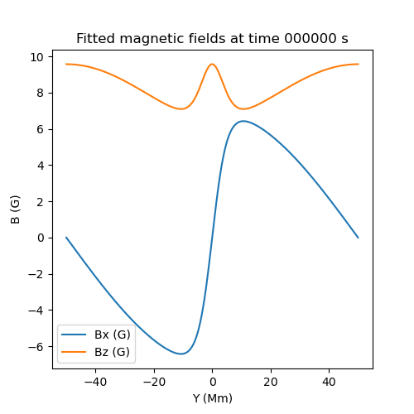
Validating the Numerical Code with static setup
Non-linear Visco-Resistive MHD equations
Lagrangian-Remap 3D code (LaRe3D)
Shock-capturing that works well in low β
Do our best at Coronal conditions
S_{L}=${10}^{6} , β=0.01$
Lundqist number is much smaller than in corona
Ratio of relevant timescales is comparable
Simple triply periodic box (~100 Mm) with 3D force-free current sheet with guide field
Seed simulation with linear combination of low amplitude Fourier modes
Allow system to evolve from linear to non-linear phase
Can calculate linear modes of tearing instability of this system and validate the simulation data
Accumulated V
Linear Theory
Accumulated V
Simulation Data

Slide 9
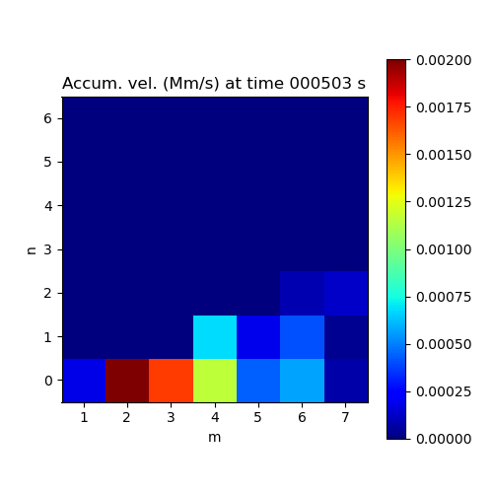
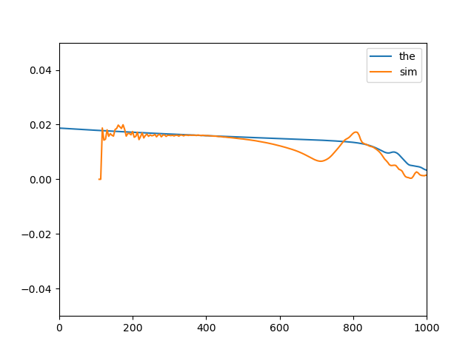
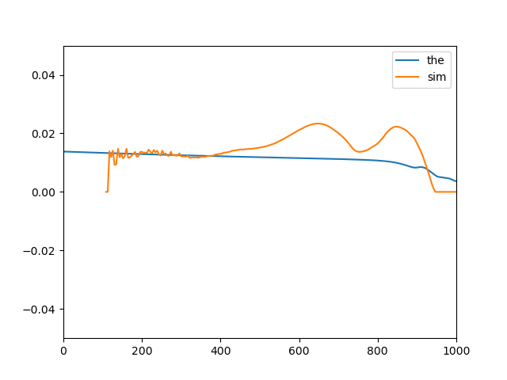
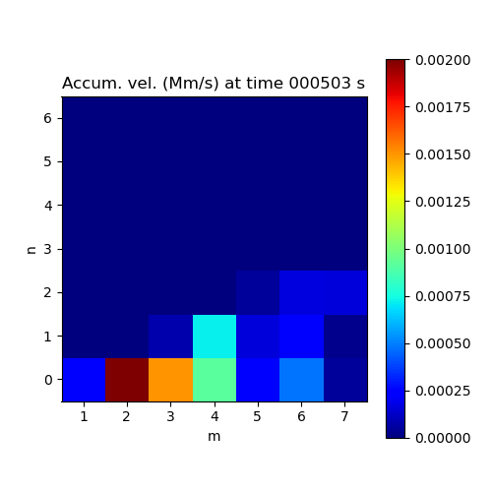
Validating the Numerical Code with static setup
Fourier decompose outflow to look at power (velocity) in each allowable mode
Compare instantaneous growth rate (below) and
accumulated velocities (right) of each allowed mode between simulation and theory
Accumulated V
Linear Theory
Growth Rate for (1,0) Mode
Growth Rate for (2,0) Mode
Accumulated V
Simulation Data
Linear phase
Linear
phase
Time (s)
Time (s)

Slide 10
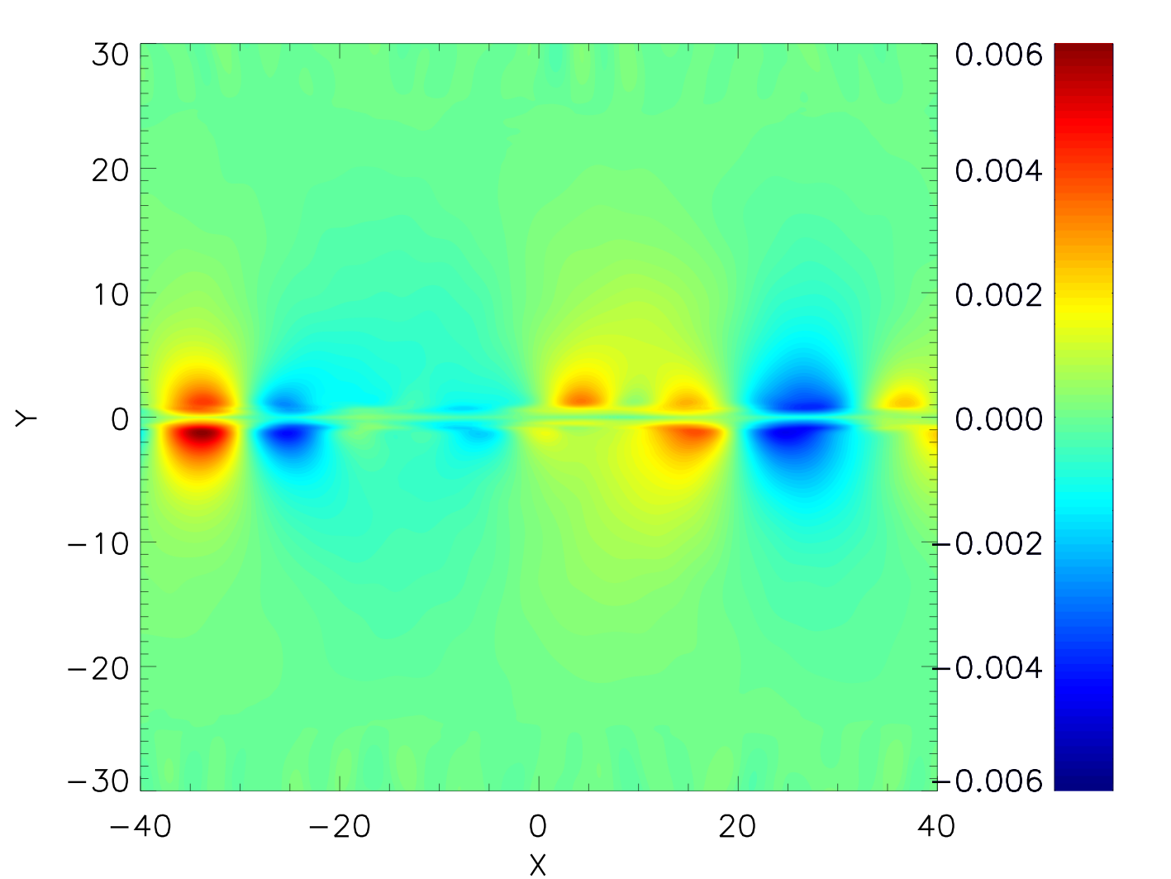
Why 3D?
Majority of studies of thinning sheets and plasmoids are 2.5D
3D oblique will affect simple plasmoid pic.
Daldorff et al. (2022)
Compare the linear and non-linear development of tearing instability in static 2D and 3D sheets
Initial dominant linear modes of tearing instability (1,0)->(4,0) coalesce and create new current sheet between a flux rope
Oblique modes are also present
Look at break-up of this new current sheet and effect of oblique modes on this break-up
Reconnected magnetic field (T)

Slide 11
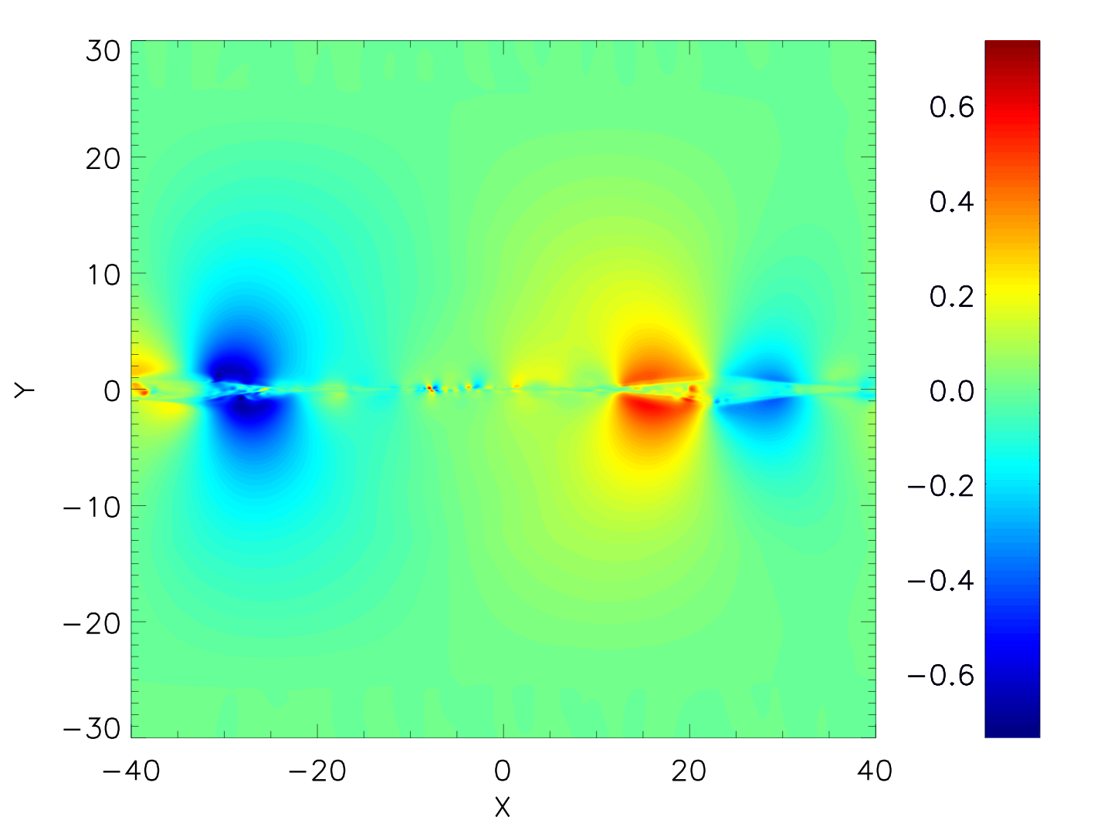
Why 3D?
Majority of studies of thinning sheets and plasmoids are 2.5D
3D oblique will affect simple plasmoid pic.
Daldorff et al. (2022)
Compare the linear and non-linear development of tearing instability in static 2D and 3D sheets
Initial dominant linear modes of tearing instability (1,0)->(4,0) coalesce and create new current sheet between a flux rope
Oblique modes are also present
Look at break-up of this new current sheet and effect of oblique modes on this break-up
Reconnected magnetic field (T)

Slide 12
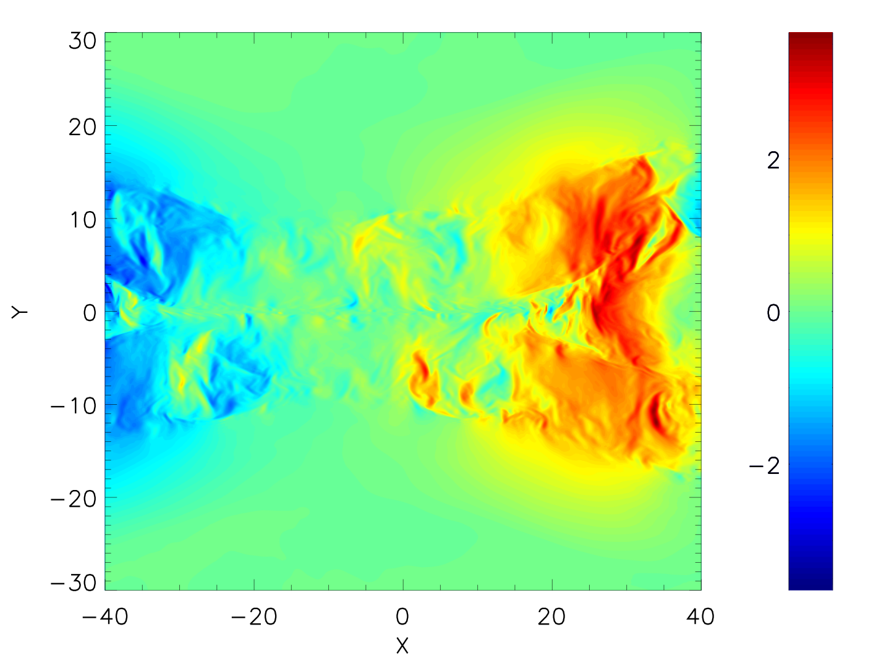
Why 3D?
Majority of studies of thinning sheets and plasmoids are 2.5D
3D oblique will affect simple plasmoid pic.
Daldorff et al. (2022)
Compare the linear and non-linear development of tearing instability in static 2D and 3D sheets
Initial dominant linear modes of tearing instability (1,0)->(4,0) coalesce and create new current sheet between a flux rope
Oblique modes are also present
Look at break-up of this new current sheet and effect of oblique modes on this break-up
Reconnected magnetic field (T)

Slide 13
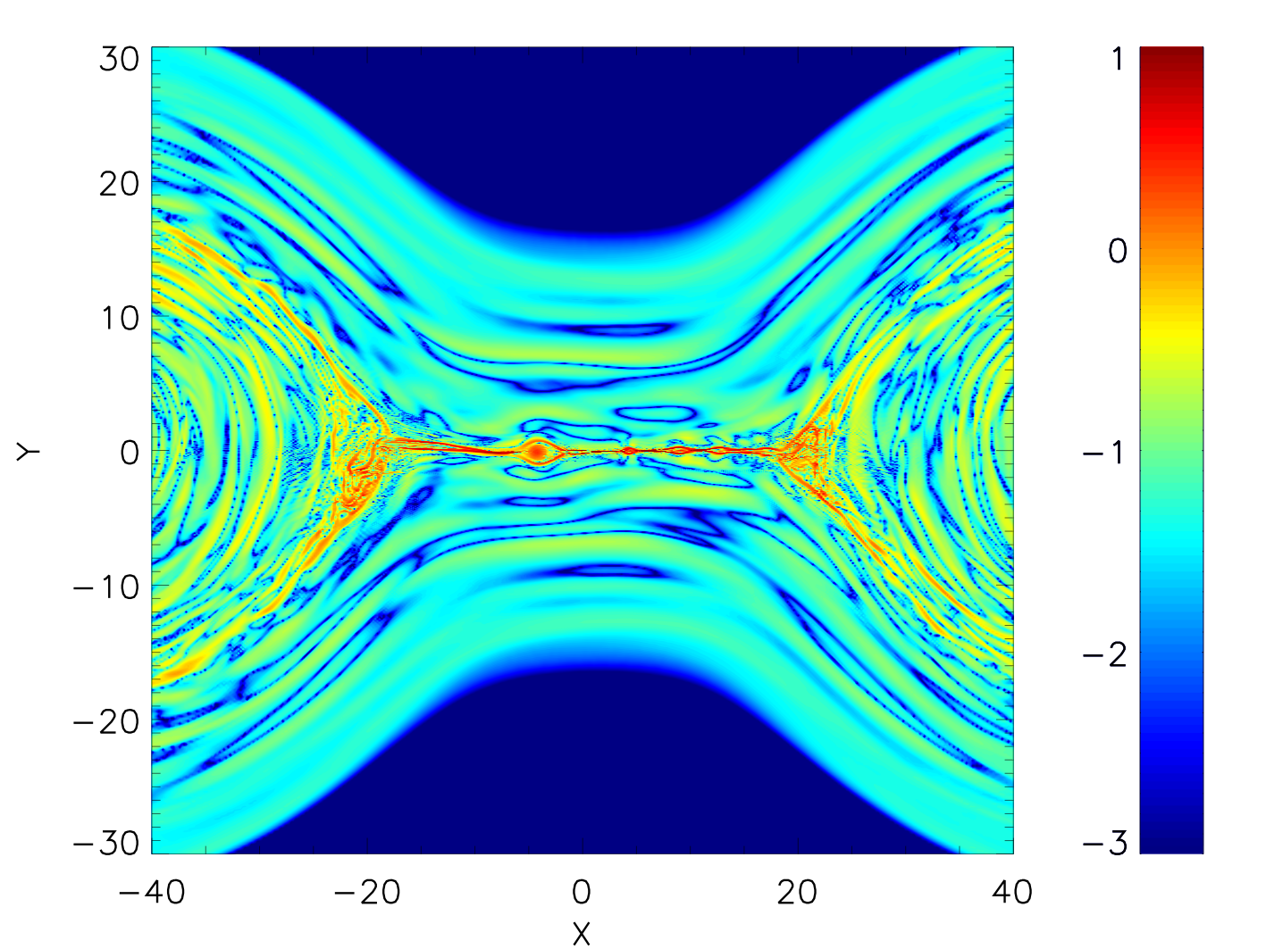
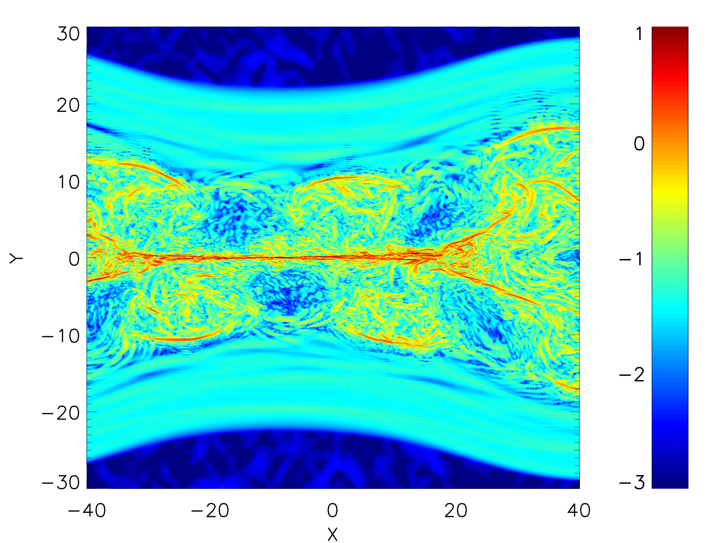
Why 3D? Ctnd.
In 2D efficient breakup of secondary current sheet by plasmoids
In 3D can see presence of oblique mode and disrupted plasmoid formation
”Turbulence” created by interacting oblique modes (Huang and Bhattachargee 2016)
2D
3D
3D
Log10(Jz)
Log10(Jz)

Slide 14
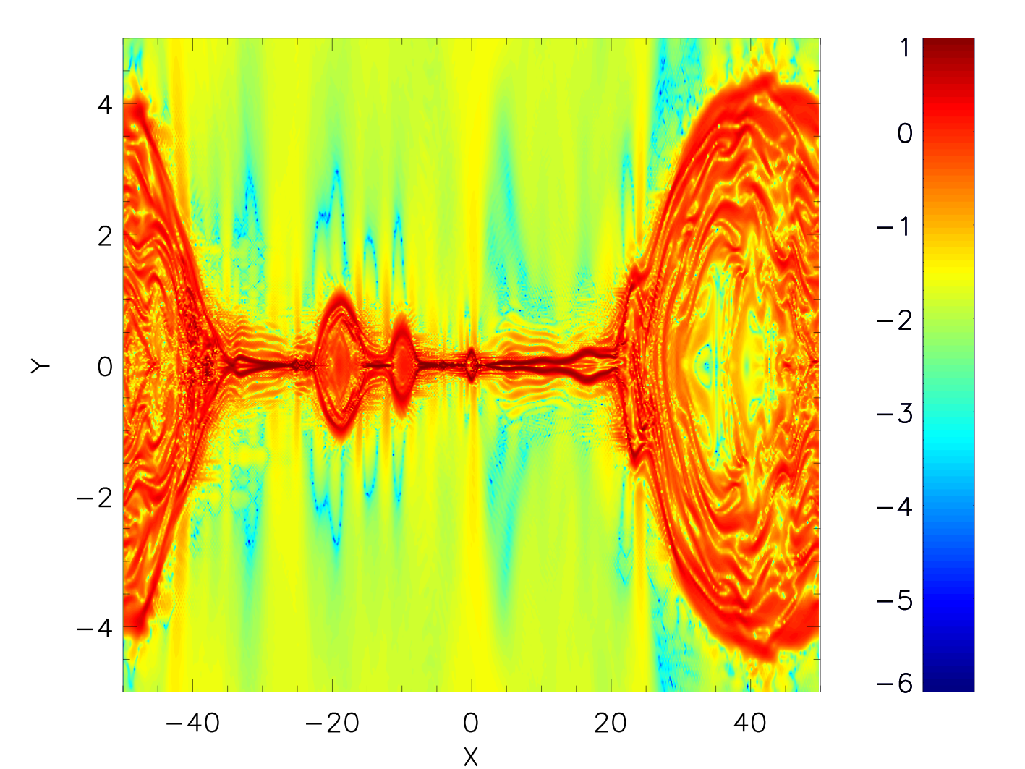
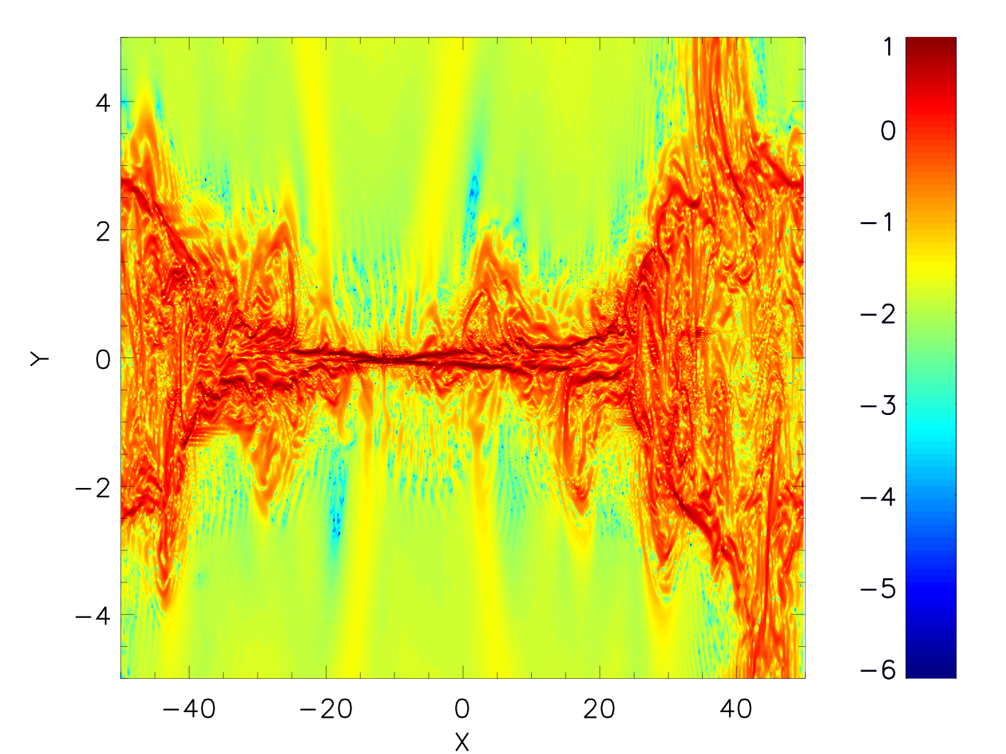
Why 3D? Ctnd.
In 2D efficient breakup of secondary current sheets by plasmoids
In 3D can see presence of oblique mode and discrupted plasmoid formation
”Turbulence” created by interacting oblique modes (Huang and Bhattachargee 2016)
2D
3D

Slide 15
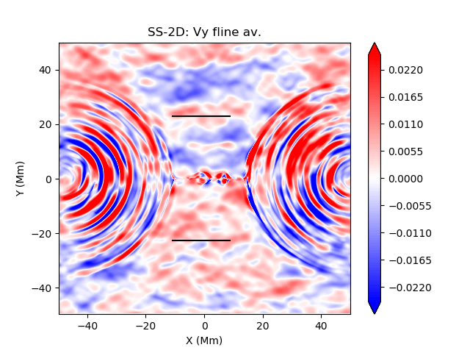
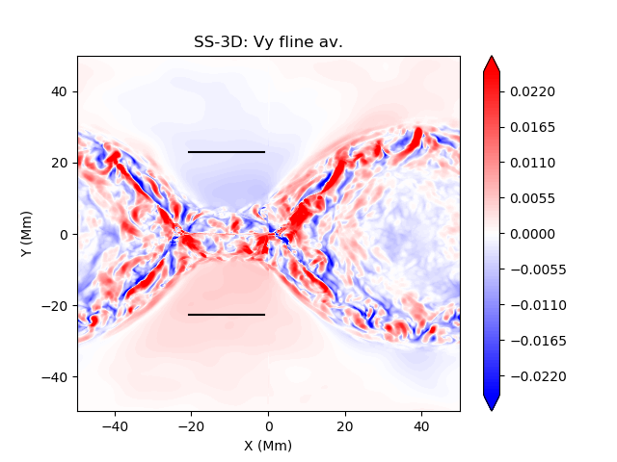
Why 3D? Ctnd.
Entangling of fieldlines created by interacting oblique modes (Klimchuk ???)
Reduces inflow into current sheet
2D
3D

Slide 16
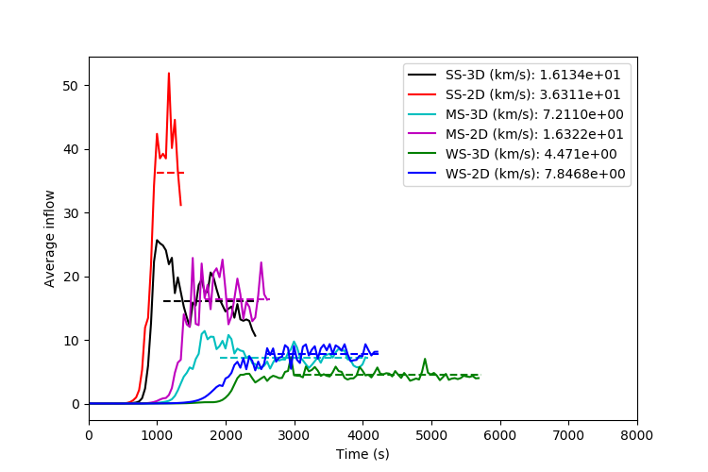
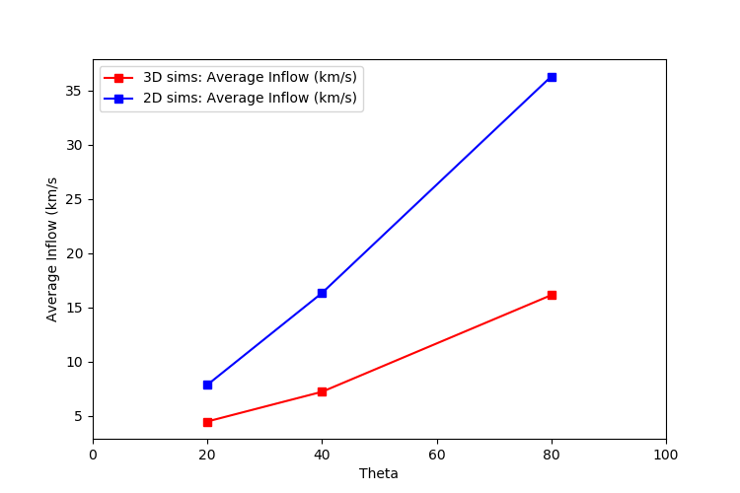
Why 3D? Ctnd.
Two effects on global inflow into recon. region
Local Alfven speed
Increased inflow with increased shear (reconnecting) field
operates in 2D and 3D
Entangling of inflow region by turbulence created by interacting oblique modes
Decreased inflow with increased shear field
Operates in 3D only
2D – efficient plasmoid reconnection
Stronger gradient in inflow vs shear field
3D – plasmoid reconnection disrupted
Weaker gradient in inflow vs shear field
Due to negative effect of entanglement on inflow
Calculate Normalized reconnection rate
Normalized inflow V_{in}/V_{A}
Rate of change of normalized reconnected flux (dɸ/dt)
Rate of change of normalized internal energy (heating)

Slide 17
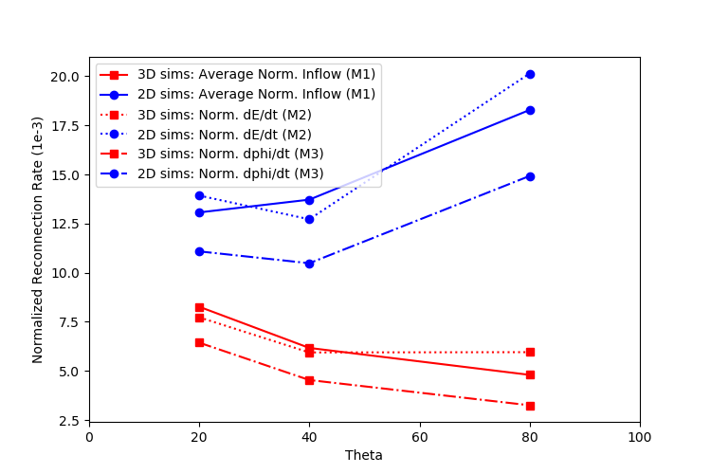
Why 3D? Ctnd.
Normalized reconnection rate, using
global normalized inflow
rate of change of internal energy (dE/dt)
Rate of change of reconnected magnetic flux (dphi/dt)
Compare 2D and 3D
Normalization removes some of effect of the Alfven speed
Reveals the negative effect of entanglement – increases with shear
Decreasing reconnection rate with increasing shear (reconnecting field)
At low shear (relatively strong guide field), system tends to 2D result

Slide 18
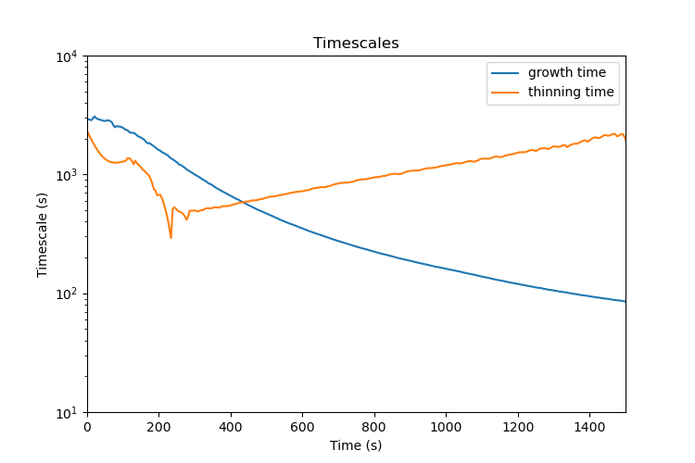
Back to Dynamically Evolving Coronal Sheets
3D modified force-free Harris Current Sheet with a guide field in low beta plasma
Initial width 5 Mm
Lundquist number S_{L} = 2.3e6
Sweet-Parker scaling for L=100 Mm is 65 km
Ideal Tearing scaling for L=100 Mm is 760 km
Guide field: Bz0 = 10.6 G
Shear (reconnecting) field: Bx0 = 7.0 G
Triply periodic – allows robust testing of simulations
Apply heating near +/- Ly/2 and decrease magnetic field – results in pressure increase and forces thinning
Initial width such that tearing instability is slow: t_{growth} > t_{thin}
System transitions to regime where t_{growth} < t_{thin}
Real corona has much higher S_{L}, but relative timescales and dominant tearing mode numbers (see later) are applicable
t_{growth} > t_{thin}
t_{growth} < t_{thin}

Slide 19
Overall Evolution
Reconnected
field
Current
Density
t_{growth} < t_{thin} at about t=500
About 5t_{growth} later the current sheet disrupts (t=1500s)
At end of linear phase (t=1000)
Multiple parallel modes (1,0)-(4,0) dominate
Non-negligible oblique modes also present
As in static case - modes coalescence into a single large flux rope and a secondary current sheet
What happens in this secondary current sheet?
t_{growth} > t_{thin}
t_{growth} < t_{thin}

Slide 20
Overall Evolution
Secondary current sheet breaks up as it is unstable to faster tearing (a new smaller width)
What ultimately determines the critical switch-on of fast reconnection
When t_growth < t_dynamic?
When width reaches ideal tearing scale?

Slide 21
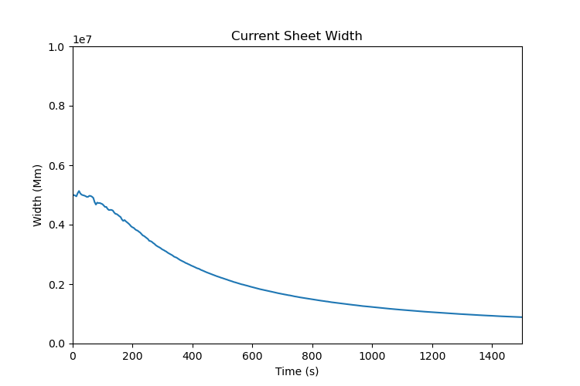
”Switch-on” of current sheet break-up
t_{growth} > t_{thin}
t_{growth} < t_{thin}
Major disruption occurs at t=1500 s
Well after growth time of tearing instability becomes less than dynamic timescale
When width ~ ideal tearing width $\frac{δ}{L}\sim {SL}^{−\frac{1}{3}}$based on initial Lundquist number (~700 km)
Not sure if these two criteria aren’t operating in tandem – parameter study over thinning timescale
Need to look at the period from onset of linear phase (200-400 s) to the break-up (1500 s)

Slide 22
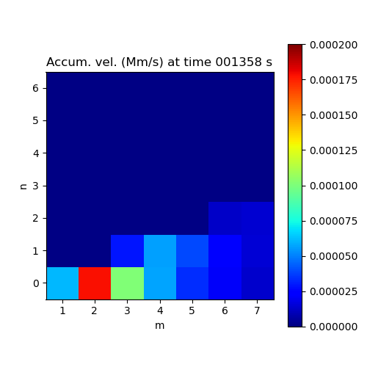
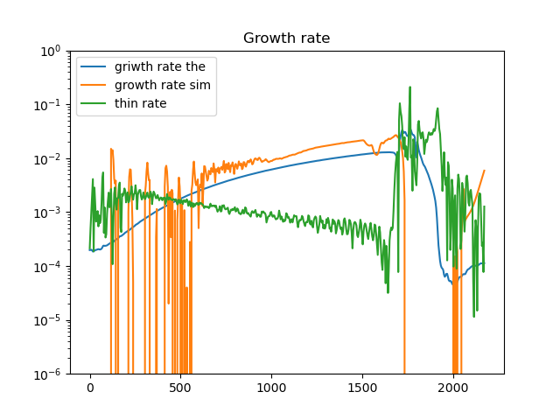
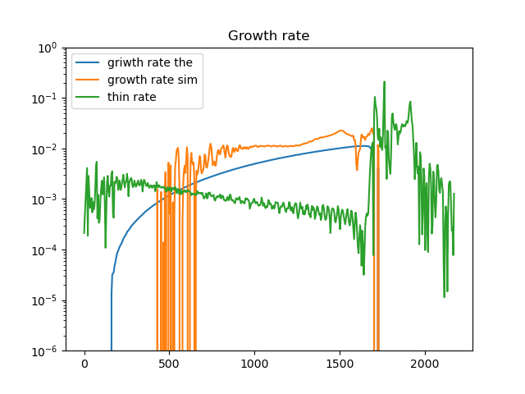
Linear growth in Thinning Sheets
Assume that the theoretical linear growth rate can be calculated instantaneously based on current B(t), width(t), Va(t)
Compare accumulated velocities in each mode based on this theoretical calculation and simulation data
Modes in simulation appear to be growing faster in simulation than this theoretical calculation!
(2,0)
(4,1)

Slide 23
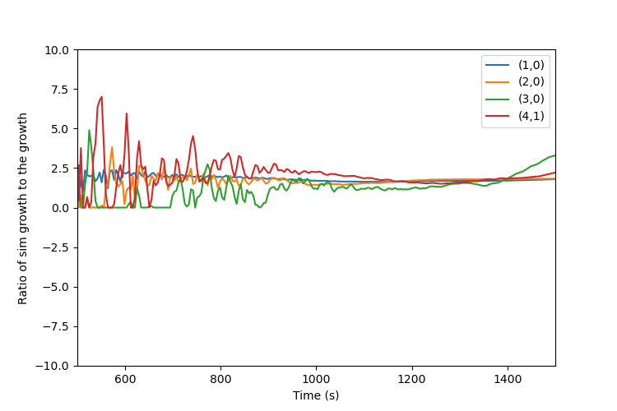
Dynamically Evolving Coronal Sheets
For most of dominant modes see larger growth rate in sim vs linear theory
Ratio of sim growth rate vs theory growth rate

Slide 24
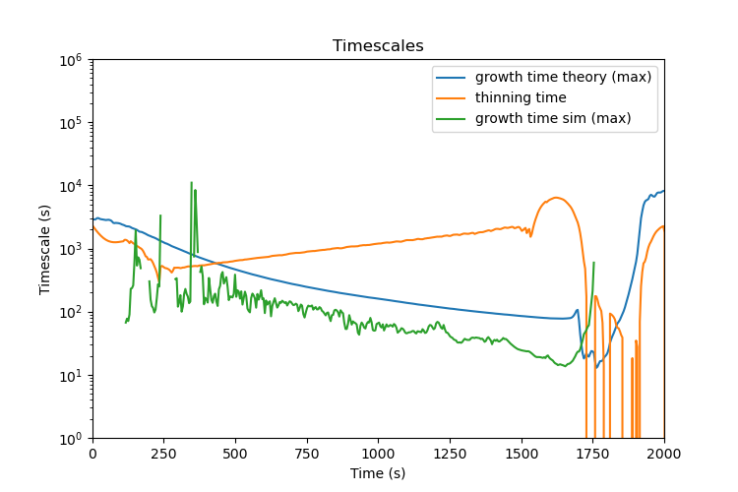
Dynamically Evolving Coronal Sheets
Tollman (2018) derives theoretical growth rates in a current sheet driven by an inflow – introduce time dependence into MHD equilibrium in calculation
The assumption that the theoretical linear growth rate can be calculated instantaneously based on current B(t), width(t), Va(t) is only valid when
t_{growth} << t_{thinning} or ɣ_{growth} >> ɣ_{thinning}
For majority of linear phase, 10t_{growth} ~ t_{thinning}
Cannot separate out time dependency in linear analysisIn
Positive effect on the theoretical growth
Should explain why our sims have higher growth rate
Need to design a thinning experiment where we don’t spend so much time in this intermediate regime

Slide 25
Conclusions
We can complicate the neat, tidy 2.5D picture of S-P, plasmoids, and Hall (kinetic) effects with
3D effects – oblique modes
Dynamic forcing (thinning)
3D – oblique modes interact non-linearly (turbulence?) to entangle inflow
Complicates the efficient plasmoid evolution – slows reconnection
Note different paradigm of well known “turbulence enhances S-P” studies (Uzdensky et al.)
Thinning - what determines when the system “switches-on” reconnection?
When the width is comparable to the “ideal tearing” scaling?
After the growth timescale is less than the dynamic timescale?
Can’t apply time-dependent linear theory to verify simulation data
When t_{growth} ~ t_{thinning} temporal region and linear phase coincide it gets complicated
Need parameter study varying thinning timescale and growth rates as well as shear
Other dynamic forcing to consider – lengthening, shearing
Reduce simplicity of boundary conditions (triply periodic) – finite length

