Slide 1

The Onset of Magnetic Reconnection in Dynamically Evolving Current
Sheets in the Solar Corona
James Leake [1]
Lars Daldorff [2]
James Klimchuk [1]
1. NASA Goddard Space Flight Center
2. Catholic University of America
JL was funded by:
NASA Heliophysics Innovation Fund
NASA Living With a Star
NASA Internal Scientist Funding Model
Adapted from Magnetic Reconnection Workshop, Japan, June 2023
Intro slides added

Slide 2
Motivation
Coronal reconnection often invoked as the energy release responsible for heating of corona, as well as driver/trigger of explosive energy release
Not continuous but sporadic - requires switch-on parameter
  Driven at large (Mm) & slow (min-hrs) scales but reconnect fast (s) at small scales (m-km)
  Need to build up magnetic energy before reconnection onset to power heating and explosive phenomena
Detailed understanding of magnetic reconnection involve kinetic physics, and the corona is collision-less (low resistivity, highly conductive)
Assume onset of reconnection (energy release) is at fluid scales
  Look for paramaters that could be `switch-on’

Slide 3
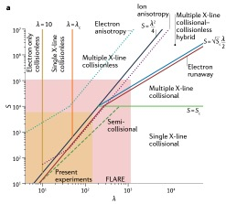
Context (Ji et al. review 2022)
Corona
Lundquist number
L.Va/D
Normzliaed System size

Slide 4
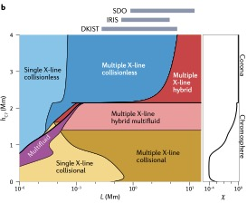
Context (Ji et al. review 2022)
SOLAR ATMOSPHERE

Slide 5
Reconnection in Fluid Regime

Slide 6
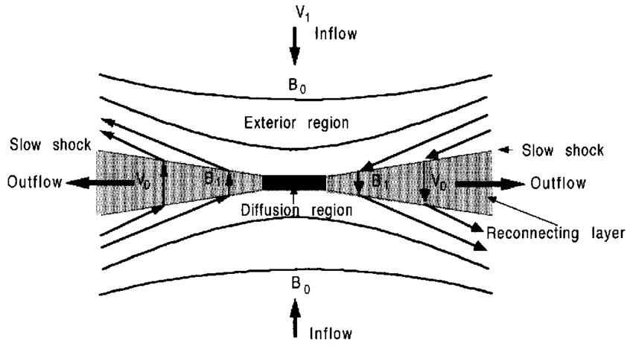
Reconnection in Fluid Regime
What about Petchek model?
Is a a solution to MHD equations
Requires spontaneous setup of flows without external forcing
Anomalous and localized resistivity
Requires Hall terms (decoupling of electrons and ions to lead to faster reconnection

Slide 7
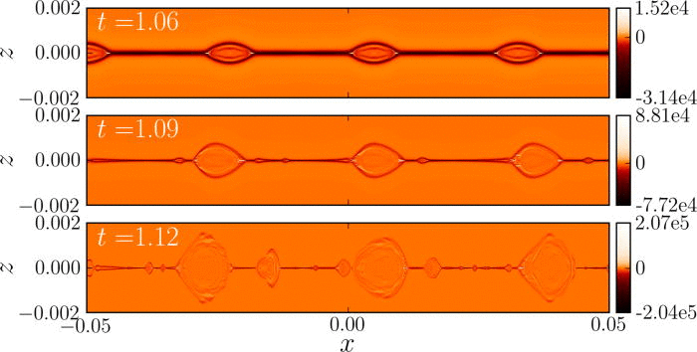
Reconnection in Fluid Regime – plasmoids?
Loureiro et al. (2007), Takima and Shibata (1997)
Once aspect ratio of a current sheet is large enough (once S is large enough)
  System breaks up into multiple X-lines – plasmoids
τV_{a}~S^{1/4}
kL ~ S^{3/8}
Pucci and Velli (2014)- this scaling is just the linear tearing instability of a current sheet applied to a current sheet undergoing S-P reconnection
Infinite growth rate for infinite S
Imagine have fat sheet thinning in time
Argue that S-P scaling a/L ~ S^{-1/2} sheets will never form as the tearing instability will be fast enough to disrupt the CS before you reach those thicknesses
a/L ~ S^{-1/3}
Huang et al. (2013)
Reconnection onset (breakup via tearing instability) occurs at scales larger than S-P scaling and hence larger than kinetic scales

Slide 8
Potential ‘onset’ criteria?
NB: Achieving fast reconnection is mostly solved by looking at kinetic physics at small scales
However, onset in corona appears to be at fluid scales
Q: What is switch-on parameter of coronal CSs?
Shear – Dalburg and Klimchuk
Thickness – Pucci and Velli (2014)
Onset of turbulence? Vishniac/Lazarian paper show that turbulence speeds up S-P reconnection
Idealized static simulations (Leake at al. 2020): magnetic shear could be a `switch-on’ in `short-sheet’ regime (described later)
Goal 1: Investigate the onset of reconnection in dynamically thinning sheets
Goal 2: Investigate whether magnetic shear result of Leake et al. 2020 translates to dynamically thinning sheets
High shear
Med shear
Low shear

Slide 9
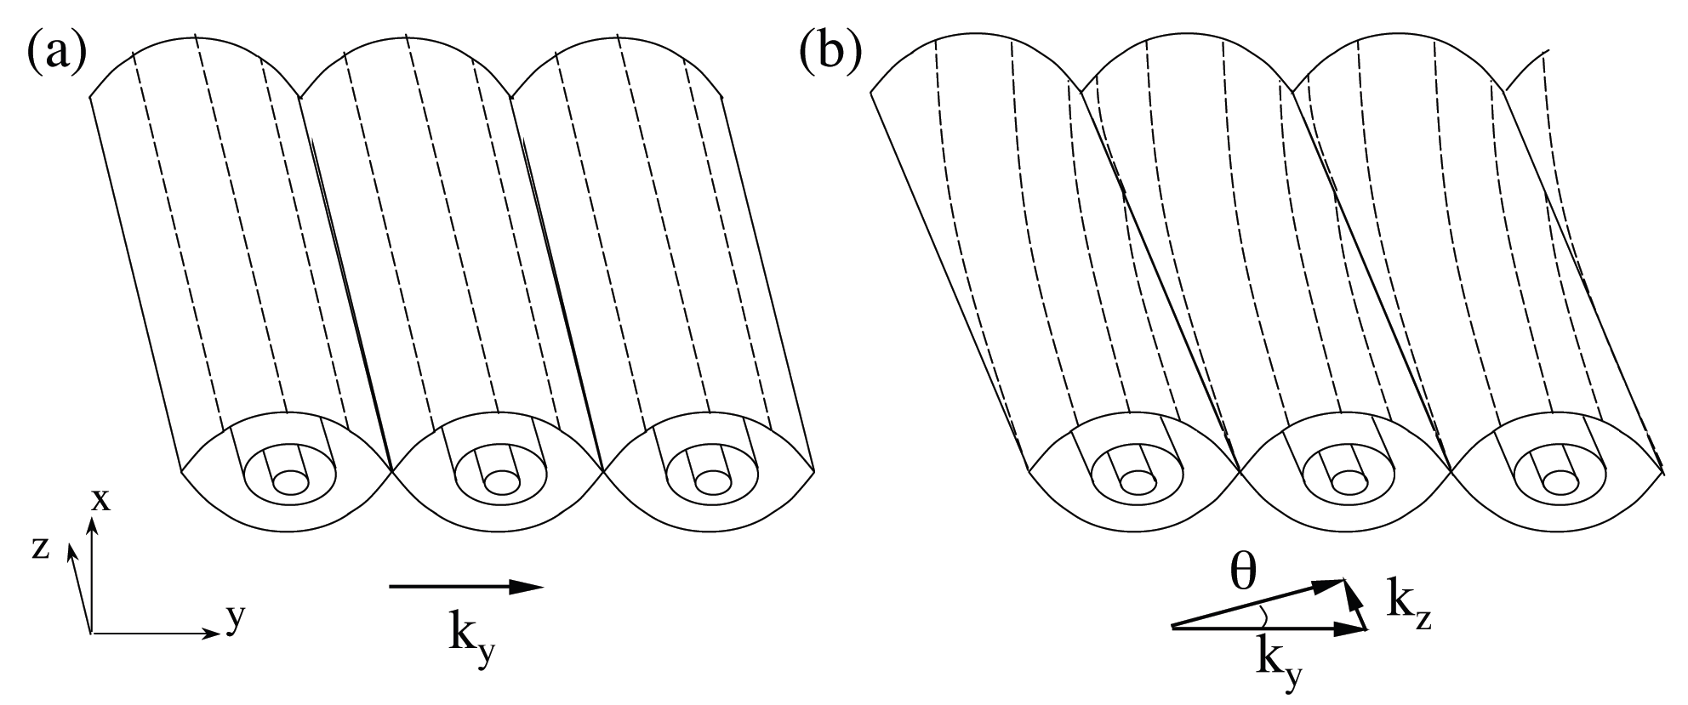
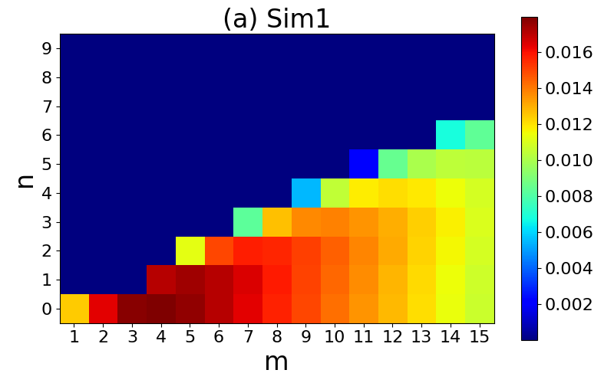
A Simple Static Study of Magnetic Shear
Is shear a ‘switch-on’ parameter? Leake et al. (2020)
Visco-res. MHD simulations - Lare3D (Arber 2001)
Modified force-free CS In a coronal plasma
Modified to -> 0 at +/- Ly/2 to allow for triply-periodic BCs
Lx=50 Mm a = 0.5 Mm - Lundquist number (S_{a}) 10⁵
See later for discussion of realistic solar values
Follow linear and non-linear stages of 3D Tearing
  parallel (n=0) and oblique (n>0) modes
Strong guide field B_{z,0} = 10 G, shear field B_{x,0} =2->7 G
Also vary length Lx: 20 Mm-> 100 Mm
Dependence on energy release during non-linear phase depends on both shear and length of the sheet
y
x
Baalrud (2016)
n
x
m
m
Leake et al. (2020)

Slide 10
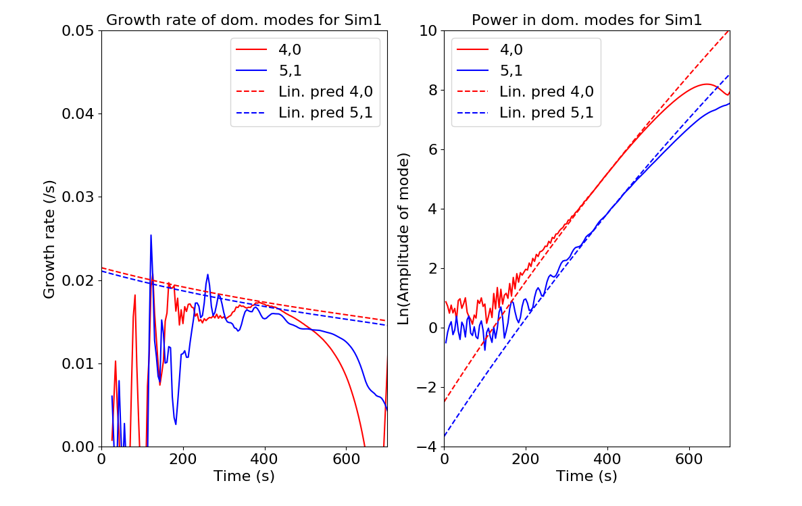
A Simple Static Study of Magnetic Shear
Is shear a ‘switch-on’ parameter? Leake et al. (2020)
Visco-res. MHD simulations - Lare3D (Arber 2001)
Modified force-free CS In a coronal plasma
Modified to -> 0 at +/- Ly/2 to allow for triply-periodic BCs
Lx=50 Mm a = 0.5 Mm - Lundquist number (S_{a}) 10⁶
See later for discussion of realistic solar values
Follow linear and non-linear stages of 3D Tearing
  parallel (n=0) and oblique (n>0) modes
Strong guide field B_{z,0} = 10 G, shear field B_{x,0} =2->7 G
Also vary length Lx: 20 Mm-> 100 Mm
Dependence on energy release during non-linear phase depends on both shear and length of the sheet
Good match between sims and linear theory

Slide 11
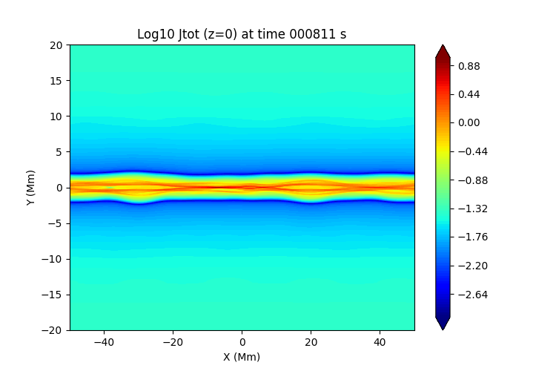
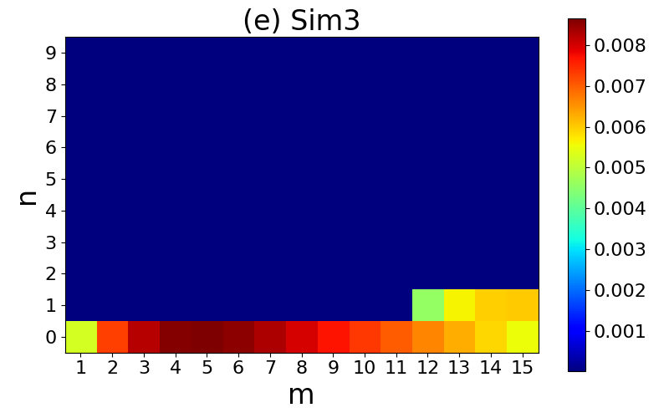
‘Long-Sheet’ Simulations: Dominant mode ƛ < L_{x}
High shear
Low shear
Higher m (4,0) mode dominates linear phase
Coalescence of flux tubes of (dominates energy release
Only difference between high and low shear is presence of oblique modes

Slide 12
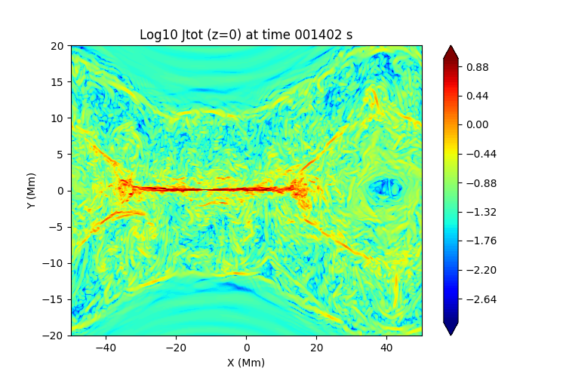
‘Long-Sheet’ Simulations: Dominant mode ƛ < L_{x}
High shear
Low shear
Higher m (4,0) mode dominates linear phase
Coalescence of flux tubes of (dominates energy release
Only difference between high and low shear is presence of oblique modes

Slide 13
‘Long-Sheet’ Simulations: Dominant mode ƛ < L_{x}
High shear
High shear
Med shear
Low shear
Low shear
Long sheet regime
Energy release dominate by coalescence of higher m parallel modes
Weak dependence on shear - no ‘switch-on’

Slide 14
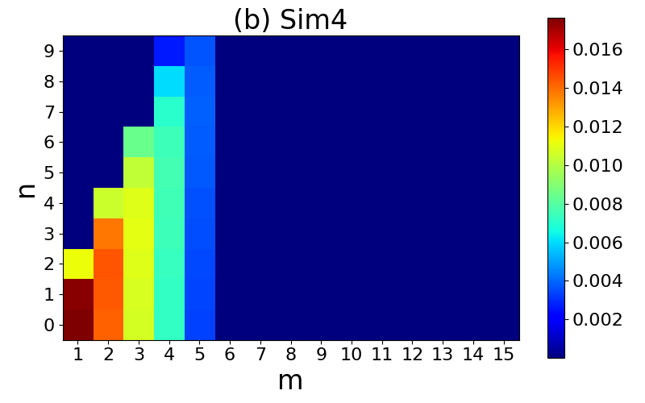
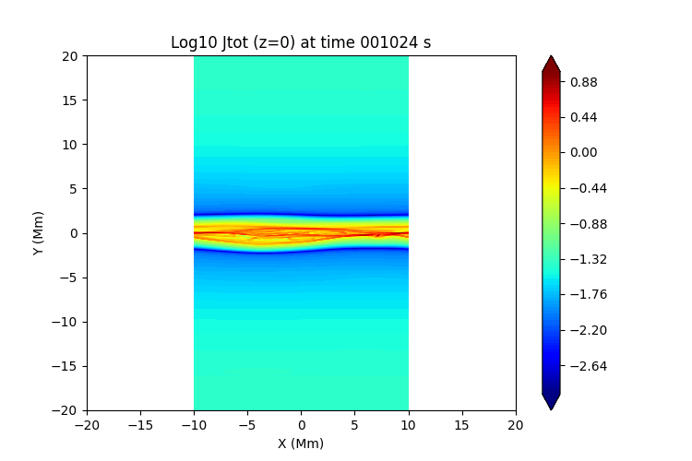
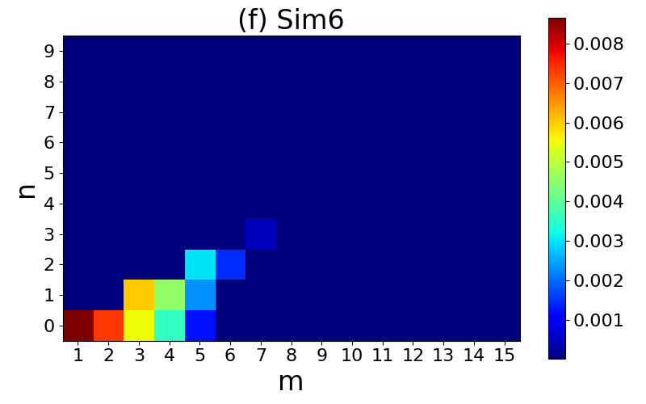
Short-Sheet Simulations: Dominant modes ƛ > L_{x}
High shear
High shear
Low shear
(1,0) and (1,1) dominate – no coalescence
interaction of parallel and oblique provides ‘turbulent’ energy release

Slide 15
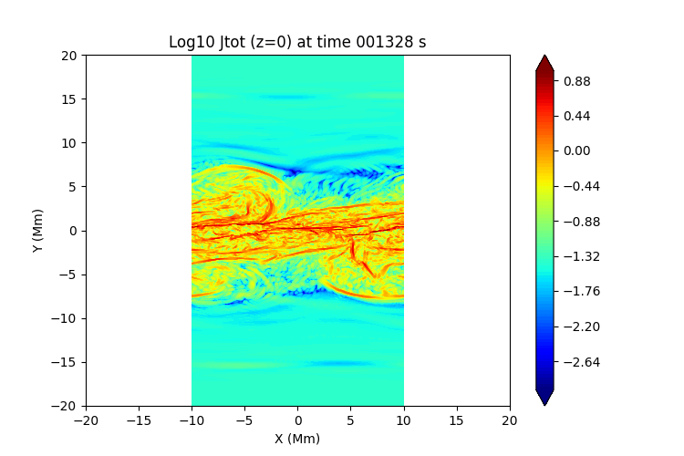
Short-Sheet Simulations: Dominant modes ƛ > L_{x}
High shear
High shear
Low shear
(1,0) and (1,1) dominate – no coalescence
interaction of parallel and oblique provides ‘turbulent’ energy release

Slide 16
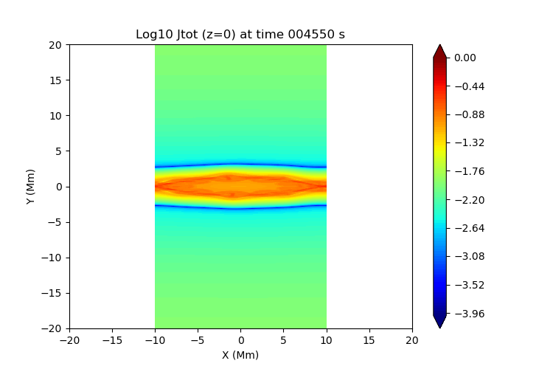
Short-Sheet Simulations: Dominant modes ƛ > L_{x}
Low shear
High shear
Low shear
(1,0) dominates – no coalescence
No oblique modes to interact with – low energy release

Slide 17
Short-Sheet Simulations: Dominant modes ƛ > L_{x}
High shear
High shear
Med shear
Low shear
Low shear
Short sheet regime
No coalescence of parallel modes
Only high shear has strong oblique modes which create ‘turbulent’ behavior
Strong dependence on shear - possible ‘switch-on’?
Does this translate to dynamically evolving sheets?

Slide 18
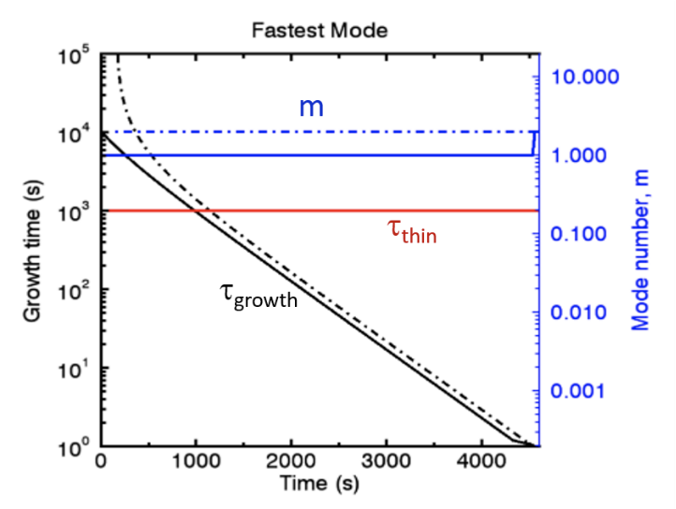
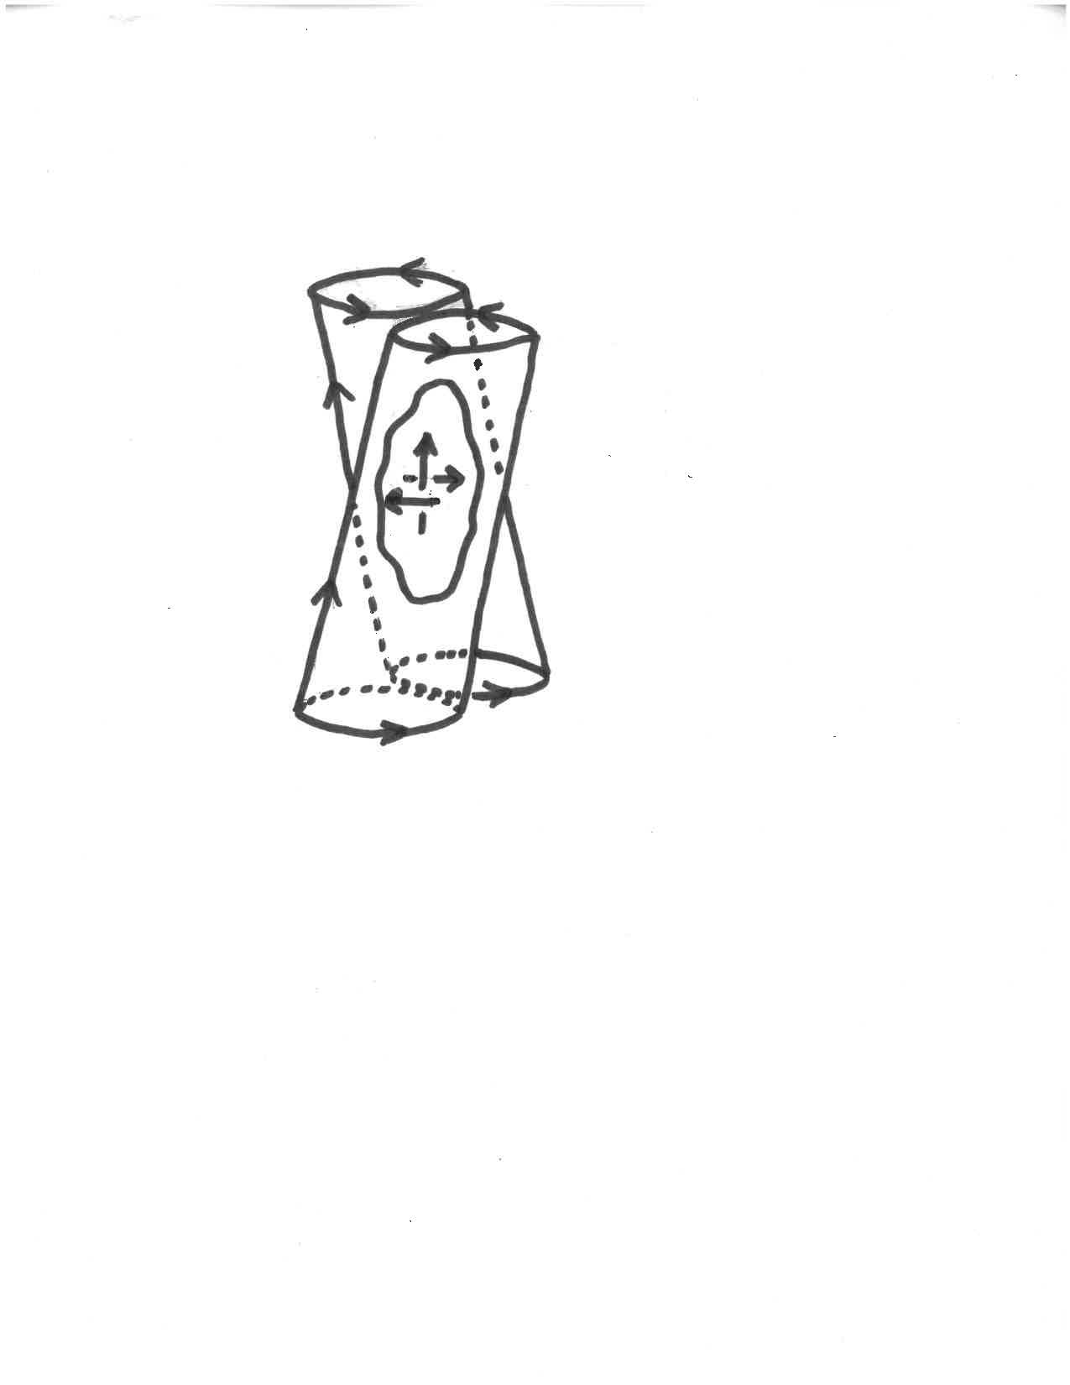
Dynamic Evolution of Coronal Current-Sheets
Pucci and Velli (2014+) – tearing instability is ideal (‘fast’) at a = Sa^{(-1/3)}L >> S-P scale
Look at dynamic thinning of current sheet
  τ_{growth} decreases as sheet thins
Predict : system disrupts after τ_{growth ~} τ_{thin}
What about real solar values?
  When τ_{growth} ~ 0.1τ_{thin} a = 2km
  S_{a} = 2e9 -> ideal tearing occurs at 80m
  ƛ_{max} = 2πaD^{(1/4)} ~ 3 Mm ~ 30L – m_{max} = 1
Realistic thinning coronal current sheets will be unstable in the ‘short-sheet’ regime and at thicknesses much larger than S-P
Does this play out in our non-linear simulations?
If we are in short-sheet regime is shear still a possible switch-on parameter?
Coronal Heating
L_{sheet} ~ d ~ 100 km
Thickness ~ 10 km

Slide 19
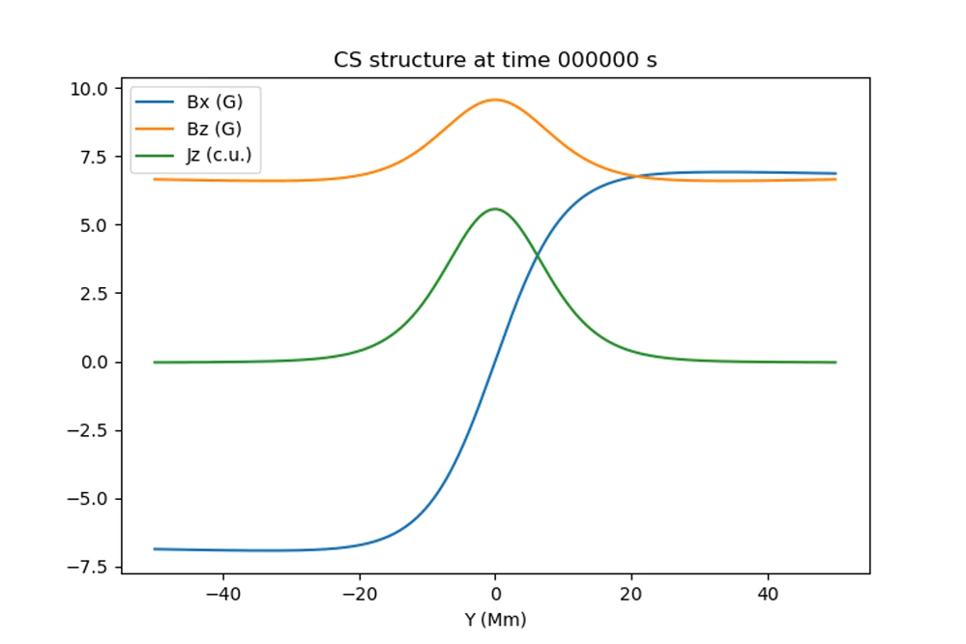
MHD Sims of Dynamic Evolution of Current-Sheets
Same current sheet as in static study but much fatter
At +/-L_{y}/2 heat plasma to increase gas pressure to drive slow inflow - Sheet thins ~ self-similarly
Tolman (2018) –phases of relative timecales
  Phase 1: τ_{growth} >> τ_{thin} ideal evolution
  Phase 2: τ_{growth} ~ τ_{thin} confluence of timescales
  Phase 3: τ_{growth} << τ_{thin} behaves like static sheet
Good match of growth rates sim vs. theory
Current sheet breaks in phase 3
Current sheet is static and short-sheet – so do we see strong shear dependence as in static sims?
  High shear – interaction of (1,0) and (1,1) – large energy release
  Low shear – (1,0) saturates – little energy release

Slide 20
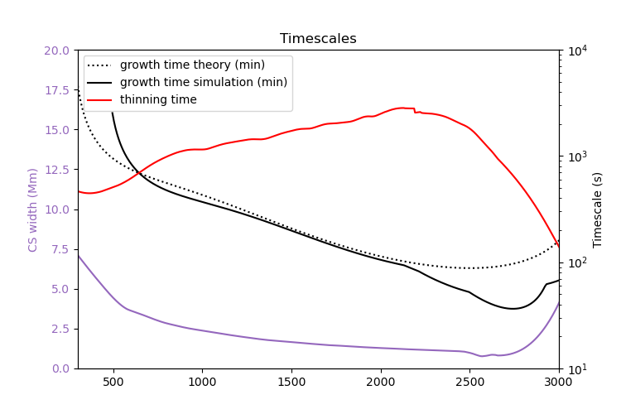
MHD Sims of Dynamic Evolution of Current-Sheets
Same current sheet as in static study but much fatter
At +/-L_{y}/2 heat plasma to increase gas pressure to drive slow inflow - Sheet thins ~ self-similarly
Tolman (2018) –phases of relative timecales
  Phase 1: τ_{growth} >> τ_{thin} ideal evolution
  Phase 2: τ_{growth} ~ τ_{thin} confluence of timescales
  Phase 3: τ_{growth} << τ_{thin} behaves like static sheet
Good match of growth rates sim vs. theory
Current sheet breaks in phase 3
Current sheet is static and short-sheet – so do we see strong shear dependence as in static sims?
  High shear – interaction of (1,0) and (1,1) – large energy release
  Low shear – (1,0) saturates – little energy release
Non Linear
Phase 2
Phase 3

Slide 21
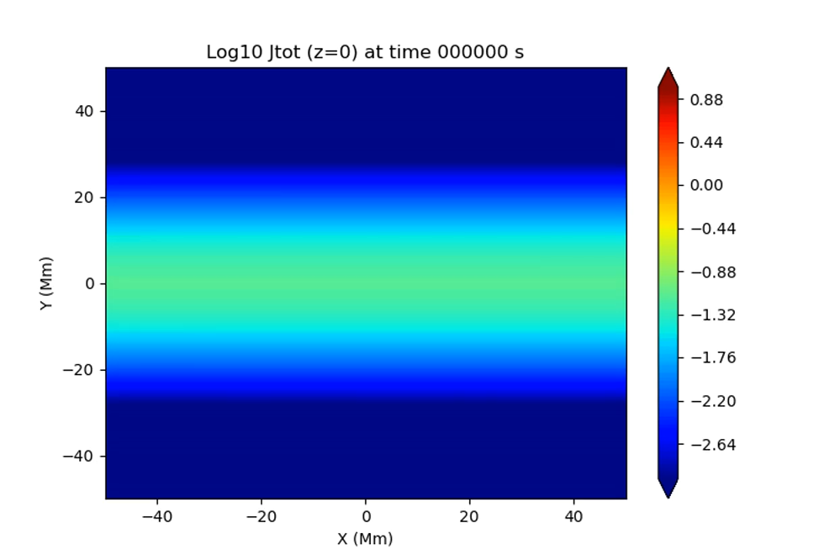
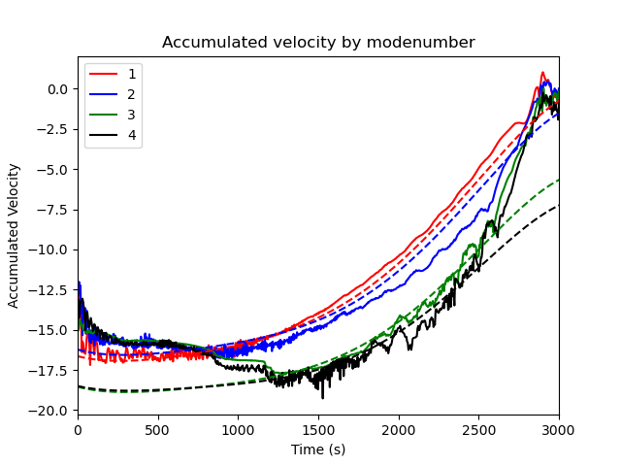
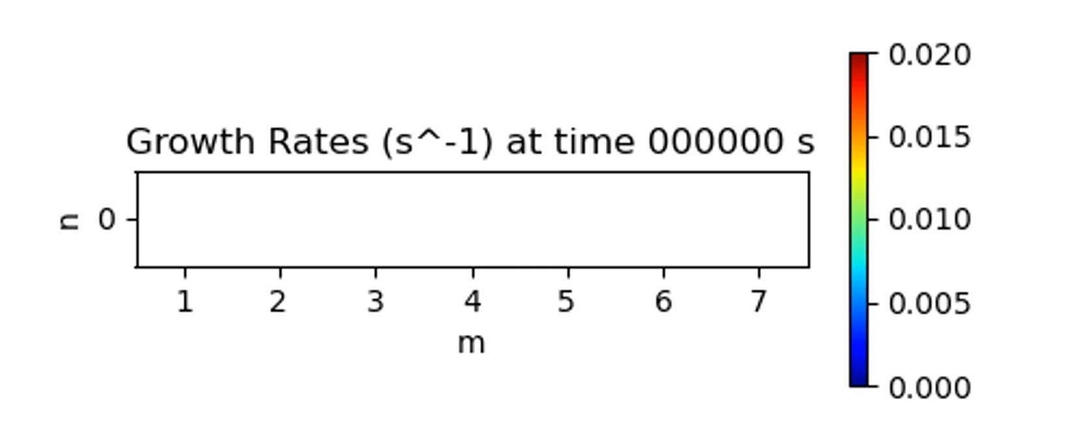
(2D) Dynamic Simulations of Reconnection Onset
Onset occurs when τ_{growth} < τ_{thin} in phase 3
Expected to behave like short-sheet (m=1)
  High shear – (1,0) and (1,1) interact
  Low – no oblique modes -little energy release
Both high and low shear behave like ‘long-sheet’
Coalescence dominates – no shear dependence
Energy injected into higher m modes in NL stage
High/Low shear
Non Linear
Phase 2
Phase 3

Slide 22
(2D) Dynamic Simulations of Reconnection Onset
Onset occurs when τ_{growth} < τ_{thin} in phase 3
Expected to behave like short-sheet (m=1)
  High shear – (1,0) and (1,1) interact
  Low – no oblique modes -little energy release
Both high and low shear behave like ‘long-sheet’
Energy injected into higher m modes in NL stage
Coalescence dominates – no shear dependence
High shear
(2,0) losing power
(3,0), (4,0) gaining power
Moves system to ‘LONG-SHEET’
Phase 2
Phase 3
Non Linear
Phase 2
Phase 3
Non Linear

Slide 23
Conclusions
Thinning current sheets break up after reaching thickness when τ_{growth} < τ_{thin}
For real solar values this is well above the ideal tearing thickness and hence above S-P scale
Thickness at reconnection onset depends on thing rate a= (τ_{thin})^{(2/3)}D^{(1/3)}Va^{(1/3)}
For these simulations - should be in ‘short-sheet’ regime where dominant mode has m=1
  Expect strong dependence on shear (switch-on?)
Unfortunately, this framework from static sims does not translate
Energy pumped into higher m modes during non-linear phase
System behaves more like ‘long-sheet’ – coalescence dominates energy release – weak dependence on shear
Robust result over multiple simulations
What next?
Shearing current sheets will also drive thinning – look at them together
Include investigation into the loss of equilibrium criterion from Klimchuk talk
Effect of line-tying (Daldorff talk next)

Slide 24
Conclusions
SPARE SLIDES

Slide 25
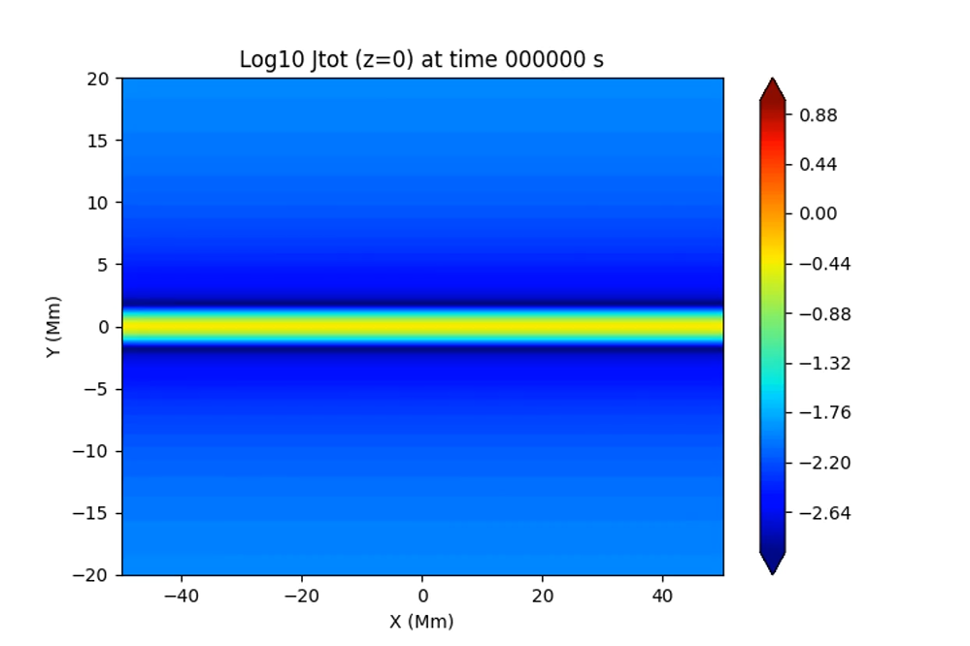
‘Long-Sheet’ Simulations: Dominant mode ƛ < L_{x}
High shear
Low shear
Low shear
(4,0) mode dominates linear phase
Coalescence of flux tubes dominates energy release

Slide 26
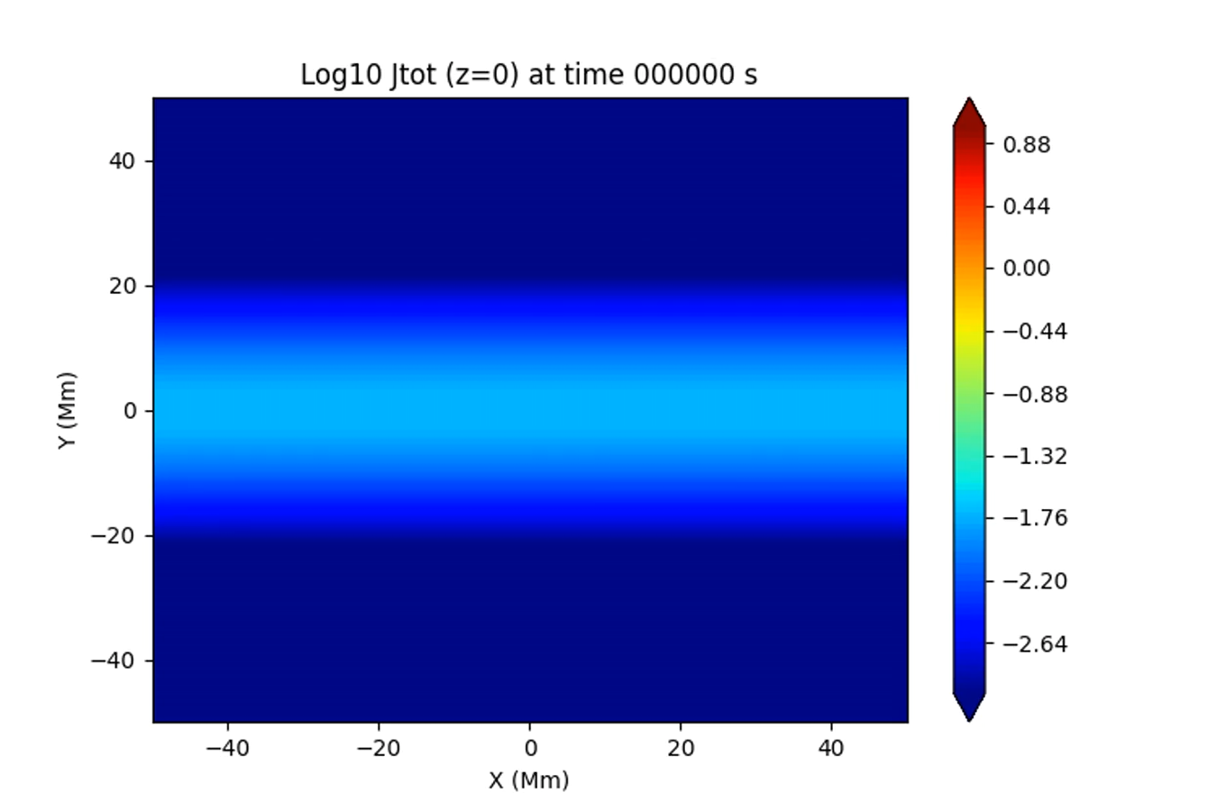
Dynamic Simulations of Reconnection Onset
Onset occurs when τ_{growth} < τ_{thin} in phase 3
Onset occurs in phase 3 ~ static
Expected to behave like short-sheet (m=1)
  High shear – (1,0) and (1,1) interact
  Low – no oblique modes -little energy release
Both high and low shear behave like ‘long-sheet’
Energy injected into higher m modes in NL stage
Coalescence dominates – no shear dependence
Low shear
Non Linear
Phase 2
Phase 3

Slide 27
(2D) Dynamic Simulations of Reconnection Onset
 | Sun
Length L | 0.1 Mm
Thinning timescale (s) tau_thin | 1000s
Diffusivity (m²/s) | 1
Alfven speed (m/s) | 1e6
Thickness a when τ_{g}=0.1τ_{thin} a= (0.1τ_{thin})^{(2/3)}D^{(1/3)}Va^{(1/3)} | 2 km >> ideal tearing a (below)
S_{a} = a.Va/D | 2e9
Ideal tearing a = S_{a}^{(-1/3)}L (m) | 80 m
ƛ_{max} = 2πaD^{(1/4)} | 3 Mm ~ 30 L ‘Short-sheet’

