Slide 1
Constraints on the Expansion of Active Region Loops Along the Line of Sight
or
Are Coronal Loops Really Cylindrical?
Terry Kucera
Code 671
T. Kucera, P. Young, J. Klimchuk & C. DeForest, ApJ 2019

Slide 2
Coronal loops give the impression of being cylindrical, but are they?

Slide 3
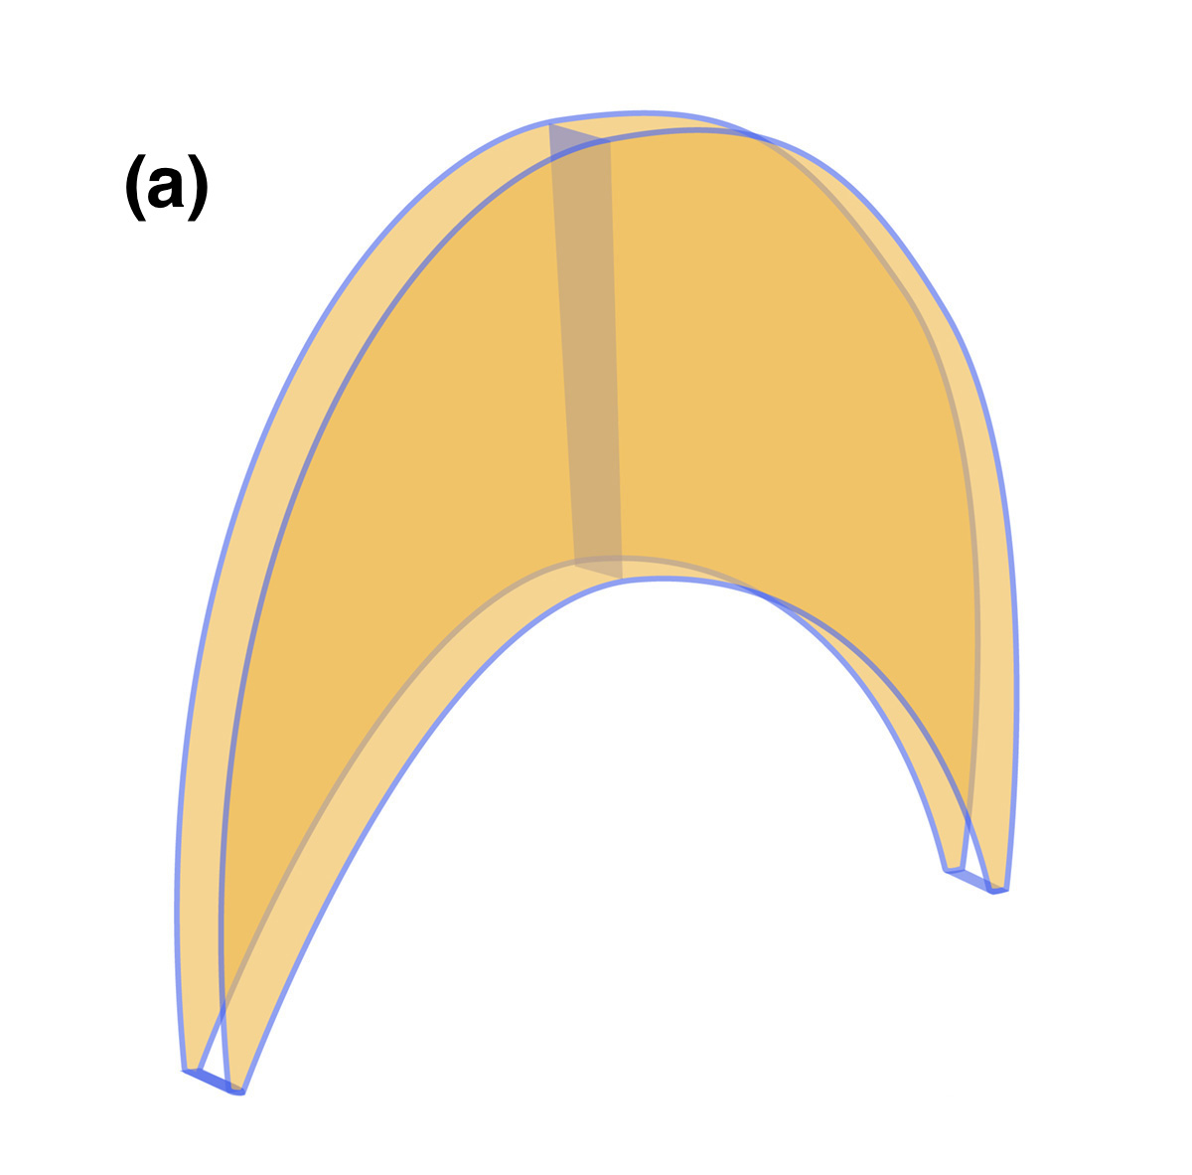
It might be hard to tell if loops had strongly asymmetric cross sections, because they could affect visibility of the loops
Apex
Point of view 1
Point of view 2
(perpendicular
point of view)
POV 2
POV 1
Footpoint
Point of view 1
(edge on)
With spectroscopy we should be able to constrain the expansion of the loops into the plan of the sky.
Notes:
Malanushenko & Schrijver 2013

Slide 4
Typical geometrical analysis, assumes that loop is cylindrical
I = A G(n_{e},T) ∫ n_{e}² dL
= A G(n_{e},T) n_{e}² D f
f = I/(A G(n_{e},T) n_{e}² D)
D
D – depth along
the line of sight
f – fraction of plasma emitting
Notes:
D – loop dimension along the line of sight
I – intensity of the loop
G – the contribution function
A – ion abundance
F – volume filling factor
Leaving out factors of 4/pi, angle considerations

Slide 5
Geometrical Analysis of a Non-Cylindrical Loop to get a limit on D
I = A G(n_{e},T) ∫ n_{e}² dL
= A G(n_{e},T) n_{e}² D f
D= I/(A G(n_{e},T) n_{e}² f )
D
Assume f = constant

Slide 6
We analyzed two loops observed by Hinode/EIS on
6-Feb-2011, AR11150
Fe VIII 186.6 Å Log T(MK) =5.7

Slide 7
Hinode/EIS observations allow us to determine intensity, temperature and electron density
Ion λ (Å) Log T (K)
O V 248.46 5.4
Mg V 276.58 5.5
Mg VI 269.00 5.7
Mg VII 278.40 5.8
Mg VII 280.74 5.8
Fe VIII 186.60 5.7
Fe X 184.54 6.0
Fe XI 188.22 6.1
Fe XII 195.12 6.2
Si VII 275.36 5.8
Si VII 278.45 5.8
Si VII 275.36 5.8
Si X 261.06 6.1
D= I/(A G(n_{e},T) n_{e}² f )
n_{e} Diagnostic
Peak Temperature Determination
For A and G(n_{e},T) we used the Chianti atomic database

Slide 8
We analyzed the loop at different locations
W
Notes:
Mg VII 630K
Fe XIII 500K

Slide 9
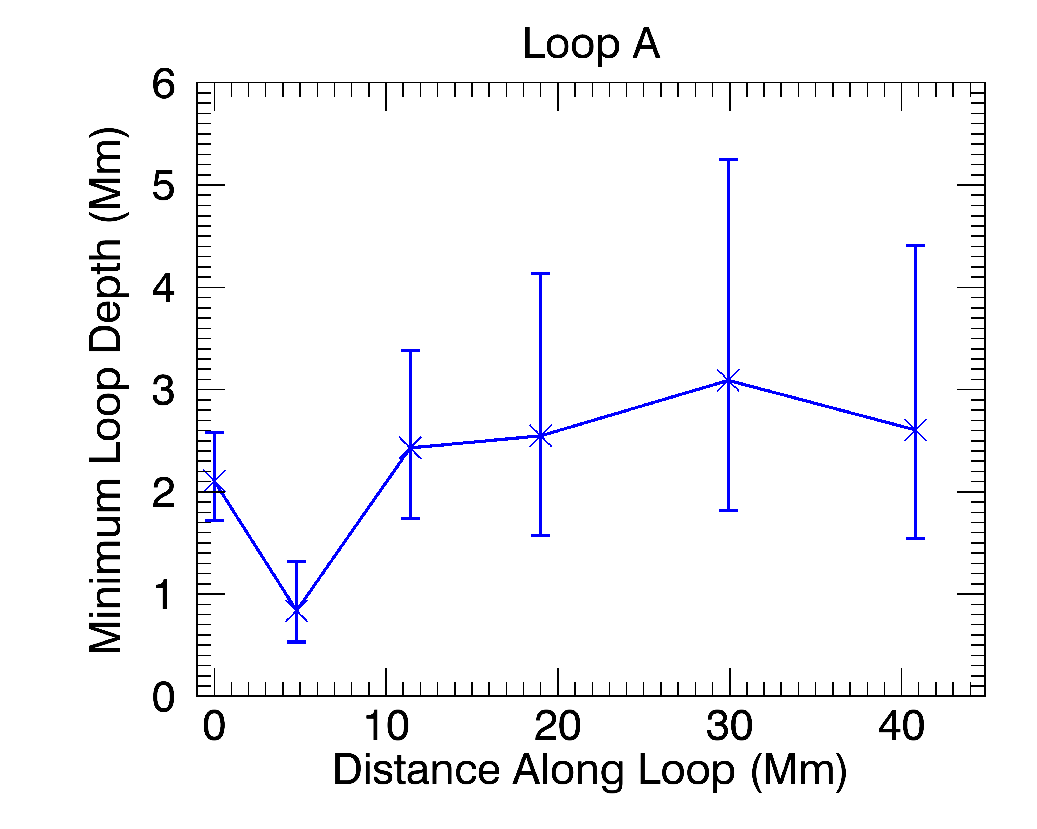
We can calculate the minimum dimension along the line of sight
D_{min} = D(f=1)
Notes:
Error bars from counting stats, fitting, est. uncertainties on atomic parameters

Slide 10
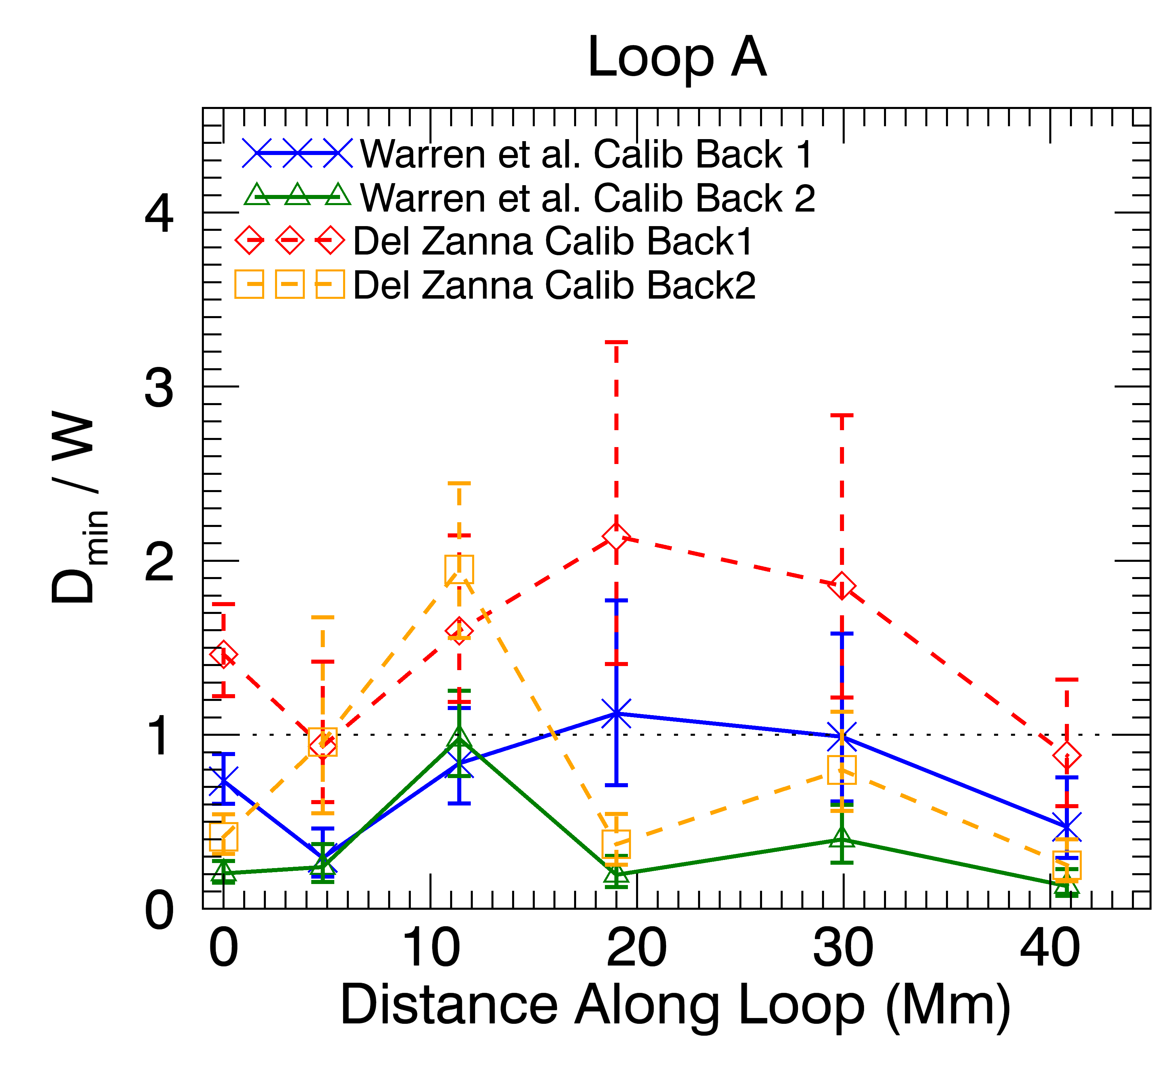
Minimum Aspect Ratio
D_{min} – Minimum loop width along
the line of sight (assuming f=1)
W – loop width in plane of the sky
D/W< 1
W
D
D/W = 1
D/W> 1

Slide 11
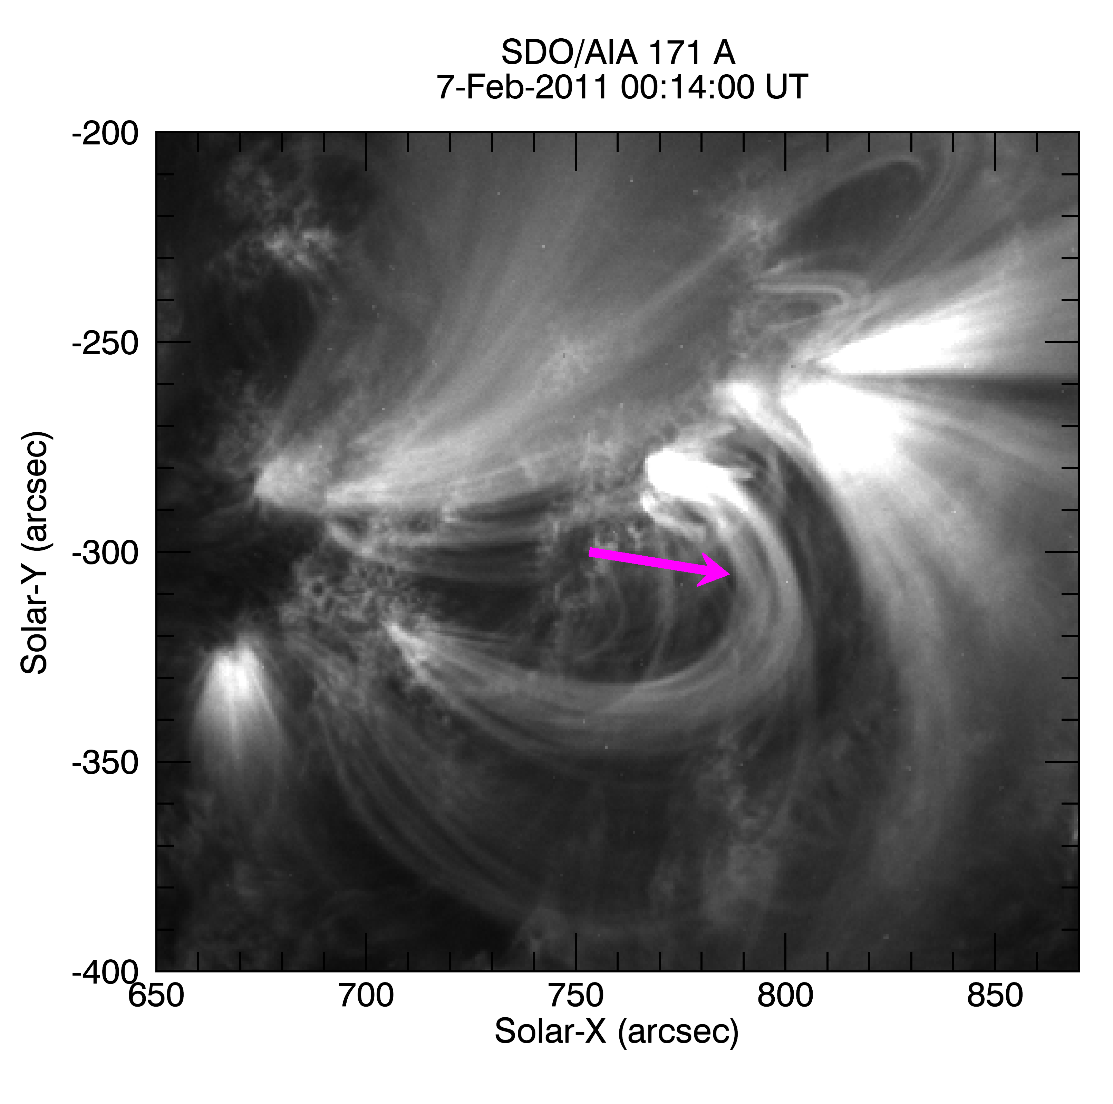
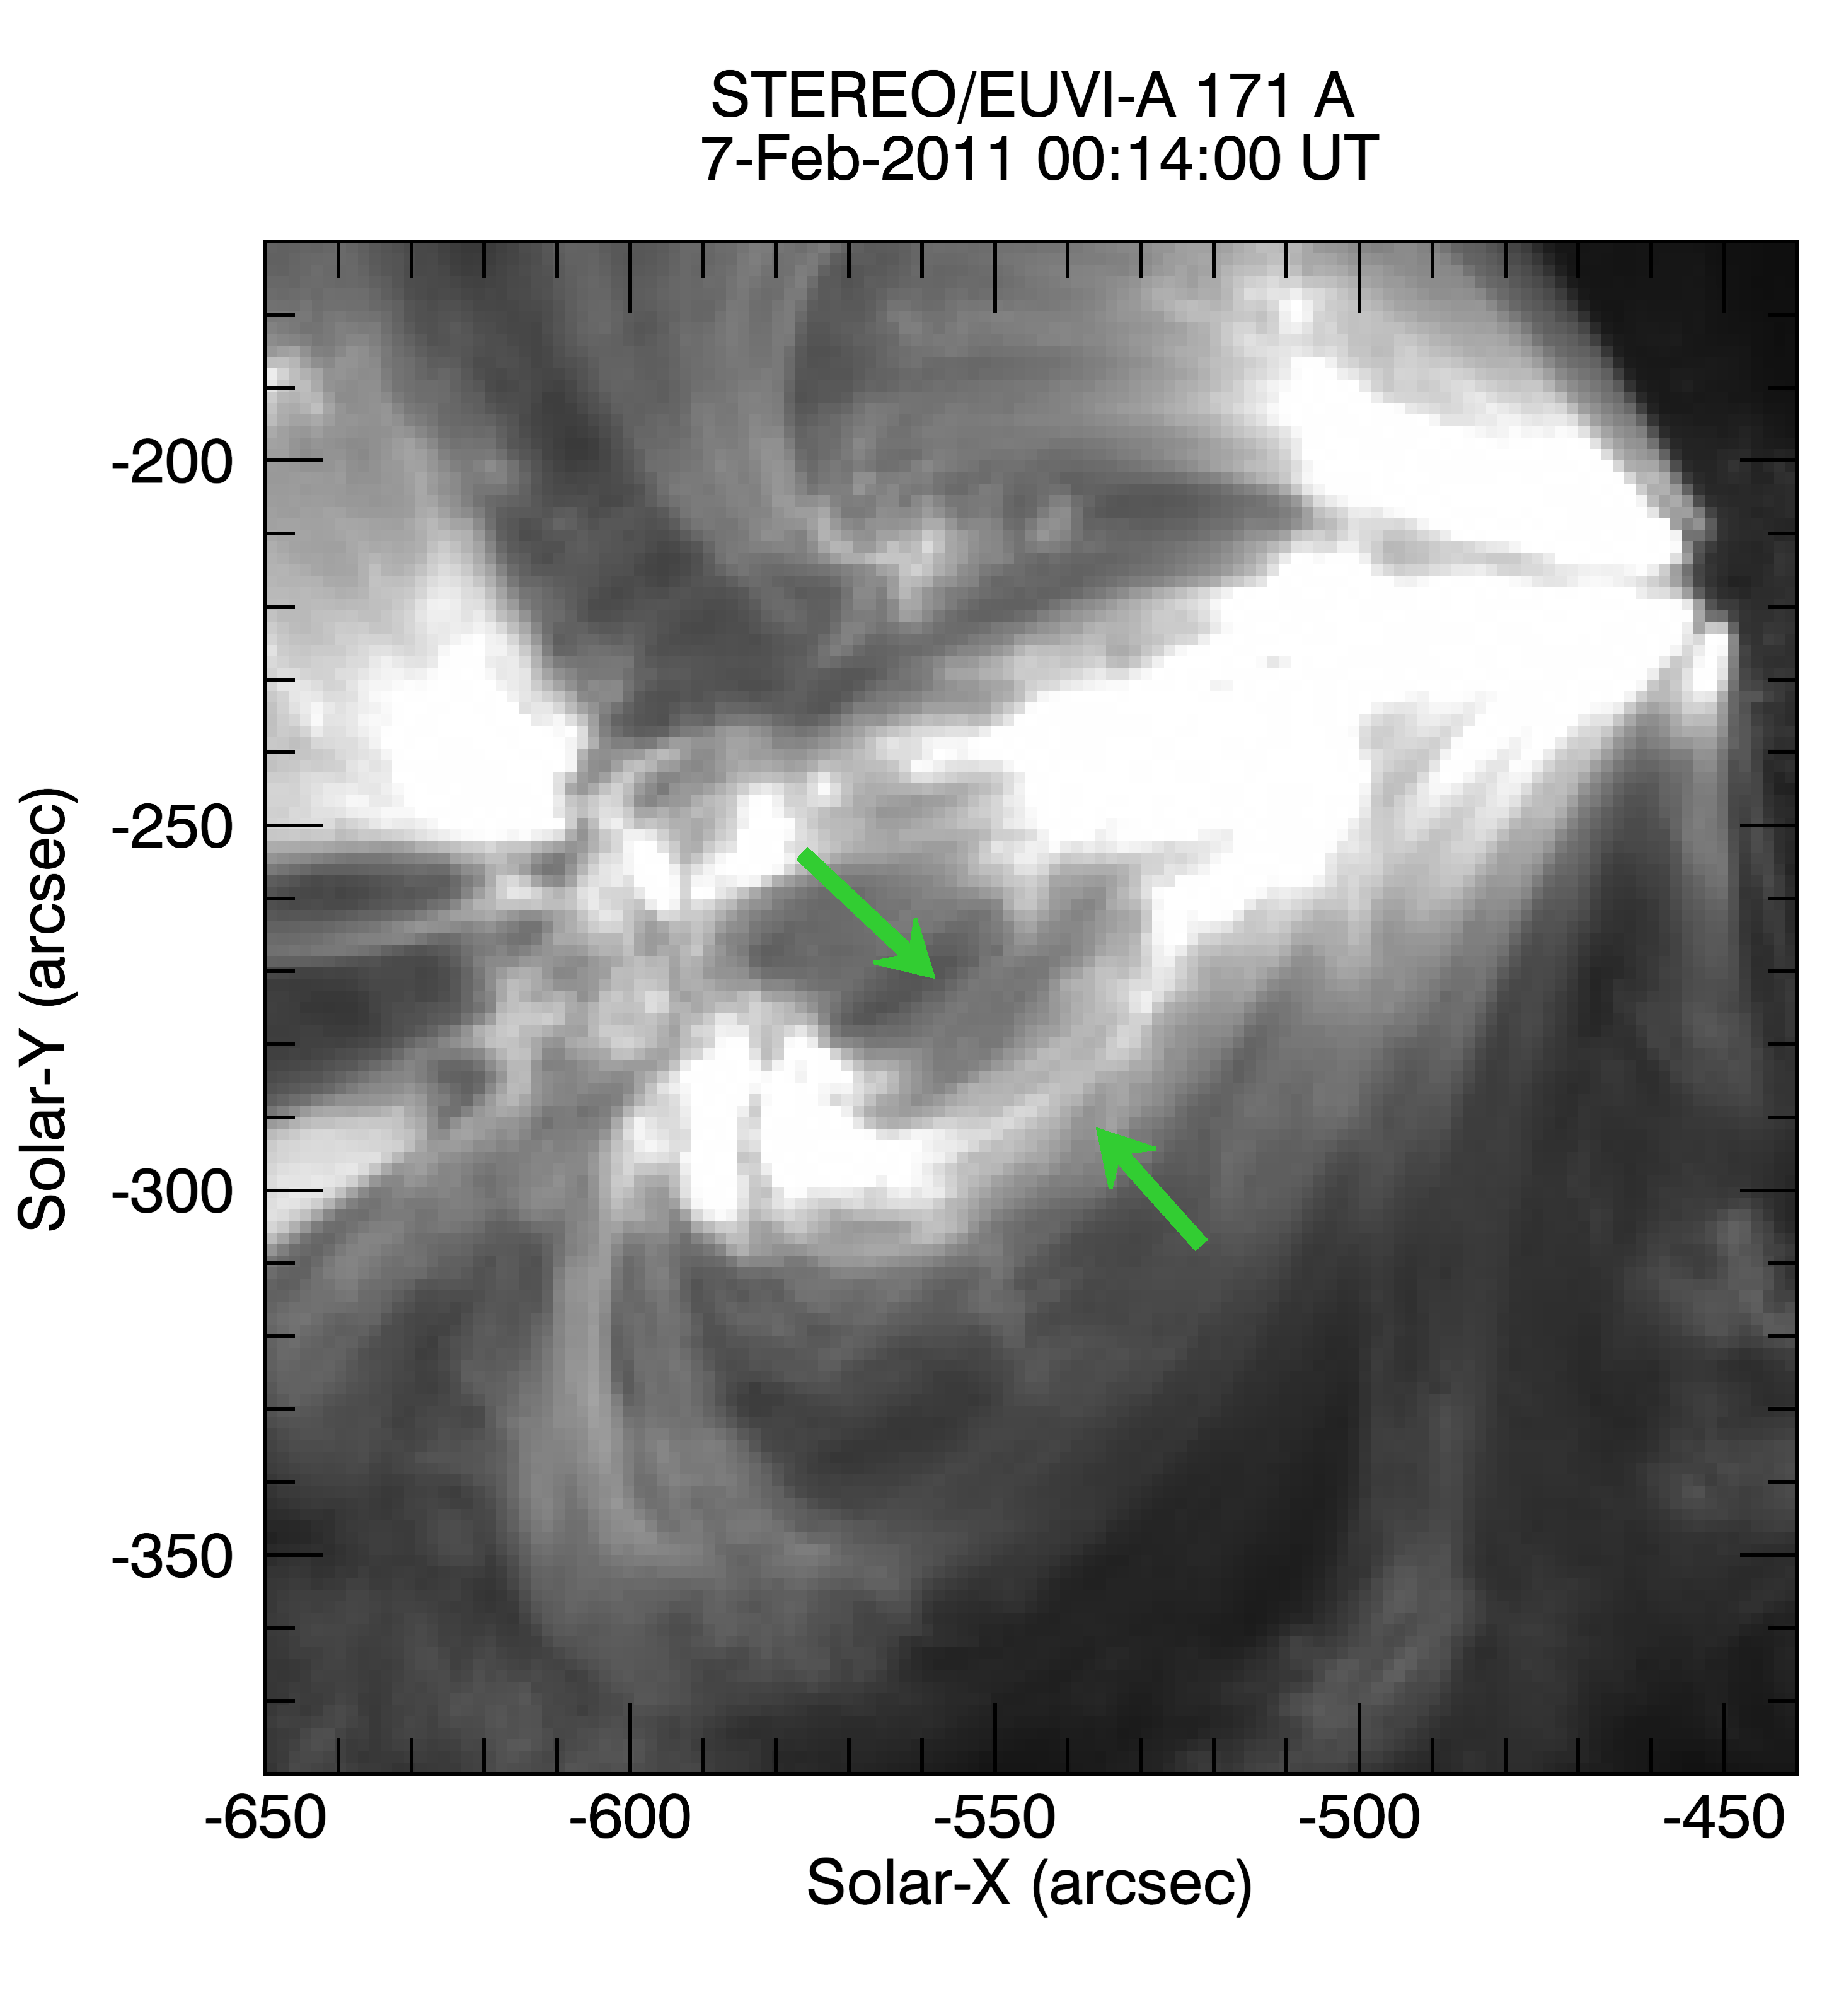
Loop width also constrained by STEREO data
Notes:
Loop could correspond to any of the loops between the green arrows. STEREO resolution is 2.2 Mm. For f=1 Dmin is below that.
Consistent by a result from West et al 2014, who found by comparing data from the two STEREO spacecraft that the loops can be considered circular in nature.
Their uncertainties were rather large too, though, because of the resolution.

Slide 12
Conclusions
The results are generally consistent with circular cross sections but also with aspect ratios as large as 2 or 3.
No clear evidence of systematic expansion.

Slide 13
How to improve the method
Higher signal to noise
Higher resolution
  Better to pick out small loop structures
  Better for background selection (although interpretation of structures is still an issue)
Better radiometric calibration
  More rocket underflights
  High quality reference spectra from laboratory sources
Better atomic data

