Slide 1
Prepping to Run GX Simulator: Progress Report
T. Kucera
March 6, 2024

Slide 2
AR 12866 and 12868, 8 Sept 2021

Slide 3
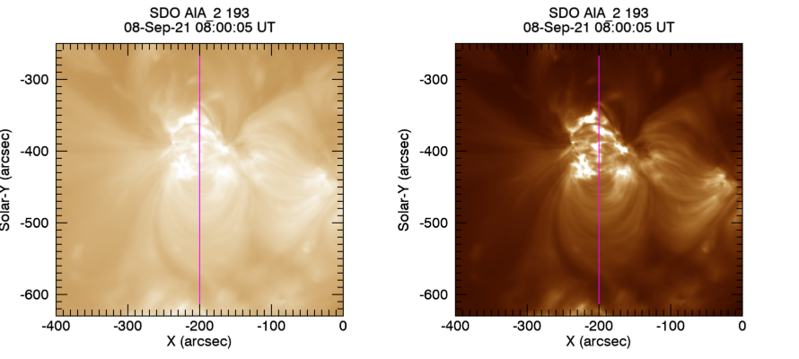
AIA 193 from 08:00-16:50 UT, 10 min cadence
Video Showing all frames in 193 Å
Min=1
Max=1500
9 hour average

Slide 4
AIA 193 from 08:00-17:00 UT
Slice at x=-200
Average from 08:00-16:50 UT
Notes:
No attempt to remove scattered light

Slide 5
AIA 193 from 08:00-17:00 UT
Slice at x=-200”
Closeup from y=-600 to -440”
Average from 08:00-16:50 UT
Notes:
No attempt to remove scattered light

Slide 6
9 hr movie,
10 min cadence

Slide 7
Initial runs of GX simulator

Slide 8
Using model that includes both active regions

Slide 9
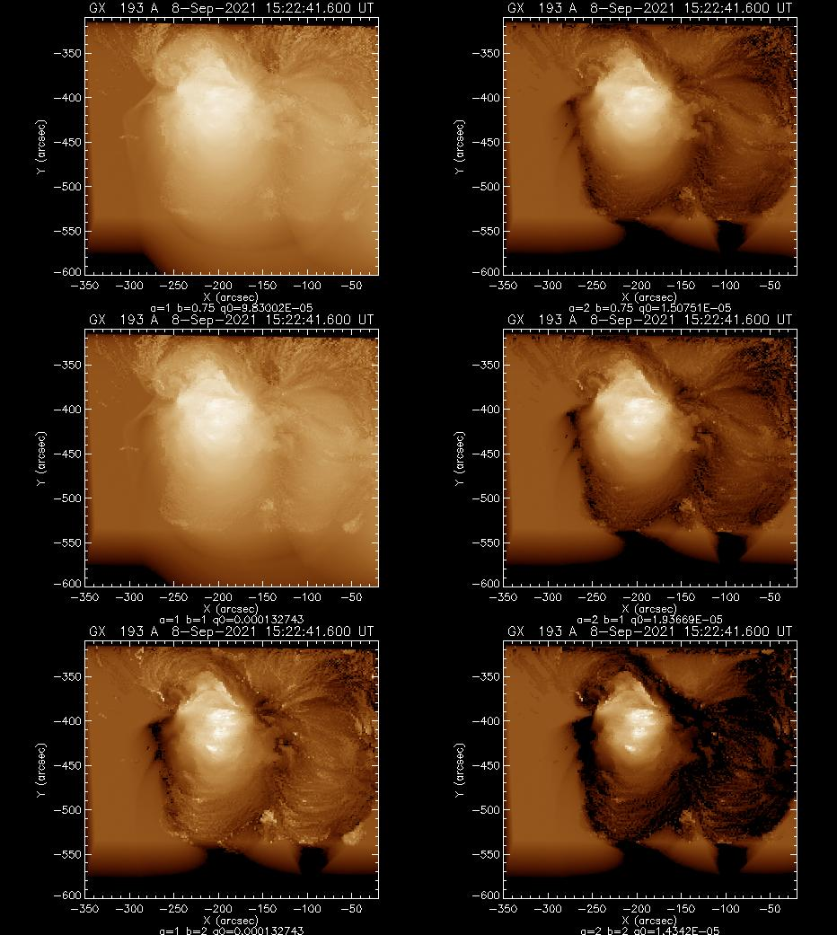
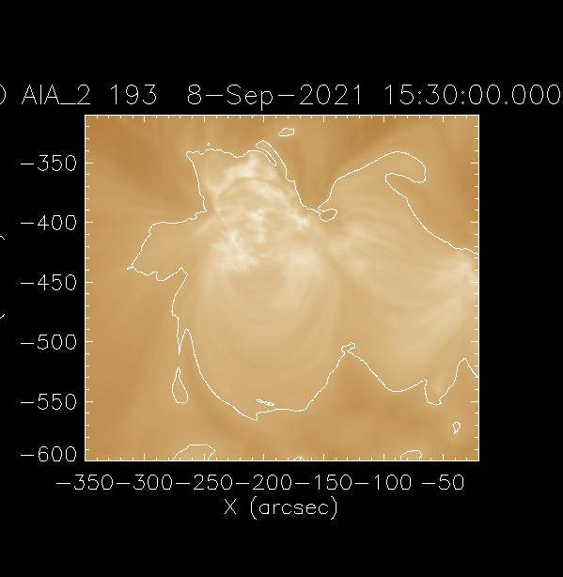
Fits for different a and b (log)
q=q0*(B/q[1])^a/(L/q[2])^b
AIA 193 Å
9 hr avg data
Notes:
Results for 29Feb2024_HighAlt
It looks like there is a ~constant value outside of the AR. Is this due to exclusion of intensity <10% Ipeak in fit? Open field lines?

Slide 10
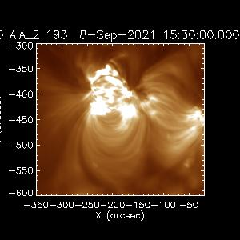
Fits for different a and b (linear)
q=q0*(B/q[1])^a/(L/q[2])^b
Notes:
Results for 29Feb2024_HighAlt

Slide 11
Mask out B>80 G in avg longitudinal magnetogram

Slide 12
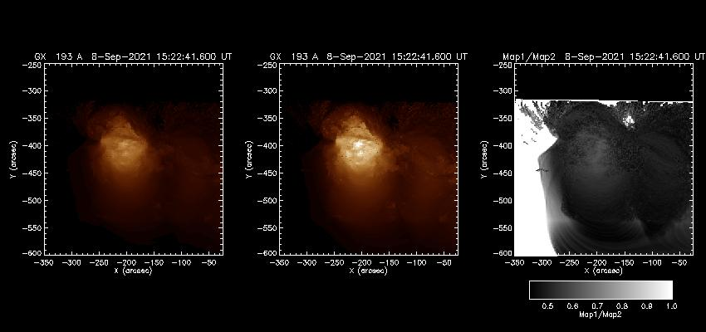
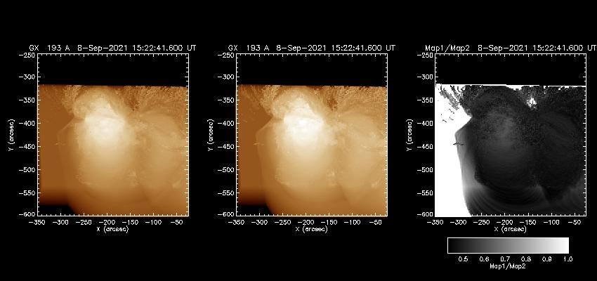
b=1, b=0.75, q0=3.88146e-4
No Mask
Masked
Linear
Log
Notes:
1Mar2024_HighAlt_mask_lev10

