Slide 1
AR 12760: The designated ISWAT region
T. Kucera
30 Oct 2024

Slide 2
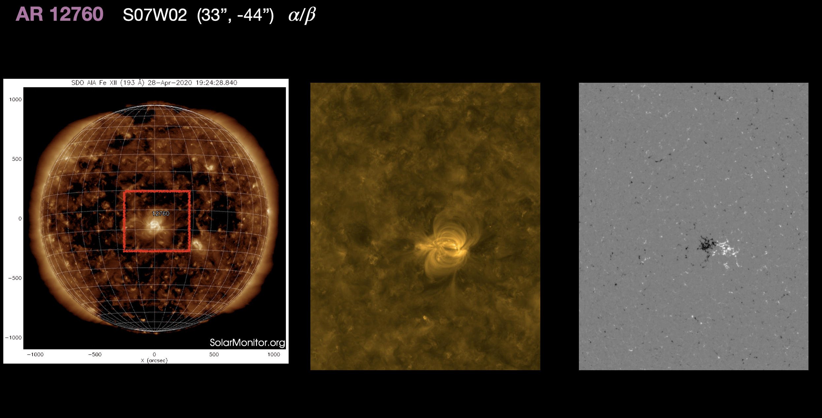
AR 12760: The designated ISWAT region
Notes:
Note made Sept 24, 2024

Slide 3
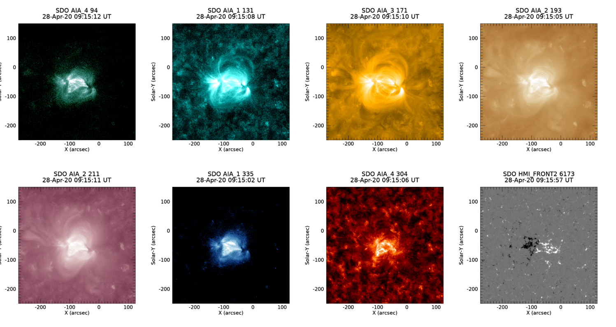
2020 Apr 28 09:15-13:10 UT

Slide 4
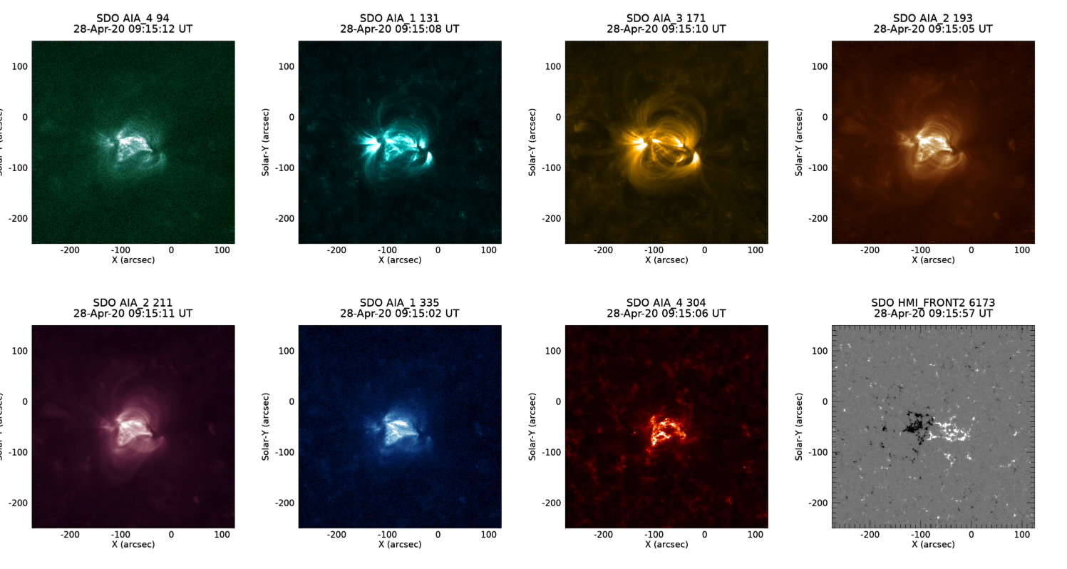
2020 Apr 28 09:15-13:10 UT

Slide 5
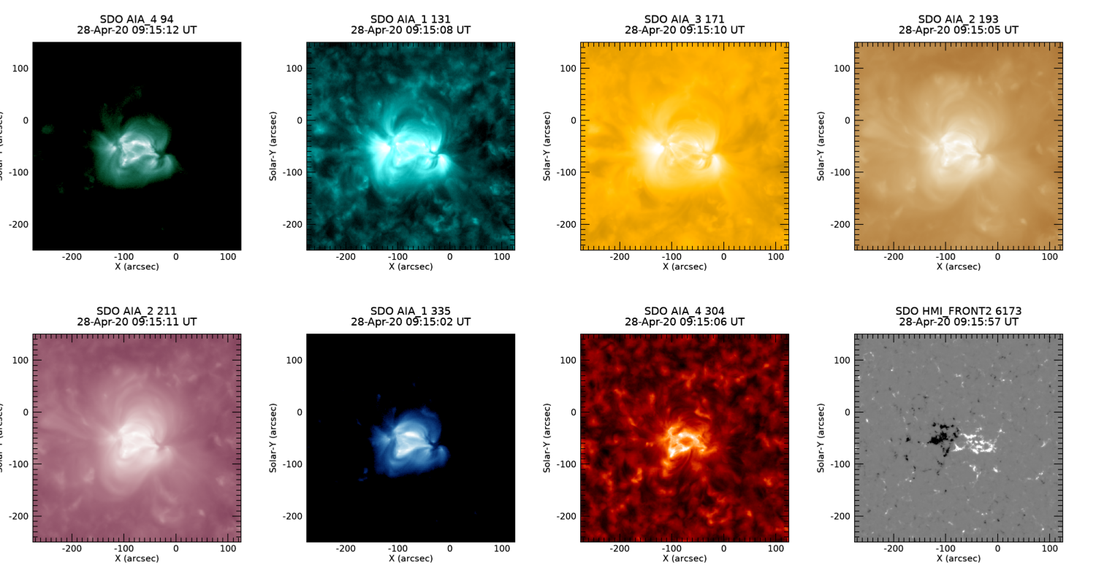
Average 2020 Apr 28 09:15 – 13:10 UT

Slide 6
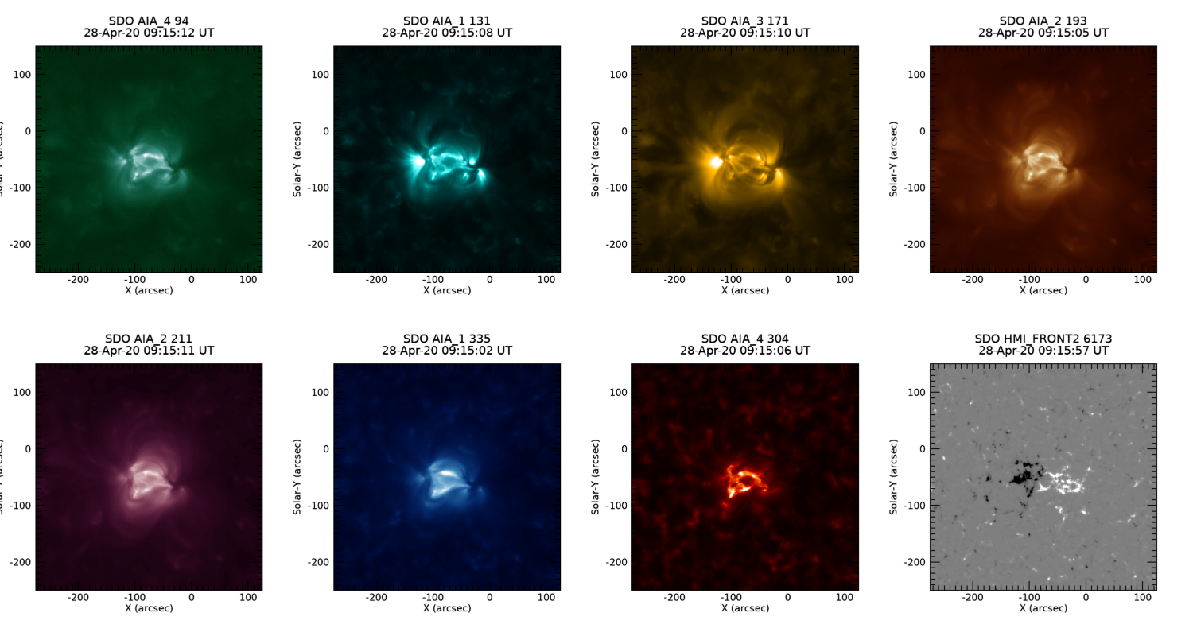
Average 2020 Apr 28 09:15 – 13:10 UT (Linear)

Slide 7
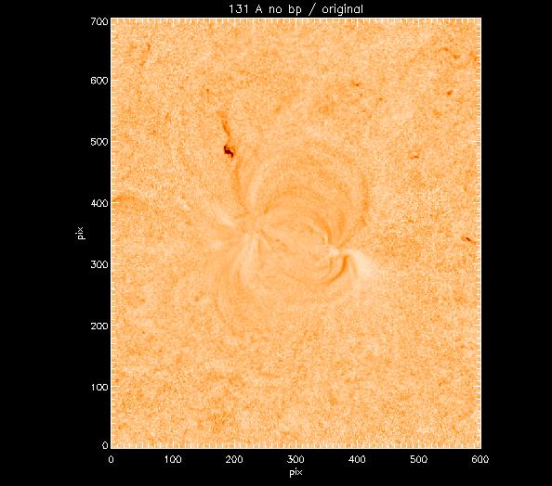
We considered removing one frame with a bright point
Max reduction ~18% for 131 Å
We decided not to worry about it.
Notes:
131 A.

Slide 8
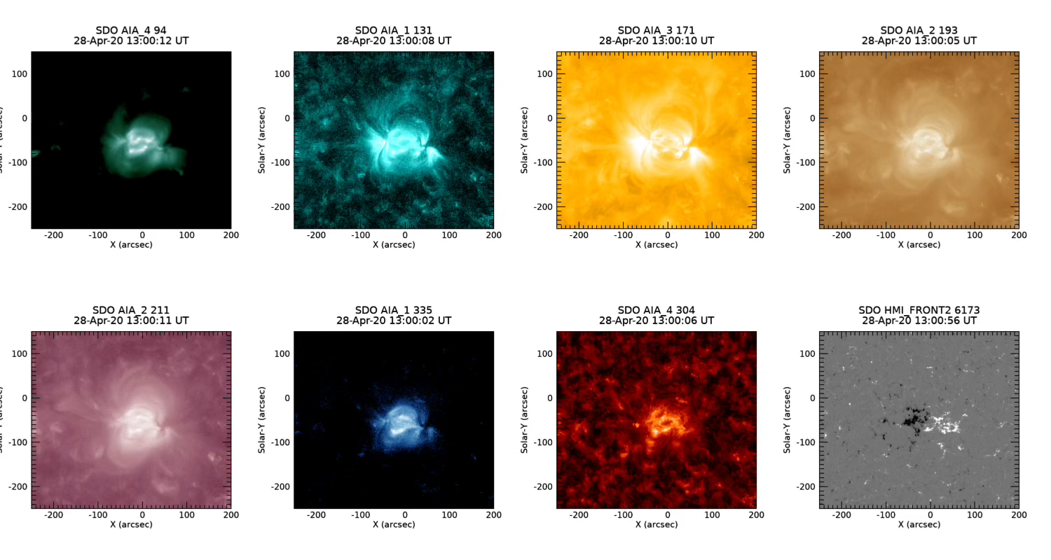
Region as it crossed the meridian – note flux emergence

Slide 9
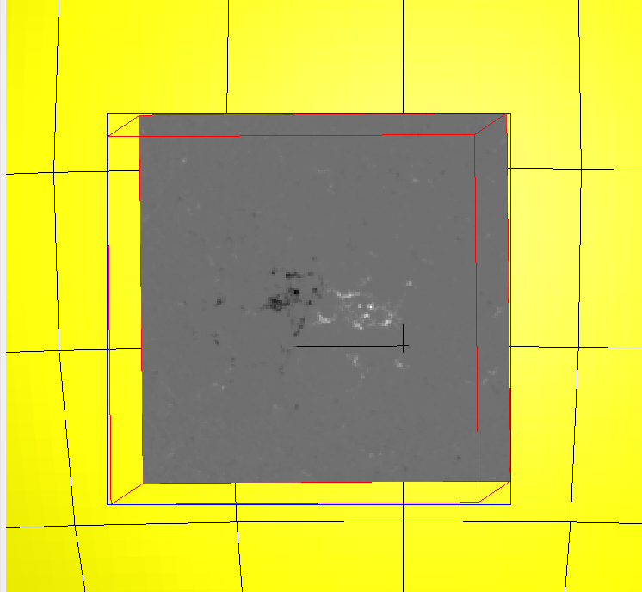
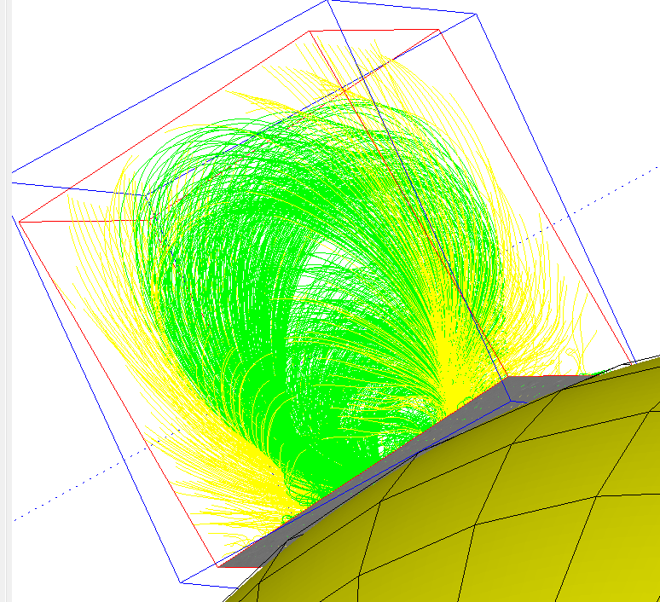
Model magnetic Field

Slide 10
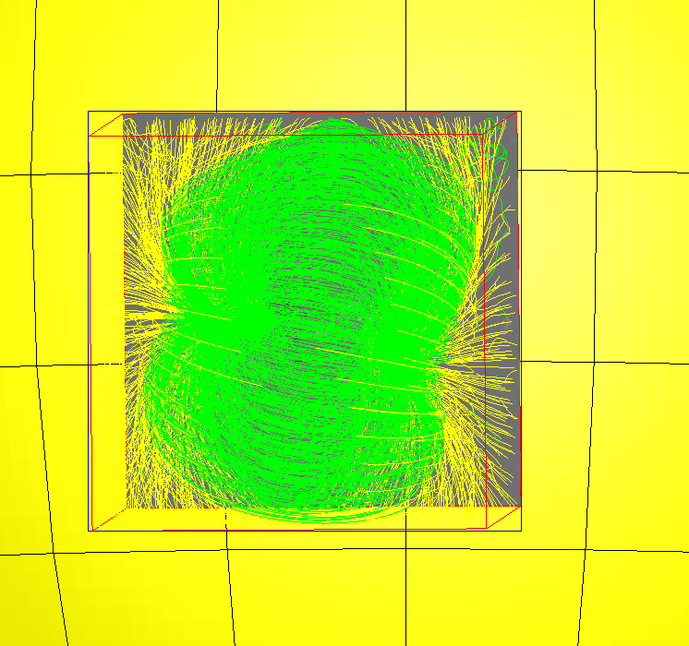
Model magnetic Field

