Slide 1
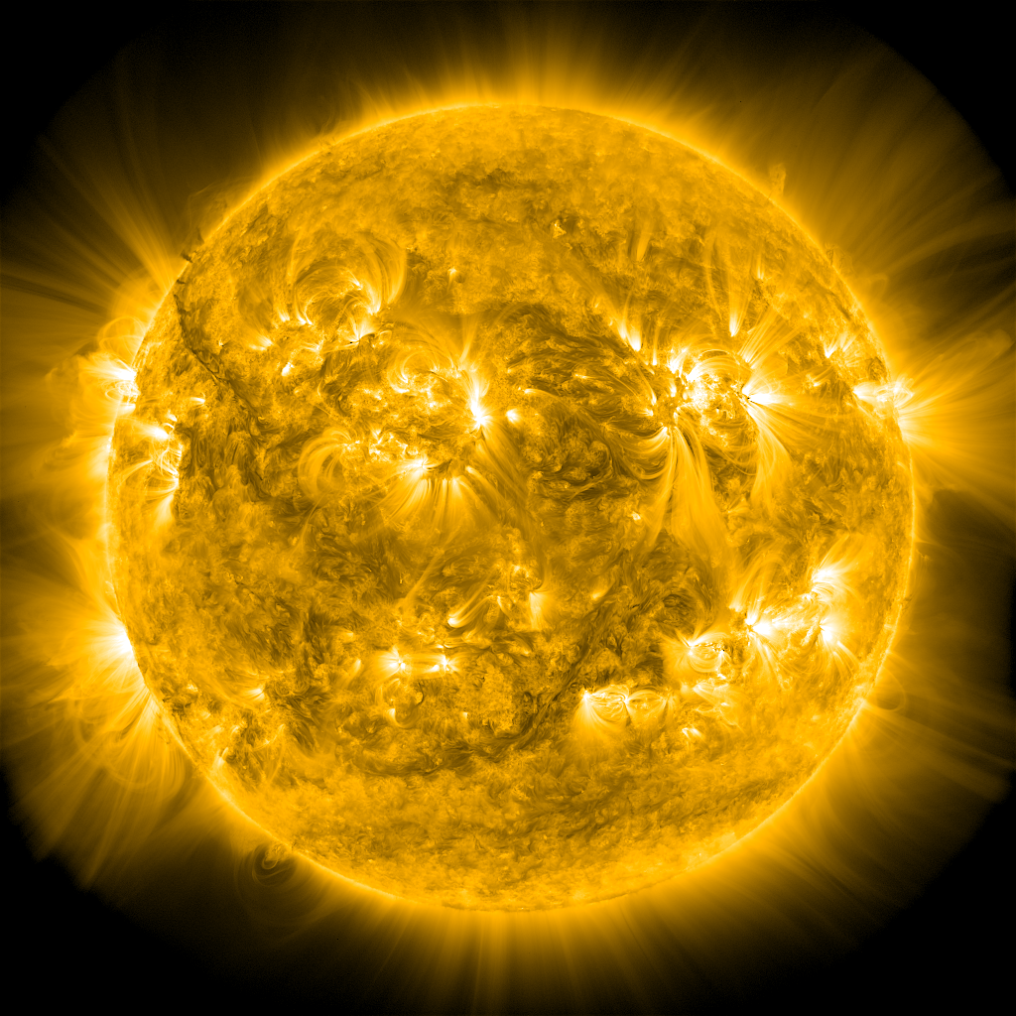
Cross Sections of Coronal Loop Flux Tubes
James A. Klimchuk
^{NASA – GSFC}
^{Code 671}
0

Slide 2
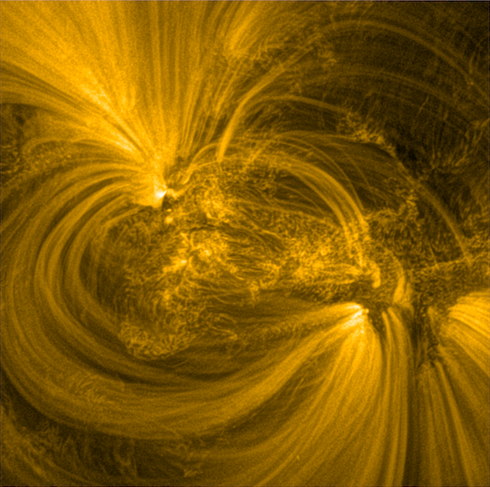
Hi-C 2.1, 2018 May 29, 172 A (Fe IX, ~0.8 MK)
1 pixel
= 0.13 arcsec
= 100 km
0.3 R_{sun}
Sharpened with multi-scale Gaussian normalization (MGN)
Notes:
First thing notice is majestic arching coronal loops.
Most every knows that trace magnetic field lines.
What are they really?
Not isolated magnetic flux tubes (common misconception).
Corona has very small plasma beta (ratio of gas to magnetic pressure), so the volume completely filled with magnetic field.
Loops are as subsets of field lines – so indeed flux tubes, just not isolate – with different temperature and density from their surroundings.
Reason they have different T and n is that they experience different coronal heating.
By studying loops, we can learn not only about the structure of the field, but also the properties of coronal heating.
Of particular interest is the cross section of the loop flux tube.
Reveals the spatial distribution of the heating, including its cross-field size scale.
Those properties provide important clues about the physical mechanism that produces the heating.
Many of us that small impulsive magnetic reconnection events are the primary source of heating, but many aspects of this picture not well established.
Loops inform us about collective behavior.
Imagine loops produce by local storms of nanoflares. Cross section is a map of the storm. Helps us understand nature of the storm. Like avalanche?
Terminology:
The terms loop and flux tube are sometimes used interchangeably. Here, today, loop is reserved for an observational feature—a 2D structure in an image.
A flux tube is corresponding structure in 3D space. Loop is projection of flux tube onto plane of sky.
Emphasizing loops, but the space between loops if equally important.
In fact, more plasma is contained in what we call diffuse component of corona than is contained in observationally distinct loops themselves.
Need to understand how diffuse corona heated. Uniformly, or many overlapping loops that are too faint or too narrow to stand out individually.
Latter more likely, as Vadim will discuss.
Even well observed loops are likely to have sub-structure well below our current resolving capability. Like to talk about loops as bundles of thin strands.
Terry will touch on this when she discussed filling factors.
Currently efforts at Goddard led by Adrien Daw and Doug Rabin to build an ultra-high resolution photon sieve telescope to search for this sub-structure.
I will concentrate on shape of X-section.
Typically assumed to be circular, but not good reason.
Recent analysis of an MHD model of an active region (Anna Malanushenko) suggests that many loops may corresponds to veils/curtains rather tubes.
I will present evidence that this is not the case, at least not in general.
---------------------------------------------------------------------------------
Hi-C 2.1
Multi-scale Gaussian normalization (MGN) sharpened
May 29, 2018
172 A
2k x 2k pixels, 4.4 x 4.4 arc min,
Hi-C 2.1 (pixel 0.13 arcsec, times of jitter avoided) 1 pix = 100 km
Williams et al. (2020) study
Low-pass filtered data
Loop FWHM ~ 500-1000 km
Uniformly emitting circle: diameter = 4 x st.dev.
Gaussian: 4 x st.dev. = 1.7 x FMHM
Hi-C 1 Resolution: 0.3-0.4 arcsec (pixel 0.1 arcsec, PSF 0.09 arcsec, spacecraft jitter)
AIA/SDO is 3-5 times coarser (~ 1.4 arcsec)

Slide 3
intensity
intensity
width
width
wide / faint
narrow / bright
I ∝ w⁻¹

Slide 4
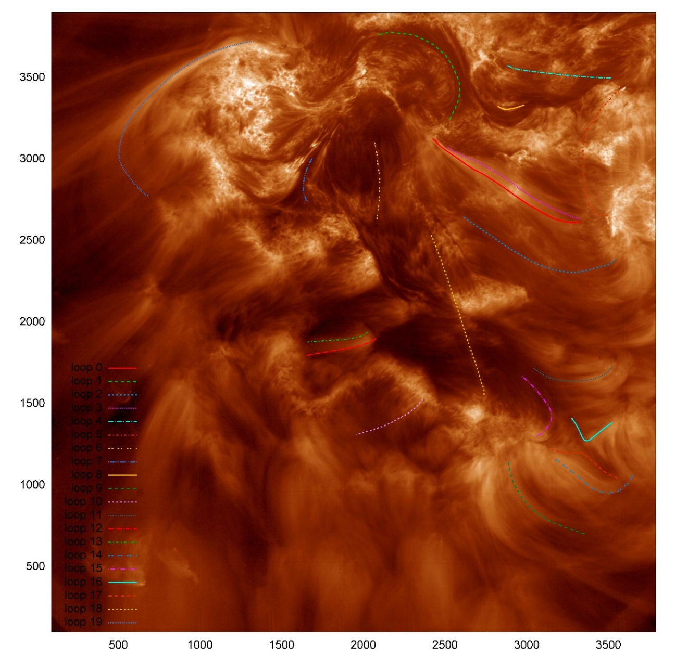
Hi-C 1, 2012 July 11, 193 A (Fe XII, ~1.5 MK)
300,000 km
1 pixel = 0.10 arcsec = 73 km, resolution = 0.3 arcsec = 220 km (incl. PSF, jitter)
Notes:
22 loops
Craig DeForest identified
Hi-C 1 Resolution: 0.3-0.4 arcsec (pixel 0.1 arcsec, PSF 0.09 arcsec, spacecraft jitter)
AIA/SDO is 3-5 times coarser (~ 1.4 arcsec)
4k x 4k pixels = 6.8 x 6.8 arcmin = 290 Mm on side

Slide 5
Loop 14
y
3600 km
x
I
x
3600 km
600 1200 1800 2400 3000
w (km)
Notes:
Intensity profile = distribution of photon wavelength positions.
St. dev. is a generic measure of width
Loops are 10-50% enhancements over background
1 pixel = 73 km
6 pixels = 1800 km
Prob. Uncorr. = 9x10⁻⁶
I ∝ w^{+0.34}

Slide 6
Statistical Analysis
Strength of correlation between I and w
Strength of dependence between I and w: I ∝ w^{α}
α = -1 expected for simple, noncircular X-section (with twist)
Non-parametric statistical method (weighted t-statistic):
Probability that I and w are correlated
Most probable α
90% confidence interval for α
Notes:
Non-parametric statistical method
Advantage that makes no assumption about the underlying distribution measurement errors, as tradition methods do
Clustering of points
Slope of line (log-log plot)

Slide 7
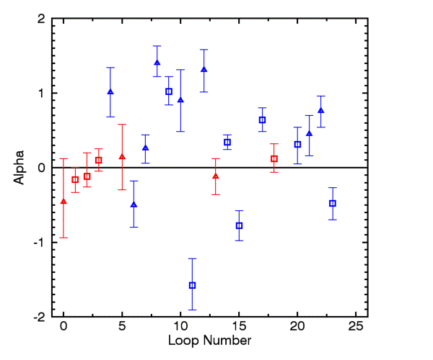
I ∝ w^{α}
Blue: strong (> 95%) likelihood of correlation
Red: weak (< 95%) likelihood
Squares: measured section longer than 250 pixels (19,000 km)
Triangles: shorter than 250 pixels
Notes:
Most probably value
Error bar = confidence interval
a sizable majority of the loops either have a clear positive correlation, α > 0, or are consistent with no correlation
dominance of loops with a positive intensity-width correlation. Eleven of the blue loops have α > 0, compared to four with α < 0. That represents a nearly three-to-one imbalance. Only one loop has α < -0.8, compared to five with α > 0.8.
Only one loop with alpha le -1, the value expected for non-circular X-section

Slide 8
Conclusions
A sizable majority of loops show a positive correlation or no correlation between intensity and width (I and w).
Either:
Tube cross sections are approximately circular
(possibly irregular, but aspect ratio of order unity)
Tubes are untwisted
Abundant evidence for coronal twist over a wide range of spatial scales.
Interpretation 1 (~ circular X-sections) is more likely.
Klimchuk & DeForest (2020, ApJ, submitted)

Slide 9
Implications
Heating is distributed “axially symmetrically” over a loop diameter
Heating is highly structured and confined to much smaller scale and:
Diffuses axially symmetrically across field lines
Is transported along “chaotic” field lines that fill a cylindrical volume
Notes:
Energy quickly transported along field lines by highly efficient field-aligned thermal conduction.
Heating envelope
Could be highly structured within envelope (multi-stranded)
Doesn’t matter where in a strand the heating occurs (energy quickly spread out along field lines by thermal conduction
Vadim will that 1 option seems to be playing out in our simulations.

Slide 10
Backup Slides

Slide 11
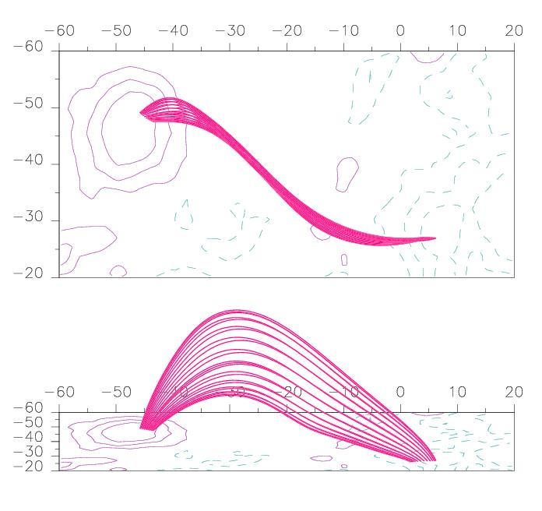
Lopez Fuentes, Klimchuk, & Demoulin (2006)

Slide 12
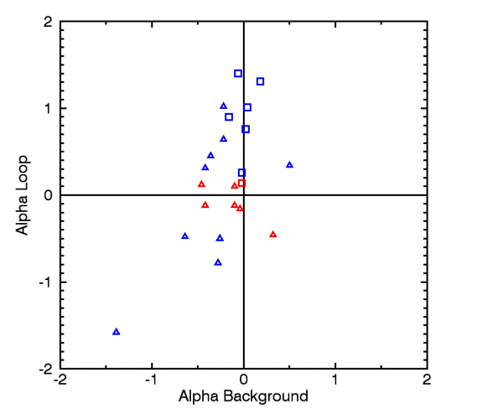

Slide 13
Measured Width: Hi-C (solid), AIA (dashed) and “degraded” Hi-C (dotted)
Notes:
Here the Hi-C (solid), AIA (dashed) and “degraded” Hi-C (dotted) measurements for loops 1, 2, 3, and 4. All four look monolithic in the Hi-C image with the exception of the loop 1, which shows some evidence of sub-strands on the right side. The coalignment is my own and is not highly precise. I estimate it is good to better than 2 AIA pixels. The units are Hi-C pixels, and the plotted quantity is the standard deviation of the background-subtracted cross-axis intensity profile. For a circular, uniformly filled cross section, the diameter is 4 times the standard deviation.

Slide 15
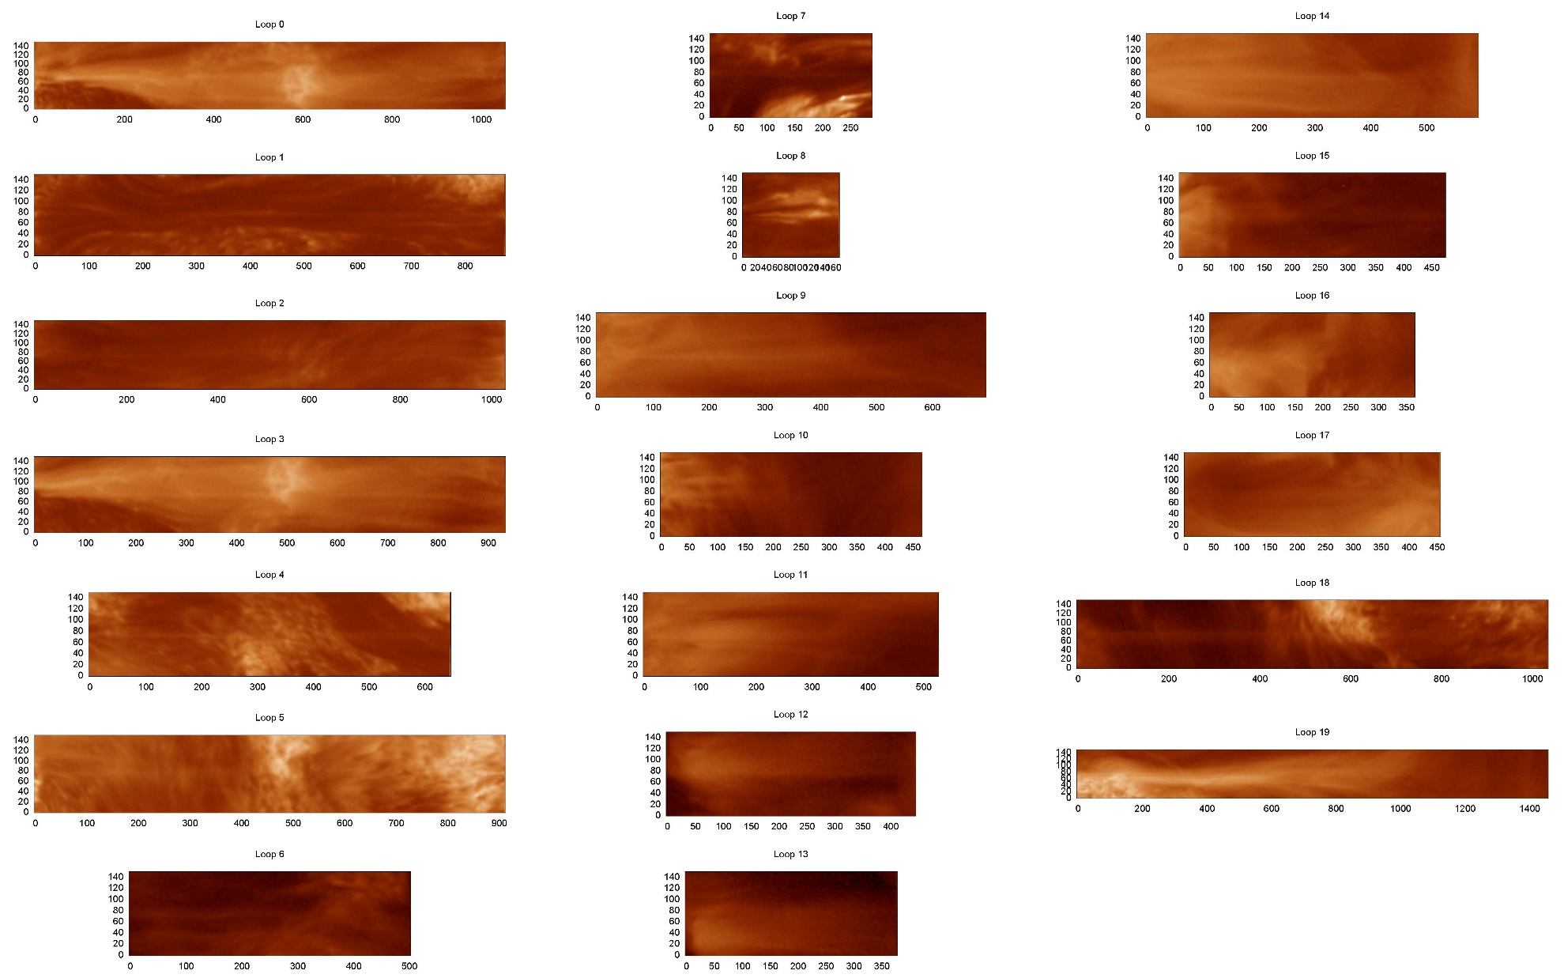

Slide 16
Loop Number | Uncorrelated Probability | Most Probable α | 90% Confidence Interval
0 | 0.19 | -0.46 | [-0.94, 0.12]
1 | 0.10 | -0.16 | [-0.33, 0.00]
2 | 0.20 | -0.12 | [-0.26, 0.20]
3 | 0.27 | 0.10 | [-0.05. 0.25]
4 | < 10⁻⁵ | 1.01 | [0.68, 1.34]
5 | 0.61 | 0.14 | [-0.30, 0.58]
6 | 9.7x10⁻³ | -0.50 | [-0.80, -.18]
7 | 0.043 | 0.26 | [0.06, 0.44]
8 | < 10⁻⁵ | 1.40 | [1.22, 1.63]
9 | < 10⁻⁵ | 1.02 | [0.84, 1.22]
10 | 1.70x10⁻⁴ | 0.90 | [0.48, 1.31]
11 | < 10⁻⁵ | -1.58 | [-1.91, -1.22]
12 | < 10⁻⁵ | 1.31 | [1.01, 1.58]
13 | 0.47 | -0.12 | [-0.36, 0.12]
14 | < 10⁻⁵ | 0.34 | [0.24, 0.44]
15 | < 10⁻⁵ | -0.78 | [-0.98, -0.58]
17 | < 10⁻⁵ | 0.64 | [0.48, 0.80]
18 | 0.27 | 0.12 | [-0.06, 0.32]
JK1 (20) | 4.9x10⁻² | 0.31 | [0.05, 0.54]
JK2 (21) | 9.3x10⁻³ | 0.45 | [0.16, 0.70]
JK3 (22) | < 10⁻⁵ | 0.76 | [0.54, 0.96]
JK4 (23) | 2.4x10⁻⁴ | -0.48 | [-0.70, -0.27]

