Slide 1
Spicules, Si IV Doppler Shifts, and Their Lack of Center-to-Limb Variation
James A. Klimchuk
Avyarthana Ghosh¹
Durgesh Tripathi¹
¹ Inter-University Centre for Astron. & Astrophys.
Pune, India

Slide 2
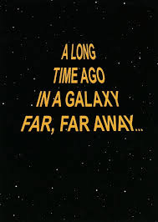
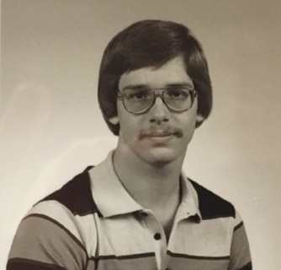
AN OFFICE

Slide 3
Red
C IV (1548)
Dopplergram
(avg. = 0)
C IV (1548)
Doppler shift
(+/- 30 km s⁻¹
“calibrated”)
Blue
Photospheric
Magnetogram
(+/- 100 G)
Hα
Spectroheliogram
White
Light
White
Light
White
Light
Notes:
3” pixels
4’ x 4’
Absolute calibration based on forced agreement with other measurements of absolute Doppler shift in QS and ARs, and assuming zero Doppler shift at limb. Average of 3 methods giving double weighting to QS.

Slide 4
C IV (1548)
Dopplergram
(avg. = 0)
C IV (1548)
Doppler shift
(+/- 30 km s⁻¹
“calibrated”)
Red
Blue
Photospheric
Magnetogram
(+/- 100 G)
Hα
Spectroheliogram
White
Light

Slide 7
300 G
30 G

Slide 9
Adjusted
strong field
corridor
12 active regions at 16 disk positions
Radius vector = fractional distance from disk ctr to limb
Notes:
Absolute calibration based on forced agreement with other measurements of absolute Doppler shift in QS and ARs, and assuming zero Doppler shift at limb. Average of 3 methods giving double weighting to QS.
Zero point adjusted by 4 km/s near the limbs, so all corridor measurements consistent with 0.

Slide 10
Avyarthana Ghosh Ph.D. Research
Ghosh, Klimchuk, & Tripathi (2019, ApJ, 886, 46)
Disk passage of one active region
IRIS
Si IV (1394)
Absolute Doppler shift calibration with O I (1356)
Notes:
O I (1355), mid-chromosphere, optically thin

Slide 11
1600 channel
Notes:
0.4” resolution

Slide 12
+/- 50 G contours
Notes:
50 G contours

Slide 13
1600 Intensity
Si IV Doppler shift
+/- 50 G mask
Notes:
0 km/s in center of corridor
Averages include much surrounding red
50 G contours

Slide 14
Strong Field Region
Weak Field Corridor
Two components
(~0 and ~10 km/s)?

Slide 16
Conclusions
Centers of weak field corridors have minimal Doppler shift at all disk positions
Strong field regions (and edges of corridors) have redshifts with a less-than-vertical center-to-limb variation

Slide 17
Adjusted
strong field
corridor
12 active regions at 16 disk positions
Radius vector = fractional distance from disk ctr to limb
Notes:
Absolute calibration based on forced agreement with other measurements of absolute Doppler shift in QS and ARs, and assuming zero Doppler shift at limb. Average of 3 methods giving double weighting to QS.
Zero point adjusted by 4 km/s near the limbs, so all corridor measurements consistent with 0.

Slide 18
Chromospheric “Well”
(Antiochos, 1984)
Impulsive heating predicts a net redshift (downflow brighter than upflow).
However, predicted magnitude is order of magnitude too slow.

Slide 19
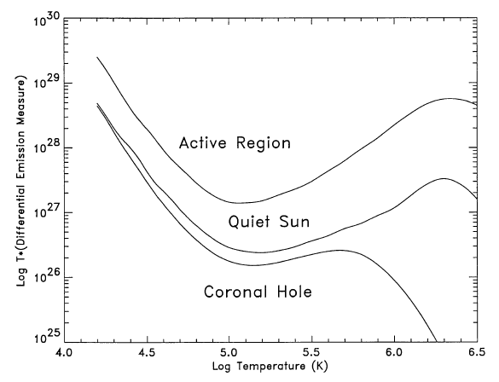
Spicule “Wall”
Type II
(10⁵ K)
Type I
(10⁴ K)
Thanks to Rob Rutten for his thermodynamic equilibrium extinction calculation.
Can explain:
Si IV & C IV redshifts, including magnitude
“Weaker than vertical” center-to-limb variation
Excess emission at T < 10⁵ K

