Slide 1
Fe XVI (335)
1000 km (1.3 arcsec)

Slide 2
Fe XVIII (94)
1000 km (1.3 arcsec)
Notes:
The FOV is 100x100 pixels. Each strand has a diameter of 20 pixels, so five strands would fit side-by-side across the FOV. The strands have random positions and random tilts between +/- 20 degrees. They have circular cross sections. Black corresponds to zero intensity and white to the maximum intensity of the 10,000 s duration.
Diameter = 200 km
FOV = 1000 x 1000 km^2
1250 strands
LOS depth = 50,000 km
The nanoflares were selected randomly from a power-law distribution with a slope of -2.4 (based on simulations of Lopez Fuentes & Klimchuk 2015). The delay between successive events in a given strand is proportional to the magnitude of the first event. This corresponds to model in which there is a critical level of stress that must be reached before a nanoflare occurs. Each strand corresponds to a window selected randomly from a 100,000 s simulation. Loop half length = 30,000 km.
mean energy flux = 1.00026e+007 erg cm^-2 s^-1
mean delay = 1317.94 s
median delay = 835.471 s
Maximum intensity:
I_335 = 3.3e-3 * 1.2e8 = 4.0e5 erg cm^-2 s^-1 sr^-1
I_94 = 3.3e-3 * 7.3e6 = 2.4e4 erg cm^-2 s^-1 sr^-1
DEM_log = (ln10)*T*DEM has a peak value of 10^29.1 cm^-5 at T=10^6.4 in the simulation.
In comparison, observations give 10^28.8 to 29.3 at T = 10^6.5 to 6.6 (Warren et al. 2012) and 10^28.3 at T = 10^6.6 (Brosius et al. 1996).
From Peter Young:
I think the 335 intensity is too high. For example the SERTS measurements of active regions are 1.04e4 (Thomas & Neupert 1994) and 5.02e3 (Brosius et al. 2000). From EIS data I checked an AR by picking the brightest part of the AR (just a few pixels) and measured an intensity of 4.6e3 for the 262.99 line, which is a factor 10 weaker than 335. Thus 335 would be implied to be 4.6e4, but this is still a factor 10 lower than your number.
94 is more difficult to check due to a lack of observations of Fe XVIII lines. Parenti et al. (2017) measured the 974.86 line above the limb in an AR and found values of about 5. According to CHIANTI, the 94/974 ratio is about 9 implying that the 94 line would be about 50 erg cm^-2 s^-1 sr^-1. However, the slit is clearly not passing through the brightest part of the AR (see their Fig. 1), so this is an underestimate. It's unlikely to be wrong by a factor 50, though, so I think your number may be too high again.
SHARPI photon sieve: 50 milliarcsec (35 km)

Slide 4
Hi-C
1
2
4
3
Notes:
Active Region 11520, taken on July 11, 2012 at about 18:54 UT.

Slide 5
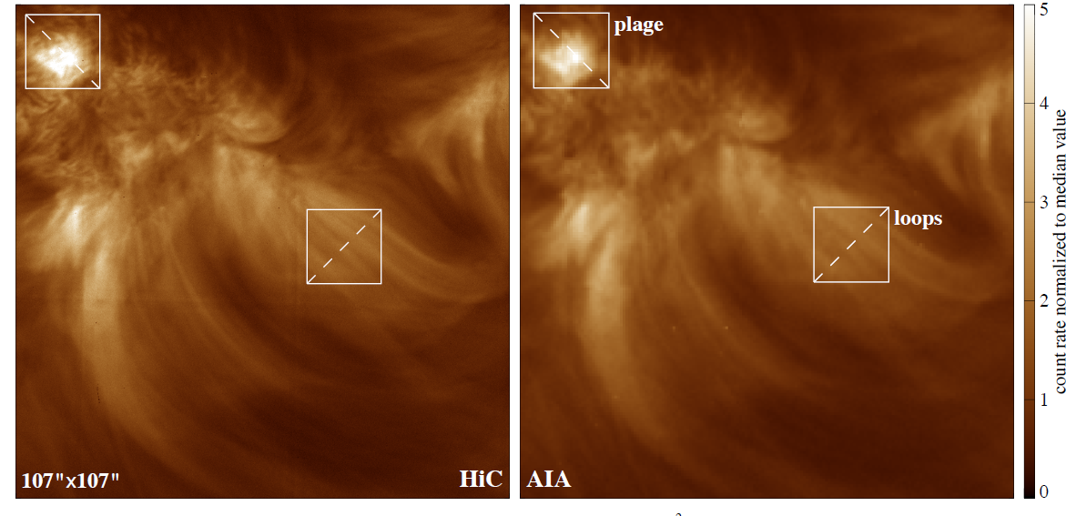
Pixel (arcsec) FWHM of PSF (arcsec)
Hi-C: 0.103 0.25-0.3 (incl. jitter)
AIA: 0.6 1.01
1 AIA pixel = 5.83 Hi-C pixels

Slide 6
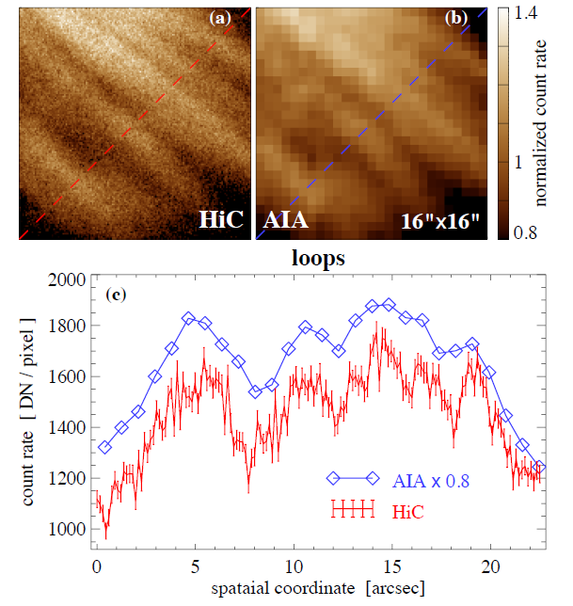

Slide 7
Measured Width: Hi-C (solid), AIA (dashed) and “degraded” Hi-C (dotted)
Notes:
Here the Hi-C (solid), AIA (dashed) and “degraded” Hi-C (dotted) measurements for loops 1, 2, 3, and 4. All four look monolithic in the Hi-C image with the exception of the loop 1, which shows some evidence of sub-strands on the right side. The coalignment is my own and is not highly precise. I estimate it is good to better than 2 AIA pixels. The units are Hi-C pixels, and the plotted quantity is the standard deviation of the background-subtracted cross-axis intensity profile. For a circular, uniformly filled cross section, the diameter is 4 times the standard deviation.

Slide 8
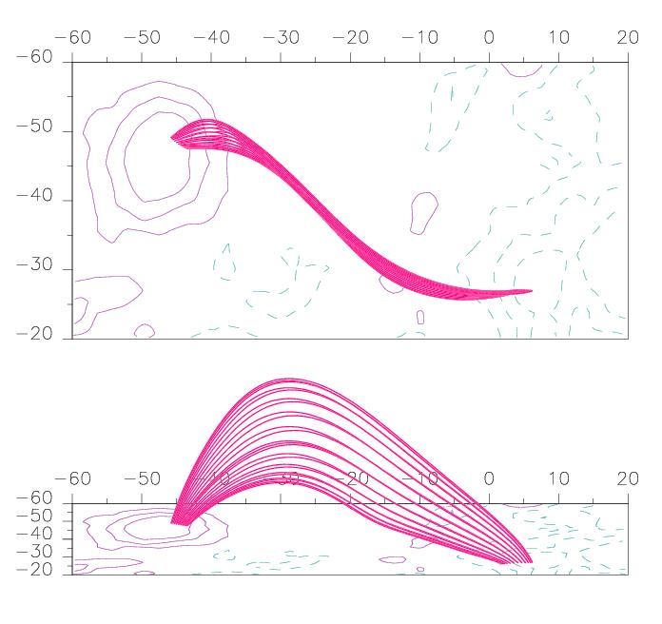
Lopez Fuentes, Klimchuk, & Demoulin (2006)

Slide 9
intensity
intensity
width
width
wide / faint
narrow / bright
I ∝ w⁻¹

Slide 10
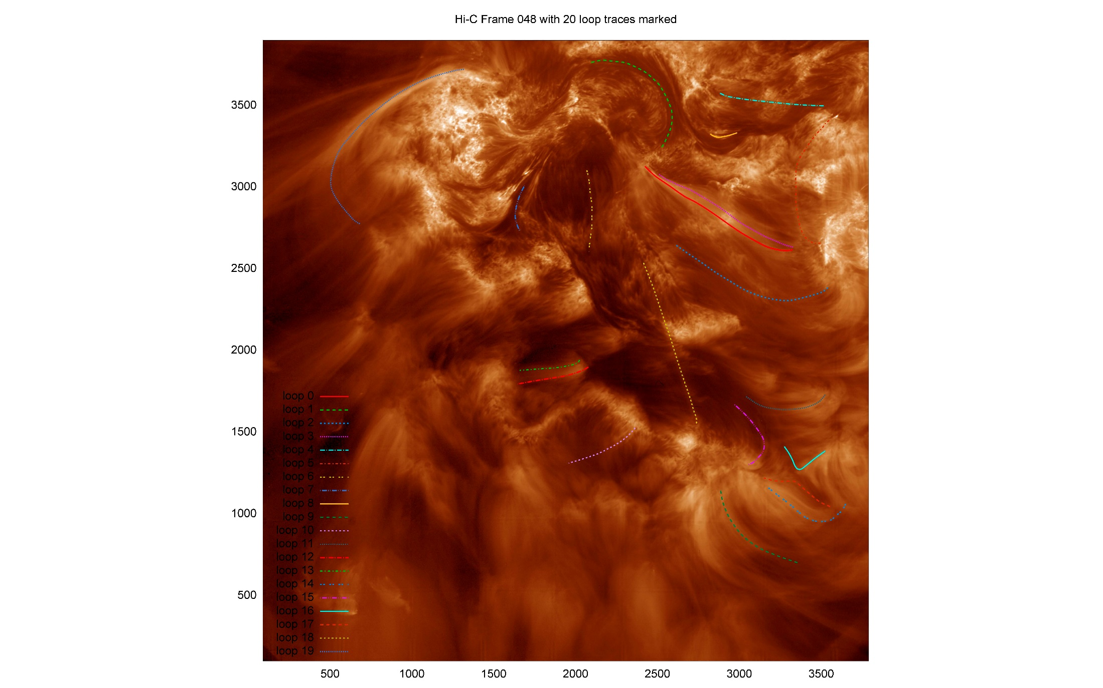

Slide 11
Loop 14
Prob. Uncorr. = 9x10⁻⁶
I ∝ w^{+0.34}

Slide 12
I ∝ w^{α}
Blue: not the best measurement for that loop
(background confusion, etc.)
Yellow: probability of no correlation > 25%
Green: α < -0.5
Lt. Green: -0.5 < α < 0
Pink: 0 < α < 0.5
Red: α > 0.5
Notes:
As the attached notes indicate, intensity should very inversely with width as we follow along a "loop" that is twisted or if we rotate the viewing angle at a fixed "loop" position. I put "loop" in quotes. We have been discussing manifolds recently, and sections of manifolds can perhaps be thought of as loops with very large aspect ratios (highly distorted cross sections).
The spreadsheet gives the results. Four loops are from my original measurements when we were comparing Hi-C with AIA (Section 9 of attached paper). These are at the bottom and labeled JK1-JK4. The other loops, labeled 1-18, are from the "riverine" data you sent. Two of the loops appear twice (JK4 = 9, JK3 = 14), but the sections measured only correspond approximately. Loops 1, 3, and 4 were measured more than once (again with sections that only correspond approximately). The least reliable measurements are color coded in blue.
I used the nonparametric t-statistic for the analysis. It is described in Sections 5.2 and 5.3 of the attached paper with Lisa Porter. The second column in the spreadsheet gives the probability that the data are uncorrelated. The two cases in yellow have a probability > 25%.
I also determined the most likely value of alpha in the relationship: I ~ w^alpha. As mentioned above, we might expect alpha = -1 if loops have non-circular cross-sections and are twisted. The numbers of cases in different alpha ranges are as follows:
3 alpha < -0.5 (dark green)
5 -0.5 < alpha < 0 (light green)
5 0 < alpha < 0.5 (pink)
7 alpha > 0.5 (red)
The two yellow cases would have been pink had I included them.
My initial assessment is that the data do not support the picture of loops as structures with non-circular cross section and twist. Approximately circular cross section or non-circular cross section without twist seem to be more consistent with the observations.

Slide 14
