Slide 1
Poynting Flux and Heating Rate
Poynting flux:
Small F
Weak heating
Large F
Strong heating
θ
v_{h}
v_{h}
The heating rate depends on the tilt of the field (level of stress),
which is determined by the heating mechanism.
Notes:
Heating mechanism determines not only temporal and spatial dependence of the heating, but also it’s magnitude.
Energy ultimately comes from the flows in photosphere and below.
Common misconception that magnitude of heating depends only on strength of field and velocity of driver flows.
AR: F=10^7, Bv=100, Vh=10^5 -> theta=7.2 deg
QS: F=3x10^5, Bv=10, Vh=10^5 -> theta=21 deg
If the angle were different, the corona would be hotter or cooler than observed.

Slide 2
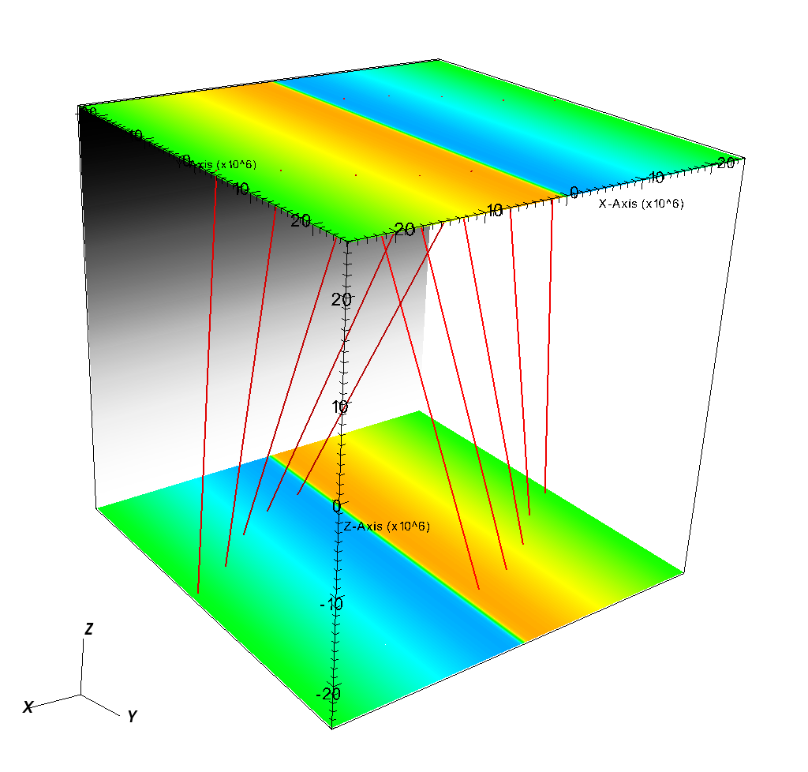
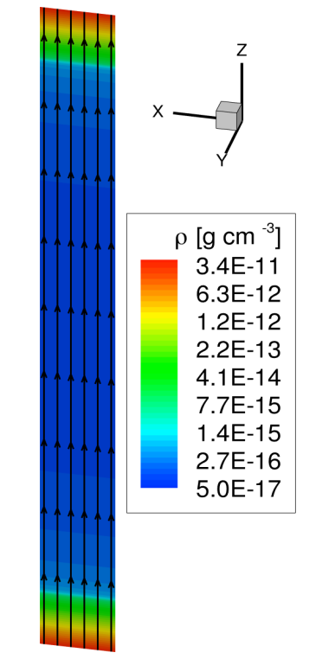
Gravity of a semi-circular loop
BATS-R-US Simulation
Shear profile
Notes:
Strategy: simplest possible system that includes the important physics we are trying to study.
For reconnection onset, spatial resolution a high priority.
Settled on single current sheet in the coupled corona-chromosphere system.
Variety of codes, including embedded PIC code (PIC region inside large region treated with Hall MHD).
First consider regular resistive MHD (BATS-R-US).
Straight uniform field with gravity of a semi-circular loop.
Stratified equilibrium atmosphere that satisfies energy balance with rad, thermal cond., steady background heating.
Highly simplified nearly isothermal chromosphere, similar to loop modeling.

Slide 3
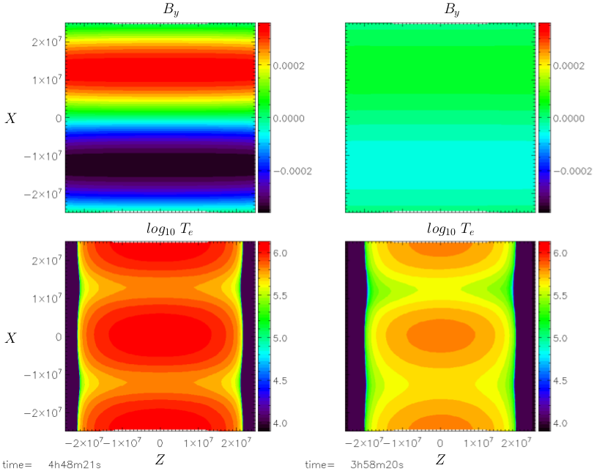
Steady-State Ohmic Heating
Low η
High η
50 x 50 Mm²
10 G
3 km/s
At 10 times higher resistivity:
Maximum tilt decreases from 20° to 3°
Mean apex temperature decreases from 1.1 to 0.6 MK
Notes:
50 Mm x 50 Mm
5 levels of cell size
Smallest = 49 km, largest = 781 km
250,000 cells total
3e6 time steps
V_drive = 3 km/s
Resistivity = 8.4e9 mu_0 and 8.4e10 mu_0 (SI units), fact 10 difference
B = 10 G (1.e-3 Tesla)
Max tilt Mean apex temp
High resistivity 3.09 deg 0.600 MK
Low resistivity 20.28 1.057

Slide 4
Observational Discriminators
Low frequency
High frequency
Intensity
Fluctuations
DEM(T)
Slope
Very Hot Plasma
Coronal DEM(T); transition region not included
Notes:
If were to observe individual strand, low-f would have much larger intensity fluctuation than high-f.
See composite emission from many strands, so light curve will have small fluctuations; nonetheless, level of fluctuation is indicator of nanoflare frequency.
DEM(T) from many out-of-phase strands (equivalent to temporal average of single strand).
In reality, the quasi-steadily heated strands will have different heating rates and therefore different mean T, so slope will be smaller than shown.
With high-f heating, slope indicates distribution of quasi steady heating rate.
With low-f heating, slope is primarily an indicator of the cooling after each heating event.
Small quantities of very hot plasma, versus none.
Case 1
length = 3.0e9 ; loop halflength
heat_bkg = 1.e-5 ; background heating rate
tau = 100 ; nanoflare duration
heat0 = 1.5e-1 ; nanoflare amplitude (maximum heating rate)
delay = 3000 ; time delay between successive nanoflares (start to start)
hcorona = 5.e9 ; vertical thickness of corona
T_max = 1.05383e+007
T_min = 474913.
n_min = 8.10605e+008
energy flux = 1.25000e+007
Case 2
heat0 = 1.5e-2 ; nanoflare amplitude (maximum heating rate)
delay = 300 ; time delay between successive nanoflares (start to start)
T_max = 3.29125e+006
T_min = 2.87520e+006
n_min = 3.01379e+009
energy flux = 1.25000e+007

