Slide 1
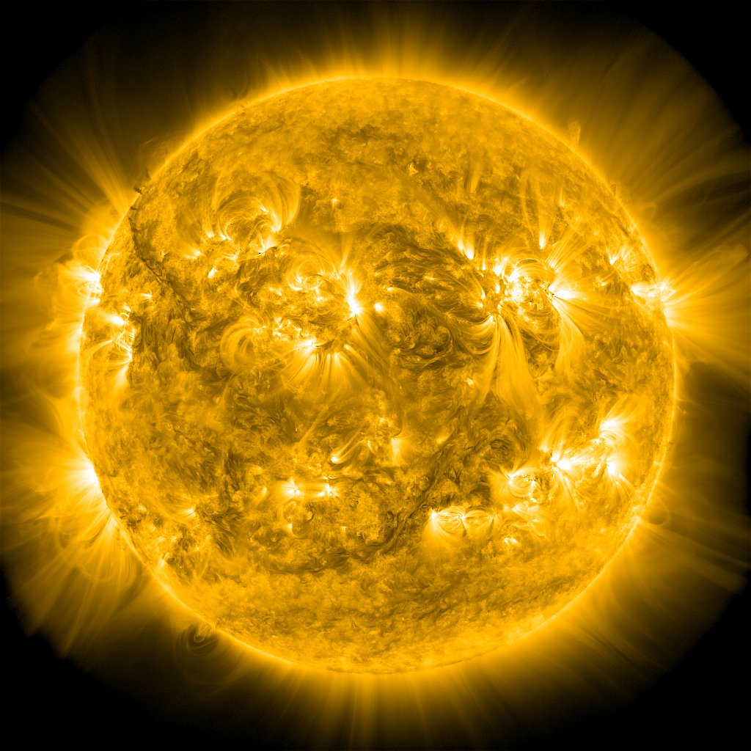


Heating of the
Magnetically Closed Corona
James Klimchuk, PI
Therese Kucera, Deputy
Jeffrey Brosius
Sherry Chhabra
Ineke De Moortel
Lars Daldorff
Craig Johnston
Judith Karpen
Kalman Knizhnik
James Leake
Samuel Schonfeld
Jennifer Rodriguez Gomez
Vadim Uritsky
Peter Young
Nicholeen Viall
Yihua Zhang
Notes:
Open vs closed corona
Slow solar wind – Viall WP
Mixture of theorists, modelers, observers
7 CS
7 women
9 men

Slide 2
Problem:
  Explain the nonuniform thermal structure and emission properties of the magnetically closed corona, including the solar spectral irradiance – an important driver of space weather.
Challenges:
  Enormous range of spatial scales (> 6 orders magnitude)
  Physical couplings between scales and between different parts of the atmosphere
Strategy:
  Different approaches tailored to different aspects of the problem
  Aspects interconnected, requiring careful coordination
  Ideally suited to a work package

Slide 3
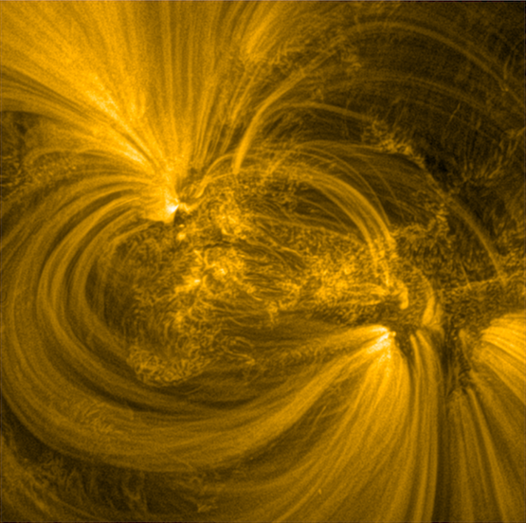
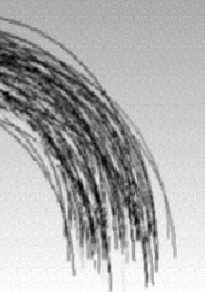
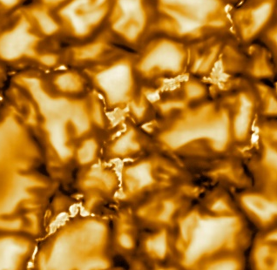
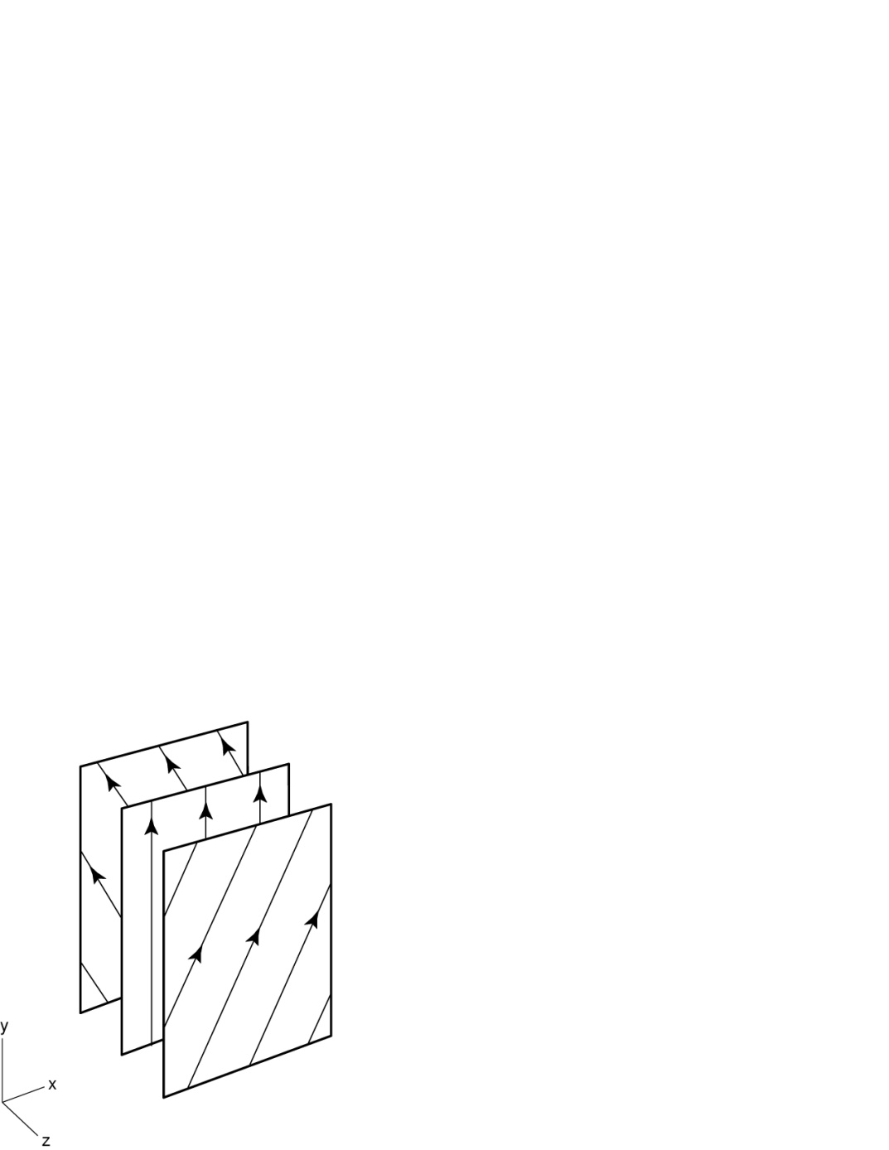
Hi-C
Corona
~ 1,000 km
nanoflare
~ 100,000 km
DKIST
~ 100 km
Photosphere
(solar surface)
current
sheet
≤ 0.1 km
Notes:
In current observations, not looking at individual strands.
Collective emission.
Could change in future: CMO – photon seive

Slide 4
Hi-C
Corona
~ 1,000 km
nanoflare
~ 100,000 km
DKIST
~ 100 km
Photosphere
(solar surface)
current
sheet
AGU Parker Lecture:
https://www.youtube.com/watch?v=rrg_cUlq0UQ
≤ 0.1 km

Slide 5
heating
radiation
thermal
cond.
flow (enthalpy)
radiation
Notes:
200 s and 20 s nanoflares with the same total energy.

Slide 6
heating
radiation
Lars Daldorff
Magnetic Reconnection
Rate Theory
thermal
cond.
flow (enthalpy)
radiation
Notes:
200 s and 20 s nanoflares with the same total energy.

Slide 7
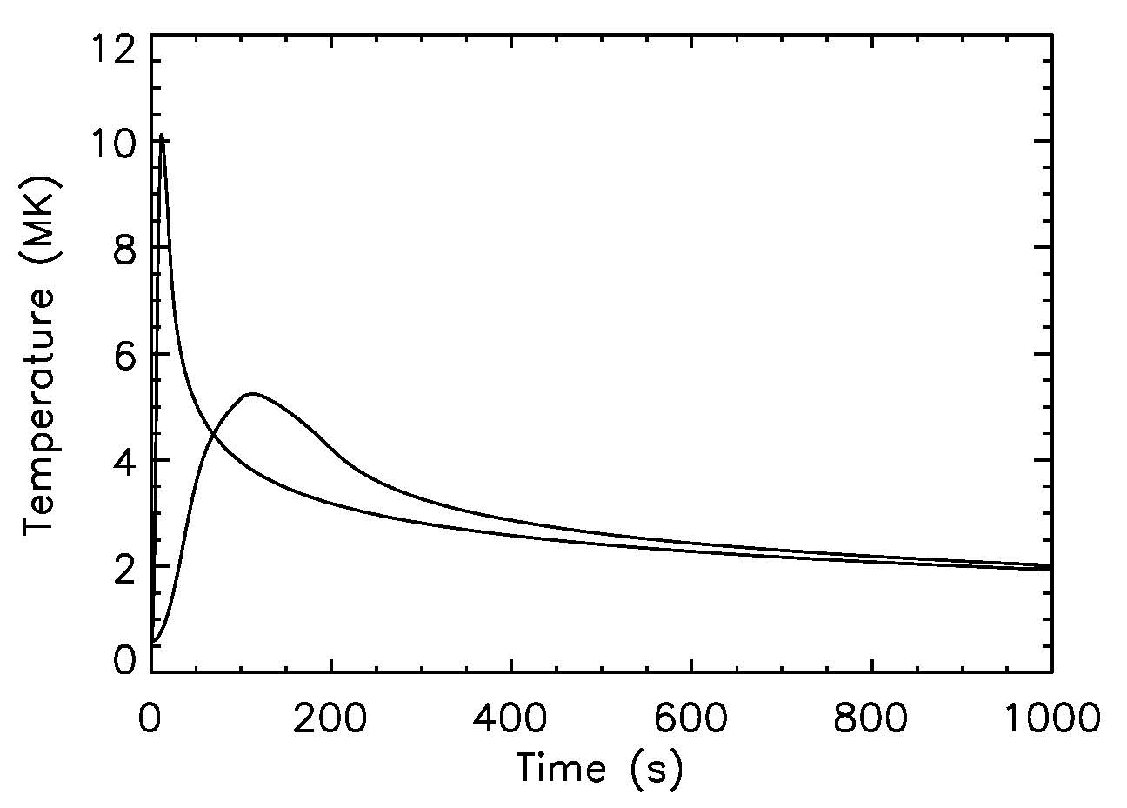
heating
radiation
Lars Daldorff
Magnetic Reconnection
Rate Theory
thermal
cond.
flow (enthalpy)
radiation
Fast nanoflare
Jeffrey Brosius
Temperature
Observations
Slow nanoflare
Notes:
200 s and 20 s nanoflares with the same total energy.

Slide 8
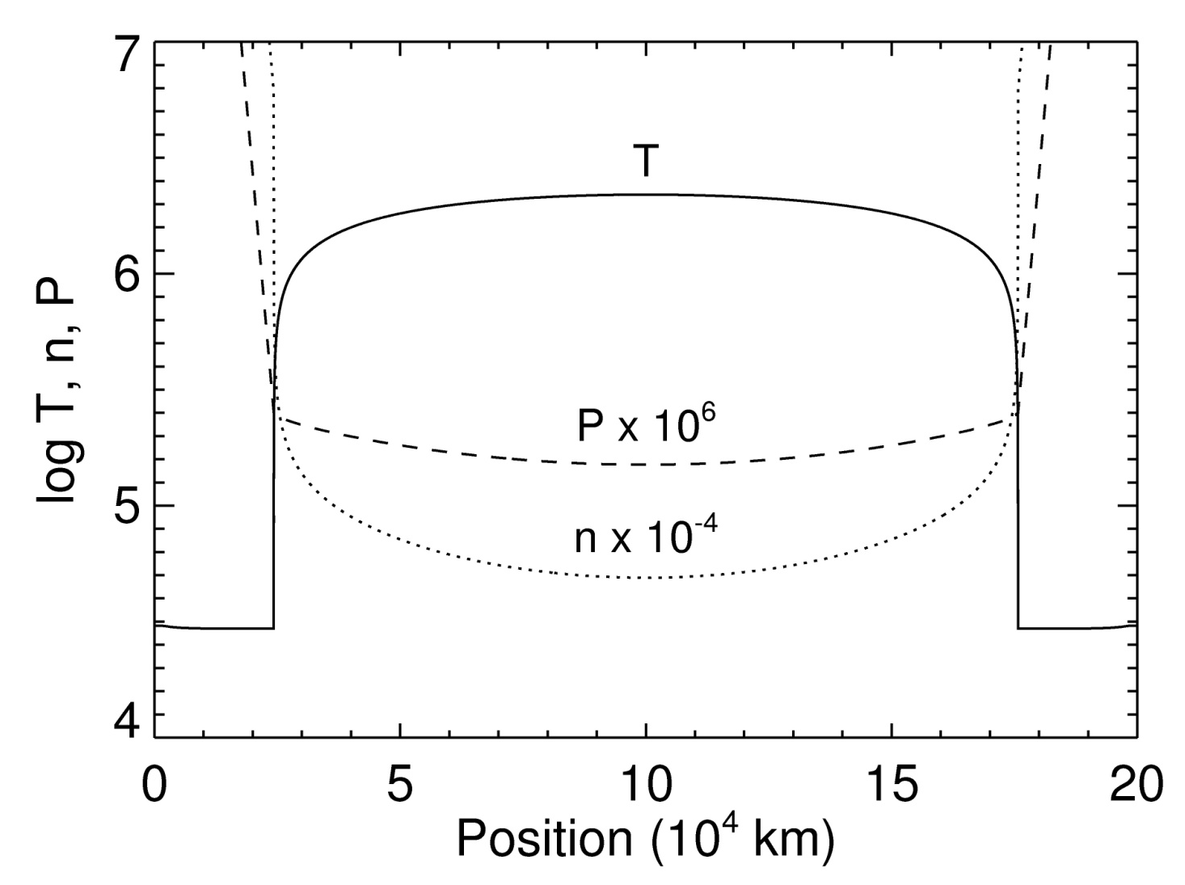
heating
radiation
Lars Daldorff
Magnetic Reconnection
Rate Theory
thermal
cond.
flow (enthalpy)
radiation
Fast nanoflare
Craig Johnston
Loop
Modeling
Jeffrey Brosius
Temperature
Observations
Slow nanoflare
Notes:
200 s and 20 s nanoflares with the same total energy.

Slide 9
Programmatics
Need for a center
  Complex, multi-faceted problem requiring a range of diverse and coordinated approaches
Benefit to science community
  Internationally recognized leaders in coronal heating research
  Magnetic reconnection is a fundamental physical process
  Numerical methods and tools
  Formal organization (Coronal Loops Workshop Series, 3 TESS sessions, etc.)
Training
  2 graduate students, 1 undergrad currently
  3 graduate students, 1 high schooler in original work package
Benefit to government and society
  Physics-based operational model of solar spectral irradiance (long-range goal)
  Int’l Space Weather Action Team (ISWAT) S2-06
  Spectral Irradiance Workshops
Scientific Productivity
  Oct. 1, 2021 – present: 16 papers published or submitted, 16 presentations
  Previous work package: 18 papers published, 94 presentations
  Total: 34 papers, 110 presentations
Notes:
Origins of the Spectral Irradiance and its Intermediate Timescale Variability

Slide 10
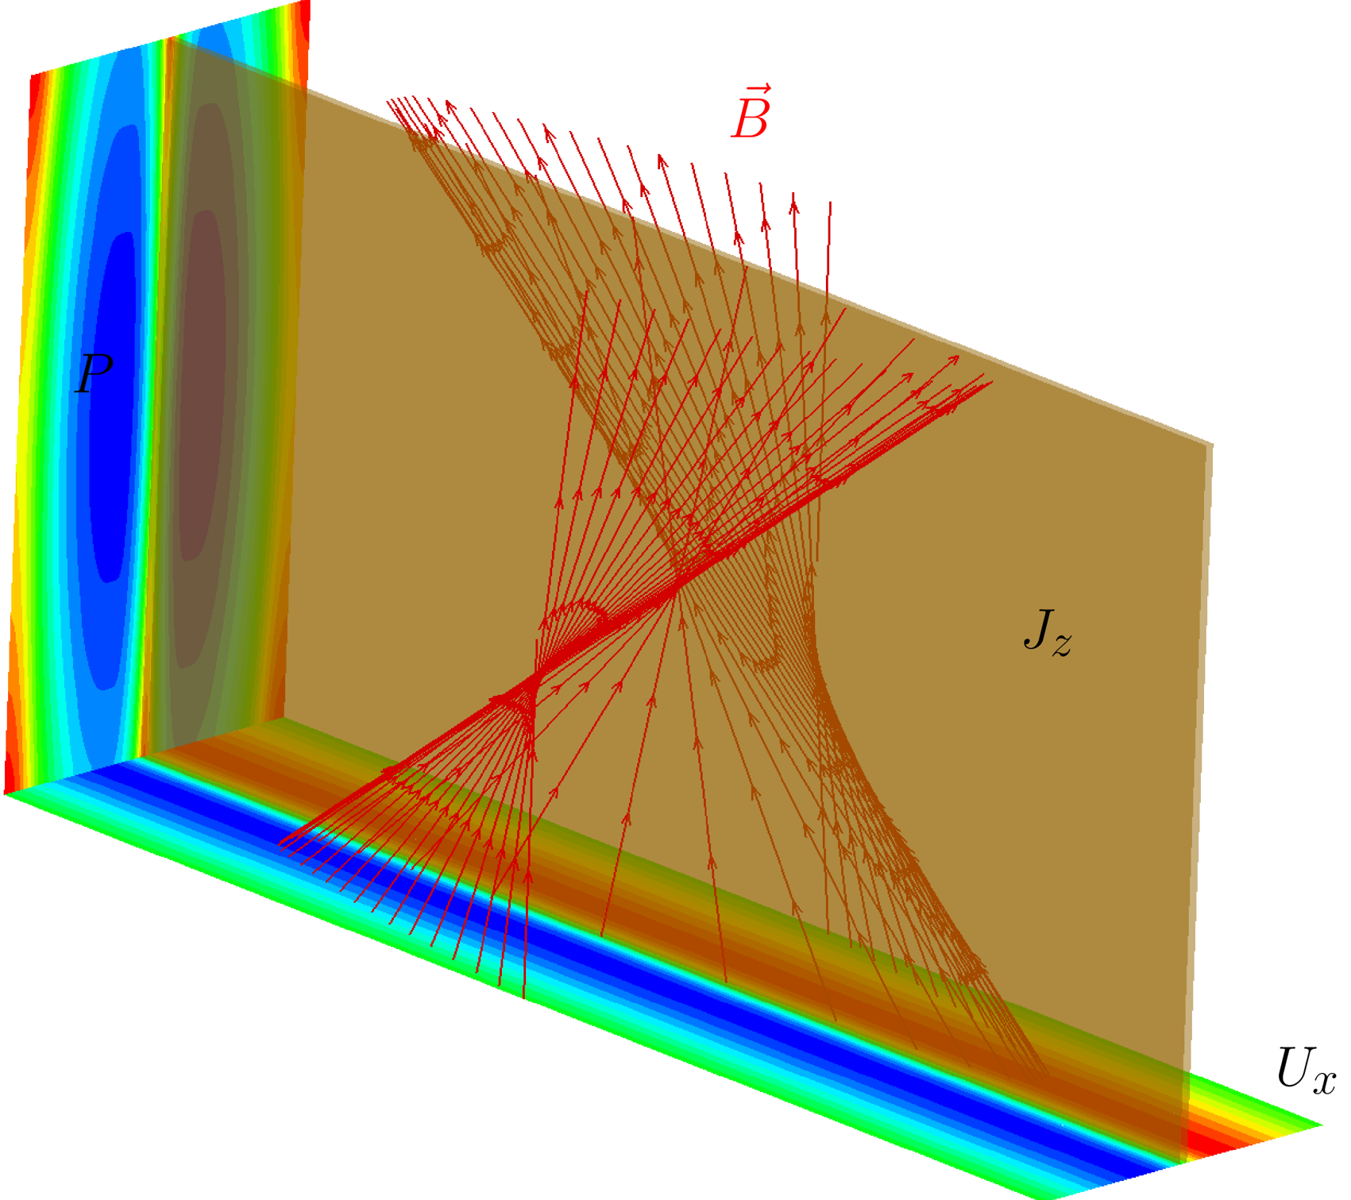
Magnetic Reconnection
A fundamental process that converts magnetic energy stored in the field to plasma kinetic and thermal energy.
Reconnection rate is typically characterized by the inflow and outflow velocities of the reconnection region.
How does the 3D nature of the process influence the reconnection rate?
Inflow
Inflow

Slide 11
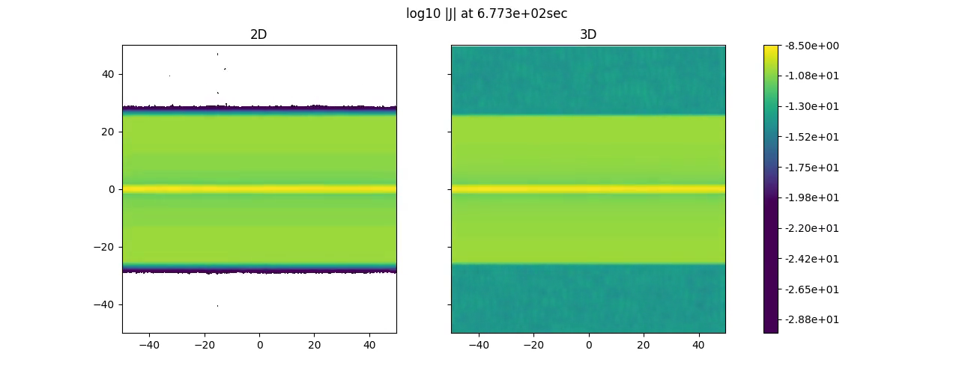
3D Complexity Reduces the Reconnection Rate
Reconnection in 2D involves the relatively simple formation, coalescence, and expulsion of plasmoids.
Tangling occurs in 3D, which impedes the orderly flow of magnetic flux into and out of the reconnection site.
Therefore, the reconnection process is less efficient in 3D.
Current (log10|J|)
2D
3D
Y [Mm]
X [Mm]
Laminar flows
Turbulent flows
Daldorff et al. 2022.

Slide 12
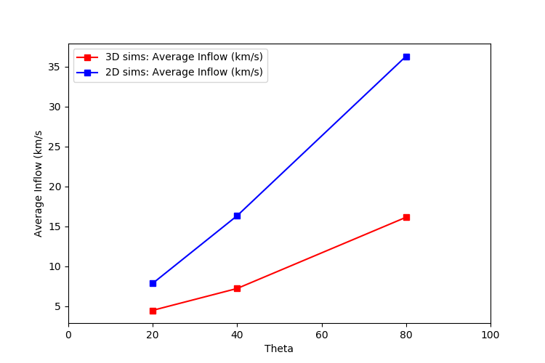
3D Complexity Reduces the Reconnection Rate
Faster inflows are associated with stronger reconnecting fields in both 2D & 3D.
The reconnection rate, as indicated by the speed of the inflow, is artificially exaggerated in 2D simulations.
The discrepancy between the 2D and 3D reconnection rates increases as the angle increases between the reconnecting and guide fields.
Inflow Velocity [km/s]
10
20
30
40
Angle of Reconnecting Field to Guide Field
Increasing Reconnecting Field
(Constant Guide Field)
Daldorff et al. 2022.

Slide 13
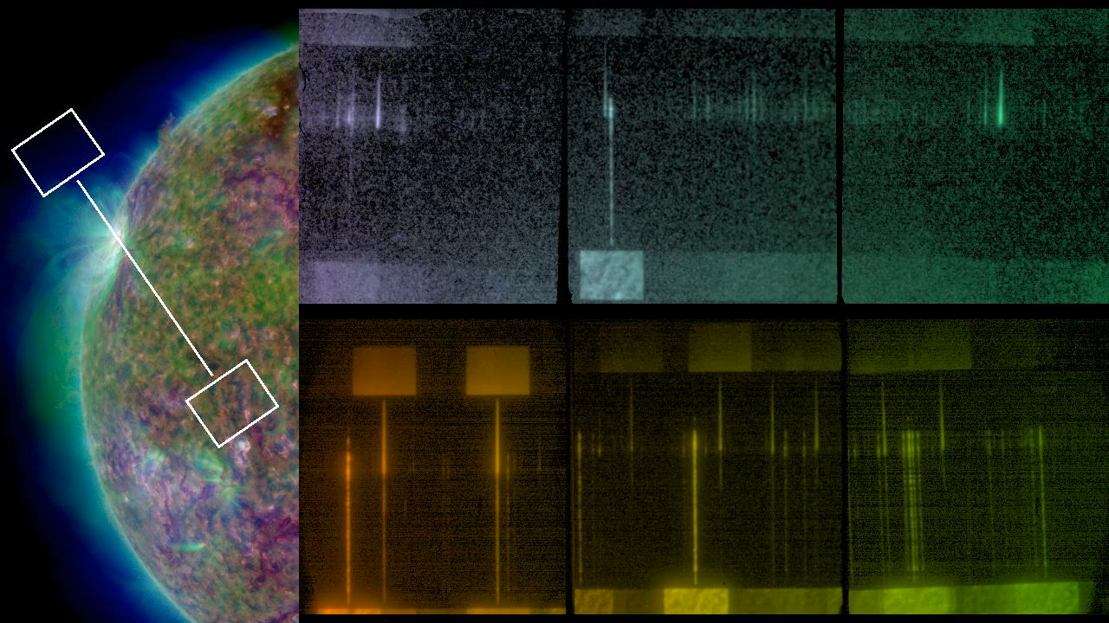
Evidence of Coronal Heating by Nanoflares Based on EUV and SXR Imaging Spectroscopy with EUNIS
Key objective: Assess nanoflare model of solar coronal heating using strong lines of Fe XVIII (7.1 MK) & XIX (8.9 MK) to detect
“smoking gun” evidence of nanoflares.
EUNIS Pointing and Spectra in Two Wavebands
EUNIS Relative Sensitivity at 92-115 Å

Slide 14
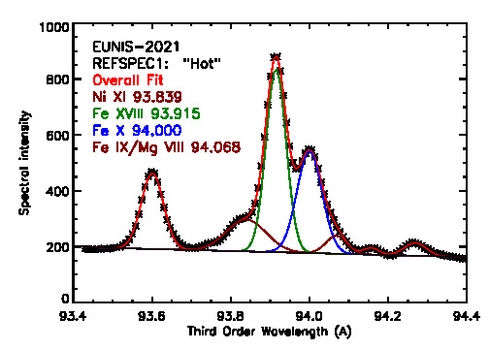
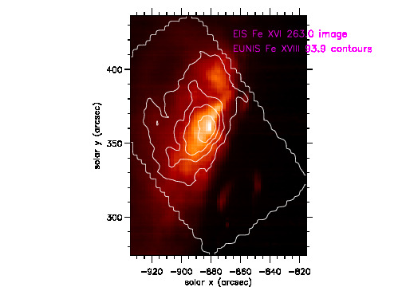
Mission success: EUNIS-2021 observed 100’s of lines in a bright, quiescent active region.
Fe XVIII and Fe XIX are observed over extended portion of active region.
Fe XVIII and Fe XIX constrain emission measure at high T; indicate small amount of plasma around 6 MK.
Additional work in progress on calibration, DEM, line widths, etc.

Slide 15
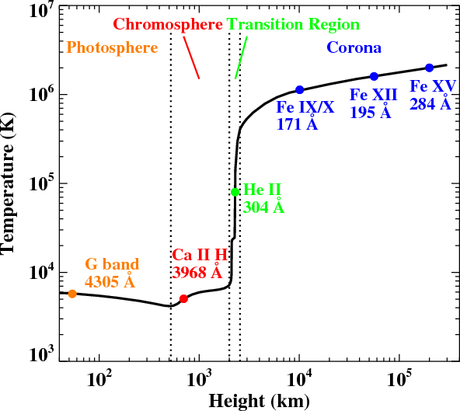
Solar Atmosphere
Simulating the plasma response to heating requires a physical connection between the corona, transition region and chromosphere.
Very difficult to fully resolve the steep temperature and density gradients in the transition region (< 1 km).
Density Reponse
Under-resolving the transition region results in coronal densities that are artificially low.
This can then lead to inaccurate conclusions when numerical predictions are compared with real observational data.
“Reality”
Better
resolution

Slide 16
Transition Region Adaptive Conduction (TRAC) Method
TRAC method increases the parallel thermal conductivity and decreases the radiative loss rate in a physically motivated way that:
  Broadens the transition region.
  Conserves the energy balance in the transition region and total amount of energy that is delivered to the chromosphere.
Density Reponse
Accurately captures the complete coronal heating and cooling cycle with low spatial resolutions (100 km).
Make meaningful comparisons between MHD simulations and observations.
“Reality”
“Reality”
Johnston & Bradshaw 2019 & Johnston et al. 2020, 2021.

Slide 17
MHD Simulations of Impulsive Heating
$$Q$$
$$B$$
$$Q$$
$$B$$
Johnston et al. 2021.

Slide 18
Our team is unique in the world – the only one investigating all aspects of the coronal heating problem using a coordination of theory, modeling, and observations.
We have highlighted just a few of them here.
See our publication list for a full appreciation of how comprehensive our approach is.
Notes:
Origins of the Spectral Irradiance and its Intermediate Timescale Variability

