Slide 1

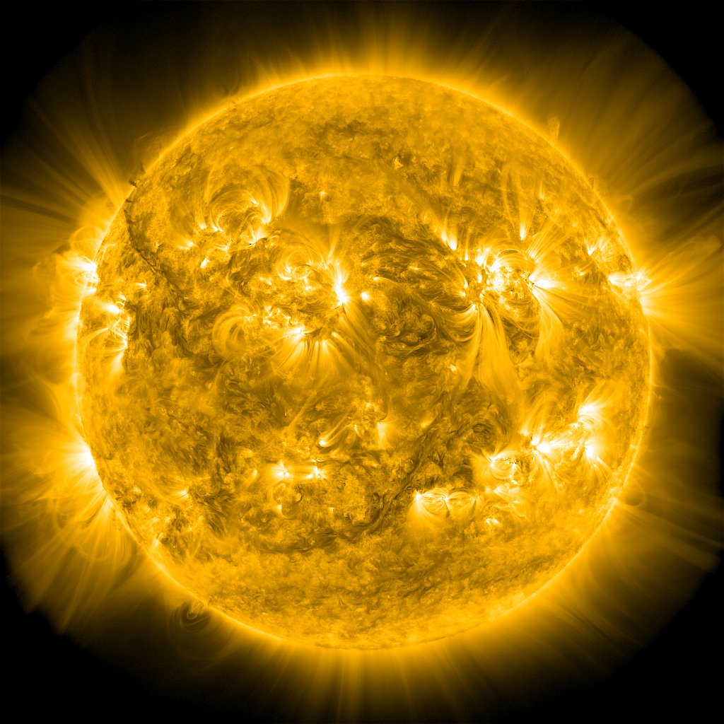

The Unavoidable Thinning
of Current Sheets
James A. Klimchuk ¹
James E. Leake ¹
Lars K. S. Daldorff ^{1,2}
Craig D. Johnston ^{1,3}
¹ NASA Goddard Space Flight Center
² Catholic University of America
³ George Mason University
0

Slide 2
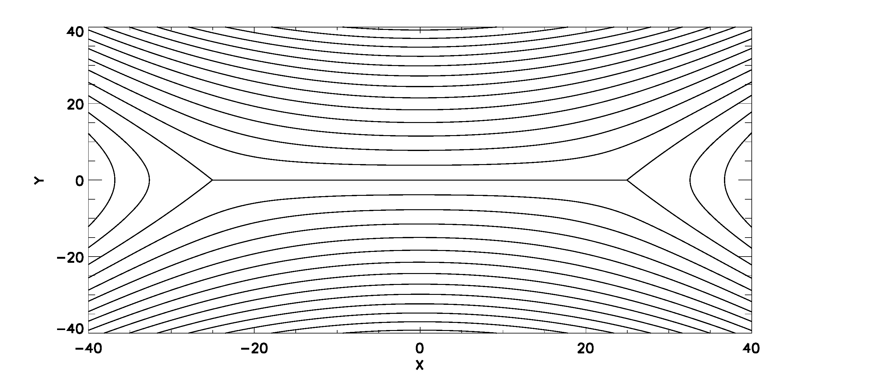
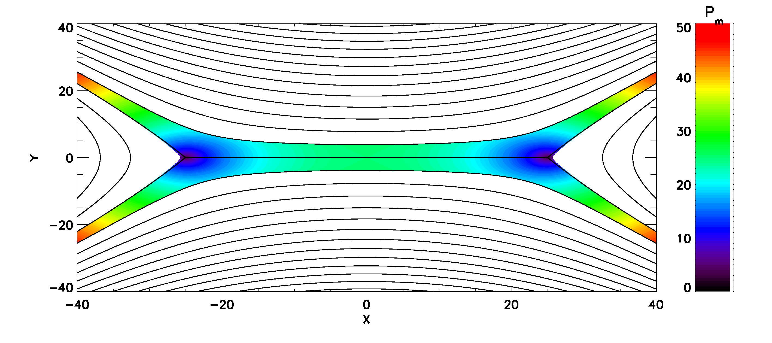
Infinitely thin current sheet
magnetic pressure
Green (1965)

Slide 3
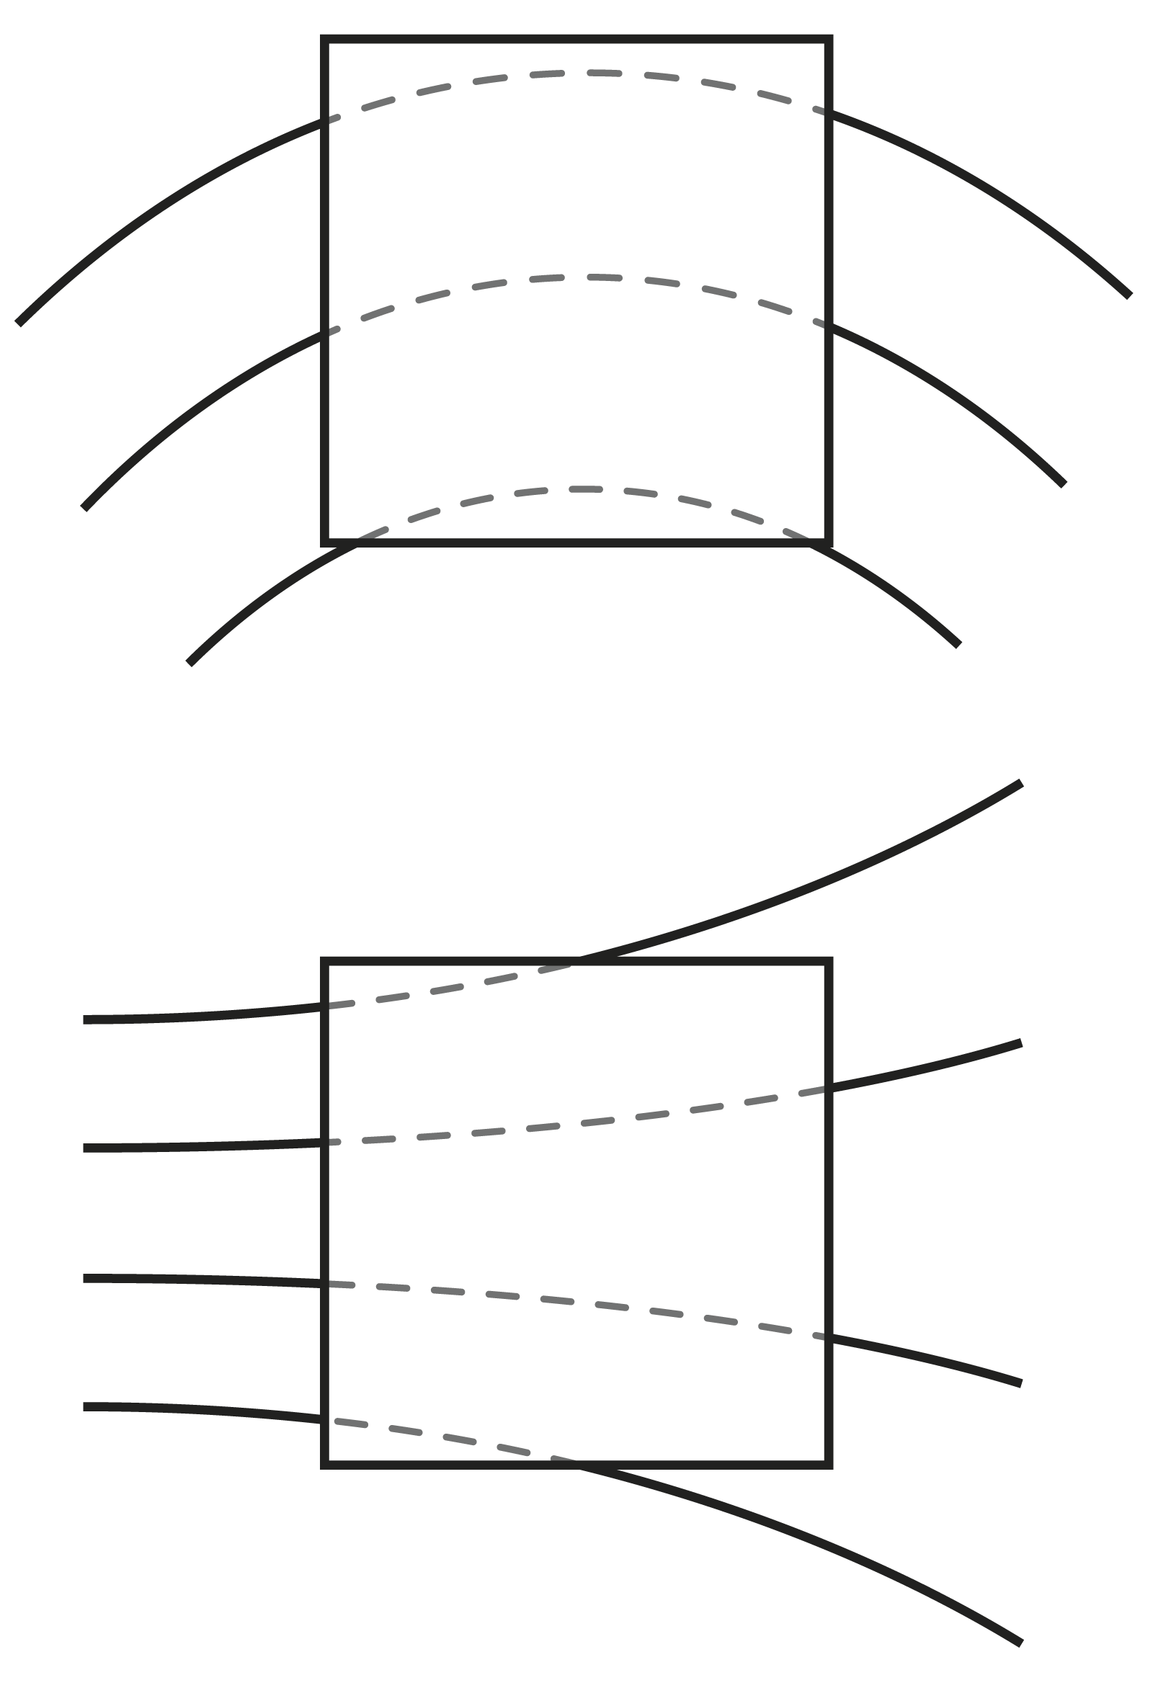

Slide 4
Infinitely thin current sheet
magnetic pressure
Green (1965)

Slide 5
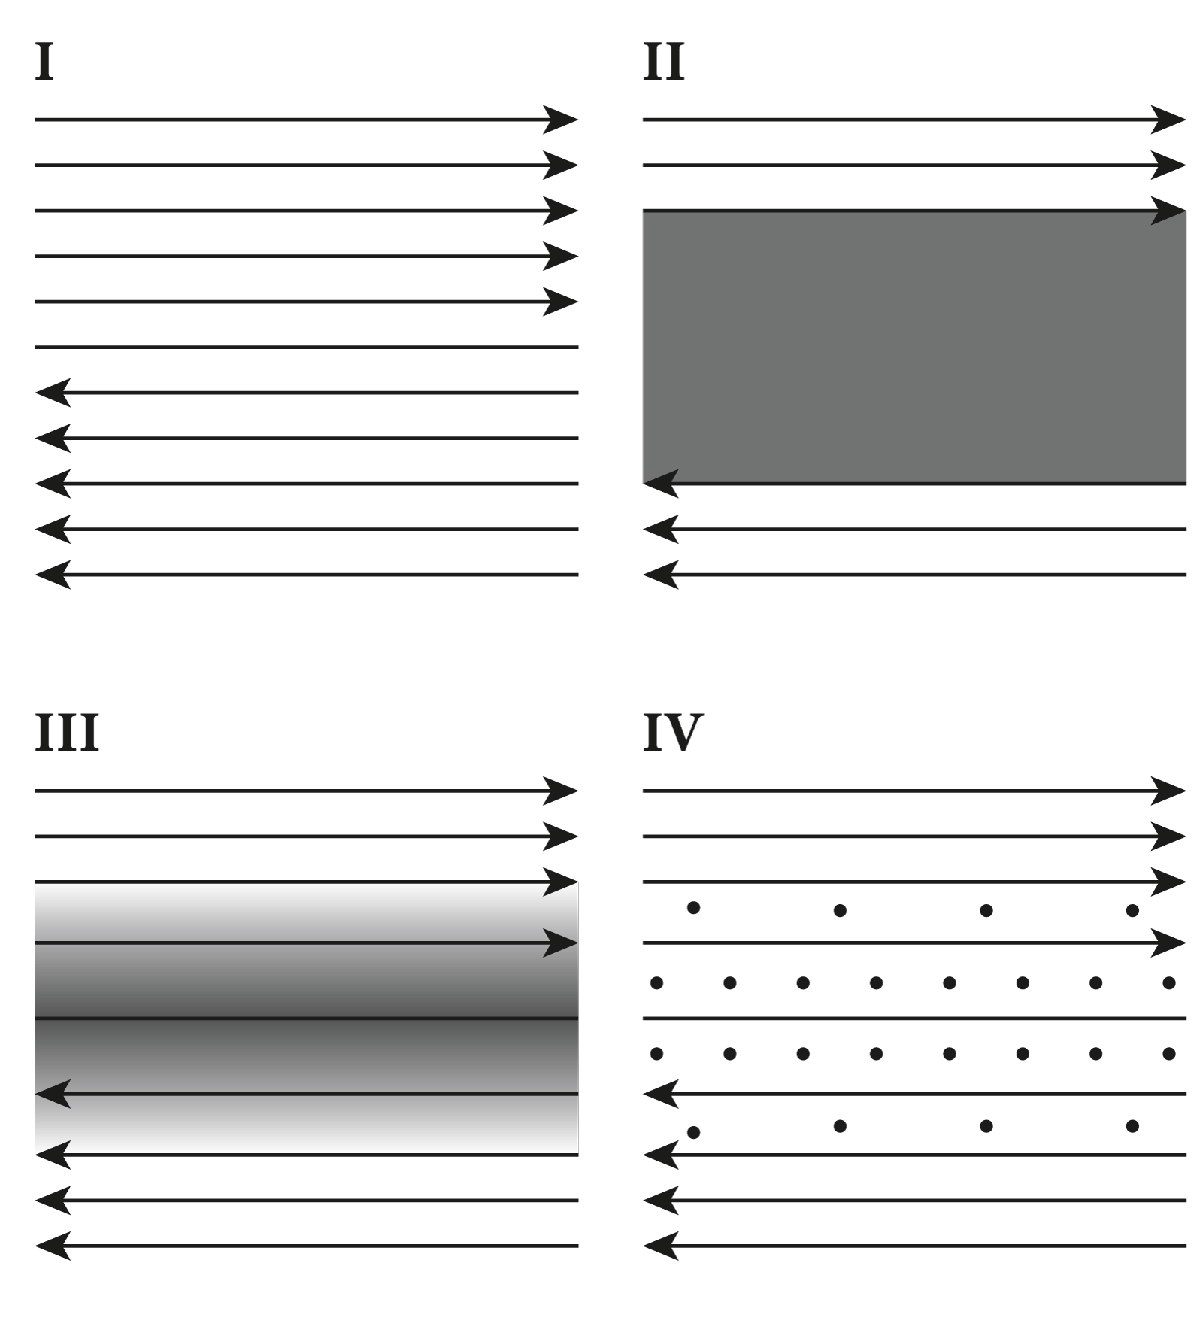

Slide 6
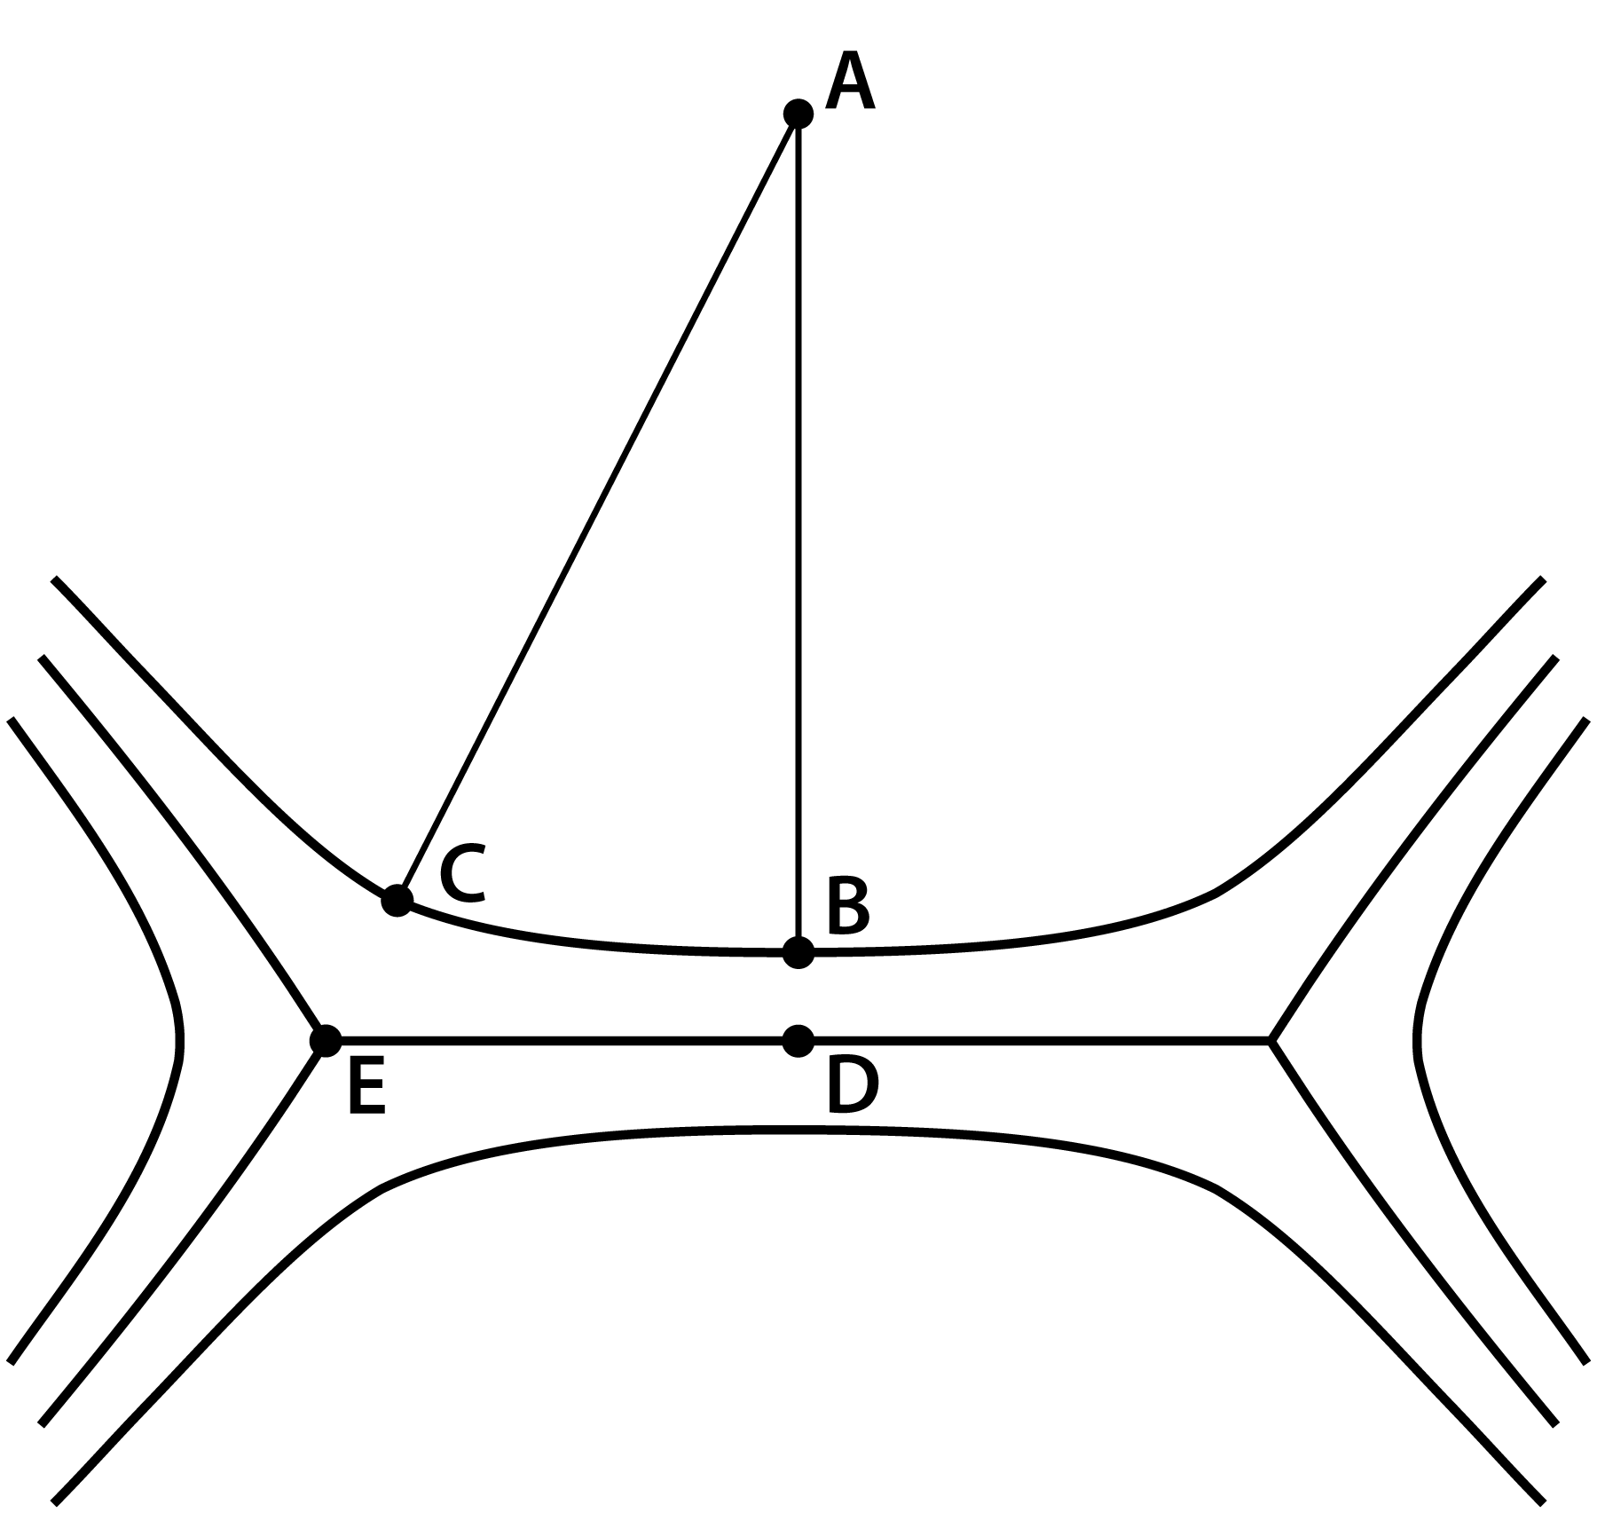
B
D

Slide 7

B
D
$$P_{tot,C}<P_{tot,E}$$

Slide 8
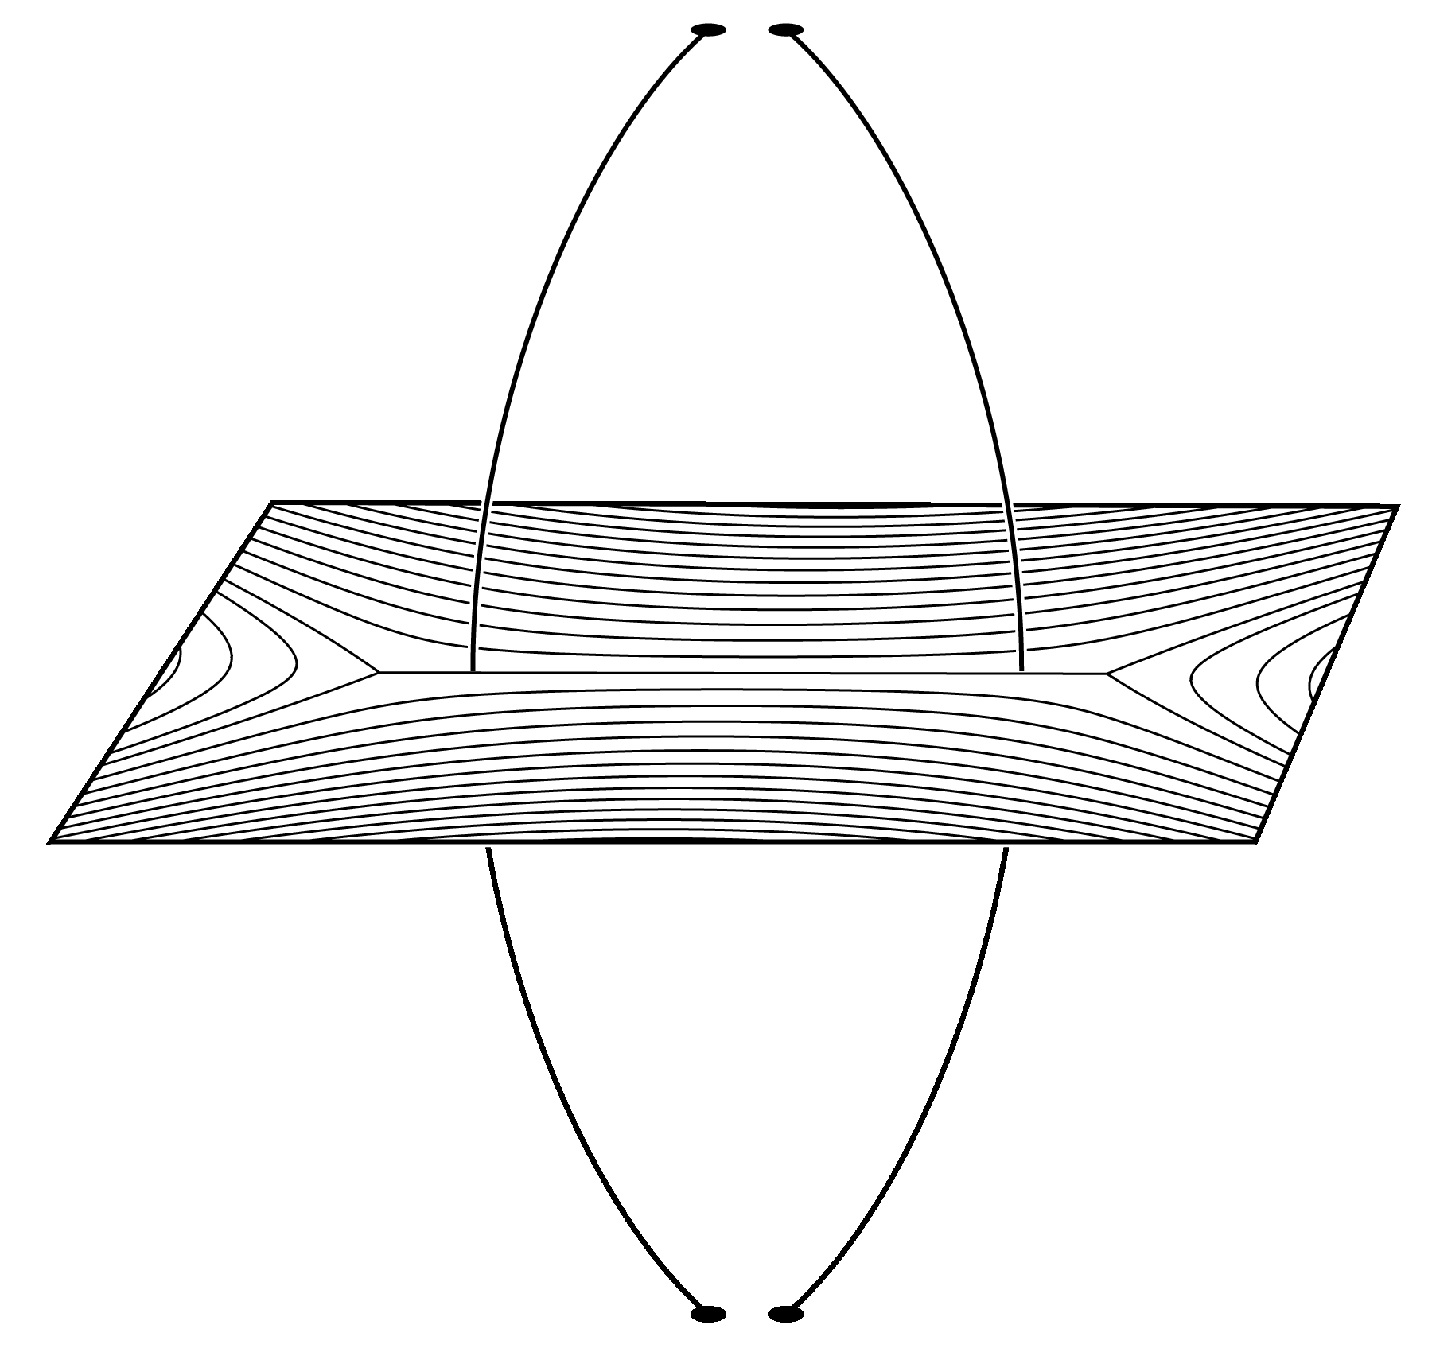
R_{c}/L ~ 0.5
Separation of the line-tying locations is comparable to the sheet half-length

