Slide 1
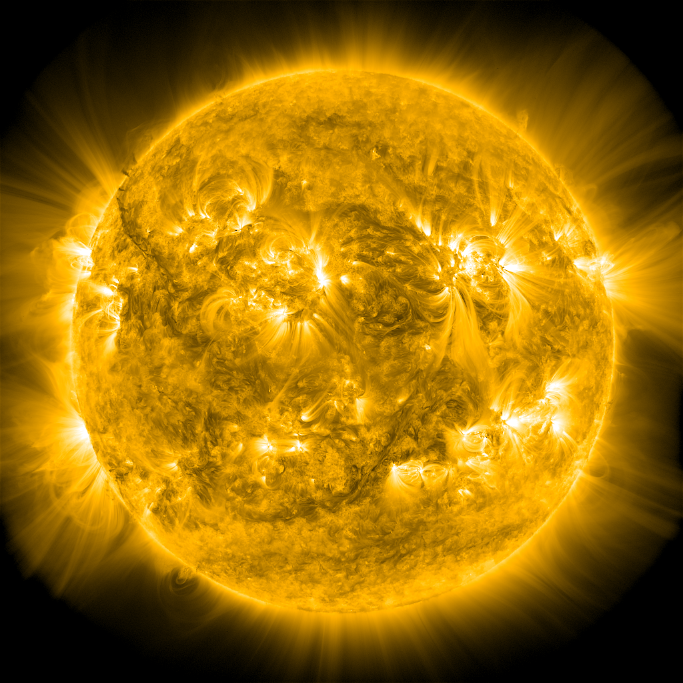
Turbulence and the Formation
of Coronal Current Sheets
James A. Klimchuk
Spiro K. Antiochos
NASA Goddard Space Flight Center
Klimchuk, J.A., & Antiochos, S.K. 2021, Front. Astron. Space Sci., 8, 662861
Notes:
Today, I’d like to discuss current sheets and the important role that they play in heating the corona.
Very little of what I will say is truly new, but I will emphasize some points that are highly underappreciated.
There are two main take-aways:
First, current sheets are far more numerous in the corona than most people realize.
Second, the magnetically-closed corona is fundamentally different from an open system like the solar wind.
The solar wind is clearly turbulent.
Instability and reconnection of the current sheets in the closed corona will produce complex messy dynamics,
but I believe it is misleading to characterize the closed corona as turbulent, as some people have done.

Slide 2
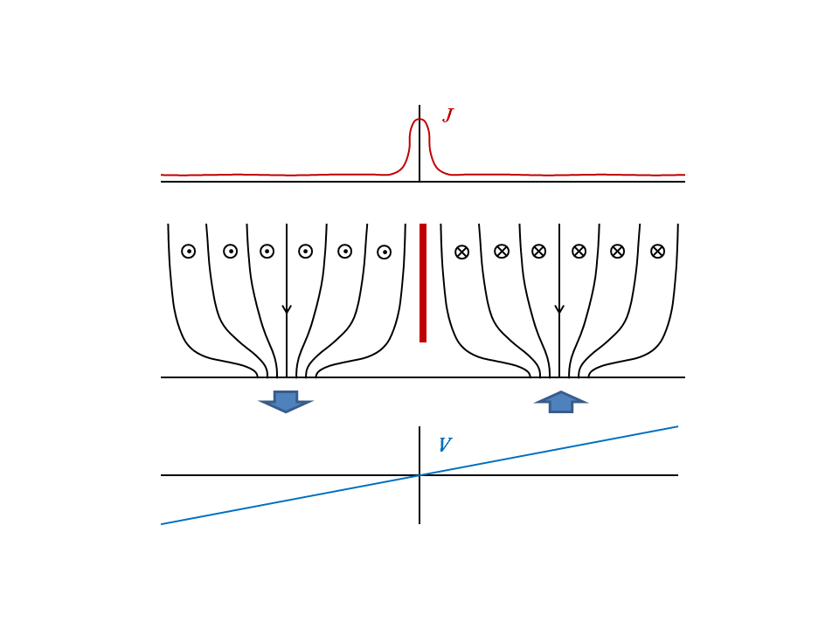
Fragmented Photospheric Magnetic Field
Notes:
As a consequence of the clumping and the flows there will be current sheets at the boundaries between the tubes up in the corona.
Indicated schematically in this cartoon.
Two kG tubes of negative polarity; field pointing downward.
Field flares out rapidly with height to become space filling in the low-beta corona.
Suppose there are smoothly varying flows in photosphere, with no steep gradients, such as indicated by this velocity profile.
Magnetic footpoints pulled out of board on left, and pushed into board on right.
Creates horizontal field component of opposite sign in the two tubes.
Because nearby field lines on either side of the boundary map to widely separate footpoints,
there is a sharp jump in the horizontal field across the boundary, and this implies a strong current sheet.
There are roughly 100,000 kG flux tubes in an active region, so expect at least 100,000 current sheets.

Slide 3
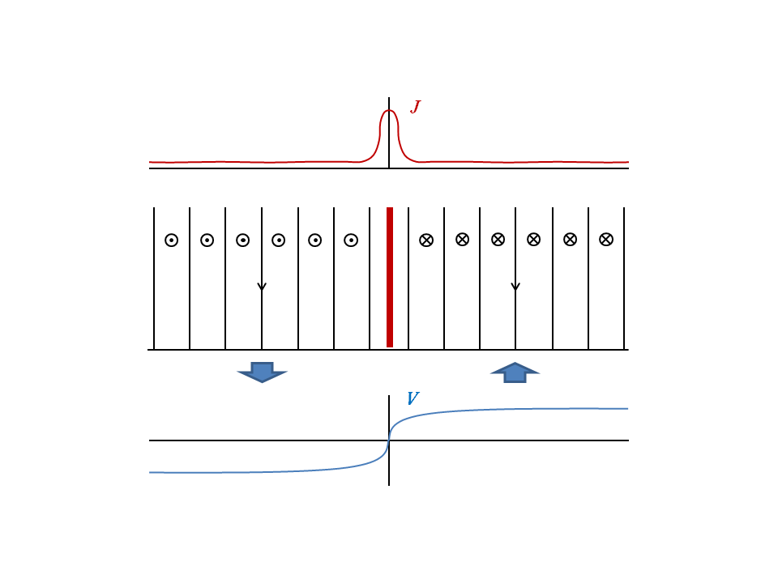
Complex Photospheric Driving
Notes:
Say at least, because current sheets will form even without a clumpy field.
Real photosphere flows are complex,
with places of steep gradient and stagnation points.
This cartoon shows how a steep gradient will produce a current sheet even in uniform continuous field.
Even without steep gradients, current sheets will form.
Aad van Ballegooijen demonstrated some time ago that a changing pattern of simple flow will cause the
currents in the corona to get progressively thinner and more intense at an exponential rate.
This can rather quickly lead to current sheets.

Slide 4
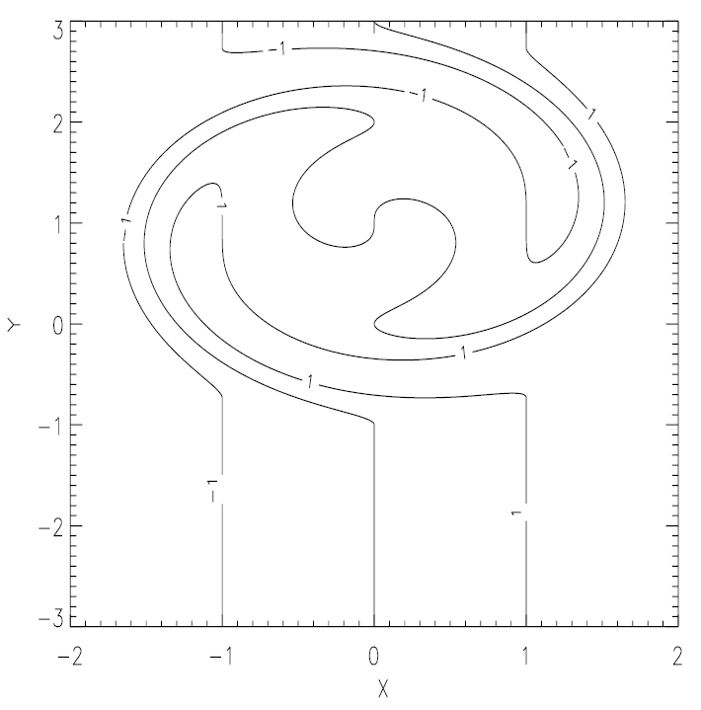
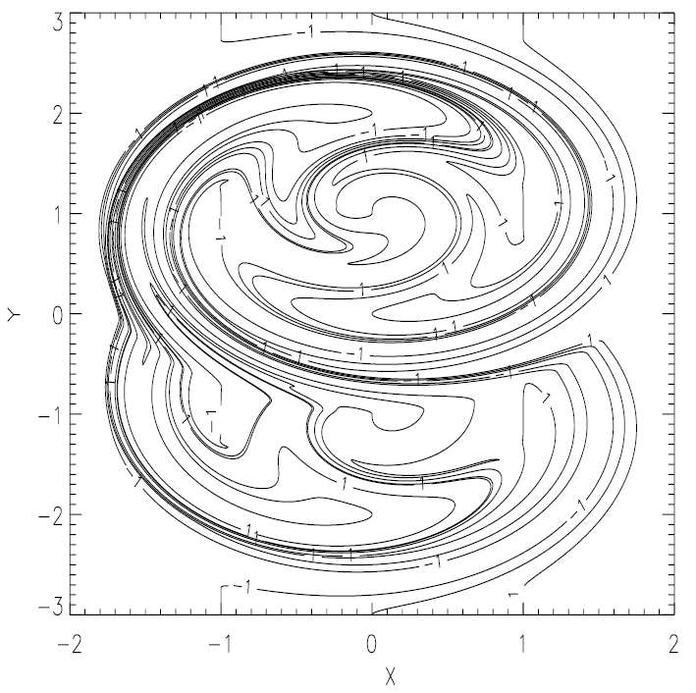
Steep Velocity Gradients NOT Necessary
One Half Turn
Four Half Turns
Euler
Potential
Antiochos & Dahlburg (1997)
Current density grows at an exponential rate (van Ballegooijen 1986)
Notes:
Alpha, Euler potential, initially straight lines at constant x.
Four alternating half turns at (0,1) clockwise and (0,-1) counterclockwise.
Velocity gradients everywhere shallow.
Gradients in alpha (connectivity) grow exponentially.

Slide 5
Partial Flux Tube Reconnection
Partial reconnection doubles the number of topologically distinct flux tubes from 2 to 4.
Doubles the number of separatrix surfaces that become current sheets.
Notes:
Current sheets are the sites of reconnection, so flux tubes will reconnect with their neighbors.
If they fully reconnect, then start with two flux tubes and end up with two different flux tubes,
with different footpoint connectivity.
But if the reconnection is partial, which is far more likely, the number of topologically distinct tubes increases from 2 to 4.
Doubles the number of separatrix surfaces at the boundaries between tubes,
which ultimately means a doubling of the number of current sheets.
Since each tube can reconnect with multiple partners, there is a proliferation in the number of current sheets.

Slide 6
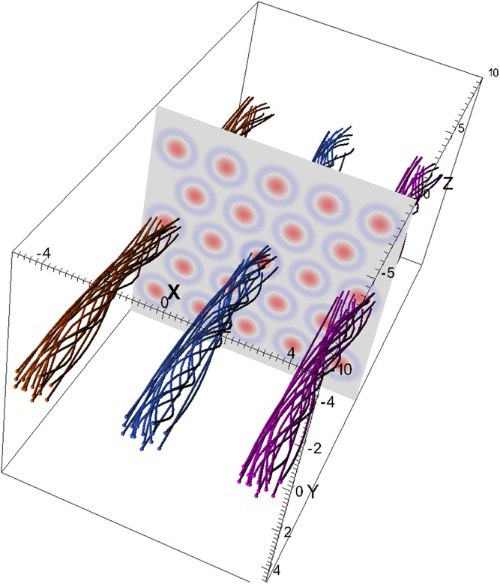
Ideal and Quasi-ideal Instabilities
Multiple Twisted Strands
Hood et al. (2016)
Notes:
Yet another way to produce current sheets is with ideal and quasi-ideal instabilities, like the internal kink instability.

Slide 7
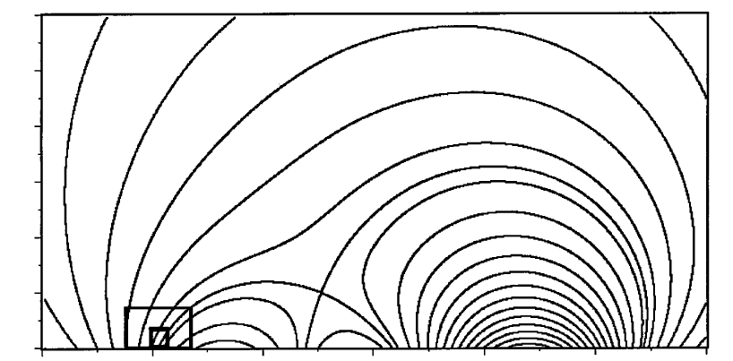
Reconnection Driven Current Filamentation
Current Density
Karpen, Antiochos & Devore (1996)

Slide 8
Turbulence
Hydrodynamic Turbulence
System self organizes into a continuum of eddies that transfer energy without loss from large spatial scales, where it is injected, to progressively smaller spatial scales, where it is dissipated.
Inertial range energy power spectrum:
E ∝ k ^{-α} , α = 5/3 (Kolmogorov)
MHD Turbulence in an Open System
magnetic energy = kinetic energy
E ∝ k ^{-α} , α = 1.5 – 2.0
Spatial and temporal intermittency
Counter streaming Alfven waves
Notes:
MHD turbulence has mostly been studied in open systems, the solar wind being a prime example.
System self organizes into a continuum of eddies of differing size, which
transfer energy from the largest scales, where it is injected, to the smallest scales where it can be dissipated.
Inertial range.
Equipartition between magnetic and kinetic energy.
Both have a power spectrum that is a power law with a slope of 1.5-2, depending on whether the turbulence is
weak or strong, isotropic or anisotropic.
Magnetically closed corona is fundamentally different.
Field lines are rooted in the photosphere at both ends.
This line tying places strong constraints on any turbulence.
What do simulations of the closed corona show.
Have been a number of simulations where chaotic-type footpoint driving is imposed that represents photospheric convection.
Here’s an example from Rappazzo et al..
Magnetic and kinetic energy, averaged over volume, as function of time.
Mag energy 100 times kinetic.
Power spectrum; slopes different.
Clearly the behavior is different from MHD turbulence in an open system.
Calling it MHD turbulence may be misleading.
We believe the behavior is as follows.

Slide 9
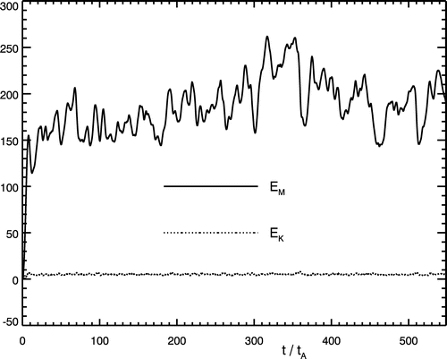
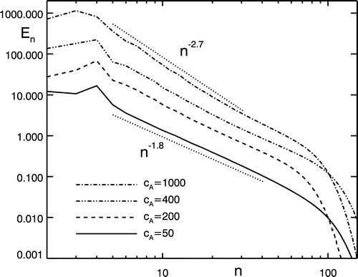
MHD Turbulence in a Closed System (?)
Line-tied low-β field lines resist bending
Simulations of the “Parker problem”
magnetic energy = 100 x kinetic energy (not equal)
E ∝ k ^{-α} , α_{M} = 1.8 – 2.7 (magnetic) , α_{K} = 0.5 (kinetic) (not 1.5-2)
Fourier Power Spectra
magnetic
energy
energy
kinetic
time
wavenumber
Rappazzo et al. (2008)
Notes:
MHD turbulence has mostly been studied in open systems, the solar wind being a prime example.
System self organizes into a continuum of eddies of differing size, which
transfer energy from the largest scales, where it is injected, to the smallest scales where it can be dissipated.
Inertial range.
Equipartition between magnetic and kinetic energy.
Both have a power spectrum that is a power law with a slope of 1.5-2, depending on whether the turbulence is
weak or strong, isotropic or anisotropic.
Magnetically closed corona is fundamentally different.
Field lines are rooted in the photosphere at both ends.
This line tying places strong constraints on any turbulence.
What do simulations of the closed corona show.
Have been a number of simulations where chaotic-type footpoint driving is imposed that represents photospheric convection.
Here’s an example from Rappazzo et al..
Magnetic and kinetic energy, averaged over volume, as function of time.
Mag energy 100 times kinetic.
Power spectrum; slopes different.
Clearly the behavior is different from MHD turbulence in an open system.
Calling it MHD turbulence may be misleading.
We believe the behavior is as follows.

Slide 10
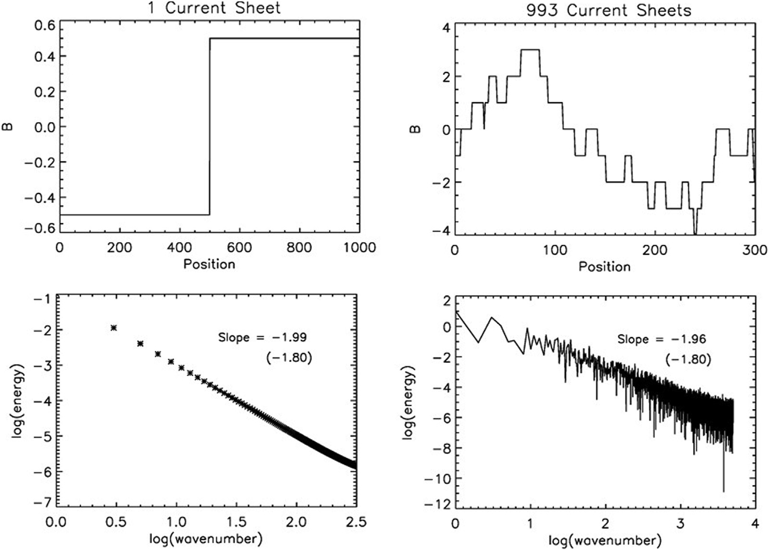
Current Sheet Power Spectra
Klimchuk, J.A., & Antiochos, S.K. 2021, Front. Astron. Space Sci., 8, 662861

Slide 11
Our Interpretation
Magnetic power spectrum is dominated by quasi-static current sheets.
Could exist a “hidden” component due to turbulent fluctuations.
But why does the kinetic spectrum have α_{K} = 0.5 if due to turbulence?
α_{K} < 1 implies more energy in small scales, at fundamental odds with turbulence!
How to explain α_{K} = 0.5?
Distribution of reconnecting current sheet sizes?
Avalanches?
How to explain magnetic α_{M} = 1.8 – 2.7 (not 2.0)?
Distribution of current sheet spacings?
(example had flat distribution)

Slide 12
Our Perspective
The magnetically closed corona evolves quasi-statically in response to slow footpoint motions.
When an instability threshold is met, there is a localized burst of turbulent activity.
The turbulent activity subsides, and quasi-static evolution resumes.
The corona is not in a perpetual state of fully-developed turbulence.
Nonetheless, turbulent episodes are numerous and widespread, with many occurring at the same time across an active region.
What fraction of the coronal volume is turbulent, on average?
Depends on:
Number density of sheets
Frequency of instability
Fraction of reconnection events that become turbulent
Decay time of the turbulence
Turbulent cascade begins at the scale of the current sheet, not the scale of the driving.

