Slide 1
Heating of the Magnetically Closed Corona: Science Questions
Determine when, where, and why nanoflares occur, and how the impulsively heated plasma responds to produced the inhomogeneous thermal structure of the corona?
Examine nanoflare properties such as their magnitude, recurrence frequency and height distribution.
Investigate how nanoflares behave collectively to produce observational features such as coronal loops.
Provide the physical understanding necessary to develop improved operational models for predicting solar spectral irradiance variability on timescales of one to several days.

Slide 2
Key Observational Tests for the Multi-Strand Simulations
Coronal images of ARs have two components:
- Diffuse component (due to random nanoflares).
- Distinct bright loops (bundles of unresolved strands that are heated by storms of nanoflares).
Observed loops in traditional coronal lines have:
- Widths averaging 1,000 km.
- Typical lifetimes of a few thousand seconds, but ranging between 600 – 18,000 s.
Correlation between intensity and width along coronal loops indicates that the cross sections are approximately circular.
- Emission can be concentrated in small irregular patches, but these patches must be distributed quasi-uniformly within an envelope that has an aspect ratio of order unity.
- Nanoflare storms have an avalanche nature, where one event triggers subsequent events. If the process begins at one location and spreads out equally in all transverse directions, then a circular shape is expected.

Slide 3
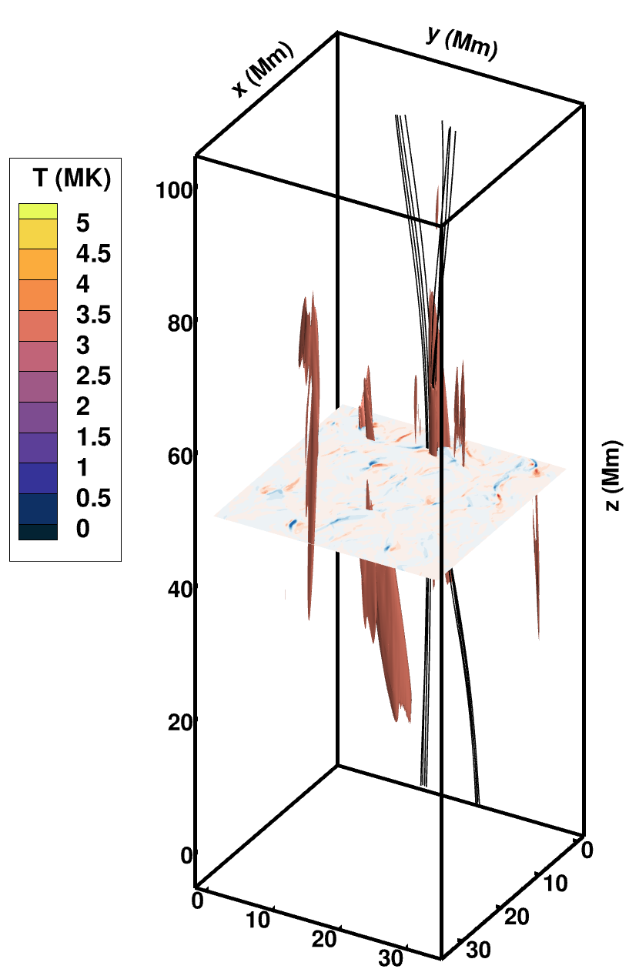
Reconnection Event – t = 68 mins
Capturing explosive energy release from narrow current sheets: converting magnetic energy into kinetic and then thermal energy through viscous dissipation of the shocks.
Notes:
Yes, so I’m going to present some exciting new results from our multi-strand MHD simulations of coronal heating.
Here I am showing an overview of our simulation box, where the top and bottom planes represent the photosphere, which is where we are imposing complex motions to displace the magnetic field lines, causing them to become twisted and tangled.
We simulate a fully stratified atmosphere in z and include the effects of field aligned thermal conduction and optically thin radiation to model the plasma response to any resulting heating and cooling.
Inside the box I am showing a particular set of field lines that are associated with a reconnection event which I’m going to discuss in detail shortly. The mid plane in z shows contours of the Vx horizonatal velocities and the surfaces shown are isosurfaces of plasma at 3.5 MK.
So here I am going to show a movie of a subset of the simulation domain that focusses on the region around the X-point field for this particular snapshot. The movie tilts the field lines forward so that we can look at their properties in the z plane.
We can see that our photospheric driving has formed two magnetic flux ropes, each with two distinguishable magnetic footpoints, seen here and here. However, we also see field lines that originated from these two flux ropes which have now reconnected and share a common footpoint, seen at the top here and the bottom here.
This picture is confirmed by the horizontal velocities because the reconnected field lines are found in the outflow regions here and here, and such outflow jets are a clear signature of the magnetic reconnection process.
The temperature isosurface then highlights localized heating that is co-spatial with these outflow jets. The other isosurfaces are associated with other nearby events.
The isosurface also shows that the localized heating gives rise to a heat flux that is conducted downwards along the field lines that are associated with the two legs of the X-point field, seen here and here. These two heat fronts will help us orientate the magnetic field on the next slide.
One feature that is super exciting about this simulation is that we are clearly capturing the explosive energy release from narrow current sheets, via magnetic reconnection where we are converting magnetic energy into kinetic and then thermal energy through viscous dissipation of the shocks, as takes place on the Sun. This represents a significant step forward towards more realistic coronal heating simulations because most other MHD models involve passive energy release through Ohmic dissipation of broad current sheets.

Slide 4
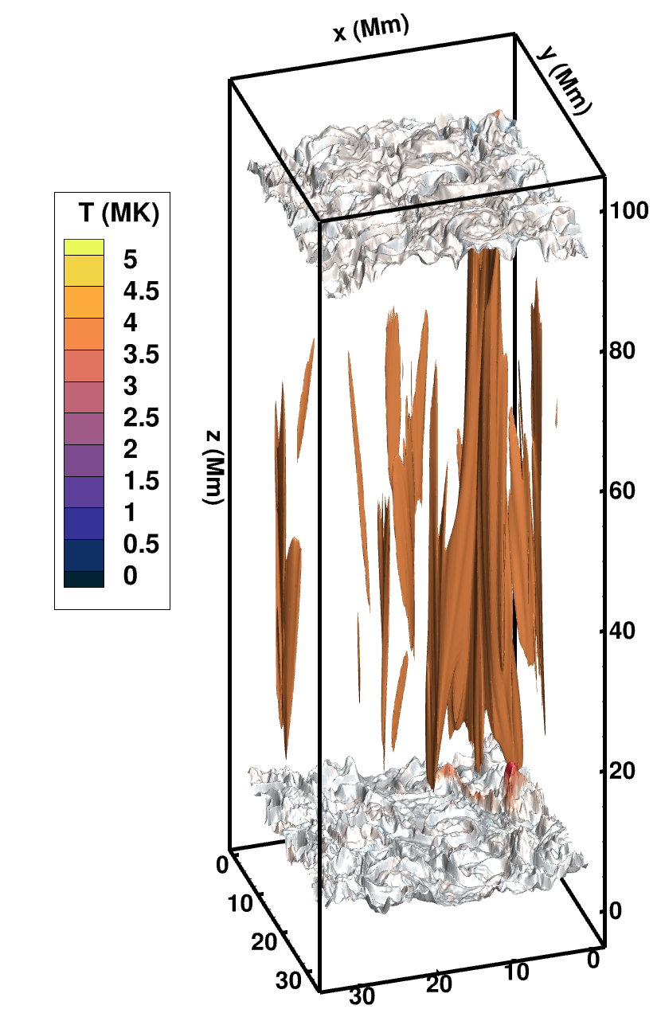
Evaporative Response – t = 71 mins
Capturing evaporative response of the plasma to the explosive energy release, allowing us to make meaningful comparisons with observations.
Notes:
So now I am showing a snapshot that is taken 3 minutes after the previous slide. At this time, we have reconnected more of the magnetic field that was associated with the two flux ropes. This heats the coronal plasma further and so the temperature isosurfaces are a different color now because they are representing hotter plasma at 4 MK.
We are also using these isosurfaces as a proxy for the magnetic field lines here because thermal conduction transports energy along the field lines.
New to this plot are the density isosurfaces at the base of the corona that are shaded in contours of the vertical Vz velocity.
Based on this representation of density, the shape of the isosurface would be flat if we had no flows. However, what we see is a very complex structure, indicating that upflows and downflows are present throughout.
So here on the RHS I am going to show a movie of the same subset of the simulation domain as before, which zooms in on the region around the lower density isosurface.
The increased coronal temperature drives an intense heat flux downwards along the field lines into the transition region, seen here as the two heat fronts that are propagating down the legs of the X-point field. The plasma is unable to radiate this extra conductive heating, and so the gas pressure increases locally. The resulting pressure gradient drives an upflow of dense material, seen here as this peak that intersects the T isosurface. This increases the coronal density and is often referred to as chromospheric evaporation. A process that is only possible to simulate in MHD models using the state-of-the-art TRAC method TRAC method that I introduced at the start of my talk.
Therefore, the second feature that is super exciting about this simulation is that we are accurately capturing the evaporative response of the plasma to the explosive energy release. This allows us to make meaningful comparisons between our simulations and observations.

Slide 5
335 Emissivity in the Z-Midplane
Many small seemingly uncorrelated brightenings that give the appearance of a twinkling throughout the plane.
Elongated structures that are comparable to the driver cell diameter.
Distinct clusters of brightenings that persist for longer than the individual features that comprise them, with an envelope that is roughly circular.
Each cluster encompasses several driver cells.

Slide 6
Emissivity in the Y-Midplane

Slide 7
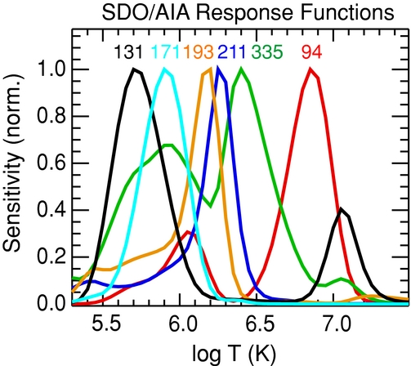
SDO/AIA Response Functions
$131 – 4×{10}^{5}\text{K}\text{,} { 10}^{7}\text{K} \text{\& 1.6 }×{10}^{7}\text{K}$.
$171 –\text{ 6.3}×{10}^{5}\text{K}$.
$1\text{93 }–\text{ 1.}2×{10}^{6}\text{K}\text{ \& }2×{10}^{7}K$.
$211 – 2×{10}^{6}\text{K}$.
$335 –\text{ 2.}5×{10}^{6}\text{K}\text{.}$
$94 –\text{ 6.}3×{10}^{6}\text{K}\text{.}$

