Slide 1
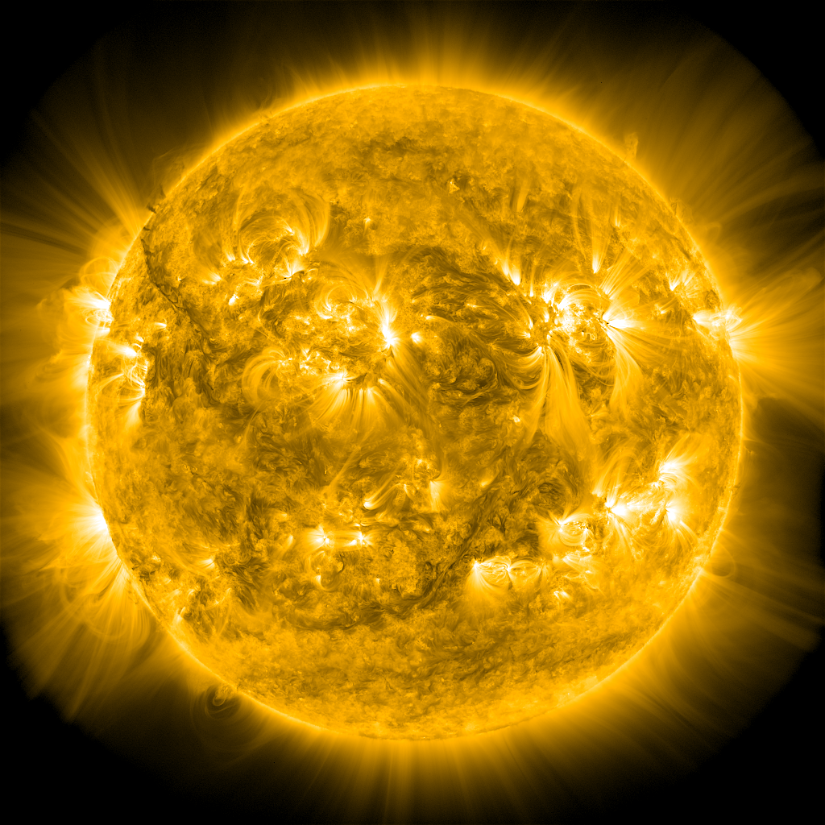
Heating of the
Magnetically Closed Corona
James Klimchuk, PI
Therese Kucera, Deputy
James Leake
Marcelo Lopez Fuentes
Cecilia MacCormack
Samuel Schonfeld
Shanwlee Sow Mondal
Jenny Rodriguez Gomez
Vadim Uritsky
Peter Young
Nicholeen Viall
Yihua Zhang
Vladimir Airapetian
Jeffrey Brosius
Sherry Chhabra
Ineke De Moortel
Lars Daldorff
Craig Johnston
Judith Karpen
Kalman Knizhnik
Pankaj Kumar
Italic – joined after start
Notes:
Magnetically closed corona
Team diverse in skill (observers, modelers, theorists), gender (43% women), age.

Slide 2
Problem:
Determine how the magnetically closed corona is heated and how the plasma responds to produce the spectrum of emitted radiation.
Long-term goal:
Develop a physics-based model of the solar spectral irradiance (SSI) with eventual operational capability.
Challenges:
Enormous range of spatial scales (> 6 orders magnitude)
Physical couplings between scales and between different parts of the atmosphere
Spatially unresolved features in observations (line-of-sight overlap)
Strategy:
Use a multi-faceted yet closely integrated (wholistic) approach
Requires a wide range of numerical and observational skills and frequent interactions
Ideally suited to a work package

Slide 3
Photospheric Convection: the Engine of Coronal Heating
Approved observing program to measure the flows
19,000 km (1% of solar diameter)
Daniel K. Inouye Solar Telescope (DKIST)
Notes:
30 km spatial resolution (0.04 arcsec)

Slide 4
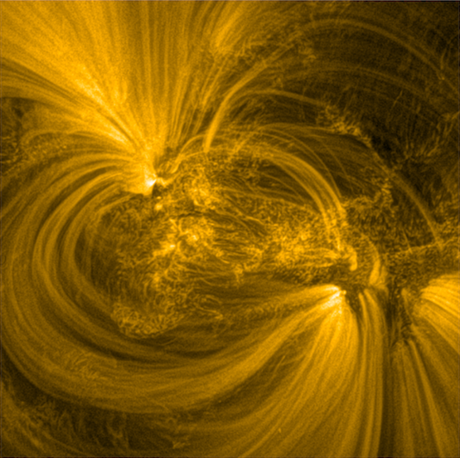
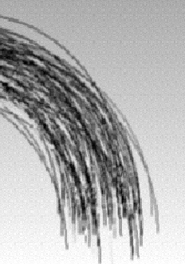
Hi-C
coronal strands
(flux tubes)
Corona
~ 1,000 km
nanoflare
~ 100,000 km
DKIST
~ 100 km
Photosphere
(solar surface)
current
sheet
≤ 0.1 km
Notes:
Strands = magnetic flux tubes

Slide 5
Hi-C
coronal strands
(flux tubes)
Corona
~ 1,000 km
nanoflare
~ 100,000 km
DKIST
~ 100 km
Photosphere
(solar surface)
current
sheet
≤ 0.1 km
Notes:
In current observations, not looking at individual strands.
Collective emission.
Could change in future: CMO – photon seive

Slide 6
Thinning Current Sheet
log |J|
B field

Slide 7
Thinning Current Sheet
log |J|
y
x
Reconnection occurs when tearing growth rate ≈ thinning rate.
Determines the level of magnetic energy build up and the magnitudes of nanoflares, CMEs, etc.
Notes:
Close up of central section of domain (decrease y range) during the late phase
Slower cadence to see details of the reconnection.
Strong shear (80 degree total rotation)

Slide 8
Hi-C
coronal strands
(flux tubes)
Corona
~ 1,000 km
nanoflare
~ 100,000 km
DKIST
~ 100 km
Photosphere
(solar surface)
current
sheet
≤ 0.1 km
Notes:
In current observations, not looking at individual strands.
Collective emission.
Could change in future: CMO – photon seive

Slide 9
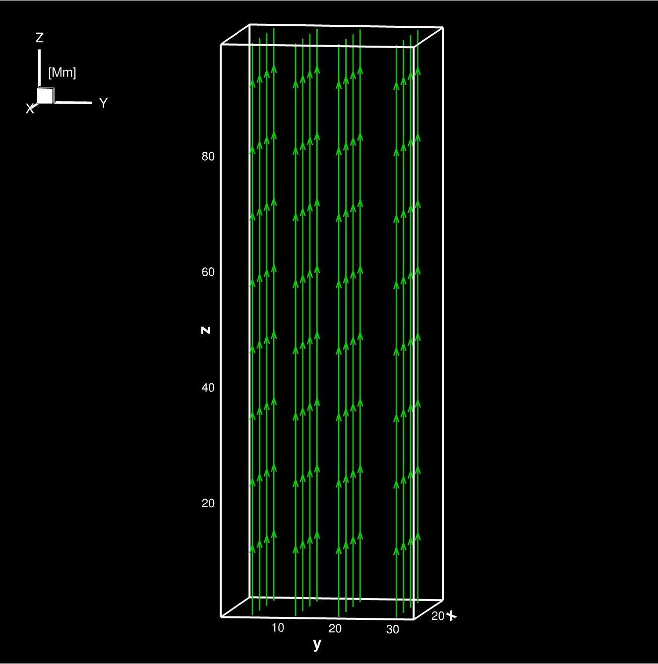
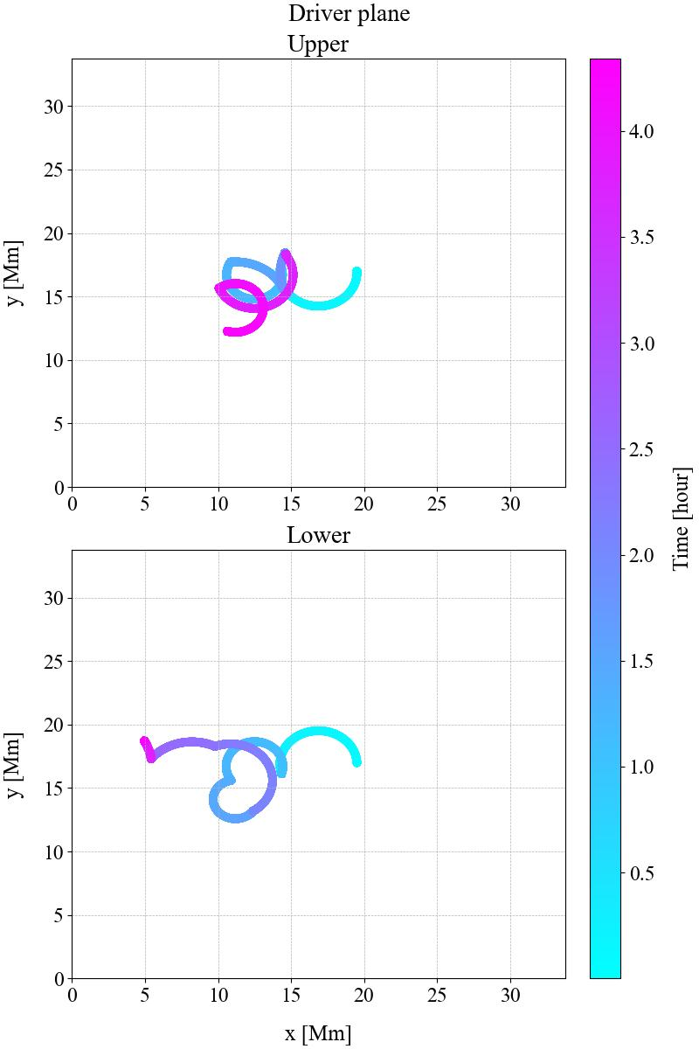
Boundary flow trajectory
(photosphere)
+
-
-
+
gravity of a curved loop

Slide 10
Magnetic
Field Lines

Slide 11
Vertical
Current Density

Slide 12
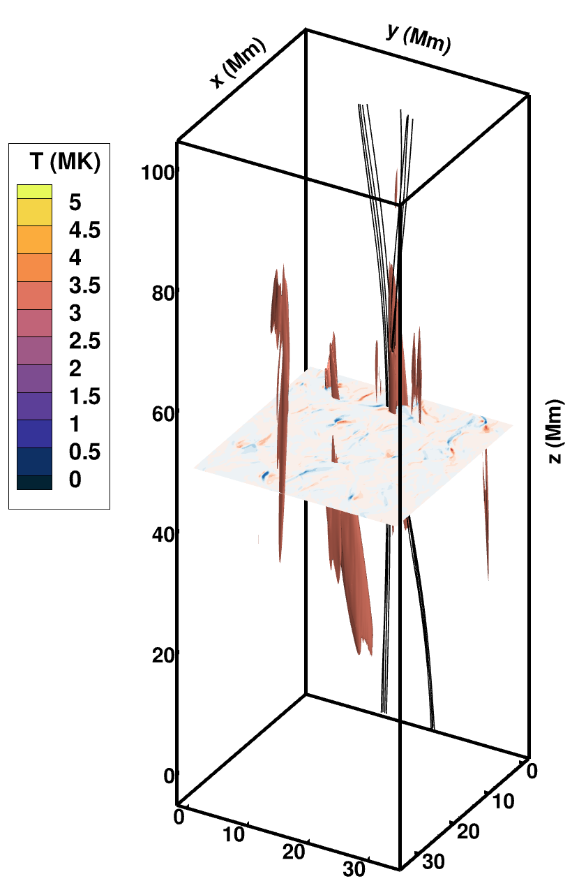
Reconnection Event – t = 68 mins
Capturing explosive energy release from narrow current sheets: converting magnetic energy into kinetic and then thermal energy through viscous dissipation of the shocks.

Slide 13
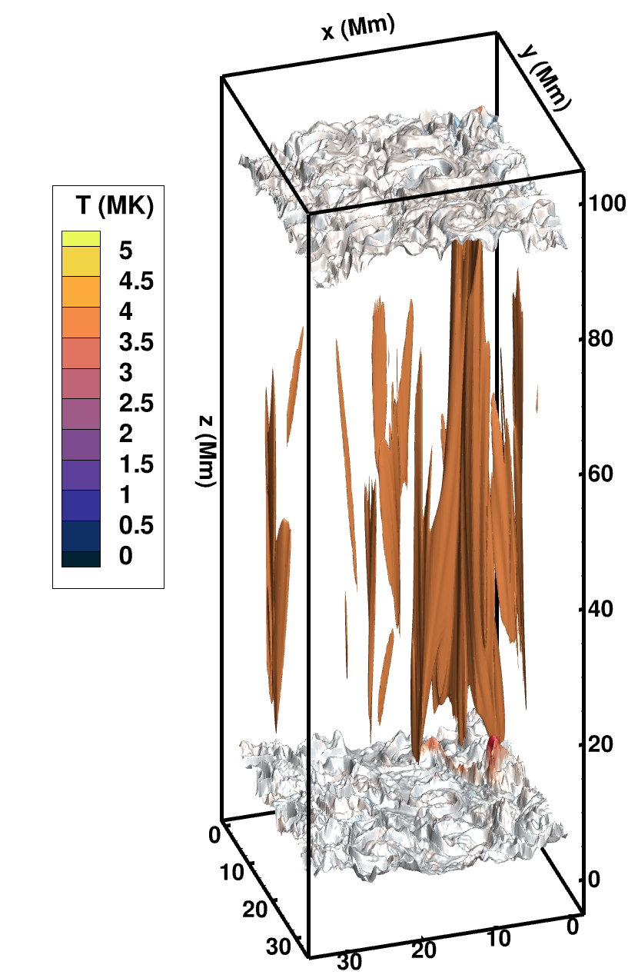
Evaporative Response – t = 71 mins
Capturing evaporative response of the plasma to the explosive energy release, allowing us to make meaningful comparisons with observations.

Slide 14
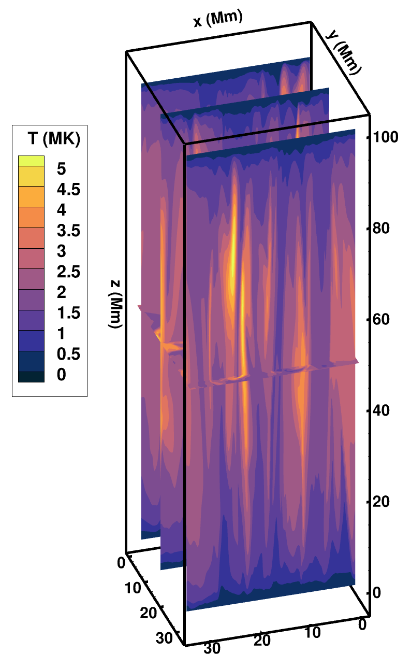
Line-of-Sight Intensity
Connecting simulations with observations.

Slide 15
Hi-C
coronal strands
(flux tubes)
Corona
~ 1,000 km
nanoflare
~ 100,000 km
DKIST
~ 100 km
Photosphere
(solar surface)
current
sheet
≤ 0.1 km
Notes:
In current observations, not looking at individual strands.
Collective emission.
Could change in future: CMO – photon seive

Slide 16
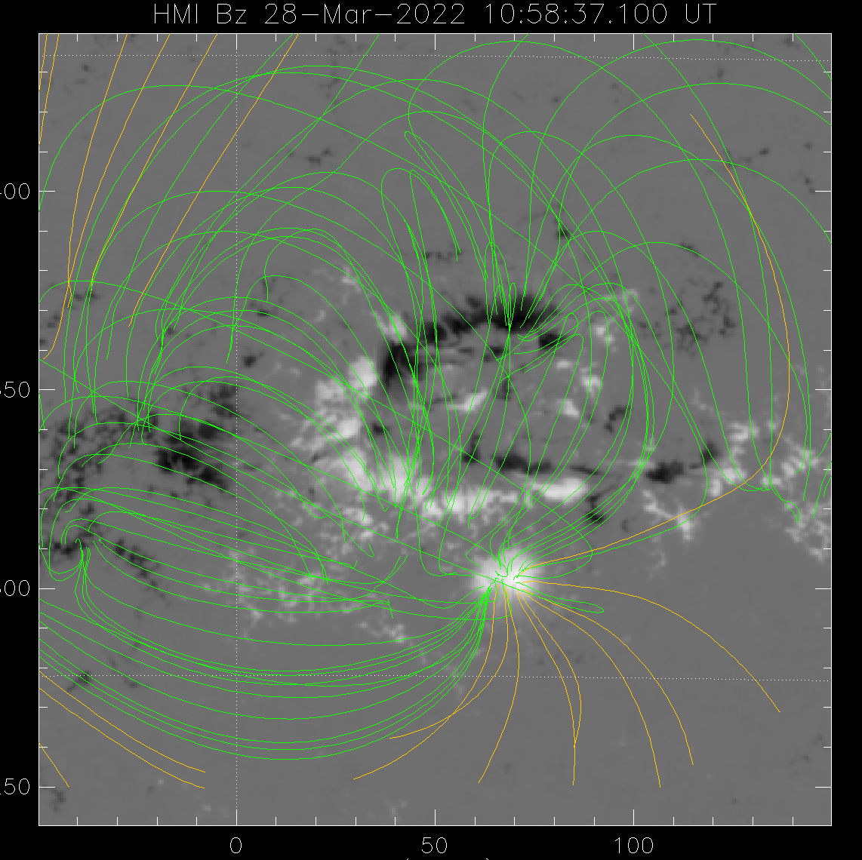
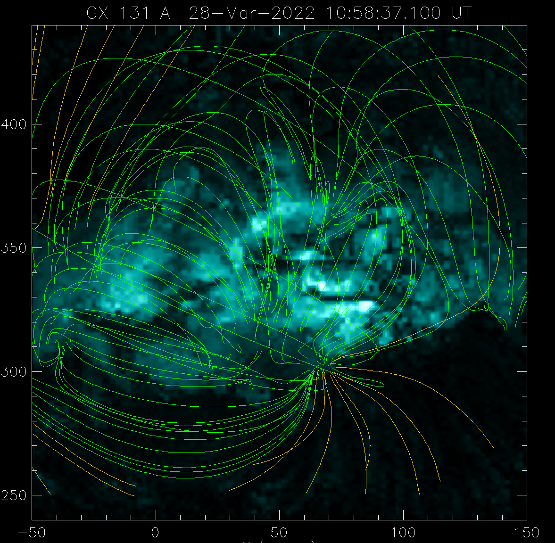
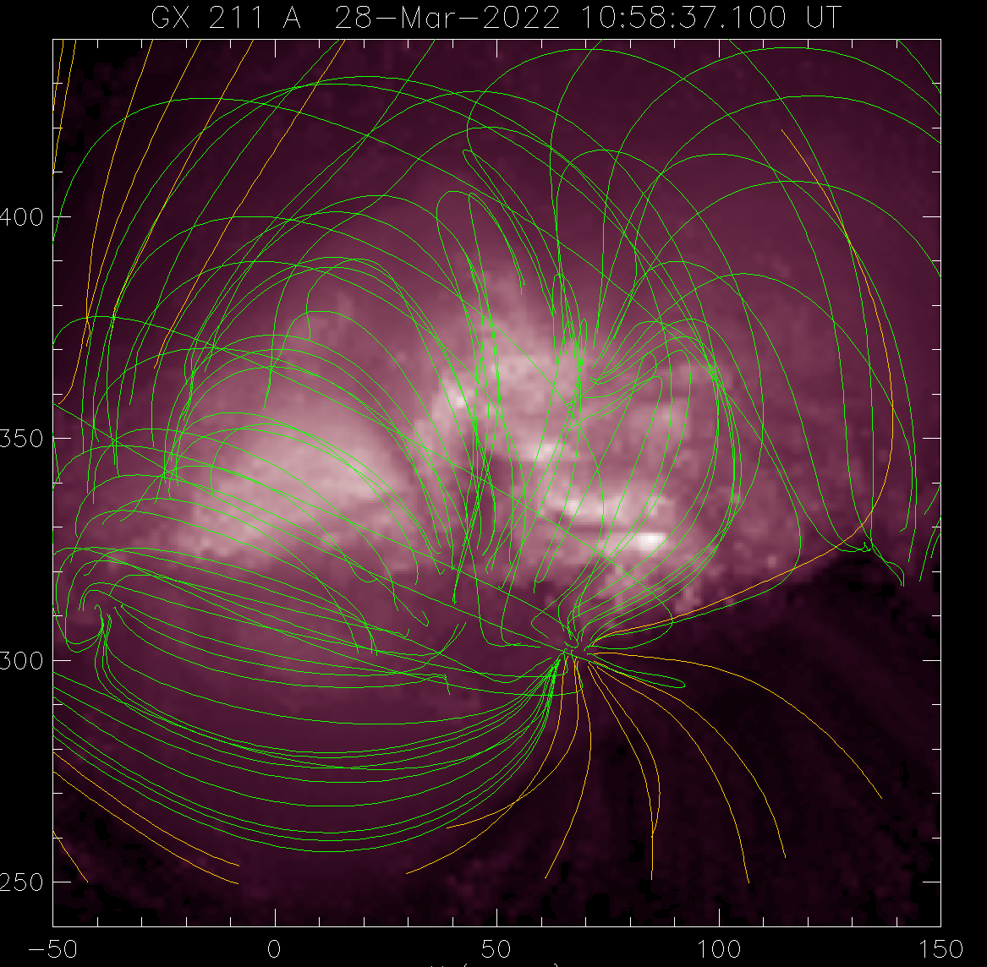
GX_Simulator Model Active Region
Simulated
SDO/AIA 131 A
(T ~ 0.5 MK)
Simulated
SDO/AIA 211 A
(T ~ 1.8 MK)
Observed
Photospheric Magnetogram
Flux tubes populated with plasma based on nanoflares with assumed properties.
Those properties must ultimately be determined from multi-strand MHD simulations.
Notes:
E ~ B^1/L^0.75
Delay / cooling time = 20%
N(tau) = tau^-1

Slide 17
Science Quality
28 peer-reviewed papers (13 first author) ¹
12 Decadal Survey white papers of relevance (2 first author)
61 presentations ¹
Recognized world leaders in coronal heating science as evidenced by invited talks and awards (e.g., 2021 AGU Parker Lecture)
¹ since Oct. 1, 2021 (51 papers and 155 presentations since the start of the first work package)

Slide 18
Science Enabling (1 of 3)
As leaders, we help guide the direction of international coronal heating research
External collaborators (33 scientists from 21 institutions in 8 countries)
Modeling tools for community use:
TRAC transition region module implemented in multiple MHD codes
EBTEL field-aligned hydro code improvements
Field-aligned thermal conduction improvements
MHD boundary driving improvements
GX_Simulator (active region model) improvements
CHIANTI spectroscopy package, new version
SunPy tool for generating synthetic images from simulations
Student training (8 graduate students, 2 undergrads)
Post-doc training (6 team members within 5 years of PhD at start)

Slide 19
Science Enabling (2 of 3)
Meeting organization
Science Organizing Committee
Triennial Earth-Sun Summit (2022; Belleview, WA)
10th Coronal Loops Workshop (2022; Paris, France)
Solar Physics Division (AAS) (2023; Minneapolis, MN)
IAU Symposium 371 (2022; Busan, Korea)
SunDC (2023; Washington, DC)
Goddard UV Symposium (2022; Greenbelt, MD)
Session Organizers
“Fast Magnetic Reconnection Onset” (AGU 2021)
“Coronal Heating” (TESS 2022)
“Solar Spectral Irradiance: Observation, Modeling, & Impacts” (TESS 2022)
Broader National Capability
Lead International Space Weather Action Team (ISWAT) S2-06:
Origins of the Spectral Irradiance and Its Intermediate Timescale Variability
Current capabilities and strategies for progress (Sp. Sci. Rev. paper, Decadal white paper)

Slide 20
Science Enabling (3 of 3)
Mission Concept Development
Coronal Microscale Observatory (CMO) (science motivation; synthetic observations)
Support of current and upcoming missions
Simulations have been and will be compared directly with observations from
SDO, Hinode, IRIS, Hi-C, EUNIS, Chandrayaan-2, EUVST/Solar-C, MUSE
Broader Impacts
Magnetic reconnection is a fundamental physical process (corona–magsphere differences)
Coronal heating on other stars impacts the origin and development of life throughout the universe
Instrument Calibration (benefits all users of the data)
EUNIS underflight of EIS/Hinode
Synergies with other ISFM Work Packages
Viall WP (slow solar wind originates in magnetically closed structures; thermal nonequilibrium)
DeVore WP (boundary conditions for photosphere driving)

Slide 21
NASA Center Uniqueness
Highly complex problem requiring a multi-faceted yet closely integrated (wholistic) approach
Results from one investigation motivate and inform other investigations
Requires a wide variety of theoretical, numerical, and observational expertise
Our coronal heating team is unique in the world
Requires regular face-to-face interactions (co-located team)
White boards are crucial!
Requires stability (time frame for full success is not short)
Eventual development of an operational model (long-term goal) will benefit from CCMC

Slide 22
Project Execution
Major progress on proposed milestones and deliverables, as indicated in the Year 1 Progress Report and our list of papers and presentations, available at our team website:
https://science.gsfc.nasa.gov/670/variability_workshop/heating.html
Highlights since the year 1 progress report:
Multi-strand simulations with complex driving, thermal conduction, radiation, full coupling with the lower atmosphere
3D thinning current sheet simulations
Spectral line profile diagnostics of nanoflare heating (observations and simulations)
Equilibrium and nonequilibrium properties of finite length current sheets (theory)
Heating of X-ray bright points (observations and simulations)
Cross-sectional properties of overlapping coronal strands (observations, semi-analytical models, sims)
Notes:
Solar X-ray Monitor (XSM) on Chandrayaan-2

