Slide 1
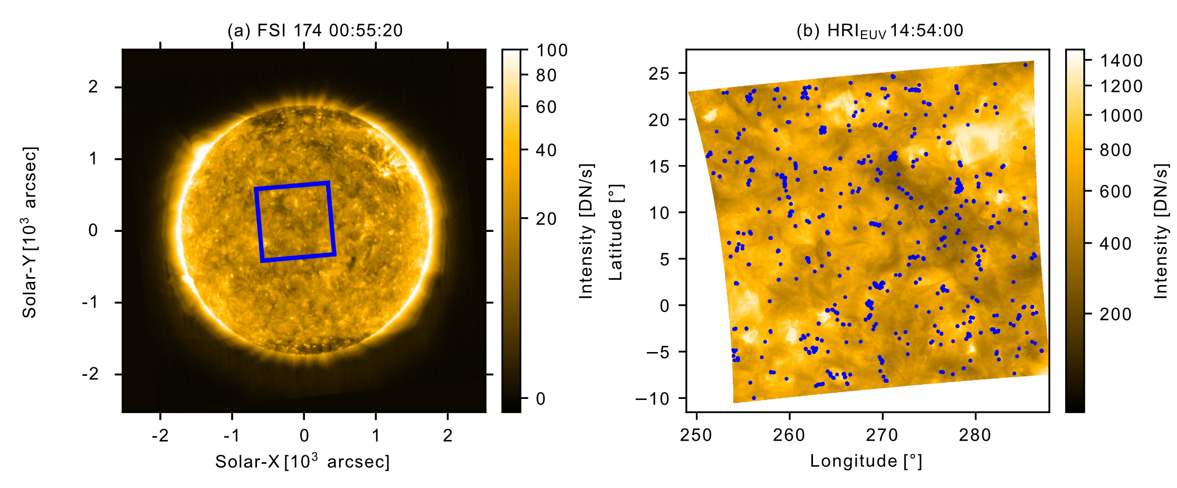
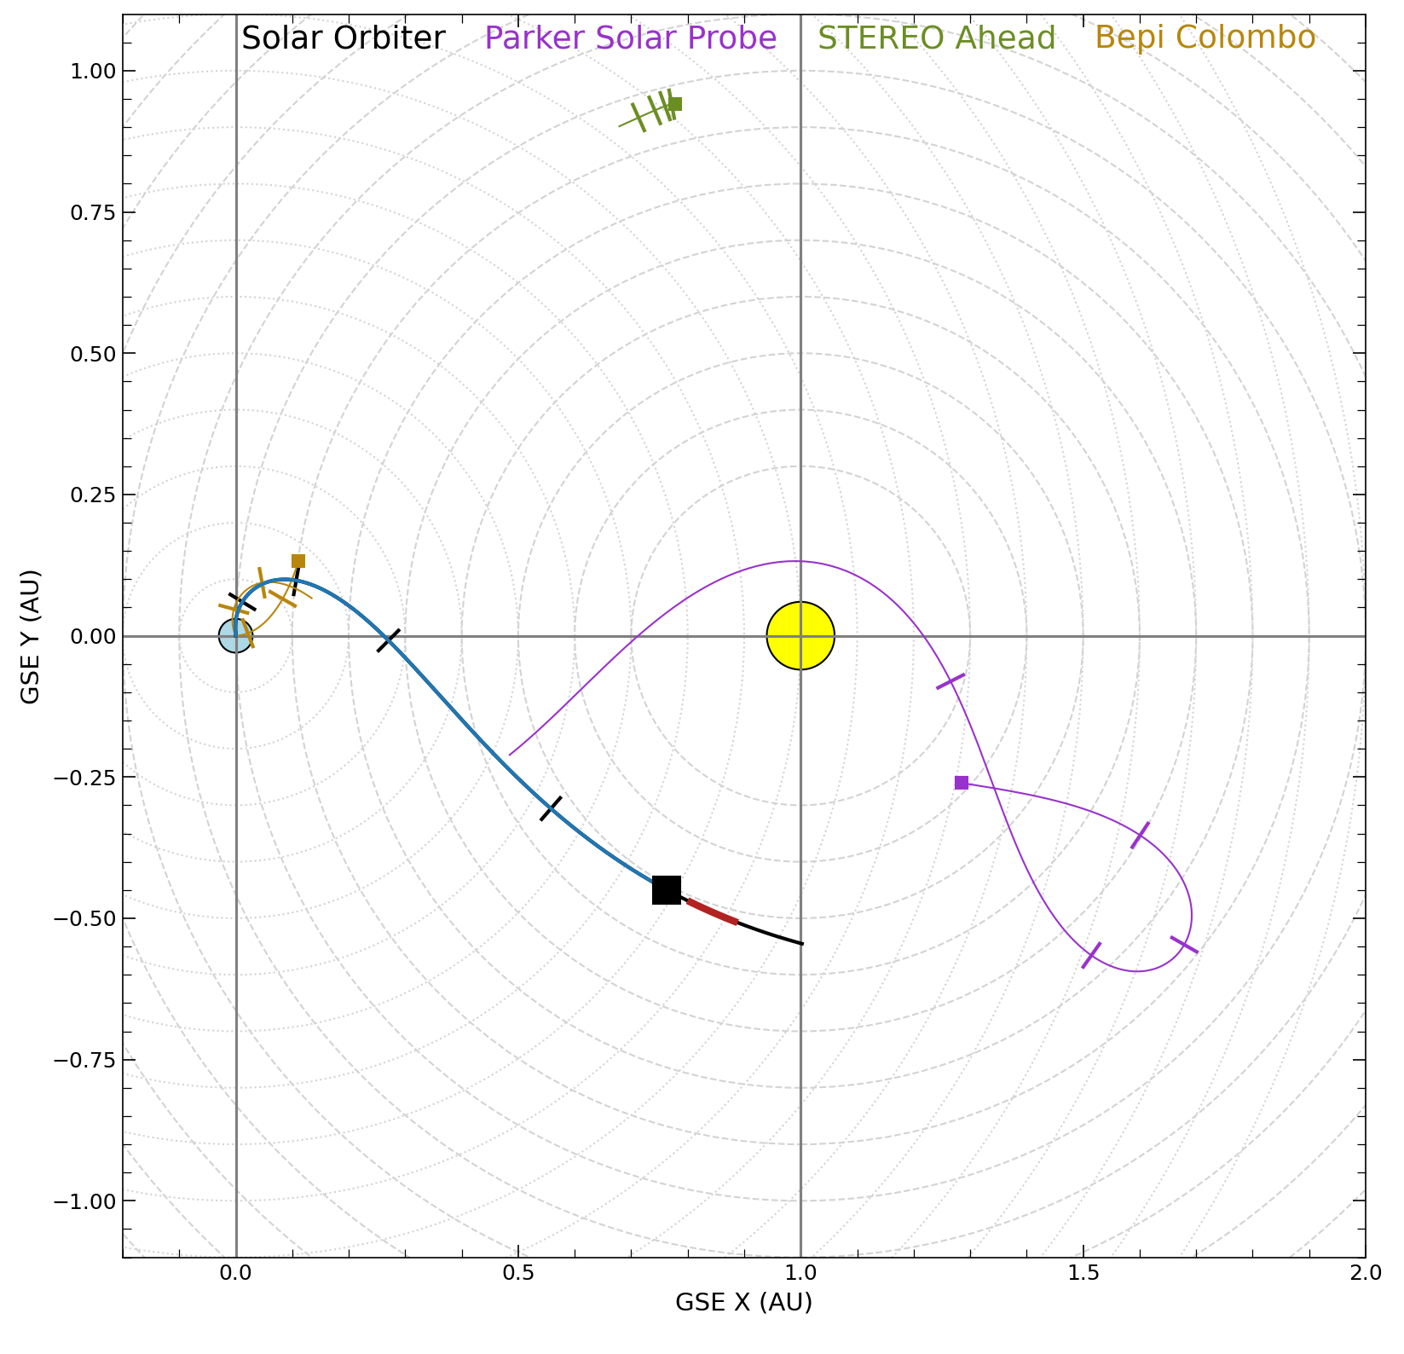

Berghmans et al. 2021: Detection of tiny EUV brightenings
Dolliou et al., A&A, 2023
30 May 2020
On May 30 2020, HRI-EUV made a 4-minutes QS observation with Solar Orbiter at 0.32 A.U. HRI-EUV had a 400 km spatial resolution in the corona, and 5 s cadence. AIA observations at 12 s cadence were also available, with a separation angle of 31.5$°$.
Notes:
Manque une introduction aux instruments.
Solar Orbiter a un Full sun imag’r’ (gauche) à deux bandes
Un imagery à haute résolution

Slide 2
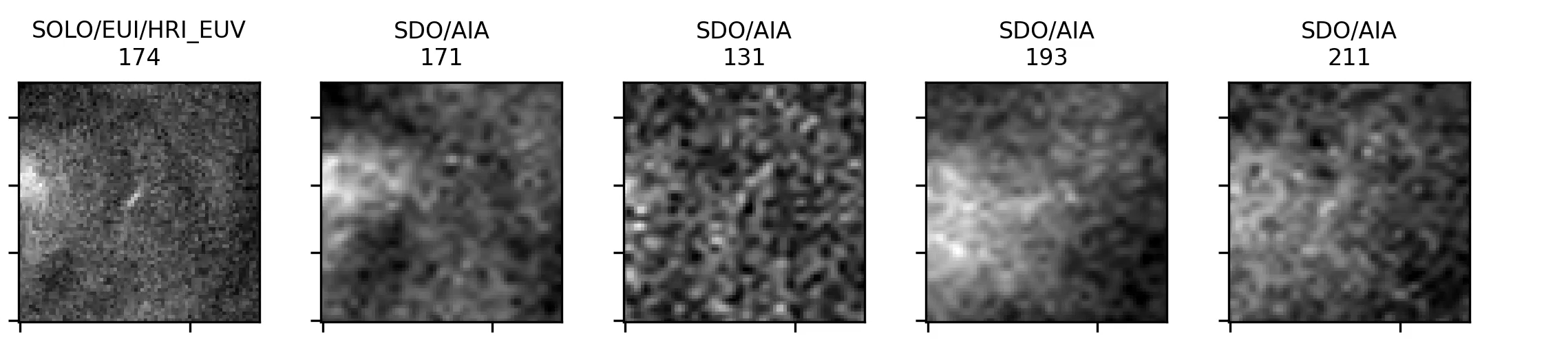
Example of a loop-like brightenings
Example of one loop-like event detected in HRI-EUV and multiple AIA channels:
1000 km
1468 small (400 – 4000 km) and short lived (10 – 200 s) EUV brightenings were automatically detected in the first two scales of a spatial wavelet transform algorithm.
The algorithm does not discriminate the physical origin of the events.
They stand around 1 to 4 Mm above the photosphere (Zhukov et al, A&A, 2021).
A first T diagnostic using AIA DEM estimated their T distribution to be centered around 1.3 MK. Their temperature is still under debates (Dolliou et al., A&A, 2023 ; Huang et al., A&A, 2023).
Notes:
Insist that these events are really small

Slide 3
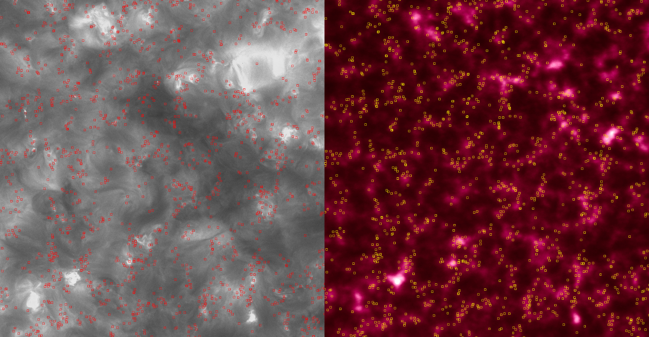
Link to the underlying chromosphere
HRIEUV
HRI Lyα
HRIEUV brightening are related to Lyα network?

Slide 4
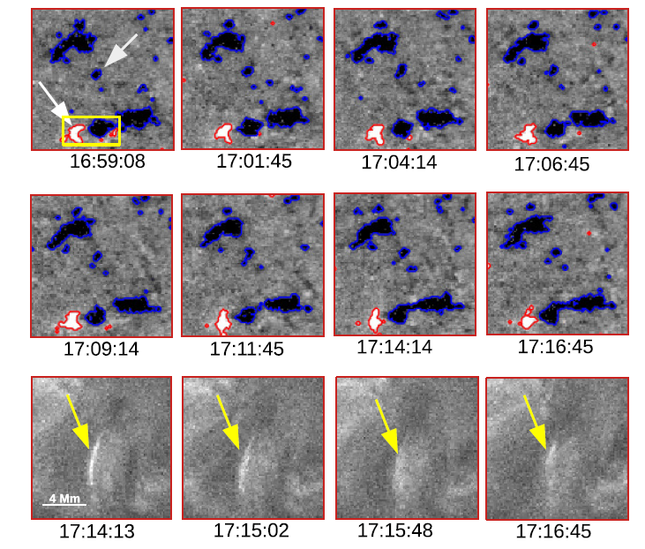
Solar Orbiter/HRI-EUV & Solar/Orbiter/PHI
SO/PHI: Kahil+ 2021:
Type I: EUV event spatially associated to PHI opposite polarities (+ sub groups)
Similar to EUV burst: flux cancellation/emerging flux

Slide 5
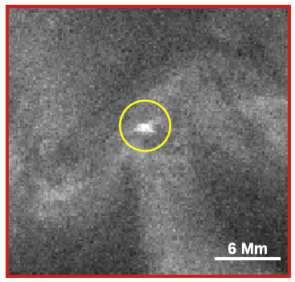
Type II: No evident connection with a dipolar photospheric feature
Involvement of larger opposite polarities areas.

Slide 6
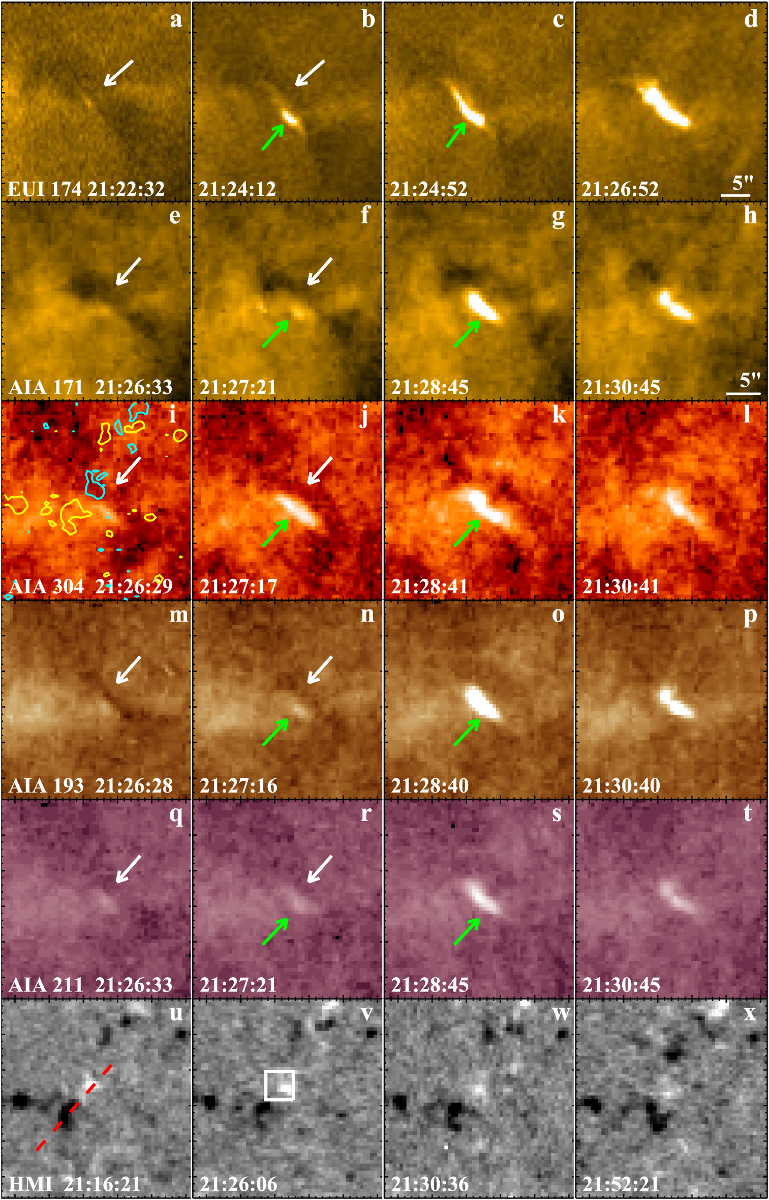
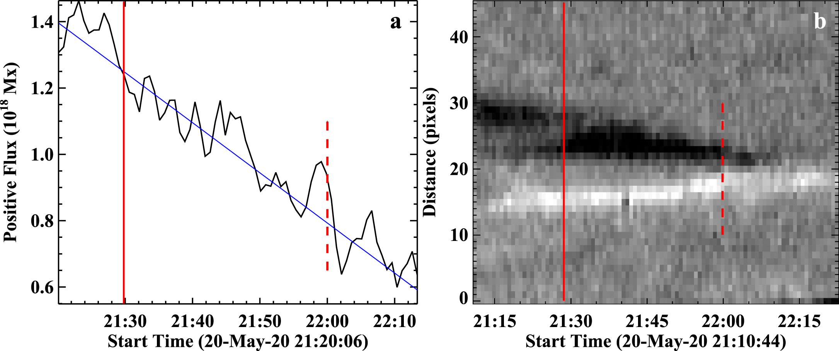
Panesar et al., A&A, 2021
Free B energy: 10^26, 10^27 ergs
B Flux cancellation rate 10^18 Mx/h
Most events are accompanied by cool plasma along the neutral line and multiple occurence in the same place

Slide 7
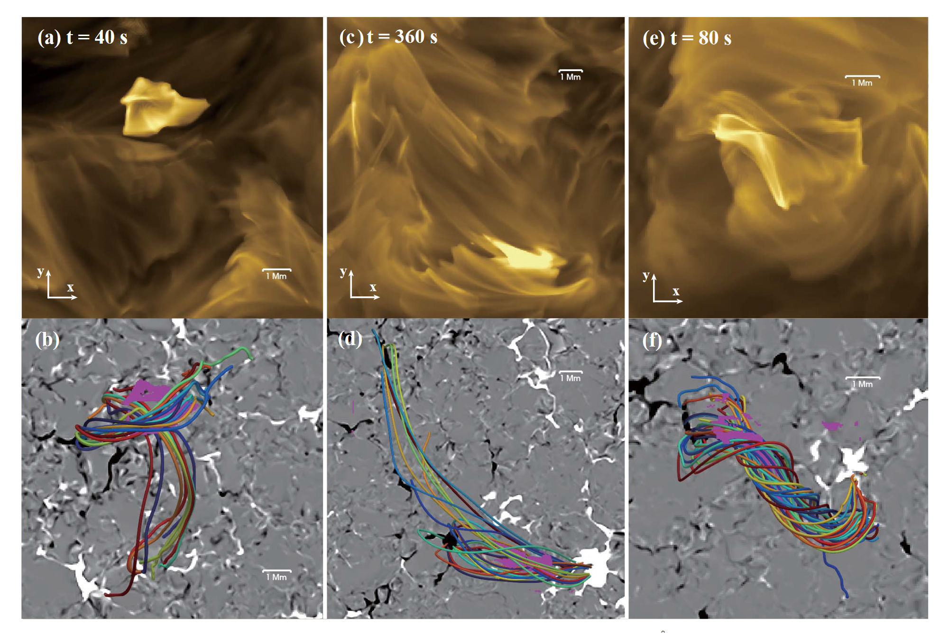
Chen et al., A&A, 2021 (MURaM 3D MHD code)
Observed 4 types of magnetic configurations:
Two perpendicular loop bundles with reconnection.
Two magnetic bundles originating from the same magnetic patch in the chromosphere
Twisted single magnetic bundle (1 occurrence only)

Slide 8
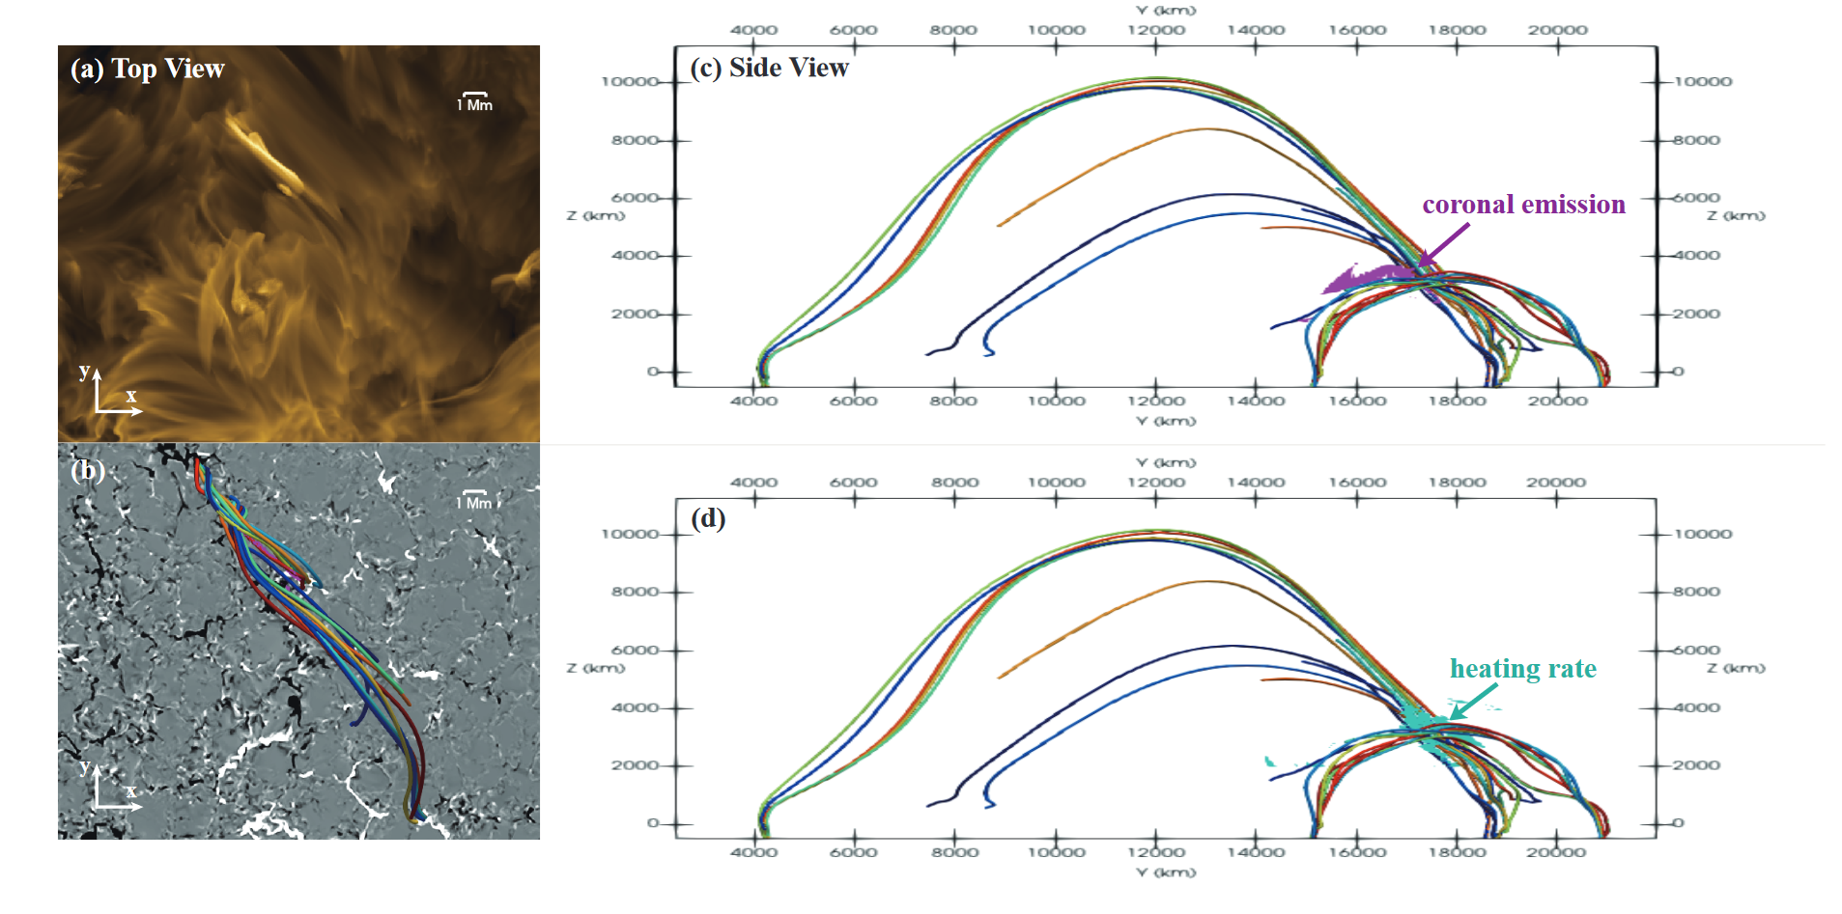
Chen et al., A&A, 2021
Coronal emission localised only at the top of the structure

Slide 9
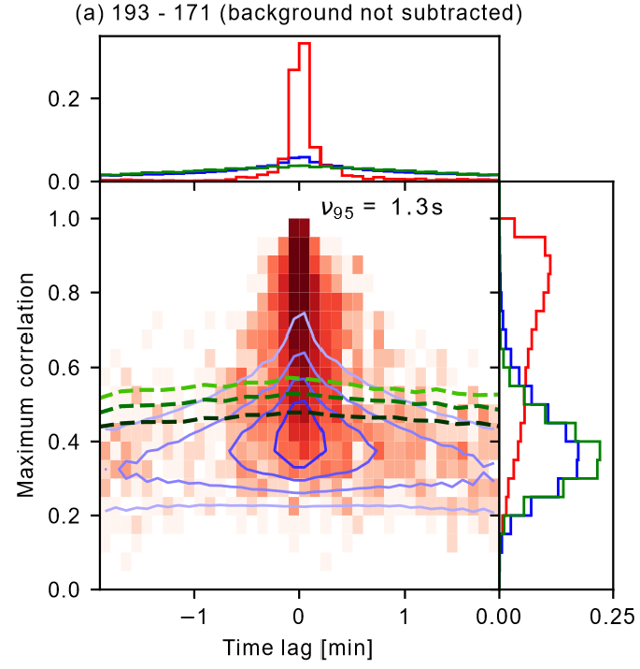
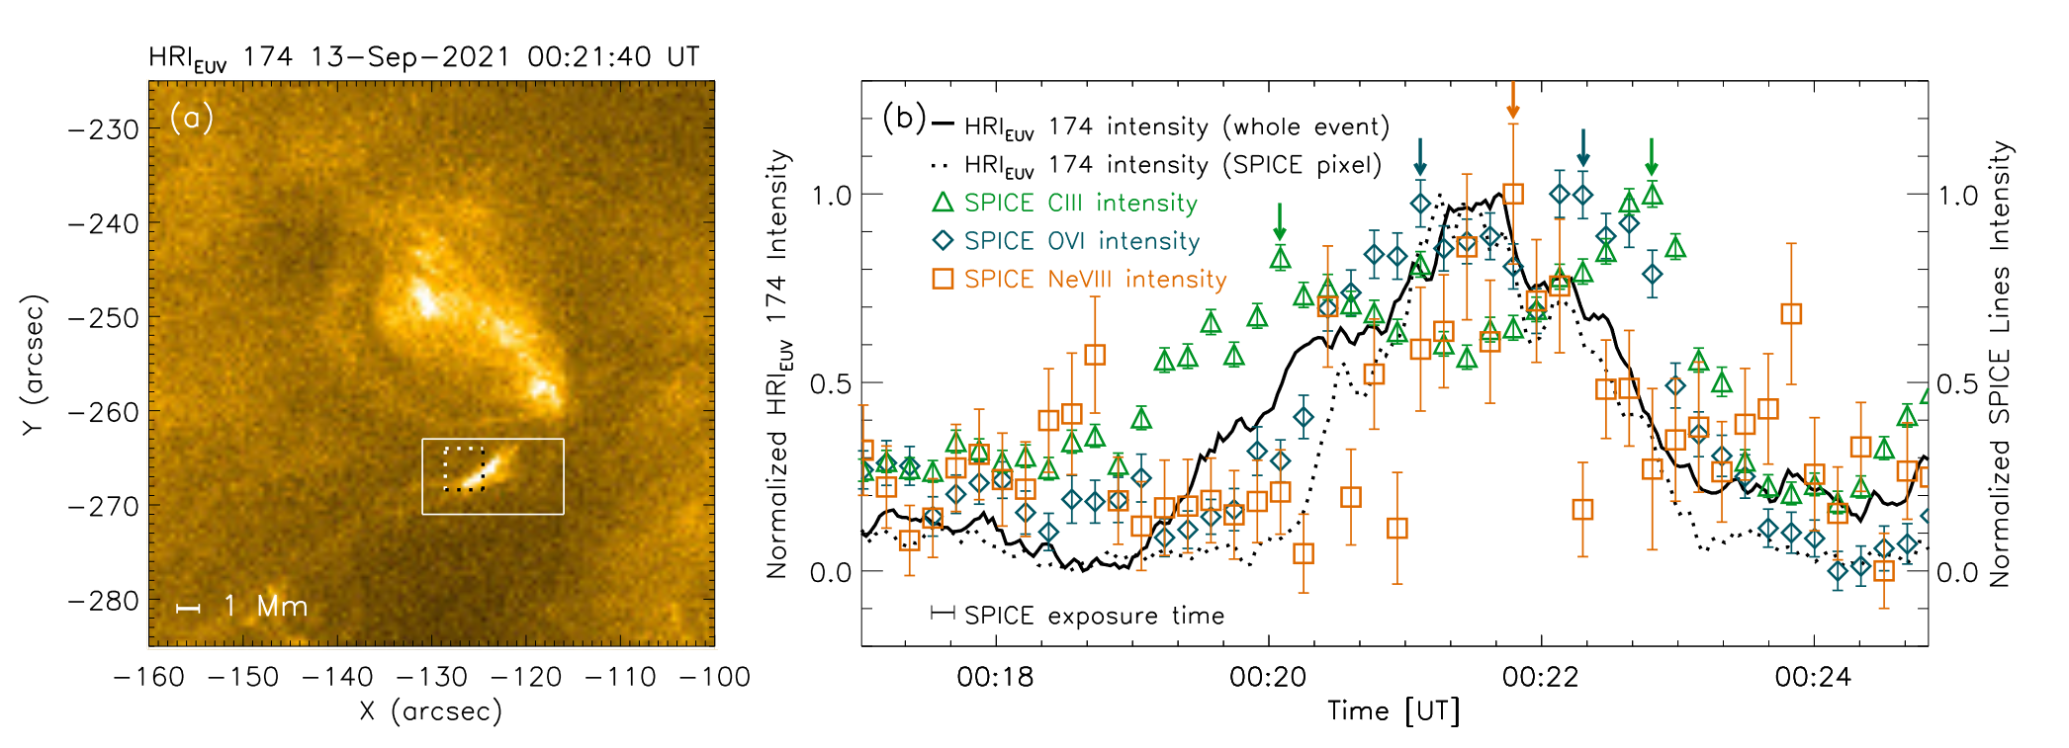
Temperature diagnostics: cool plasma dominates the EM ?
Dolliou et al, A&A, 2023: HRI-EUV & time lags applied to AIA light curves.
Huang et al, A&A 2023: HRI-EUV & SPICE observations.
Only one peak in Ne VIII lines, 2 peaks in CIII & O VI lines.
➔ events might barely reach coronal temperatures.
➔ Events are (1) peaking below 1MK, or (2) have cooling time scale below the AIA cadence (12 s)

Slide 10
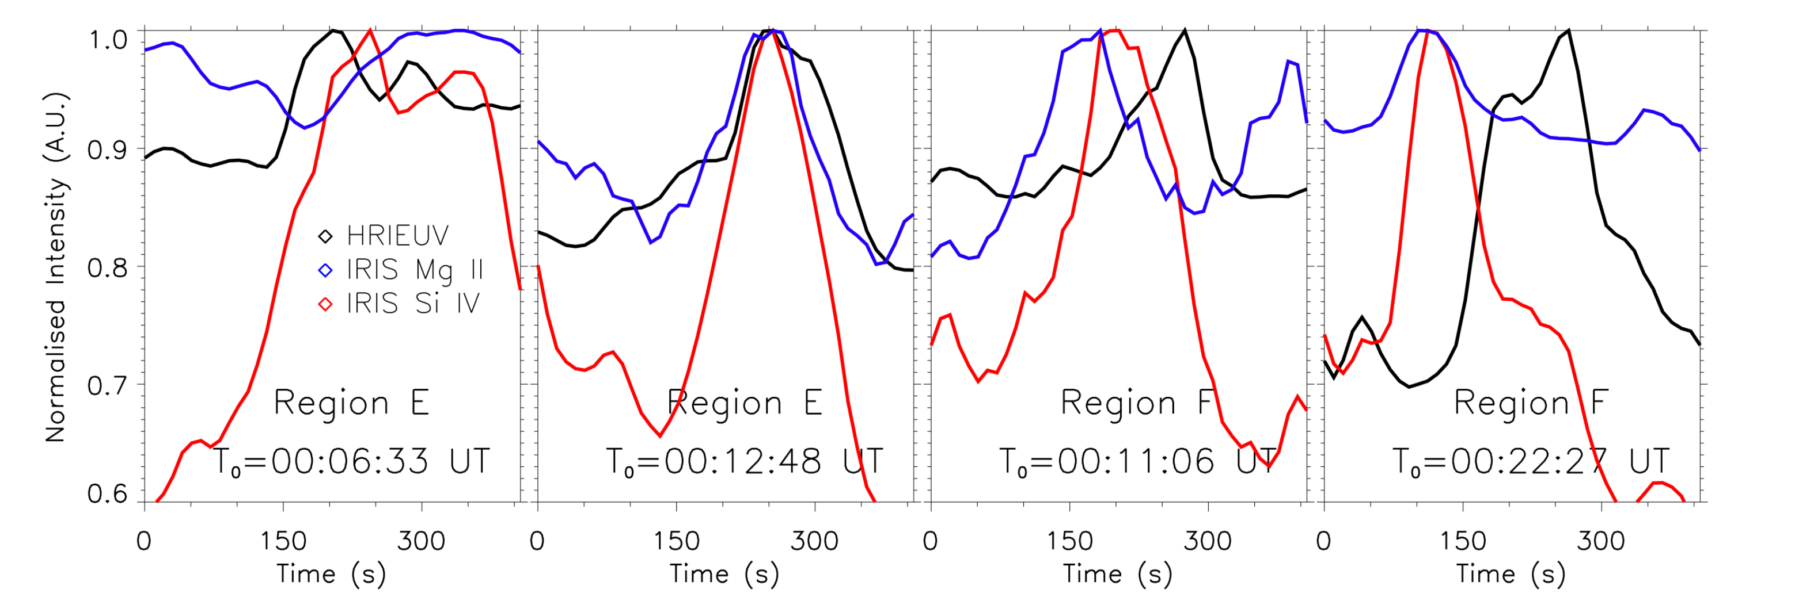

HRIEUV brightenings detected by IRIS
Nelson et al, A&A 2023: HRI-EUV & IRIS observations.
IRIS Si IV ($8⋅{10}^{4}$ K) & Mg II ($2⋅{10}^{4}$ K) lines light curves can peak before, after, or at the same time as HRI-EUV light curves
EUV brightenings show different thermal behavior. They probably refer to large range of small scale phenomenon, with different physical origin (reconnection or not, for instance)

Slide 11
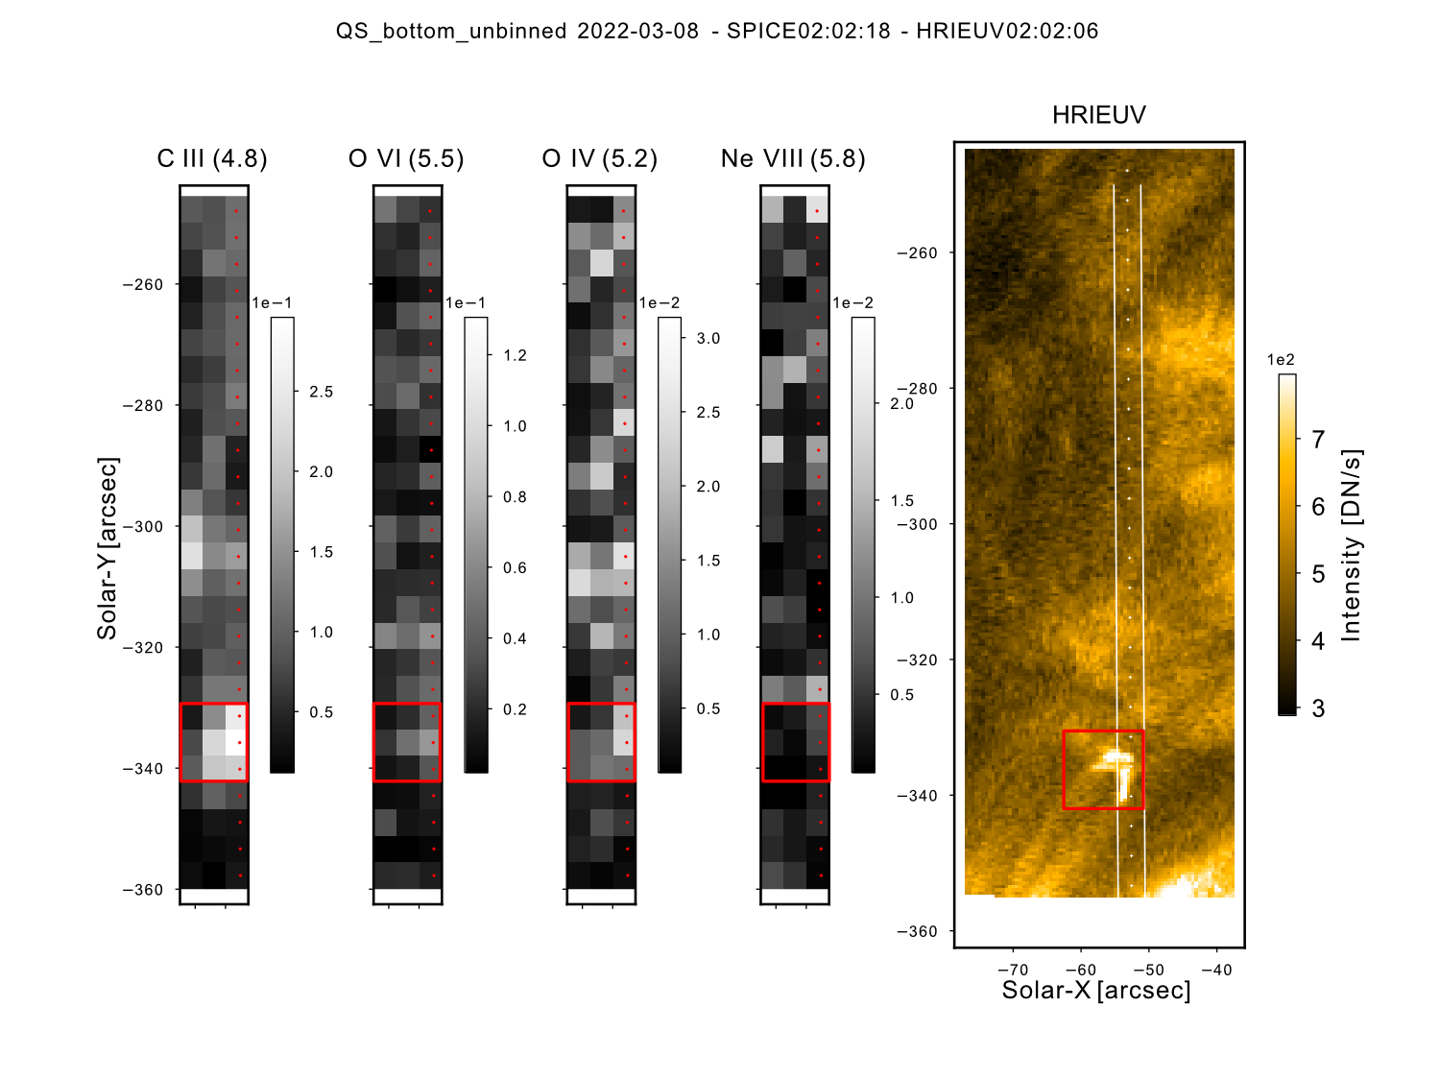
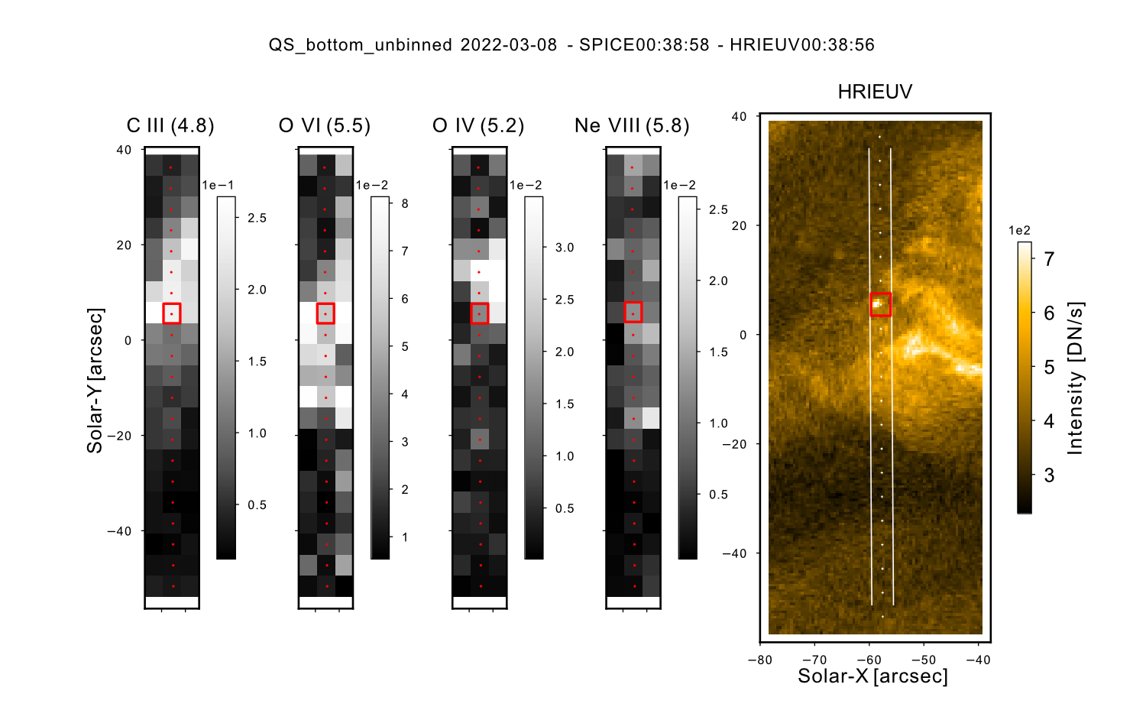
Example of 2 brightenings detected by SPICE & HRI-EUV on the 08/03/22.
Event 2: Larger event ($≈3500$ km)
Event 1: Small dot-like brightening ($≈300$ km)
SPICE radiances are then averaged over the red box to compute light curves
Notes:
Vous voiyez ici les radiances ce C III O IV… en augmentant en température, entre 4.8 & 5.8.

Slide 12
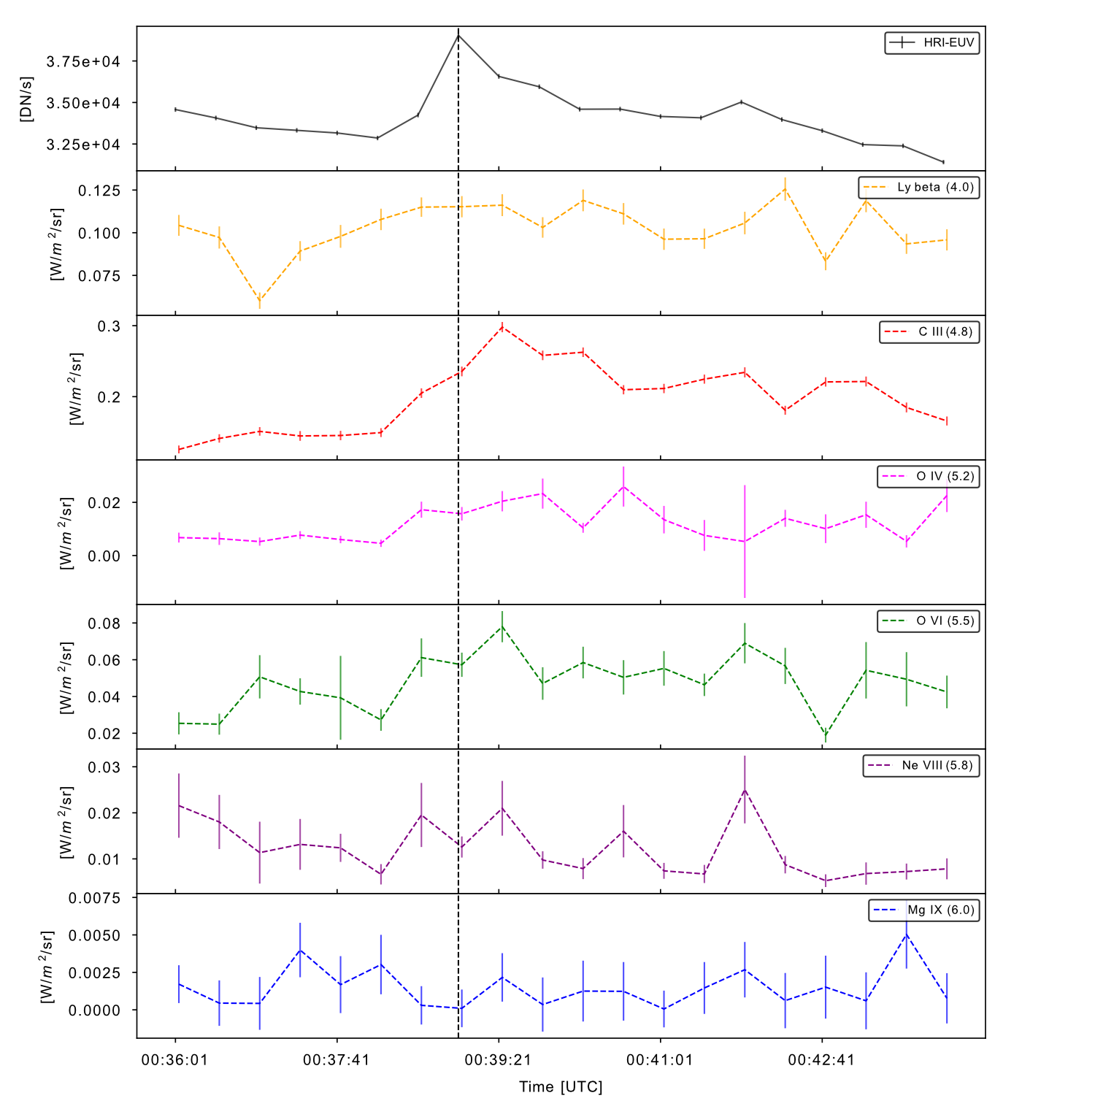
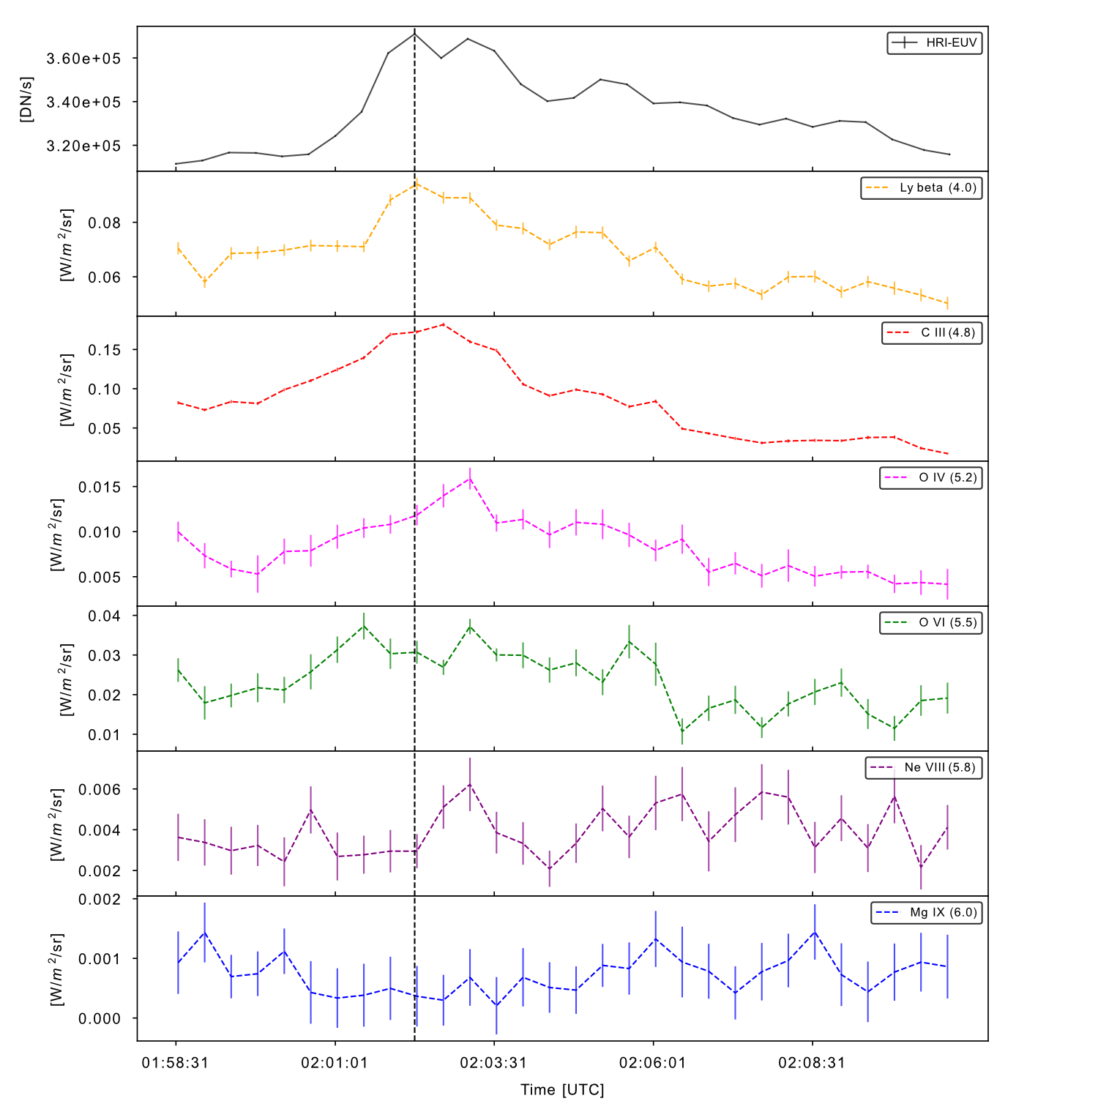
Other QS dot-like brightening detected on the 08/03/22.
Event 1: SPICE lines peak together slightly after HRI-EUV
Event 2: colder SPICE lines before hotter ones
HRI-EUV
HRI-EUV
LyB (4.0)
LyB (4.0)
C III (4.8)
C III (4.8)
O IV (5.2)
O IV (5.2)
O VI (5.5)
O VI (5.5)
Ne VIII (5.8)
Ne VIII (5.8)
Mg IX (6.0)
Mg IX (6.0)
Notes:
JE vous montre deux exmeples with different behavior. Light curves from HRIEUV and SPICE, temperature growing from the top to the bottom.

Slide 13
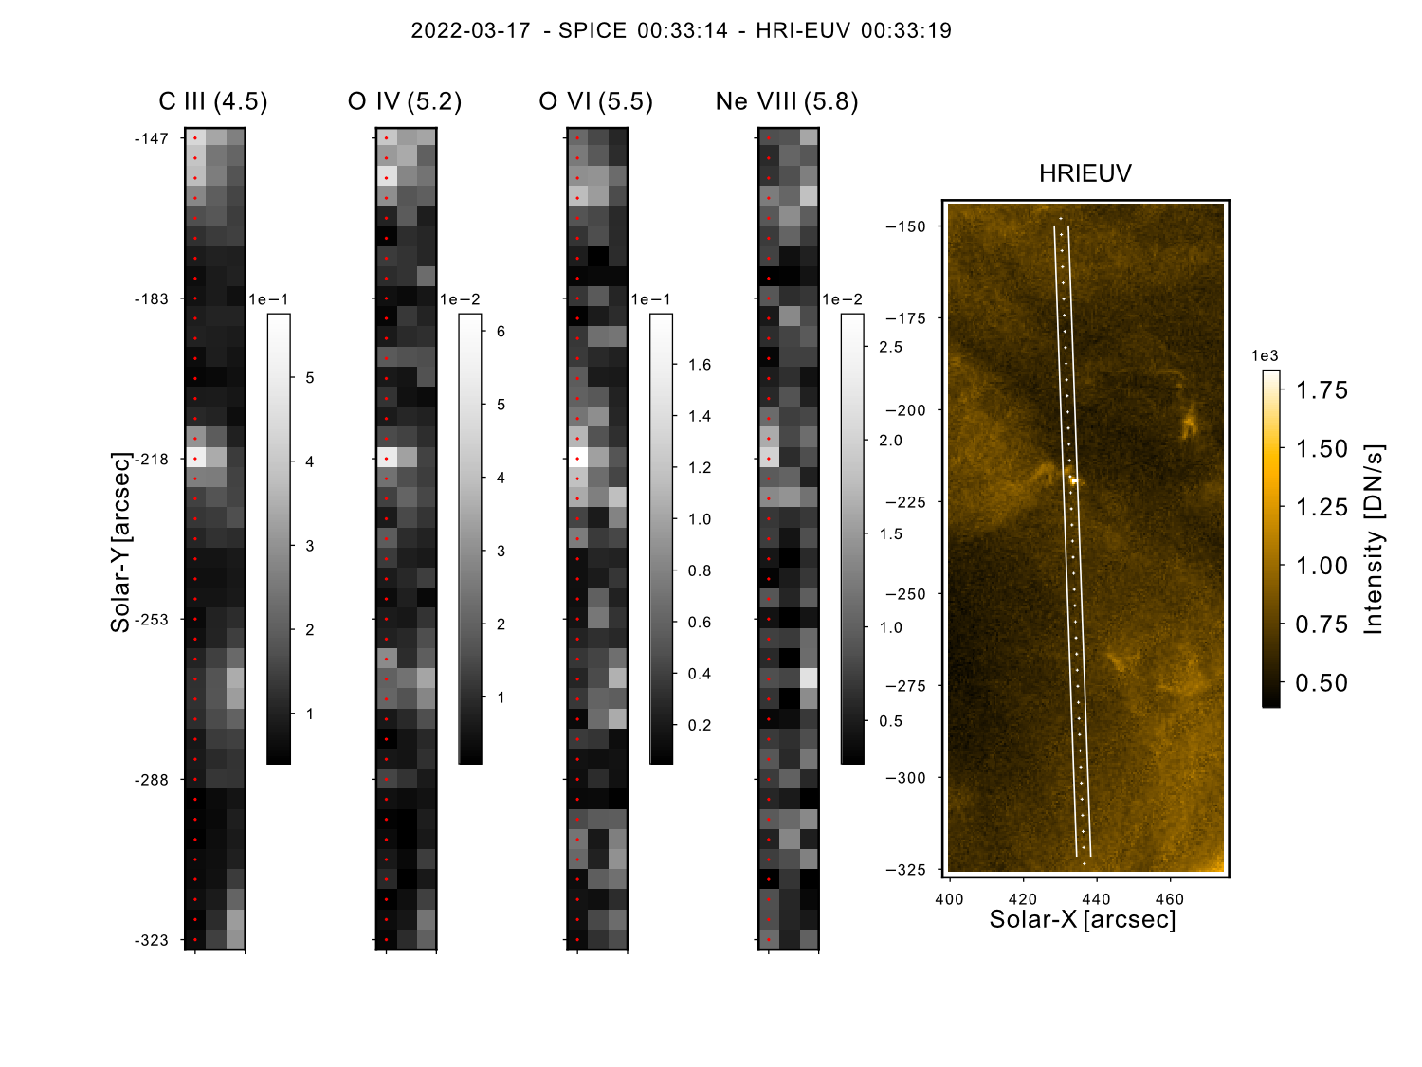
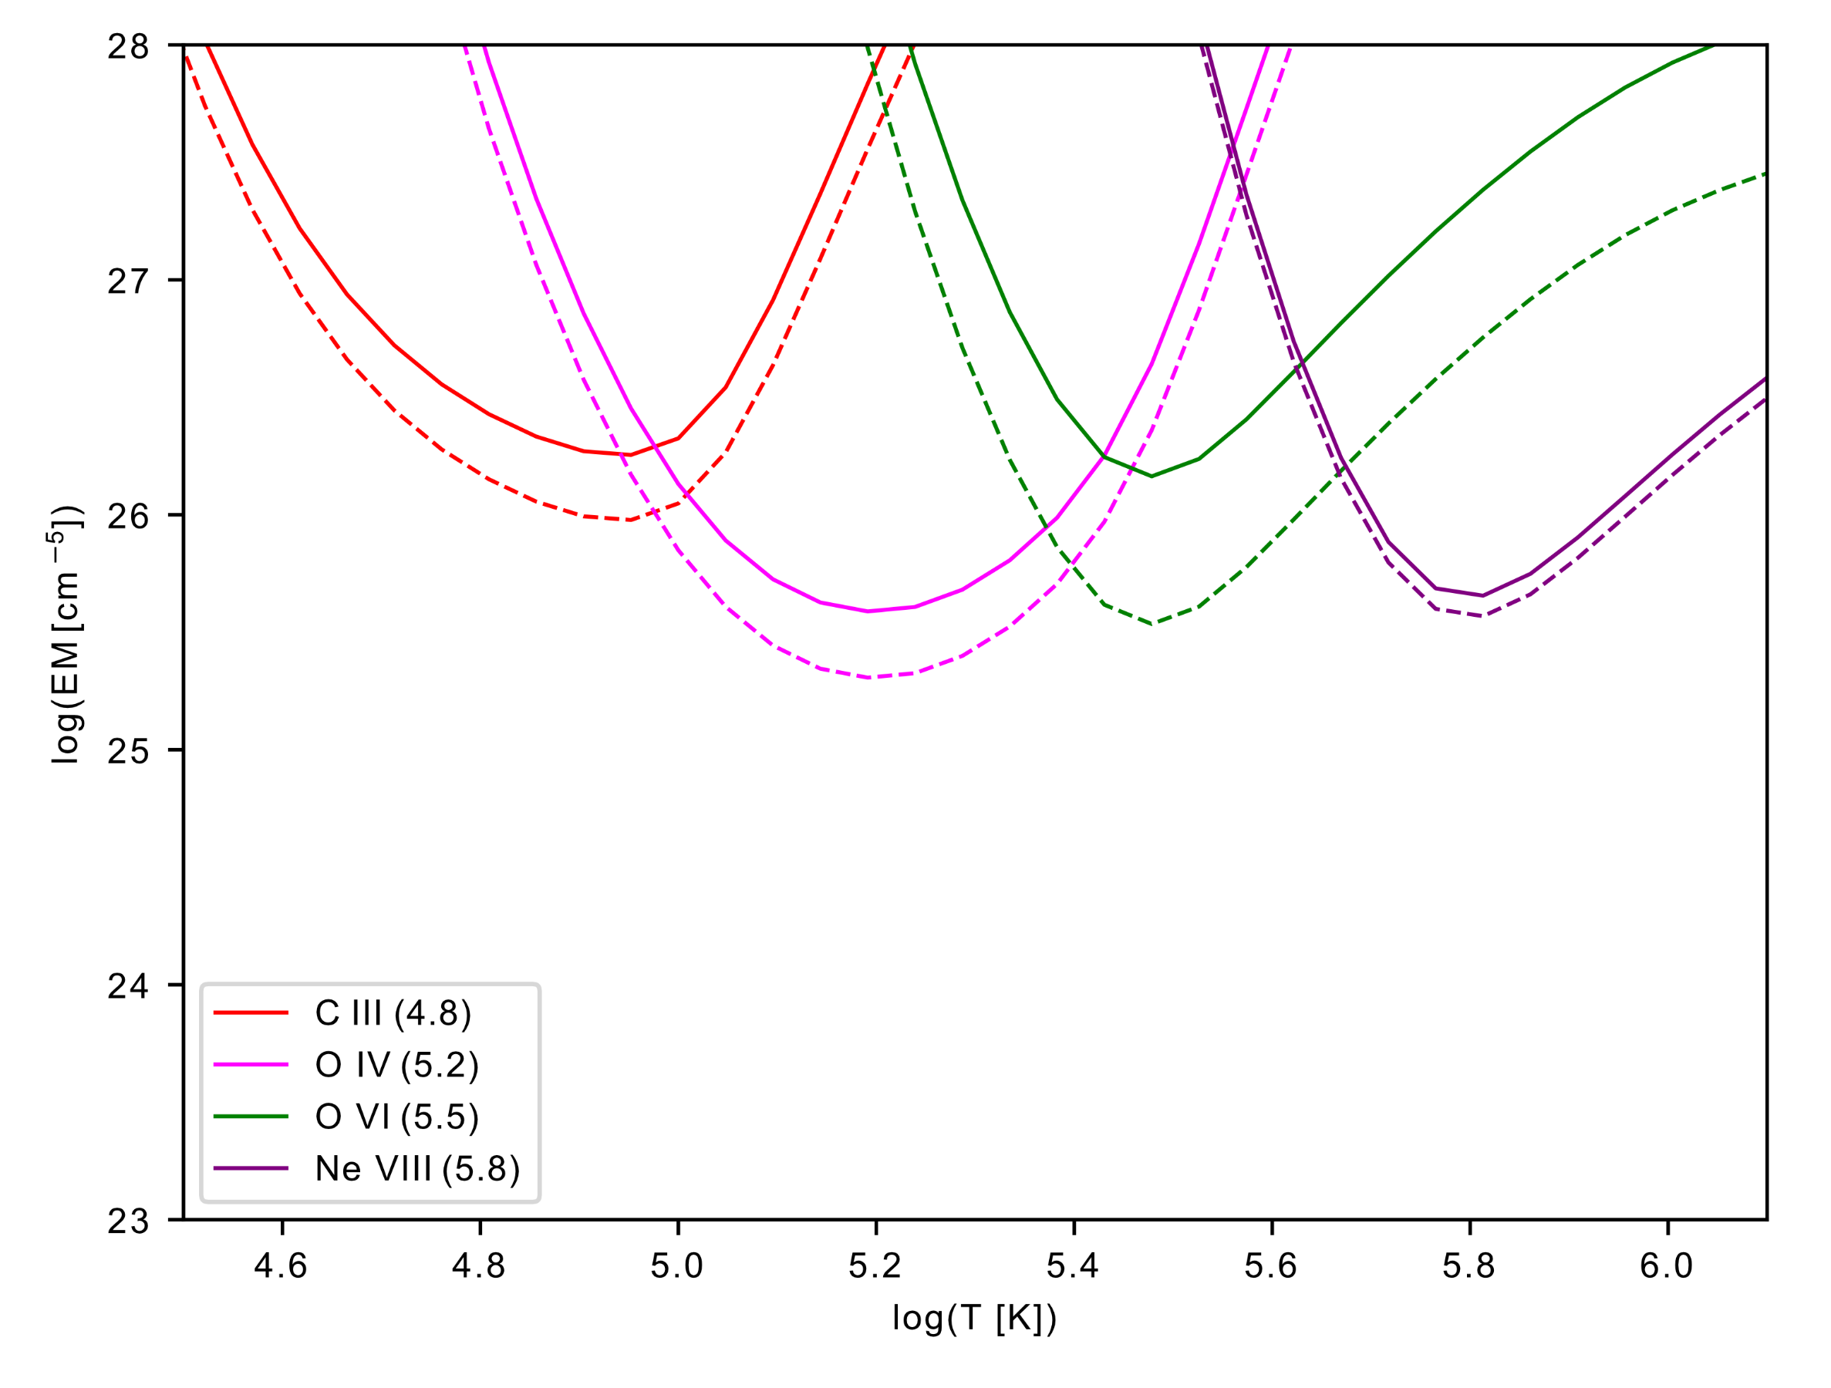
EM LOCI applied to event 3 and the background.
The spectra are averaged over the event and the background. At each time step, the Emission Measure (EM) LOCI method is applied to the SPICE C III, O IV, O VI, Ne VIII intensities. EM LOCI provides an upper limit of the EM.
Event: solid line
Background: dotted line
There is an offset in EM between the event and the background, particularly around log (T [K]) = 5.5, and no offset above.
Notes:
The $\log{T_{e}[K]}<$4.8 & $\log{T_{e}[K]}>$5.8 are not constrained by SPICE.
Conclusion : on a essayé de faire la DEM, et on a pas beaucoup de raies.
C III pzur être optiquement épais dans certains cas.
Rajouter slide conclusion et transition avec EIS

Slide 14
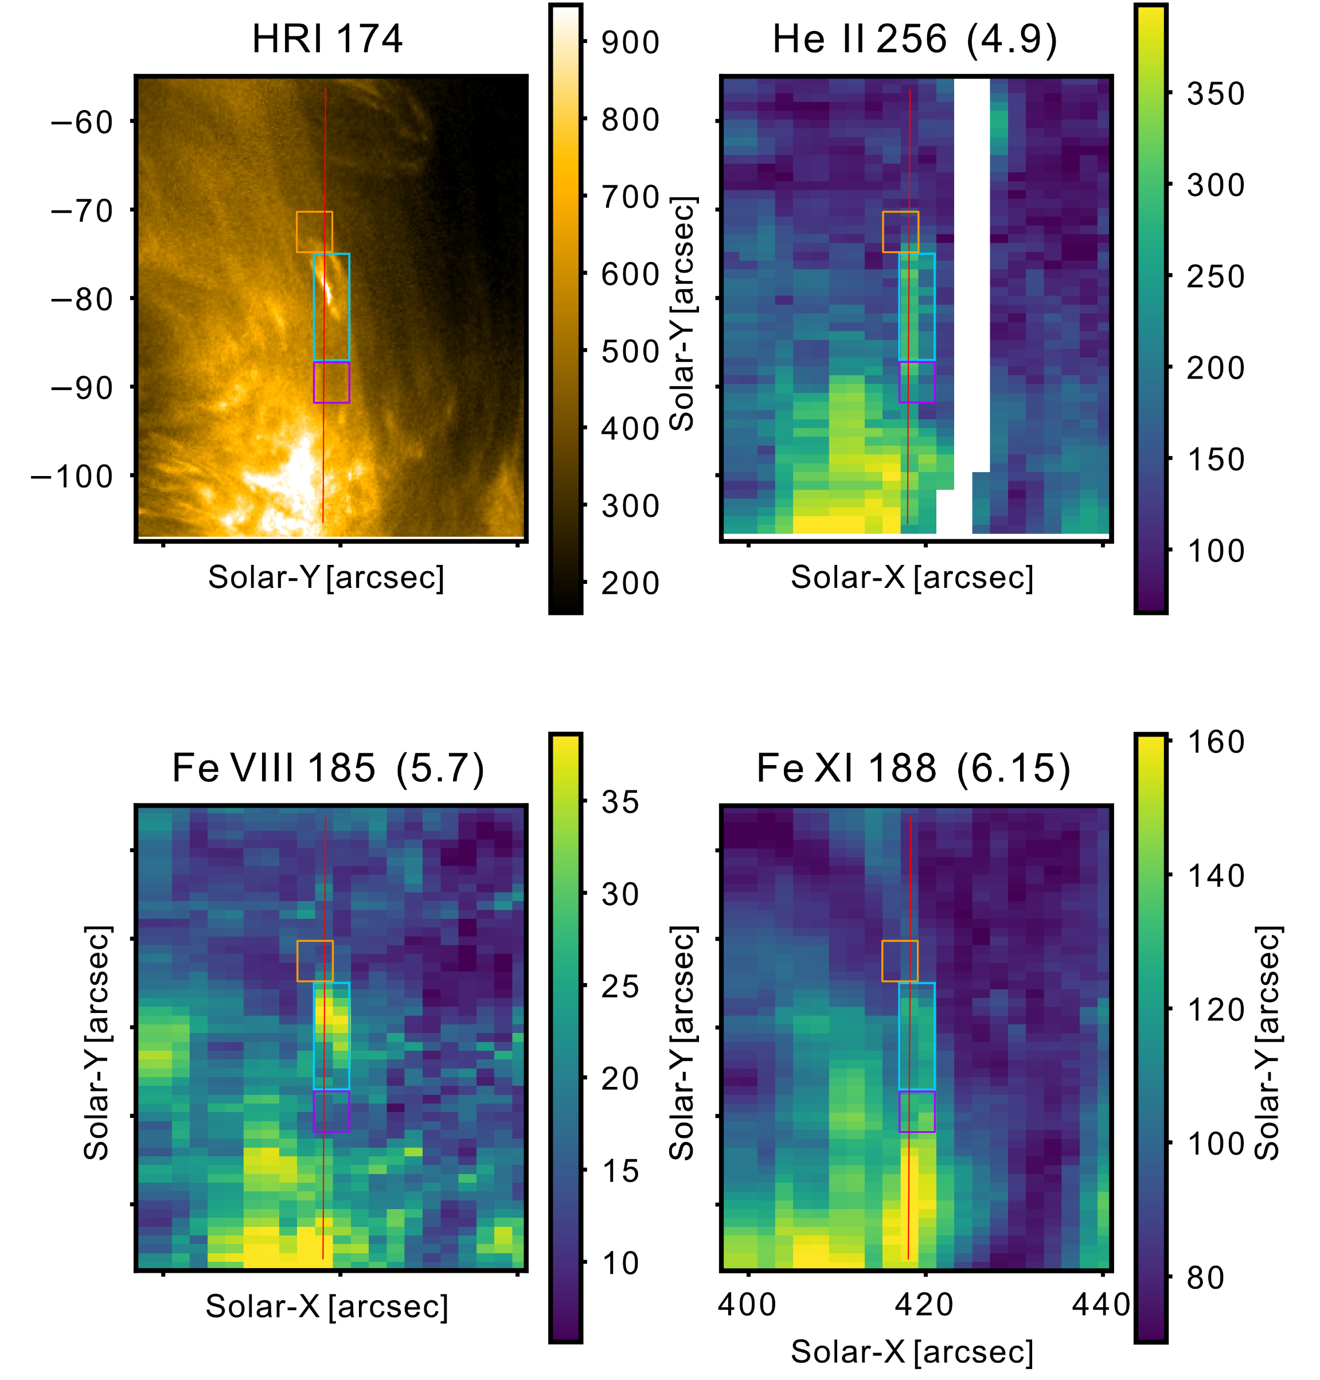
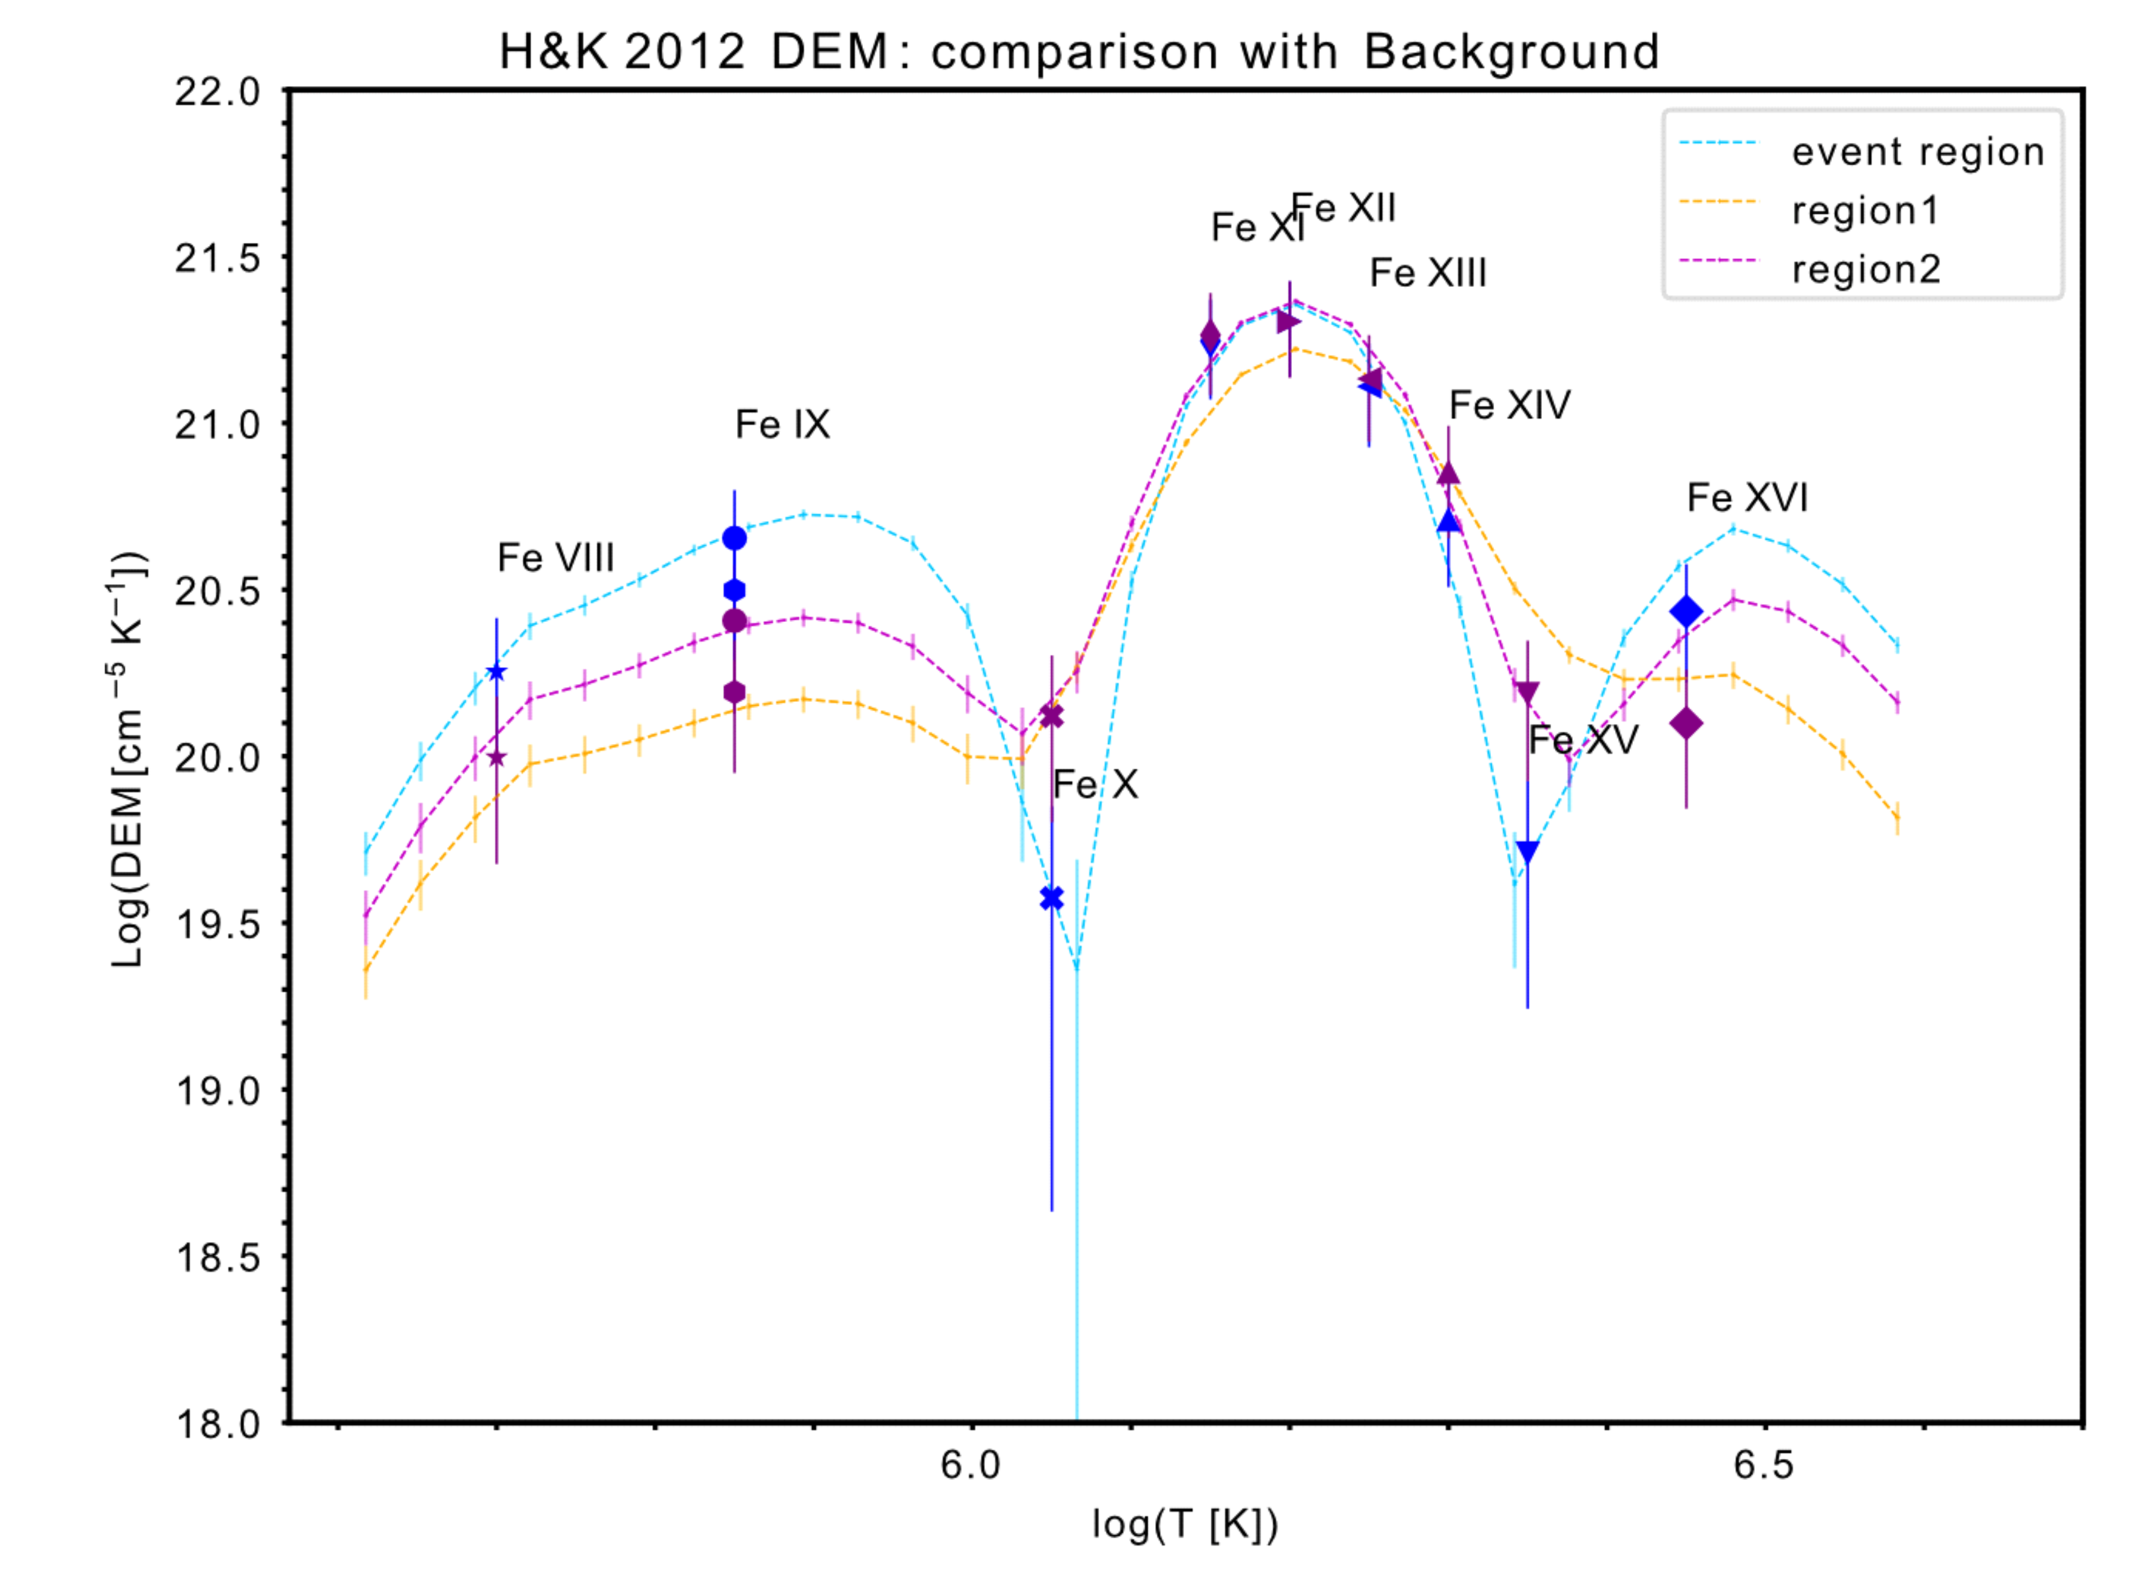
H&K 2012 DEM with EIS iron lines
Discussion:
The DEM of the event is highter at $\log{T_{e}} \left[K\right]<6.0$ compared with that of the background regions. At $\log{T_{e}} \left[K\right]> 6.0$ that, the difference disappear. At $\log{T_{e}} \left[K\right]>6.4$, the DEMs are poorly constrained.
➔ The event has higher plasma density than the QS at at $\log{T_{e}} \left[K\right]<6.0$ . This is a mostly a TR event.
Notes:
Set region to ref (consistent with right)
Set Elements in DEM.

