Slide 1
Possible Consequences of the 3rd Dimension on Reconnection
L. k. S. Daldorff, J. L. Leake and J. A. Klimchuk
10/06/2021

Slide 2
Outline
Simulations
Setup, runs, theory and conclusions
Observations Indicators

Slide 3
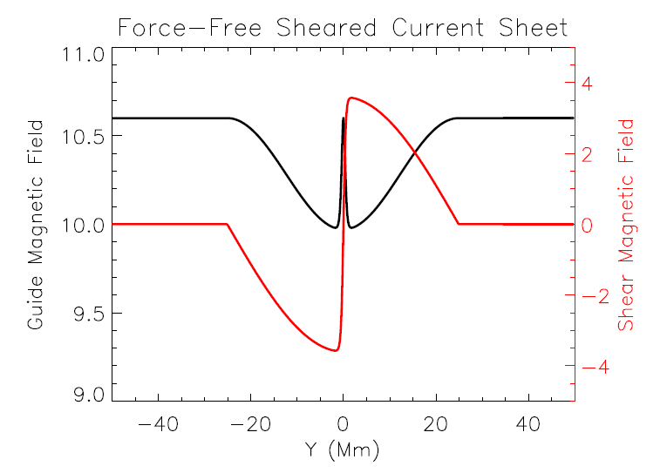
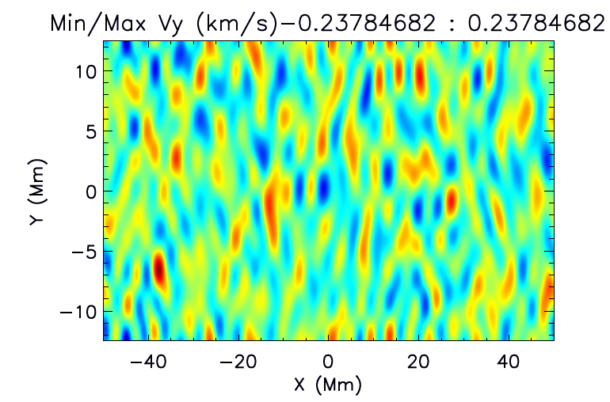
Initial setup
Resistive MHD simulation
Coronal plasma with an enveloped Harris current sheet:
${Bx= Bx}_{0}$ tanh(y/a)cos(2pi/b)
a= 0.5 Mm, b = 25 Mm
Bz = $\sqrt{{Bz}_{0}^{2} − {Bx(y)}^{2}}$
$n_{e}=1.5e8 {cm}^{−3}, T=1e6 K, β≈0.02$
$V_{y} pertubation to initiate reconnetion$
Periodic boundaries in all directions
Name | Lx, Ly, Lz (Mm) | ${Bx}_{0}$ (G) | ${Bz}_{0}$ (G) | θ
1 | 100x100x50 | 7.0 | 10 | 80
2 | 100x100x50 | 3.6 | 10 | 40
3 | 100x100x50 | 1.9 | 10 | 20

Slide 4
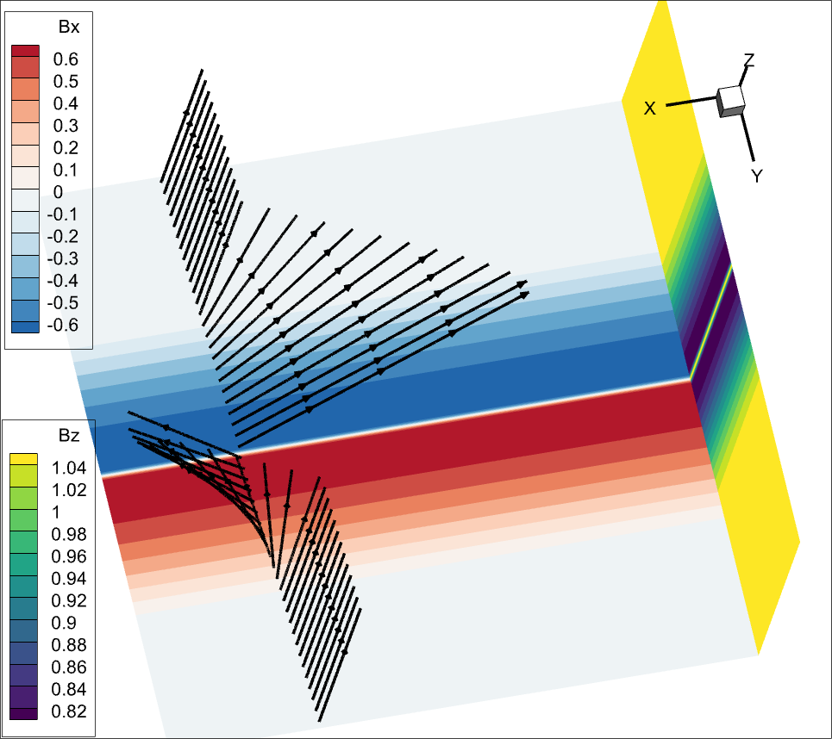
3D view initial setup Sim 1
Return current
Central current sheet Reconnecting current sheet, between min and max Bx
The simulation grid is adapted to resolve the central current sheet

Slide 5
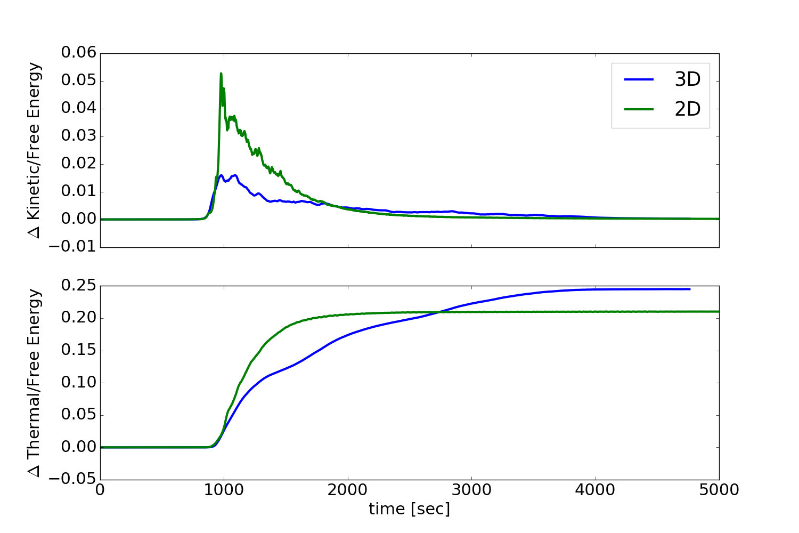
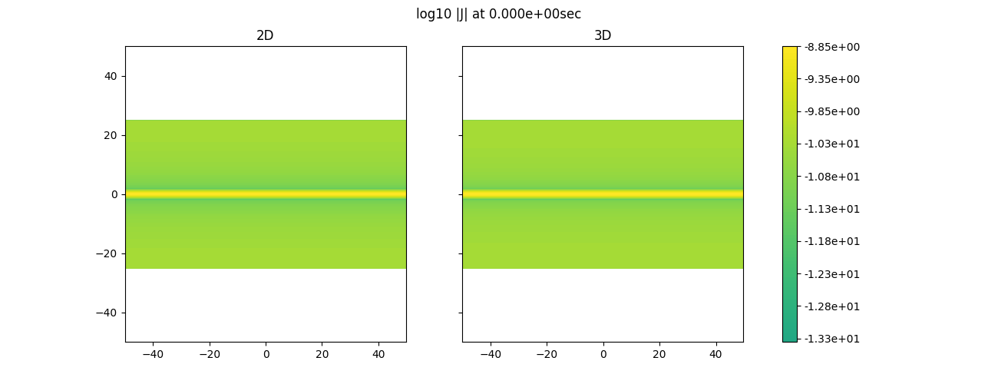
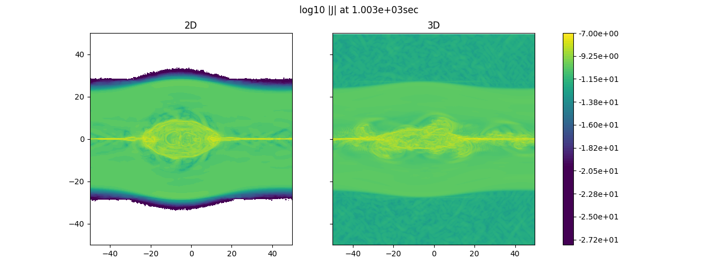
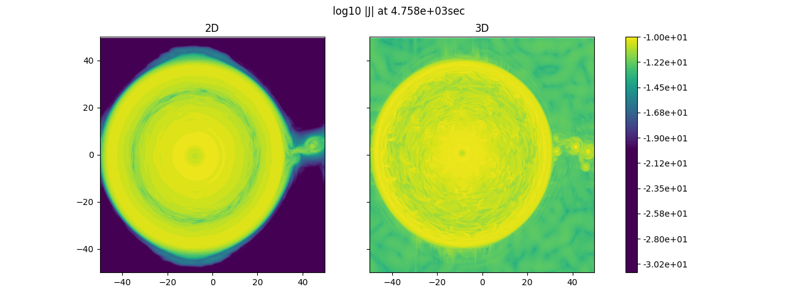
Generation of a flux rope (Leake et al 2019)
Reconnecting current sheet between two flux ropes with self generated “turbulence” (This presentation)

Slide 6
Total Current in 2D and 3D
Y [Mm]
X [Mm]

Slide 7
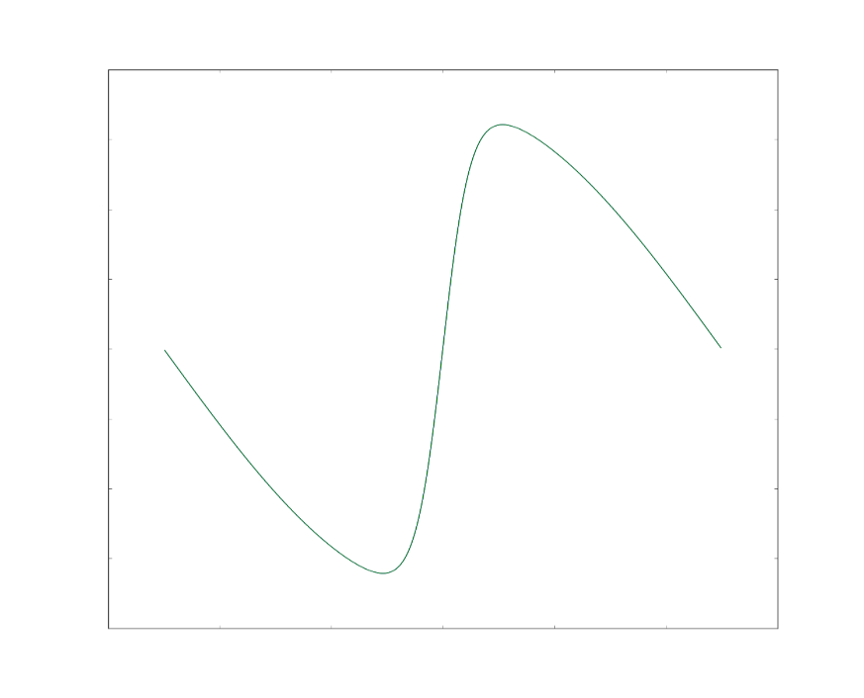
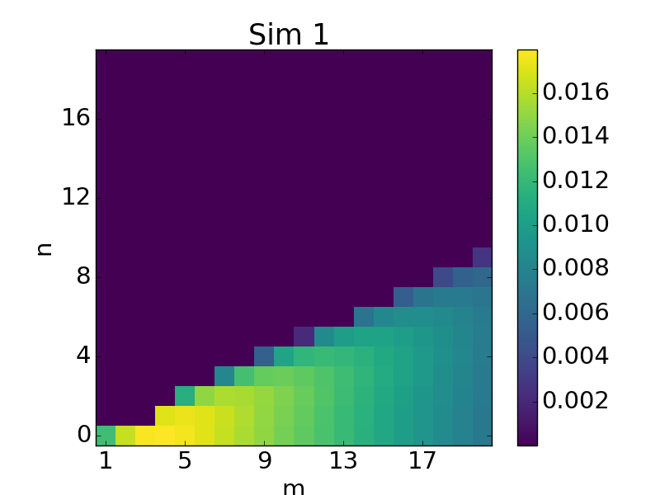
Sheared Magnetic Field Profile
3D Tearing Instability
Geometry
Profile
3×
k ∙ B = 0
(m, n) mode:
m λ_{x} = L_{x} (shear field direction)
n λ_{z} = L_{z} (guide field direction)
Oblique
Parallel
Only modes that exist in 2D, center of current sheet
Notes:
In addition to there being multiple planes,
there are multiple modes with each plane, corresponding to different wavelengths (flux tube diameters)
In an infinite current sheet there is a continuum of modes.
In a real current sheet with finite dimensions, only modes with an integral number of wavelengths along the dimension are possible.
Two mode numbers for each mode, m and n, give the number of wavelengths that fit in the shear and guide field directions.

Slide 8
Movie of only later time evolution of 3D
2D shows more and larger plasmoids
3D have a “turbulent” layer around the current sheet
3D only show larger plasmoids when reconnection of the return current starts at the end of the run, more laminar flow
3D have a longer lasting reconnection process giving lower kinetic energy but accumulated higher thermal energy (PS: no heat conduction or radiation loss)

Slide 9
Late time evolution with expanded view along Y-axis.
Y [index]
X [index]

Slide 10
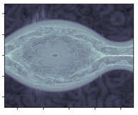
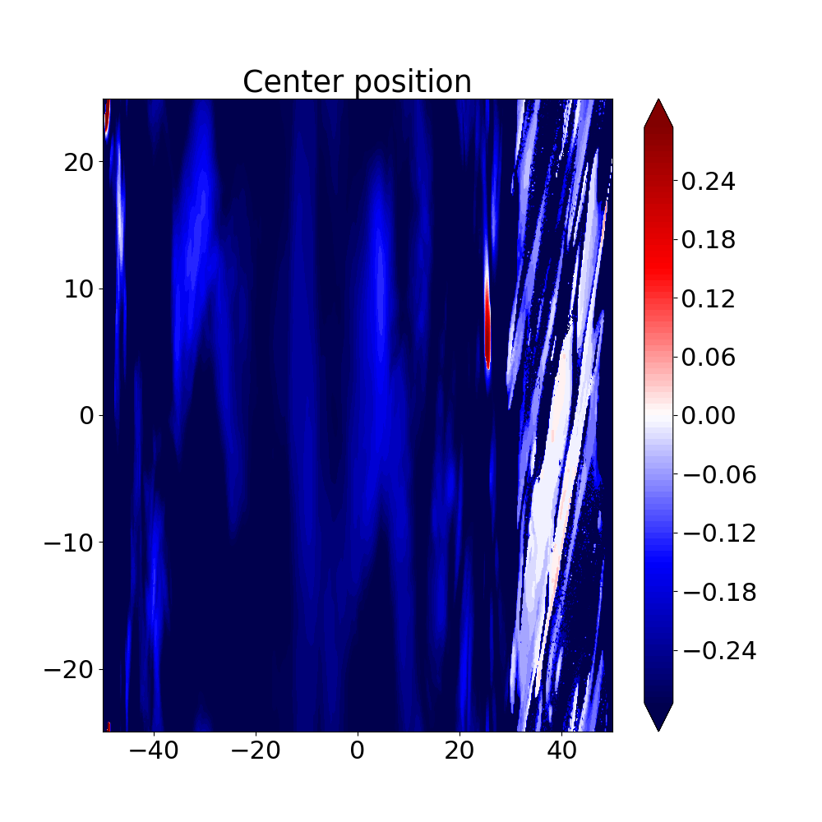
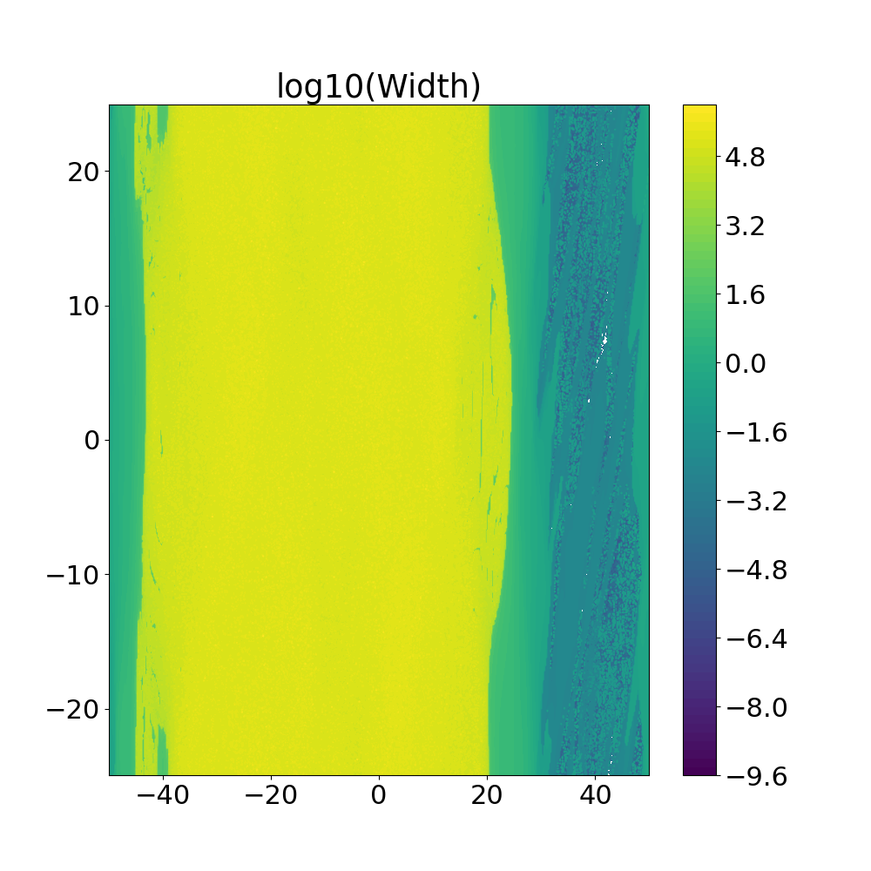
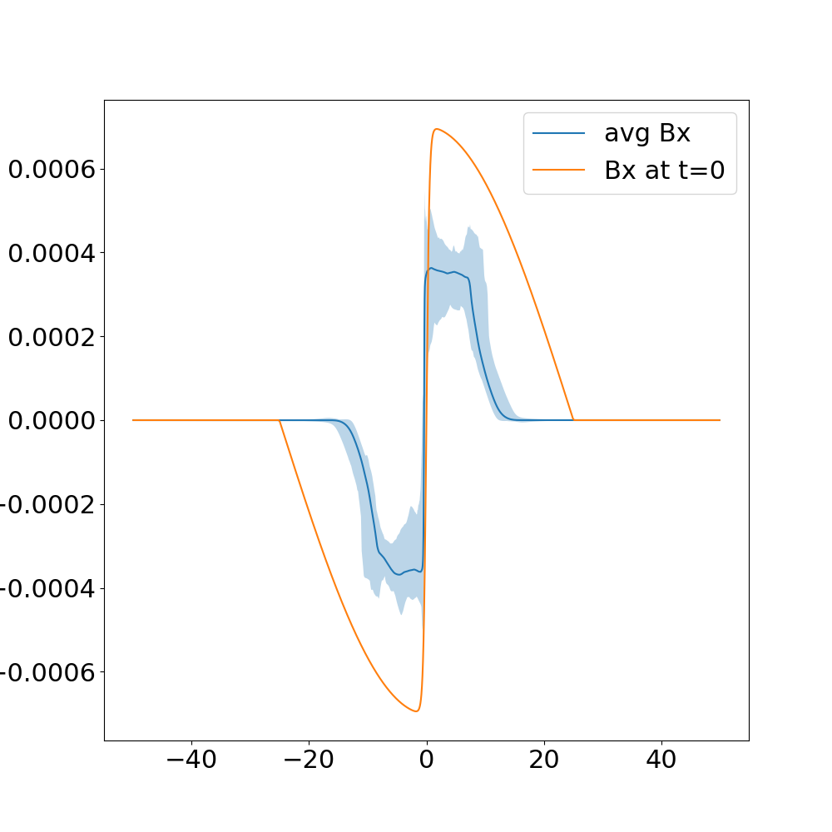
Characteristics of the newly formed current sheet
Parameters for fitting function taken of the current sheet.
The 3D oblique modes crate tilted structures interfering with the more efficient vertical 2D structures. Reducing the reconnection rate.
Initial Bx profile
Average Bx with min/max outliers
Area of oblique modes

Slide 11
Clarification
We are not saying that “turbulence” reduces reconnection rate. Some structures in the turbulence may exist that could reduce the reconnection rate.

Slide 12
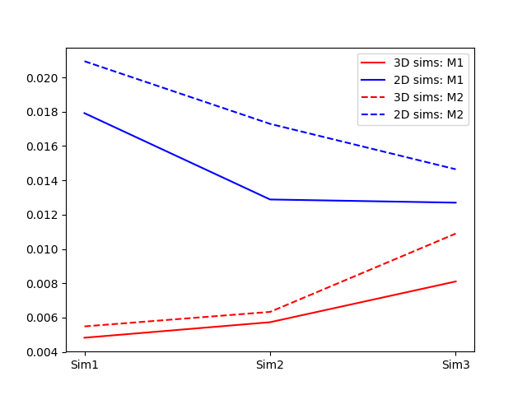
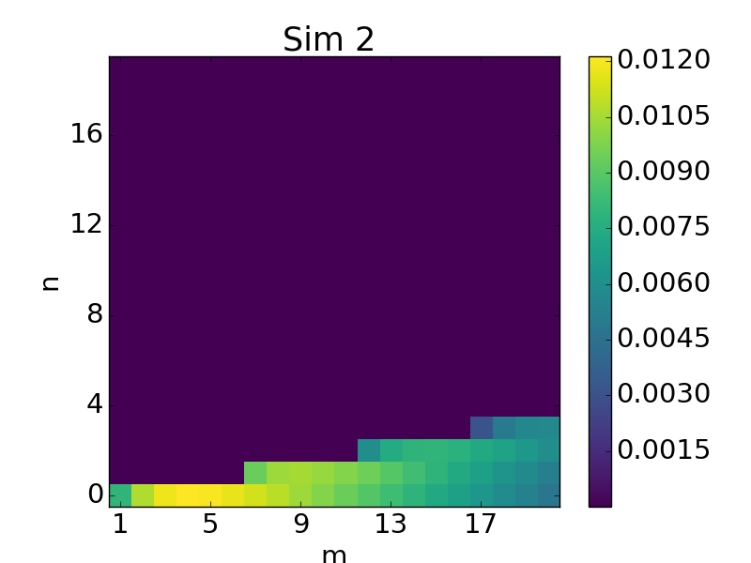
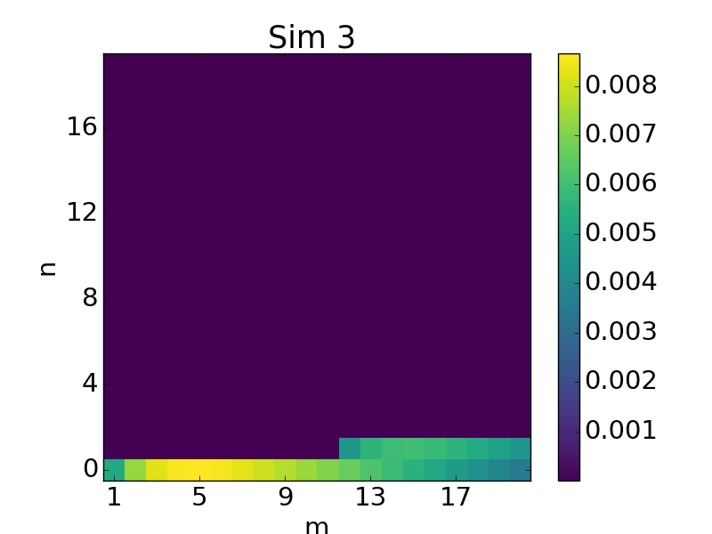
Changing shear
Growing modes
Reconnection rate
More 3D
More 2D
For self generated 3D turbulence, the lower the shear is the closer we come to the 2D solution
The structure created bye oblique modes are closer to vertical
There are fewer and weaker modes to interfere with the domination parallel, 2D mode.

Slide 13
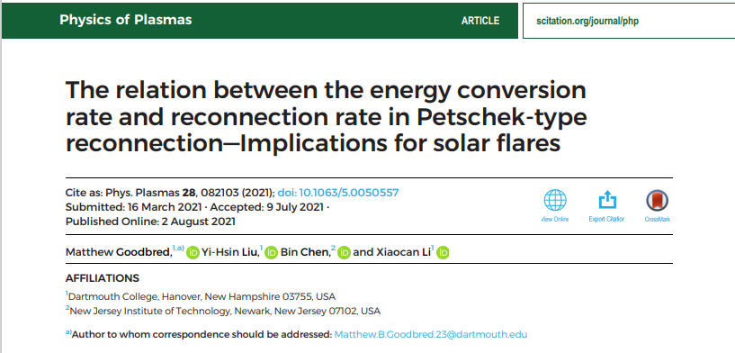
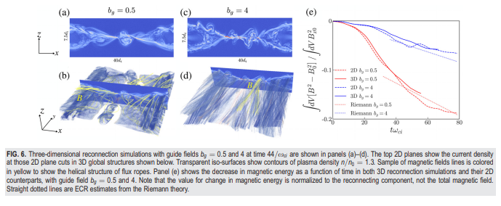
Kinetic simulations
Similar values for 3D and 2D.
We do not see any surrounding turbulence but the same trend of 2D little faster than 3D
Electron and ion scales

Slide 14
Conclusions
External fluctuation/turbulence in the inflow to a current sheet can interfere in the reconnection process and reduce the effective reconnection rate
For the self consistent generated fluctuations/turbulence in our simulations the difference between 2D and 3D reconnection rate decreases with reduced shear.
With decreased shear we get less interfering of the symmetric 2D reconnection case and production of larger and more frequent plasmoids will occur.
3D show much more fine scale structures and less ring patterns in the final flux ropes than 2D

Slide 15
Observations Indicators? no heat conduction and radiation loss included in simulation so cannot say anything about temperatures and so on.
Nanoflare
For nano-flare and other unresolved similar structure relying on statistical model or integrated values we do not see any observable clean indicator for suppression of reconnection process occurring

Slide 16
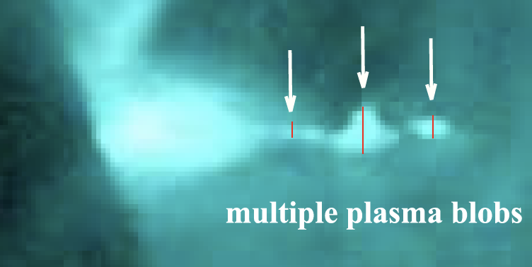
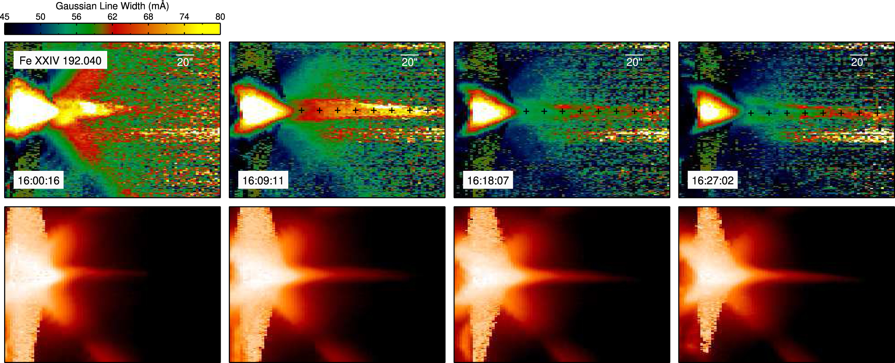
Observations Indicators? no heat conduction and radiation loss included in simulation so cannot say anything about temperatures and so on.
Observables for flare
Self consistent generated turbulence, our simulations
The turbulent layer will growth initially and change with the magnetic field configurations changes
Observe only large scale plasmoids/blobs early in the evolution
As it takes time for turbulence layer to generate
As the current sheet fields rotate, increasing its shear, resulting in a stronger turbulent region
External generated turbulence can have similar properties and effects on the reconnection process
Warren et al. (2018)
Kumar & Cho 2013

