Slide 1
Updates on EUNIS-2021
Jeff Brosius

Slide 2
Fe XIX Observed in AR 11726 by EUNIS-2013
Two independent imaging spectrographs:
- Longwave channel: 525–635 Å.
- Shortwave channel: 300–370 Å.
Rapid cadence (1.3 s) enabled by
- Throughput ~ 100 times that of SERTS.
- High-speed APSs (3 per channel).
1.7" × 636″ slits, with 150" × 200″ slots.
Cooled APS units increase dynamic range.
Suggested modification: 89-111 Å channel to
- Assess coronal heating w. Fe XVIII, XIX (7.1-8.9 MK).
- Fill gaps in spectral line observations.

Slide 3
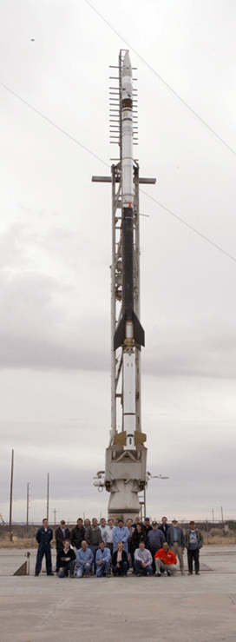
EUNIS-2021 Program Objectives
Assess validity of nanoflare model of solar coronal heating: strong lines of Fe XVIII (7.1 MK), XIX (8.9 MK) are ideal to detect “smoking gun” of nanoflare heating of solar corona.
Explore a relatively poorly observed and poorly understood portion of solar EUV spectrum: 92 – 115 Å.
Provide cross calibration support for orbiting solar instruments: SDO/AIA & Hinode/EIS.
Investigate structure and dynamics of solar corona and transition region: density, emission measure, abundances, bulk flows, nonthermal velocities,...

Slide 4
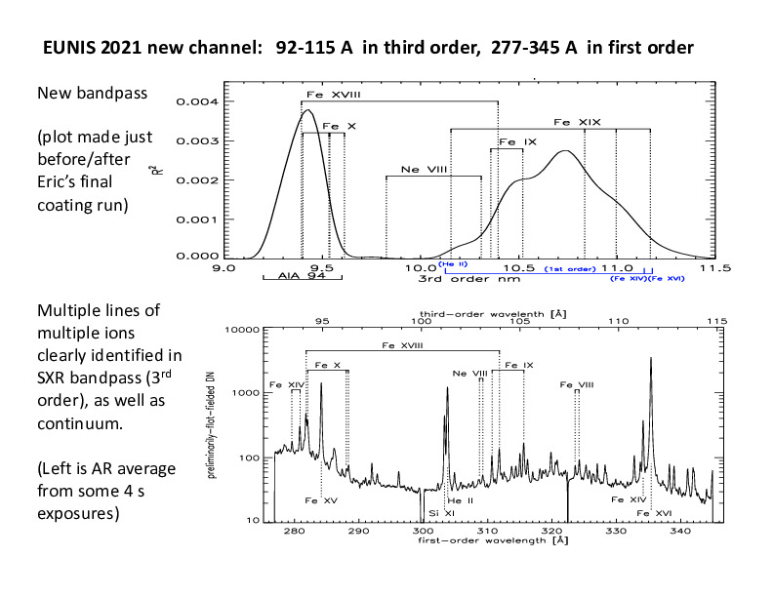
New EUV/SXR Channel on EUNIS-2021

Slide 5
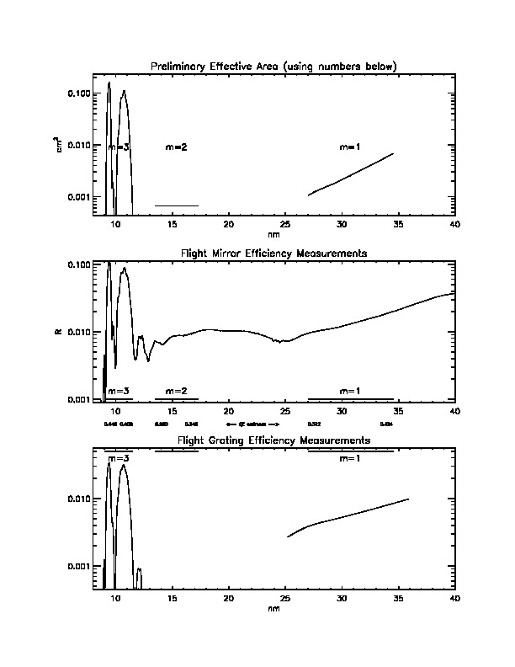
New EUV/SXR Channel on EUNIS-2021: Grating & Mirror Efficiencies, and Effective Area

Slide 6
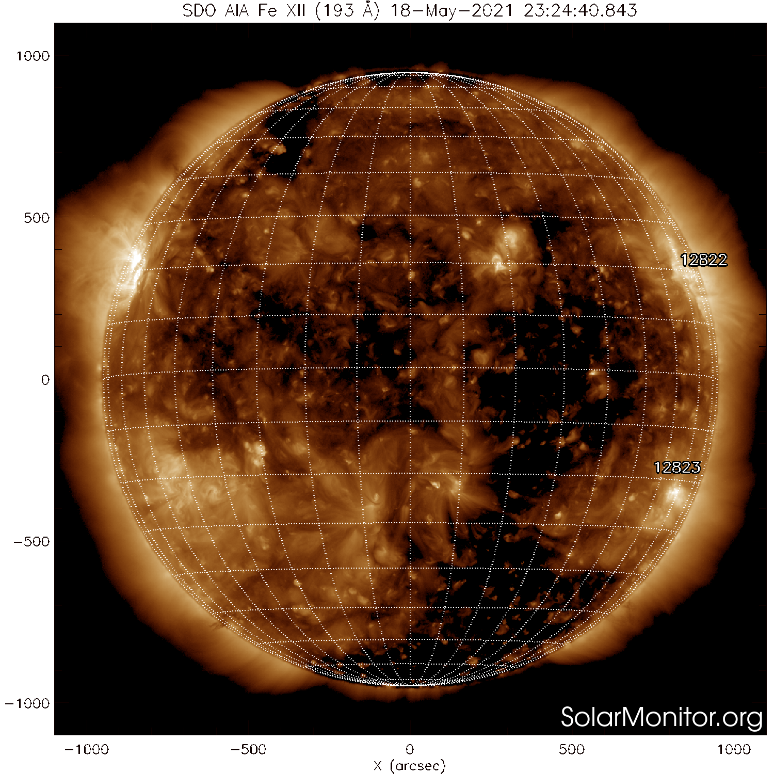
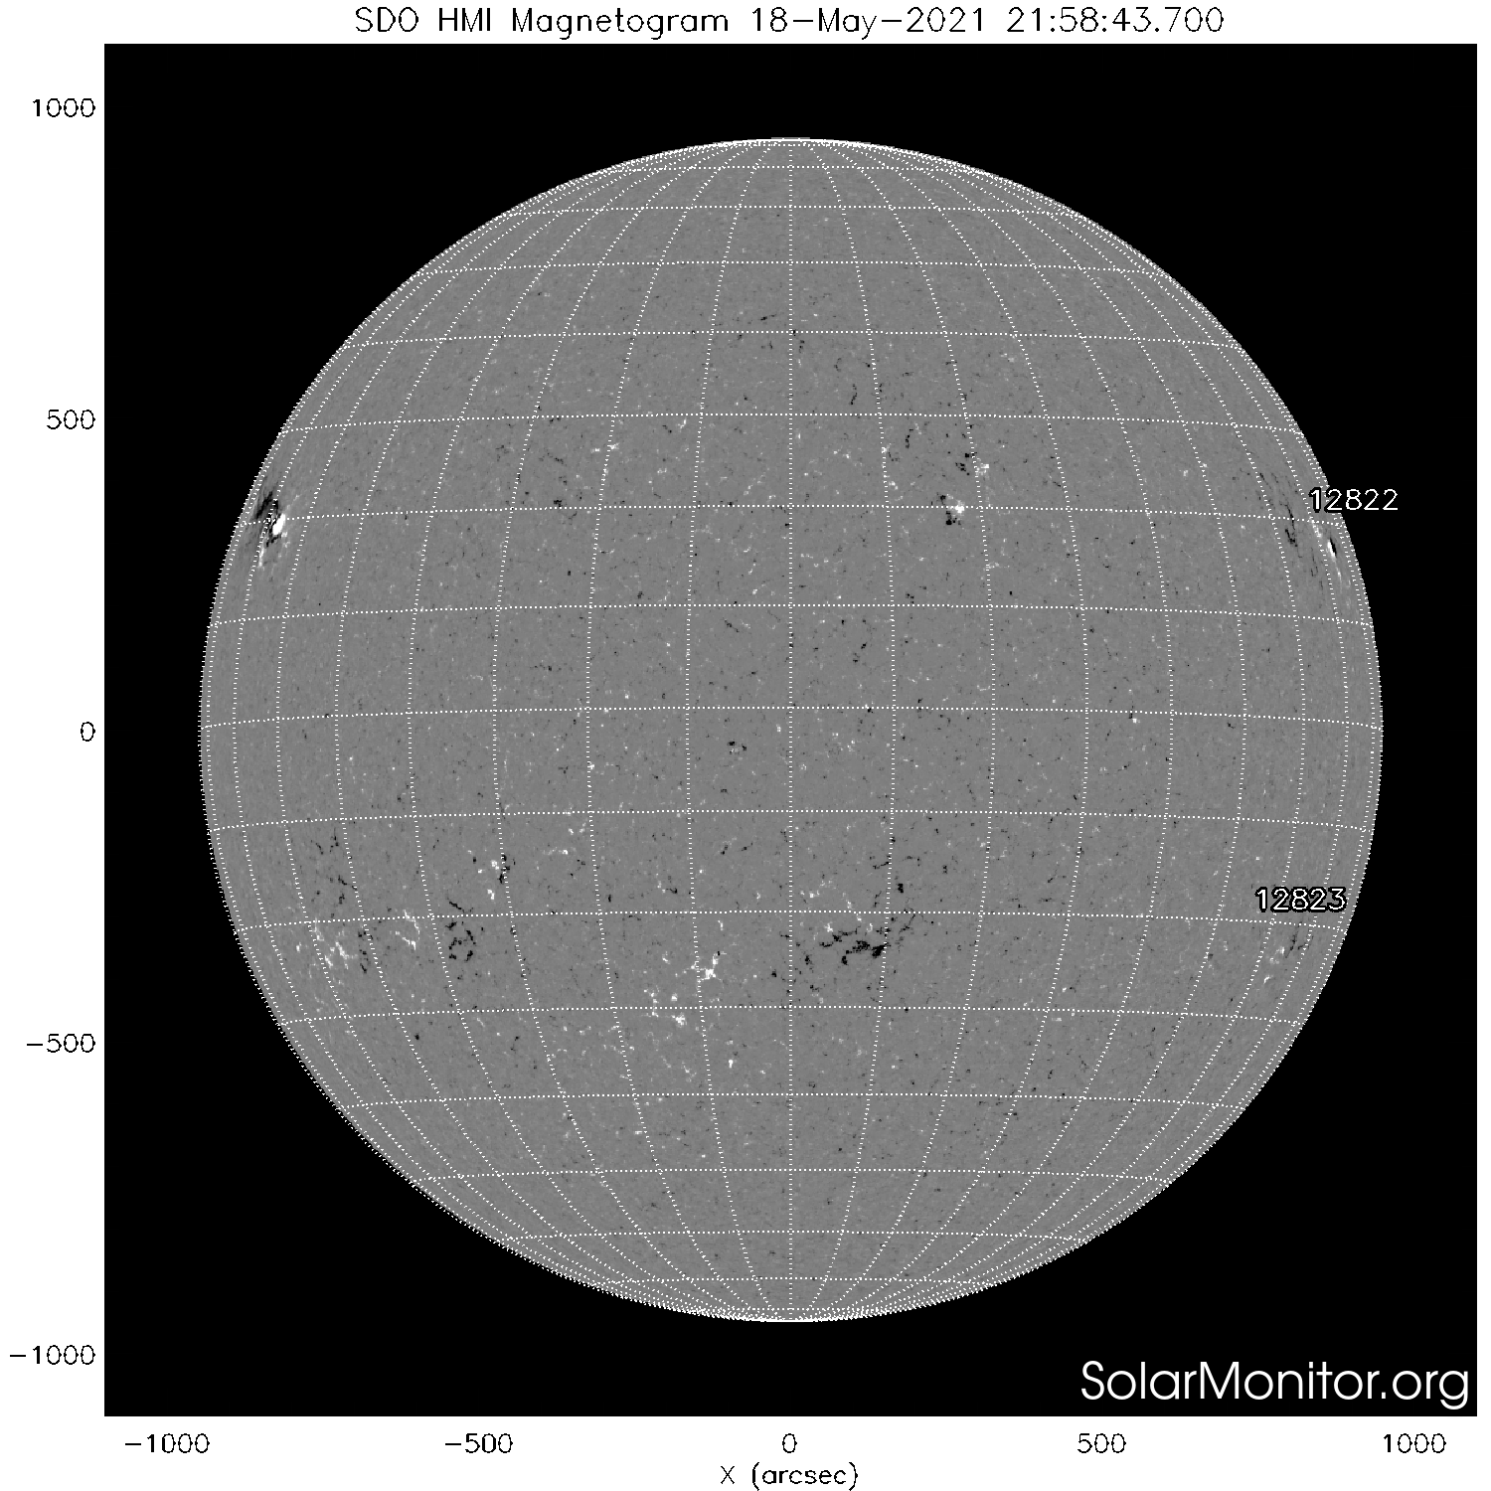
The Sun on 2021 May 18 During EUNIS Flight: AR 12824 near E70 N20 in Fe XII 193 Å and Bz

Slide 7
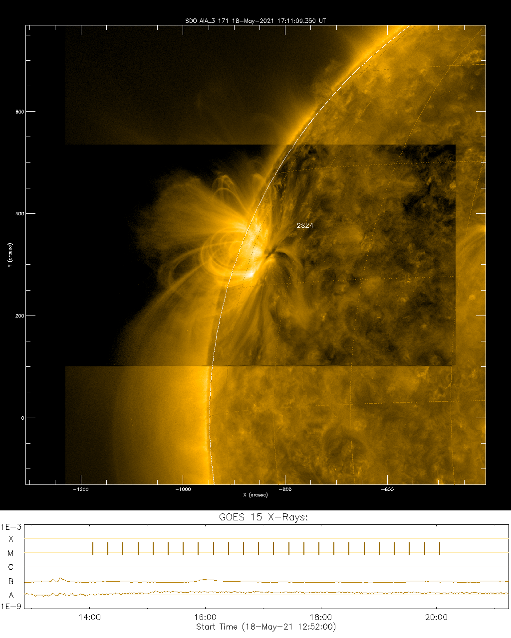
Closer view of AR 12824 in AIA 171 Å Channel Near Time of EUNIS Launch (17:30 UT) on 2021 May 18. Neither GOES nor AIA nor IRIS detected flaring activity during flight. GOES list:
01:58 02:09 02:13 C1.1 N16E84 12824
08:15 08:23 08:27 B2.3 N16E73 12824
13:17 13:22 13:26 B1.2 12824
13:26 13:30 13:34 B1.5 12824
15:50 15:58 16:12 B1.0 12824
21:27 21:35 21:45 B2.1 12824

Slide 8
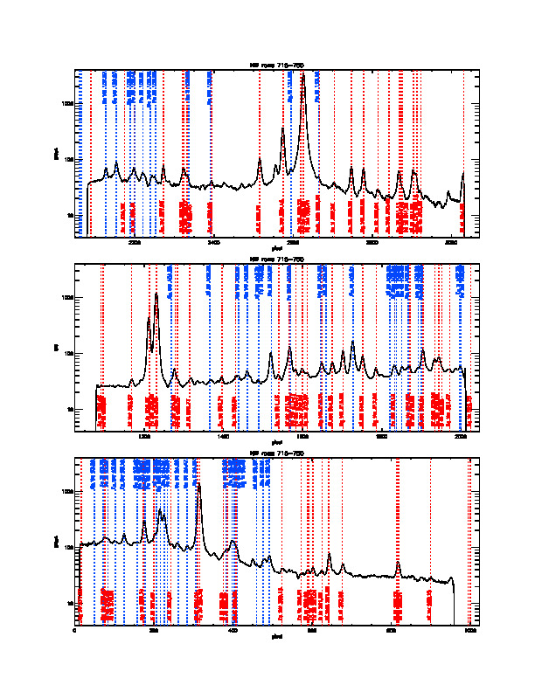
Lots of 1st order (red) and 3rd order (blue) lines in new EUNIS channel.

Slide 9
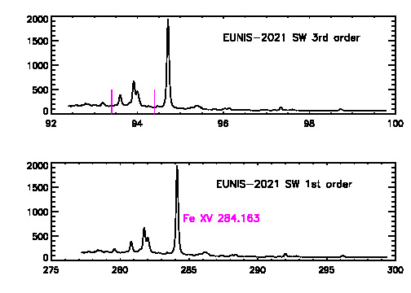
Average Spectrum in 1st-third of New Waveband

Slide 10
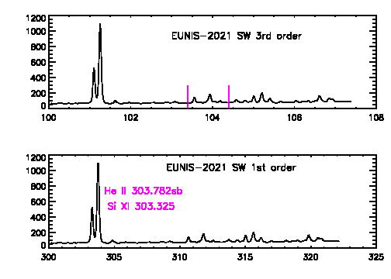
Average Spectrum in 2nd-third of New Waveband

Slide 11
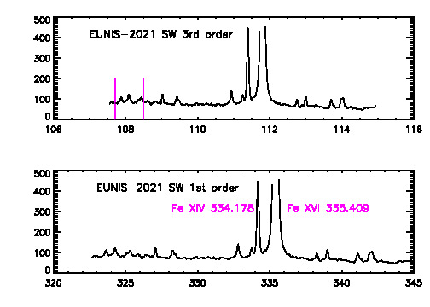
Average Spectrum in 3rd-third of New Waveband

Slide 12
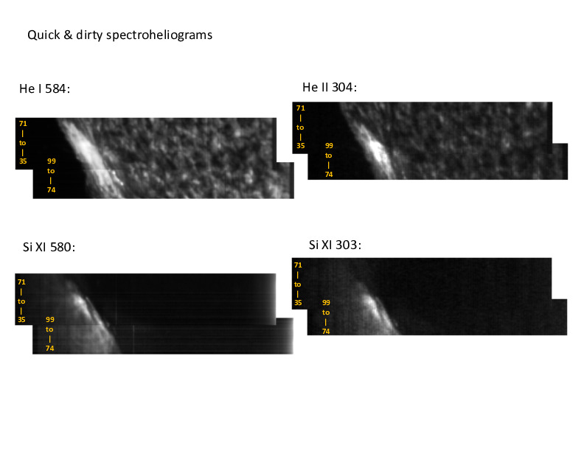
Quick and Dirty EUNIS Spectro-heliograms of Off-Limb, AR, and QS

Slide 13
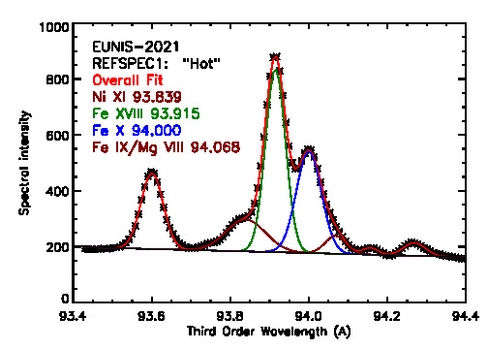
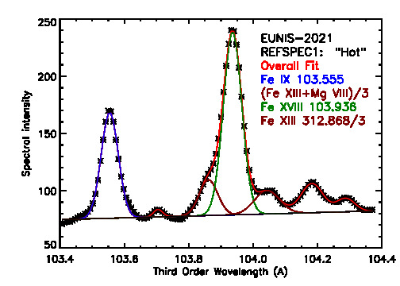
Fe XVIII Observed with EUNIS-2021
Fe XVIII 93.915 Å is not dominated by any known first or third order blend. FWHM_obs = 59.76 mÅ, FWHM_thermal = 23.95 mÅ.
Fe XVIII 103.936 Å is not dominated by any known first or third order blend. FWHM_obs = 67.48 mÅ, FWHM_thermal = 26.50 mÅ.

Slide 14
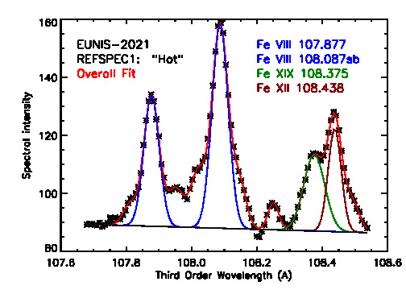
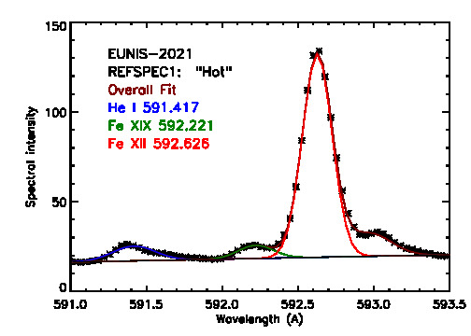
Fe XIX Observed with EUNIS-2021
Fe XIX 108.375 is not dominated by any known first or third order blend. FWHM_obs = 75.58 mÅ, FWHM_thermal = 31.01 mÅ.
Fe XIX 592.236 is not dominated by any known first or third order blend. FWHM_obs = 270.5 mÅ, FWHM_thermal = 169.4 mÅ.

Slide 15
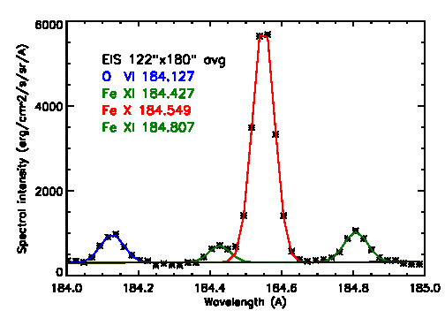
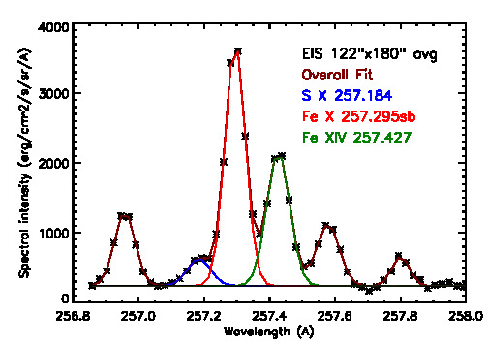
Sample EIS Profiles Featuring Fe X 184.5 and 257.3 Å
Essential for a new technique used to derive the coronal magnetic field strength (Landi et al. 2020).

Slide 16
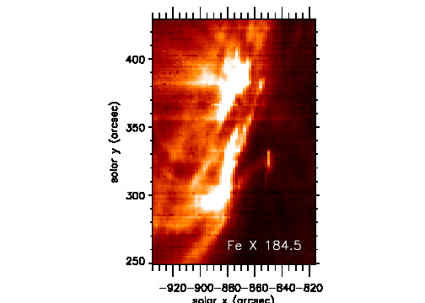
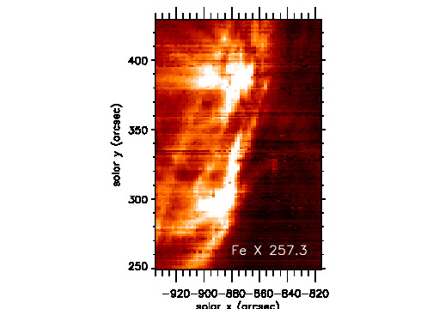
EIS Raster Images of AR in Fe X 184.5 & 257.3

Slide 17
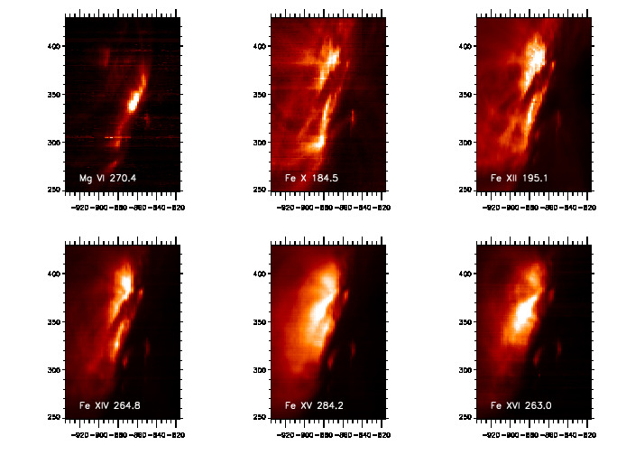
EIS Raster Images in Lines Formed at 0.45 – 2.8 MK Eventually Used to Cross Calibrate EIS with EUNIS

Slide 18
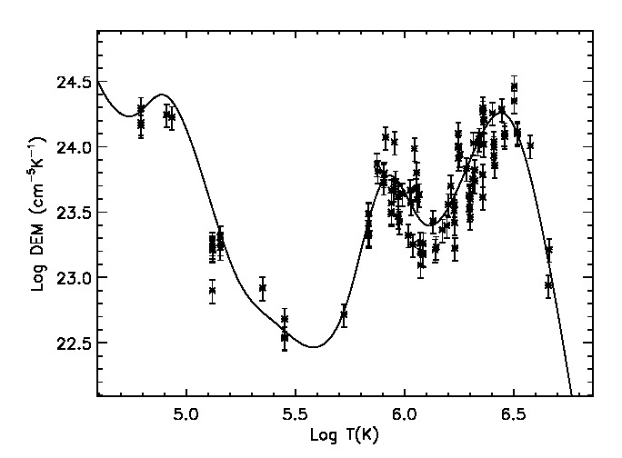
Preliminary AR DEM Based on EUNIS Only, in DN units (not yet in physical units).

Slide 19
Summary
Clear, unambiguous detections of multiple lines of Fe XVIII (7.1 MK) and Fe XIX (8.9 MK) in quiescent AR 12824 strongly supports nanoflare model of coronal heating. Still need to determine how widespread the hot plasma is in the region, DEM, Vnonthermal,...
Clean, well resolved 92 – 115 Å spectra (including unidentified lines) enable exploration of this poorly understood wavelength range.
Coordinated EIS spectra will enable cross calibration of EIS with EUNIS, and coordinated AIA images will improve understanding of 94 Å channel’s T response.

