Slide 1
Nonthermal Line Broadening and Velocities Observed by EUNIS-2021 and EIS in the Core of AR 12824
Jeff Brosius (Catholic U at NASA/GSFC)
Adrian Daw (NASA/GSFC)
Enrico Landi (U Michigan)
Doug Rabin (NASA/GSFC)
Don Schmit (U Colorado)

Slide 2
Can Vnonth Help Constrain Coronal Heating Mechanisms?
Nanoflare reconnection jets suggest Vnonth ≈ 250 km/s (Cargill 1996).
Nanoflare high-speed upflows suggest nonthermal broadening ≈ 16 – 37 km/s (Patsourakos & Klimchuk 2006).
Alfven wave energy dissipation through shocks yield mean V ≈ 50, max V > 200 km/s (Antolin et al. 2008).
3-D MHD model of coronal loop heating by Alfven wave turbulence and dissipation yield coronal velocity amplitudes 20 – 40 km/s (van Ballegooijen et al. 2011).
Ponderomotive force to produce FIP effect yields Alfven amplitudes ≈ 50 – 100 km/s (Laming et al. 2012).
Plasma response to reconnection strand heating using 2DCAM-EBTEL (Lopez Fuentes & Klimchuk 2022): 9 < Vnonth < 16 km/s for T up to 3 MK.

Slide 3
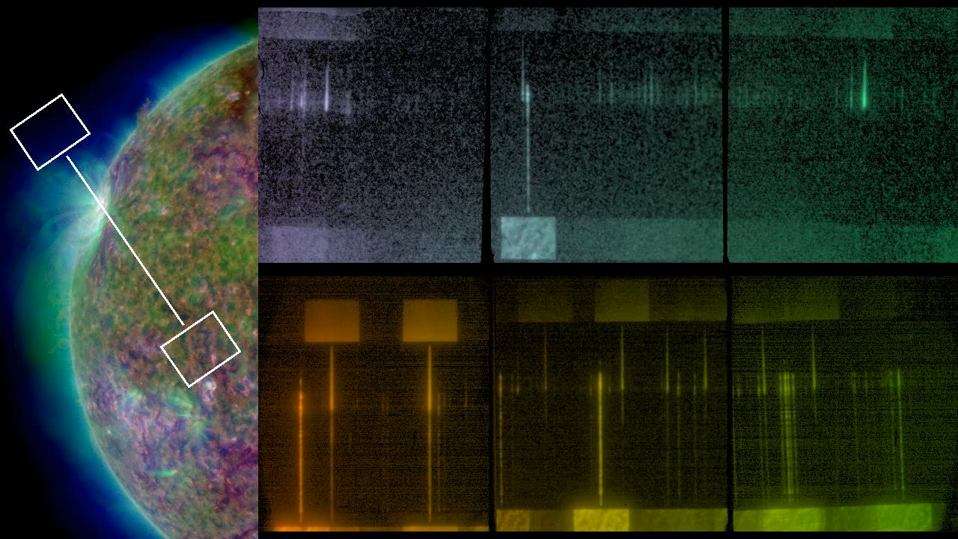
EUNIS Observations of AR 12824 on 2021 May 18
New SW channel at 92-115 Å in 3rd order superimposed on 277-345 Å in 1st, plus LW channel at 525-639 Å; 17:32 - 17:38 UT. GOES recorded one C1 flare early in day, otherwise nothing greater than B2; last pre-launch microflare ended ≈80 m before flight.

Slide 4
Extreme Ultraviolet Normal Incidence Spectrograph:
EUNIS-2021
Designed to observe line emission from Fe XVIII (Tmax = 7.1 MK) & Fe XIX (Tmax = 8.9 MK): key to assessing nanoflare model.
Overall, EUNIS observed 100s of lines formed at 0.03 < T < 10 MK.
Fe XVIII & Fe XIX detected over extended portion of AR. These lines constrain EM at high T, with preliminary results indicating small amount of plasma around 6 MK.
Ongoing work: finalize flat fielding, radiometric calibration, and instrumental width; assemble AR and QS line lists.
Here focus on instrumental width and nonthermal velocities.

Slide 5
Measuring Nonthermal Velocities
F²obs = F²therm + F²inst + F²nonth
Ftherm = (λ/c)(2akT/m)^(1/2), where a=4ln2, m=atomic mass
Finst : measured in laboratory
F²nonth = F²obs - F²inst - F²therm
Vnonth = (cFnonth)/[λa^(1/2)]

Slide 6
Instrumental Widths
EUNIS-2021
Hinode/EIS
Lab spectrum with Ar II, Ar III, & He I at 530-640 Å reveal Finst independent of λ in long wavelength (L) channel.
Strongest, well separated lines yield Finst = 189.8 ± 11.7 mÅ in L channel.
Gaussian profiles fit well.
Uncertainties:
* Best focus around 578 Å.
* He I 584.3 alone: Finst = 205.5 mÅ.
* Widths slightly depend on λ range of profile fit.
* Lab vs. solar illumination.
Korendyke et al. (2006): Mg III 187 Å → Finst = 47 mÅ in SW (170-210 Å); He II 256 & Ne III 267 → Finst = 55-57 mÅ in LW (250-290 Å).
Brown et al. (2008): Finst = 54 mÅ in SW based on solar obs and Vnonth ≈ 30 km/s.
Young (2011): Quantify Finst(Y-pixel) based on off-limb solar obs of Fe XII 193.5; removed Ftherm but not Fnonth.
Brooks & Warren (2016): Gaussian profiles fit well.
Widths slightly depend on λ range of profile fit.
Uncertainty on Finst ≈ 3.1 mÅ (Young 2011).

Slide 7
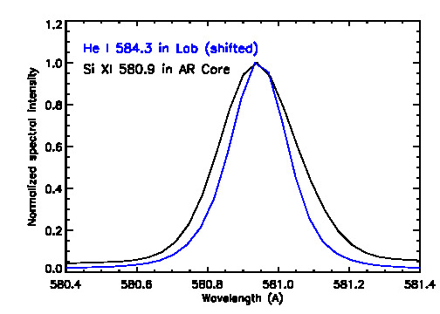
Comparison of Normalized Solar Profile of Si XI 580.9 Å With Normalized Shifted Lab Profile of He I 584.3 Å

Slide 8
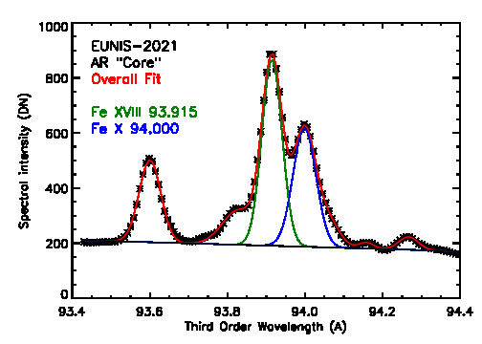
EUNIS Profile fits to Fe XVIII 93.9, Fe X 94.0 Å

Slide 9
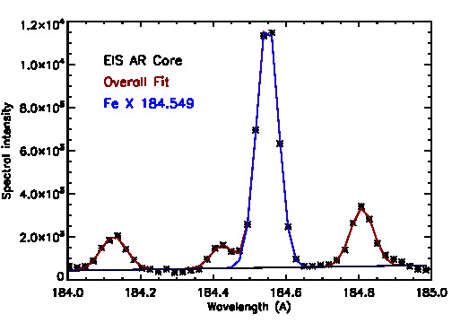
EIS Profile fits to Fe X 184.5 Å and Neighbors

Slide 10
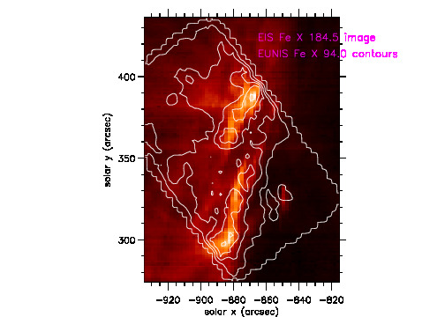
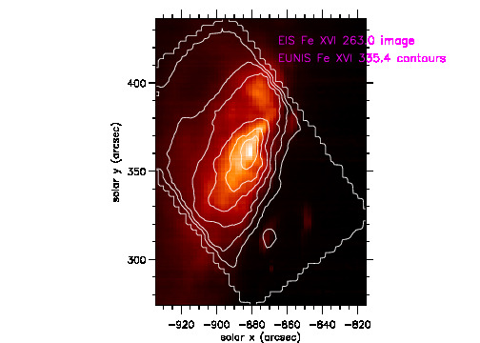
Coalignment of EUNIS & EIS

Slide 11
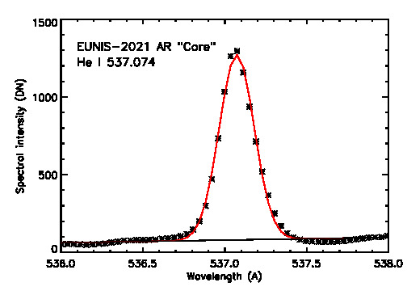
EUNIS Profile Fit to He I 537.1 Å

Slide 12
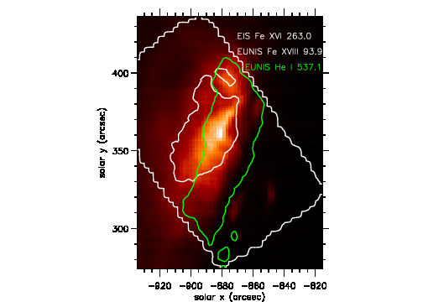
Fe XVIII and He I Contours Outlining AR Core
EIS raster image of Fe XVI at 263.0 Å. White contour is where Fe XVIII 93.9 Å intensity exceeds 33% of its max; green contour is where He I 537.1 exceeds 20% of its max. Overlap of these contours outlines AR “Core” (884 arcsec²).

Slide 13
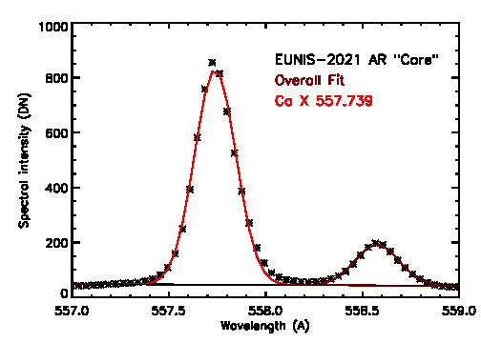
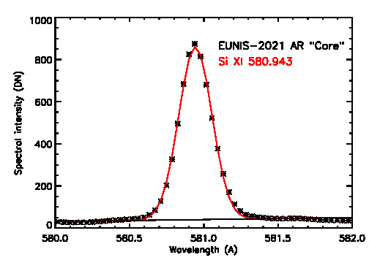
More EUNIS Profiles in Core: Ca X 557.7 & Si XI 580.9

Slide 14
EUNIS Vnonth for Strong, Separate Lines with Finst = 189.8 ± 11.7 mÅ.
Here, Teff is temperature at which most emission originates based on preliminary DEM.
Range of measured values is Vnonth = 49.9 ± 6.6 km/s ; average ± 1σ = 48.9 ± 3.7 km/s.
Line | Log (Teff) | FWHMtherm (mÅ) | FWHMobs (mÅ) | Vnonth (km/s)
He I 537.1 | 4.49 | 33.80 | 256.0 +/- 12.8 | 56.5 +/- 7.9
O III 599.6 | 4.88 | 29.57 | 248.9 +/- 13.0 | 47.5 +/- 7.4
O V 629.7 | 5.35 | 53.35 | 263.4 +/- 9.7 | 49.9 +/- 5.5
Ca X 557.7 | 6.09 | 69.98 | 251.2 +/- 5.1 | 48.1 +/- 5.6
Mg X 609.8 | 6.22 | 114.3 | 274.5 +/- 6.7 | 47.9 +/- 5.3
Mg X 624.9 | 6.22 | 117.1 | 281.9 +/- 7.0 | 49.7 +/- 5.0
Si XI 580.9 | 6.29 | 109.6 | 262.9 +/- 9.1 | 45.0 +/- 7.0
Si XI 604.2 | 6.29 | 114.0 | 264.9 +/- 9.1 | 43.3 +/- 6.7
Al XI 550.0 | 6.32 | 109.6 | 271.2 +/- 7.6 | 52.3 +/- 6.2

Slide 15
EUNIS Vnonth for Strong, Separate Lines with Finst = 205.5 ± 11.7 mÅ.
Here, Tmax is temperature of max ionization fraction, and Finst is based on only He I 584.3 in lab.
Range of measured values is Vnonth = 44.7 ± 5.7 km/s; average ± 1σ = 44.6 ± 3.8 km/s.
Line | Log (Tmax) | FWHMtherm (mÅ) | FWHMobs (mÅ) | Vnonth (km/s)
He I 537.1 | 4.3 | 27.16 | 256.0 +/- 12.8 | 50.4 +/- 9.1
O III 599.6 | 4.9 | 30.26 | 248.9 +/- 13.0 | 41.2 +/- 8.8
O V 629.7 | 5.35 | 53.35 | 263.4 +/- 9.7 | 44.6 +/- 6.4
Ca X 557.7 | 5.9 | 56.23 | 251.2 +/- 5.1 | 43.0 +/- 6.6
Mg X 609.8 | 6.05 | 93.84 | 274.5 +/- 6.7 | 46.0 +/- 5.7
Mg X 624.9 | 6.05 | 96.16 | 281.9 +/- 7.0 | 48.2 +/- 5.4
Si XI 580.9 | 6.21 | 99.98 | 262.9 +/- 9.1 | 40.3 +/- 8.1
Si XI 604.2 | 6.21 | 104.0 | 264.9 +/- 9.1 | 39.0 +/- 7.8
Al XI 550.0 | 6.2 | 95.47 | 271.2 +/- 7.6 | 48.8 +/- 7.0

Slide 16
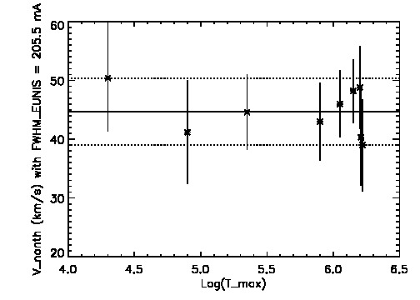
EUNIS Vnonth in AR Core: 44.7 ± 5.7 km/s Independent of Tmax

Slide 17
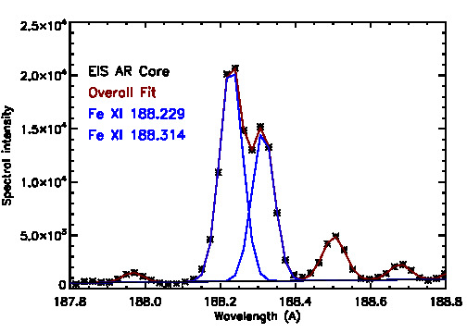
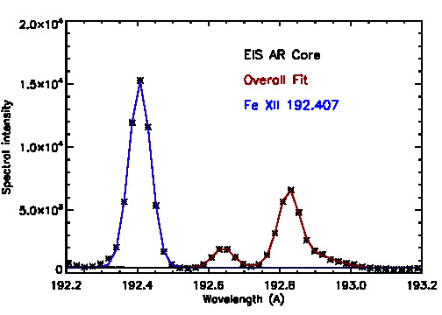
More EIS profiles in Core: Fe XI 188.2, 188.3; Fe XII 192.4

Slide 18
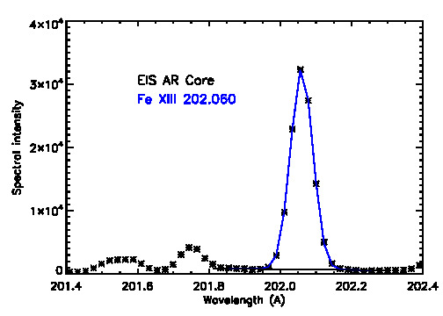
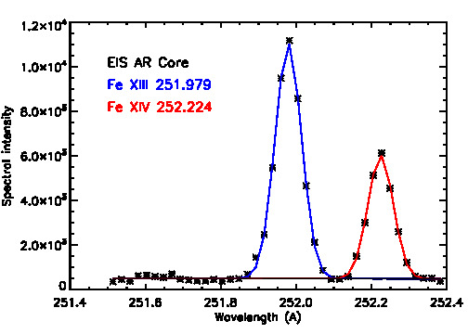
More EIS profiles in Core: Fe XIII 202.0 & Fe XIII 252.0

Slide 19
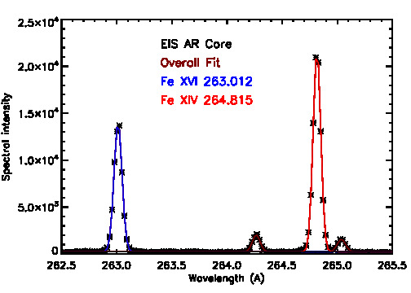
More EIS profiles in Core: Fe XIV 264.8 with Fe XVI 263.0

Slide 20
EIS Vnonth for Subset of 19 Strong, Separate Lines with Finst = [54, 55] mÅ
Here, Tmax is temperature of max ionization fraction, and Finst is from Korendyke et al. and Brown et al.
Range of measured values for all 19 lines is Vnonth = 35.4 ± 3.8 km/s; average ± 1σ = 36.0 ± 2.6 km/s.
If use average of fits in individual spatial pixels rather than fits to average core spectrum, get 38.7 ± 6.1, 39.0 ± 4.1.
Line | Log (Tmax) | FWHMtherm (mÅ) | FWHMobs (mÅ) | Vnonth (km/s)
Fe X 184.5 | 5.98 | 17.28 | 69.15 ± 3.47 | 38.6 ± 7.2
Fe XI 188.2 | 6.07 | 19.55 | 70.49 ± 3.53 | 39.1 ± 7.0
Fe XI 188.3 | 6.07 | 19.56 | 69.34 ± 3.43 | 37.1 ± 7.1
Fe XII 192.4 | 6.13 | 21.42 | 71.62 ± 2.17 | 39.2 ± 5.1
Fe XIII 202.0 | 6.20 | 24.37 | 72.83 ± 1.35 | 37.8 ± 4.1
Fe XIII 252.0 | 6.20 | 30.41 | 82.36 ± 3.64 | 38.0 ± 4.6
Fe XIV 264.8 | 6.28 | 35.03 | 81.31 ± 2.75 | 33.0 ± 3.9
Fe XV 284.2 | 6.32 | 39.37 | 91.68 ± 1.70 | 39.2 ± 2.4
Fe XVI 263.0 | 6.42 | 40.88 | 85.42 ± 2.89 | 34.9 ± 4.0

Slide 21
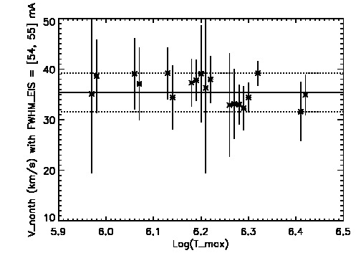
EIS Vnonth in AR Core: 35.4 ± 3.8 km/s Independent of T

Slide 22
Vnonth in AR Core With EUNIS and EIS
Range of EUNIS measurements: 44.7 ± 5.7 km/s.
Average ± 1-sigma of EUNIS measurements: 44.6 ± 3.8 km/s.
Range of EIS measurements: 35.4 ± 3.8 km/s.
Average ± 1-sigma of EIS measurements: 36.0 ± 2.6 km/s.
Range of EUNIS and EIS measurements: 41.0 ± 9.4 km/s.
Average ± 1-sigma of EUNIS and EIS measurements: 38.7 ± 5.0 km/s.
Vnonth is independent of T for 4.3 < log T < 6.42.
If use EIS Finst = 68 ± 3 (Note #7), get range of real values 18.0 ± 12.2 km/s.

Slide 23
EUNIS Vnonth for Strong, Separate QS Lines (Finst = 205.5 ± 11.7 mÅ).
Here, Tmax is temperature of max ionization fraction, and Finst is based on only He I 584.3 in lab.
Range of measured values is Vnonth = 45.5 ± 7.1 km/s; average ± 1σ = 42.9 ± 4.8 km/s.
Line | Log (Tmax) | FWHMtherm (mÅ) | FWHMobs (mÅ) | Vnonth (km/s)
He I 537.1 | 4.3 | 27.16 | 260.0 +/- 12.8 | 52.6 +/- 8.8
O III 599.6 | 4.9 | 30.26 | 244.0 +/- 13.0 | 38.4 +/- 9.3
O V 629.7 | 5.35 | 53.35 | 256.0 +/- 9.7 | 40.9 +/- 6.9
Ca X 557.7 | 5.9 | 56.23 | 250.2 +/- 5.1 | 42.3 +/- 6.7
Mg X 609.8 | 6.05 | 93.84 | 261.1 +/- 6.7 | 38.7 +/- 6.7
Mg X 624.9 | 6.05 | 96.16 | 274.7 +/- 7.0 | 44.6 +/- 5.7
Si XI 580.9 | 6.21 | 99.98 | - | -
Si XI 604.2 | 6.21 | 104.0 | - | -
Al XI 550.0 | 6.2 | 95.47 | - | -

Slide 24
EIS Vnonth for Subset of Strong, Separate QS Lines with Finst = [54, 55] mÅ
Here, Tmax is temperature of max ionization fraction, and Finst is from Korendyke et al. and Brown et al.
Range of measured values for 5 useful lines is Vnonth = 41.6 ± 4.2 km/s; average ± 1σ = 40.9 ± 3.2 km/s.
Line | Log (Tmax) | FWHMtherm (mÅ) | FWHMobs (mÅ) | Vnonth (km/s)
Fe X 184.5 | 5.98 | 17.28 | 70.38 ± 3.47 | 40.7 ± 6.9
Fe XI 188.2 | 6.07 | 19.55 | 74.77 ± 3.53 | 45.8 ± 6.2
Fe XI 188.3 | 6.07 | 19.56 | 69.49 ± 3.43 | 37.4 ± 7.1
Fe XII 192.4 | 6.13 | 21.42 | 74.09 ± 2.17 | 43.0 ± 4.7
Fe XIII 202.0 | 6.20 | 24.37 | 72.80 ± 1.35 | 37.7 ± 4.1
Fe XIII 252.0 | 6.20 | 30.41 | - | -
Fe XIV 264.8 | 6.28 | 35.03 | - | -
Fe XV 284.2 | 6.32 | 39.37 | - | -
Fe XVI 263.0 | 6.42 | 40.88 | - | -

Slide 25
Vnonth in QS With EUNIS and EIS
Range of EUNIS measurements: 45.5 ± 7.1 km/s.
Average ± 1-sigma of EUNIS measurements: 42.9 ± 4.8 km/s.
Range of EIS measurements: 41.6 ± 4.2 km/s.
Average ± 1-sigma of EIS measurements: 40.9 ± 3.2 km/s.
Range of EUNIS and EIS measurements: 45.0 ± 7.6 km/s.
Average ± 1-sigma of EUNIS and EIS measurements: 42.0 ± 4.3 km/s.
Vnonth is independent of T for 4.3 < log T < 6.2.

Slide 26
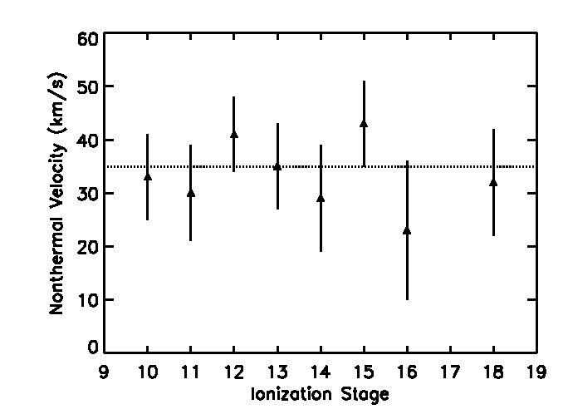
Comparison With Other Measurements
Nonthermal AR Velocities from SERTS-97
Finst = 115.0 ± 1.4 mÅ; all values consistent with 35 km/s (Brosius et al 2000).
Nonthermal AR Velocities from Hinode/EIS, SoHO/SUMER, HRTS, SMM/XRP
Saba & Strong (1991; XRP AR): Vnonth = 42 ± 30, 58 ± 4, 44 ± 4 km/s for O VIII, Ne IX, Mg XI.
Doyle et al. (1997; HRTS QS limb): Vnonth = 27 km/s for Fe XII.
Chae et al. (1998; SUMER QS): Vnonth = 23 ± 5, 16 ± 7 for Mg X, Fe XII.
Landi et al. (2003; SUMER, above AR at 1.06-1.20 Rsolar): Vnonth = 20-35 km/s independent of T or height for T = 2.6-6.6 MK.
Brooks & Warren (2016; EIS): Vnonth = 17.6 ± 5.3 km/s for 16 loops in 15 ARs for 1.1-3.6 MK; use Young (2011) for Finst . No trend with T or B flux.

Slide 27
Summary and Conclusions
Lab measurements of Finst are challenging & uncertain, but essential.
For the EUNIS LW channel we adopt Finst = 205.5 ± 11.7 mÅ; for the EIS SW channel we adopt Finst = 54.0 ± 3.1 mÅ; for the EIS LW channel we adopt Finst = 55.0 ± 3.1 mÅ.
In AR core, EUNIS & EIS yield Vnonth = 41.0 ± 9.4 km/s independent of T for 4.3 < log T < 6.4.
In QS, EUNIS & EIS yield Vnonth = 45.0 ± 7.6 km/s independent of T for 4.3 < log T < 6.2.
Can these measurements constrain coronal heating mechanisms and/or other processes that occur in solar atmosphere?

