Slide 1
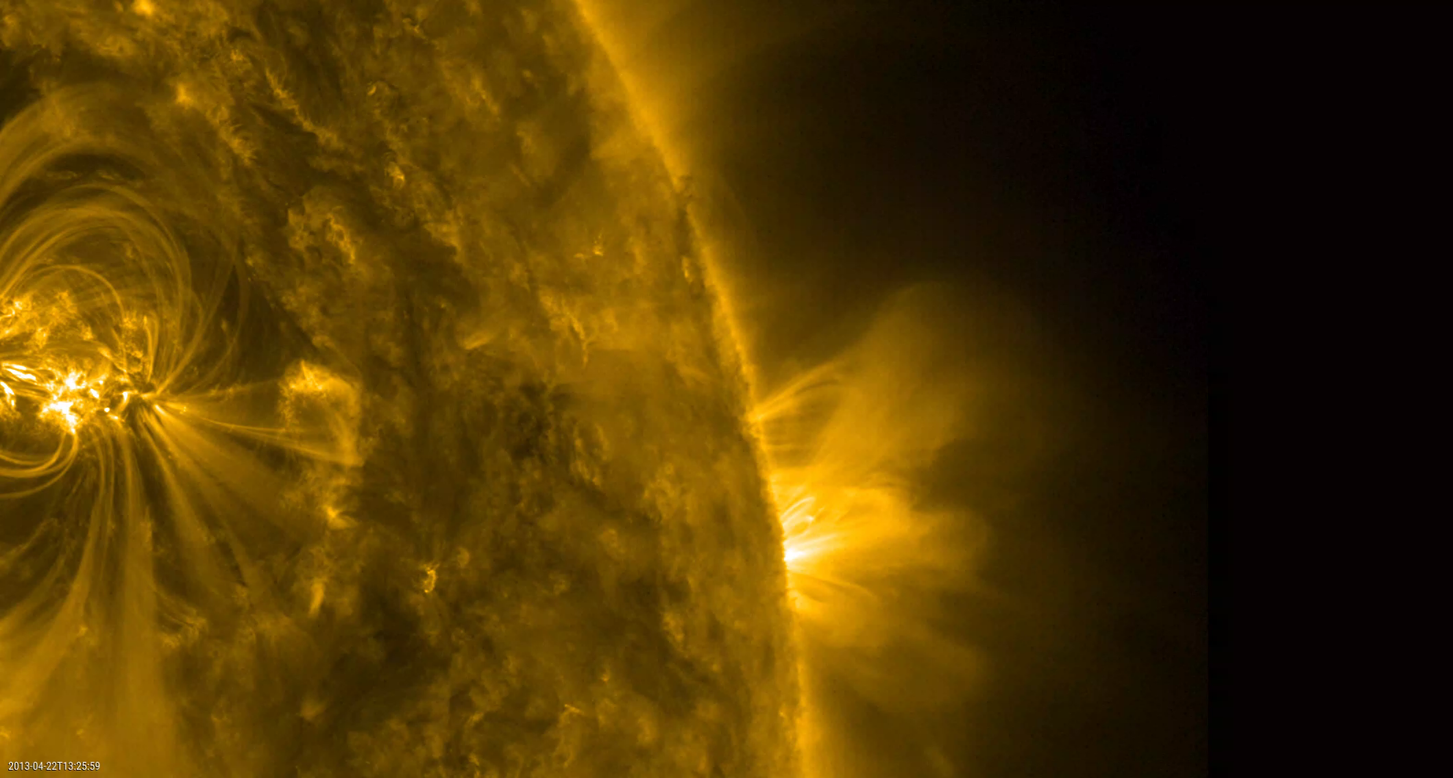

A 3D Model of AR 11726 Heated by Nanoflares

Slide 2

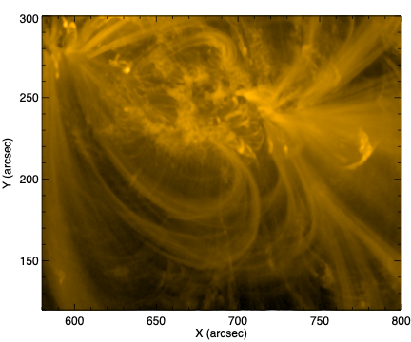
Observations of AR 11726
Simultaneously observed by EIS, EUNIS, HMI, and AIA on 23 April 2013.
The broad temperature coverage of these instruments make this AR an ideal candidate for studying impulsive heating events.

Slide 3

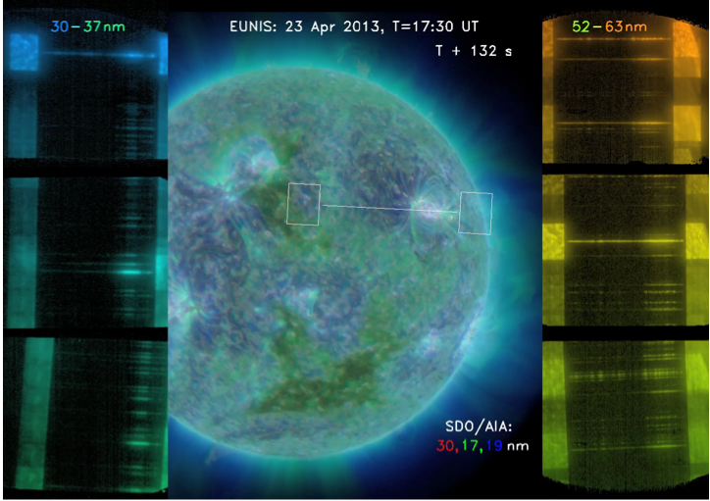
EUNIS Sounding Rocket
EUNIS (Extreme Ultraviolet Normal Incidence Spectrometer) is a two-channel imaging spectrograph that observes the solar corona and transition region with high resolution and rapid (1.3 s) cadence.
Highest dynamic range observations of the 30-37 and 52-63 nm spectral region of the Sun to date.
Coordinated observation with Hinode/EIS.
Observes many lines formed over the range log T = 4.3 – 7.0 K.
Constrains models of coronal heating

Slide 4
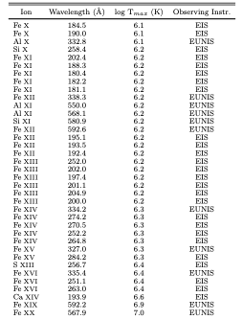
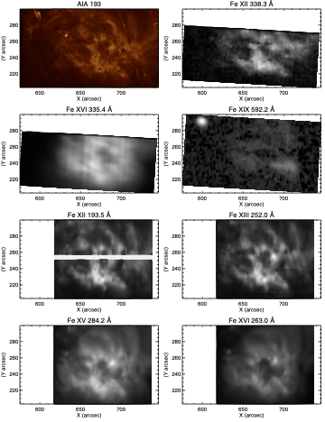
Lines observed by EUNIS and EIS

Slide 5
Construct a 3D Model of AR11726
Extrapolate magnetic field into the corona and trace field lines
Using 1D hydrodynamic code, simulate the loop response to various models of nanoflare coronal heating.
Determine time-averaged temperature and density as a function of position.
Using CHIANTI, predict emission in lines observed by EUNIS and EIS.
Project along the line of sight and compare predicted emission with observed to constrain nanoflare heating models.

Slide 6
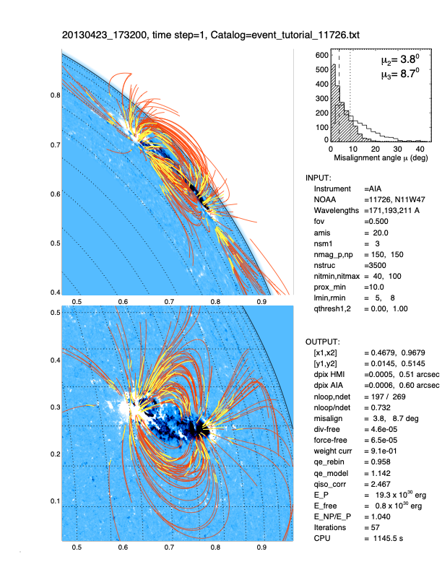
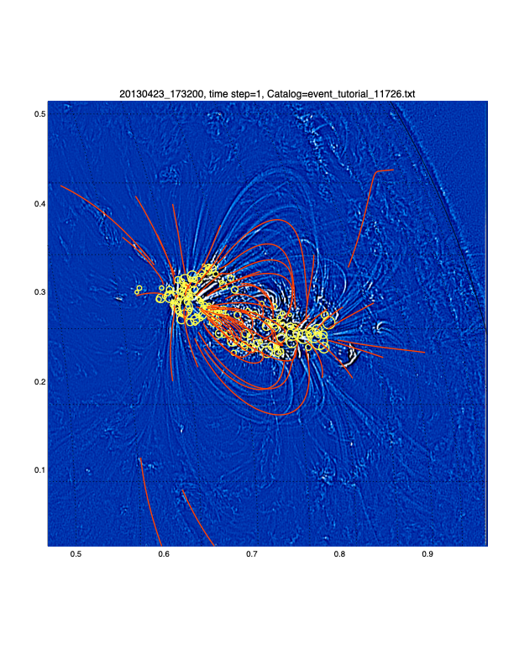
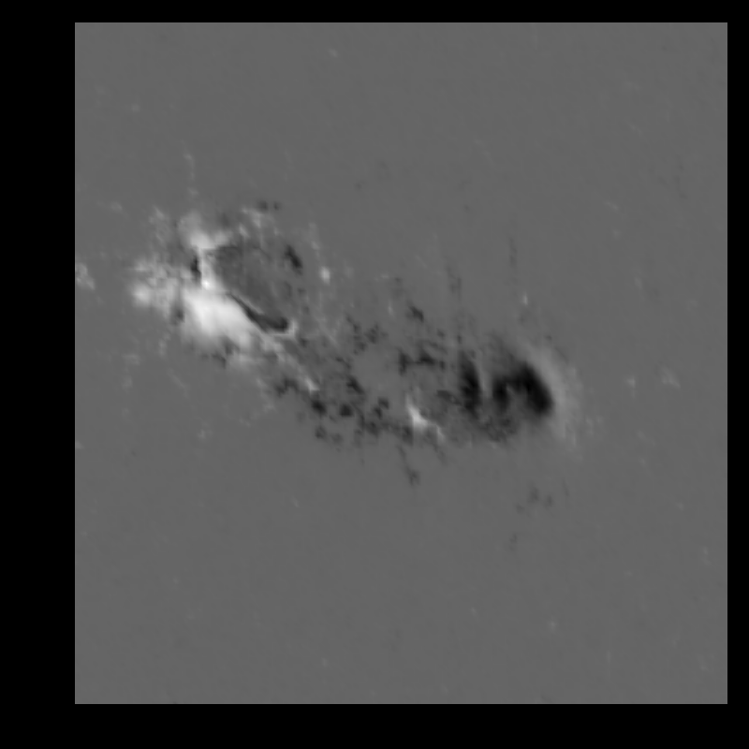
Coronal Extrapolation of the Magnetic Field
Extrapolated with VCA-NLFFF (Aschwanden 2016). Ensures that loops are located where observed by AIA.
150 magnetic sources

Slide 7
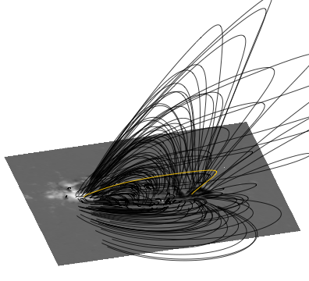
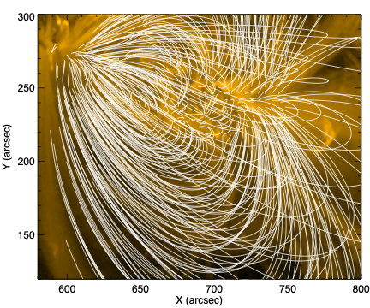
Traced 2048 closed loops

Slide 8



A Parametric Model for Nanoflare Heating
The frequency of occurrence of a nanoflare with energy between E and E + dE and in volume, dV, is assumed to have the form:
f = f0 (L/L0)^{γ} (B/B0)^{β} (E/E0)^{α} dE dV
The free parameters varied in this study are: q0, α, β, and γ.
where:
f0 = q0 (α + 2) / [E0² ((Ef/E0)^{α+2} - 1) ] is a scale factor.
L is the loop length.
B is the average magnetic field magnitude within dV.
α, β, and γ are power-law indices.
L0 (50 Mm), B0 (5 G), E0 (10²³ erg), and Ef (10²⁷ erg) are scale sizes.
Ran > 500 parameter sets
The time-averaged volumetric heating rate in dV is given by:
      ⎰f E dE = q0 (L/L0)^{γ} (B/B0)^{β} (erg cm⁻³ s⁻¹)
Ef
E0

Slide 9

RADYN or ARC7
RADYN solves radiation hydrodynamics in 1.5D for non-LTE populations of H, He Ca II, and Mg II.
Uniform loop cross-sectional area.
Useful for chromospheric studies.
Analyzing temporal evolution of Doppler velocities
Models kinetic transport of particle beams
Allred et al. (2015).
ARC7 solves 2.5 MHD — simplified to solve loop 1D hydrodynamics.
Loop cross-sectional area conserves magnetic flux (R B^{-1/2})
Useful for coronal evolution in loop simulations.
Does not include kinetic transport
Time-averaged coronal DEM similar to what is obtained from RADYN.
Runs very efficiently
Allred & MacNeice (2015).
$$∝$$

Slide 10
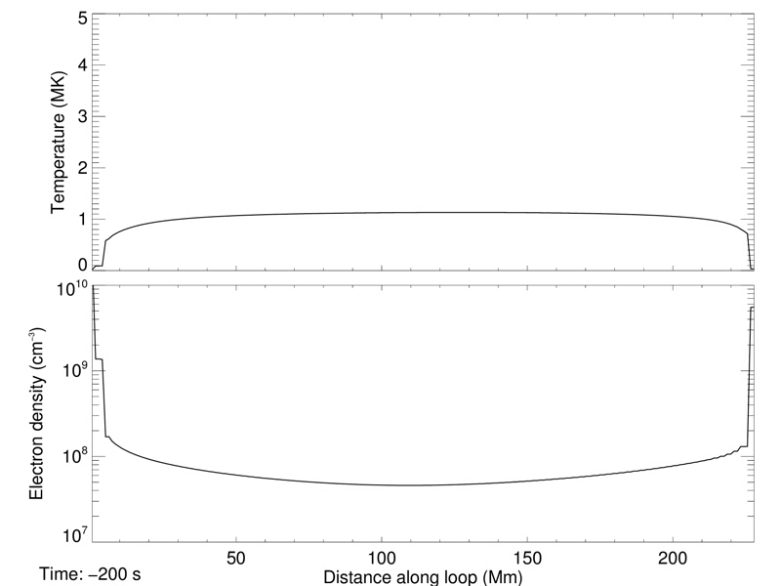
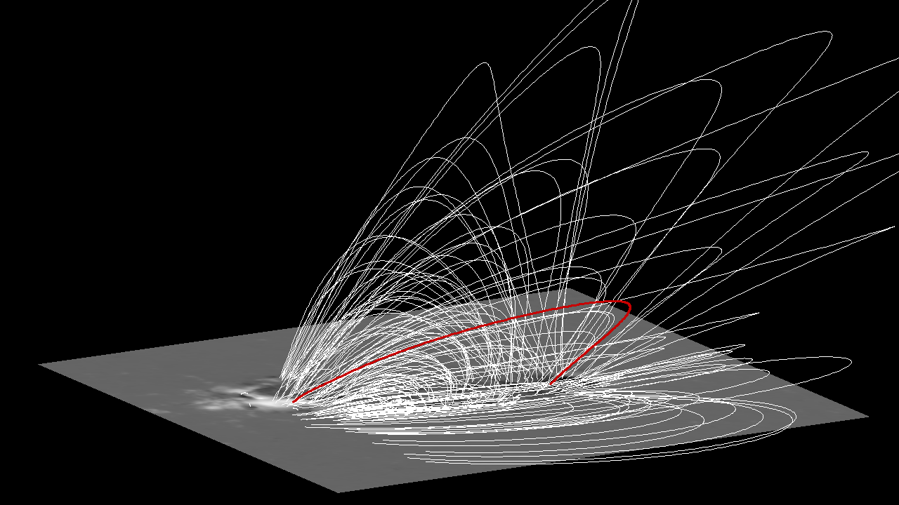
Simulate the Response of Loops to Nanoflare Heating
In loop simulations, the onset of nanoflares is determined by randomly sampling the frequency distribution function.
Our results have shown that, for a given energy nanoflare, the time-averaged emission measure is not sensitive to the duration of the nanoflare event. Therefore, we assume a fixed duration of 100 s.
Sample loop response for q0 = 5 ✕ 10⁻⁴ (erg cm⁻³ s⁻¹), α = -2.5, β = 1.5, and γ = -1.5
Hydrodynamic response modeled in 1D using the ARC7 MHD code (Allred & MacNeice 2015)

Slide 11
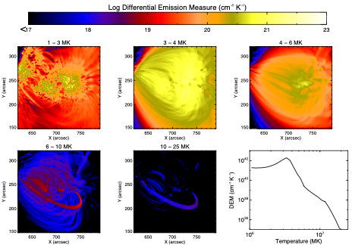
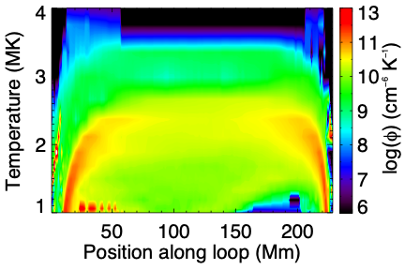

Line of sight projected DEM
Time averaged DEM along loop

Slide 12
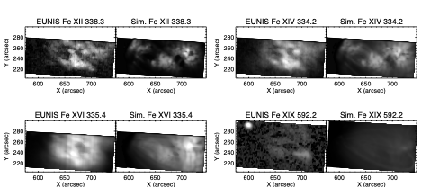
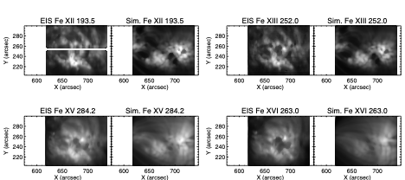
Compare EUNIS Lines
Compare EIS Lines
Line emission modeled using G(n,T) from CHIANTI with coronal abundances from Schmelz et al. (2012)

Slide 13

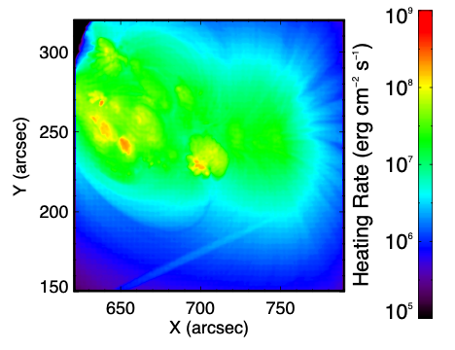
Finding the best fit
Minimize Mean Squared Error:
Time-averaged LOS heating rate
f = f0 (L/L0)^{γ} (B/B0)^{β} (E/E0)^{α} dE dV
Best fit:
    q0 = 1 ✕ 10⁻³ (erg cm⁻³ s⁻¹)
    α = -2.4
    β = 1.5
    γ = -1.0

Slide 14
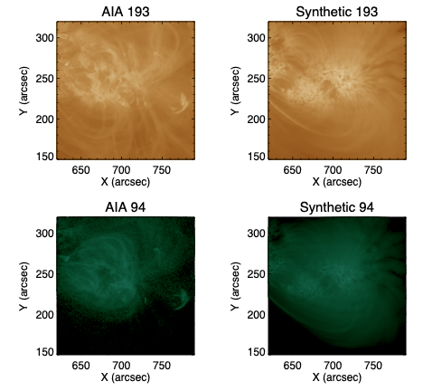
Comparison with AIA Images

Slide 15
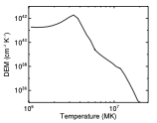
Spatially-Integrated DEM
Peaks at 3.3 MK
Falls off with slope of approx. -9 in log-log space.
For comparison, Ishikawa et al. (2017) found a slope of -12 in AR 12234 using FOXSI-2 sounding rocket.

Slide 16
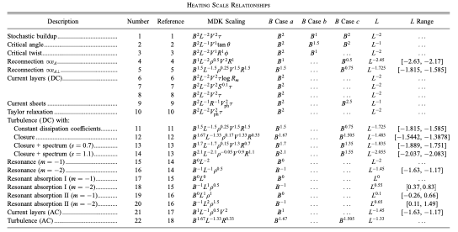



From Lundquist et al. (2008); Mandrini et al. (2000)
We assume:
(B case b)
Best Match: Critical Angle
(Parker 1988; Berger 1993)

Slide 17

Conclusions
The EIS and EUNIS observations of AR11726 constrain the emission measure over a wide range of temperatures.
We have constructed a 3D model of this active region and used the observations to constrain a parameteric nanoflare heating frequency distribution of the form,
          f = f0 (L/L0)^{γ} (B/B0)^{β} (E/E0)^{α} dE dV
Our best fit: q0 = 1 ✕ 10⁻³ (erg cm⁻³ s⁻¹), α = -2.4, β = 1.5, and γ = -1.0.
Download paper here: https://arxiv.org/abs/1807.00763
Future Work
Determine photospheric transverse velocity (e.g., from DAVE4VM) to better constrain frequency scaling with photospheric footpoint motions.

