Slide 1


Validation of Satellite-Derived Land Products on a Global Scale
Joanne Nightingale, Jaime Nickeson
Sigma Space Corporation
Robert Wolfe
NASA GSFC
Terrestrial Information Systems Branch Seminar June 1, 2010

Slide 2
Outline
EOS land product validation (MODIS)
CEOS WGCV LPV sub-group
Decadal Survey Mission validation planning

Slide 3
EOS Land Product Validation

Slide 4
Task Objective
To facilitate the coordination and development of data and methods for global validation of NASA EOS satellite land products through use of shared field, airborne, and satellite datasets and promoting international collaboration

Slide 5
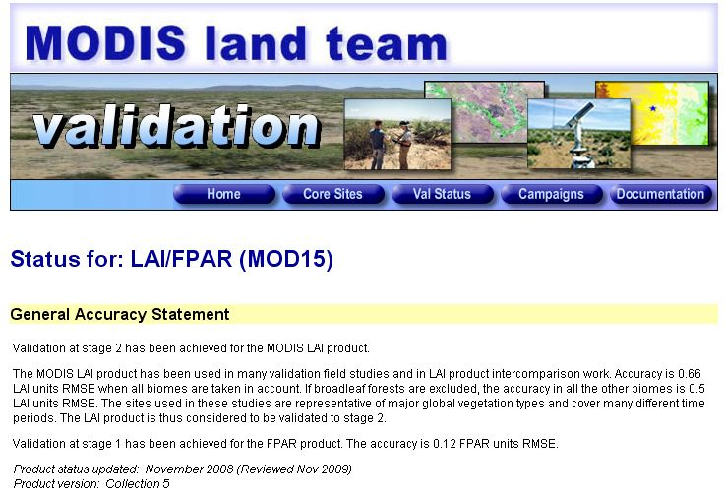
MODIS Validation: Website
http://landval.gsfc.nasa.gov
Product accuracy statements
Updated Sept-Nov 2009 / Collection 5
> 30 new support studies / peer-reviewed publications

Slide 6
MODIS land validation status
PRODUCT | NAME | STAGE | ACCURACY
MOD09 | Land Surface Reflectance | 2 (3 pending) | +/- (0.005 + 5 %)
MOD10 | Snow | 2 | 92 %
MOD11 | Land Surface Temperature / Emissivity | 2 | +/- 0.5-1.0 K
MOD12 | Land Cover / Dynamics | 2 / 1 | > 75-80 %
MOD13 | NDVI / EVI | 2 / 2 | +/- (0.002 + 2%)
MOD14 | Active Fire | 2 | > 100 m2 @ 800 K
MOD15 | LAI fPAR | 2 1 | +/- 0.50-0.66 +/- 0.12
MOD17 | GPP / NPP | 2 | +/- 10%
MOD29 | Sea Ice | 2 | 92%, +/- 1.3 K
MCD43 | BRDF / Albedo | 1 | +/- 5%
MOD44 | VCF / VCC | 1 | +/- 11-16 %
MCD45 | Burned Area | 1 (2 pending) | 75%

Slide 7
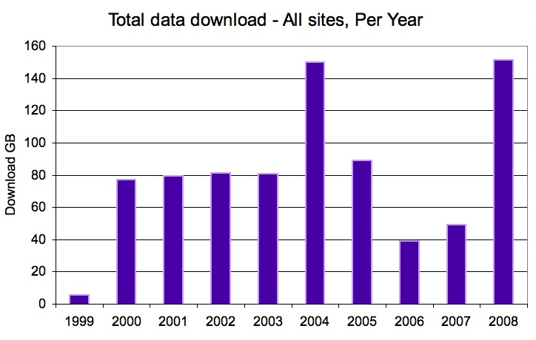
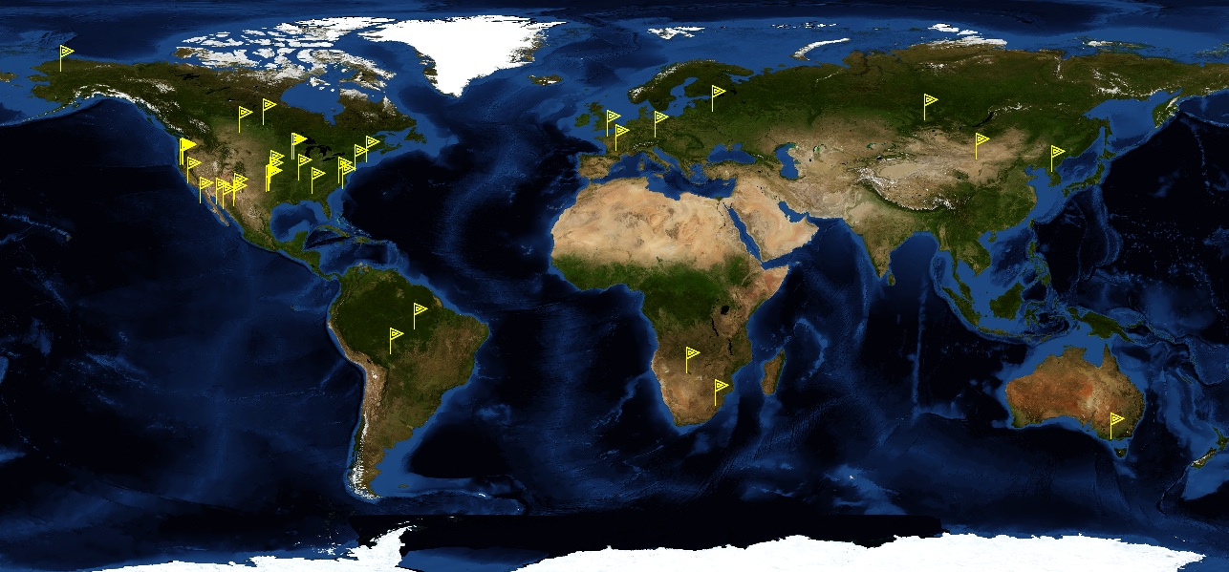
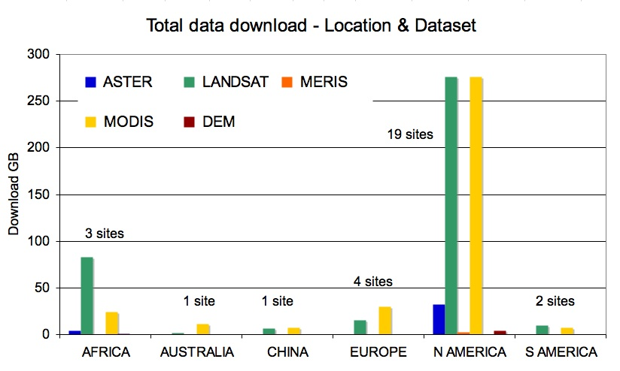
Validation Core Sites
34 Core sites / data download statistics - March 2009
Looking to expand with VIIRS and LPV international efforts

Slide 8
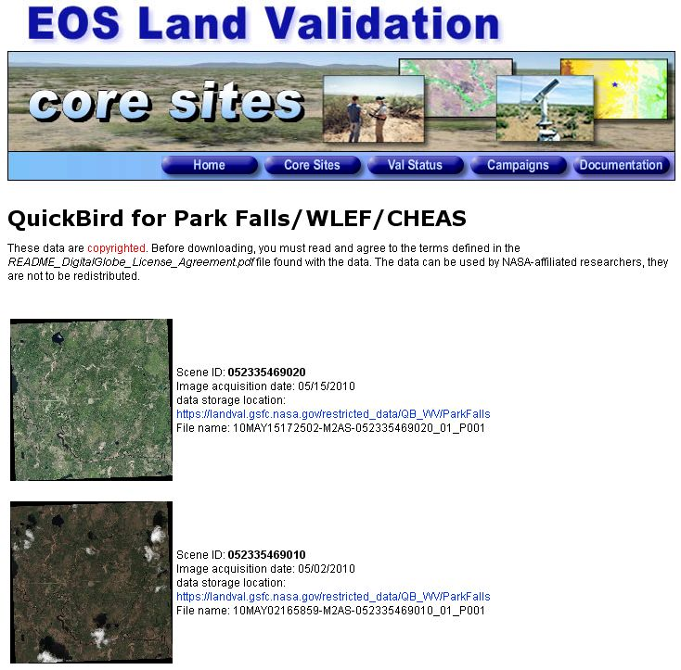
Image Acquisitions / Tasking
Maintaining / updating core site database
Recent acquisition of Quickbird images at Park Falls
Image tasking requested by MODIS PI’s

Slide 9

Access to Field Equipment
  Digital Camera with fish-eye lens loaned to:
  BU - field work in California, Summer 2008
  A. Huete - capture leaf flushing in the Amazon during the wet-dry transition period
  Leaf optics + LAI + Productivity
  Scaling ASTER - MODIS

Slide 10
CEOS WGCV
Land Product Validation Sub-group

Slide 11
Land Product Validation Sub-group
CEOS (Committee on Earth Observing Satellites)
WGCV (Working Group on Calibration and Validation)
Chair: Joanne Nightingale (NASA GSFC)
Vice-Chair: Gabriela Shaepman-Strub (University of Zurich)
NASA EOS Validation: Joanne Nightingale / Jaime Nickeson
7 Land Product Focus Groups
  Established in June 2009
  2 co-leads per group
  ~3-year terms

Slide 12
LPV Focus Groups
Focus Group | North America | Europe / Other
Land Cover * | Mark Friedl (Boston University) | Martin Herold (Wageningen University, NL & GOFC/GOLD)
Fire* (Active/Burned Area) | Luigi Boschetti (University of Maryland) | Kevin Tansey (University of Leicester, UK)
Biophysical (LAI*, ƒAPAR*) | Richard Fernandes (NR Canada) | Stephen Plummer (ESRIN, IT)
Surface Radiation (Reflectance, BRDF, Albedo*) | Crystal Schaaf (Boston University) | Gabriela Schaepman (University of Zurich, SW)
Land Surface Temperature | Simon Hook (JPL) | Jose Sobrino (University of Valencia, SP)
Soil Moisture* | Tom Jackson (USDA) | Wolfgang Wagner (Vienna Uni of Technology, AT)
Land Surface Phenology | Jeff Morisette (USGS) | TBD
* = Essential Climate Variable: Essential measurement for global earth observation and understanding long-term affects of climate change

Slide 13
LPV Objective
To foster quantitative validation of higher level global land products derived from remotely sensed data, in a traceable way, and relay results so they are relevant to users

Slide 14
LPV Goals
To increase the quality and efficiency of global satellite product validation by developing and promoting international standards and protocols for:
    Field sampling
    Scaling techniques
    Accuracy reporting
    Data / information exchange
To provide feedback to international structures (GEOSS) for:
    Requirements on product accuracy and quality assurance (QA4EO)
    Terrestrial ECV measurement standards
    Requirements for future missions
GEOSS : Global Earth Observation System of Systems

Slide 15
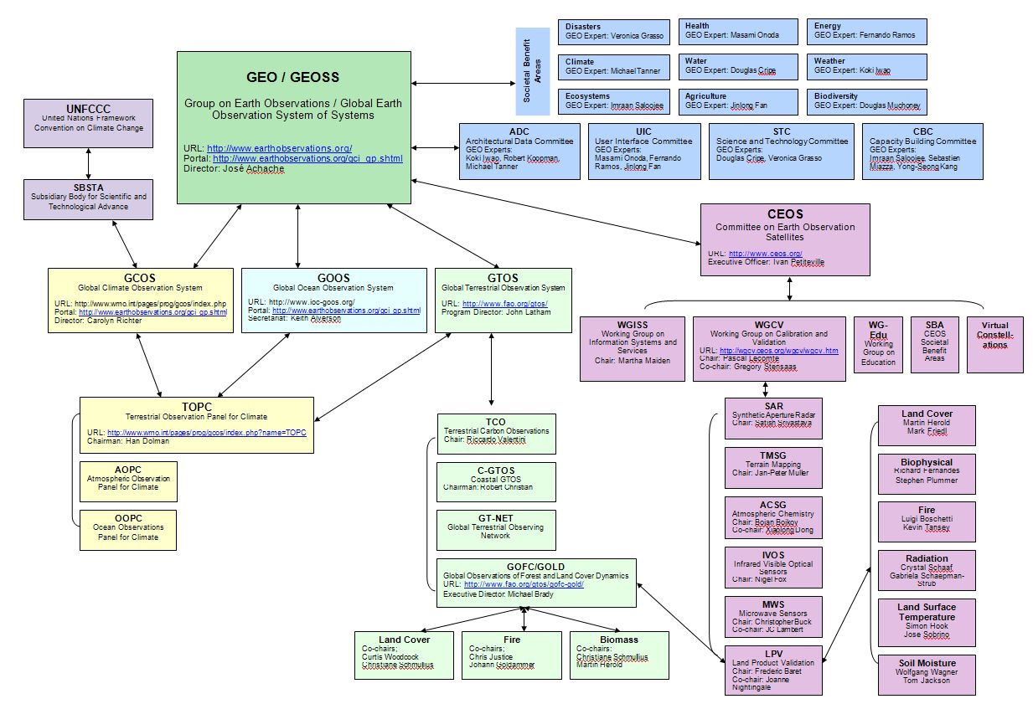
GEOSS Schematic
Linkages between International Programs concerned with Terrestrial Earth Observation

Slide 16
Role of Focus Groups
Engage community members (via listserv), update on progress, relevant meetings
Report back to LPV working group on activities, meetings, new products, funding mechanisms
Organize at least 1 topical workshop
Expand LPV activities, field sites, collaboration beyond North America and Europe!
Lead product inter-comparison activities
Lead the development and writing of “best practice” land product validation guidelines

Slide 17

Land Product Validation Protocols
“Best practice” for land product validation
  Current knowledge
  Available data
  Tools and methods
  Tested and repeatable
  Peer-reviewed
  CEOS endorsed/published
  “Living” documents

Slide 18
Protocol Components
Template developed ~ June 2009 may be tailored to suit each product group
Process for CEOS endorsement / publication
Protocol key attributes:
  Background / product definitions (ECV)
  Accuracy assessment (comparison with in-situ, high resolution image reference data)
    Existing data sets, field sites, sampling schemes, data quality issues
    Spatial and temporal requirements for new datasets
  Product Consistency (repeatability of products through time)
    Address issues concerned with sensor calibration, data-reprocessing, algorithm refinement
  Product Inter-comparison
  Recommendations / Conclusions

Slide 19
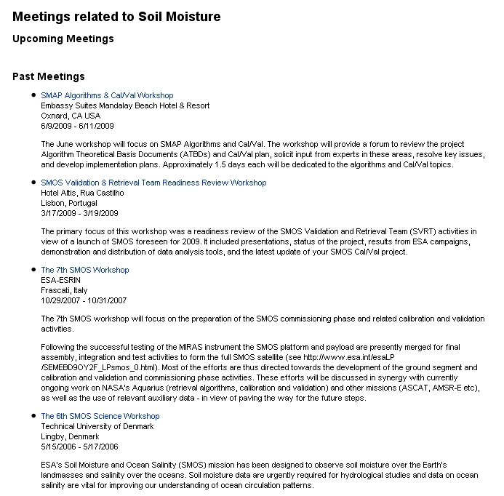
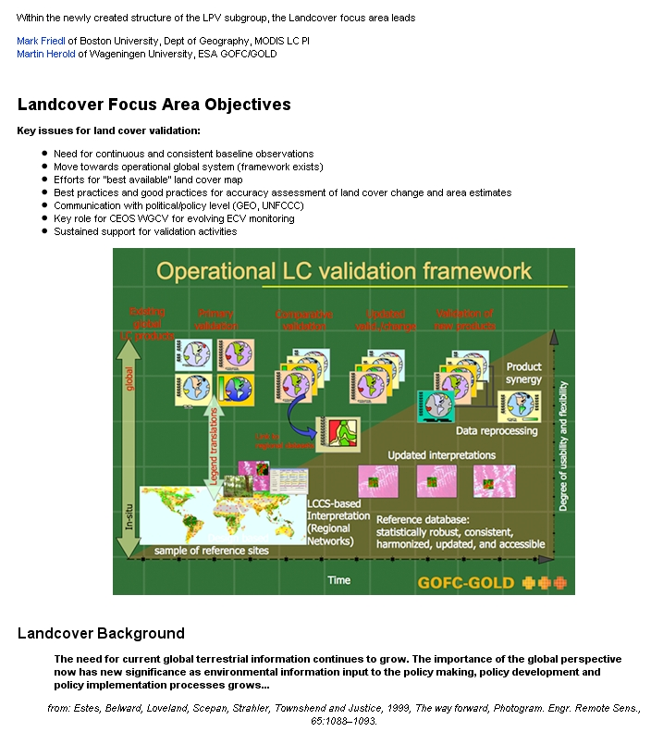
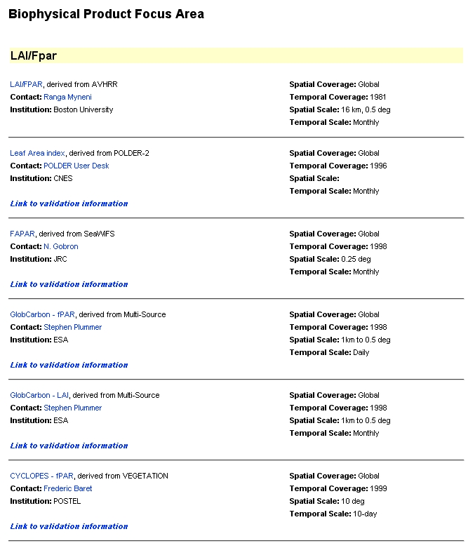
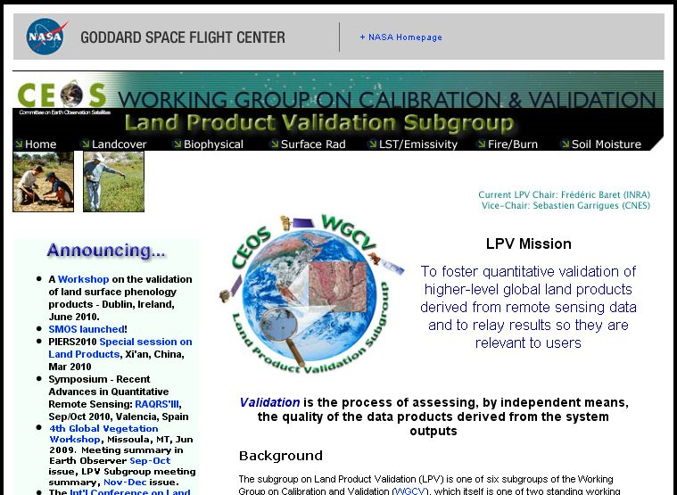
LPV Webpage
Updating product lists and background validation information per focus group
Background
Products
Meetings
Case Studies
Inter-comparisons

Slide 20
Validation Stages
Consensus from LPV leads / MODIS land PI’s
Stage 1 | Product accuracy is assessed from a small (typically < 30) set of locations and time periods by comparison with in-situ or other suitable reference data.
Stage 2 | Product accuracy is estimated over a significant set of locations and time periods by comparison with reference in situ or other suitable reference data. Spatial and temporal consistency of the product and with similar products have been evaluated over globally representative locations and time periods. Results are published in the peer-reviewed literature.
Stage 3 | Uncertainties in the product and its associated structure are well quantified from comparison with in situ or other suitable reference data. Uncertainties are characterized in a statistically robust way over multiple locations and time periods representing global conditions. Spatial and temporal consistency of the product and with similar products have been evaluated over globally representative locations and periods. Results are published in the peer-reviewed literature.
Stage 4 | Validation results for stage 3 are systematically updated when new product versions are released and as the time-series expands.

Slide 21
Key Activities per Focus Area
Examples of key activities since June 2009
Planned activities / meetings

Slide 22
Land Cover
Planning for Global Land Cover Validation Exercise
  Collaboration with BU, GOFC-GOLD, VIIRS Surface Type validation team
Planning for ESA Climate Change Initiative Call
  Discussions with JRC on independent accuracy assessment (use of FRA 2010 remote sensing survey data)
Accuracy assessment of land cover change
  Will move ahead in concert with GOFC-GOLD REDD Sourcebook updates and GEO Forest Carbon Tracking task
GOFC GOLD: Global Observations of Forest Cover and Land Cover Dynamics
FRA: Forest Resources Assessment
REDD: Reducing Emissions from Degradation and Deforestation

Slide 23
Biophsyical
Letter sent to GTOS, GCOS : Adoption of a consistent definition for the Leaf Area Index ECV
  GTOS-L2008, GTOS-GV2009, GCOS-IP10, GCOS-TEMS
  Sent December 2009, awaiting reply
Status of LAI and ƒPAR validation paper in prep
OLIVE (OnLine Validation Exercise) (Baret et al.)
  Activity funded (ESA)
  Operational 2011
GTOS: Global Terrestrial Observation System
GCOS: Global Climate Observing System

Slide 24
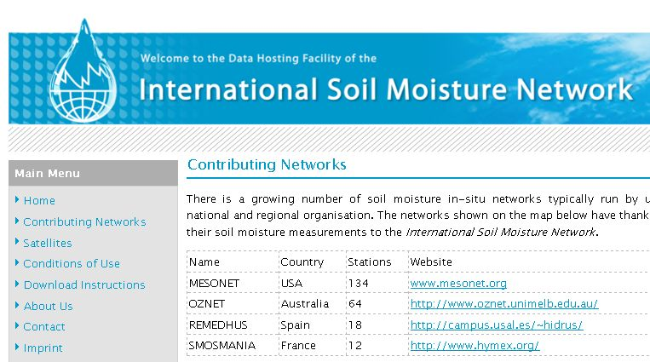
Soil Moisture
International Soil Moisture Network
  Global in-situ soil moisture database
  Collaboration between CEOS, GEWEX and GEO
  Collaboration with Australia, Russia and China
  SMAP (Soil Moisture Active Passive / NASA)
  SMOS (Soil Moisture and Ocean Salinity / ESA)
Online February 2010!
GEWEX: Global Energy and Water Experiment

Slide 25
Land Surface Phenology
No pre-existing LSP validation methods or papers
The seasonal pattern of variation in vegetated land surfaces observed from remote sensing
Estimation of seasonal carbon dynamics
Assess impacts of global climate change
Growing season information in ecosystem models
Recent proliferation of LSP products derived from moderate-resolution, high temporal frequency satellite sensors
9 products available, 1 pending

Slide 26


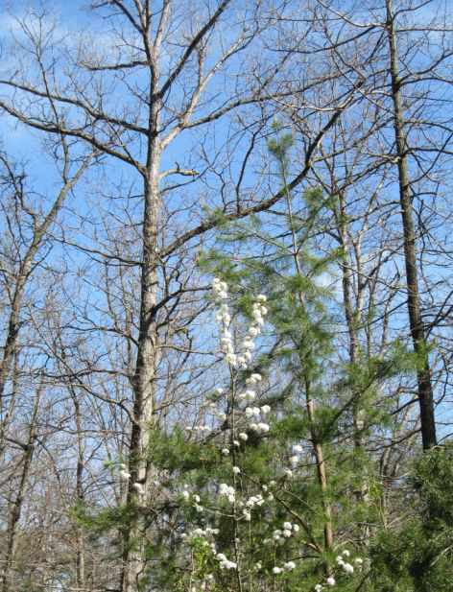

Phenology cont.
Validation is essential for assessing algorithm accuracy and ensuring improvements
Several studies relating in-situ data to pixel DOY for green-up and brown-down
In situ data from ground volunteer networks
  (NPN, Plantwatch, Project budburst)
Bud-burst or flowering date ≠ Pixel / Bulk vegetation properties

Slide 27
LSP Assessment / Workshop
LSP product assessment
  2 global products (MODIS, SPOT-Vegetation)
  5 products for US/North America (MODIS, AVHRR, Data Fusion)
  2 products for Europe (MERIS)
  1 product for South Africa (AVHRR)
LPV workshop at the Phenology 2010 conference
  Incorporting ground networks (NPN, PEN)
  To bring together producers of continental- to global-scale land surface phenology products; as well as those collecting field, tower, or airborne data useful for validating those products, to develop an international protocol to quantify the accuracy of these products and initiate a validation-based inter-comparison

Slide 28
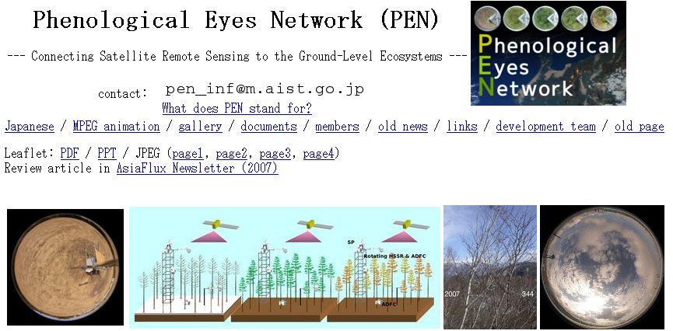
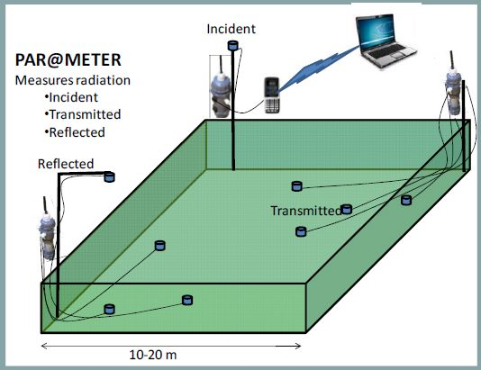
Spectral Networks
Phenological Eyes Network (PEN) Japan
  Hyperspectral sensors on flux /LTER site towers
  In association with basic RGB cameras
Par@meter – INRA France
  Wireless system for continuous monitoring of LAI/fPAR
  20x20m sampling

Slide 29
Decadal Survey Mission Requirements

Slide 30
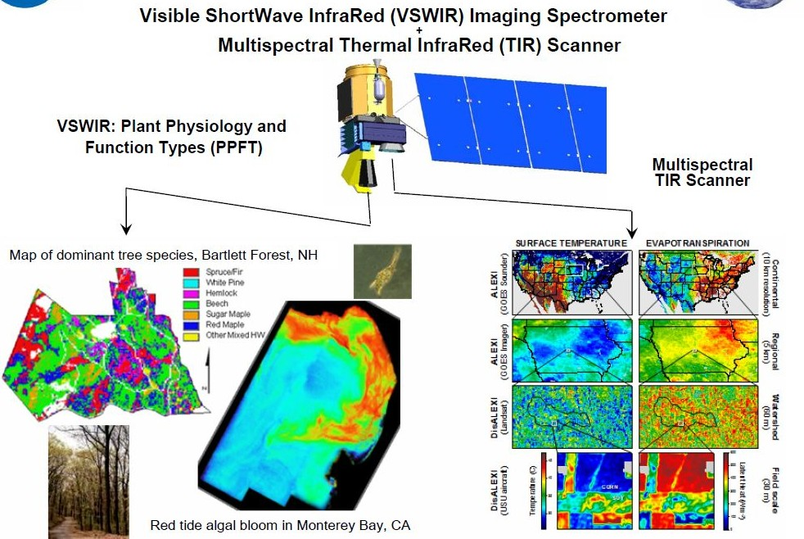
HyspIRI: Hyperspectral InfraRed Imager
60m nadir, 3 week revisit, 2013-2016 launch (Tier 2)

Slide 31
HyspIRI Products
Existing Val Methods
Research
Required
LPV Focus Group / Product | VSWIR L 2/ 3 | VSWIR L4 | VSWIR Global | TIR L4 | SWIR / TIR
LAND COVER
Fractional land cover / veg cover
Disturbance, PFT, hazard susceptibility
SURFACE RADIATION
Surface Reflectance
Albedo
BIOPHYSICAL
Gross / Net Primary Production
fPAR
LAI
Water content, LUE, Pigments
FIRE
Detection of Fire events
Fire fuel loads
LAND SURFACE TEMPERATURE
LST
Emissivity
Evapotranspiration

Slide 32
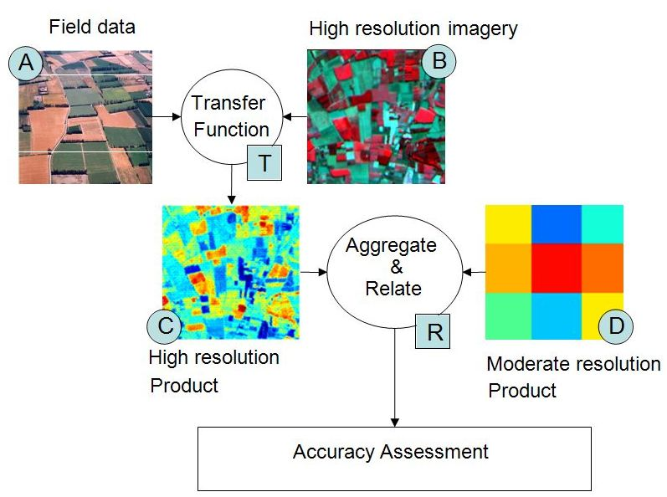
Scaling of Biophysical Products
LAI, fPAR, GPP, NPP, Albedo
Protocol for ground sampling, scaling and validation of LAI, fPAR and albedo products in preparation
HyspIRI will provide enhanced spatial / temporal capabilities for scaling activities (bridge 30m – 250m/1km+ gap)

Slide 33
Test Validation Activities
Use of Hyperion for validation approach testing
  Hyperion archive being collected at Core Sites
Temporal variation in spectral characteristics, Railroad Valley, NV
Similar datasets are being assembled at other CEOS Cal/Val and LPV sites

Slide 34
For more information
Contact:
Joanne.M.Nightingale@nasa.gov
Jaime.E.Nickeson@nasa.gov
Or visit: http://lpvs.gsfc.nasa.gov/ http://landval.gsfc.nasa.gov/

